Slide 1


How does Raleigh use open source?
Gail Roper, Chief Information and Community Relations Officer at City of Raleigh - @gailmroper
Jason Hibbets, Code for Raleigh brigade captain and Opensource.com project manager at Red Hat - @jhibbets

Slide 2


Citizen-led communities: CityCamp
Source: http://citycampnc.org/
Notes:
Describe CityCamp as an international unconference series similar to BarCamp designed to bring open source and other technology solutions to local municipalities
Provide a brief history of CityCamp Raleigh
Describe the format of our CityCamps

Slide 3



Evolving CityCamp
Source: http://citycampnc.org | http://codeforamerica.org
Notes:
Describe the evolution of CityCamp Raleigh to CityCamp NC and eventually Code for Raleigh brigade
Identify the problem that the brigade was trying to solve
Code for Raleigh was established in October 2012
Describe the partnership with National Day of Civic Hacking

Slide 4

Code for Raleigh
Source: http://brigade.codeforamerica.org/
Notes:
Describe the dynamic of Code for Raleigh
4 captains
Meet once a month
During International Open Data Day in 2013, we planted the seeds for Code for Cary and Code for Durham
Describe the collaborative work nature of Code for Triangle

Slide 5



Citizen-led projects
Notes:
Describe some of the citizen-led projects from CityCamp and Code for Raleigh
TriangleWiki
Adopt-a-bus shelter
RGreenway
Code for Durham recently created NC food inspector

Slide 6
Code for Raleigh timeline
February 25, 2012 – TriangleWiki Day (part of International Open Data Day)
March 6, 2011 – First planning meet-up for CityCamp Raleigh
November 2013 – Adopta Bus Shelter launched
June 3-5, 2011 – 1st CityCamp Raleigh, 225 attendees
March 14, 2012 – Launch of TriangleWiki.org
February 23, 2013 – Cary, NC Open Data Day
August 17, 2011 – 1st CityCamp Raleigh meet-up
June 1-3, 2012 – 2nd CityCamp Raleigh, 225 attendees
May 2013 – Triangle Code for America formed
November 28, 2011 – 2nd CityCamp Raleigh meet-up
October 2013 – Code for Raleigh brigade formed
May 30 - June 1, 2013 – CityCamp Raleigh becomes CityCamp NC

Slide 7
Code for Raleigh timeline
June 2013 – Monthly meet-ups start for Code for Raleigh
February 22, 2014 – Cary Open Data Day becomes Triangle Open Data Day, 300 attendees
October 2013 – Code for Cary, Code for Durham become brigades
May 29-31, 2014 – 4th annual CityCamp NC
October 15-17, 2013 – Code for America Summit
June 25, 2014 – Code for Raleigh tries first hack night
December 2013 – Open data “barn raising” Code for Triangle
July 8, 2014 – Code for Raleigh tries first demo night

Slide 8

Building the foundation
Source: http://www.flickr.com/photos/opensourceway/5496629913/in/set-72157628737085119

Slide 9


Telling our story
Source: http://theopensourcecity.com/
Notes:
Describe the book and the five elements of an open source city
Culture/participation
Open government policy
Open data policy
Open source conferences & user groups
Economic development

Slide 10

Partnership opportunities
Digital Connector Program
Code for Raleigh
CityCamp NC
Start-up high
Innovate Raleigh
American Underground & HQ Raleigh
Source: http://www.flickr.com/photos/opensourceway/8516817076/in/photostream
Notes:
Discuss some of the amazing partnership opportunities
Stress the fact the “we” can not do this alone

Slide 11

The game is changing
Source: http://opensource.com/government/13/8/citizen-cio

Slide 12
Questions
Contact Gail
Twitter: @gailmroper
Email: Gail.Roper@raleighnc.gov
Contact Jason
Twitter: @jhibbets
Email: jhibbets@redhat.com -or- jhibbets@gmail.com
IRC: shibby
Slides: https://github.com/jhibbets/presentations
Book: http://theopensourcecity.com

Slide 13
References &
supporting material

Slide 14
Raleigh’s Open Government Resolution
RESOLUTION NO. (2011) - A RESOLUTION INDICATING THE INTENT OF THE CITY COUNCIL TO CREATE AN OPEN GOVERNMENT BY ENCOURAGING THE USE OF OPEN SOURCE SYSTEMS AND ENSURING OPEN ACCESS TO PUBLIC DATA
WHEREAS, the City of Raleigh is committed to using technology to foster open, transparent, and accessible government; and
WHEREAS, by sharing data freely, the City of Raleigh seeks to develop opportunities for economic development, commerce, increased investment and civic engagement; and
WHEREAS, the adoption of open standards improves transparency, access to public information, and improved coordination and efficiencies among organizations across the public, non-profit and private sectors; and
WHEREAS, open source standards harnesses the power of distributed peer review and transparency to create high-quality, secure and easily integrated software at an accelerated pace and lower cost; and
WHEREAS, the City of Raleigh seeks to encourage the local software community to develop software applications and tools to collect, organize and share public data in new and innovative ways that benefit both citizens and government;
NOW, THEREFORE, BE IT RESOLVED BY THE CITY COUNCIL OF THE CITY OF RALEIGH:
Section l. That the City of Raleigh Information Technology department will establish an open systems procurement policy that will include specifications in future Requests for Proposals (RFP) to encourage technology solutions with an open source licensing model which store and expose public data using industry-standard and open protocols.
Section 2. The City of Raleigh will establish an open data website at www.raleighnc.gov/open that will serve as an open data catalog of the data available from the City of Raleigh in open formats.
Source: http://www.raleighnc.gov/content/ITechAdmin/Documents/OpenSourceSystemsResolution.pdf

Slide 15
Open government roadmap
1) Open Data Next Steps: Staff Response
  Continue to gain executive sponsorship
  Define resource requirements
  Establish governance model
3) Open source
Create the internal procurement policy for evaluation and selection criteria for open source software
Create inventory of potential open source software and protocols
Create framework for Raleigh to participate as producer of open source software (licensing model, code repositories, etc.)
2) Open Data Preparation
  Establishment of the catalog
  Policy creation for open data (how we determine what data can/will be published, prioritization, formats, internal process, business ownership, etc.)
  Catalog product selection
  Project implementation
  Engagement with Raleigh’s open data community
4) Community Participation – Taking it to the streets
Citizen-led communities
Connection between youth-development programs and open government community
Connection entrepreneurial community and open government community
Importance of broadband access for any of this to be useful

Slide 16
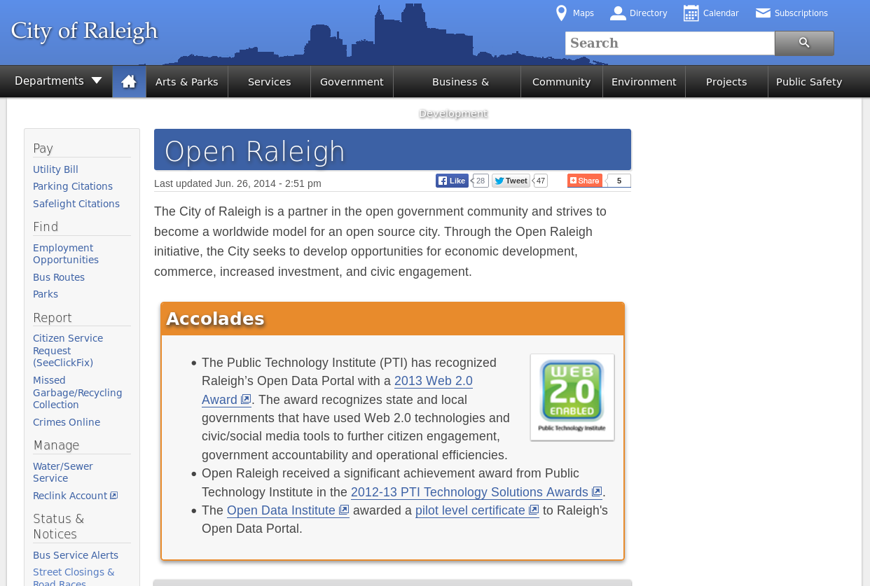
Open Raleigh
A primary objective is a framework that supports a culture of openness and transparency and leads to an open government process.
Source: http://www.raleighnc.gov/open

Slide 17

Open data portal (beta)
Source: https://data.raleighnc.gov/

Slide 18

Open data portal
Source: https://data.raleighnc.gov/

Slide 19
Open source solutions in Raleigh
Ruby
MediaWiki
PostgreSQL
MySQL
DokuWiki
Eclipse and Sublime IDE's
GIMP
Android Mobile OS
Jenkins
JBoss Portal
JBoss SOA
WordPress
Alfresco
GitHub
Maven
Subversion
JBoss Application Server
Apache Tomcat
Red Hat Enterprise Linux

