Slide 1


How does Raleigh use open source?
Gail Roper, Chief Information and Community Relations Officer at City of Raleigh -@gailmroper
Jason Hibbets, Code for Raleigh brigade captain and Opensource.com project manager at Red Hat -@jhibbets

Slide 2

How Does Raleigh Use Open Source?
Gail M. Roper, City of Raleigh
Jason Hibbets, Red Hat
Photo by marfis75 - Creative Commons Attribution-ShareAlike License https://www.flickr.com/photos/45409431@N00
Created with Haiku Deck

Slide 3

Connected CIO
Gail M. Roper
CIO & Community Relations Officer
City of Raleigh, North Carolina
@GailMRoper|www.gailmroper.com
Photo by apdk - Creative Commons Attribution License https://www.flickr.com/photos/62337512@N00
Created with Haiku Deck

Slide 4

Raleigh Connected
Open Source
Open Data
Open Access

Slide 5

Our Journey
Photo by Thomas Rousing - Creative Commons Attribution License https://www.flickr.com/photos/43812360@N05
Created with Haiku Deck

Slide 6
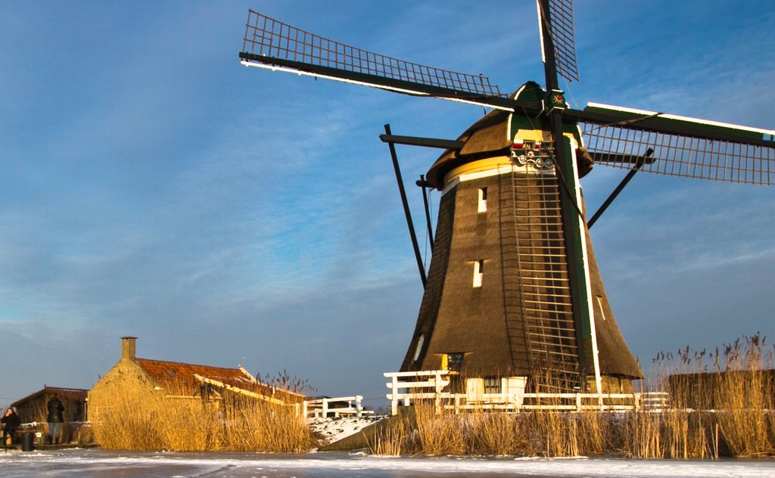
Cultural Shift
Photo by zilverbat. - Creative Commons Attribution-NonCommercial License https://www.flickr.com/photos/25228175@N08
Created with Haiku Deck

Slide 7

Governance
Photo by YannGarPhoto (Where are the stats??) - Creative Commons Attribution-ShareAlike License https://www.flickr.com/photos/39528897@N06
Created with Haiku Deck

Slide 8
APRIL-JUNE 2012
Prioritized
Data Sets
FEBRUARY 2012
Adopted Open Source Resolution
MARCH 2013
Released Open Data Portal
AUGUST 2013
PTI Awards Web 2.0
JUNE 2014
VettedDraftFramework & Policy
SEPTEMBER 2012
Published First Data Sets
2012
2013
2014
APRIL 2012
Published Open Resources Page
SEPTEMBER 2012
Created Open Initiatives Roadmap
MAY 2013
Formed Steering Committee
MARCH 2014
Released
Open Raleigh 2.0
JULY 2012
Drafted Open Data Policies
MAY-JULY 2014
Open Data Portal Tool Evaluation
Open Raleigh Timeline

Slide 9
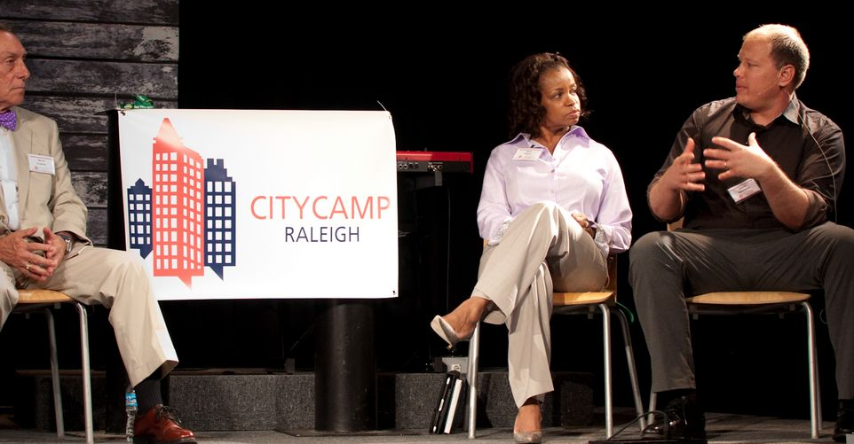
Collaboration
Photo by dtraleigh - Creative Commons Attribution-NonCommercial License https://www.flickr.com/photos/22361272@N00
Created with Haiku Deck

Slide 10

Success
Photo by CAGATOTA - Creative Commons Attribution-NonCommercial-ShareAlike License https://www.flickr.com/photos/27127577@N05
Created with Haiku Deck

Slide 11
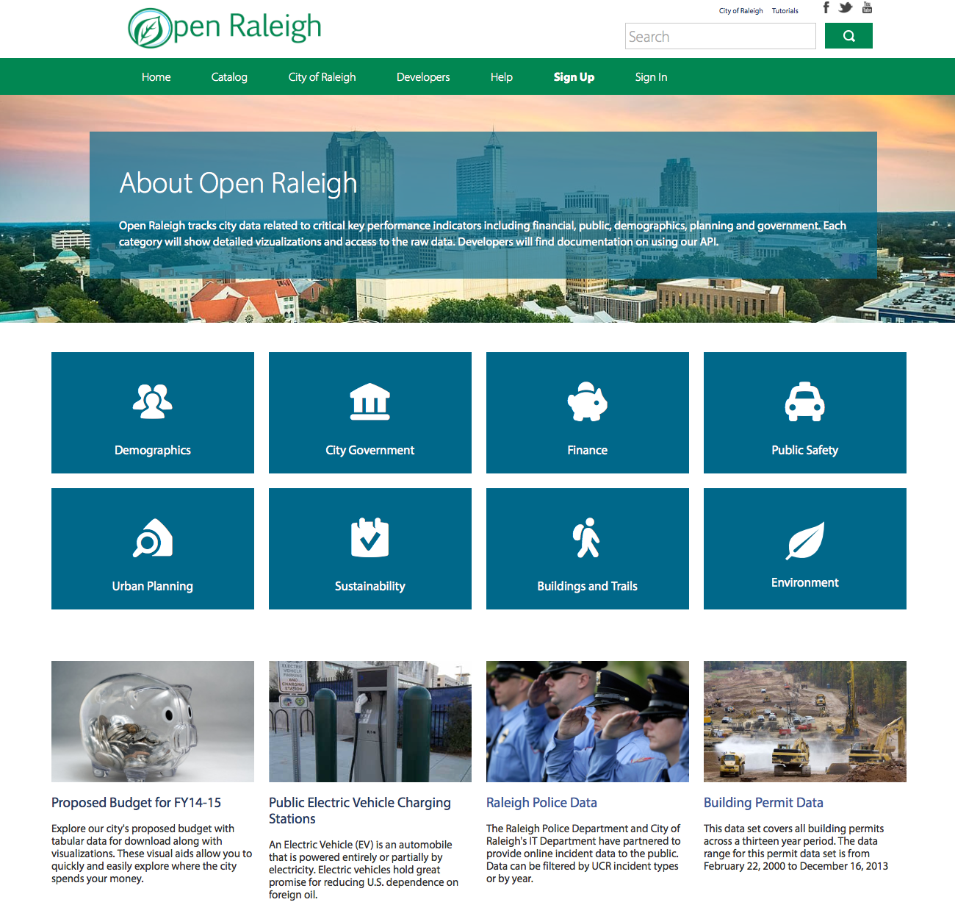
Data.Raleighnc.gov

Slide 12
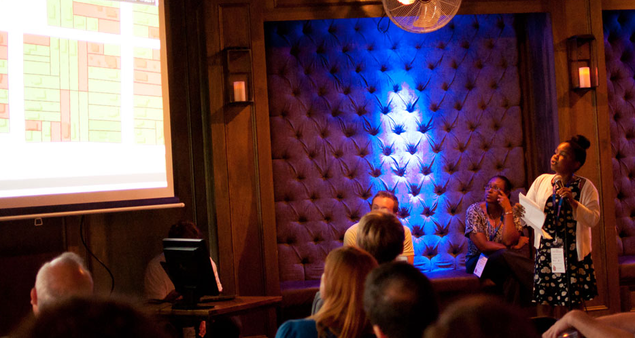
Digital Connectors
Photo Courtesy of Leo Suarez

Slide 13
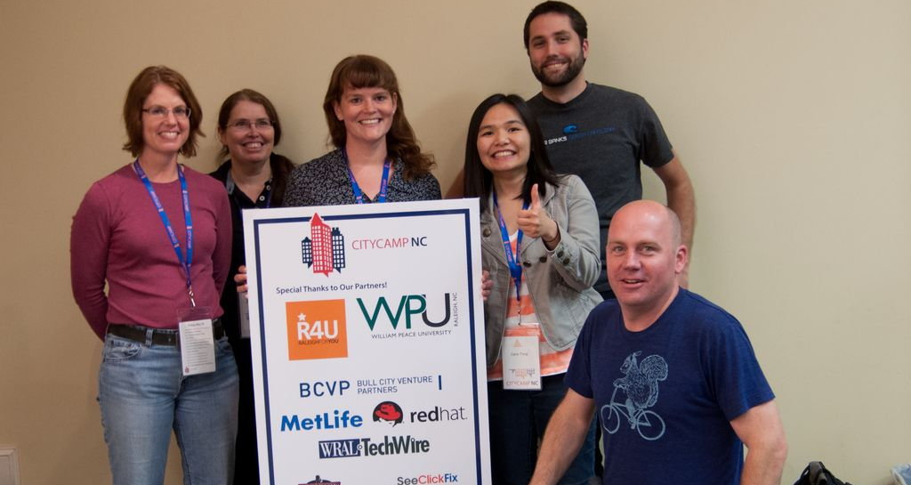
FreeWheelingNC
Photo by dtraleigh - Creative Commons Attribution-NonCommercial License https://www.flickr.com/photos/22361272@N00
Created with Haiku Deck

Slide 14
Open Source Toolkit

Slide 15


Citizen-led communities: CityCamp
Source: http://citycampnc.org/
Notes:
Describe CityCamp as an international unconference series similar to BarCamp designed to bring open source and other technology solutions to local municipalities
Provide a brief history of CityCamp Raleigh
Describe the format of our CityCamps

Slide 16



Evolving CityCamp
Source: http://citycampnc.org|http://codeforamerica.org
Notes:
Describe the evolution of CityCamp Raleigh to CityCamp NC and eventually Code for Raleigh brigade
Identify the problem that the brigade was trying to solve
Code for Raleigh was established in October 2012
Describe the partnership with National Day of Civic Hacking

Slide 17

Code for Raleigh
Source: http://brigade.codeforamerica.org/
Notes:
Describe the dynamic of Code for Raleigh
4 captains
Meet once a month
During International Open Data Day in 2013, we planted the seeds for Code for Cary and Code for Durham
Describe the collaborative work nature of Code for Triangle

Slide 18



Citizen-led projects
Notes:
Describe some of the citizen-led projects from CityCamp and Code for Raleigh
TriangleWiki
Adopt-a-bus shelter
RGreenway
Code for Durham recently created NC food inspector

Slide 19
Code for Raleigh timeline
February 25, 2012 – TriangleWiki Day (part of International Open Data Day)
March 6, 2011 – First planning meet-up for CityCamp Raleigh
November 2013 – Adopta Bus Shelter launched
June 3-5, 2011 – 1st CityCamp Raleigh, 225 attendees
March 14, 2012 – Launch of TriangleWiki.org
February 23, 2013 – Cary, NC Open Data Day
August 17, 2011 – 1st CityCamp Raleigh meet-up
June 1-3, 2012 – 2nd CityCamp Raleigh, 200+ attendees
May 2013 – Triangle Code for America formed
November 28, 2011 – 2nd CityCamp Raleigh meet-up
October 2013 – Code for Raleigh brigade formed
May 30 - June 1, 2013 – CityCamp Raleigh becomes CityCamp NC

Slide 20
Code for Raleigh timeline
June 2013 – Monthly meet-ups start for Code for Raleigh
February 22, 2014 – Cary Open Data Day becomes Triangle Open Data Day, 300 attendees
October 2013 – Code for Cary, Code for Durham become brigades
May 29-31, 2014 – 4th annual CityCamp NC
October 15-17, 2013 – Code for America Summit
June 25, 2014 – Code for Raleigh tries first hack night
December 2013 – Open data “barn raising” Code for Triangle
July 8, 2014 – Code for Raleigh tries first demo night

Slide 21

Building the foundation
Source: http://www.flickr.com/photos/opensourceway/5496629913/in/set-72157628737085119

Slide 22


Telling our story
Source: http://theopensourcecity.com/
Notes:
Describe the book and the five elements of an open source city
Culture/participation
Open government policy
Open data policy
Open source conferences & user groups
Economic development

Slide 23

Partnership opportunities
Digital Connector Program
Code for Raleigh
CityCamp NC
Start-up high
Innovate Raleigh
American Underground & HQ Raleigh
Source: http://www.flickr.com/photos/opensourceway/8516817076/in/photostream
Notes:
Discuss some of the amazing partnership opportunities
Stress the fact the “we” can not do this alone

Slide 24

The game is changing
Source: http://opensource.com/government/13/8/citizen-cio

Slide 25
Questions
Contact Gail
Twitter: @gailmroper
Email: Gail.Roper@raleighnc.gov
Contact Jason
Twitter: @jhibbets
Email: jhibbets@redhat.com -or- jhibbets@gmail.com
IRC: shibby
Slides:https://github.com/jhibbets/presentations
Book:http://theopensourcecity.com

Slide 26

Questions
Jason Hibbets
Twitter: @jhibbets
Email: jhibbets@redhat.com -or- jhibbets@gmail.com
IRC: shibby
Slides: https://github.com/jhibbets/presentations
Book: http://theopensourcecity.com
Gail M. Roper
CIO & Community Relations Officer
City of Raleigh, North Carolina
@GailMRoper
www.gailmroper.com
Photo by medically_irrelevant - Creative Commons Attribution-NonCommercial-ShareAlike License https://www.flickr.com/photos/16941958@N02
Created with Haiku Deck

Slide 27
References &
supporting material

Slide 28
Raleigh’s Open Government Resolution
RESOLUTION NO. (2011) - A RESOLUTION INDICATING THE INTENT OF THE CITY COUNCIL TO CREATE AN OPEN GOVERNMENT BY ENCOURAGING THE USE OF OPEN SOURCE SYSTEMS AND ENSURING OPEN ACCESS TO PUBLIC DATA
WHEREAS, the City of Raleigh is committed to using technology to foster open, transparent, and accessible government; and
WHEREAS, by sharing data freely, the City of Raleigh seeks to develop opportunities for economic development, commerce, increased investment and civic engagement; and
WHEREAS, the adoption of open standards improves transparency, access to public information, and improved coordination and efficiencies among organizations across the public, non-profit and private sectors; and
WHEREAS, open source standards harnesses the power of distributed peer review and transparency to create high-quality, secure and easily integrated software at an accelerated pace and lower cost; and
WHEREAS, the City of Raleigh seeks to encourage the local software community to develop software applications and tools to collect, organize and share public data in new and innovative ways that benefit both citizens and government;
NOW, THEREFORE, BE IT RESOLVED BY THE CITY COUNCIL OF THE CITY OF RALEIGH:
Section l. That the City of Raleigh Information Technology department will establish an open systems procurement policy that will include specifications in future Requests for Proposals (RFP) to encourage technology solutions with an open source licensing model which store and expose public data using industry-standard and open protocols.
Section 2. The City of Raleigh will establish an open data website at www.raleighnc.gov/open that will serve as an open data catalog of the data available from the City of Raleigh in open formats.
Source:http://www.raleighnc.gov/content/ITechAdmin/Documents/OpenSourceSystemsResolution.pdf

Slide 29
Open government roadmap
3) Open source
Create the internal procurement policy for evaluation and selection criteria for open source software
Create inventory of potential open source software and protocols
Create framework for Raleigh to participate as producer of open source software (licensing model, code repositories, etc.)
1) Open Data Next Steps: Staff Response
Continue to gain executive sponsorship
Define resource requirements
Establish governance model
2) Open Data Preparation
Establishment of the catalog
Policy creation for open data (how we determine what data can/will be published, prioritization, formats, internal process, business ownership, etc.)
Catalog product selection
Project implementation
Engagement with Raleigh’s open data community
4) Community Participation – Taking it to the streets
Citizen-led communities
Connection between youth-development programs and open government community
Connection entrepreneurial community and open government community
Importance of broadband access for any of this to be useful

Slide 30
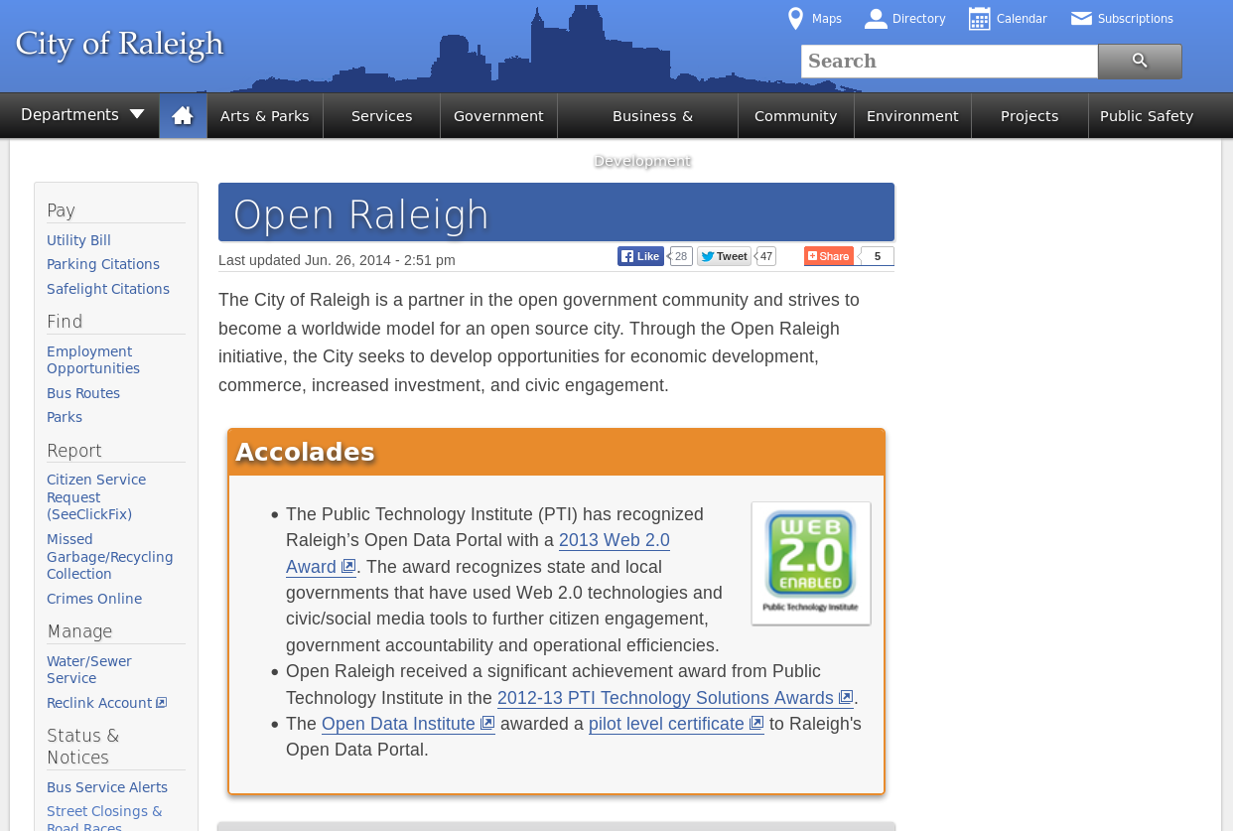
Open Raleigh
A primary objective is a framework that supports a culture of openness and transparency and leads to an open government process.
Source:http://www.raleighnc.gov/open

Slide 31

Open data portal (beta)
Source:https://data.raleighnc.gov/

Slide 32

Open data portal
Source:https://data.raleighnc.gov/

Slide 33
Open source solutions in Raleigh
Ruby
MediaWiki
PostgreSQL
MySQL
DokuWiki
Eclipse and Sublime IDE's
GIMP
Android Mobile OS
Jenkins
JBoss Portal
JBoss SOA
WordPress
Alfresco
GitHub
Maven
Subversion
JBoss Application Server
Apache Tomcat
Red Hat Enterprise Linux

