Slide 1
The Future of Civic Hacking
is Open
Jason Hibbets
Opensource.com community manager, Red Hat
National Advisory Council, Code for America
Code for Raleigh brigade captain
NC Open Pass co-chair
September 25, 2017 | A night of Open Source

Slide 2

Improve the citizen experience
Credit: http://opensource.com/government/13/8/citizen-cio

Slide 3

Open government & open data
Credit: http://www.flickr.com/photos/opensourceway/4459199503/in/set-72157625738142672

Slide 4

Taxes in --> services out
Credit: http://opensource.com/sites/default/files/imagecache/image-full-size/images/education/gov_vending.png

Slide 5

Shake the vending machine
Credit: http://opensource.com/government/14/5/national-day-civic-hacking

Slide 6
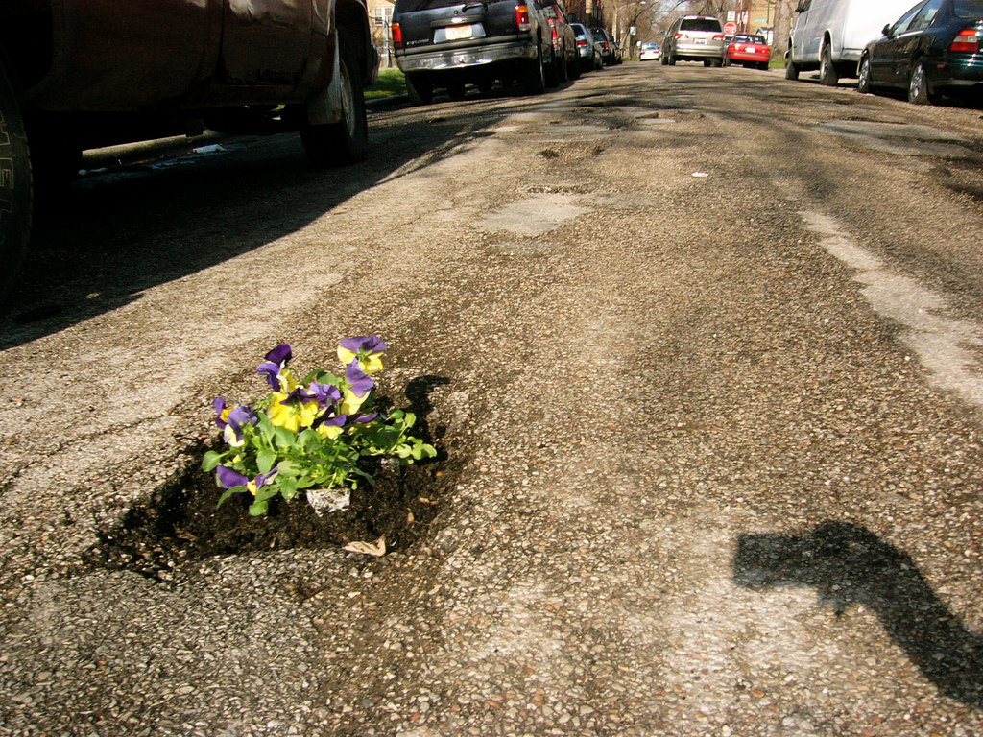
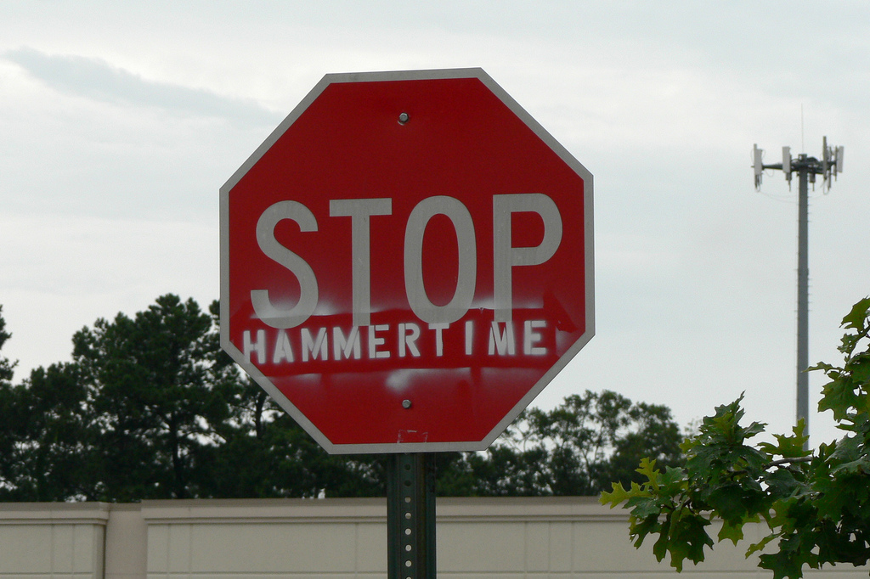
Creative citizen hacking
Credits: http://bit.ly/2nc7xwx and https://www.flickr.com/photos/rkimpeljr/1584665666/

Slide 7

Why open source?
Credit: http://opensource.com/government/14/5/recordtrac

Slide 8

The power of open source
Credit: http://opensource.com/government/15/6/3-models-civic-hackers-green-field-cloned-augmentation

Slide 9

Boston: Adopt-a -Hydrant
Credit: http://www.adoptahydrant.org/

Slide 10

Seattle: Adopt-a-storm drain
Credit: http://www.seattle.gov/util/EnvironmentConservation/GetInvolved/AdoptaDrain/Adopt-a-DrainSignup

Slide 11

Honolulu: Adopt-a-siren
Credit: http://sirens.honolulu.gov/

Slide 12

Raleigh: Adopt-a-bus shelter
Credit: http://adoptashelter.raleighnc.gov/

Slide 13
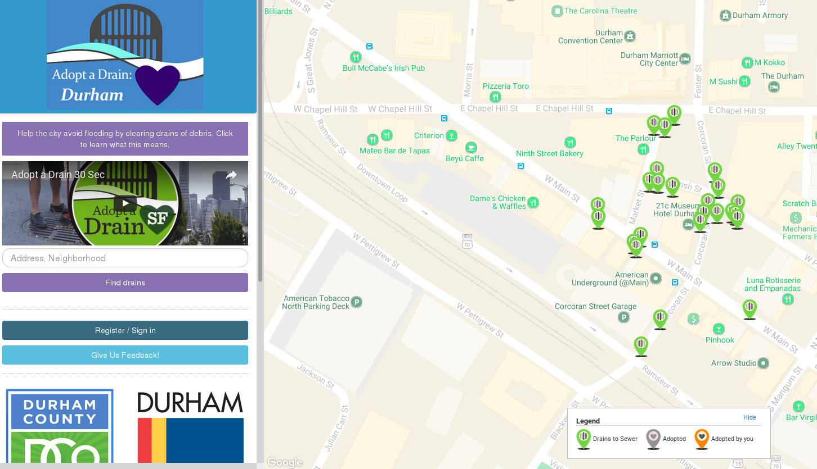
Durham: Adopt-a-drain
Credit: https://adoptadraindurham.herokuapp.com/

Slide 14

The game has changed
Credit: http://opensource.com/government/13/8/citizen-cio

Slide 15
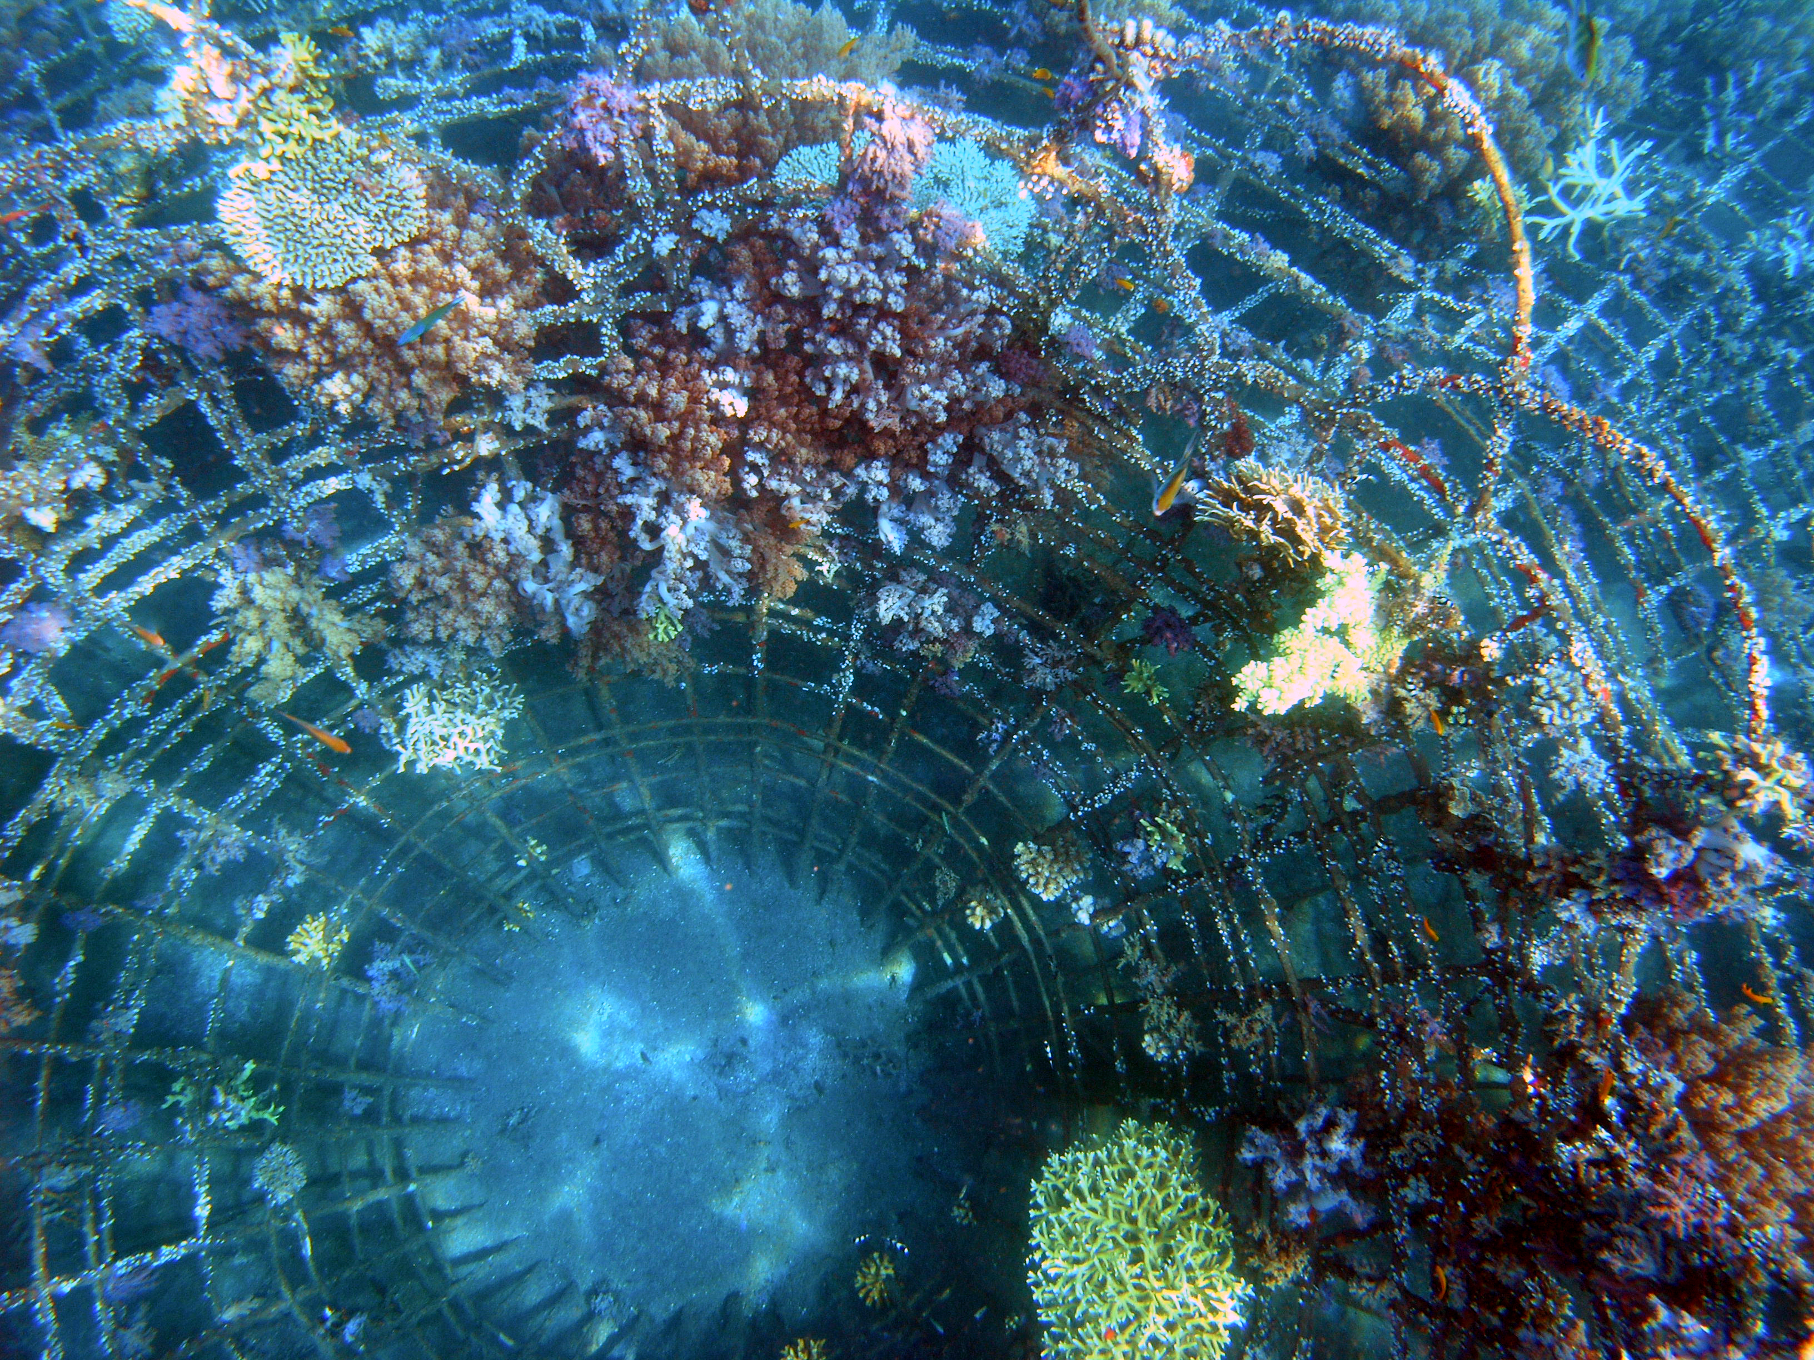
Create an environment for success
Credit: https://commons.wikimedia.org/wiki/File:Biorock_reef_construction,_photo_2.jpg

Slide 16
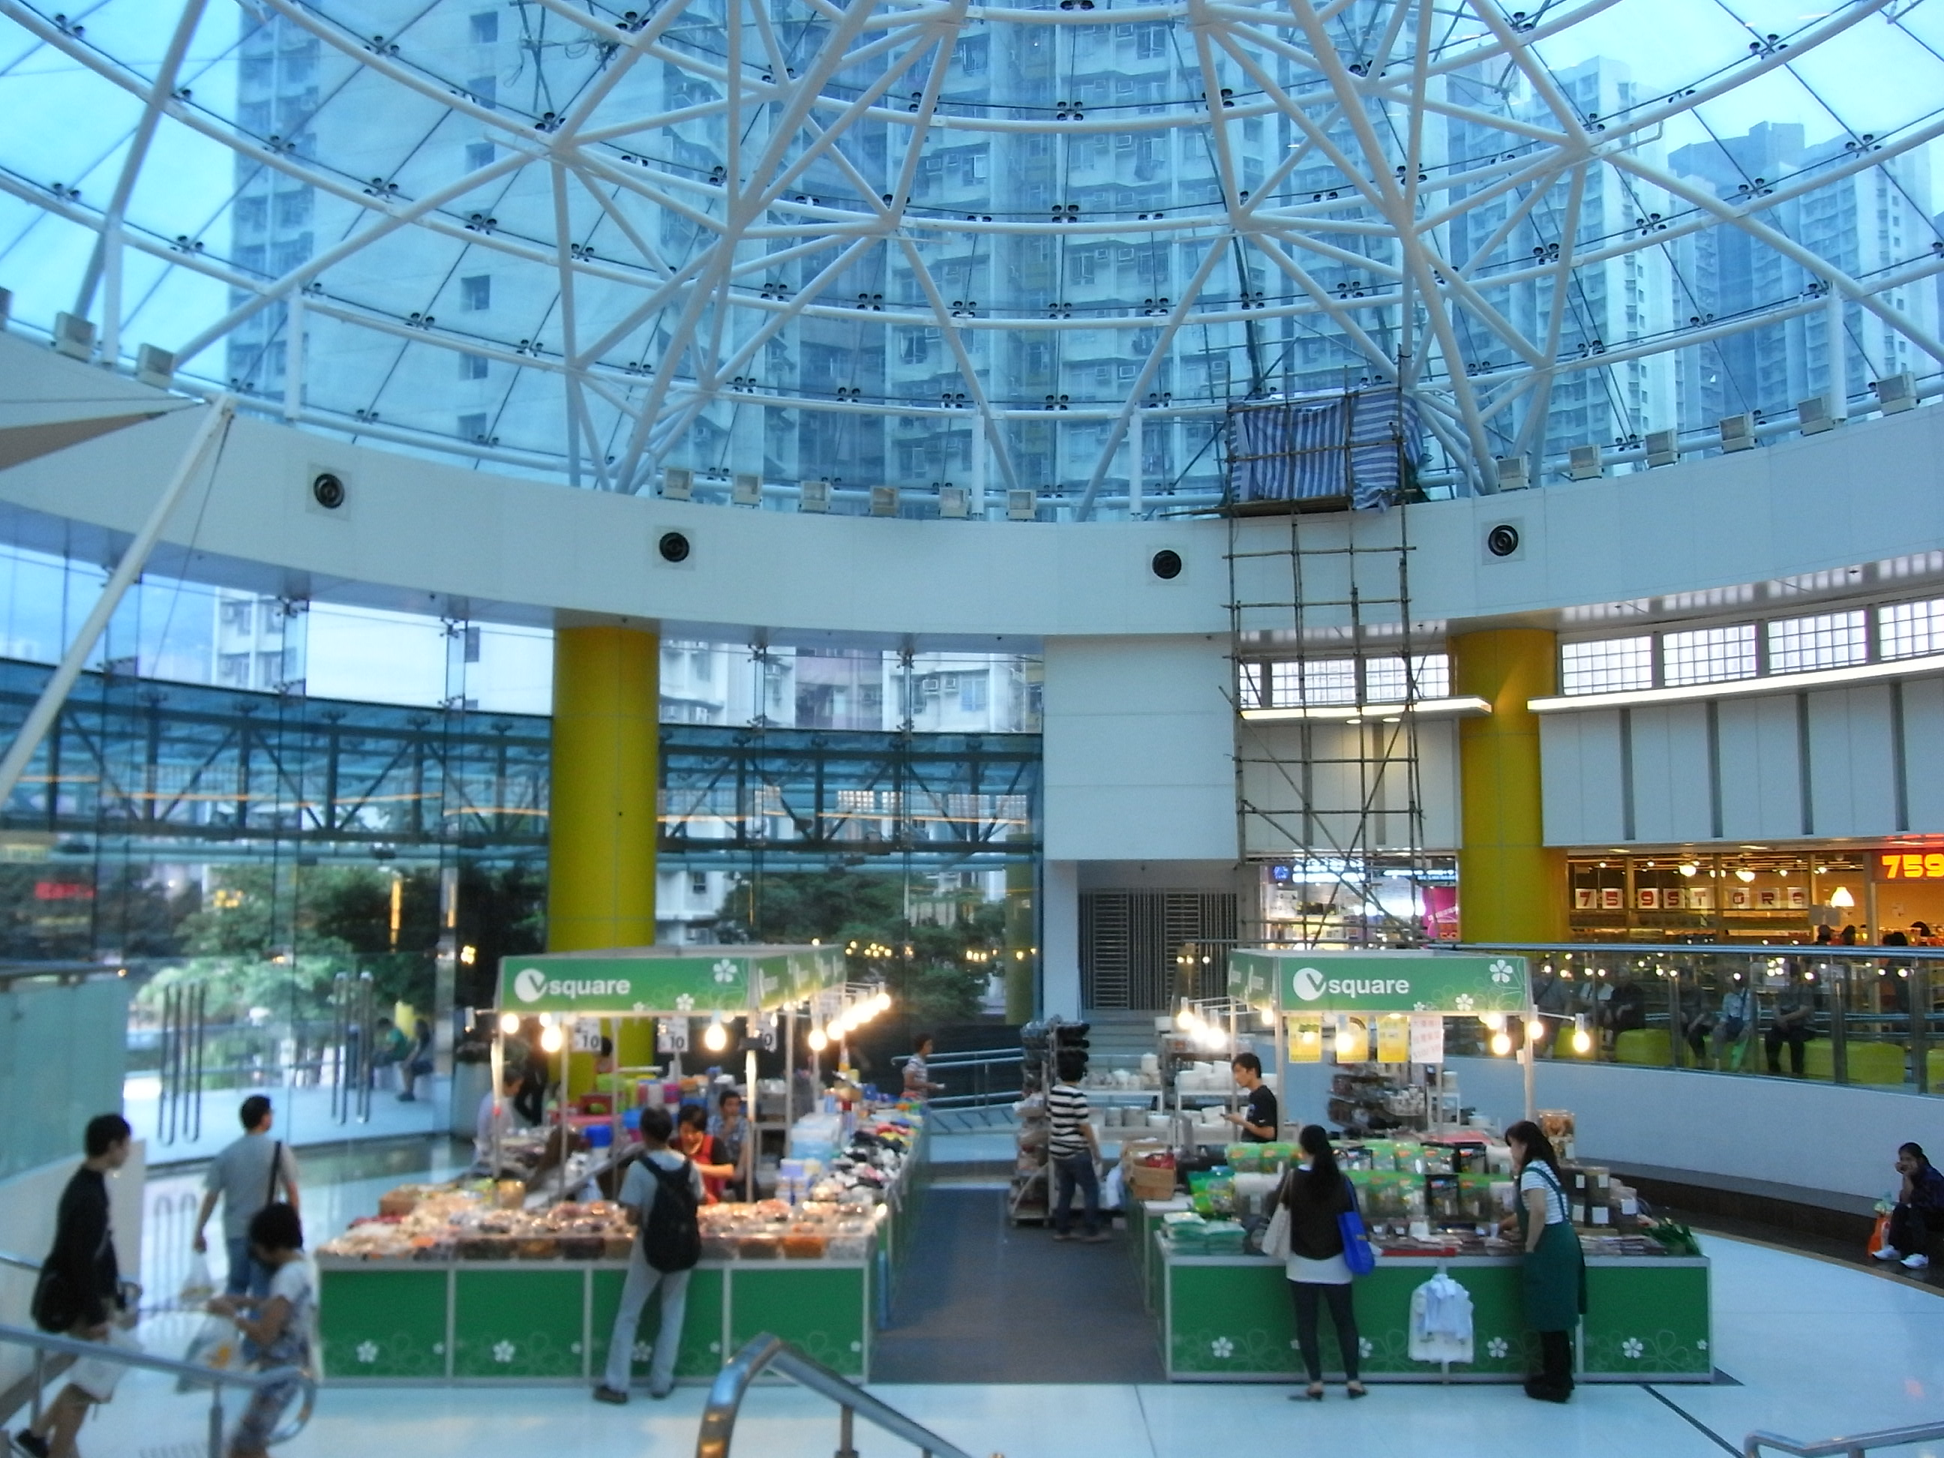
Be inclusive and value diversity
Credit: https://upload.wikimedia.org/wikipedia/commons/f/f4/HK_Tung_Chung_Fu_Tung_Estate_Plaza_void_courtyard_06_Transparent_roof_Oct-2012.JPG

Slide 17
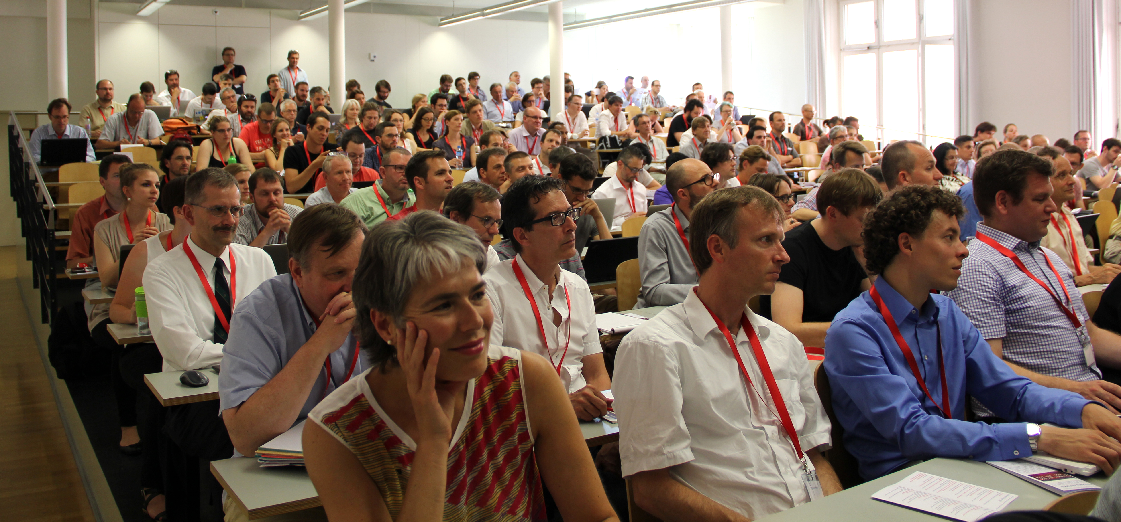
Don’t do this alone
Credit: https://commons.wikimedia.org/wiki/File:Open_Data_Conference_2015_at_the_University_of_Bern.JPG

Slide 18
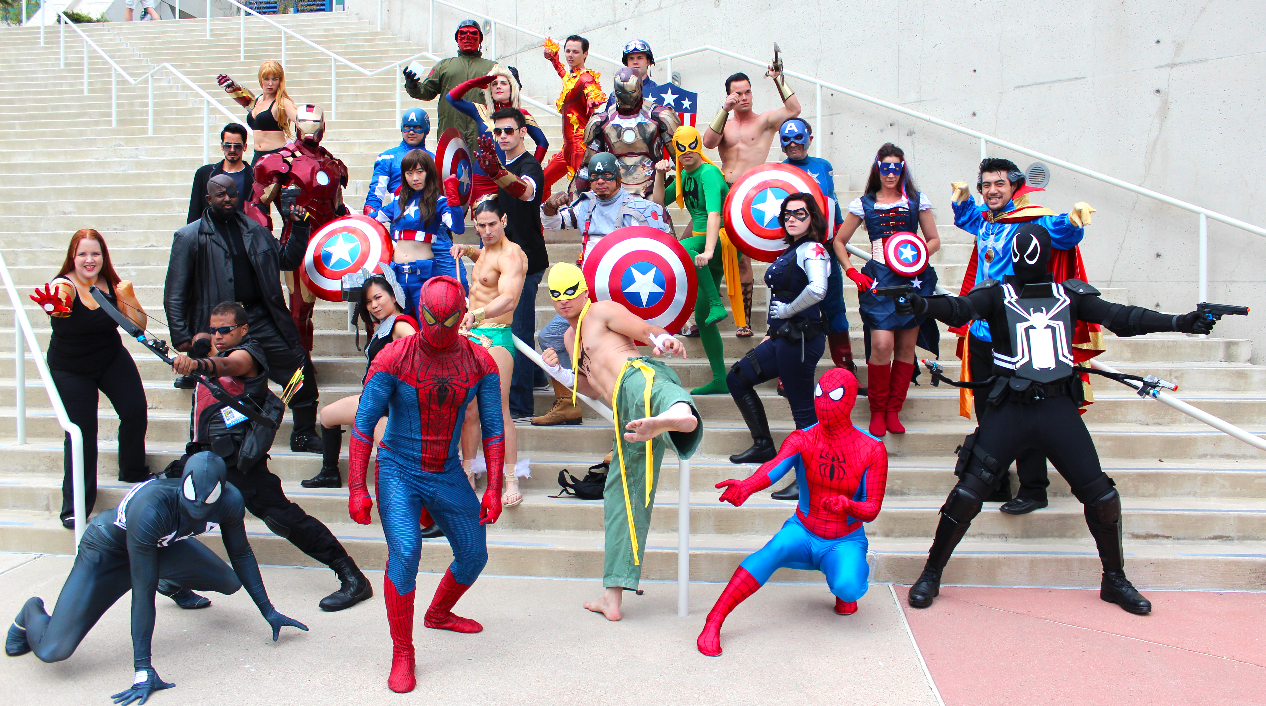
Collaborate with other organizations
Credit: https://upload.wikimedia.org/wikipedia/commons/4/4a/The_Avengers!_(9363713850).jpg

Slide 19

Default to open
Credit: https://www.jisc.ac.uk/sites/default/files/open-hero.jpg

Slide 20
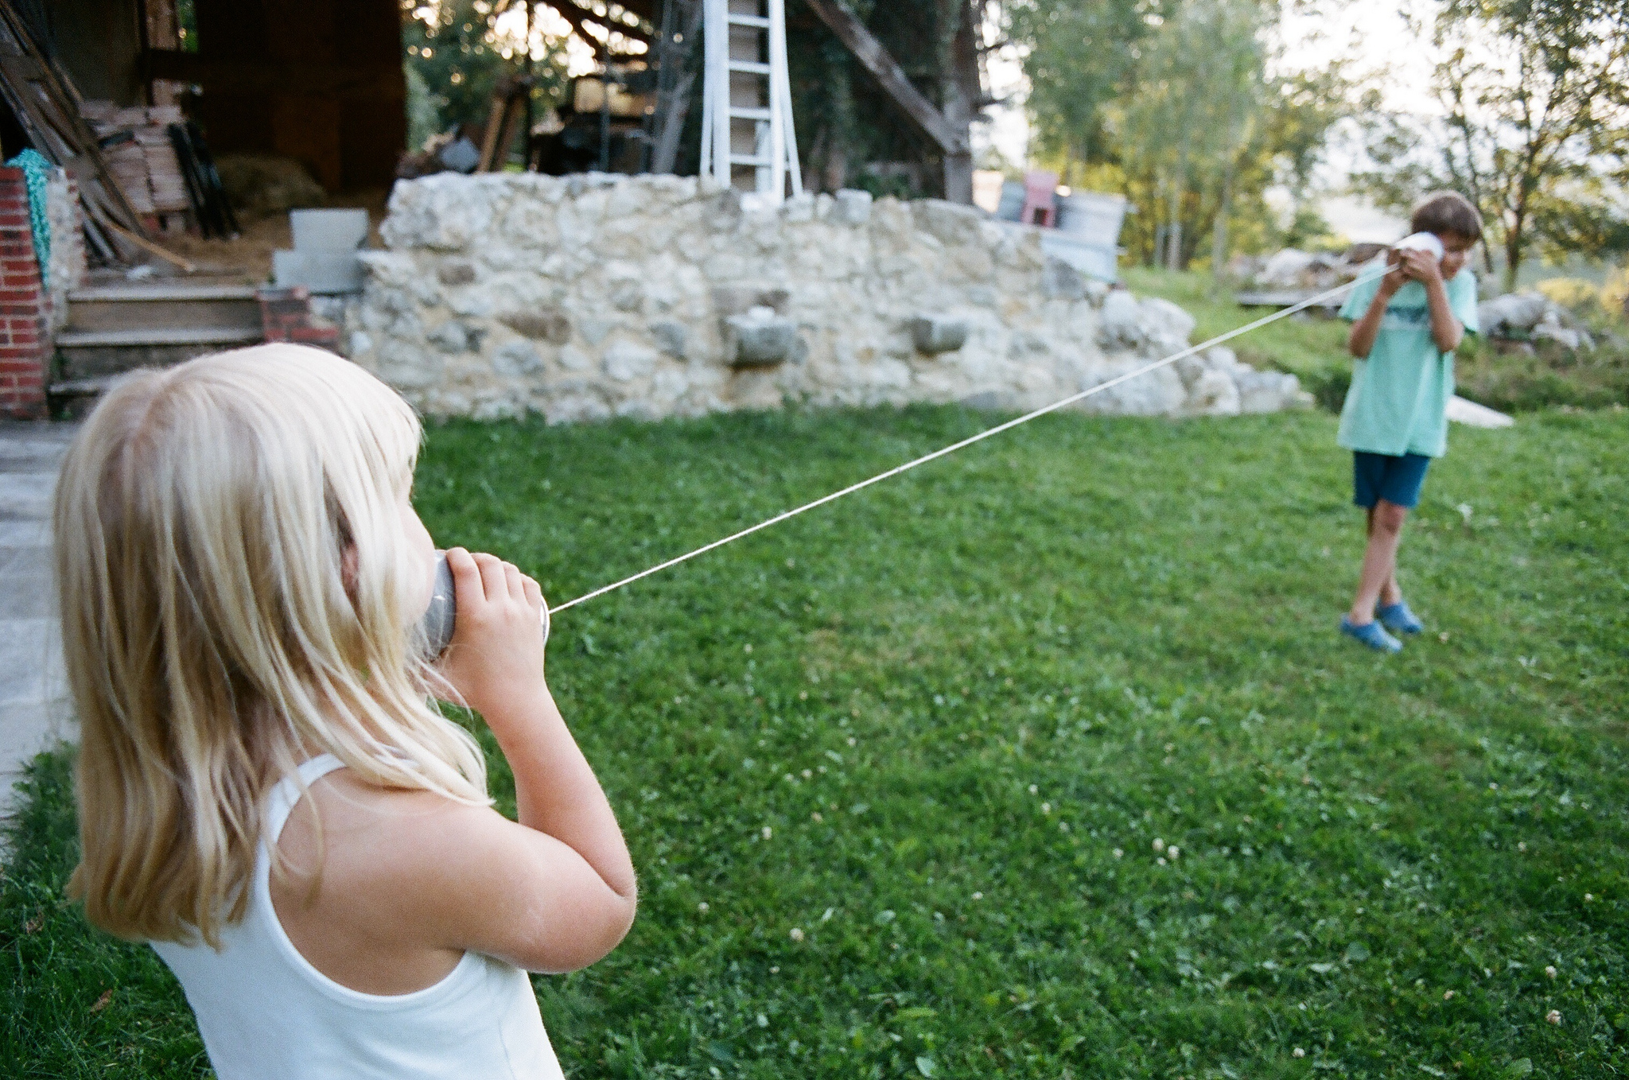
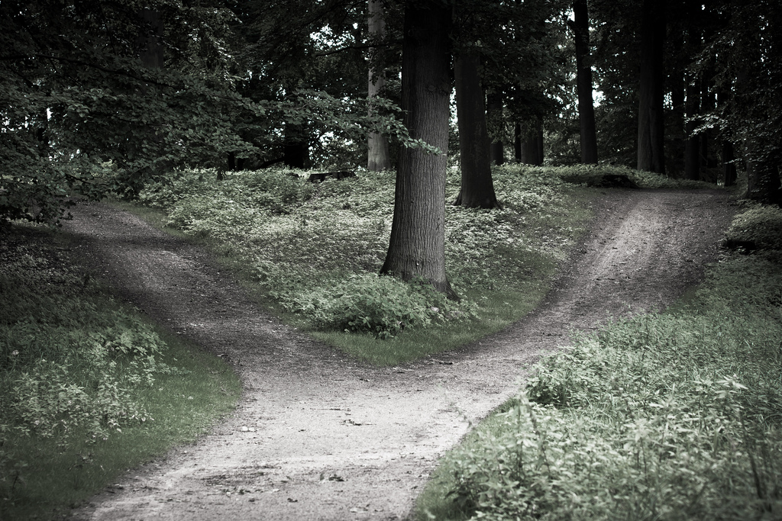
Open communications, documentation, decision-making
Credits: https://www.flickr.com/photos/uncoolbob/15322582642/ and https://www.flickr.com/photos/laenulfean/5943132296/

Slide 21

Get all the details at http://ncopenpass.com

Slide 22

Discover your passion
Thank you
Email: jhibbets@redhat.com
Twitter: @jhibbets
Slides: https://github.com/jhibbets/presentations
Book: http://theopensourcecity.com
Credits: http://www.flickr.com/search/?w=47691521@N07&q=lolcat
Notes:
Discover your passion, make great partnerships, and together, let's make government, for the people, by the people, for the 21st century.

