Slide 1
Civic Hacking 101:
The Engaged Citizen
Jason Hibbets
Opensource.com community manager, Red Hat
Code for Raleigh brigade captain
CityCamp NC co-chair
June 4, 2016
Notes:
By day, I’m the community manager at Red Hat for Opensource.com.
An online publication and community highlighting how the principles of open source can be applied to other disciplines business, education, and government.
By night, I’m a self proclaimed civic geek.
Code for Raleigh brigade
Co-chair for CityCamp NC

Slide 2

WARNING: Objects in government are transparent, collaborative, and participatory
Credit: http://hibbets.net
Notes:
Background details

Slide 3

Open government
Credit: http://www.flickr.com/photos/opensourceway/4459199503/in/set-72157625738142672
Notes:
Through my work at Opensource.com, I discovered the open government and open data movement.
I found a way to blend my passions. My passion for open source, my passion for civic participation, and my passion for my local community...Raleigh NC.
Open gov't is a combination of transparency, collaboration, and participation.

Slide 4

Improve the citizen experience
Credit: http://opensource.com/government/13/8/citizen-cio
Notes:
Mission: Improve the citizen experience
More engaging, inviting..
Create an environment for people to do amazing things

Slide 5

Taxes in > services out
Credit: http://opensource.com/sites/default/files/imagecache/image-full-size/images/education/gov_vending.png
Notes:
Most people view gov't like this: you put taxes in and get services out.
Police, fire protection, roads, trash collection, recycling, etc.

Slide 6

What government should be
Credit: http://www.flickr.com/photos/opensourceway/5537457791/in/set-72157628737085119
Notes:
I view government like this. Us. Citizens actively engaged in their city.
“Never doubt that a small group of thoughtful, committed people could change the world. Indeed, it's the only thing that ever has.” Margaret Mead

Slide 7

Creating a brand
Credit: http://www.flickr.com/photos/opensourceway/5496629913/in/set-72157628737085119
Notes:
Idea: What if Raleigh could be an open source city?

Slide 8

Creating a community
Credit: http://www.flickr.com/photos/opensourceway/8516817076/in/photostream

Slide 9

The catalyst
Credit: http://citycampral.org
Notes:
And we discovered CityCamp.
International unconference series designed to bring open source thinking to local municipalities.

Slide 10

https://twitter.com/BonnerGaylord/status/43714934470746115
https://twitter.com/jhibbets/status/43715324276776960
Notes:
March 4, 2011.

Slide 11

Community of passion
Credit: http://citycampral.org
Notes:
Started meeting weekly
Engaged citizens with a vision

Slide 12

An open government unconference
Credit: https://www.facebook.com/CityCampRal/photos_stream
Notes:
Explain the format

Slide 13


Evolving CityCamp
Credits: http://citycampnc.org | http://codeforamerica.org
Notes:
Explain how we are evolving the brand

Slide 14


Soooo 2014:
Credit: Carsi Tong
Notes:
Explain the new logo

Slide 15

A Peace Corp for geeks
Credit: http://codeforamerica.org/
Notes:
Explain Code for America

Slide 16

Code for Raleigh
Credit: http://brigade.codeforamerica.org/
Notes:
Explain the brigade program and Code for Raleigh.

Slide 17

Triangle Code for America Division
Join in: http://www.meetup.com/Triangle-Code-for-America/
Credit: http://brigade.codeforamerica.org/
Notes:
Explain collaboration in the Triangle

Slide 18
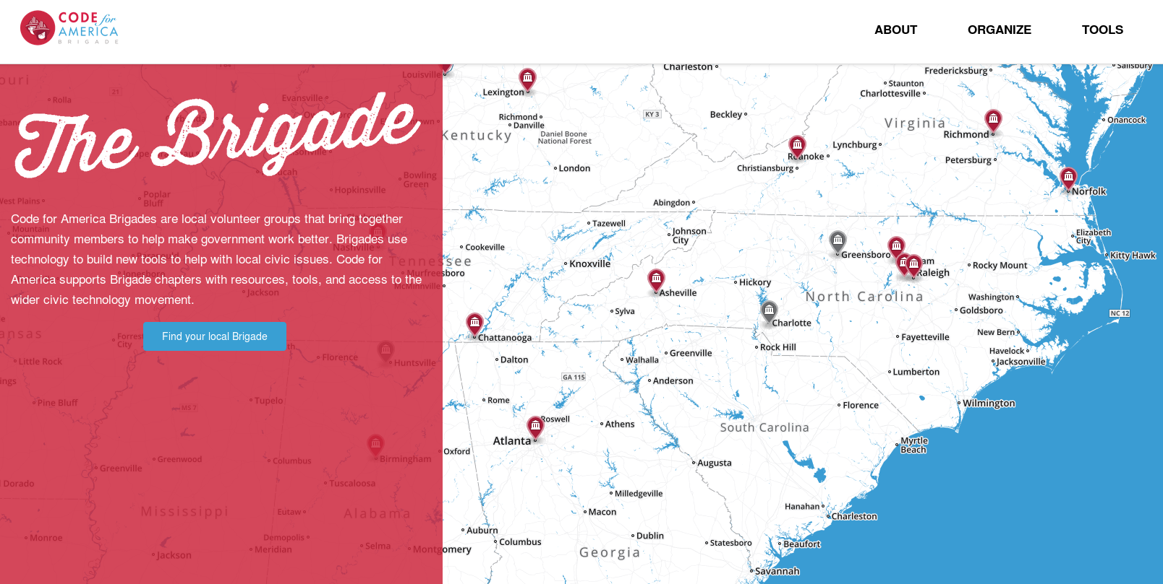
Code for North Carolina
Credit: http://brigade.codeforamerica.org/
Notes:
Explain the expanding ecosystem in NC

Slide 19
Code for NC Summit
NC Datapalooza
Code for Raleigh
Code for Greensboro
Code for Charlotte
Code for Durham
Code for Cary
Code for Asheville
Open data day
Notes:
Vision for CityCamp NC

Slide 20

Shake the vending machine
Credit: http://opensource.com/government/14/5/national-day-civic-hacking
Notes:
How do we influence change in a slow moving system like the govt?

Slide 21

3 models for civic hackers
Credit: http://opensource.com/government/15/6/3-models-civic-hackers-green-field-cloned-augmentation
Notes:
Explain the impact of civic hacking

Slide 22

Green field project
Credit: http://opensource.com/open-organization/15/10/using-open-source-fight-man
Notes:
New ideas, little to no existing code, brand new projects.

Slide 23

RGreenway
Credit: RGreenway – http://RGreenway.com
Notes:
Example: RGreenway

Slide 24

Reuse / cloned projects
Credit: http://opensource.com/government/14/5/recordtrac
Notes:
An open source project exists, most likely from Code for America or another Code for America Brigade that could be "cloned" (copied) and implemented for your city, region, or state.

Slide 25

Adopt-a-bus shelter
Credit: http://adoptashelter.raleighnc.gov/
Notes:
Example: Adopt-a

Slide 26

Augmentation projects
Credit: http://opensource.com/government/15/10/ato-interview-kaitlin-devine-18f
Notes:
Vetted and supported projects that are currently being worked on by a city, county, or state agency where civic hackers can support development activity, provide user feedback, increase adoption, and assist in testing by augmenting a sponsored project.

Slide 27

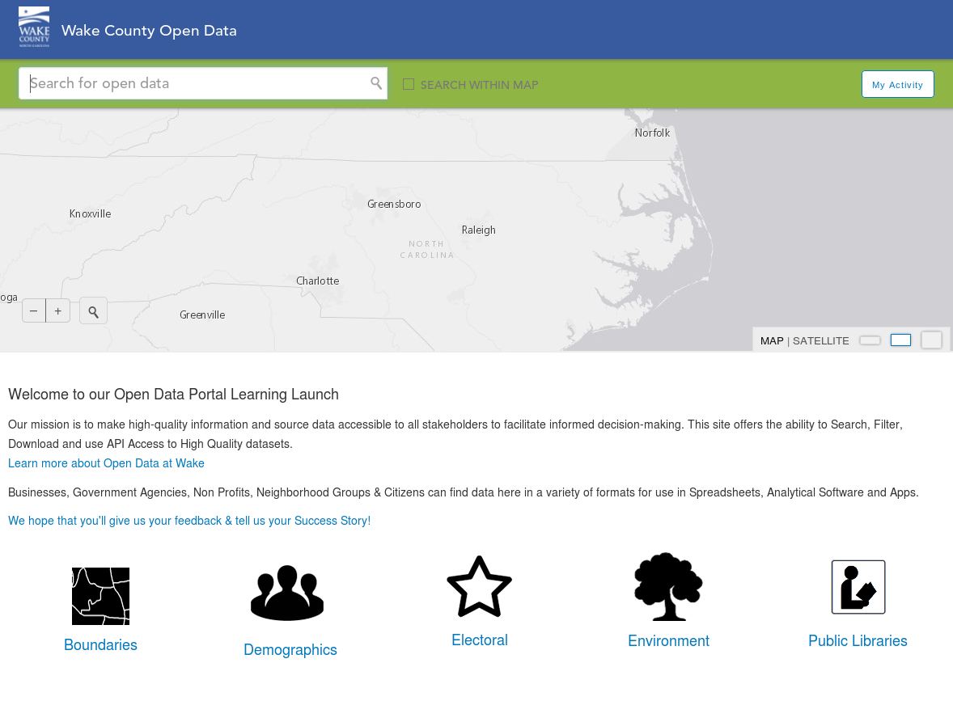
Credit: https://data.raleighnc.gov/ & http://data.wake.opendata.arcgis.com/
Notes:
Example: Raleigh open data portal meta data

Slide 28

The game has changed
Credit: http://opensource.com/government/13/8/citizen-cio
Notes:
Civic hacking is having a positive impact on open government.
It's all about partnerships.

Slide 29


theopensourcecity.com
Credit: http://theopensourcecity.com/
Notes:
My experience with open gov't inspired me to write a book.

Slide 30
Elements of an open source city
Culture/participation
Open government policy
Open data policy
Open source conferences & user groups
Economic development
Notes:
The 5 elements

Slide 31
A gathering of the tribes
Notes:
Re-iterate the vision for CityCamp NC.

Slide 32

Credit: http://opensource.com/life/13/11/open-source-thank-you
Notes:
Attend a future CityCamp or hackathon
Get involved, find a project or an organization that can use your skills.
Together, we can make government better by improving the citizen experience.

Slide 33

Q&A :: Contact
Questions
Contact
Email: jhibbets@redhat.com
Twitter: @jhibbets
IRC: shibby
Slides: https://github.com/jhibbets/presentations
Book: http://theopensourcecity.com
Credits: http://www.flickr.com/search/?w=47691521@N07&q=lolcat

Slide 34
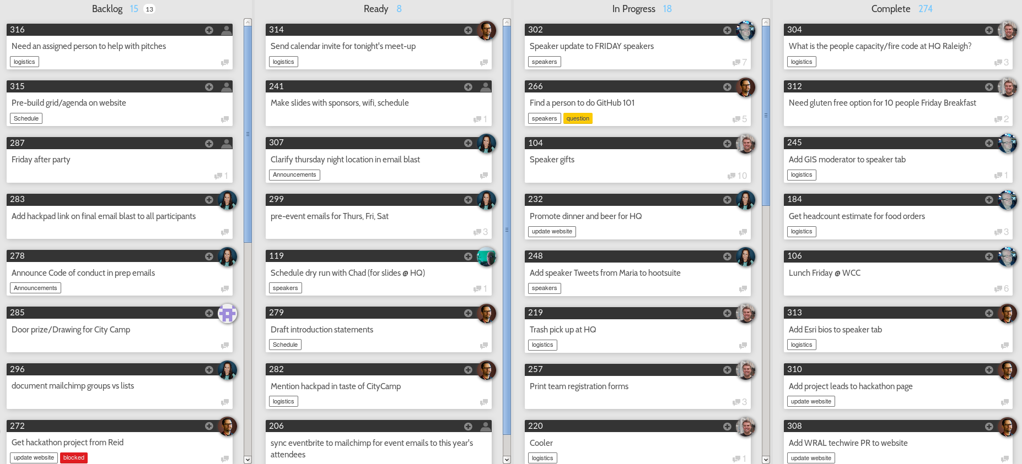
Credit: https://waffle.io/ashumz/citycamp

