Slide 1
Open Source Government & Civic Engagement Innovation Lab
2015 Emerging Issues Forum
From Vending Machine
to Civic Engagement
Jason Hibbets
Opensource.com community manager, Red Hat
Code for Raleigh brigade captain
CityCamp NC co-chair
February 9, 2015 | Emerging Issues Forum
Notes:
By day, I’m the project manager, community, manager, and team lead for Opensource.com.
An online publication and community highlighting how the principles of the open source development model, things like
transparency, collaboration, and rapid prototyping
can be applied to other disciplines business, education, and government.
By night, I’m a self proclaimed civic geek.
A captain for the Code for Raleigh brigade and co-chair for CityCamp NC.

Slide 2

Credit: http://www.flickr.com/photos/opensourceway/4459199503/in/set-72157625738142672
Notes:
Through my work at Opensource.com, I discovered the open government and open data movements.
I found a way to blend my passions.
My passion for open source,
my passion for civic participation, and
my passion for my local community...Raleigh NC.

Slide 3

Improve the citizen experience
Credit: http://opensource.com/government/13/8/citizen-cio
Notes:
My mission has been to improve the citizen experience. Today, I’d like to share a few things that are making that vision become reality.

Slide 4
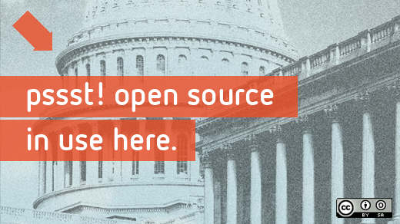
Beyond coding
Credit: http://www.flickr.com/photos/opensourceway/4581225603/in/set-72157623343008011/
Notes:
I’m not a coder; I’m a community organizer.
And like any open source project that needs contributors, I found a way to bring my skillset to the table.

Slide 5

Credit: http://opensource.com/sites/default/files/imagecache/image-full-size/images/education/gov_vending.png
Notes:
Most people view government like this, you put taxes in and get services out.
Things like police service, fire protection, and trash collection.

Slide 6
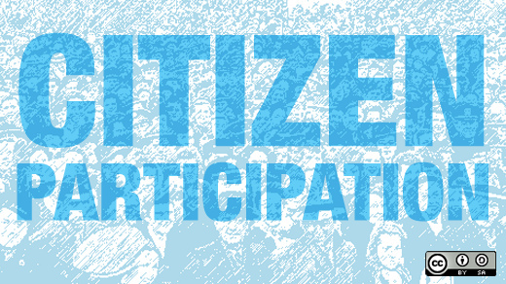
Credit: http://www.flickr.com/photos/opensourceway/5537457791/in/set-72157628737085119
Notes:
I view government like this.
All of us.
Citizens actively engaged in their government—beyond petitions and beyond that one things that gets them fired up.

Slide 7
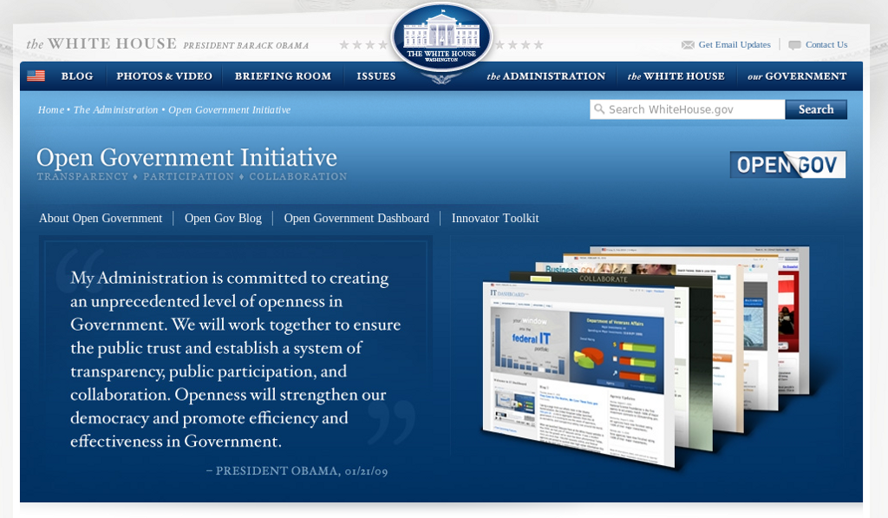
Credit: http://www.whitehouse.gov/open
Notes:
The open government movement got a kickstart back in January 2009 shortly after President Obama took office.
The open government initiative from The Whitehouse highlighted three components to help bring more openness to government:
transparency, collaboration, and participation.
These attributes are staples in the open source software world.

Slide 8
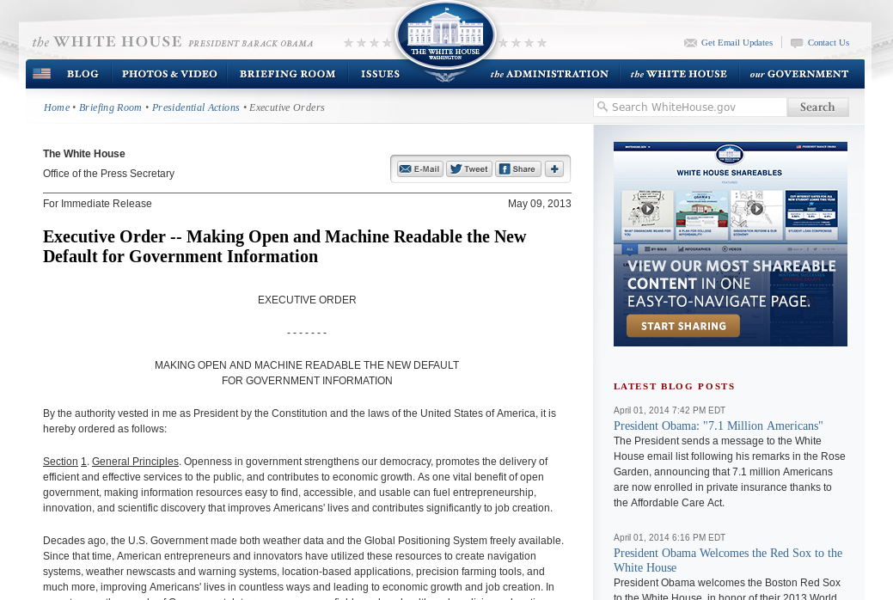
Default to open
Credit: http://whitehouse.gov
Notes:
In May 2013, The open data movement saw support at the Federal level with this Executive Order.
It basically says that all data from the federal government should be open and machine readable.

Slide 9

WARNING:
Objects in city government are more open than expected
Credit: http://hibbets.net
Notes:
My story begins here in Raleigh when I got a chance to interview former Raleigh Mayor Charles Meeker.
We sat down in his office and talked about how we could apply the principles of open source to a living and breathing city.

Slide 10

Sharing a story
Credit: http://opensource.com
Notes:
After publishing the interview, something happened that I didn’t quite expect.
People started to contact me to say they wanted to help explore this idea of an open source city.

Slide 11

Creating a community
Credit: http://www.flickr.com/photos/opensourceway/8516817076/in/photostream
Notes:
A community started to form in Raleigh around the ideas of open source and open government.
This community eventual embraced open data.

Slide 12

Creating a brand
Credit: http://www.flickr.com/photos/opensourceway/5496629913/in/set-72157628737085119
Notes:
We started talking about how we could brand Raleigh as an open source city and what that would mean.

Slide 13

The catalyst
Credit: http://citycampral.org
Notes:
We discovered a movement called CityCamp—which is an international unconference series designed to bring open source thinking to local governments through technology and citizen ideation.
Explain unconference.
There have been CityCamp events all over the world. I’ve had the privilege to attend CityCamps in Denver, Kansas City, and Honolulu.

Slide 14

Community of passion
Credit: http://citycampral.org
Notes:
A group of citizens, including one of our city councilors came together to plan the first CityCamp Raleigh.
City of Raleigh CIO, Gail Roper, and her team was very supportive of our citizen-led efforts.
In fact, one her team members was a critical member of our planning team.

Slide 15

An open government unconference
Credit: https://www.facebook.com/CityCampRal/photos_stream
Notes:
These team of volunteers have run four successful CityCamps in the Triangle, two as CityCamp Raleigh and two as a CityCamp NC.
These events have drawn interest from over 150 attendees at each event to help improve our government and explore ways that citizens could contribute.

Slide 16


Citizen-led projects
Notes:
We’ve had great success with our CityCamps and some really cool projects have come out of our events and competitions.
We have TriangleWIki, a hyperlocal version of Wikipedia that allows citizens to “edit” their city.
Our most successful apps to date has been Rgreenway, a mobile app that uses open data from the city that allows people to explore our extension trail and park system.

Slide 17

TriangleWiki Day
Credit: http://citycampral.org
Notes:
As an example of citizen participation, this is a picture from Triangle Wiki Day.
We had 50 people show up, on a cold morning in February 2012, including two city councilors and the city planning director.
We taught people how to use the wiki and then let them create pages and document their communities and places of interest.

Slide 18

The impact
633 page edits
100 maps
138 new photos added
Credit: http://citycampral.org
Notes:
Here are the results.
More than 600 edits, almost 150 new photos, and 100 new maps.
All this happened in just a few hours with the only motivation coming from the other participants and a food truck at lunch.
The lesson learned: Communities of passion can achieve a lot when we work together.

Slide 19


Evolving our CityCamp
Credits: http://citycampnc.org | http://codeforamerica.org
Notes:
The organizers needed to evolve CityCamp to help it grow. We rebranded as CityCamp NC to extend our reach beyond the Triangle.
Along the way, CityCamp organizers eventually become Code for Raleigh and we partnered with a great organization called Code for America.

Slide 20

A Peace Corp for geeks
Credit: http://codeforamerica.org/
Notes:
CfA is a non-profit in San Francisco who’s missions it to bring open source technologies to government. They have several programs to accomplish this, the most popular being their fellowship program that assigns a team of problem solvers to applicant cities each year.
The solutions the fellows design are all open source, and that means other municipalities around the world can implement and deploy these solutions.

Slide 21

Boston: Adopt-a -Hydrant
Credit: http://www.adoptahydrant.org/

Slide 22

Seattle: Adopt-a-storm drain
Credit: http://www.seattle.gov/util/EnvironmentConservation/GetInvolved/AdoptaDrain/Adopt-a-DrainSignup

Slide 23

Honolulu: Adopt-a-siren
Credit: http://sirens.honolulu.gov/

Slide 24
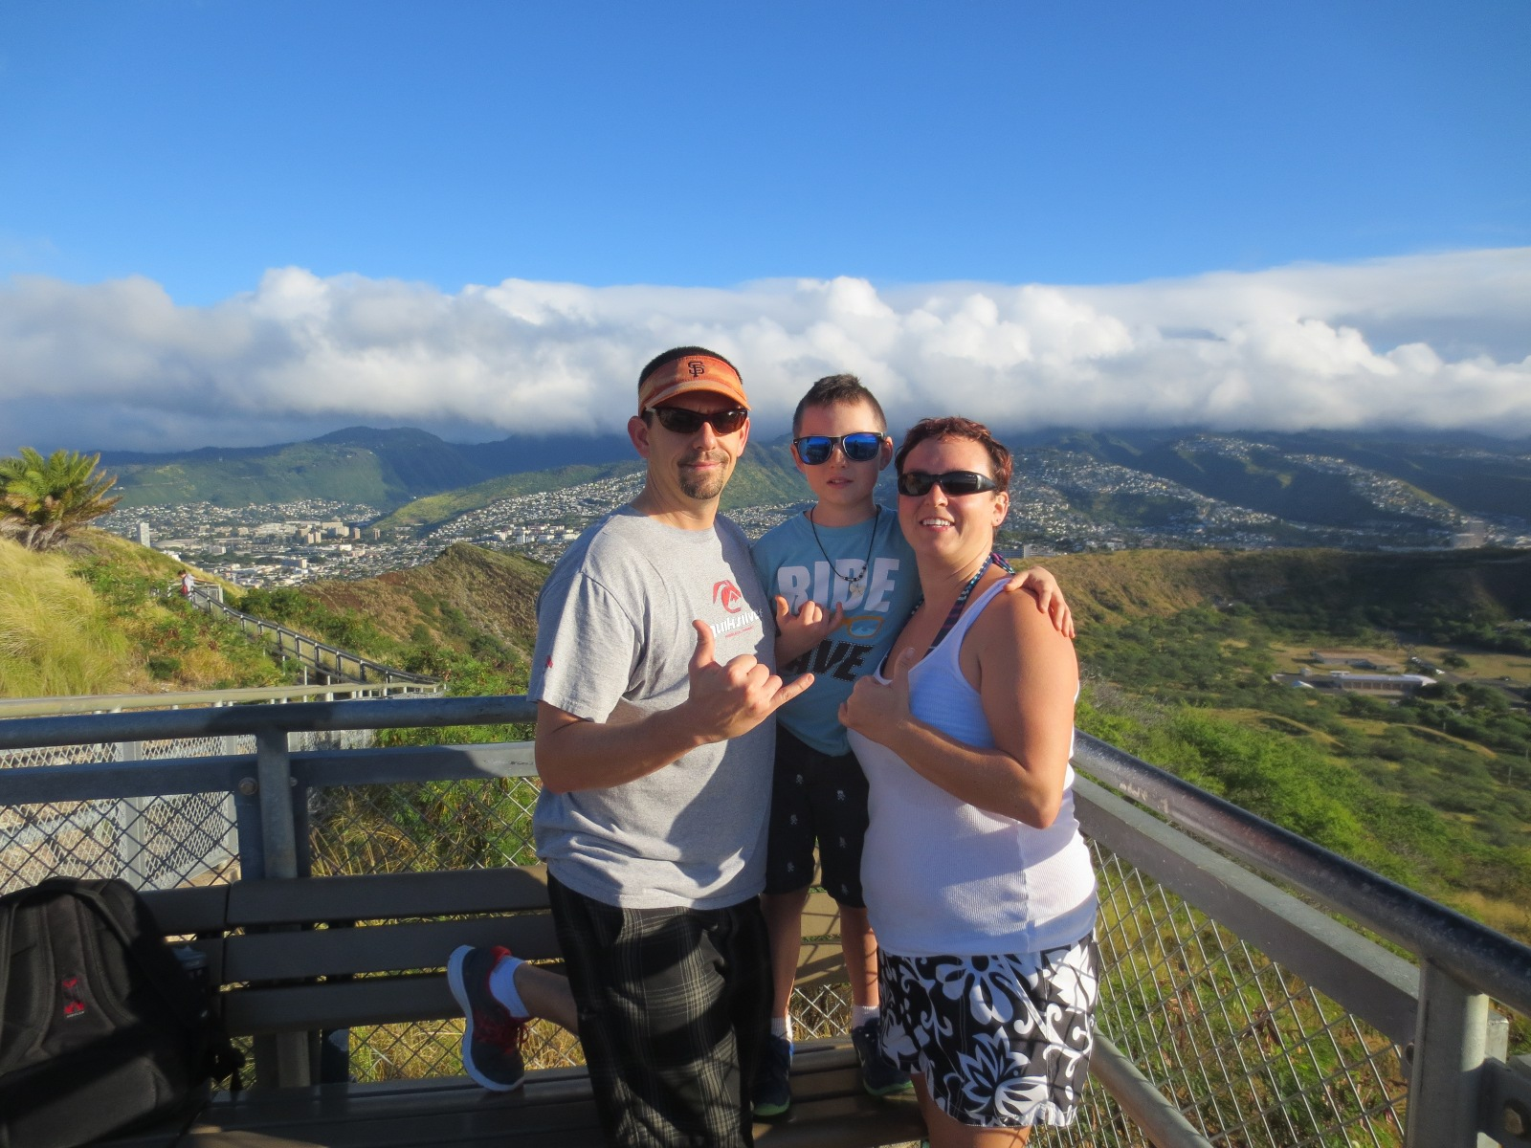
Since we’re talking about Hawaii...
Credit: http://hibbets.net

Slide 25
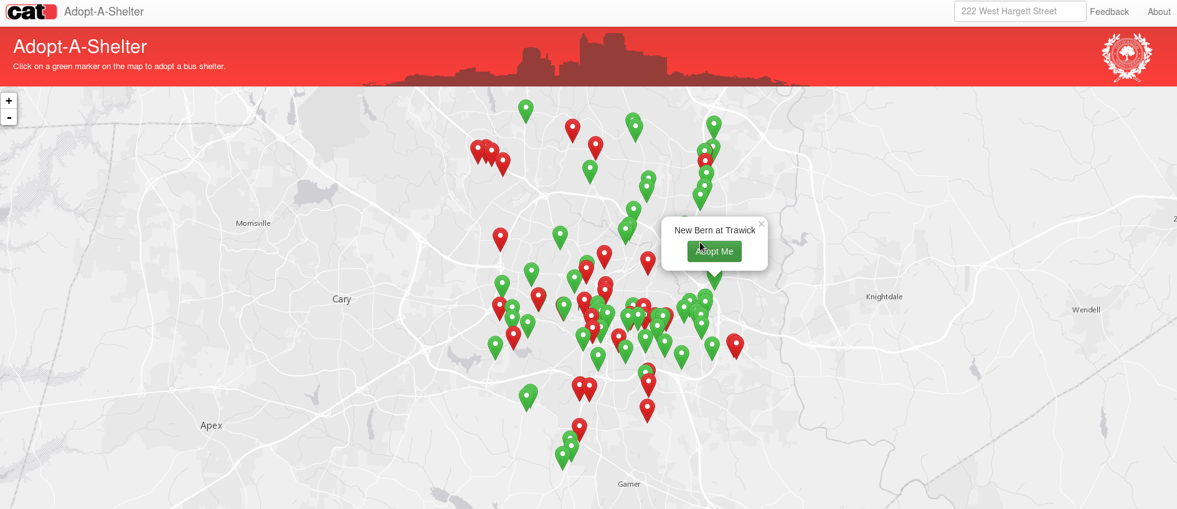
Raleigh: Adopt-a-shelter
Credit: http://openmaps.raleighnc.gov/adoptashelter/

Slide 26

Code for Raleigh
Credit: http://brigade.codeforamerica.org/
Notes:
The program that Code for Raleigh is part of is the Code for America brigade.
It allows volunteers like myself and my fellow captains to help our local city through civic hacking in partnership with our city officials.

Slide 27
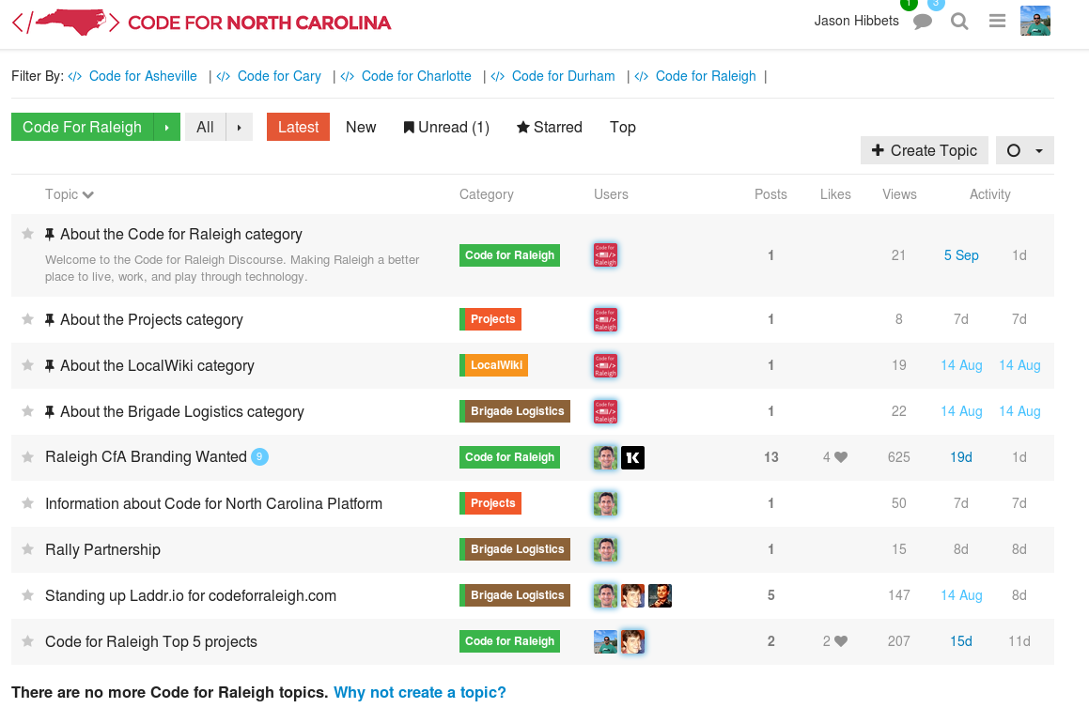
A safe place to code
Credit: http://forum.codeforraleigh.com/category/code-for-raleigh
Notes:
I like to think that our brigade is a safe place to learn how to code.
We’re working on projects at our monthly meet-up such as NC Free Wheeling—an app that uses open data from the state of NC to promote safe bike routes.
I’m leading a project to deploy the Where’s my school bus?
An app that shows real-time locations of school buses after users authenticate with the app
We’ve partnered with the Wake County Public School System to pursue how to bring this app to the parents of school children in Wake County.

Slide 28

Triangle Code for America Division
Join in: http://www.meetup.com/Triangle-Code-for-America/
Credit: http://brigade.codeforamerica.org/
Notes:
Locally, we have other brigades in Cary and in Durham. We call ourselves the first CfA division.
There is also a brigade in Asheville.
If you are interested in participating or want to see what we do, I encourage you to visit our meet-up page and attend a meet-up.

Slide 29
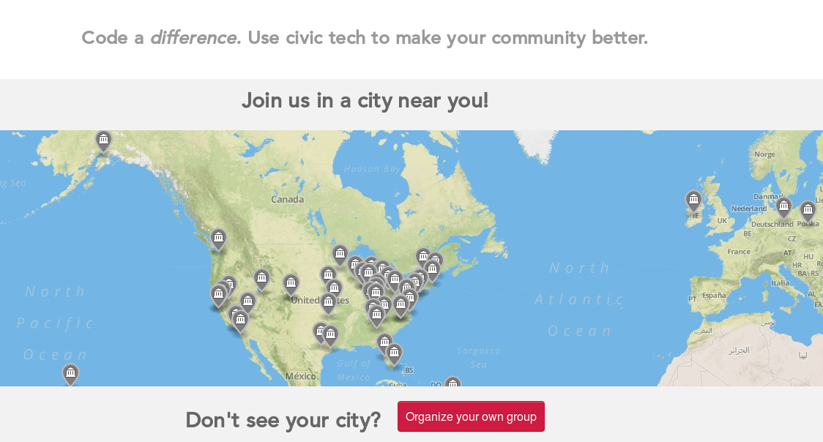
Join a brigade near you
Credit: http://brigade.codeforamerica.org/
Notes:
There are brigades all over the US, in fact, all over the world.
Our brigades in NC are part of a world-wide effort to engage citizen volunteers, partner with local municipalities, and work on meaningful projects.

Slide 30
Raleigh: A case study
Credit: http://www.flickr.com/photos/opensourceway/5496629913/in/set-72157628737085119
Notes:
Now that you’ve seen a few things that citizens are working on, let’s take a look at a few things the City of Raleigh has accomplished.

Slide 31

SeeClickFix
Credit: http://seeclickfix.com/raleigh
Notes:
This is SeeClickFix. It’s a website and mobile platform that the City of Raleigh has deployed.
SeeClickFix is a way for citizens to report non-emergency issues to the City, such as graffiti, pot holes, or broken sidewalks.
While citizens don’t have a direct impact in the actual resolution, they do get a sense of accomplishment that they were able report an issue, and in doing so, become part of the solution.

Slide 32

Open government resolution
Credit: http://opensource.com/government/12/2/how-get-your-city-pass-open-government-policy
Notes:
In February of 2012, the City of Raleigh unanimously passed an open government resolution. It basically accomplished two things:
1) When the city reviews software during it’s procurement process, it must consider an open source solution.
2) It also said that the city should create and fund an open data portal.
The best part about this effort is that the resolution included a road map on how to implement the resolution, which made it more than just words on paper and a vote by city council.

Slide 33

Open Raleigh
Credit: City of Raleigh – http://raleighnc.gov
Notes:
Raleigh launched these efforts on their website under “Open Raleigh.”
It includes information about the program and links to the open government resolution, the open data portal, as well as many other application that are part of the program.

Slide 34
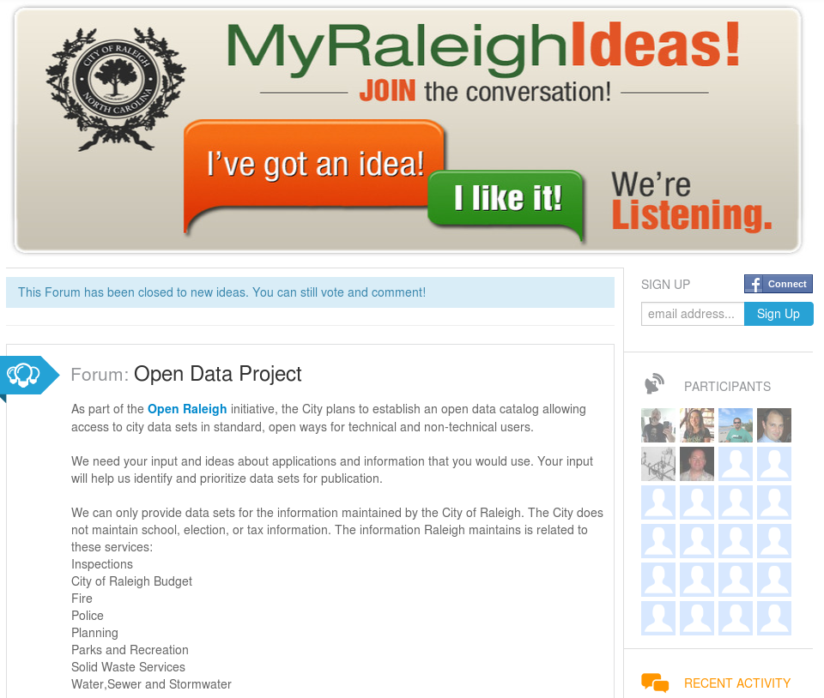
Credit: City of Raleigh – http://myraleighideas.com
Notes:
The City is also using solutions to crowdsource ideas and get feedback on different initiatives the city wants citizen feedback on.
Here we see they are looking for feedback on the open data portal.
They’ve also used this platform to get feedback on the proposed budget or various corridor studies that would impact citizens.

Slide 35

data.raleighnc.gov
Credit: https://data.raleighnc.gov/
Notes:
This is the first version of the open data portal.
One of the key parts that made the portal successful is that the City focused on getting strategic data to citizens and other users.
>> Mention the types of data

Slide 36

Credit: https://data.raleighnc.gov/
Notes:
This is the latest version of the open data portal with more even more data and better usability.

Slide 37


We built this city on open source
Open Raleigh
Code for Raleigh
Open government
resolution
My Raleigh Ideas!
My Raleigh
Subscriptions
RGreenway
NC Datapalooza
Notes:
As you can see, Raleigh is helping to lead parts the open government and open data movements.
Collectively, we are helping to blaze a trail for others to become open source cities and we’re sharing our story along the way.

Slide 38

Partner with your city
Digital Connector Program
Code for Raleigh
CityCamp NC
Innovate Raleigh
American Underground & HQ Raleigh
Credit: http://opensource.com/government/13/8/citizen-cio
Notes:
Part of the reason we’ve been so successful is because of our municipal partners.
Our brigade works closely with Gail Roper’s team and have also formed good relationships with Wake County.

Slide 39

theopensourcecity.com
Credit: http://theopensourcecity.com/
Notes:
I published a book in 2013 called The Foundation for an Open Source City, that includes many of the stories I’ve shared today in greater detail.

Slide 40

Elements of an open source city
Culture/participation
Open government policy
Open data policy
Open source conferences & user groups
Economic development
Credit: http://theopensourcecity.com/
Notes:
The book outlines the five elements of an open source city highlighting the culture of participation we have here in Raleigh.
It includes details on Raleigh’s open government and open data policies.
I also talk about why it’s important to support user groups and host conference such at All Things Open.
Lastly, I touch on how open source and open data can impact economic development and provide a ripe business environment for open source-minded companies and start-ups to thrive in.

Slide 41
Thoughts for this innovation lab
What can we do to make North Carolina the hub of open government and open data?
Does North Carolina need to pursue a state-wide open data policy?
How can the North Carolina public and private sectors be more attractive to civic innovators?
How can we foster collaboration between cities and counties across the state?
Notes:
And here are some thoughts for you to explore during today’s innovation lab.

Slide 42

Contact
  Twitter: @jhibbets
  Email: jhibbets@redhat.com
  or: jhibbets@gmail.com
  IRC: shibby
  Slides: https://github.com/jhibbets/presentations
  Book: http://theopensourcecity.com
Credits: http://www.flickr.com/search/?w=47691521@N07&q=lolcat

