Slide 1
The Evolution of chat:
Building community with Twitter
Jason Hibbets
Senior community evangelist
Opensource.com, Red Hat
Open Source Leadership Summit
February 2017
Notes:
Introduce yourself. Smile!

Slide 2


Community + content
Notes:
Explain Opensource.com
Content marketing == Community building
Gathering 100 articles / month
Generating +1M page views; 670k unique visits

Slide 3
Topics
Techniques for building community by using social media
Best practices for promoting and leading a Twitter chat
Successes / failures from our experience
How to measure the success
Ideas on how you can use Twitter chats to build community
Practice!!
Notes:
Hook
Today, I'm going to talk about my experience planning, leading, and learning from Twitter chats. Along the way, I want to demonstrate:

Slide 4
Our process
Phase 1
Chat
preparation
Phase 2
Chat
execution
Phase 3
Chat
conclusion
Notes:
To do this, I'm going to walk you through the chat process, step by step. I'll organize my presentation into three periods or "phases":
But before I do that, let me tell you about why I started running Twitter chats in the first place.

Slide 5
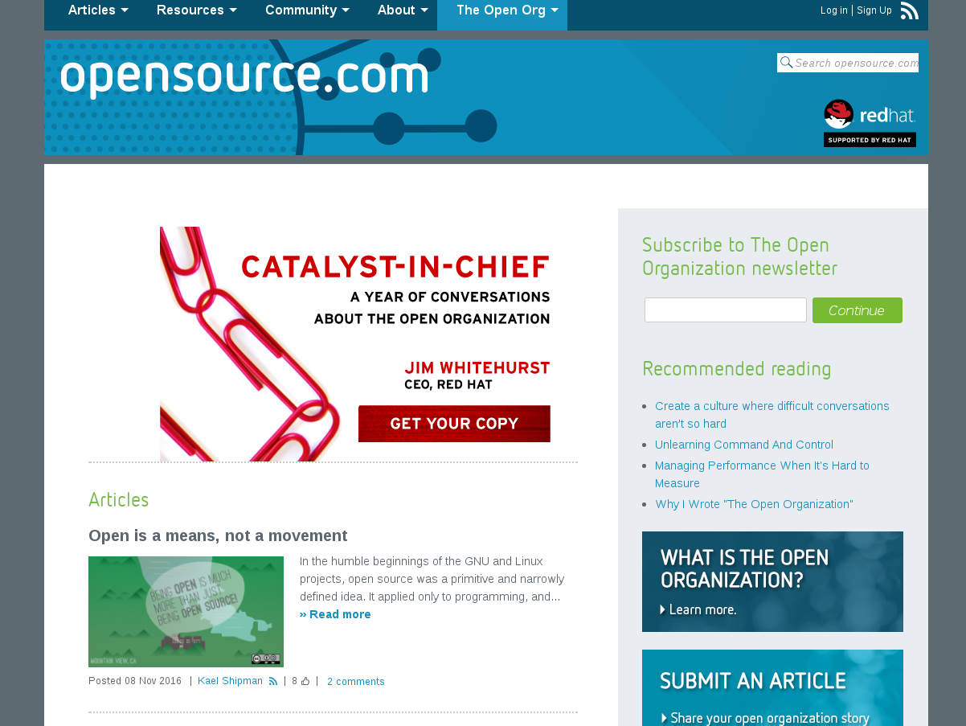
Notes:
Introduce the Open Organization community at Opensource.com

Slide 6

Background
Notes:
Explain the virtual book club event
Answer the question: "Why Twitter?" (why not IRC or Hangouts or something else?)
One more note (on format): We chose to structure our chats as Q&A-style
All questions coming from @OpenOrgBook

Slide 7

Phase 1: Hashtag selection
#OpenOrgChat
6-8 weeks
Notes:
Importance of research onto popular/viable hastags to identify the chat
Eight weeks before the chat

Slide 8

Phase 1: Date selection
6-8 weeks
Notes:
Choose regularly-occurring dates and times
Consider time zone differences of community members
Eight weeks before the chat

Slide 9

Phase 1: Topic selection
6-8 weeks
Notes:
Determine what your community will enjoy discussing
Tie to recent content, themes, guests' interests
Eight weeks before the chat

Slide 10
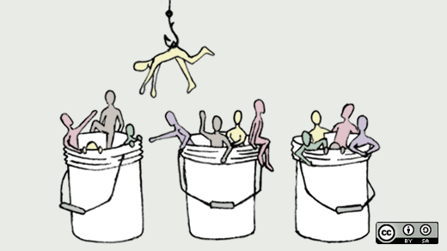
Phase 1: Select and invite guests
6-8 weeks
Notes:
Write personal invitations to would-be guest hosts and attendees
Include chat themes, times, and dates
Six or seven weeks before the chat

Slide 11
Phase 1: Create a calendar event
4-5 weeks
Notes:
Circulate this to people who RSVP in the affirmative
Include in the event: basic chat instructions, themes, etc.
Also book a physical location for the chat, a "chat headquarters," where people participating locally can convene to participate in person
Five weeks before the chat

Slide 12

Phase 1: Configure reporting mechanisms
4-5 weeks
Notes:
Hashtracking, etc.
Define success metrics
Five weeks before the chat

Slide 13

Phase 1: Announce chats
4-5 weeks
Notes:
Create a publicly-available calendar listing of upcoming chat dates and times
Publish your list(s) of confirmed guests online
Start tweeting about the upcoming chat (be sure to include handles of confirmed participants and start using the hashtag you've identified above!)
Four weeks (one month) before the chat

Slide 14

Phase 1: Draft pre-event, intro, and closing “scripts"
2-3 weeks
Notes:
Explain the importance of using scripts
Analogy: Airline safety announcements
Three weeks before the chat

Slide 15
Example: Pre-event Tweets
#OpenOrgChat starts at 2pm ET with @charleneli @martenmickos @thomasdcameron and @jhibbets red.ht/1QnXlZs #TheOpenOrg
Very excited to have author @charleneli (The Enagaged Leader - http://ow.ly/TonQu ) join #OpenOrgChat today: red.ht/1QnXlZs
In 30 minutes #OpenOrgChat about "Catalyzing direction" will start taking over Twitter | red.ht/1QnXlZs #TheOpenOrg
While you wait for #OpenOrgChat, watch this behind the scenes video with @jwhitehurst https://www.youtube.com/watch?v=hd-PsTVZqj4&index=1&list=PL4jrq6cG7S45xEWnfLakoszRQIHtlPQ04
#OpenOrgChat about "Catalyzing direction" starts in 5 minutes: red.ht/1QnXlZs #TheOpenOrg
#OpenOrgChat "Catalyzing direction" is starting, get ready! red.ht/1QnXlZs #TheOpenOrg [attach openorg model image]
Next #openorgchat starts soon @mairin @dmirams @JosepMLozano @maximumchange @OpenMatt @lcongdon @brentholden @jackieyeaney @BryanZwan3

Slide 16
Example intro script
Welcome to our final #OpenOrgChat of #TheOpenOrg book club! Today we're discussing "Catalyzing direction"
Tune into this chat at: {URL}, or start tracking #OpenOrgChat in your favorite social media tool
Our special guests this week are: @charleneli, @martenmickos, @thomasdcameron, and @jhibbets #TheOpenOrg
Here's the format: We'll preface each question with "Q" (Q1, Q2.). So begin your matching answers with "A" (A1, A2) #OpenOrgChat
And be sure all your tweets include our Twitter chat hashtag #OpenOrgChat, so everyone can follow along
You can pose your own questions to #OpenOrgChat, too
If you'd like to introduce yourself, please do so now. Feel free to share why you're here today. Selfies welcome! #OpenOrgChat
[ wait 2 minutes]
Welcome, everyone. Here's today's first question ... #OpenOrgChat
Notes:
Explain selfie process

Slide 17
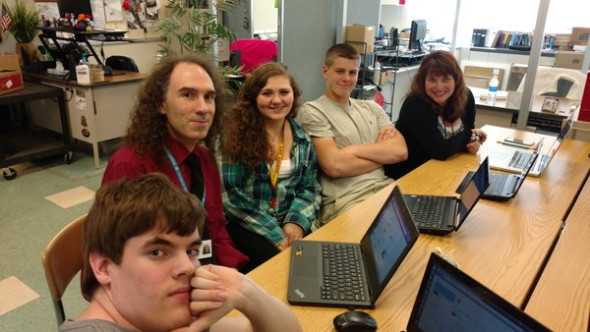
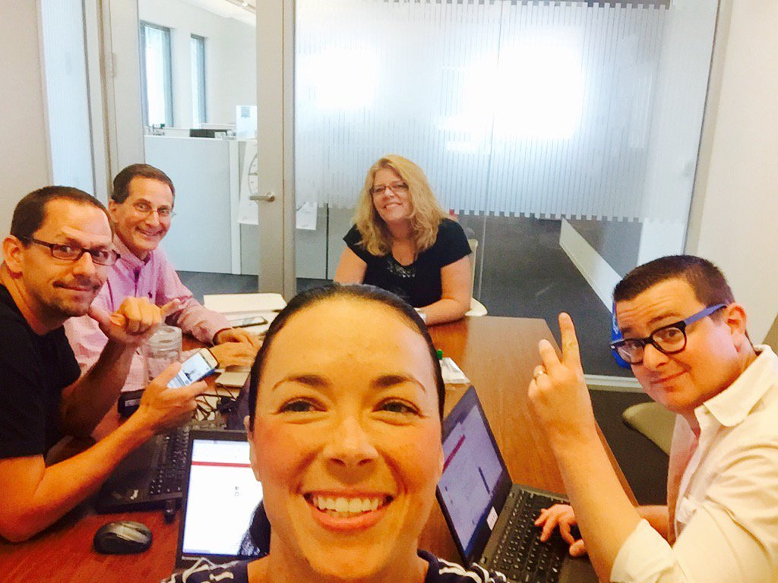
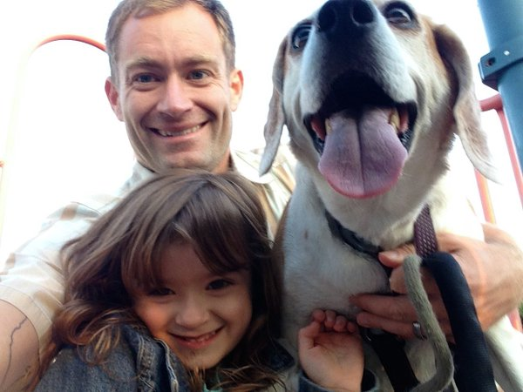
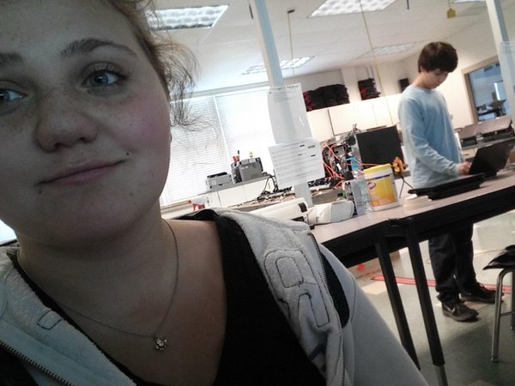
Example selfie introductions

Slide 18
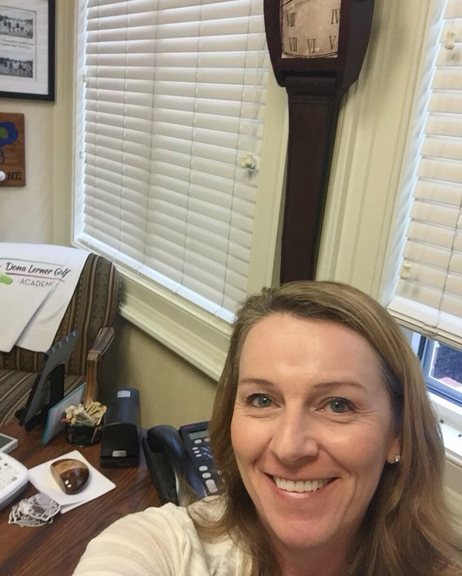
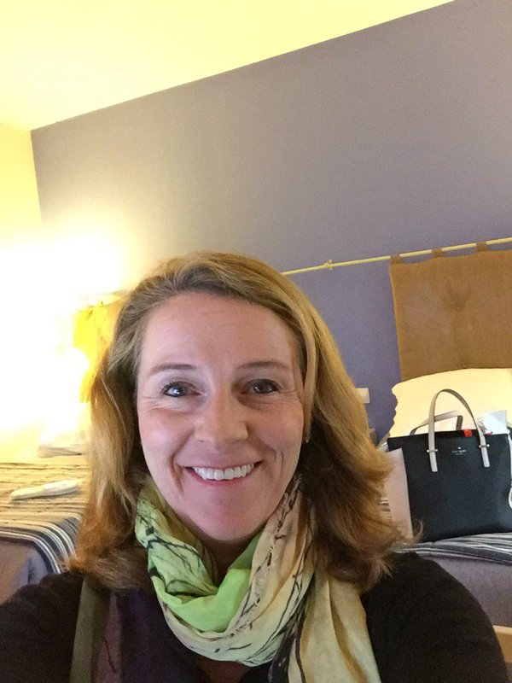
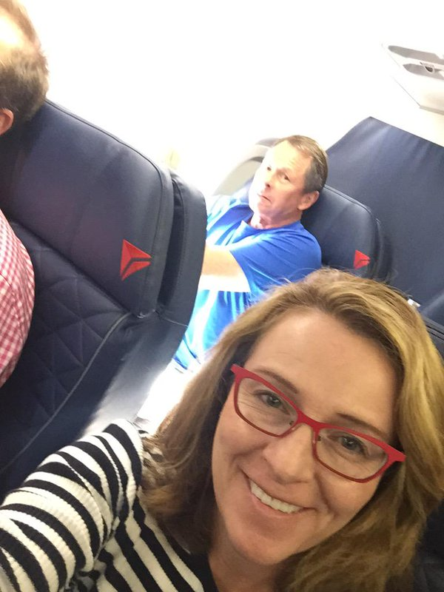
Example selfie introductions

Slide 19
Example closing script
Closing Tweets
Thanks, everyone, for joining today! #OpenOrgChat
Tune in next week, same time, place w/ @thomasdcameron @jhibbets @charleneli @martenmickos http://ow.ly/RLfJl #OpenOrgChat
Next #OpenOrgChat is on Thursday, October 7 (next week) at 2pm ET. See you then!
See our full list of upcoming #OpenOrgChat Twitter chats at [URL]
That's all, folks! #OpenOrgChat

Slide 20

Phase 1: Finalize event questions
1-2 weeks
Notes:
Draft all questions for the chat in advance of the event
Cadence: one question every 7-10 minutes
Questions should invite answers in 140 characters (obviously!)
Talk about multi-threading
Demonstrate sample questions
Two weeks before the chat

Slide 21
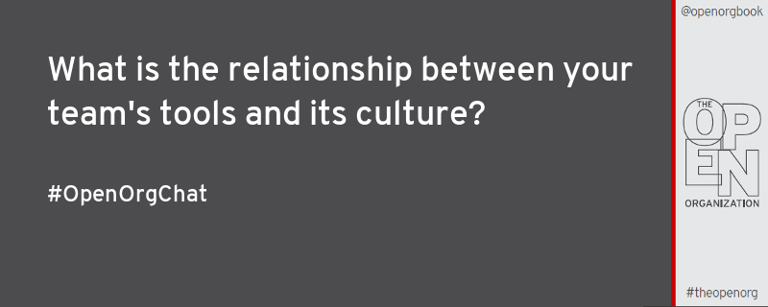
Example event question card

Slide 22

Phase 1: Send preparation emails
1 week
Notes:
This should include a review of dates and times, the chat hashtag, and instructions on how the chat will proceed (e.g., using "Q1"/"A1" format, etc.)
Give hosts pre-chat access to the questions you're planning, so they can think about them in advance of the event (speed!)
Also give hosts information related to an optional backchannel (I'll discuss this in a moment)
One week before the chat (don't do this much sooner, because people will forget!)

Slide 23
Example prep email
Hello all,
First of all, thank you for helping us with our first Twitter chat for @OpenOrgBook tomorrow at 2pm ET / 11am PT. We are exciting to start the #OpenOrgChat conversation.
Here are some of the questions we've prepared for the chat. The questions will come from the @OpenOrgBook account. We may tweak them, a bit, but the essence and spirit is already there. Feedback is welcome.
We'd like to ask general questions first, then throw in a few specifics to some of of you.
Be sure to join our conference call during the chat for any real-time questions and support. <Include dial-in details>
Thanks,
Jason
Questions:
Q1: What's the best way to explain open organization benefits to senior leaders? #OpenOrgChat
Q2: What are some of your favorite examples of open organizations? What qualities do they share? #OpenOrgChat
Q3: What are the major risks of an open organization, and how would you mitigate those risks? #OpenOrgChat

Slide 24

Phase 2: Execution
Event day
Notes:
Now you're ready to host your Twitter chat. Here are a few things to keep in mind on the day of the event.

Slide 25

Phase 2: Promote
Event day
Notes:
Promote heavily
Tweet about the chat several times the day it's occurring
Tag participants so they can help generate awareness
Schedule all these tweets leading up to the intro script

Slide 26

Phase 2: Pre-event prep
Event day
Notes:
Convene in the "headquarters" half an hour before the event begins
Discuss the importance of a headquarters
Discuss experiences with (and preferences for) a backchannel for guests and hosts
Set up your tools
Community preferences for tools (Web interface, Hootsuite, TweetDeck, HashTracking, etc.)
Open the phone line
Start taking photos

Slide 27
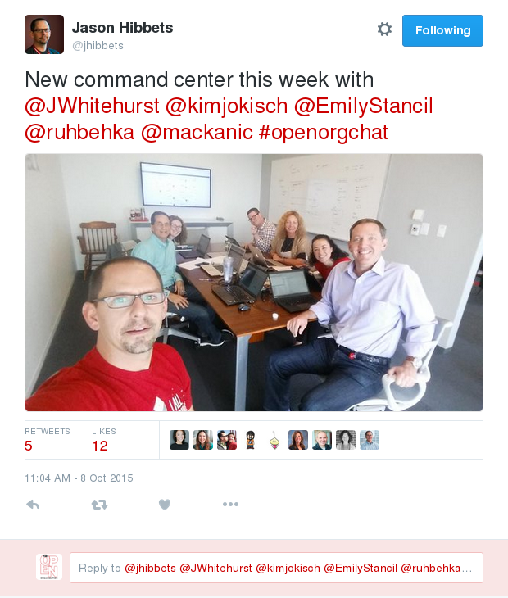
Phase 2: Command center
Notes:
Headquarters and selfies

Slide 28
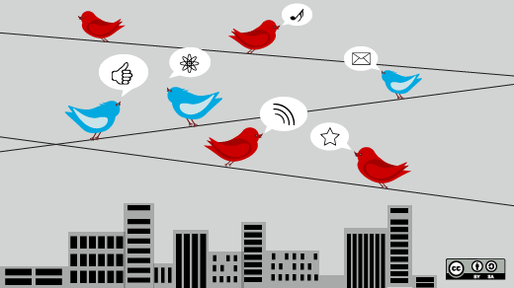
Phase 2: The event!
Event day
Notes:
Conduct the chat!
Roll the introductory script
Tweet out questions
Help others see tweets directed at them
Value of repeat guests
"Feel" the rhythm of the questions, etc.
Dedicate someone to collecting "best of the best" tweets (grab permalinks as the chat is proceeding; important for phase 3)
When finished, run conclusion script

Slide 29

Phase 3: The aftermath
Post event
Notes:
The chat itself is over—but the work is not. Here are a few things you can do to maximize the value of your chat.
Identify new participants
Build your community by identifying folks who've joined you for the first time
Add names of chat participants to a Twitter list devoted specifically to the chat community

Slide 30

Phase 3: Content & metrics
Post event
Notes:
Collect your best-of-best tweets -> turn it into content
Retweet these in the days and weeks ahead, in order to generate interest in future chats
(Optional: Turn these into a blog post if you have access to a platform)
Collect metrics

Slide 31
Phase 3: Sample metrics
October 15, 2015
602 tweets from 110 contributors
3,795,507 timeline deliveries
640,116 reach
#OpenOrgChat report from 10/15
https://www.hashtracking.com/reports/openorgbook/openorgchat/openorgchat7
October 8, 2015
678 tweets from 106 contributors
1,646,468 timeline deliveries
469,503 reach
#OpenOrgChat report from 10/8
https://www.hashtracking.com/reports/openorgbook/openorgchat/openorgchat6
Notes:
To give you some context, on average, we have about 30-50 unique participants generating about 300-400 tweets in about an hour.

Slide 32
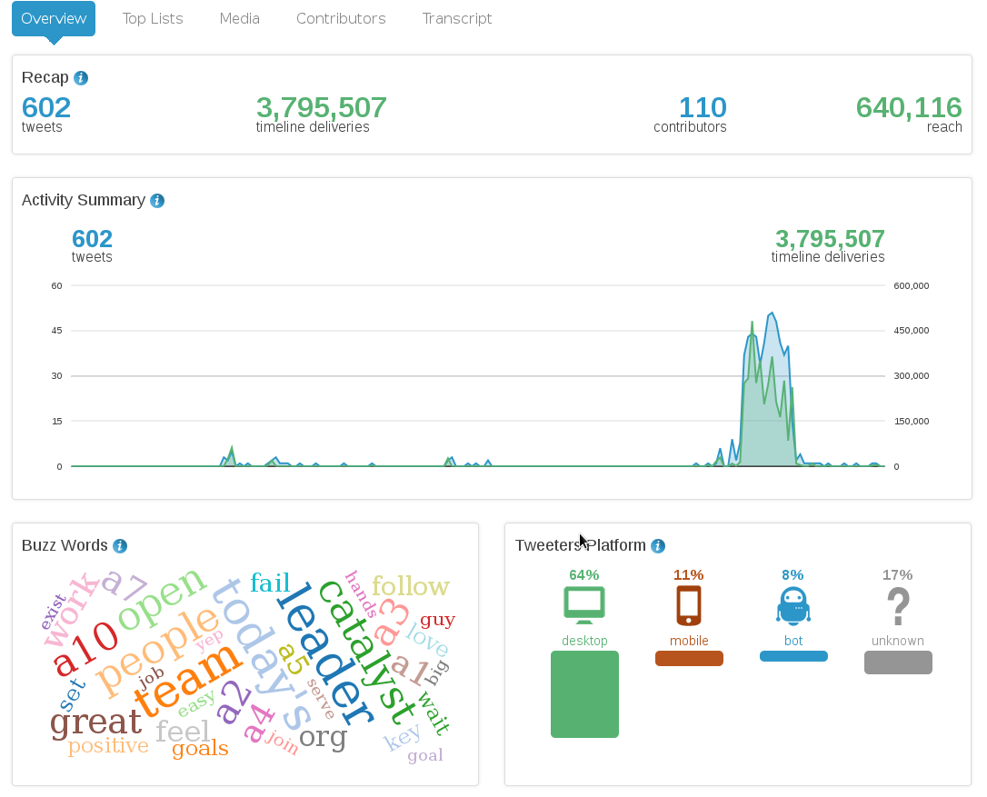

Slide 33

Phase 3: Follow-up
Post event
Notes:
Follow up
Contact invited guests with a note of thanks
Include the metrics, your impressions, and an invitation to come again
(Optional: If you have a blog, you could ask participants to consider turning some of their most powerful tweets into blog posts)

Slide 34

Conclusion
Notes:
I've just taken you through all three phases of a Twitter chat: preparation, execution, and conclusion
Along the way, I hope you've learned a bit about what makes a chat successful—and what can help one fail
As I said, we've found that a Twitter chat is simply a great way to bring a community together, strengthen its spirit, and identify outstanding participants.

Slide 35

Build your community
Notes:
Make it valuable
Source matter experts
Common interests
Other ideas: Events, emerging tech, new product

Slide 36
Q1: What’s been your favorite Open Source Leadership Summit session? #lfoslsChat
Notes:
Practice!!

Slide 37
Q2: What’s the most important topic facing open source leaders today? #lfoslsChat
Notes:
Practice!!

Slide 38
Q3: What open source project has the most buzz around it today? #lfoslsChat
Notes:
Practice!!

Slide 39

Q&A :: Contact
Questions
Contact
Email: jhibbets@redhat.com
Twitter: @jhibbets
IRC: shibby
Slides: https://github.com/jhibbets/presentations
Book: http://theopensourcecity.com

