Slide 1
Why your open source story matters
Jason Hibbets
Senior community evangelist
Opensource.com editor, Red Hat
Code for Raleigh brigade captain
CityCamp NC co-chair
April 14, 2015 | POSSCON
Notes:
Introduce yourself, 12 years at Red Hat.
The Open Org
Explain Opensource.com

Slide 2

Build the world’s premier storytelling platform
Credits: http://www.flickr.com/photos/opensourceway/7496801912/
Notes:
The mission at Opensource.com is to build the world’s premier, open source storytelling platform. We do this by being a catalyst for the open source community.
We collect stories from all over the globe and provide a platform for the open source community to share their stories on how open source is changing the world.
We are also a place to discover open source for those new to this ideology.

Slide 3

Improve the citizen experience
Credit: http://opensource.com/government/13/8/citizen-cio
Notes:
My personal mission for the last four years has been to improve the citizen experience.
I’ve been doing this through my discovery of the open government and open data communities.

Slide 4

WARNING: Objects in government are transparent, collaborative, and participatory
Credit: http://hibbets.net
Notes:
Today, I’d like to take you on a journey and share some stories.
Not only will I share some of my story, but the stories of other open source advocates who are doing amazing things—essentially building on the shoulders of giants.

Slide 5

Open source model of participation
Credit: Red Hat
Notes:
To begin, let’s take a look at the open source model of participation.
How are the principles of transparency, collaboration, and passion integral to open source?

Slide 6

Transparency
Credit: http://www.flickr.com/photos/opensourceway/7496800772/
Notes:
Let’s start with transparency. This is fundamental to many open source projects. You’ll find project roadmaps, bug tracking systems, documentation, and open communications such as mailing lists and IRC channels. Source code is available online for all to use, review, test, and enhance.

Slide 7

Collaboration
Credit: http://www.flickr.com/photos/opensourceway/4404008626/
Notes:
Next there’s collaboration. Many projects will use a combination of websites, wiki’s, email, mailing lists, etherpads, and other tools.
We’ve seen the rise of collaborative programming with communities like GitHub.

Slide 8

Credit: http://www.flickr.com/photos/opensourceway/5752191750/
Notes:
Then there’s passion—the secret ingredient to many successful open source communities.
These are the projects start with a “scratch your own itch” mentality, but then expand to solve other people’s problems.
People want to work on stuff the matters—open source provides a variety of opportunities for people to work on something they are passionate about.

Slide 9

Credit: Red Hat
Notes:
Transparency, collaboration, and passion are some of the basics to the open source model. But there are more pillars that make open source superior.
There are several other tenets that come together to create the Open Source Way—a way to apply the principles of open source to other disciplines.
Let’s explore what these are.

Slide 10

Credit: https://wiki.gnome.org/OutreachProgramForWomen#Cartoon
Notes:
We’ll begin with participation.
When we are free to collaborate, we create.
We can solve problems that no one person may be able to solve on their own.

Slide 11

Rapid prototyping
Credit: http://www.flickr.com/photos/opensourceway/5041738335/
Notes:
Rapid prototypes can lead to rapid failures, but that leads to better solutions found faster.
When you're free to experiment, you can look at problems in new ways and look for answers in new places.
You learn by doing.

Slide 12

Meritocracy
Credit: http://www.flickr.com/photos/opensourceway/4426824995/
Notes:
In a meritocracy, the best ideas win.
In a meritocracy, everyone has access to the same information.
Successful work determines which projects rise and gather effort from the community.

Slide 13

Community
Credit: http://opensource.com/sites/default/files/styles/image-full-size/public/images/life/osdc_Commnity_520x292.png
Notes:
Communities are formed around a common purpose. They bring together diverse ideas and share work.
Together, a global community can create beyond the capabilities of any one individual. It multiplies effort and shares the work.
Together, we can do more.

Slide 14
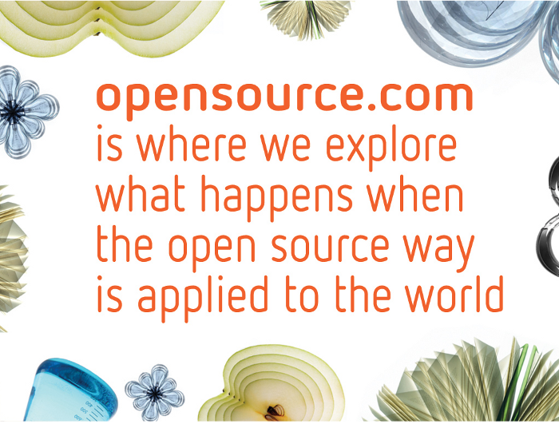
Discover an open world
Credit: Red Hat & Opensource.com
Notes:
Highlighting the open source way is part of our mission. Participation, rapid prototyping, meritocracy, and community are essential to the stories we tell at Opensource.com.

Slide 15

Credit: http://www.flickr.com/photos/opensourceway/4459199503/in/set-72157625738142672
Notes:
My story started several years ago.
Because of my work with Opensource.com, I found my calling in the open government and open data worlds.
I found a way to blend my passions for open source, civic participation, and my local community in Raleigh, NC.

Slide 16

Credit: http://opensource.com/sites/default/files/imagecache/image-full-size/images/education/gov_vending.png
Notes:
Most of you probably view government like this, you put taxes in, you get services out—things like police protection and garbage collection.
I view government differently. I see opportunity for collaboration and citizen engagement.
I started to explore the world of open government.

Slide 17

Creating a community
Credit: http://www.flickr.com/photos/opensourceway/8516817076/in/photostream
Notes:
I didn’t know it at the time, but essentially, I was going down to path to create a community.
I’ve experienced first had how this community formed around a common purpose. It started with an idea and was fueled by passion from the participants.

Slide 18

Creating a brand
Credit: http://www.flickr.com/photos/opensourceway/5496629913/in/set-72157628737085119
Notes:
The idea started with trying to brand the City of Raleigh as an open source city.
With other open source-related events becoming more popular and a thriving community of engaged citizens, I thought the idea was achievable.

Slide 19



Evolving our CityCamp
Credits: http://citycampnc.org | http://codeforamerica.org
Notes:
I discovered a brand called CityCamp—which is an international unconference series designed to bring open source thinking to local governments through technology and citizen ideation.
I’ve run four successful CityCamps in the Triangle, two as CityCamp Raleigh and two as a re-branded CityCamp NC that let organizers broaden our reach to the entire state. These events have drawn interest from over 150 attendees at each event.
Along the way, the CityCamp organizers eventually become Code for Raleigh—and I’ll get to that in just a moment.

Slide 20


Community of passion
Credit: http://citycampral.org
Notes:
We had a great team of volunteers to help organize our CityCamps and a very engaged group of attendees that brought their ideas and solutions to our event.

Slide 21

TriangleWiki
Credit: http://trianglewiki.org
Notes:
One of the results from CityCamp is an site called Triangle Wiki—think of it as a hyper-local version of WikiPedia that let’s you add your favorite places or local history to a map-based wiki program called LocalWiki.

Slide 22

TriangleWiki Day
Credit: http://citycampral.org
Notes:
We hosted other events such as Triangle Wiki Day, which was essentially a write-a-thon to help populate Triangle wiki in preparation for launching it to the public.

Slide 23

The impact
633 page edits
100 maps
138 new photos added
Credit: http://citycampral.org
Notes:
The results of that event included over 600 edits, 100 new maps and over 100 new photos added.

Slide 24

Credit: RGreenway – http://RGreenway.com
Notes:
Another one of our success stories is an app called RGreenway.
It uses open data from the city of Raleigh and highlights our parks and greenway system (aka multi-purpose paths). The app is available for all citizens to download and use.

Slide 25

Code for Raleigh
Credit: http://brigade.codeforamerica.org/
Notes:
As I mentioned before, the organizers from CityCamp NC formed Code for Raleigh—a volunteer group of civic hackers.

Slide 26

A Peace Corp for geeks
Credit: http://codeforamerica.org/
Notes:
We partnered with CfA—a non-profit in San Francisco who’s missions it to bring open source technologies to government. They have several programs to accomplish this, the most popular being their fellowship program that assigns a team of problem solvers to applicant cities each year.
The solutions the fellows design are all open source, meaning that other cities around the world can implement and deploy these solutions.
The program that Code for Raleigh is part of is the brigade. It’s allows volunteers like myself to help my local city through civic hacking in partnership with our city officials.

Slide 27
Raleigh: A case study
Credit: http://www.flickr.com/photos/opensourceway/5496629913/in/set-72157628737085119
Notes:
Raleigh has made a lot of progress over the last few years.

Slide 28

Open government resolution
Credit: http://opensource.com/government/12/2/how-get-your-city-pass-open-government-policy
Notes:
In February of 2012, our City Council unanimously passed an open government resolution.

Slide 29

Open Raleigh
Credit: City of Raleigh – http://raleighnc.gov
Notes:
The resolution set the stage for the Open Raleigh program.

Slide 30

data.raleighnc.gov
Credit: https://data.raleighnc.gov/
Notes:
And the first version of Raleigh’s open data portal was released in early 2013.

Slide 31

Credit: https://data.raleighnc.gov/
Notes:
The next version was released in 2014 with enhanced visualization and more data sets.
Code for Raleigh helped add meta data to over 200 data sets to help prepare this version of the portal for launch.

Slide 32


We built this city on open source
Open Raleigh
Code for Raleigh
Open government
resolution
My Raleigh Ideas!
My Raleigh
Subscriptions
RGreenway
NC Datapalooza
Notes:
It wasn’t easy to set the stage for Raleigh to become an open source city, but we’ve made great progress in a short amount of time.
Along the way, I captured bits and pieces of that story through articles posted on Opensource.com.

Slide 33

theopensourcecity.com
Credit: http://theopensourcecity.com/
Notes:
In April of 2013, I self-published a book called The Foundation for an Open Source City. It’s about my open government, open data, and CityCamp experiences.
Writing this book allowed me to test my marketing, sales, and storytelling skills.
And for the rest of our time today, I’d like to share a few more stories that have been published on Opensource.com.

Slide 34

Why your open source story matters
Credit: http://opensource.com/education/15/3/open-textbooks-drive-down-cost-of-college
Notes:
There are a lot of GREAT stories out there that need to be told. At Opensource.com, we are constantly looking for ways to highlight how open source is changing the world.

Slide 35
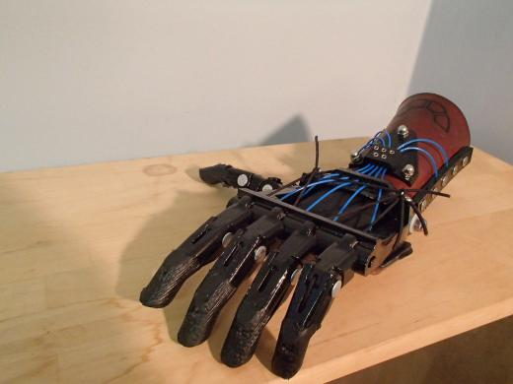
The Talon 3D printed hand
Credit: http://opensource.com/life/14/3/3D-printed-hand-enable
Notes:
Peregrine Hawthorn is a 19 year-old, serving in Americorps and an active member of the e-NABLE community.
He's involved in Research & Design, making 3D printed prosthetic hands—which he uses one himself, called the Talon.
His hand is made from open source design files and the hardware was made from a 3D printer and other materials you can get at a hardware store.
This is a 19-year old young man, using open source to improve his life.

Slide 36
Why your open source story matters
Credit: http://opensource.com/education/15/3/open-textbooks-drive-down-cost-of-college
Notes:
This is open source, making lives better.

Slide 37
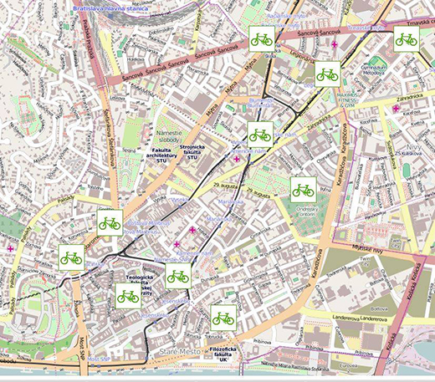
WhiteBikes open source bike sharing
Credit: http://opensource.com/life/15/3/open-source-bike-share
Notes:
Daniel Duris is working on an open source software project aimed at improving life for citizens in Bratislava, Slovakia. It's an Open Source Bike Share system.
The idea of a bike share system is nothing new, but this one is different.

Slide 38
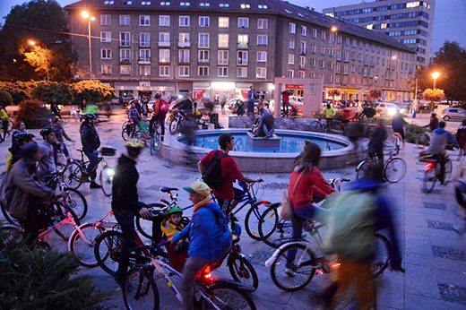
WhiteBikes open source bike sharing
Credit: http://opensource.com/life/15/3/open-source-bike-share
Notes:
Shared bicycles have a coded U-lock with a four-digit number, when you rent a bike, you get a code to unlock it, and another to reset it to once you're done.
It works like this: Send a text message, receive the answer, unlock the bike, reset the lock, and you're off pedaling.
It's custom oss built on Bootstrap, Bootstrap validator, JQuery and it uses MariaDB.
Since the article was published, they’ve had several inquiries on how to use their project in other places.
This is how open source creates value.

Slide 39
Why your open source story matters
Credit: http://opensource.com/education/15/3/open-textbooks-drive-down-cost-of-college
Notes:
This is the power of story telling.

Slide 40
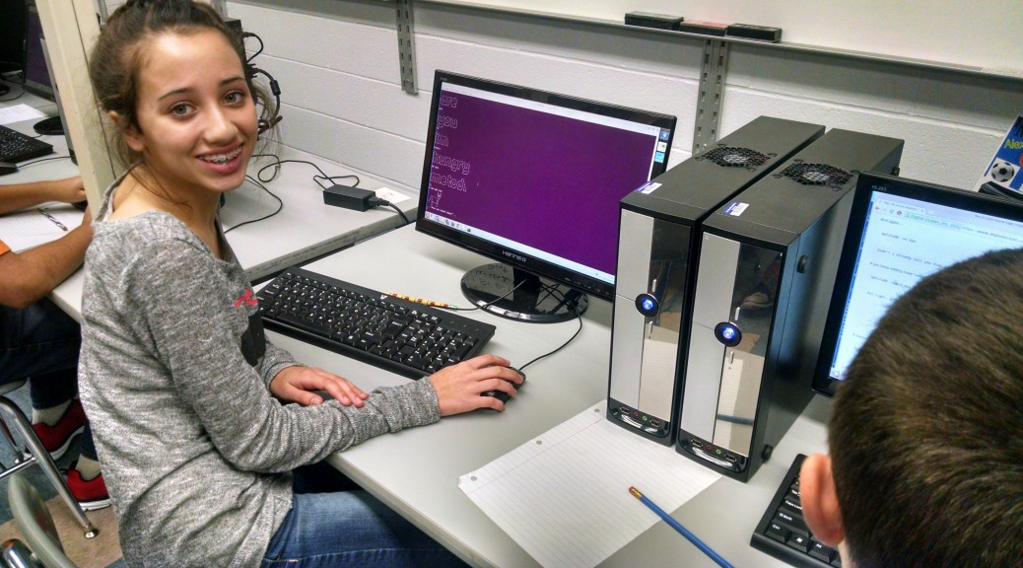
Penn Manor 1:1 laptop program
Credit: http://www.pennmanor.net/techblog/
Notes:
Charlie Reisinger is a K12 EdTech veteran and the IT Director for Penn Manor School District. Penn Manor is an open source high school.
They have a 1:1 student laptop program and a supporting student peer help desk.

Slide 41
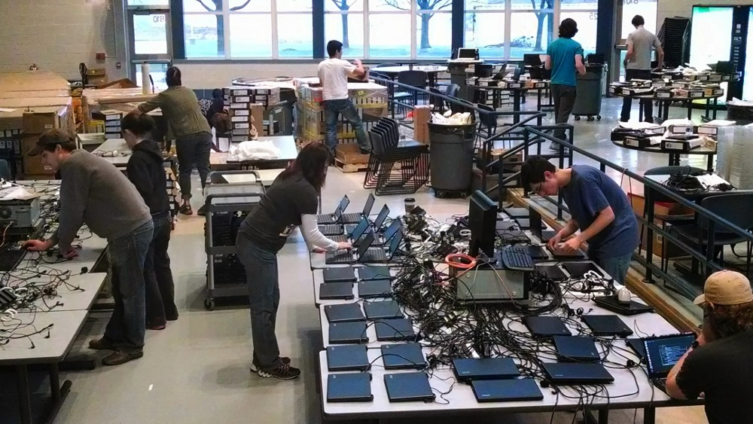
Penn Manor 1:1 laptop program
Credit: http://www.pennmanor.net/techblog/
Notes:
Students work alongside IT staff on hardware support, repairs, software setup, instructional tutorials, system imaging, peer training, and any number of tasks related to their school-wide laptop program.
It started as a pilot program for 90 of their online HS students before deploying to all 1,700 students.
Their Linux fleet has grown to over 3,500 laptops and desktops across grades Kindergarten through 12.

Slide 42
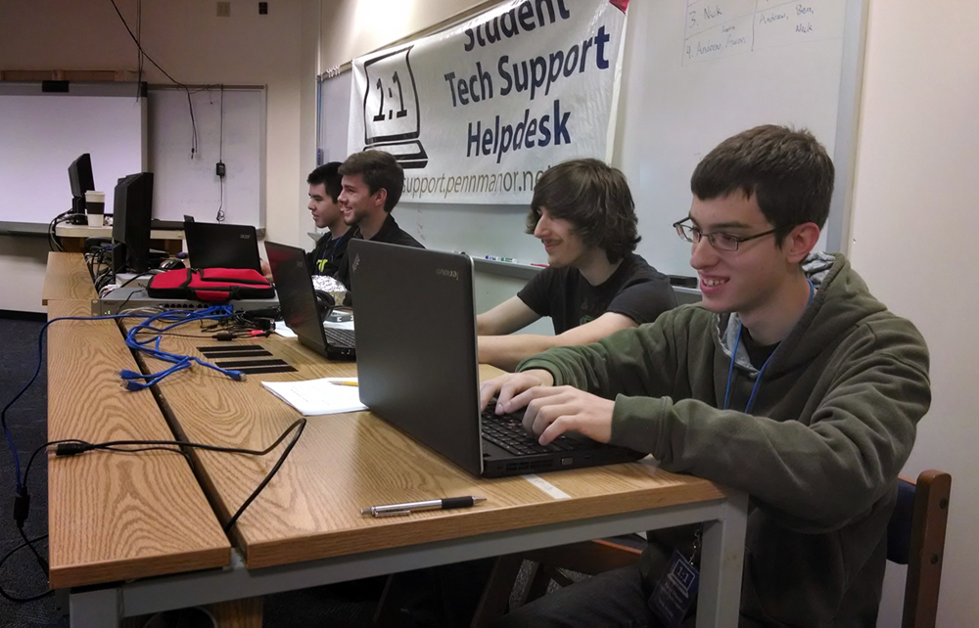
Penn Manor 1:1 laptop program
Credit: http://www.pennmanor.net/techblog/
Notes:
It gets better!
All students have root access to their machines. And if they mess up, its not such a bad thing because now they have to learn to fix their mistake.
Penn Manor uses a lot of open source in their program. They use Koha, Moodle, Linux, WordPress, OwnCloud, VirtualBox and much more.

Slide 43

Penn Manor 1:1 laptop program
Credit: http://opensource.com/business/10/5/trust-catalyst-open-source-way
Notes:
In an interview with Opensource.com, Charlie told us the following:
“This is not only about test scores and saving money; it about placing the most flexible, open-ended, creative, learning toolkits in front of kids, and then trusting them to create amazing and meaningful work.”
Trusting them with root access. Relying on them to help support 3,500 systems across the district.
What they are doing at Penn Manor was not possible 5 years ago. This means that your contributions to open source made this possible.

Slide 44
Why your open source story matters
Credit: http://opensource.com/education/15/3/open-textbooks-drive-down-cost-of-college
Notes:
This is open source, preparing children for the world if IT.

Slide 45

Asian Penguins club
Credit: http://opensource.com/education/15/3/asian-penguins-Linux-middle-school-club
Notes:
Stu Keroff is a middle school teacher at the Community School of Excellence, a charter school in Saint Paul, MN. He enjoys teaching history and civics to his students, most of whom are immigrants or children of immigrants from Southeast Asia.
He is also the school's technology coordinator and a long time Linux enthusiast.
More importantly, he is the founder and faculty adviser of the Community School of Excellence Asian Penguins, the school's Linux users group.

Slide 46
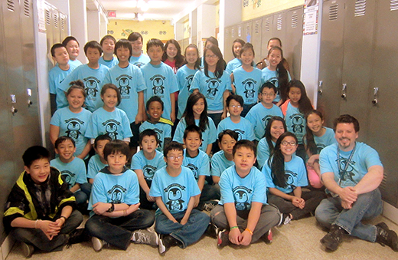
Asian Penguins club
Credit: http://opensource.com/education/15/3/asian-penguins-Linux-middle-school-club
Notes:
The start of every meeting begins like this:
The leader says “What are we trying to do?"
The kids respond, "Change the world!"
The leader then asks, "How do you change the world?"
And the kids then respond, "Be crazy enough to think you can!"
Not only do the Asian Penguins learn about Linux through this program, its become a movement for change that challenges the students to improve people's lives through the power of open source technology.

Slide 47
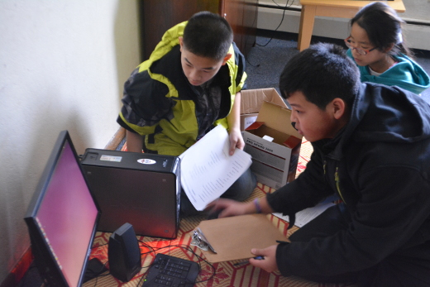
Asian Penguins club
Credit: http://opensource.com/education/15/3/asian-penguins-Linux-middle-school-club
Notes:
They ran an experiment one year to convert a portion of the school laptops to Linux.
The kids who took part had to do the same schoolwork their peers were doing and report back on how it went. The students were surveyed at the end of the year to see what their experience was.
In comparing the use of Linux to Windows 7 using the same hardware, the kids overwhelmingly preferred Linux. They liked the speed, look and feel, and general stability.

Slide 48

Asian Penguins club
Learn more:
https://sites.google.com/a/csemn.org/asian-penguins/
https://www.youtube.com/user/CSEAsianPenguins
Twitter: @StuKeroff
Credit: https://sites.google.com/a/csemn.org/asian-penguins/
Notes:
And then there’s Linux for good.
A group called Free Geek in Minneapolis volunteers to recycle computers. The Asian Penguins saw this and wanted to help their community.
They found some older machines, learned how to install Linux, and then found families to help.
They go on missions to deliver these computers.
To date, they’ve given 20 computers to families in the Twin Cities metro area.
People talk about changing the world, but the Asian Penguins get to leave school on their missions and go out and do it!

Slide 49
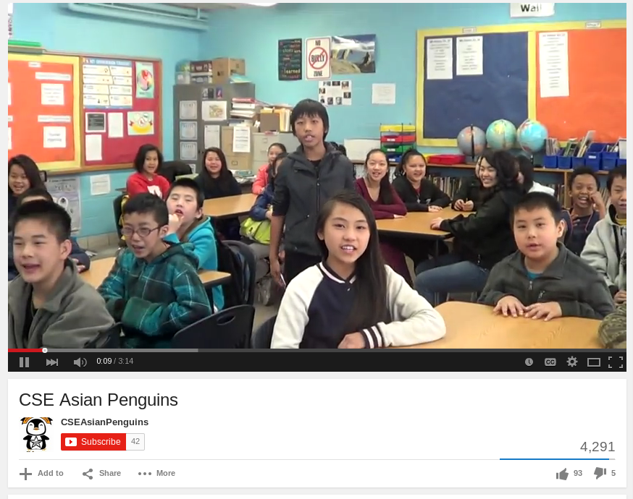
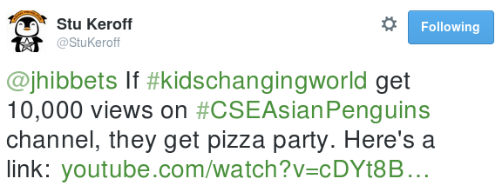
Asian Penguins club
CSE Asian Penguins need 10,000 views for a pizza party:
https://www.youtube.com/watch?v=cDYt8BbqTQo
Credit: https://www.youtube.com/watch?v=cDYt8BbqTQo
Notes:
If #kidschangingworld get 10,000 views on #CSEAsianPenguins channel, they get pizza party.

Slide 50

What’s your story?
Credit: http://opensource.com/government/13/8/citizen-cio
Notes:
Whether your mission is to be the next citizen CIO, design the next 3D printed hand, code a new bike share program, deploy Linux laptops, or give back to your community—your story matters.

Slide 51
Change the world.
Notes:
Sharing your story is part of contributing to open source.
I learned this through my work in Raleigh because I’m not a coder, I’m a community organizer.
The value of sharing these stories is making the world more aware of free and open source software and how it's making a difference.
And your contributions make a difference. Just consider how the work you do has influenced the stories you heard today.
Keep up the great work. The open source philosophy is making more of a difference than you can imagine.
Take what you’ve learned today and change the world with open source! Thank you.

Slide 52

Contact
Twitter: @jhibbets
Email: jhibbets@redhat.com
or: jhibbets@gmail.com
IRC: shibby
Slides: https://github.com/jhibbets/presentations
Book: http://theopensourcecity.com
Credits: http://www.flickr.com/search/?w=47691521@N07&q=lolcat
Notes:
Mention how to contribute.

