Slide 1
Community building:
The open source way
Jason Hibbets
Opensource.com editor and community manager, Red Hat
SCALE 13x
February 20, 2015
Notes:
Brief intro – I’ve been at Red Hat for more than 12 years.
Ask everyone to follow @opensourceway
There no reason why the #scale13x hashtag shouldn’t be trending by the end of this talk.
Go ahead and give us a RT now to get things going.

Slide 2

Build the world’s premier storytelling platform
Credits: http://www.flickr.com/photos/opensourceway/7496801912/
Notes:
Our mission is to build the world’s premier, open source storytelling platform. We do this by being a catalyst for the open source community. My team collects stories from all over the globe and provides editorial services, search engine optimization, images, and distribution of content. We provide a platform for the open source community to share their stories on how open source is changing the world and by being a place to discover open source for those new to this ideology.
Jim Whitehurst: “This site is one of the ways in which Red Hat gives something back to the open source community. Our desire is to create a connection point for conversations about the broader impact that open source can have--and is having--even beyond the software world.”
“This will not be a site for Red Hat, about Red Hat. Instead this will be a site for open source, about the future.”

Slide 3
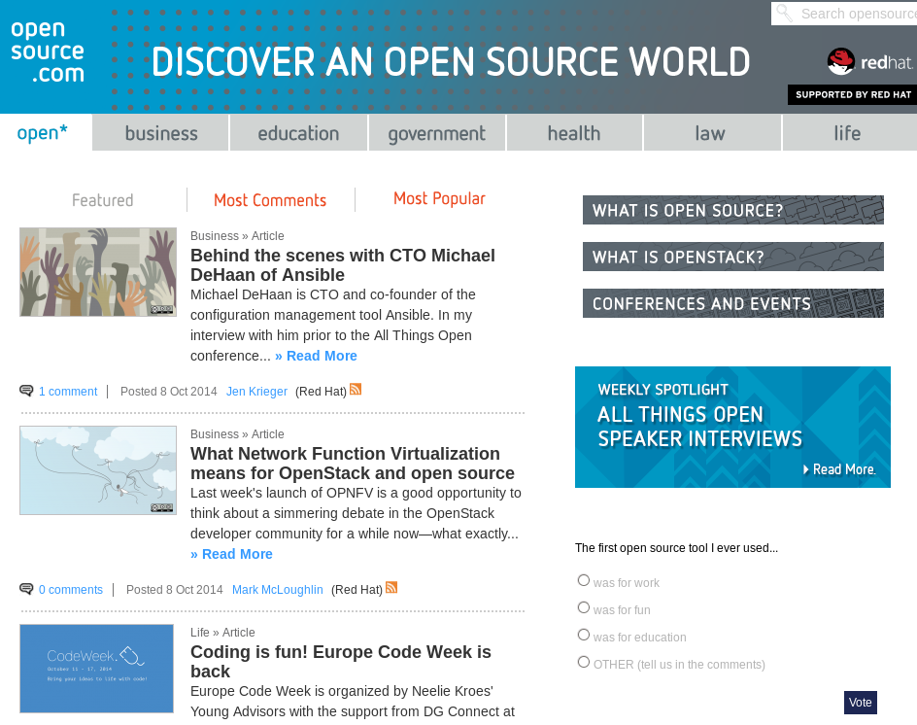
Notes:
I often describe Opensource.com as an online publication and community, highlighting how open source is influencing the world around. We focus on different disciplines such as business, education, government, health, law, and life.
On average, we publish 18 articles a week and generate almost 600,000 page views each month.
My team consists of four people and I often describe us as a start-up with-in Red Hat, but we could not accomplish our goals without a great group of moderators and community members who help us on a daily basis.

Slide 4


Before January 25, 2010
Notes:
We’ve started publishing in January 2010. And a lot has changed in the past 5 years. Before our launch, the opensource.com domain served one purpose: to redirect to redhat.com.
We wanted to create an online community based on the open source a movement...after looking for an appropriate domain name, we discovered that we had this property.
The rest is history. And today, I’d like to share with you the methodology my team uses, some of the programs we’ve implemented, the tools we use, and some of the results that we’re proud of.

Slide 5

Open source is like a recipe
Credit: http://www.flickr.com/photos/47691521@N07/5497223072/
Notes:
Before we get to into the weeds, I’d like to take a moment and make sure everyone understands open source.
If you’re new to open source, think about it like a recipe. Let’s say you have a chocolate chip cookie recipe that you share with a friend. Your friend is able to recreate the recipe because the list of ingredients and instructions on how to prepare and bake the cookies are available to them.
Now, because we can see how they are created, you can modify the recipe. You can add walnuts or make it gluten-free, then you can share your modifications with the rest of the world.
This is what open source is all about, making the “source code”--or list of ingredients and instructions--available and allowing others to build upon existing work.

Slide 6
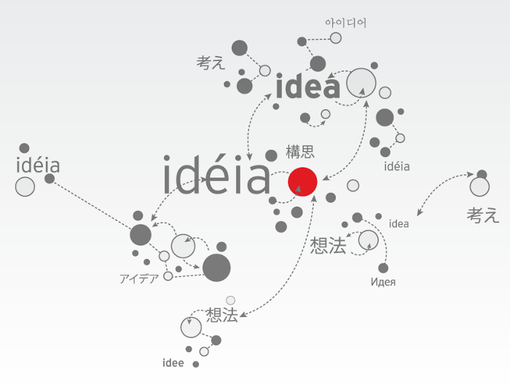
Open source model of participation
Credit: Red Hat
Notes:
In open source, we have a certain set of values and principles that allow us to create better software.

Slide 7

Transparency
Credit: http://www.flickr.com/photos/opensourceway/7496800772/
Notes:
Let’s start with transparency. This is fundamental to many open source projects. You’ll find project roadmaps, bug tracking systems, documentation, and open communications such as mailing lists and IRC channels. Source code is available online for all to use, review, test, and enhance.

Slide 8

Collaboration
Credit: http://www.flickr.com/photos/opensourceway/4404008626/
Notes:
Next there’s collaboration. Many projects will use a combination of websites, wiki’s, email, mailing lists, etherpads, Google Docs, and now we’ve seen the rise of collaborative programming with sites like GitHub.

Slide 9

Participation
Credit: https://wiki.gnome.org/OutreachProgramForWomen#Cartoon
Notes:
The most successful open source projects draw participation from all walks of life. It’s not just about coders and developers. Open source projects need designers, testers, project managers, community organizers, and a lot of them could use better marketing.

Slide 10

Rapid prototyping
Credit: http://www.flickr.com/photos/opensourceway/5041738335/
Notes:
One of the core principles behind open source is rapid prototyping. Another way to think about that is to release early and often. The larger projects can release code on a daily basis, usually referred to as rawhide (the latest source code of a project). But this principle can go much further than code and can be embraced as a way to create better results. At Red Hat, we call this “failing faster.”

Slide 11

Meritocracy
Credit: http://www.flickr.com/photos/opensourceway/4426824995/
Notes:
In the open source world, meritocracy provides a level of governance and is usually defined as “the best code wins.” It doesn’t matter if you’re a senior developer or someone brand new to the project—if your code is superior, it wins out.
Another way to think about this is that the best ideas rise to the top.

Slide 12

Passion
Credit: http://www.flickr.com/photos/opensourceway/5752191750/
Notes:
Last but not least, there’s passion. I think this is the secret ingredient to many successful open source communities. Many projects start with a “scratch your own itch” mentality, but then expand to solve other people’s problems.
People want to work on stuff the matters and open source provides a variety of opportunities for people to work on something they are passionate about.

Slide 13
Open source is a better way
Transparency → accountability
Collaboration → innovative ideas
Participation → more eyes, ideas
Rapid prototyping → failing faster
Meritocracy → best ideas, buy-in
Passion → commitment
Notes:
To summarize, these are some of the core principles that make the open source model superior.
Transparency creates accountability, with more participation, you get bugs fixed faster, you get creative ideas, and more features and enhancements as the project grows.
Rapid prototyping allows you to fail faster and find winning solutions, while passion leads to committed community members participating in open source projects.

Slide 14

Credit: Red Hat
Notes:
All the principles that we just talked about can be applied to other disciplines outside of technology. We call this the Open Source Way. And on Opensource.com, we do this everyday by publishing content that highlights these principles and share the stories from the open source community.

Slide 15

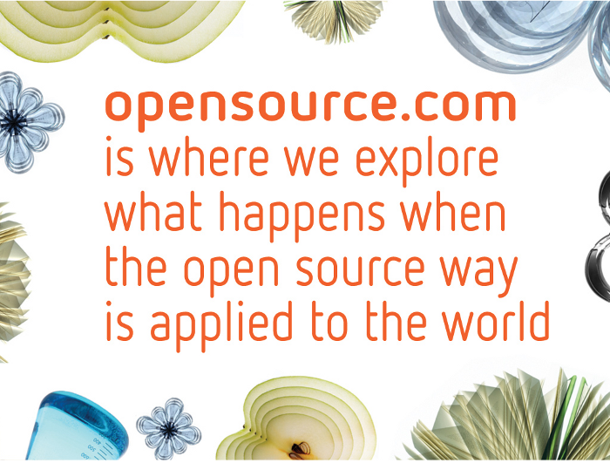
Discover an open world
Credit: Red Hat & Opensource.com
Notes:
Red Hat wanted to build a robust storytelling platform and to maintain thought-leadership in open source. Opensource.com is the vehicle to accomplish that mission.
Let’s start by taking a look at the methodology my team uses to accomplish our goals...

Slide 16
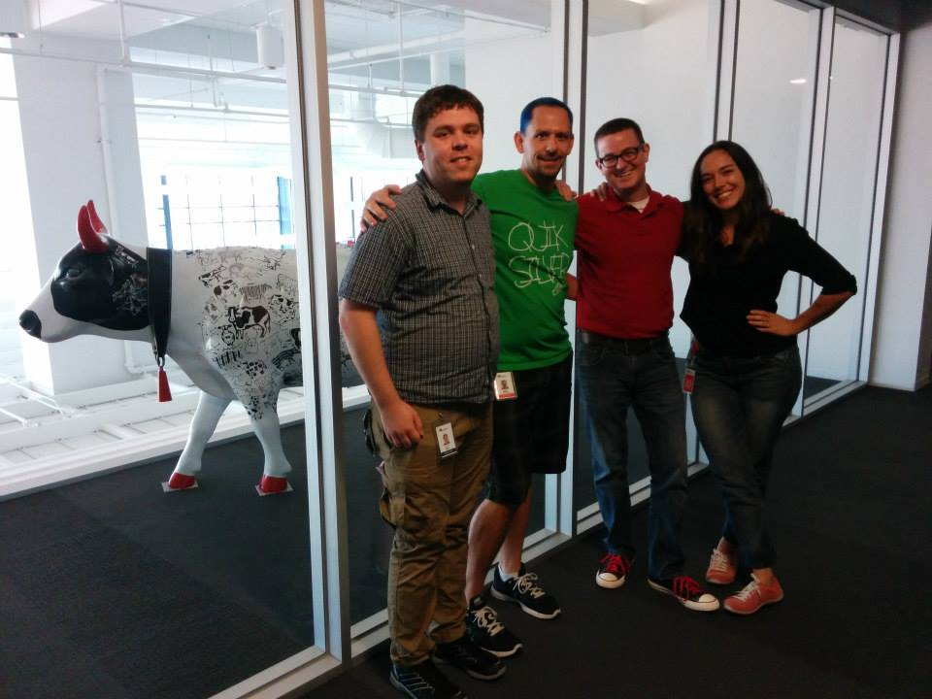


The team
Notes:
First, I’d like to introduce you to my team. We are a well-oiled machine that operates like a start-up. All of us know how to do each others job so we can back each other up.
Jen is the content manager for the team and does a weekly top-5 video on YouTube.
Brian is our perpetual intern.
Baker is our cloud and Openstack editor.
Alex is our social media strategists that manages our social media and content syndication.

Slide 17

Methodology
Notes:
There are few things that are core to having my team operate smoothly.
When I hire people, I look for someone who has the skillset I need for the position, but I’m also looking for passion and an entrepreneurial-spirit.

Slide 18

Methodology: Lean
Decision-making
Feedback loops
Measure everything
MVP – minimum viable product
Credit: Eric Ries, http://theleanstartup.com/
Notes:
If you haven’t read the book The Lean Startup by Eric Ries, I highly recommend you add this to your reading list. This book changed my work-style and really helps my team stay focused on practicing strategic decision-making.
The book emphasizes creating an MVP, having a way to measure success, and incorporating feedback loops to make future decisions.
Examples:
Community calendar
Top 5 YouTube post

Slide 19
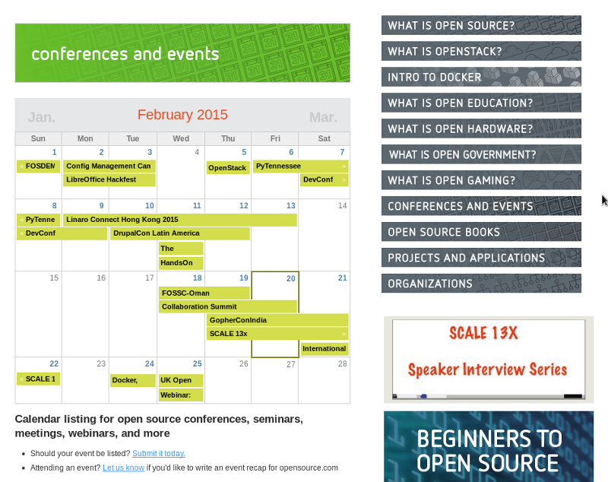
Notes:
Example: Community calendar

Slide 20
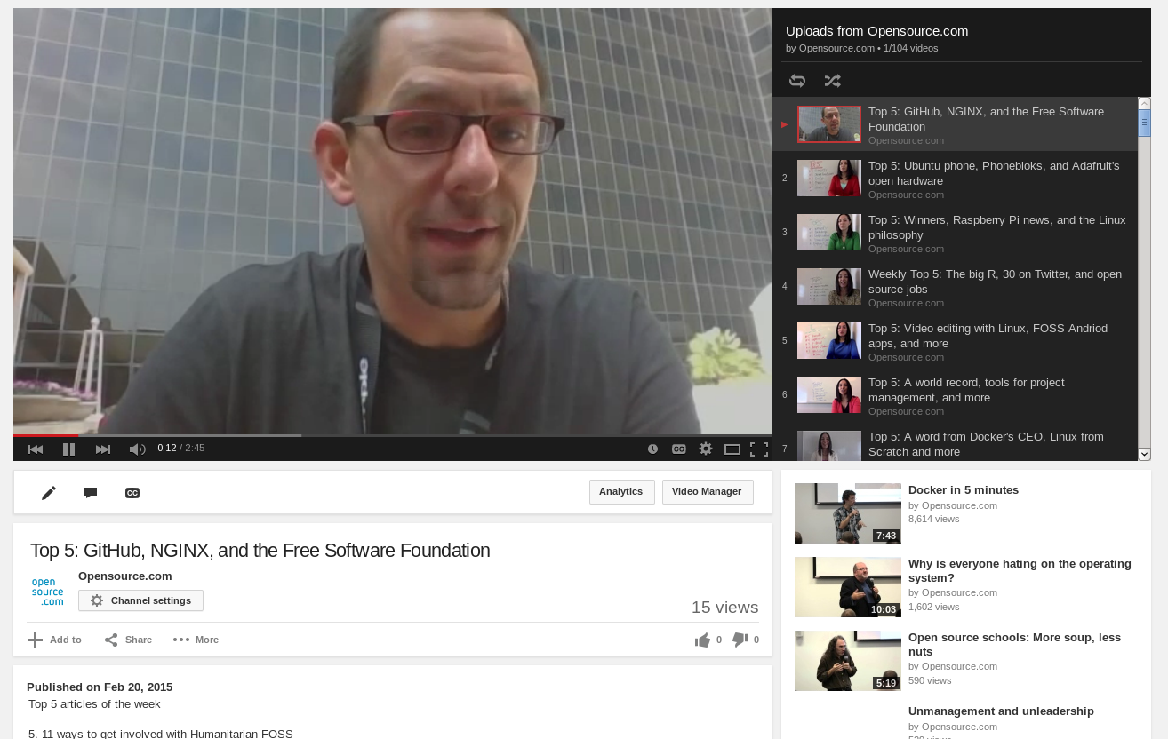
Notes:
Example: Weekly top 5

Slide 21

Methodology: ROWE
Modified results only work environment
30-60-90 monthly goals
Notes:
I trust my team to get their work done, so we use a modified version of the results only work environment methodology. The extreme version of this says that an employer doesn’t care where you are, what you do, or when you do it, as long as you produce results inline with your set goals.
Our modified version of this pairs a flexible schedule with 30-60-90 goal setting to achieve our top initiatives. We know we have a whirlwind of activities that we could get caught up in everyday (ahem, email) but we need to chip away at strategic goals.
For example, one of my big goals last year was to upgrade our Drupal platform from D6--> D7. I accomplished that in May—but it took weeks of planning and testing.
Another example is our WFH Wednesday. This teaches everyone how to communicate remotely and gives us a day free of meetings to GSD—get stuff done.

Slide 22

Strategy
Notes:
Let’s get down to the nuts and bolts of how we GSD. Part of this is the daily grind, but you’ll also see how we use our strategy to feed into our everyday work as a publication.

Slide 23

Strategy: Daily heartbeat
Strategy
Notes:
This is an example of our daily heartbeat. This helps my team, as well as our moderators see the health of the site. We’ve modified the format over the years, but a key component has been to keep it simple.
The elements that we think are important are how the previous days articles performed, how content was syndicated, and other metrics around page views, search traffic, and social media.
For guest authors, we will typically forward this daily health check to them so they have instant feedback on how their contribution performed.
This report rolls up to a weekly update that we send out with a top 5 posts to our community. And eventually, this feeds into a monthly report.

Slide 24

Strategy: Content is king
Notes:
Our content has grown over the years. When we first started out, we were publishing 1 article a day—5 articles a week. Then we increased that to 10 posts a week or two articles a day. Now we are publishing almost 20 articles each week.
More than half of our content comes from the open source community—the other portion is written by a Red Hat associate, and part of that number is someone writing from my team.
Other aspects include:
Weekly topics: Linux, Docker, etc.
Weekly columns: OpenStack news, weekly news, open gaming, HFOSS, DevOps, Apache, Open Hardware, Open CMS
Themed content weeks: Women in OSS, back to school, partnering with events
Resources – evergreen content
What is open source, what open is education

Slide 25

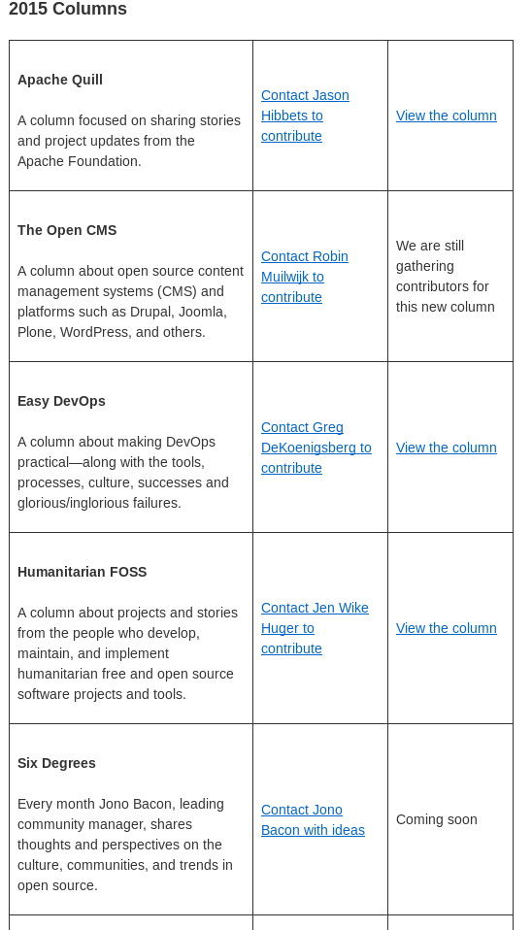
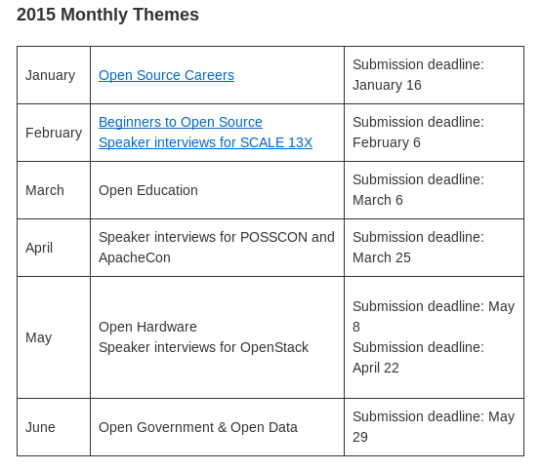
Strategy: Planning ahead
opensource.com/resources/editorial-calendar
Notes:
We finally started to plan ahead. And then we shared it out with our readers and writers.
You can see the themed content weeks we have for the next six months and what the deadlines are for them.
We have also listed the weekly / bi-weekly / monthly columns that we started in 2015.

Slide 26
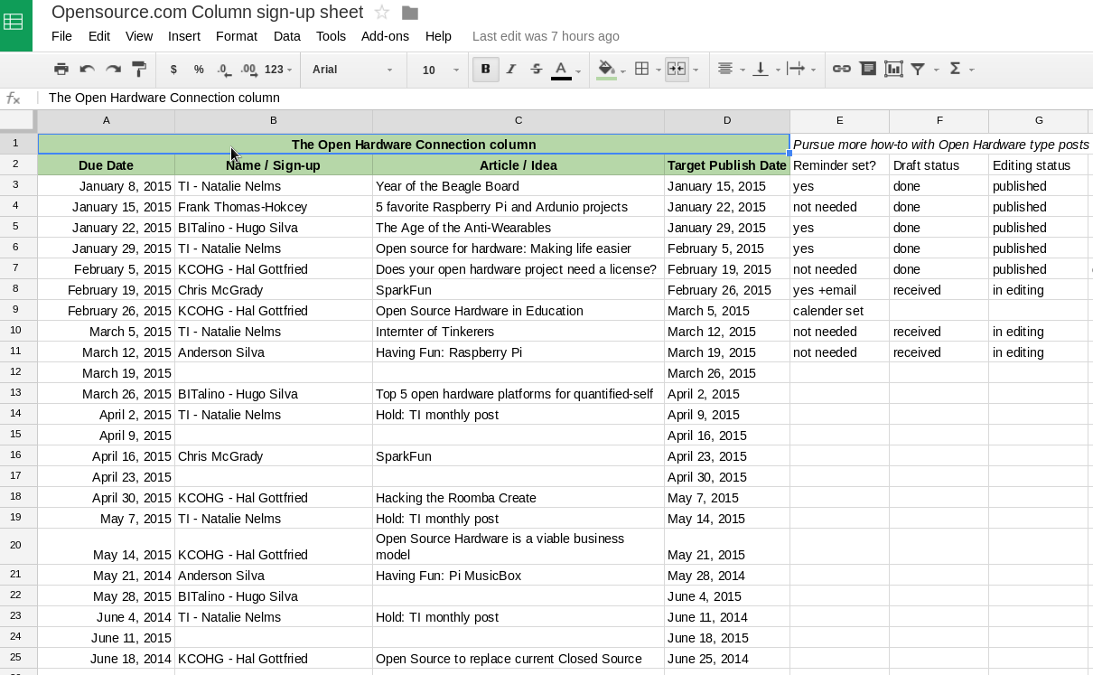
Strategy: Columns
Notes:
Example: recurring columns
Many others instead of one
Transparency created accountability

Slide 27

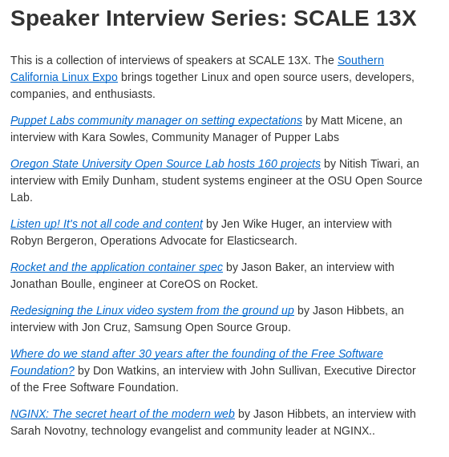
Strategy: Speaker interviews
opensource.com/scale13x
Notes:
Example: speaker interview series

Slide 28
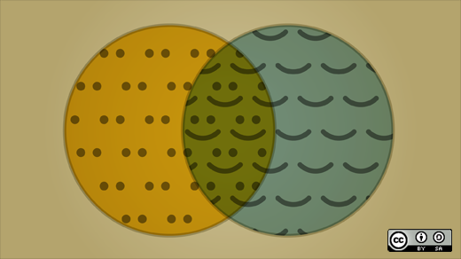
Strategy: SEO
Notes:
I know more about Search Engine Optimization that I care to. SEO is crazy because it can make or break your site. The other tricky part of SEO is that its constantly changing.
Example: Google Panda update (May 2012). SEO audit and Google News.
Our basic strategy it to write naturally and avoid keyword stuffing. The other part of our strategy is to generate content that people are searching for that we have domain expertise in.
Our search traffic is growing, and I’ll show you some of that in the results a little later.

Slide 29

Strategy: Content distribution
Notes:
While my team spends about half our time preparing content, we spend the other half of our time on the distribution side. If you play the fire and forget game then you’re probably not getting the results you want.
We have a weekly email newsletter that goes out to 220K subscribers every Tuesday at 6am.
We have a detailed social media strategy for Twitter, Facebook, and Google+. We have a documented syndication strategy and talk about where to submit each article every week.
We also have guidance on how to interact with Reddit, YouTube, and LinkedIn, where we’ve decided not to spend as much time.

Slide 30

Strategy: Social media
Notes:
We schedule a lot of social media. But all of them aren’t just promoting our content. We include other open source news and happenings in our stream. Provide value.
And we don’t just tweet an article once. Everyday we promote new article in the morning and evening. Then we create new tweets for the next 2-6 weeks to extend the life of the content. Remember Tweets have a short life-span.
Success for us on Twitter is searching for opensource.com, and seeing a bunch of results from other people.
Describe our Facebook and Google+ strategy.

Slide 31

Programs
Notes:
We’ve implemented several programs over the years to help us achieve our goals and be a catalyst in the open source community.
Next, we’ll look at some details about how we curate content from our community of writers and look at our flagship program designed for our community moderators.

Slide 32
Programs: Our audience
High touch, high impact
Moderators
Writers-list =
opportunities
Curate based
on results
Once/month
guest writers
One-time guest writers
Readers, comments, & sharers
Notes:
This is an example of how we segment our audience and our community of writers.
We have a webform of the site that allows anyone to contact us with a story lead or idea. We get some SPAM, but we get some really good posts through our webform.
Many of these submissions end up being a one-time post, but some of authors have the potential contribute more.
My team nuture’s the authors that have well-performing content and gauge their interest in writing for us once a month. They are added to our writers-list where we send opportunities about every two week. We launched our writers-list in August and have added more than 200 people.
We invest most of our time and resources to our moderator program.

Slide 33
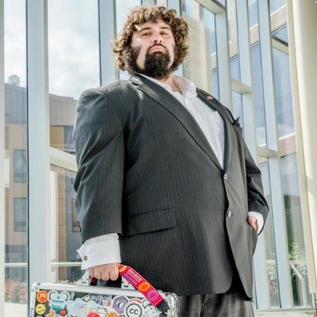


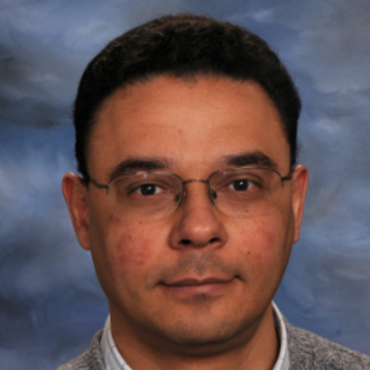
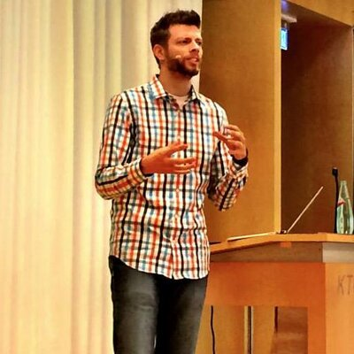


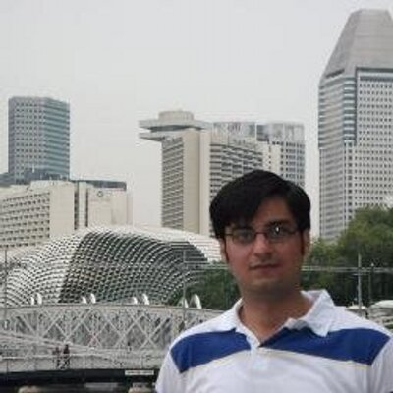


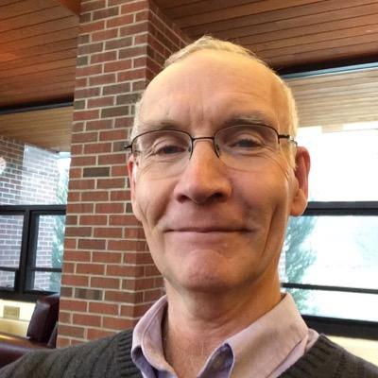

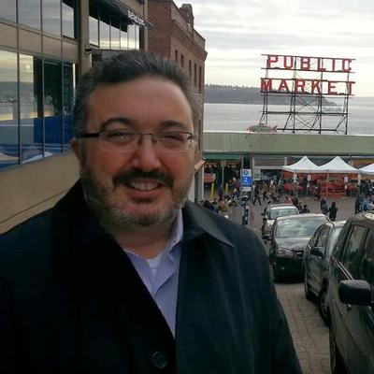
Programs: Meet the moderators
More details at: http://opensource.com/community-moderator-program
Notes:
This is the most important slides of this presentation. I’d like you to meet Remy, Nicole, Robin, Luis, David, Marcus, Phil, Aseem, Scott, Joshua, Don, Nitish, and Jason. If you have people like this promoting your project or organization, then you’ve made it. If you don’t have volunteers and advocates like this, then you have a lot of work to do.
This is the foundation of our community.
This is the future of marketing.
Let me tell you how this all starting:
First year we celebrated our community
Launched a points and badge system
Started giving out more community awards
Launched community moderator v1 and v2
One thing we need: More diversity, more women, more international.

Slide 34
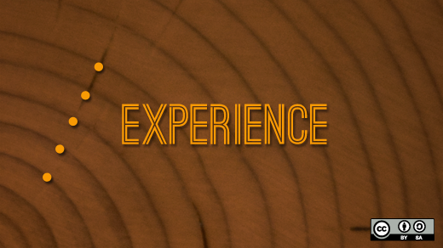
Programs: Create a win-win
Notes:
These volunteers write for us, tweet for us, join a quarterly video conference, and do so much more. But they don’t do it for us, they do it for themselves. My team provides the support, guidance, editing and other services while Red Hat supports the platform.
I dedicate a lot of my time to making sure their needs are met and that we are helping them achieve their goals.
Last year, we brought in nine moderators to Raleigh for an in-person strategy meeting. It was widely successful. One of the highlights of my career.
We will have our annual in-person meeting again in October. Well be sending all of them to the All Things Open conference and several of our them should have speaking opportunities at the conference.

Slide 35

Programs: Awards and badges
Newbie / 0-9 points
Community Member / 10-29
Open Enthusiast / 30-99
Open Minded / 100-499
Open Source Evangelist / 500-999
Open Source Champion / 1,000-2,499
Open Source Sensei / 2,500-4,999
Open Sourcerer / 5,000+
Notes:
This an example of the some of the awards that we give out every year. Last year, we awarding outstanding community members with:
People’s Choice, Reader’s Choice
Moderator’s Choice, Social Sharer
Conversation Starter
This year, we added Emerging Contributor and Best Interview categories.
Each month we highlight a community member as a top contributor in our community spotlight.
Our points and badge system was developed to entice participation but was really to help my team identify community members who were participating.
We didn’t implement it for gamification, it’s all about participation. A side effect was to also combat against Blackhat SEO—where SPAMmers would sign up to get links on our site. We hide any profiles that don’t earn 10 points.

Slide 36

Creating a community
Credit: http://www.flickr.com/photos/opensourceway/8516817076/in/photostream
Notes:
Let’s talk about community building...
I want to take a quick detour to tell you about another community that I’m personally involved with.
Because of my work with Opensource.com, I found my calling in the open government and open data worlds.
I found a way to blend my passions for open source, civic participation, and my local Raleigh community.

Slide 37

Creating a brand
Credit: http://www.flickr.com/photos/opensourceway/5496629913/in/set-72157628737085119
Notes:
It started with the idea to brand the City of Raleigh as an open source city.
We already had a few open source events happening, SparkCON is a 4-day celebration of creativity that uses the open source methodology to plan the event.
Raleigh also has a thriving community of engaged citizens, so I thought the idea was achievable.

Slide 38



CityCamp unconference
Credits: http://citycampnc.org | http://codeforamerica.org
Notes:
I discovered a brand called CityCamp—which is an international unconference series designed to bring open source thinking to local governments through technology and citizen ideation.
CityCamp is like barcamp, but for civic geeks.
I’ve helped run four successful CityCamps in the Triangle, two as CityCamp Raleigh and two as a re-branded CityCamp NC to broaden our reach to the entire state. These events have drawn interested from over 150 attendees at each event to help improve our government.
Along the way, the CityCamp organizers eventually become Code for Raleigh and we partnered with a great organization called Code for America.

Slide 39

A Peace Corp for geeks
Credit: http://codeforamerica.org/
Notes:
CfA is a non-profit in San Francisco who’s missions it to bring open source technologies to government. They have several programs to accomplish this, the most popular being their fellowship program that assigns a team of problem solvers to applicant cities each year.
The solutions the fellows design are all open source, meaning that other cities around the world can implement and deploy these solutions.
The program that Code for Raleigh is part of is the brigade. It’s allows volunteers like myself to help my local city and county through civic hacking in partnership with our city officials.

Slide 40

theopensourcecity.com
Credit: http://theopensourcecity.com/
Notes:
I’ve written my open government, open data, and CityCamp experiences in a book called The Foundation for an Open Source City.
Writing this book allowed me to test my storytelling, marketing, and sales skills. I ran a successful Indiegogo crowdfunding campaign pre-selling 165 copies of the book.
Since then, Iover 500 copies have been sold but what’s really great is that it’s used as a guide for other cities around the world to implement an open government strategy, using Raleigh as a case study.

Slide 41

Follow your heart
Notes:
I wanted to share this experience because I want to challenge each one of you to find a safe place to practice your skills.
Running CityCamp and writing a book about my experience has allowed me to put my community building and marketing skills into practice outside of my work environment while at the same time build my personal brand.
If you don’t have a safe place like a non-profit or other volunteer opportunity to practice and fine-tune your skills, there are many organizations that could use your help.

Slide 42

Tools
Notes:
Back on track now. Let’s talk about tools.
What does our quiver of tools look like to get the job done for Opensource.com?

Slide 43
Tools: The quiver
Drupal
Etherpad
Google Docs
Mojo (Internal documentation)
Omniture
Moz (formerly SEOmoz)
Eloqua
Sprout Social
Hootsuite
Email, lots of email
Mailing lists
IRC (Internal relay chat)
Social media: Twitter, Facebook, Google+, LinkedIn
Notes:
We’ll take a quick look at some of these, but I’ll point out that many of the tools listed on your right are primarily for communication.
Email, mailing lists, IRC, and social media are primary ways that we communicate with our community and moderators and also allows us to interact with our readers and potential writers.
The unfortunate part of today’s reality is that you need to be available on multiple channels. And that means that you need to be where your audiences is. For my team, we have to balance time with where we get the most return.

Slide 44

Tools: Drupal -Content Management
Notes:
Drupal is a content management system and the platform that we choose to build our community on. When making the technical decision five years ago, it really came down to Drupal, Wordpress, and Joomla.
If we just wanted a blog, we would have went with Wordpress. We decided on Drupal for several reasons, including the ability to build a robust, community platform but also because of future job opportunities (i.e. indeed.com), and a support model from an enterprise level provider.
Drupal does require a higher level of technical expertise, but the investment has been worth it for us. And, its open source. Which was a requirement to maintain our brand integrity.

Slide 45

Tools: Omniture - Tracking
Notes:
One of the tools we spend a lot of time in is Omniture. It’s similar to Google Analytics. We monitor page views, visitors, campaigns, and lots of data that helps us make decisions about the future of the site.
What type of content is performing well and who syndicates the content.

Slide 46
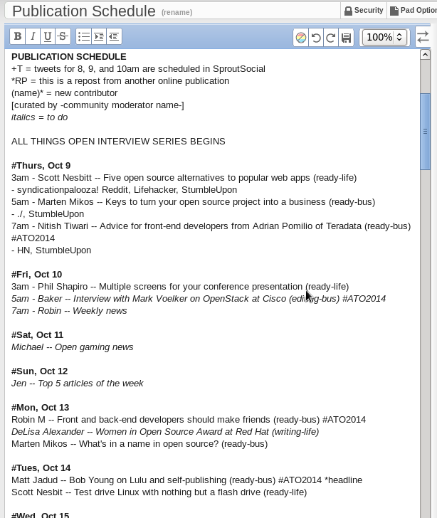
Tools: Etherpad - collaborative pads
Notes:
Etherpad is a light-weight Google Doc. We use Etherpad internally for meetings notes, scratch pads, and first drafts for documentation.
Ehterpad allows multiple users to collaborate on a document.

Slide 47
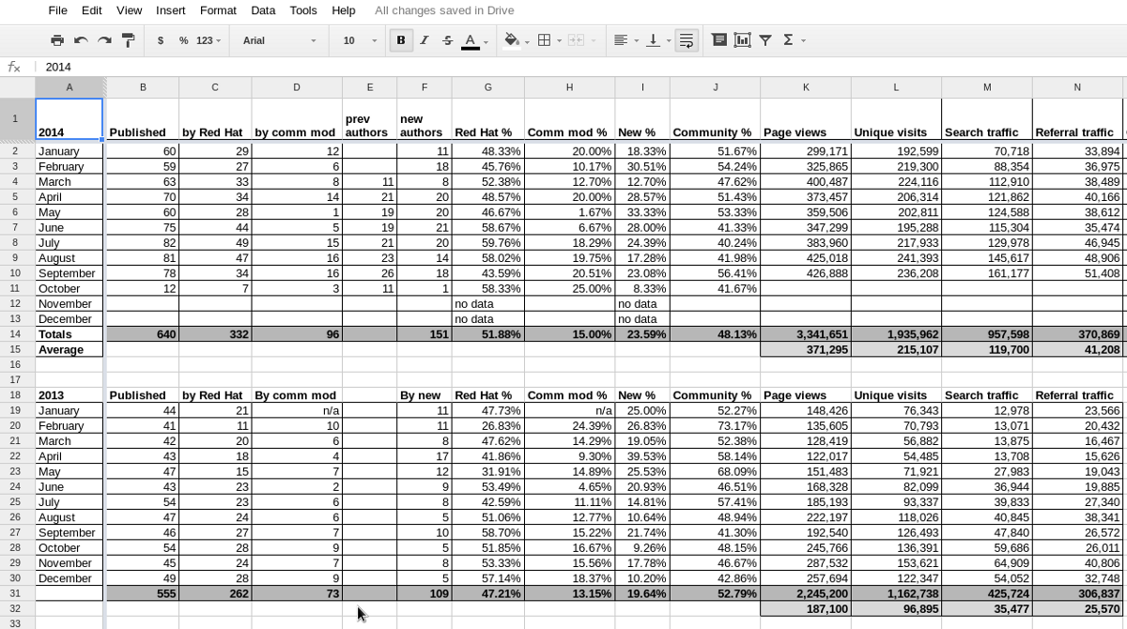
Tools: Google Docs: Tasks, stats
Notes:
We use several Google Docs, both internally and externally. This is a view of one of our dashboards that keeps track of publication statistics and high-level omniture data such as page views, unique visits, search traffic, and referral traffic.
We also use Google Docs to collaborate with our moderators during our weekly moderator meeting. Our moderators also use this to assemble our weekly news and share important social media items.

Slide 48

Tools: Internal documentation
Notes:
Internally at Red Hat, we call this platform Mojo. It’s a collaborative solution from Jive.
My team documents just about everything on Mojo. We know how to perform each other jobs and we document the tasks that each of us do.
Our strategy, how to run reports, how to perform the daily health check--it’s all written down in a step-by-step format.
While my team does provide value for the tasks that they perform, the real value is the creativity and the new ideas that progress our platform and publication.
The up-front investment to document what we do pays off in the long-term.

Slide 49

Tools: Moz
Notes:
We use Moz, formerly SEO moz to monitor our SEO and keyword rankings.
Moz crawls our site every week and reports on our site health as well as our SEO rankings.
We will look at some of our rankings in just a few minutes.

Slide 50

Results
Notes:
This was just a brief deep-dive into some of the tools that makes my team successful. Now let’s take a look at some of the results we track.

Slide 51
Results: Content
60%
Notes:
60% of our content comes from the open source community. Our content strategy helps us achieve this goal.
Our themed-content weeks and partnering with events as media sponsors allows us to find the most relevant and interesting people in open source to share their story.
Getting people to contribute and write for free is not an easy task. But when you have a robust platform with impressive results, it does get a little easier.

Slide 52
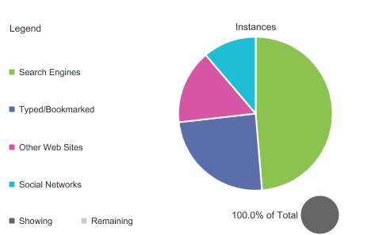
Results: Referral traffic
Notes:
This is a view of our referral traffic from last quarter. As you can see, 50% of our traffic is coming from search.
And 10-15% of our traffic comes from social media. We’re happy to invest the time for this result.
Our Twitter account has over 20k followers, plus everyone in this room.
Our Facebook page has more than 110k fans.
All of our social media efforts are organic, no paid media.

Slide 53

Results: Search keywords
Notes:
Our SEO audit has paid off. We corrected some unintentional bad SEO practices and started paying attention to on-page SEO, page titles, and tagging. Again, we write naturally, but on strategic topics.
For example, we noticed that people were getting to our site by searching for the term “open source” but bouncing. So we created a What is open source page that now generates 20k page views a month and is #1 is search results.
We are now proactive in creating evergreen resource content such as What is OpenStack, What is open gaming, and what is open education—and this is a main driver for our content strategy.
We just published what is open access today.

Slide 54
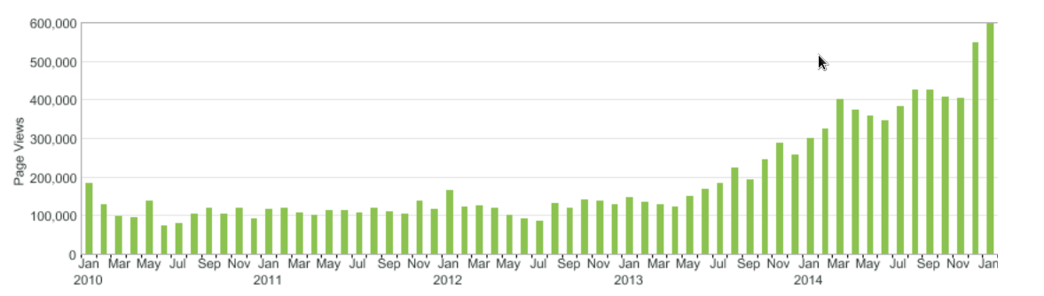
Results: Page views
Notes:
This is the traffic to our site from day one. You can see we were pretty steady for a while.
Then in May 2013, the triple play happened for us. We recovered from Google Panda, we were accepted to Google News, and we started publishing more quality content after launching our community moderator program in February of 2013.
With a renewed focus on community contributions, the results speak for themselves.
We’ve experienced tremendous growth over the last year and half and now we just want to keep the machine going.

Slide 55

The magic is in the community
Credit: http://opensource.com/business/13/12/five-community-management-tips
Notes:
What I’ve learned over the last five years is that community is everything. My team rewards the behaviors that help us meet our goals and we are always on the look-out for the next contribution and our next community moderator.
Finding these advocates is not easy. It takes work and it takes a lot of one-on-one time. But that investment will pay off later.
When you consider the limits we have between time, money and resources, the future choices should be simple:
invest in your community advocates and the programs that invest in them.

Slide 56
Build the world’s premier storytelling platform
Credits: http://www.flickr.com/photos/opensourceway/7496801912/
Notes:
We are fulfilling our mission, and it’s amazing to work on a project that Red Hat executives are very supportive of.
I want to wrap up with a few lessons learned and take a look at what the future holds for Opensource.com.

Slide 57
Lessons learned
Content is king
Know your SEO (Search Engine Optimization)
Find your stars and let them shine
Keep your platform/website simple
Practice Lean methodology

Slide 58
The future for Opensource.com
Increase number of community moderators
Continue to expand on strategic content
Optimize for mobile and responsive design

Slide 59

Change the world
Credit: http://www.flickr.com/photos/opensourceway/4371000464/
Notes:
With all the said, I hope that what I’ve presented today gives you some insight into many of the components that have made Opensource.com the success it is today.
I would like to challenge everyone here to take what you’ve learned today about open source and change the world.
Define your community, build your community and nuture it. Community building is the future of marketing. If you’re not spending time building programs and finding your advocates, then your competition will.
Thank you.

Slide 60

Q&A :: Contact
Questions
Contact
Email: jhibbets@redhat.com
Twitter: @jhibbets
IRC: shibby
Slides: https://github.com/jhibbets/presentations
Book: http://theopensourcecity.com
Credits: http://www.flickr.com/search/?w=47691521@N07&q=lolcat

