Slide 1
Open source all the cities
Jason Hibbets
Opensource.com editor, Red Hat
Code for Raleigh brigade captain
CityCamp NC co-chair
February 22, 2014 | SCaLE 12x

Slide 2

Why do you love open source?
Credits: http://www.flickr.com/photos/opensourceway/7496801912/

Slide 3
Open is better.

Slide 4

Open source is like a recipe
Credit: http://opensource.com/life/12/12/open-source-pumpkin-spice-latte

Slide 5

Open source model of participation
Transparency
Collaboration
Participation
Rapid prototyping
Meritocracy
Passion
Credit: Red Hat

Slide 6

Transparency
Credit: http://www.flickr.com/photos/opensourceway/7496800772/

Slide 7

Collaboration
Credit: http://www.flickr.com/photos/opensourceway/4404008626/

Slide 8

Participation
Credit: https://wiki.gnome.org/OutreachProgramForWomen#Cartoon

Slide 9

Rapid prototyping
Credit: http://www.flickr.com/photos/opensourceway/5041738335/

Slide 10

Meritocracy
Credit: http://www.flickr.com/photos/opensourceway/4426824995/

Slide 11

Passion
Credit: http://www.flickr.com/photos/opensourceway/5752191750/

Slide 12
Open source is a better way
Transparency → accountability
Collaboration → innovative ideas
Participation → more eyes, ideas
Rapid prototyping → failing faster
Meritocracy → best ideas, buy-in
Passion → commitment

Slide 13

Credit: Red Hat

Slide 14


Discover an open world
Credit: Red Hat & Opensource.com

Slide 15

Open source applied to government
Credit: http://www.flickr.com/photos/opensourceway/4459199503/in/set-72157625738142672

Slide 16

Credit: http://opensource.com/sites/default/files/imagecache/image-full-size/images/education/gov_vending.png

Slide 17

Beyond coding
Credit: http://www.flickr.com/photos/opensourceway/4581225603/in/set-72157623343008011/

Slide 18

Beyond voting
Credit: http://www.flickr.com/photos/opensourceway/5537457791/in/set-72157628737085119

Slide 19
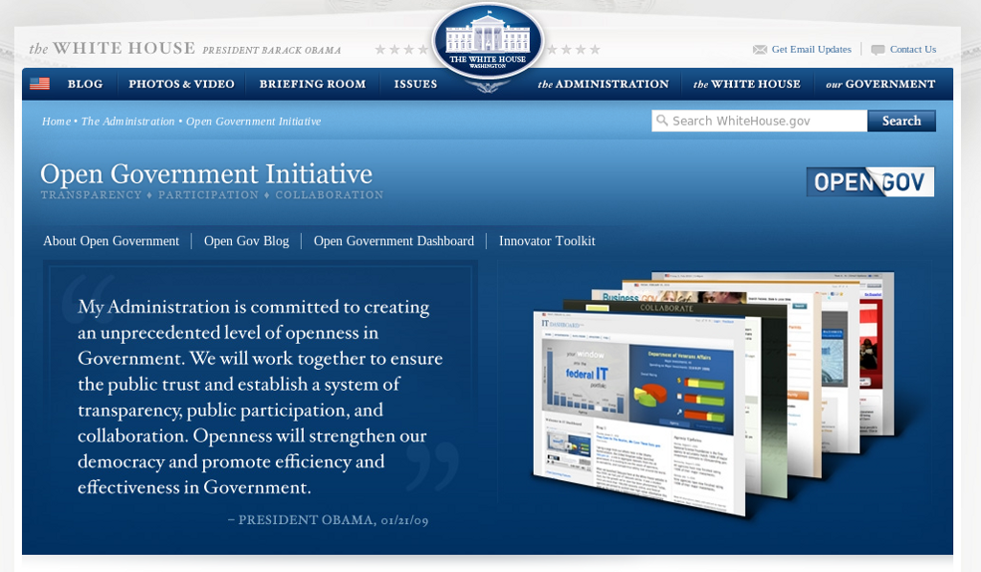
Open government initiative
Credit: http://whitehouse.gov

Slide 20

WARNING: Objects in city government are more open than expected
Credit: http://hibbets.net

Slide 21

Sharing a story
Credit: http://opensource.com

Slide 22

Creating a brand
Credit: http://www.flickr.com/photos/opensourceway/5496629913/in/set-72157628737085119

Slide 23

Creating a community
Credit: http://www.flickr.com/photos/opensourceway/8516817076/in/photostream

Slide 24

The catalyst
Credit: http://citycampral.org

Slide 25

Community of passion
Credit: http://citycampral.org

Slide 26

An open government unconference
Credit: https://www.facebook.com/CityCampRal/photos_stream

Slide 27

TriangleWiki
Credit: http://trianglewiki.org

Slide 28

TriangleWiki Day
Credit: http://citycampral.org

Slide 29

The impact
633 page edits
100 maps
138 new photos added
Credit: http://citycampral.org

Slide 30

RGreenway
Credit: RGreenway – http://RGreenway.com

Slide 31


Evolving CityCamp
Credits: http://citycampnc.org | http://codeforamerica.org

Slide 32

A Peace Corp for geeks
Credit: http://codeforamerica.org/

Slide 33

Code for Raleigh
Credit: http://brigade.codeforamerica.org/

Slide 34

Recycling code/projects
Credit: http://brigade.codeforamerica.org/

Slide 35
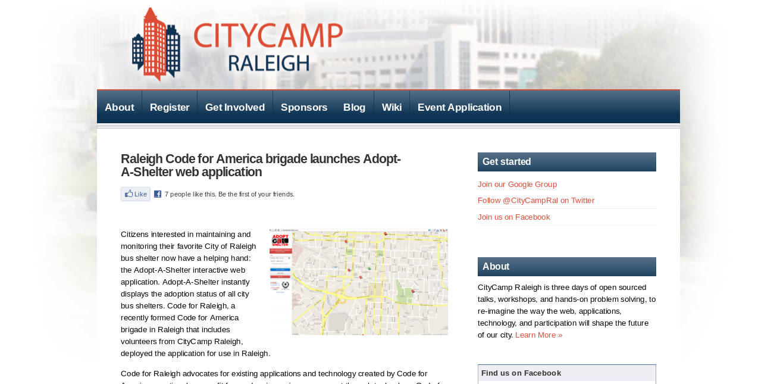
Credit: http://citycampral.org/2012/11/raleigh-code-for-america-brigade-launches-adopt-a-shelter-web-application/

Slide 36

Adopt-a-bus shelter
Credit: http://adoptashelter.raleighnc.gov/

Slide 37
Triangle Code for America Division
Join in: http://www.meetup.com/Triangle-Code-for-America/
Credit: http://brigade.codeforamerica.org/

Slide 38
Raleigh: A case study
Credit: http://www.flickr.com/photos/opensourceway/5496629913/in/set-72157628737085119

Slide 39

SeeClickFix
Credit: http://seeclickfix.com/raleigh

Slide 40

Open government resolution

Slide 41
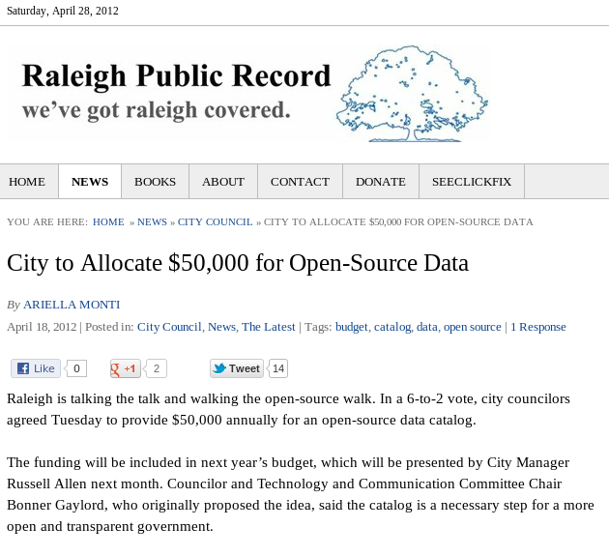
$50k for open data portal
Credit: http://raleighpublicrecord.org

Slide 42

Open Raleigh
Credit: City of Raleigh – http://raleighnc.gov

Slide 43
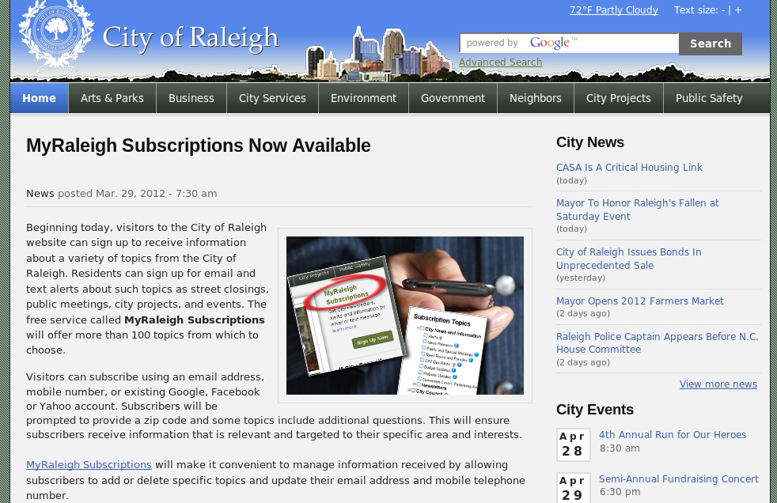
My Raleigh Subscriptions
Credit: City of Raleigh – http://raleighnc.gov

Slide 44

My Raleigh Ideas!
Credit: City of Raleigh – http://myraleighideas.com

Slide 45
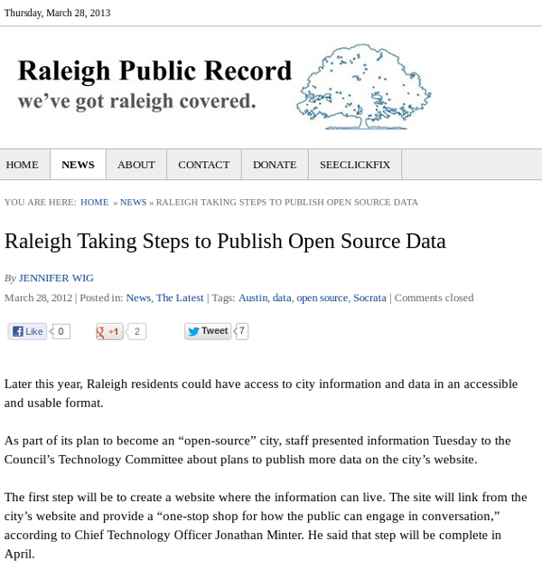
Open data sets
Credit: http://www.raleighpublicrecord.org/news/2012/03/28/raleigh-taking-steps-to-publish-open-source-data/

Slide 46

data.raleighnc.gov
Credit: https://data.raleighnc.gov/

Slide 47

Open source all the data!
Credits: http://www.flickr.com/photos/opensourceway/5538036200/

Slide 48
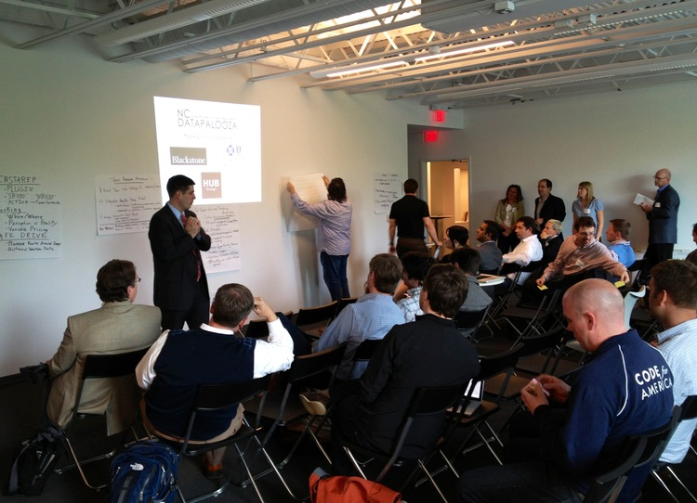

DataJam & Datapalooza
Credits: http://ncdatapalooza.com/ | #NCDataPalooza

Slide 49


We built this city on open source
Open Raleigh
Code for Raleigh
Open government
resolution
My Raleigh Ideas!
My Raleigh
Subscriptions
RGreenway
NC Datapalooza

Slide 50

theopensourcecity.com
Credit: http://theopensourcecity.com/

Slide 51

Credit: http://theopensourcecity.com/

Slide 52
Elements of an open source city
Culture/participation
Open government policy
Open data policy
Open source conferences & user groups
Economic development

Slide 53

Credit: http://opensource.com/government/13/8/citizen-cio

Slide 54

Change the world
Credit: http://www.flickr.com/photos/opensourceway/4371000464/

Slide 55

Q&A :: Contact
Questions
Contact
  Email: jhibbets@redhat.com
  Twitter: @jhibbets
  IRC: shibby
  Slides: https://github.com/jhibbets/presentations
  Book: http://theopensourcecity.com
Credits: http://www.flickr.com/search/?w=47691521@N07&q=lolcat

