Slide 1
The 3 keys to successful civic hacking
Jason Hibbets
Opensource.com community manager, Red Hat
National Advisory Council, Code for America
Code for Raleigh brigade captain
CityCamp NC co-chair
March 5, 2017 | SCALE15X
Notes:
By day, I’m a community manager at Red Hat for Opensource.com.
An online publication and community highlighting how the principles of open source can change the world.
By night, I’m a self proclaimed civic geek.
Code for Raleigh brigade
Co-chair for CityCamp NC
Board member: Code for America Brigade Advisory Council

Slide 2

Improve the citizen experience
Credit: http://opensource.com/government/13/8/citizen-cio
Notes:
Mission: Improve the citizen experience
Gov't more engaging, participatory
Create an environment for people to do amazing things
And I'll take more about CityCamp NC.

Slide 3






Credit: http://www.flickr.com/photos/opensourceway/7496800772/
Credit: http://www.flickr.com/photos/opensourceway/4404008626/
Credit: https://wiki.gnome.org/OutreachProgramForWomen#Cartoon
Credit: http://www.flickr.com/photos/opensourceway/5041738335/
Credit: http://www.flickr.com/photos/opensourceway/4426824995/
Credit: http://www.flickr.com/photos/opensourceway/5752191750/
Notes:
Tremendous experience in open source communities.
Part of Red Hat's DNA.
Explain the pillars of the open source development model.

Slide 4
Open source is a better way
Transparency → accountability
Collaboration → innovative ideas
Participation → more eyes, ideas
Rapid prototyping → failing faster
Meritocracy → best ideas, buy-in
Passion → commitment

Slide 5

Open government
Credit: http://www.flickr.com/photos/opensourceway/4459199503/in/set-72157625738142672
Notes:
Through my work at Opensource.com, I discovered the open government and open data movement.
I found a way to blend my passions. My passion for open source, my passion for civic participation, and my passion for my local community...Raleigh NC.
Open gov't is a combination of transparency, collaboration, and participation.

Slide 6
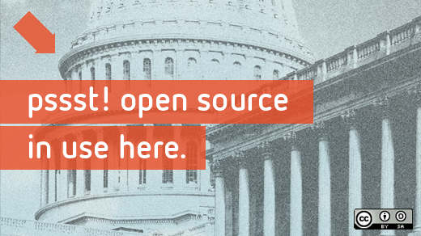
Beyond coding
Credit: http://www.flickr.com/photos/opensourceway/4581225603/in/set-72157623343008011/
Notes:
I’m not a coder I’m a community organizer.
Find ways to match volunteer skills to needs
And like any open source project that needs contributors, I found a way to bring my skillset to the table.

Slide 7

Taxes in > services out
Credit: http://opensource.com/sites/default/files/imagecache/image-full-size/images/education/gov_vending.png
Notes:
Most people view gov't like this: you put taxes in and get services out.
Police, fire protection, roads, trash collection, recycling, etc.

Slide 8
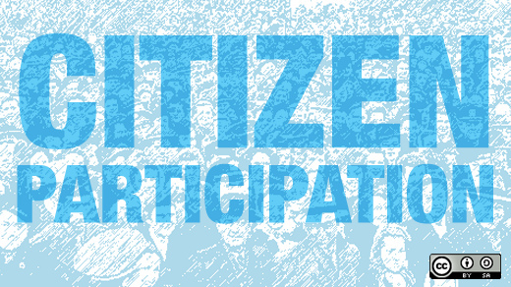
Beyond voting
Credit: http://www.flickr.com/photos/opensourceway/5537457791/in/set-72157628737085119
Notes:
I view government like this. Us. Citizens actively engaged in their city.

Slide 9
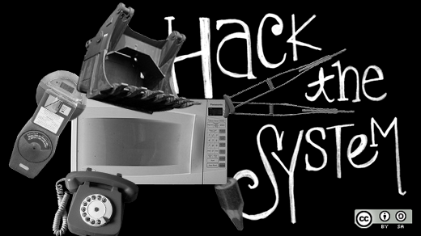
Shake the vending machine
Credit: http://opensource.com/government/14/5/national-day-civic-hacking
Notes:
How do we influence change in a slow moving system like the govt?
Enough people started getting frustrated with the system, we decided that we could find a way to change it ourselves.
Transparency camp
Gov 2.0
Code for America
Open government
Open data
Civic tech

Slide 10
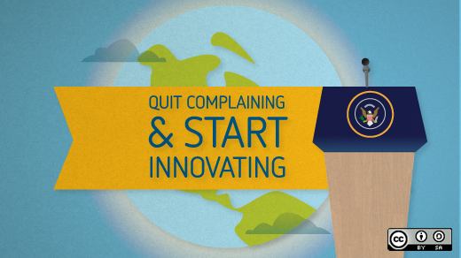
3 models for civic hackers
Credit: http://opensource.com/government/15/6/3-models-civic-hackers-green-field-cloned-augmentation
Notes:
Explain the impact of civic hacking

Slide 11

Green field project
Credit: http://opensource.com/open-organization/15/10/using-open-source-fight-man
Notes:
New ideas, little to no existing code, brand new projects.
Benefit: attractive, new
Risk: hard to get contributors

Slide 12

RGreenway
Credit: RGreenway – http://RGreenway.com
Notes:
Example: RGreenway

Slide 13

Reuse / cloned projects
Credit: http://opensource.com/government/14/5/recordtrac
Notes:
An open source project exists,
from Code for America
Code for America Brigade
Civic tech group
>> "cloned" (copied) and implemented for your city, region, or state
Power of the open source development model
Benefit: Don't reinvent the wheel, join existing team
Risk: customizing for your needs

Slide 14

Boston: Adopt-a -Hydrant
Credit: http://www.adoptahydrant.org/
Notes:
High level concept is a way for citizens to adopt civic infrastructure – just like you can adopt a stream or freeway

Slide 15

Seattle: Adopt-a-storm drain
Credit: http://www.seattle.gov/util/EnvironmentConservation/GetInvolved/AdoptaDrain/Adopt-a-DrainSignup
Notes:
Example: Adopt-a

Slide 16

Honolulu: Adopt-a-siren
Credit: http://sirens.honolulu.gov/
Notes:
Example: Adopt-a

Slide 17
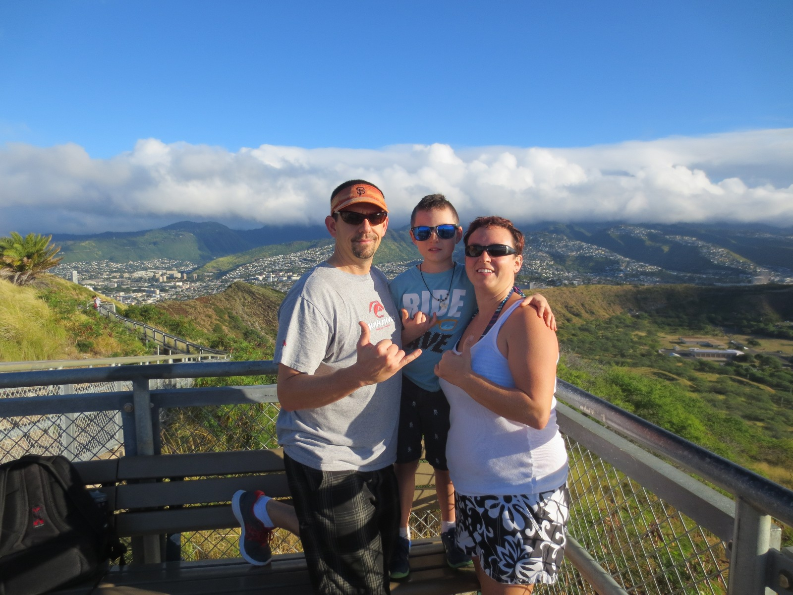
Since we’re talking about Hawaii...
Credit: http://hibbets.net
Notes:
Moment of zen....

Slide 18

Adopt-a-bus shelter
Credit: http://adoptashelter.raleighnc.gov/
Notes:
Example: Adopt-a

Slide 19

Augmentation projects
Credit: http://opensource.com/government/15/10/ato-interview-kaitlin-devine-18f
Notes:
Vetted and supported projects
With a project champion
city, county, or state agency
Volunteers can...
support development activity, provide user feedback, increase adoption, and assist in testing by augmenting a sponsored project

Slide 20

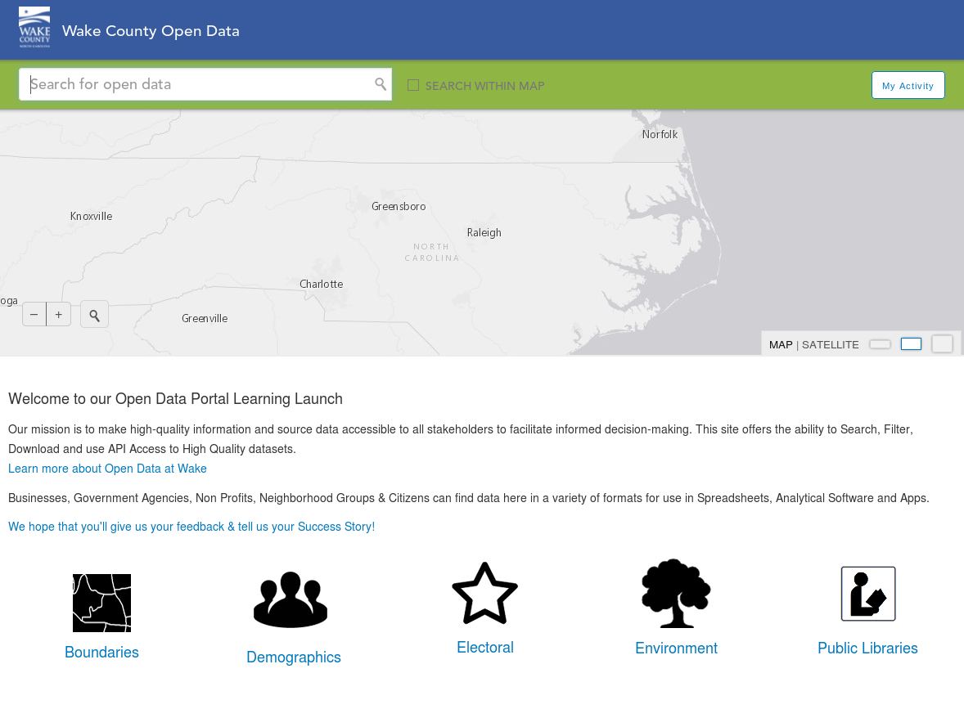
Credit: https://data.raleighnc.gov/ & http://data.wake.opendata.arcgis.com/
Notes:
Example: Raleigh open data portal meta data

Slide 21

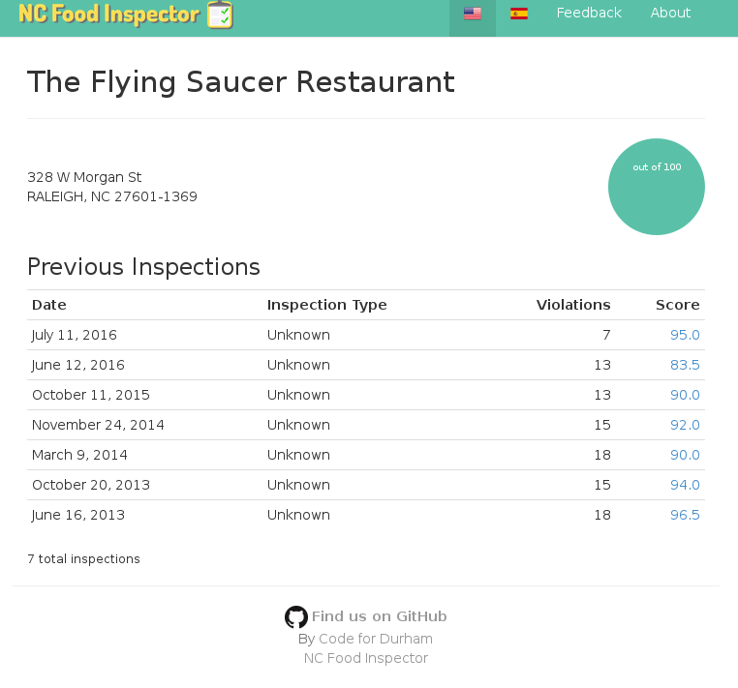
Notes:
Wake county team in NC Datapalooza open data competition working to improve NC Food Inspector

Slide 22

The game has changed
Credit: http://opensource.com/government/13/8/citizen-cio
Notes:
Civic hacking is having a positive impact on open government.
And provides a way for citizens to participate and re-engage with government.
Civic hacking allows people who are passionate about technology to volunteer in a different way

Slide 23
Creating a community
Credit: http://opensource.com/government/15/6/3-models-civic-hackers-green-field-cloned-augmentation
Notes:
Those are the three models, let's look at how an event can change the attitude of open government and innovation.

Slide 24


theopensourcecity.com
Credit: http://theopensourcecity.com/
Notes:
My experience with open gov't inspired me to write a book.

Slide 25
Elements of an open source city
Culture/participation
Open government policy
Open data policy
Open source conferences & user groups
Economic development
Notes:
The 5 elements

Slide 26

WARNING: Objects in city government are more open than expected
Credit: http://hibbets.net
Notes:
Things really took off when I got a chance to interview Mayor Charles Meeker a few years ago.
We sat down and talked about how we could apply the principles of open source to a living and breathing city.

Slide 27

Creating a community
Credit: http://www.flickr.com/photos/opensourceway/8516817076/in/photostream
Notes:
A community started to form in Raleigh around the ideas of open source and open government. That eventually included open data.

Slide 28

The catalyst
Credit: http://citycampral.org
Notes:
We discovered a movement called CityCamp—which is an international unconference series designed to bring open source thinking to local governments through technology and citizen ideation.
There have been CityCamp events all over the world. I’ve had the privilege to attend CityCamps in Denver, Kansas City, and Honolulu.
Help organize 6 CityCamp events in Raleigh.

Slide 29

https://twitter.com/BonnerGaylord/status/43714934470746115
https://twitter.com/jhibbets/status/43715324276776960
Notes:
March 4, 2011.

Slide 30

Community of passion
Credit: http://citycampral.org
Notes:
A group of citizens, including one of our city councilors came together to plan the first CityCamp Raleigh.

Slide 31

An open government unconference
Credit: https://www.facebook.com/CityCampRal/photos_stream
Notes:
Explain the format for unconference
Again, creating the environment for people to come together and solve their own problems
Key: government folks actively participating and partnering

Slide 32


Evolving CityCamp
Credits: http://citycampnc.org | http://codeforamerica.org
Notes:
Explain how we are evolving the brand

Slide 33
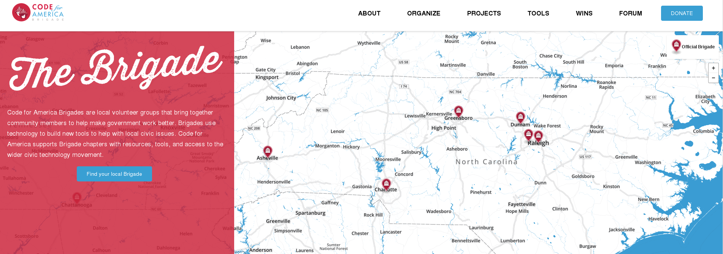
Code for North Carolina
Credit: http://brigade.codeforamerica.org/brigade/
Notes:
Explain the expanding ecosystem in NC

Slide 34

A gathering of the tribes
Visit citycampnc.org
Notes:
Re-iterate the vision for CityCamp NC.

Slide 35
Civic hacking lessons learned
Have a code of conduct and enforce it
Write it down or it didn't happen
Get organized: Waffle.io + Google Docs
Match assets and skills to needs
Don't re-invent the wheel
Recognize opportunities and make connections
Hard to lead and code at the same time

Slide 36
3 keys for civic hacking success
Create an environment for success
  Be inclusive and value diversity
Partner with organizations with similar goals
  Don’t do this alone
Default to open
  Open communications

Slide 37
Engaged participants
Credit: http://www.flickr.com/photos/opensourceway/5537457791/in/set-72157628737085119
Notes:
“Never doubt that a small group of thoughtful, committed people could change the world. Indeed, it's the only thing that ever has.” Margaret Mead

Slide 38

Credit: http://opensource.com/life/13/11/open-source-thank-you
Notes:
Discover your passion, make great partnerships, and together, let's improve the citizen experience

Slide 39

Q&A :: Contact
Questions
Contact
Email: jhibbets@redhat.com
Twitter: @jhibbets
IRC: shibby
Slides: https://github.com/jhibbets/presentations
Book: http://theopensourcecity.com
Credits: http://www.flickr.com/search/?w=47691521@N07&q=lolcat

