Slide 1
Open source beyond technology: Why open source rocks
Jason Hibbets
Opensource.com project manager, Red Hat
November 20, 2014

Slide 2

What is open source?
http://www.flickr.com/photos/opensourceway/4371000818/in/set-72157623343017387

Slide 3


Open source is like a recipe
Credit: http://opensource.com/life/12/12/open-source-pumpkin-spice-latte

Slide 4
Red Hat mission statement
To be the catalyst in communities of customers, contributors, and partners creating better technology
the open source way.

Slide 5
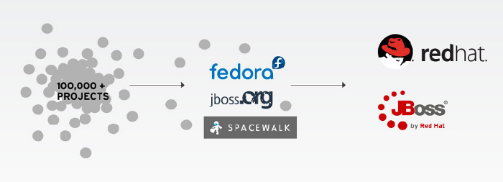
Catalyst in communities

Slide 6

Open source model of participation
Transparency
Collaboration
Rapid prototyping
Meritocracy
Passion

Slide 7

Transparency
Credit: http://www.flickr.com/photos/opensourceway/7496800772/

Slide 8

Collaboration
Credit: http://www.flickr.com/photos/opensourceway/4404008626/

Slide 9

Rapid prototyping
Credit: http://www.flickr.com/photos/opensourceway/5041738335/

Slide 10

Meritocracy
Credit: http://www.flickr.com/photos/opensourceway/4426824995/

Slide 11

Passion
Credit: http://www.flickr.com/photos/opensourceway/5752191750/

Slide 12

More than a development model

Slide 13

Beyond software

Slide 14

Beyond coding
http://www.flickr.com/photos/opensourceway/4581225603/in/set-72157623343008011/

Slide 15


Beyond participation
http://www.flickr.com/photos/opensourceway/5537457791/in/set-72157628737085119

Slide 16

Creating a community
http://www.flickr.com/photos/opensourceway/8516817076/in/photostream

Slide 17

Creating a brand
http://www.flickr.com/photos/opensourceway/5496629913/in/set-72157628737085119

Slide 18


Slide 19
Open source is a better way
Transparency → accountability
Collaboration → innovative ideas
Rapid prototyping → failing faster
Meritocracy → best ideas, buy-in
Passion → commitment

Slide 20

Change the world
http://www.flickr.com/photos/opensourceway/4371000464/

Slide 21
Q&A
Questions
Contact
  Twitter: @jhibbets
  Email: jhibbets@redhat.com
  or: jhibbets@gmail.com
  IRC: shibby
  Slides: https://github.com/jhibbets/presentations
  Book: http://theopensourcecity.com

