Slide 1

5 things I wish I knew before becoming a community organizer
Well, more like 25 things I wish I knew
Jason Hibbets
Community Evangelist, Opensource.com and Red Hat

Slide 2
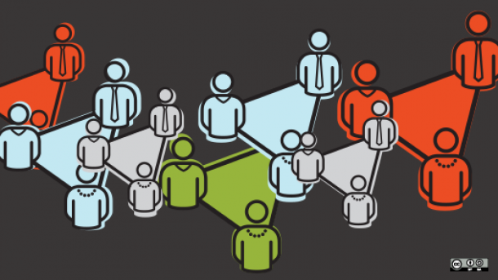
Shared purpose and passion
Image credits: https://opensource.com/article/17/4/community-leaders-gather-advance-art-community
Notes:
The goal of community is to connect people around a shared purpose and aim passion in the right direction, which means creating a sense family, camaraderie, and togetherness.
Today I want to take a look at some key themes and practical things you can do to build engaging and passionate communities of practice.
Context: My experience is from building community programs for Opensource.com where my interactions are mostly in-person with my team, but mostly online with our community members.
Additionally, I volunteer time, effort, and talent to the local and national civic hacking communities, which is a combination of in-person and online.

Slide 3
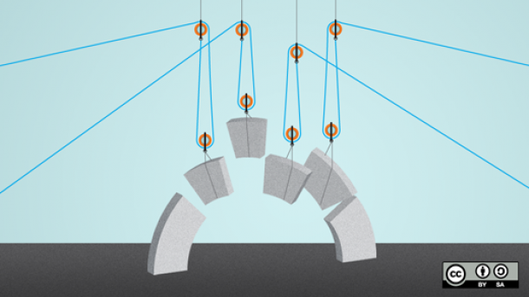
Understand the talent and motivations of participants
Image credits: https://opensource.com/open-organization/17/4/how-branding-decisions-open
Notes:
Ask participants what they like to do, what they are good at, and what new things they want to explore to amplify engagement
Practice two-way goal setting
Send thank-you’s lots of thank you’s
They can take the form of email, hand-written notes, or small gifts / swag
Public recognition
Listen more, talk less, and be inquisitive
Remember that every interaction is a gift and that surprise is the opposite of engagement
Incorporate feedback loops (i.e. Lean Start-up) into everyday practices:
Learn, test, measure, validate; then repeat

Slide 4

Find your superstars and let them shine
Image credits: https://opensource.com/article/17/4/top-5-april-21
Notes:
Create an environment for collaboration, trust, and accountability
Empower and trust your top participants
Gamification doesn’t have to be competitive; implement a points and badge system to have a method of tracking and seeing activity as well as a way to show participant achievement
Show appreciation and gratitude; this is beyond the thank you’s and includes bigger rewards and recognition such as conference passes, travel, additional access, or exclusive privileges
In-person experiences are the ultimate reward; Opensource.com moderator program in person planning and strategy session
Create a community awards program to recognize achievement at all levels, from beginners and new contributors to experienced ones

Slide 5
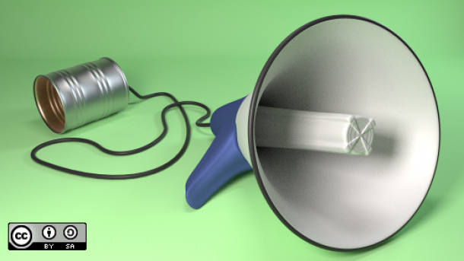
Be prepared and communicate effectively
Image credits: https://opensource.com/article/17/4/podcast-kubernetes-sarah-novotny
Notes:
Prepare as much in advance as possible so that you can have time to react to fires when you need to address them
Automate as much as you can, but realize when a personal touch is warranted
As a community organizer, you are going to have a lot single-touch interactions, which for many of us, translates into lots of email and/or social media interactions
Practice being short and concise in your messaging; save the longer form details for documentation or similar methods of sharing details; keep the important details and required actions clear and don’t bury them in your messaging
Don’t go to participants with an ask every time--provide value in other ways
Avoid engaging in endless debates such as which Linux distribution people should use, Slack vs IRC, or which flavor of La Croix is the best

Slide 6

Community means something different to almost every person
Image credits: https://opensource.com/article/17/4/introduction-functional-programming
Notes:
Community means something different to almost every person
Management, software engineers, community members
As a community organizer educating each of these audiences is very important
Be aware that part of the community organizer role is to balance the value between community and your organization
Document what you do in order to measure success; more specifically:
High touch interactions
Value of events
Contact list
Monthly report
Big wins, especially the ones with hard to track metrics; Example would be:
Someone got a new job because of their involvement with the community
You drove additional website traffic to an up-and-coming or lesser known community (and brought their web server down)
Your community creating something of extreme value without asking

Slide 7

Burnout is real (avoid it)
Image credits: https://opensource.com/article/17/4/testing-certificate-chains-34-line-go-program
Notes:
Know and understand that community doesn’t stop at 5:00 pm on Friday;
“Always-on”
It can be tough to explain this to managers and stakeholders
Flexible work schedules are key to addressing this
Know the signs of burnout for both participants and for yourself
Have a plan for how to address burnout and recharge energy levels
Be intentional about creating time and space to be alone and to be with your personal network, friends, and family

Slide 8

Bonus: Grow your career and sharpen the stone
Image credits: https://opensource.com/article/17/4/itch-to-scratch-model-user-problems
Notes:
Meet and talk with other community organizers at events, on forums, on social media, and on one-on-one interactions
Read books on the subject
Get inspired from other walks of life to cross-pollinate those ideas into your work
Go to other meet-up groups
Go to or watch Ignite Talks, Ted Talks, lightning talks, Pecha Kucha 20x20
Find ways to partner with other organizations and find the win-wins

Slide 9

Your most valuable asset
Image credits: https://opensource.com/article/17/2/mysql-8-coming
Notes:
Sometimes you just do something to help someone out, to pay it forward; examples would be taking a survey, making a connection in your network, making a job recommendation
As you are presented with different career opportunities, your network can go with you
Your network is the most valuable thing you have;

Slide 10

Questions & contact details
Email: jhibbets@redhat.com
Twitter: @jhibbets
IRC: shibby
Slides: https://github.com/jhibbets/presentations
Book: http://theopensourcecity.com
Image credits: https://opensource.com/education/13/9/how-get-more-kids-code

