Slide 1
Building sustainable civic tech with open data
Jason Hibbets, Senior Community Architect Opensource.com, Red Hat
Notes:
By day, I’m a community architect at Red Hat.
I work on Opensource.com, an online publication and community highlighting how the principles of open source can change the world
By night, I’m a self proclaimed civic geek
Open Raleigh Brigade
Co-chair for NC Open Pass
Code for America Brigade National Advisory Council
CfA: network of people making government work for the people, by the people, in the 21st century

Slide 2

The evolution of civic tech
Image credits: http://opensource.com/government/13/8/citizen-cio (Opensource.com)
Notes:
Mission for the last 7 years has been to improve the citizen experience with civic tech
Superpower: community organizing
Create an environment for people to do amazing things, to re-engage with local government
Goal: Find ways to foster participation and increase engagement;
Find workarounds or hacks to broken policy
Civic tech is evolving, we’ve learned from the early experiments
Many civic hackers or civic geeks want to inspire change
The only people who can change government is us

Slide 3
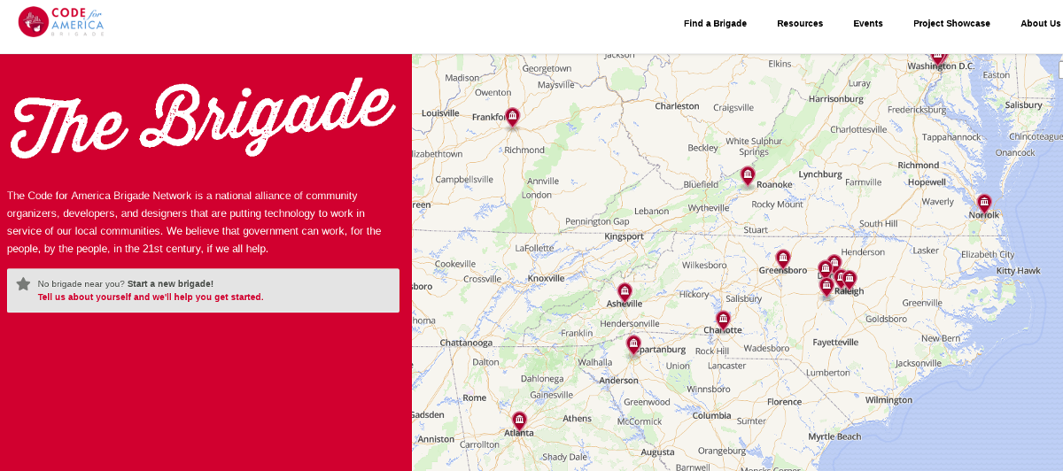
Send in the brigade
Image credits: Code for America
Notes:
Brigades are groups of volunteers who work with local government to improve their community
I live in NC - 3,000 miles / 4800 km away
We have 6 brigades across the state:
Asheville, Cary, Charlotte, Durham, Greensboro, and Raleigh
And we work together to collaborate on civic tech projects
Today I want to talk about how the civic tech movement is evolving
But first, a brief quiz

Slide 4

Quiz: Who likes to eat out at restaurants?
Image credits: https://opensource.com/life/15/11/tasty-translations-the-open-source-way (Opensource.com)
Notes:
By a show of hands
Quiz 1: How many of you have been out to eat in a restaurant?
Quiz 2: How many of you have noticed a health inspection score/grade?
Quiz 3: How many of you know how those scores calculated?

Slide 5

Image credits: https://www.rivcoeh.org/Programs/food
Notes:
Quiz 4: How many of you would eat in a restaurant who scored a C or worse?

Slide 6

Exploring sustainable civic tech
Image credits: https://opensource.com/article/18/1/foss-tools-agile-teams (Opensource.com)
Notes:
Story: In 2016, a team lead by the IT staff in my local county government, Wake County, started a project related to health inspection score risk factors
Goal: Allow people to drill down into the Health inspection scores on Yelp (and Wake County open data portal) to learn more about the violations
Examples: raw meat left out vs a sealed box stored improperly
Didn’t have to start from scratch: NC Food Inspector -- allowed you to search online for restaurant health inspection scores
Partnership with Code for Durham volunteers
The NC Food Inspector project had new life with a government partner

Slide 7

Forming an innovative partnership
Image credits: https://opensource.com/article/17/12/who-drives-culture-devops (Opensource.com)
Notes:
Story: Bill Greeves, Wake County CIO, approached me about an innovative way to partner with his team
2016 was an MVP to answer the question
Could government successfully partner with civic tech volunteers?
We expanded on this prototype in 2017 and evolved it even further in 2018

Slide 8

The future of civic tech
Image credits: https://opensource.com/open-organization/16/9/culture-trumps-tools-every-time (Opensource.com)
Notes:
Involved in civic tech for 8 years
The game is changing and evolving
Not: another app for government
Not: 24-48 hour hackathon; where teams/projects disappear after the event
Is: Smart cities/communities initiatives
Is: volunteer civic technologists and civic geeks working in partnership government

Slide 9

Civic tech challenges
Image credits: http://opensource.com/government/14/5/national-day-civic-hacking (Opensource.com)
Notes:
Don’t want our work to look like a hack
People
What we work on
Project management

Slide 10
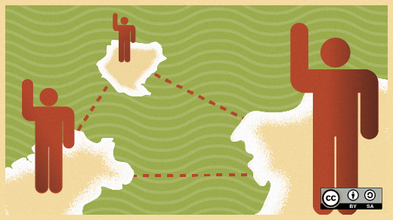
Civic tech challenges: People/consumers
Image credits: https://opensource.com/article/18/2/essential-roles-devops-culture-success (Opensource.com)
Notes:
People who need help in our community aren’t attending civic tech meet-ups or coming to tech conferences
They can ill-afford to attend town council meetings
Probably not engaging in the latest rezoning case in their neighborhood

Slide 11

Work on stuff that matters
Image credits: https://opensource.com/article/18/2/essential-roles-devops-culture-success (Opensource.com)
Notes:
10 years ago, Tim O’Reilly told us to work on stuff that matters
What resonated to me was to create more value than you capture
You could probably go a few blocks from here and find
A person who was formerly incarcerated who is having trouble getting work
Someone who applied for food stamps but was rejected because of a clerical error or gave up because the system is too complicated
A person working 2-3 jobs just to survive in our current economy
We have the tech skills, the connections, the ideas
This is why we should work on stuff that matters

Slide 12

Civic tech challenges: Project management
Image credits:: http://opensource.com/government/15/10/ato-interview-kaitlin-devine-18f (Opensource.com)
Notes:
3 models of civic tech
Green field / new projects
Open source / re-used / cloned projects
Augmentation model
Today, we’re going to focus on the idea of an augmentation model and how partnership play a valuable role in the future of civic tech
The challenge is about how we set-up and manage these projects

Slide 13

A valuable partnership
Image credits: https://opensource.com/open-organization/17/2/tracking-issues-publicly (Opensource.com)
Notes:
Up to this point, we relied on participant input and their passions -- whoever showed up
Instead of focusing on the next cool app the Open Raleigh Brigade wanted to tie our efforts to actual government objectives
Why didn’t we think of this before?
Connecting our volunteer efforts to government objectives
It sounds boring doesn’t it?
We were first focused on building a momentum, now that we’ve got momentum, it was time for us to be more strategic
How did we do this?

Slide 14

Effective collaboration with government
Image credits: https://opensource.com/open-organization/17/4/how-branding-decisions-open (Opensource.com)
Notes:
Started meeting and collaborating with key leaders
Open Raleigh Brigade + County IT team
We agreed to narrow down the list of 75 goals
We got the list down to 12 ideas that we could map to civic tech
Sent out a survey to our brigade
We hosted a meet-up to get feedback
We made a decision for the top 3
Key objective was to connect volunteers with county staff responsible for the objective

Slide 15

2017 civic tech focus
Image credits: https://opensource.com/article/18/2/devops-delivers-cool-apps-users (Opensource.com)
Notes:
Parks and Rec park finder – an app to find all the parks and greenways across our region, including programs and amenities in all municipalities
Not just a flu-shot finder – an app to where you can search for where to get flu shots and expanding the capabilities to include other health-related needs such as finding narcan and prescription drop-off locations
Business development diversity accelerator – looking at ways to help minority and underrepresented people turn their business ideas into actual businesses by providing resources to streamline the business-creation process

Slide 16
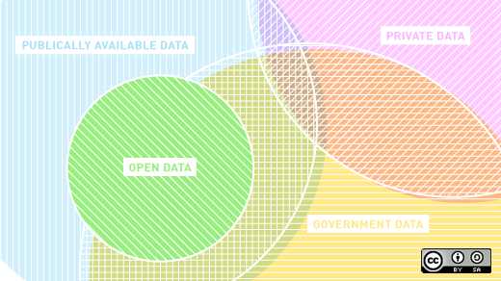
Open data, open data, and more open data
Image credits: https://opensource.com/article/17/5/open-data-trends (Opensource.com)
Notes:
Where do you start with open data?
There are so many open data sets available from local to state to federal
Data.gov has more than 300,000 data sets
Our team: Brigade + County IT curated local, state, and federal data sets for our 3 initiatives
County IT team pitched the augmentation model to stakeholders

Slide 17
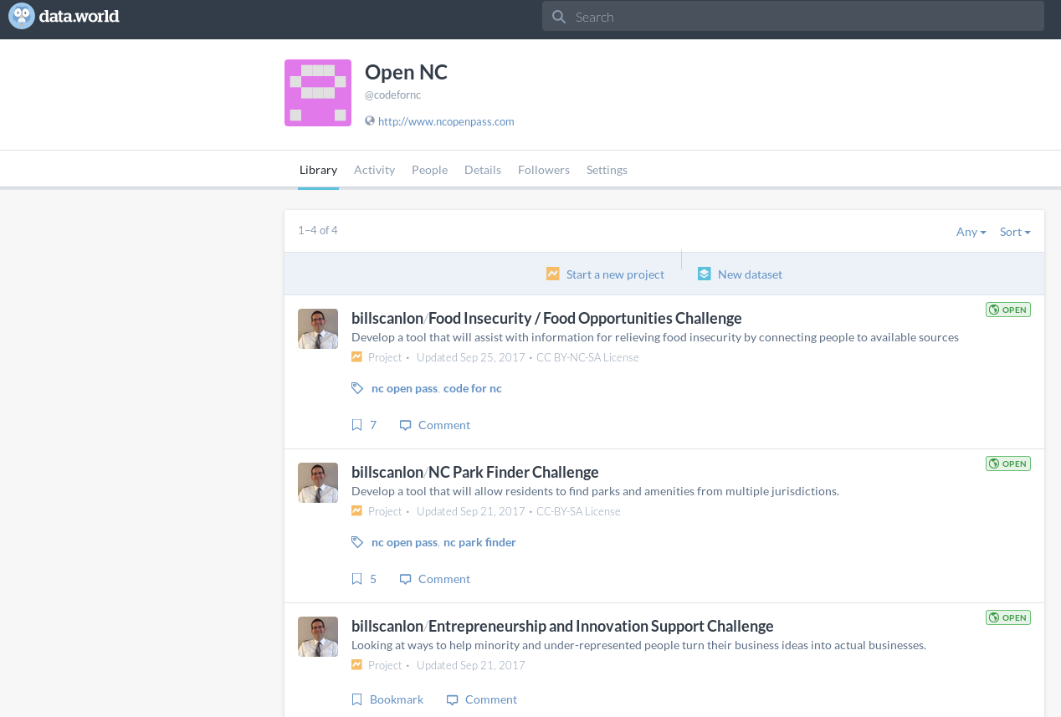
data.world
Image credits: data.world
Notes:
Created projects for the 3 initiatives
Each project had a description, MVP, and curated data sets
D.w gives you the ability to add all types of datasets, for example GeoJSON or html
d.w helps you connect as much data as you want
You can then query across the datasets in a project and save the query in d.w as SQL or SPARQL (maybe other formats too)

Slide 18
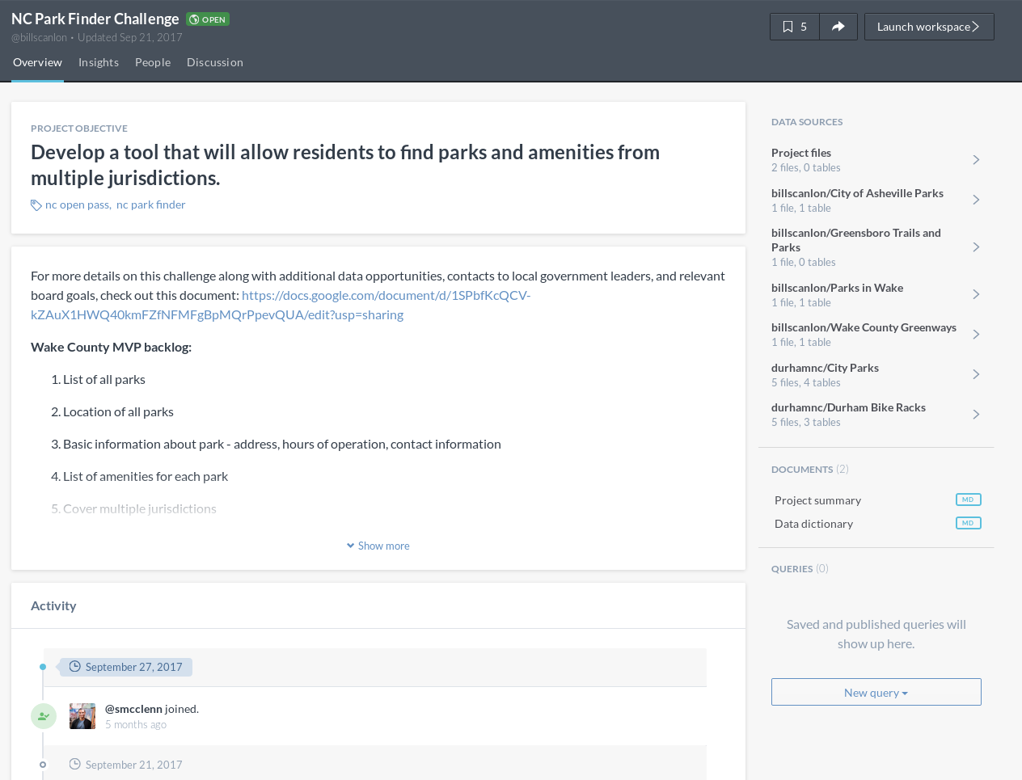
Image credits: data.world
Notes:
Takeaways:
Easy to add datasets
Ability to add other files
Allows project discussion
Ability to query within projects

Slide 19
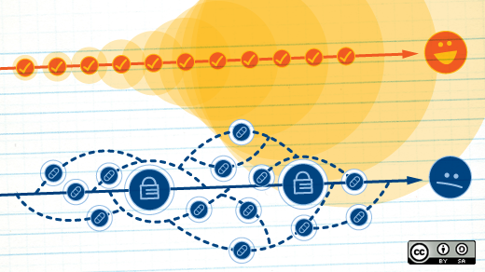
NC Open Pass event series
Image credits: https://opensource.com/business/15/6/interview-jen-krieger-redhat (Opensource.com)
Notes:
We use in-person events to help foster sustainable projects
We created an event series throughout the year to keep people and stakeholders engaged

Slide 20

NC Open Pass event series
Open Data Day
Community action day
National Day of Civic Hacking
Civic Camp (formerly CityCamp NC)
DataPalooza (formerly NC DataPalooza)
Notes:
Open Data Day - intro to open data
Community action day - work on projects
National Day of Civic Hacking - start to build teams
Civic Camp (formerly CityCamp NC) - gathering of the civic tech tribes and open data competition kickoff
DataPalooza (formerly NC DataPalooza) - open data competition
6-7 week period between Civic Camp and open data finale

Slide 21

Discovering our community issues
Image credits: https://opensource.com/life/16/3/creating-welcoming-and-inclusive-open-source-space (Opensource.com)
Notes:
Story: Meeting with the Mayor and city councilors
Gained an understanding of community issues
Learned that affordable housing was a major issue
Our leadership team decided that should be our focus for 2018
This is working on stuff that matters

Slide 22

2018: A focus on affordable housing
Image credits: https://opensource.com/government/11/4/blockboard-puts-whole-neighborhood-your-hands (Opensource.com)
Notes:
More than 400 Open Data Day events
Focus on affordable housing—the holistic view (housing costs, location, transit options, food)
We used our open data day event to bring together community partners
During our project time we did data analytics as well as policy analytics
Workshop Data journalism: How reporters use data to find and tell stories

Slide 23
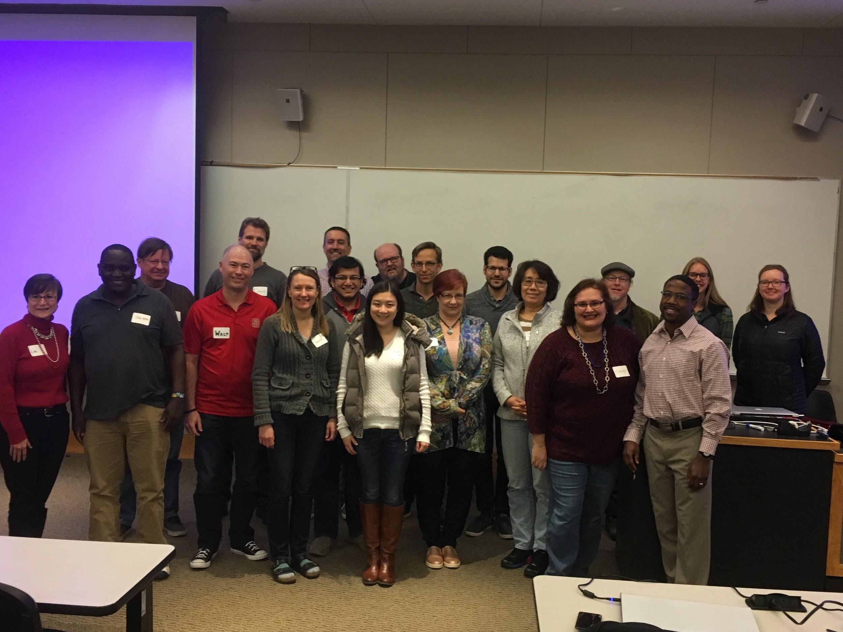
Image credits: NC Open Pass
Notes:
Used a weekend to unite our community, start the conversation
Goal: Use open data and our new knowledge to make progress
Seed ideas for Civic Camp and DataPalooza

Slide 24
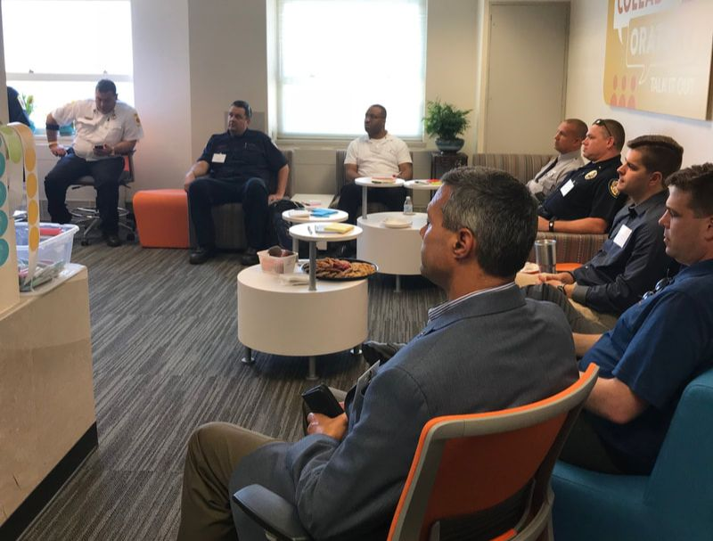
Image credits: NC Open Pass
Notes:
We decided to pivot a little with challenges in keeping the affordable housing teams motivated
For National Day of Civic Hacking - we partnered with First Responders

Slide 25
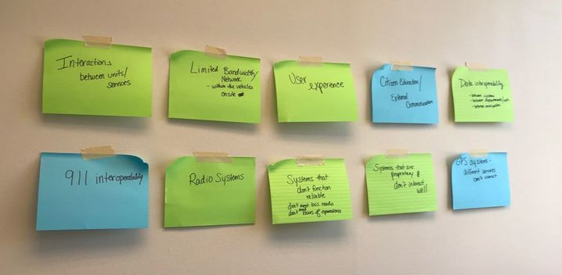
Image credits: NC Open Pass
Notes:
We invited them to two different design thinking sessions
And they came up with ideas
9-1-1 interoperability
Challenges between units and services

Slide 26
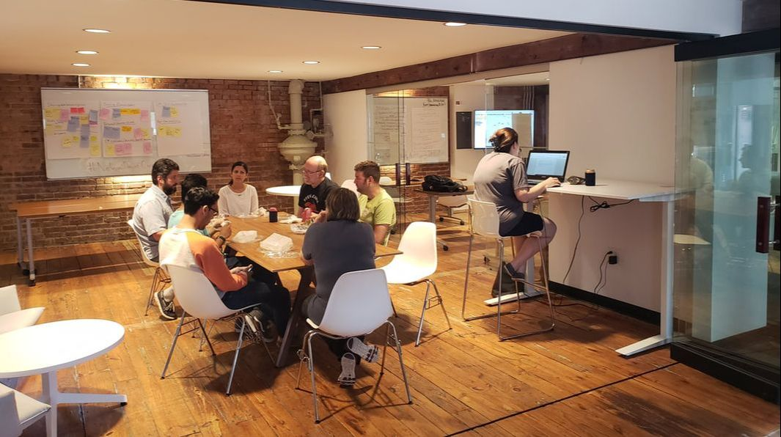
Image credits: NC Open Pass
Notes:
And then volunteers hacked on those ideas
One team is creating a web application that will assist fire department personnel with creating pre-plans of sites
Essentially pdf files that indicate where specific elements of a building are: the location of doors, windows, gas shut off, storage of any hazardous materials, etc.
A member of the fire department visits commercial sites to create the pre-plan which is then stored for later reference.
The another team is creating an open inventory form which can allow firefighters to use any internet connected device to check the truck inventory.
If something is missing, an email would automatically be sent to the contact person assigned to that department.
They would also have access to a log with date and timestamps when the item was last seen in inventory and who checked it in.

Slide 27
What’s next: NC Open Pass
Civic Camp ~ Sept 21-22
All Things Open ~ Oct 21-23
DataPalooza ~ Nov 8
Notes:
Civic Camp ~ Sept 21-22
All Things Open ~ Oct 21-23
DataPalooza ~ Nov 8

Slide 28

5 ways to create sustainable civic tech
Image credits: https://opensource.com/article/17/4/top-5-april-21 (Opensource.com)
Notes:
5 ways to create sustainable civic tech
Form strategic partnerships
Engage with civic tech volunteers, focus passion with strategy
Use an augmentation model where government partners own the projects
Curate open data sets for success
Update your community on progress

Slide 29
5 ways to create sustainable civic tech
Form partnerships
Engage with volunteers
Use an augmentation model
Curate open data
Update your community
Notes:
5 ways to create sustainable civic tech
Form strategic partnerships
Engage with civic tech volunteers, focus passion with strategy
Use an augmentation model where government partners own the projects
Curate open data sets for success
Update your community on progress

Slide 30

Image credits: http://opensource.com/life/13/11/open-source-thank-you (Opensource.com)
Notes:
Your mission:
Discover your passion, make great partnerships, and let's continue to evolve civic tech to work not only in our communities, but for our communities
Thank you for attending today

Slide 31
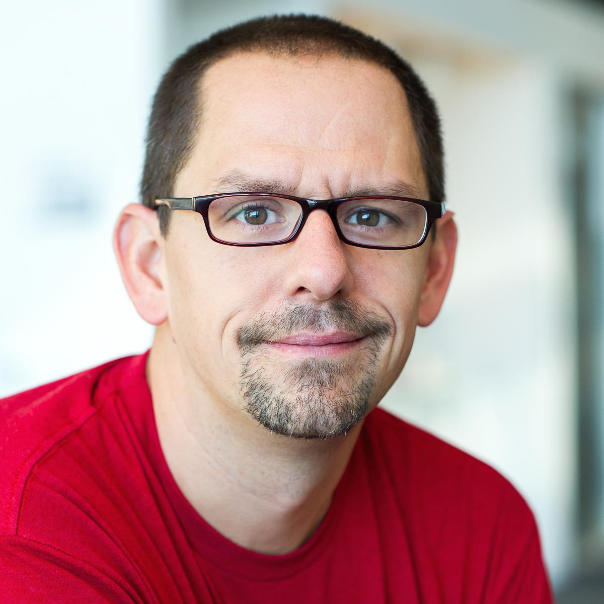

Contact
Email: jhibbets@redhat.com
Twitter: @jhibbets
IRC: shibby | Slack: jhibbets
Book: http://theopensourcecity.com
Slides: https://github.com/jhibbets/presentations
Notes:
Hope you learned something today about sustainable civic tech and open data, I’m happy to take any questions

