Slide 1


Open Source Government
Resolution 524
Unanimously Adopted Feb. 2012
Gail M. Roper
Chief Information &
Community Relations Officer
City of Raleigh
Notes:
<number>

Slide 2

JBoss Portal
JBoss SOA
WordPress
Alfresco
GitHub
Maven
Subversion
JBoss Application Server
Apache Tomcat
Red Hat Enterprise Linux
Ruby
MediaWiki
PostgreSQL
MySQL
DokuWiki
Eclipse and Sublime IDE's
GIMP
Android Mobile OS
Jenkins
City of Raleigh Open Source Toolkit

Slide 3

City of Raleigh Open Data Policy

Slide 4
FEBRUARY 2012
Adopted Open Source Resolution
JULY 2012
Drafted Open Data & Open Source Policies
MARCH 2013
Released Open Data Portal
SEPTEMBER 2012
Publish First Data Sets
APRIL 2012
Published Open Resources Page
MAY 2013
Formed Steering Committee
APRIL-JUNE 2012
Prioritized Data Sets
SEPTEMBER 2012
Created Future Open Initiatives Roadmap
AUGUST 2013
PTI Awards Web 2.0
2012
2013
2014
City of Raleigh Open Raleigh Timeline
Notes:
<number>

Slide 5

Credit: http://www.flickr.com/photos/opensourceway/8516817076/in/photostream

Slide 6
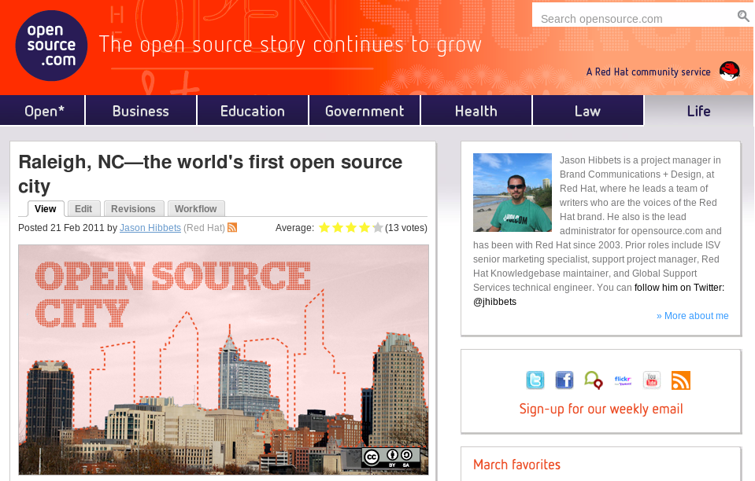
Credit: http://opensource.com

Slide 7



Credits: http://citycampnc.org | http://codeforamerica.org

Slide 8

Credit: http://www.flickr.com/photos/opensourceway/5537457791/

Slide 9
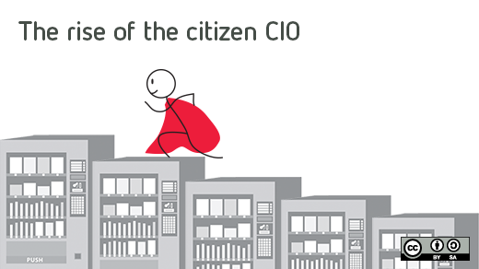
Credit: http://opensource.com/government/13/8/citizen-cio

Slide 10

Credit: http://www.flickr.com/photos/47691521@N07/4371000486/

