Slide 1
Avoiding the DevOps pit of misery: Tips from the trenches
Jason Hibbets, Senior Community Architect Opensource.com, Red Hat
Chris Short, Senior DevOps Advocate, SJ Technologies
Notes:
JASON
Introduce yourself. Smile.
Remind them about social media and to Tweet what they like.

Slide 2

Dilly, Dilly
Image credits: http://ow.ly/O1aF30ig12B (Attributed to Adweek, Bud Light)
Notes:
CHRIS
Don’t be the people who delivery the wrong goods--like mead
Talk about what the DevOps pit of misery looks like
What is DevOps and the purpose of DevOps
We’ll talk about why you need DevOps and the culture

Slide 3
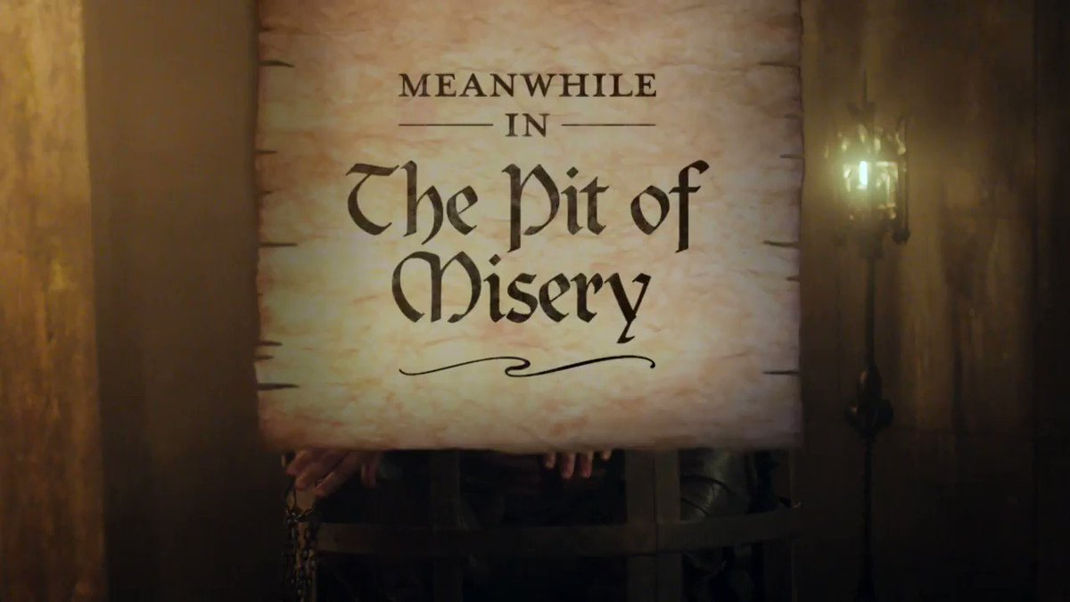
What is the DevOps pit of misery?
Image credits: https://twitter.com/budlight/status/934851751655636993 (Attributed to Bud Light)
Notes:
JASON
Let’s pretend that we all work for the ACME company
It takes weeks sometimes months to deploy code into production
ACME’s IT department implemented a “tool” and the CIO “checked” the DevOps box
Then a small group of people in ACME's IT department tried out some DevOps practices and deployed a new feature in record time
Now the CIO wants “all the DevOps”
Signs that you’re living in the pit of misery -- JASON
Do customers know your systems are down before you know do? -- CHRIS
Do outages occur repeatedly for the same or unknown reasons? -- JASON
Do you have knee jerk reactions to outages (restarting services at random, re-deploy code, etc.) -- CHRIS
Do you do postmortems? Do you blame people or systems? -- JASON
Does it take a long time to deliver features? -- CHRIS

Slide 4

What is DevOps?
Image credits: https://opensource.com/article/18/2/devops-delivers-cool-apps-users (Opensource.com)
Notes:
CHRIS
DevOps means different things to different people (and that's fine)
DevOps is a set of modern IT practices to bring software developers and operations staff together
Work collaboratively, with a goal to reduce the time and friction involved in deploying new versions of software
Outcomes Focused:
Shorter development cycles
Organization a competitive edge
Reduced costs
No more devs throwing code over the wall to ops

Slide 5
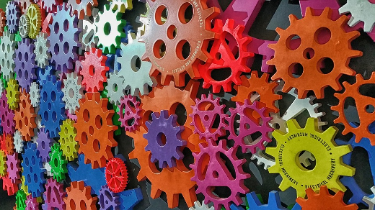
What DevOps is not
Image credits: https://opensource.com/article/17/10/dear-devops (Opensource.com)
Notes:
JASON
Not a singular group in a larger org; Multifaceted team
You can't buy DevOps; you have to change the culture
DevOps is not a tool you buy or clone from GitHub

Slide 6

What is the purpose of DevOps?
Image credits: https://opensource.com/article/17/7/state-systems-administration (Opensource.com)
Notes:
JASON
DevOps was coined by Andrew ‘Clay’ Shafer and Patrick Debois in 2009
Goal: Bring developers and operators together for continuous learning and improvement
For many the goal is to shorten development cycles and reduce costs
How do you get to this goal? Culture drives the desired changes

Slide 7

Why DevOps?
Image credits: https://opensource.com/article/16/12/yearbook-linux-test-driving-distros (Opensource.com)
Notes:
CHRIS
We’re going to share some statistics from the latest State of DevOps reports
I'm from Detroit so we're going to use an auto manufacturing analogy to help translate what each one means
From the 2017 State of DevOps report, high performers have:

Slide 8
46x
46 times more frequent code deployments
Source: 2017 State of DevOps Report (Puppet Labs)
Notes:
CHRIS
46 times more frequent code deployments
Making smaller changes more frequently increases safety, speed, and reliability
The Toyota Camry typically gets better every year
A new style is announced and the following years allow for iterative improvements
Think about doing this with code multiple times a day

Slide 9
400x
440 times faster lead time from commit to deploy
Source: 2017 State of DevOps Report (Puppet Labs)
Notes:
CHRIS
440 times faster lead time from commit to deploy
All of the work is put into making the car and the finished product is deployed all at once
This means that all the bugs and issues are deployed all at once too
If batch sizes are smaller there is less likelihood of error
Agile methods go hand in hand with DevOps

Slide 10
5x
5 times lower change failure rate (changes are 1/5 as likely to fail)
Source: 2017 State of DevOps Report (Puppet Labs)
Notes:
CHRIS
5 times lower change failure rate (changes are 1/5 as likely to fail)
Vehicles take four to five years before entering the market
What happens once they're on the market and flaws are discovered?
You can't redeploy a car.
RECALLS!
JASON
My entire car got recalled; something about diesel emissions

Slide 11
96x
96 times faster mean time to recover from downtime
Source: 2017 State of DevOps Report (Puppet Labs)
Notes:
CHRIS
96 times faster mean time to recover from downtime
If your car is a flop, you don't know that until five years of effort and time is put into it.
Downtime in a car means you don't sell cars
Cars will just sit on the dealer’s lot

Slide 12

DevOps: The three ways
The First Way: Systems thinking
The Second Way: Amplify feedback loops
The Third Way: Culture of continual experimentation and learning
Source: IT Revolution
Image credits: https://opensource.com/article/18/2/essential-roles-devops-culture-success (Opensource.com)
Notes:
JASON
The First Way: Systems thinking
The First Way emphasizes the performance of the entire system, as opposed to the performance of a specific silo of work or department
The Second Way: Amplify feedback loops
The Second Way is about creating the right to left feedback loops
The Third Way: Culture of continual experimentation and learning
The Third Way is about creating a culture that fosters two things: continual experimentation→ taking risks and learning from failure; and understanding that repetition and practice is the prerequisite to mastery.
Key takeaway
“These are the values and philosophies that frame the processes, procedures, and practices of DevOps”
Source: https://itrevolution.com/the-three-ways-principles-underpinning-devops/

Slide 13

Who drives culture in DevOps?
“Writing a few bullet points and printing them on colorful posters is not leadership.” -- Chris Short
Image credits: https://opensource.com/article/17/12/who-drives-culture-devops (Opensource.com)
Notes:
CHRIS
Google's Project Aristotle stated "physiological safety" is a key contributor to effective teams
Bottom-up and top-down approaches
Key takeaways
The best driver of culture is the CEO of an organization
Why? They set the tone for all activities and spreads the culture
When you define a culture: the organization's ideals, values, and tenets must be instilled and driven by its most senior leaders

Slide 14

Why is change so hard?
“The primary need is not overcoming resistance but enabling and supporting people to adapt.” -- Dr. Alison Eyring
CMO.com
Image credits: https://opensource.com/article/18/2/essential-roles-devops-culture-success (Opensource.com)
Notes:
JASON
Change is hard because it involves people
People resist change
We need to routinely implement small, subtle changes to avoid getting stuck in repetitiveness
Enable the facilitation of changes in our organizations
Example: Update to all the apps on your phone
Key takeaways
Being agile, adaptable, and flexible is key
“The primary need is not overcoming resistance but enabling and supporting people to adapt.”

Slide 15
54%
54% of C-suite executives polled by management consultancy A.T. Kearney said that having a corporate culture unable to embrace digital technologies was one of their biggest barriers. Source: CMO.com
Source: 2017 State of DevOps Report (Puppet Labs)
Notes:
JASON
54% of C-suite executives polled by management consultancy A.T. Kearney said that having a corporate culture unable to embrace digital technologies was one of their biggest barriers.
CMO.com

Slide 16

Diversity on your team
Image credits: https://opensource.com/life/16/3/creating-welcoming-and-inclusive-open-source-space (Opensource.com)
Notes:
CHRIS
I understand Jason and I are two white men
My time in the military showed me a inclusion and diverse ideas were key to mission success
Diverse groups are great for organizations because they provide unique perspectives
Human resource can be a great partner here to help you hire a diverse team
JASON
Military brat background
We are very keen about diversity and inclusion at Red Hat
Learnings from open source communities
Teams & committees: Diversity and inclusion, Women in Open Source Award, scholarships

Slide 17
Diversity & DevOps outcomes
Image credits: https://opensource.com/life/16/3/creating-welcoming-and-inclusive-open-source-space (Opensource.com)
Notes:
CHRIS
Coming back around to the Outcomes philosophy of DevOps
You won't know how people use the products you're working on
But a diverse group of people will be able to come up with more use cases
If you're all white folks from Silicon Valley you're probably going to make a bad product

Slide 18
35%
“Analysis of the data from the group of 366 companies indicates racially/ethnic diverse organizations were 35 percent more likely to have financial returns above their national industry median”
Source: McKinsey & Company Why Diversity Matters
Source: 2017 State of DevOps Report (Puppet Labs)
Notes:
CHRIS
McKinsey & Company Why Diversity Matters report shows...
Analysis of the data from the group of 366 companies indicates racially/ethnic diverse organizations were 35 percent more likely to have financial returns above their national industry median

Slide 19
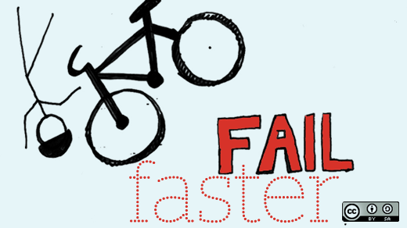
Fail early, fail often
Image credits: https://opensource.com/open-organization/17/4/accountability-by-design (Opensource.com)
Notes:
JASON
Raise your hand if you've blown up production
It's a rite of passage in DevOps; you're going to break stuff
Failure should occur as quickly as possible in your pipeline before (preferably WAY before) prod
If it fails in production you're not doing DevOps
Failures are blameless; the system you created failed, a person didn't break something

Slide 20

Why is “failure” so hard?
Image credits: https://enterprisersproject.com/article/2017/10/why-agile-leaders-must-move-beyond-talking-about-failure (Enterprisers Project)
Notes:
CHRIS
Talk of failure is uncomfortable to many who are trying to make the transition to agile and DevOps culture
DevOps is about is creating a culture in which failure is not only safe but encouraged
Always shift left--getting testing done early in the development process
Automation will help provide the safety net but you have to know metrics that indicate impending failures
Deploy an application and your response times skyrockets, that’s a problem
Your automation should know this and ease off the deployment
Don’t tell your team that you want them to fail. Tell them that you expect them to make good decisions by testing out ideas before committing to them

Slide 21
Tips from the trenches:
Avoiding the pit of misery
Notes:
JASON
Now it’s time to dive into some practical advice

Slide 22
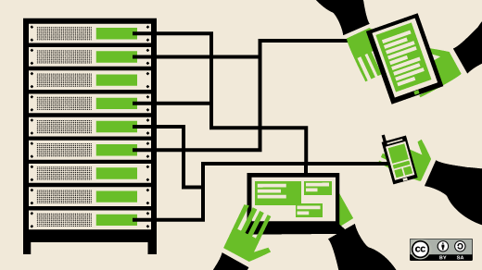
Identify your stakeholders
Image credits: https://opensource.com/open-organization/16/11/exploring-cultures-agility-and-blamelessness (Opensource.com)
Notes:
JASON
Stakeholders: identify who they are and start to educate them
Ask: Who do you think some of your stakeholders might be?

Slide 23
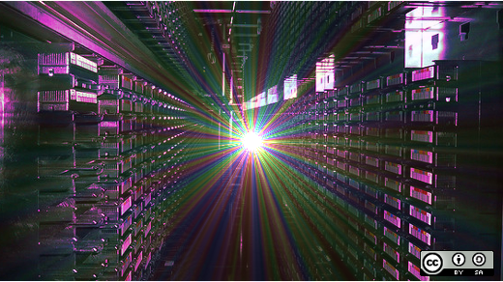
Set goals *AND* measure them
Image credits: https://opensource.com/open-organization/16/9/culture-trumps-tools-every-time (Opensource.com)
Notes:
CHRIS
Goals: Set them, determine how you’ll measure them, and measure them
"you can only expect what you inspect"
“what gets measured is what gets done”

Slide 24
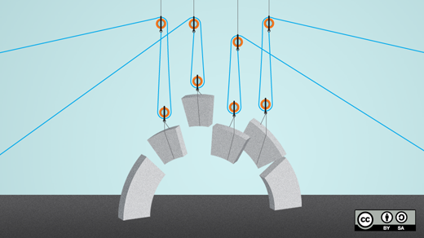
Establish processes: Then test and iterate
Image credits https://opensource.com/life/15/5/constructing-open-infrastructure (Opensource.com)
Notes:
JASON
Processes: Establish them, make them visible to stakeholders, test them, then iterate
Ask: What’s a process you might document?
Ask: How do you make them visible to stakeholder?

Slide 25
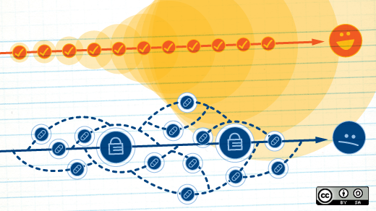
Start your delivery
Image credits: https://opensource.com/business/15/6/interview-jen-krieger-redhat (Opensource.com)
Notes:
CHRIS
Delivery: Start small, start with singular features, ease into continuous delivery
From multiple small groups simultaneously
You’re not Netflix, but you could be one day

Slide 26

Recognition: Successes and failures
Image credits: https://opensource.com/article/17/10/cascadia-community-builder-award (Opensource.com)
Notes:
JASON
Recognition: celebrate successes and recognize failures as learning opportunities

Slide 27

Attend events and grow your network
Image credits: https://opensource.com/article/18/1/foss-tools-agile-teams (Opensource.com)
Notes:
CHRIS
Events: Attend events like DevOpsDays and network with other practitioners
JASON
DevOpsDays Raleigh CFP

Slide 28

Must read DevOps resources
Image credits: https://opensource.com/article/17/12/10-must-read-devops-books (Opensource.com)
Notes:
CHRIS
Visit: https://opensource.com/article/17/12/10-must-read-devops-books
The Phoenix Project - by Kevin Behr, George Spafford, and Gene Kim
The DevOps Handbook - by Gene Kim, Jez Humble, John Willis, and Patrick Debois
Continuous Delivery - by Jez Humble and David Farley
Lean Enterprise - by Jez Humble, Barry O'Reilly, and Joanne Molesky
The Open Organization Guide to IT Culture Change - by The Open Organization
JASON
Example about Jim’s leadership transformation

Slide 29

Join the Open Source DevOps Team
https://opensource.com/devops-team
Notes:
JASON
For those interested in the intersection of open source and DevOps, join our team of DevOps practitioners
Sharing their open source DevOps stories.
We are looking for writers, curators, and others who can help us cover:
DevOps practical how to's (we want lots of these)
DevOps and talent
DevOps and culture

Slide 30



Contact
Email: jhibbets@redhat.com
Twitter: @jhibbets
IRC: shibby | Slack: jhibbets
Book: http://theopensourcecity.com
Email: chris@chrisshort.net
Twitter: @ChrisShort
IRC | Slack: ChrisShort
Site: https://devopsish.com/
Slides: https://github.com/jhibbets/presentations
Notes:
Hope you learned something today, either something to avoid the pit of misery
Or we threw the rope down to you and you can start to climb out

