Slide 1
10 ways to get started with open source
Digital Connectors
Jason Hibbets, Red Hat
Opensource.com
April 28, 2016

Slide 2
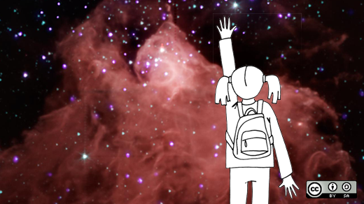
What is open source?
http://www.flickr.com/photos/opensourceway/4371000818/in/set-72157623343017387

Slide 3
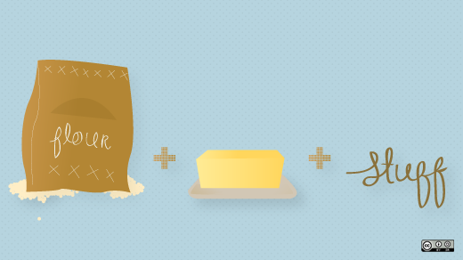

Open source is like a recipe
Credit: http://opensource.com/life/12/12/open-source-pumpkin-spice-latte

Slide 4
Red Hat mission statement
To be the catalyst in communities of customers, contributors, and partners creating better technology
the open source way.

Slide 5
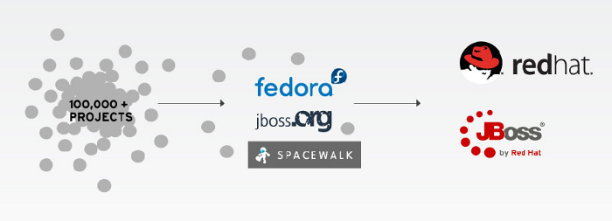
Catalyst in communities

Slide 6

Open source model of participation
Transparency
Collaboration
Rapid prototyping
Meritocracy
Passion

Slide 7
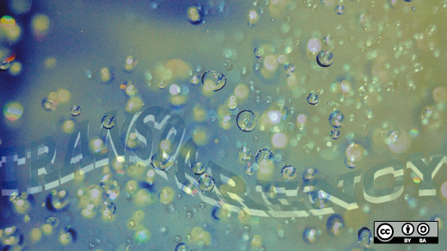





Credit: http://www.flickr.com/photos/opensourceway/7496800772/
Credit: http://www.flickr.com/photos/opensourceway/4404008626/
Credit: https://wiki.gnome.org/OutreachProgramForWomen#Cartoon
Credit: http://www.flickr.com/photos/opensourceway/5041738335/
Credit: http://www.flickr.com/photos/opensourceway/4426824995/
Credit: http://www.flickr.com/photos/opensourceway/5752191750/
Notes:
Know a lot about open source.
Part of Red Hat's DNA.
Explain the pillars of the open source development model.

Slide 8

1) Everyday productivity
Image credits: http://www.flickr.com/photos/opensourceway/8296581995/in/photostream

Slide 9
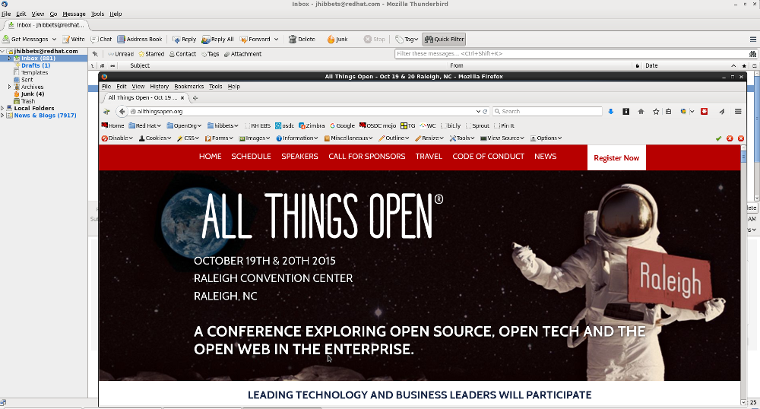
Thunderbird & Firefox from Mozilla
Image credits: Jason Hibbets desktop

Slide 10

Office suite – Libre Office
Image credits: http://www.libreoffice.org/

Slide 11
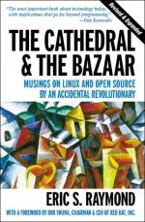
2) Read a book about open source
The Cathedral and the Bazaar, by Eric S. Raymond
Free Software, Free Society, by Richard M. Stallman
Rebel Code, by Glyn Moody
Producing Open Source Software, by Karl Fogel
Image credits: http://www.1000manifestos.com/eric-raymond-the-cathedral-and-the-bazaar/

Slide 12

Image credits: http://theopensourcecity.com

Slide 13
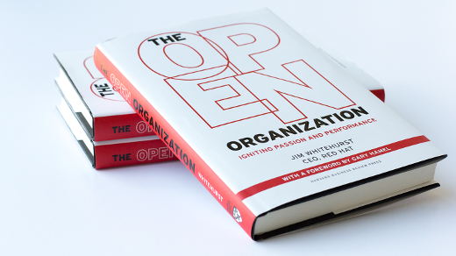
https://opensource.com/open-organization/ | #TheOpenOrg
Image credits: https://opensource.com/open-organization/

Slide 14
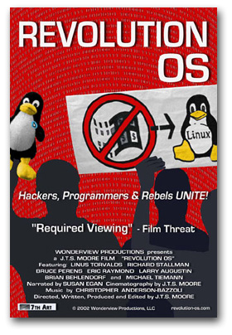
3) Watch a movie
www.revolution-os.com

Slide 15
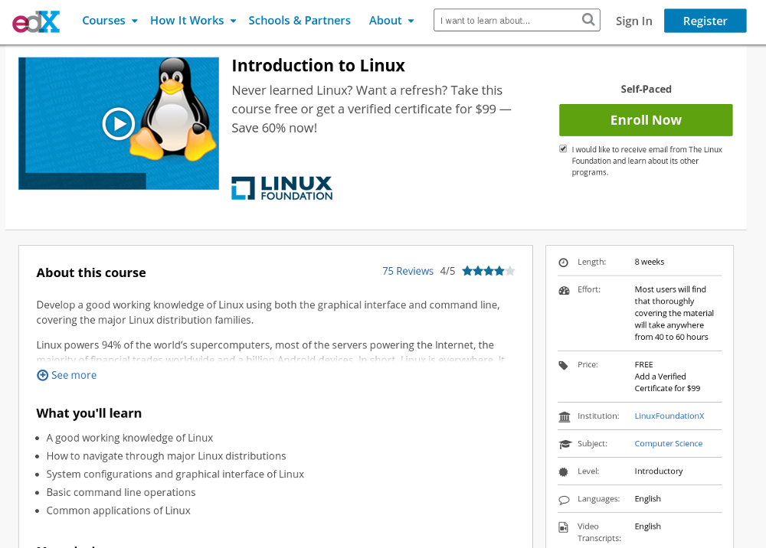
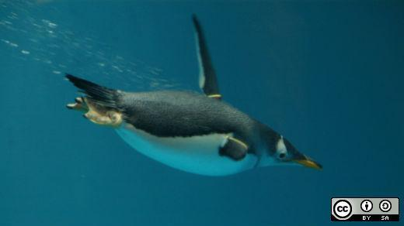
4) Take a class on Linux
Screenshot credits: https://www.edx.org/course/introduction-linux-linuxfoundationx-lfs101x-2#.U_9_rEhy-Cg
Image credits: http://opensource.com/business/14/8/newbie-learns-linux

Slide 16
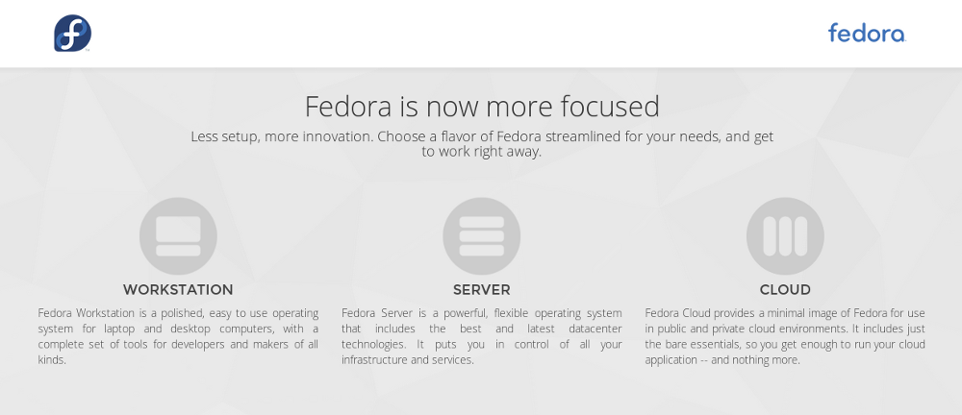
5) Install Linux
https://getfedora.org/en/
Screenshot credits: https://getfedora.org/en/

Slide 17
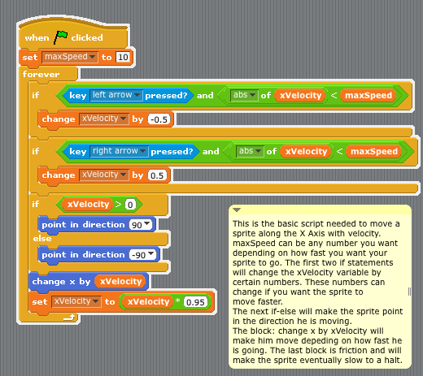
6) Learn to program
Scratch, a programming language for kids
http://opensource.com/education/12/10/scratch-programming-language-kids
Image credits: http://en.wikibooks.org/wiki/Scratch/Lessons/Movement
Notes:
Girl Develop IT
CoderDojos

Slide 18
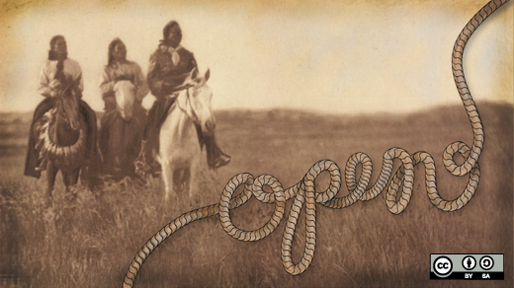
7) Get creative
GNU Image Manipulation Program (GIMP)
Scribus
MyPaint
Inskape
Audacity
Blender
Dream Studio
TuxPaint
KDEnlive
A look back at open source creative tools in 2012
http://opensource.com/life/13/1/open-source-design-tools-review-2012

Slide 19
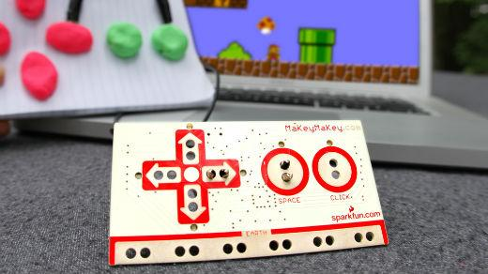
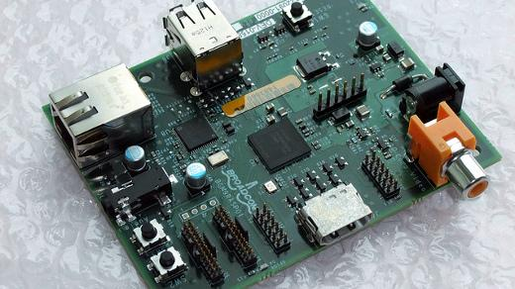
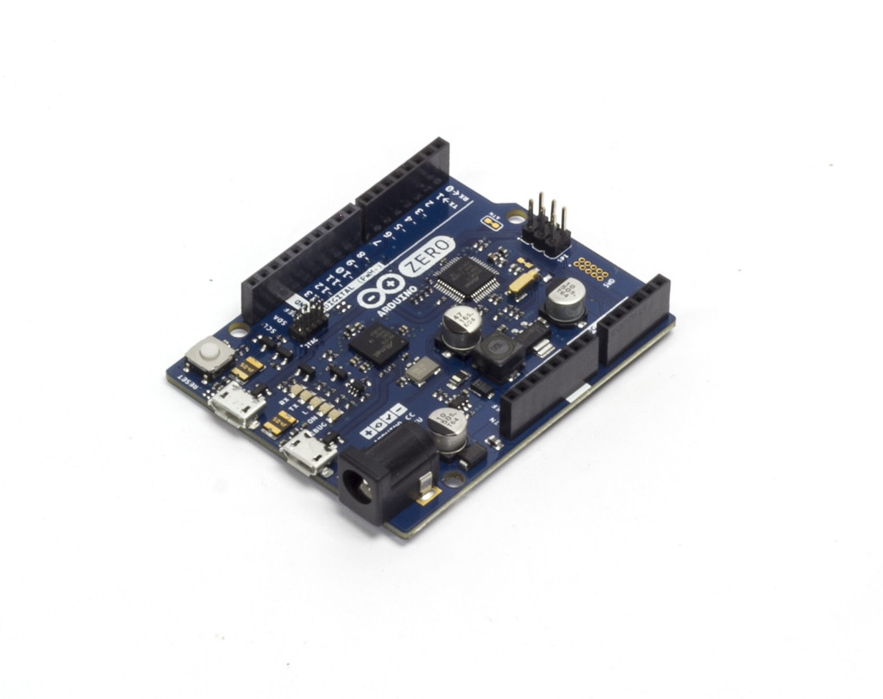
8) DIY & create something
Image credits: MaKey MaKey
Image credits: Raspberry Pi by blogeee.net
http://www.flickr.com/photos/13815526@N02/6055754448/
Image credits: https://www.arduino.cc/
Notes:
Automated lawn watering systems
GPS unit
Home made juke boxes
Musical holiday light shows

Slide 20
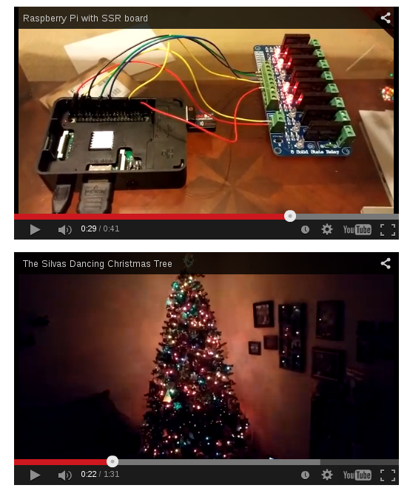
Image credits (and howto) - http://opensource.com/life/15/2/music-light-show-with-raspberry-pi

Slide 21

9) Join an open source project
Repositories: Github, SourceForge
Wanted:
project managers
designers
writers
marketers
other skills
and yes...coders
Image credits: http://opensource.com/life/12/3/its-scary-join-open-source-project

Slide 22
10) Attend a conference (and meet some people)
National Day of Civic Hacking – Durham, NC (June)
CityCamp NC – Raleigh, NC (September)
All Things Open – Raleigh, NC (October)
NC Datapalooza – Raleigh, NC (November)

Slide 23

All Things Open
October 26-27 | Raleigh Convention Center | allthingsopen.org
Image credits: http://allthingsopen.org/

Slide 24
Image credits: http://www.flickr.com/photos/opensourceway/5752191750/

Slide 25

Twitter: @jhibbets
Email: jhibbets@redhat.com
or: jhibbets@gmail.com
Slides: https://github.com/jhibbets/presentations
Book: http://theopensourcecity.com
Image credits: http://www.flickr.com/search/?w=47691521@N07&q=lolcat

