Slide 2
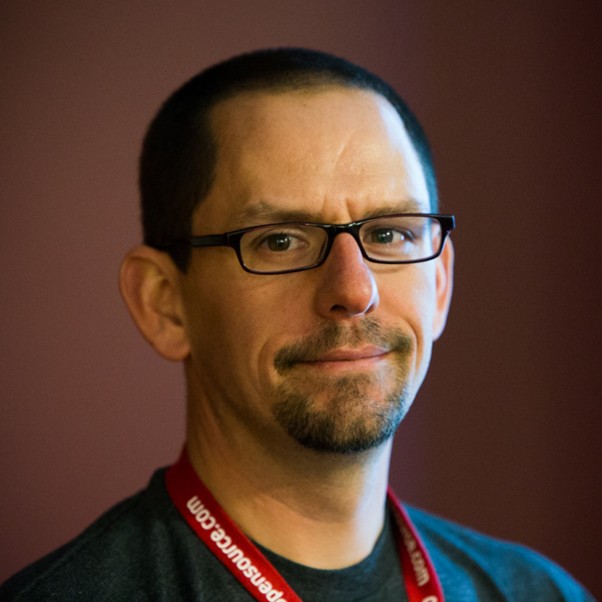
Welcome, Jason Hibbets
CityCamp NC co-chair

Slide 3
Taste of CityCamp NC

Slide 4
Taste of CityCamp NC
Code for Durham
Code for Greensboro
Code for Raleigh
Intro to open data

Slide 5
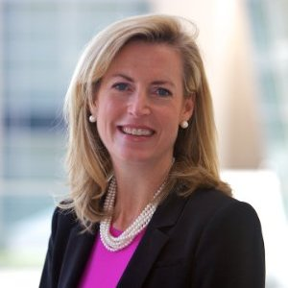
Lightning talks
Emcee, Carolina Sullivan

Slide 6
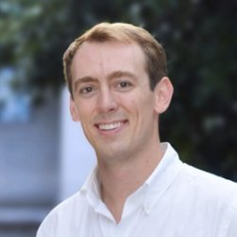
Lightning Talk:
Jay Dawkins
Baby Pics, Citizen
Engagement, Cat Pics

Slide 7
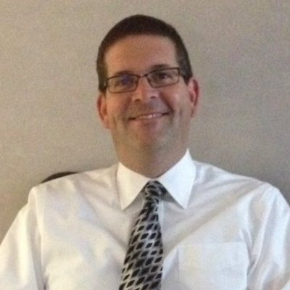
Lightning Talk:
Bill Scanlon
Get a little help from your friends – A way to find solutions with community input

Slide 8
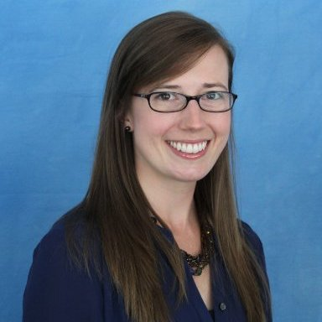
Lightning Talk:
Rebecca Tippett
Diversity in the Triangle: Insights from Census Data

Slide 9
Intermission

Slide 10
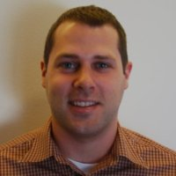
Lightning Talk:
David Green
Introducing Chapel Hill
Open Data

Slide 11
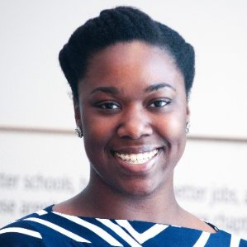
Lightning Talk:
Tia Bethea
What does the digital divide look like in the Triangle?

Slide 12
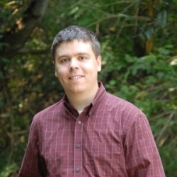
Lightning Talk:
Jason Baker
Making zoning changes consumable with maps and charts from open data

Slide 13
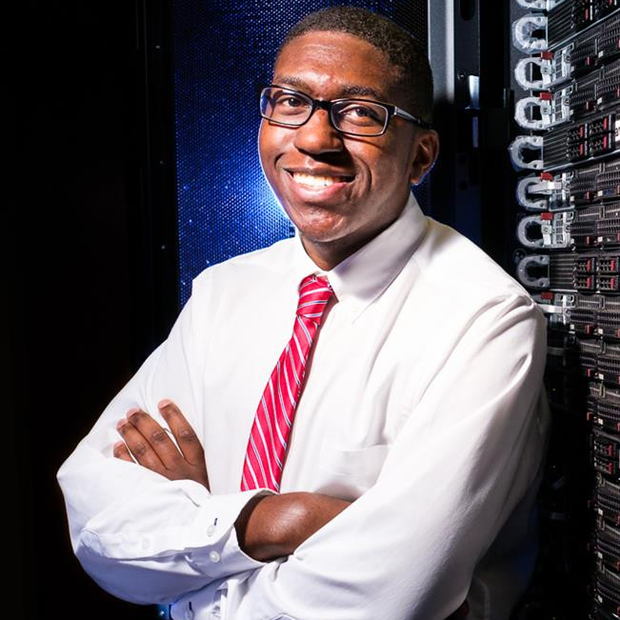
Lightning Talk:
Richard Marshall
Digital Inclusion Efforts in the City of Raleigh

Slide 14
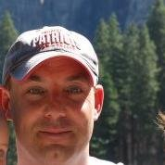
Lightning Talk:
James Alberque
Invisions Raleigh

Slide 15
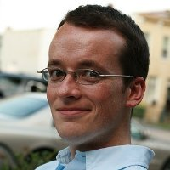
Lightning Talk:
Andrew Turner
Space-Time Visualizations and You

Slide 16
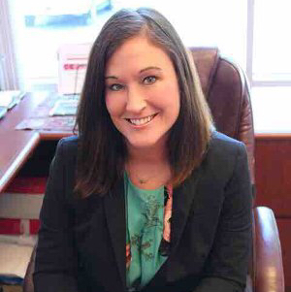
Lightning Talk:
Allison Warren-Barbour
Ending Poverty through Virtual Reality

Slide 17
Thank you!
Networking at
The London Bridge Pub
110 E. Hargett Street, Raleigh, NC

Slide 18
Friday

Slide 19
Welcome to
CityCamp NC

Slide 20
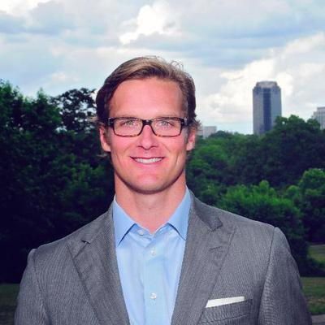
Welcome
Bonner Gaylord

Slide 21
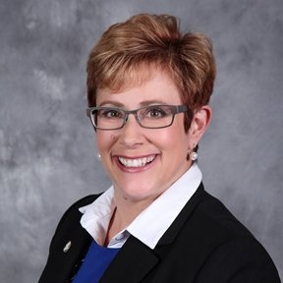
Emcee
Lori bush

Slide 22
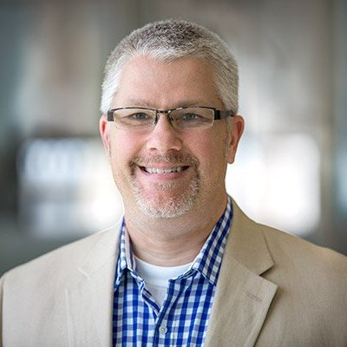
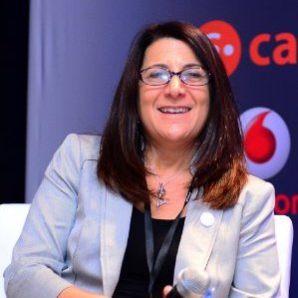
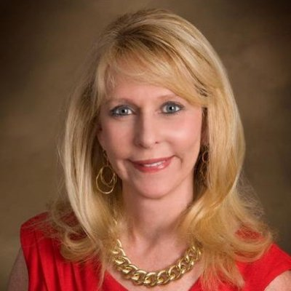
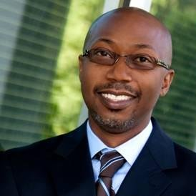
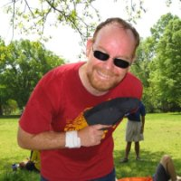
CIO Panel
Bill Greeves, Wake County
Leah Kraus,
NC Central
Jane Nickles, Greensboro
Darnell Smith,
City of Raleigh
Moderator, Dr. John B. Stephens, UNC School of Governance

Slide 23
Keynotes
&
Inspiration

Slide 24
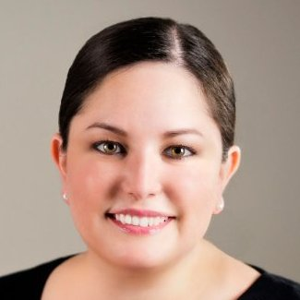
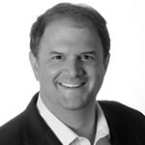
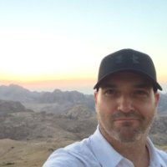
Inspiration
Amy Gaskins
Founder at Panopticon, Inc.
Erik Garr
Regional Manager – Google Fiber, Google
John Yaist
EDN Technology Evangelist at Esri

Slide 25
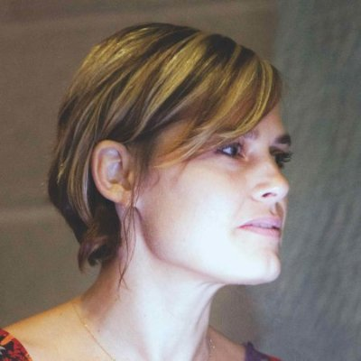
Keynote
Jen Pahlka
Founder and Executive Director,
Code for America

Slide 26
What's a good pitch?

Slide 27
Unconference

Slide 28
Thank you!
Networking social
at BuKu
110 E Davie St, Raleigh, NC

