Slide 1
OPEN SOURCE VS OPEN DATA
Jason Baker | @jehb
Triangle Open Data Day
February 22, 2013

Slide 2
Open is better.

Slide 3

Open source software
Image credits: http://www.flickr.com/photos/opensourceway/7496801912/

Slide 4

Open government
Image credits: http://www.flickr.com/photos/opensourceway/4459199503/in/set-72157625738142672

Slide 5

Open data
Image credits: http://www.flickr.com/photos/opensourceway/5538036200/

Slide 6

Open source is like a recipe
Image credits: http://opensource.com/life/12/12/open-source-pumpkin-spice-latte

Slide 7

Open source model of participation
Transparency
Collaboration
Rapid prototyping
Meritocracy
Passion

Slide 8

Transparency
Image credits: http://www.flickr.com/photos/opensourceway/7496800772/

Slide 9

Collaboration
Image credits: http://www.flickr.com/photos/opensourceway/4404008626/

Slide 10

Rapid prototyping
Image credits: http://www.flickr.com/photos/opensourceway/5041738335/

Slide 11

Meritocracy
Image credits: http://www.flickr.com/photos/opensourceway/4426824995/

Slide 12

Passion
Image credits: http://www.flickr.com/photos/opensourceway/5752191750/

Slide 13
Open source is a better way
Transparency → accountability
Collaboration → innovative ideas
Rapid prototyping → failing faster
Meritocracy → best ideas, buy-in
Passion → commitment

Slide 14

More than a development model

Slide 15

Beyond software

Slide 16
Open data
Image credits: http://www.flickr.com/photos/opensourceway/5538036200/

Slide 17
Open data
Data that can be freely used, reused, and redistributed by anyone
Availability and access
Reuse and redistribution
Universal participation
http://opendatahandbook.org

Slide 18
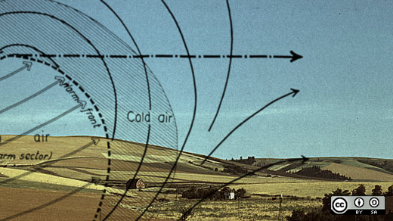
NOAA
Image credits: http://www.flickr.com/photos/47691521@N07/4370250533/

Slide 19
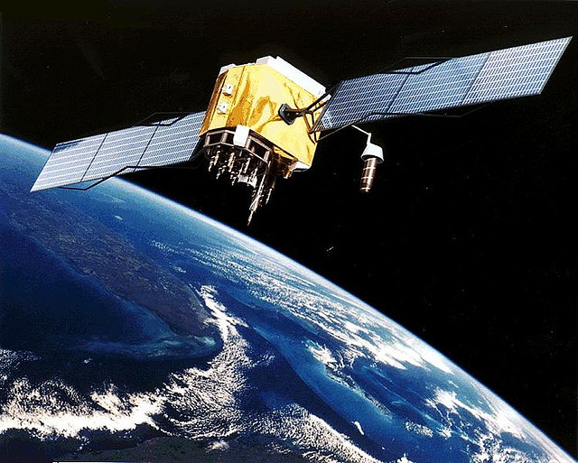
GPS
Image credits: http://www.flickr.com/photos/vthokiefans/3147647393/

Slide 20
Open source vs open data
Process
Collaboration
Participation
Access
Transparency
Enablement
http://opendatahandbook.org

Slide 21

Open source is a better way
Image credits: http://www.flickr.com/photos/opensourceway/5751540267/

Slide 22

Email:
Twitter: @jehb
Image credits: http://www.flickr.com/search/?w=47691521@N07&q=lolcat

Slide 23

Who thinks government is this?
http://opensource.com/sites/default/files/imagecache/image-full-size/images/education/gov_vending.png

Slide 24

Beyond voting
http://www.flickr.com/photos/opensourceway/5537457791/in/set-72157628737085119

Slide 25

Beyond coding
http://www.flickr.com/photos/opensourceway/4581225603/in/set-72157623343008011/

Slide 26

Creating a community
http://www.flickr.com/photos/opensourceway/8516817076/in/photostream

