Slide 1
10 ways to get started with open source
RTP 180
Jason Hibbets, Red Hat
Opensource.com
September 17, 2015

Slide 2

1) Everyday productivity
Image credits: http://www.flickr.com/photos/opensourceway/8296581995/in/photostream

Slide 3
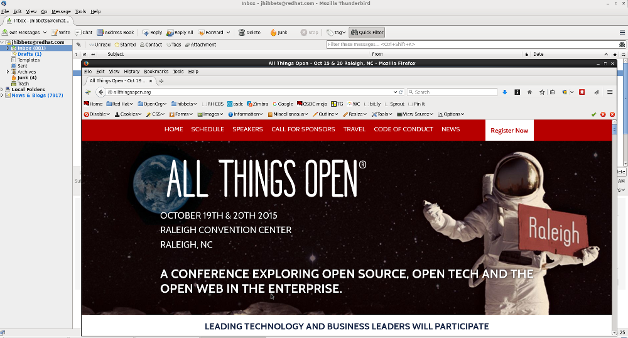
Thunderbird & Firefox from Mozilla
Image credits: Jason Hibbets desktop

Slide 4

Office suite – Libre Office
Image credits: http://www.libreoffice.org/

Slide 5

2) Read a book about open source
The Cathedral and the Bazaar, by Eric S. Raymond
Free Software, Free Society, by Richard M. Stallman
Rebel Code, by Glyn Moody
Producing Open Source Software, by Karl Fogel
Image credits: http://www.1000manifestos.com/eric-raymond-the-cathedral-and-the-bazaar/

Slide 6

Image credits: http://theopensourcecity.com

Slide 7

https://opensource.com/open-organization/ | #TheOpenOrg
Image credits: https://opensource.com/open-organization/

Slide 8
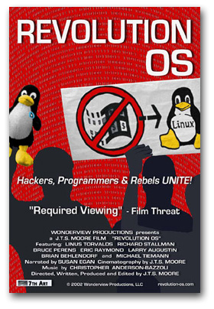
3) Watch a movie
www.revolution-os.com

Slide 9
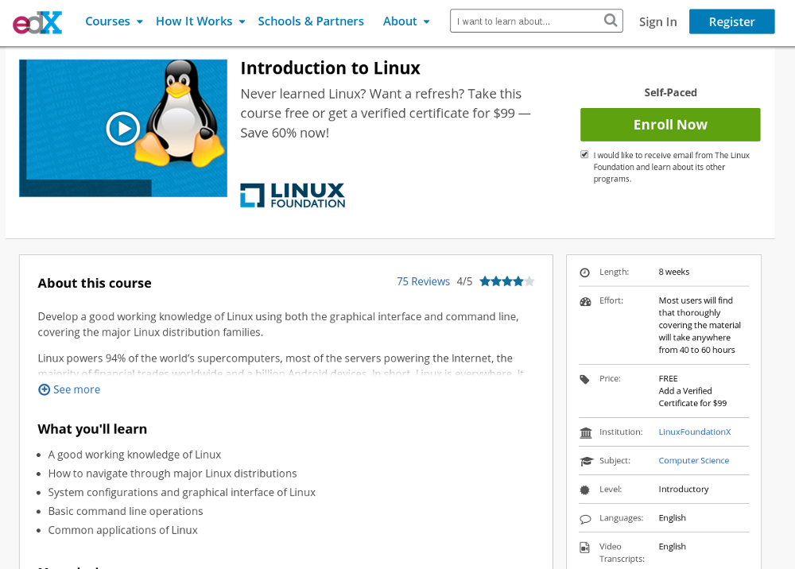

4) Take a class on Linux
Screenshot credits: https://www.edx.org/course/introduction-linux-linuxfoundationx-lfs101x-2#.U_9_rEhy-Cg
Image credits: http://opensource.com/business/14/8/newbie-learns-linux

Slide 10
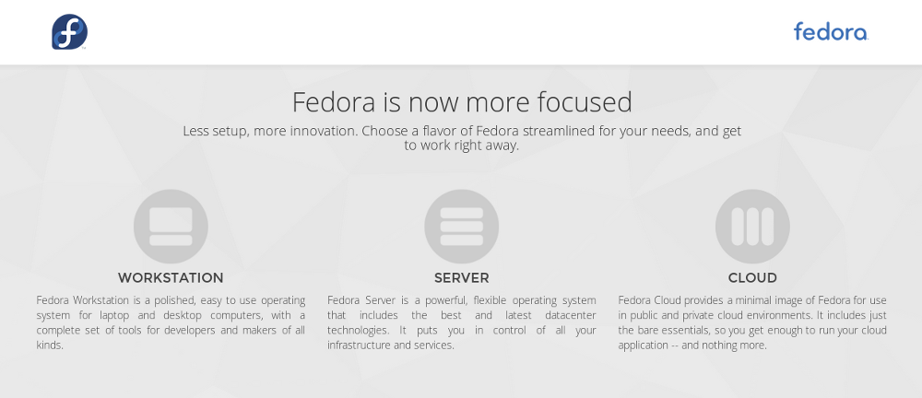
5) Install Linux
https://getfedora.org/en/
Screenshot credits: https://getfedora.org/en/

Slide 11
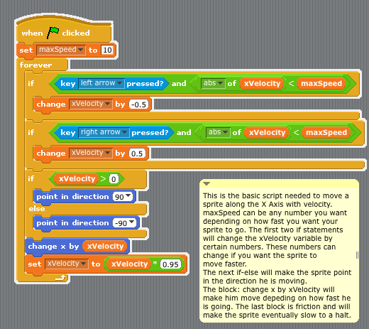
6) Learn to program
Scratch, a programming language for kids
http://opensource.com/education/12/10/scratch-programming-language-kids
Image credits: http://en.wikibooks.org/wiki/Scratch/Lessons/Movement
Notes:
Girl Develop IT
CoderDojos

Slide 12
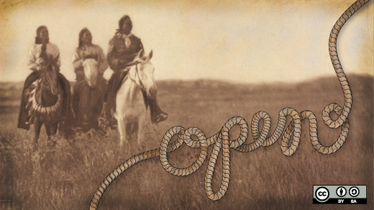
7) Get creative
GNU Image Manipulation Program (GIMP)
Scribus
MyPaint
Inskape
Audacity
Blender
Dream Studio
TuxPaint
KDEnlive
A look back at open source creative tools in 2012
http://opensource.com/life/13/1/open-source-design-tools-review-2012

Slide 13
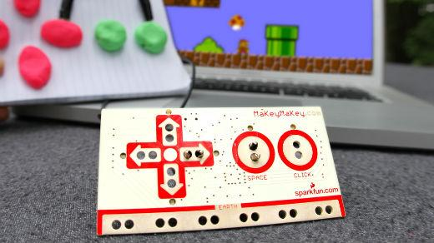
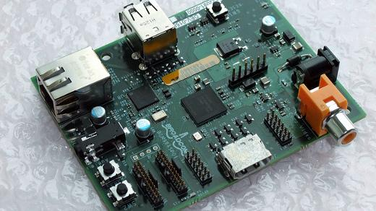
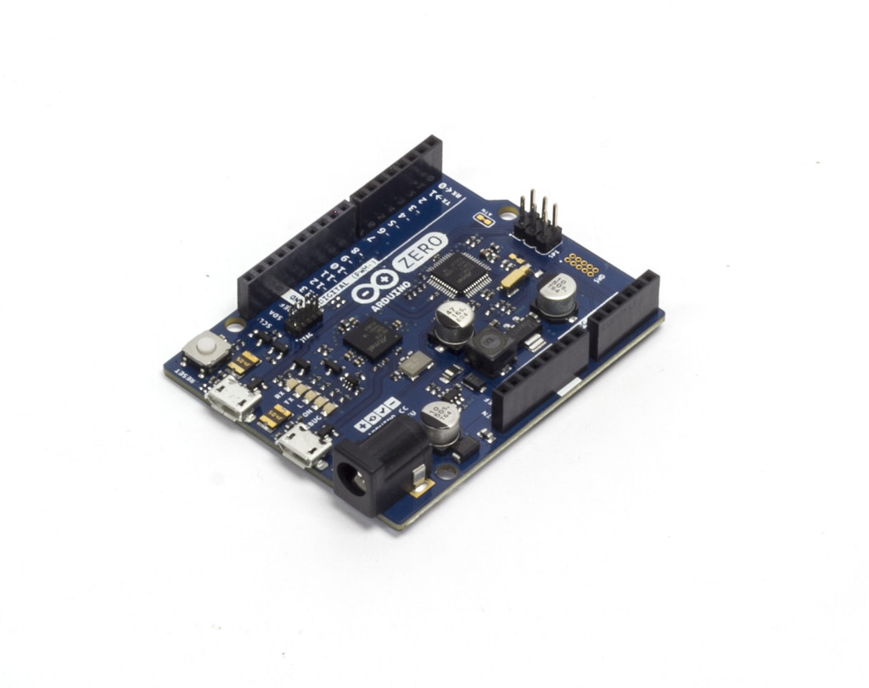
8) DIY & create something
Image credits: MaKey MaKey
Image credits: Raspberry Pi by blogeee.net
http://www.flickr.com/photos/13815526@N02/6055754448/
Image credits: https://www.arduino.cc/
Notes:
Automated lawn watering systems
GPS unit
Home made juke boxes
Musical holiday light shows

Slide 14
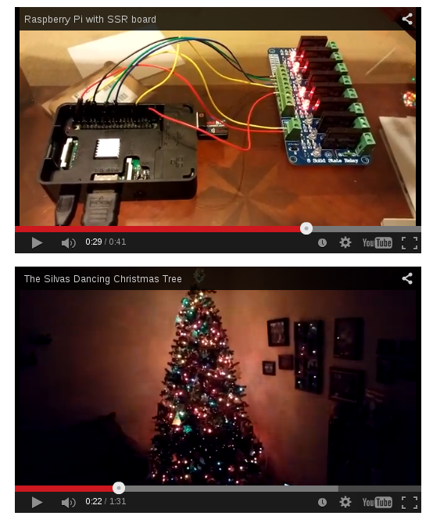
Image credits (and howto) - http://opensource.com/life/15/2/music-light-show-with-raspberry-pi

Slide 15

9) Join an open source project
Repositories: Github, SourceForge
Wanted:
project managers
designers
writers
marketers
other skills
and yes...coders
Image credits: http://opensource.com/life/12/3/its-scary-join-open-source-project

Slide 16
10) Attend a conference (and meet some freakin' people)
NC Datapalooza – Raleigh, NC (September 21)
All Things Open – Raleigh, NC (October 19-20)
NC FOSS Fair – Raleigh, NC
POSSCON – Columbia, SC
CityCamp NC – Raleigh, NC

Slide 17

NC Datapalooza
September 21, 2015
5:30 – 8:00 pm
Red Hat Annex
3 team competing:
Open 511
BernieSez
Points of Note
Image credits: http://www.ncdatapalooza.com/
Notes:
Rob Burns, CEO of Predictify.me
Nicole Raimundo, CIO for the Town of Cary
Keynote Speaker – Lee Congdon, CIO at Red Hat

Slide 18

All Things Open
October 19-20 | Raleigh Convention Center | allthingsopen.org
Image credits: http://allthingsopen.org/

Slide 19

Image credits: http://www.flickr.com/photos/opensourceway/5752191750/

Slide 20

Twitter: @jhibbets
Email: jhibbets@redhat.com
or: jhibbets@gmail.com
Slides: https://github.com/jhibbets/presentations
Book: http://theopensourcecity.com
Image credits: http://www.flickr.com/search/?w=47691521@N07&q=lolcat

