Slide 1
The power of community
Jason Hibbets
Opensource.com community manager, Red Hat
Code for Raleigh brigade captain
CityCamp NC co-chair
Evergreen International Conference
April 21, 2016
Notes:
Brief intro – Describe your role
follow @opensourceway @codeforraleigh
Tweet questions

Slide 2

Improve the citizen experience
Credit: http://opensource.com/government/13/8/citizen-cio
Notes:
Mission: Improve the citizen experience
Gov't more engaging, participatory
Create an environment for people to do amazing things

Slide 3

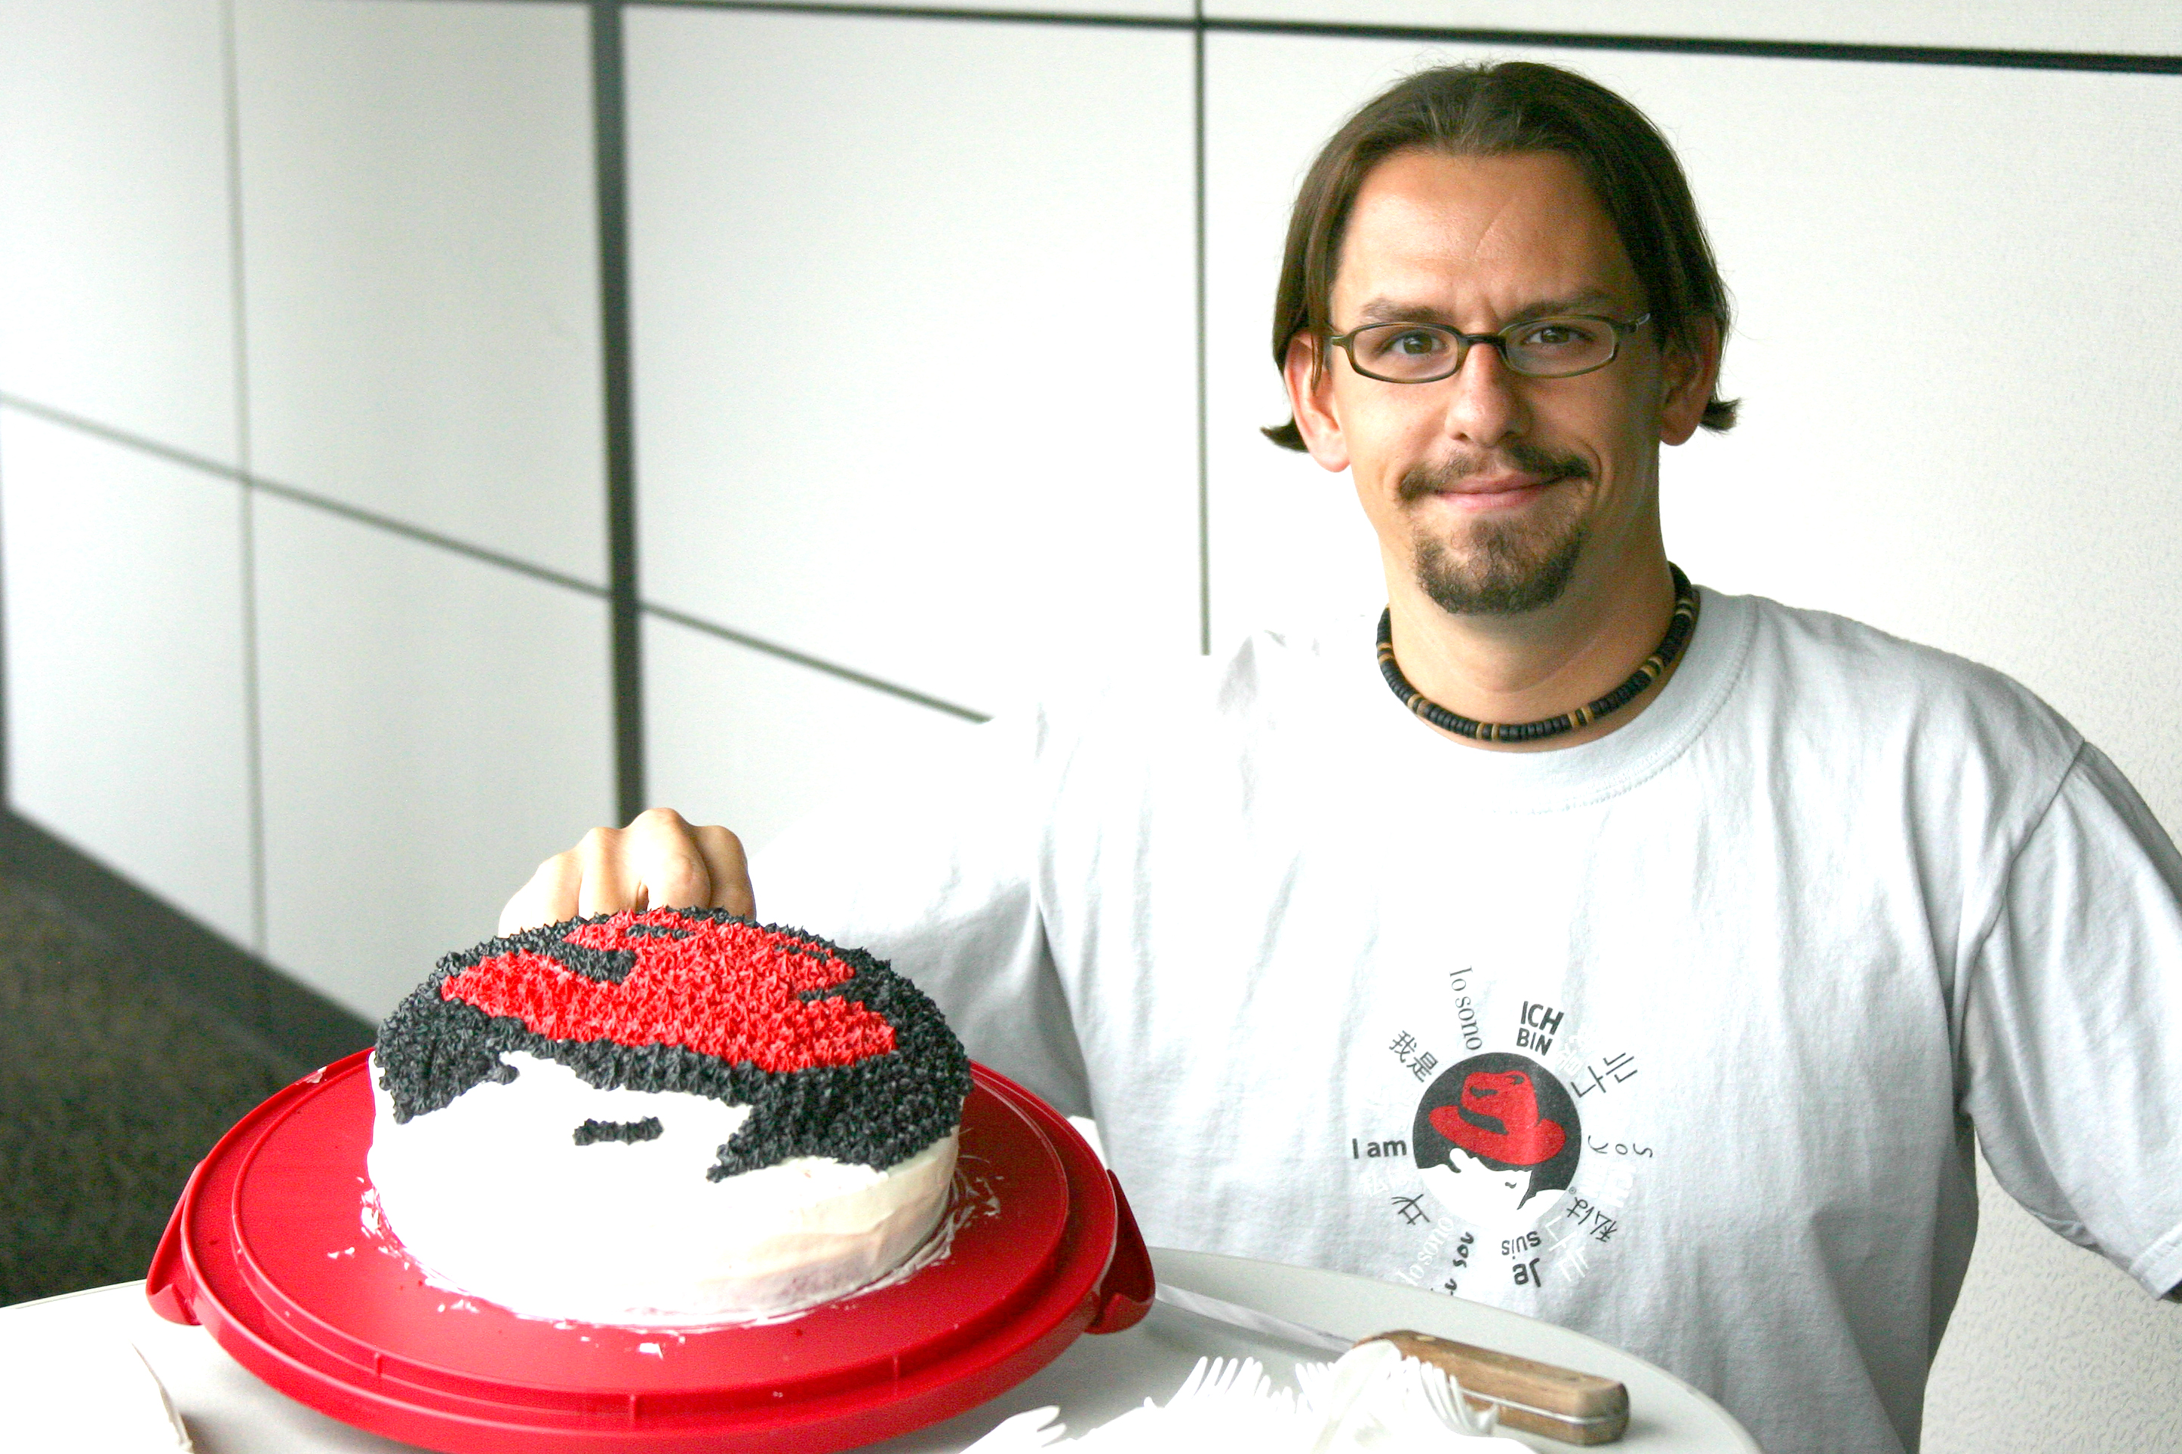
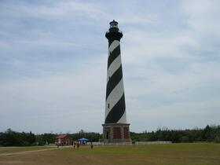

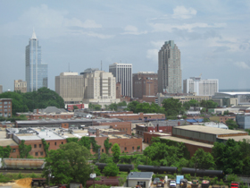
My journey
Credit: Jonathon Opp, circa 2003
Sources: Wikipedia, hibbets.net, NC State, hibbets.net
Notes:
Describe how you got to NC, your role at Red Hat

Slide 4


Community + content
Notes:
Describe OSDC
Volunteer community moderators
1M page views in March

Slide 5

https://opensource.com/open-organization/ | #TheOpenOrg
Image credits: https://opensource.com/open-organization/
Notes:
My current role is to build community around The Open Organization book

Slide 6

Community
Credit: http://www.flickr.com/photos/opensourceway/4371000464/
Notes:
Hook:
Today I want to talk about the power of community and share a few things I've learned
3 communities:
Community watch
Code for America
Opensource.com

Slide 7
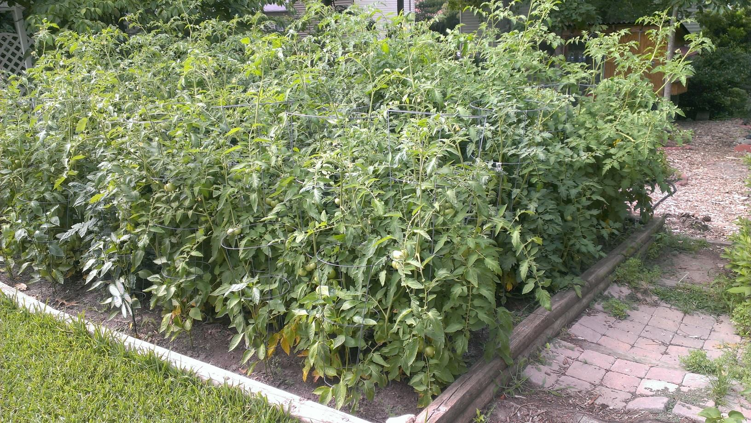
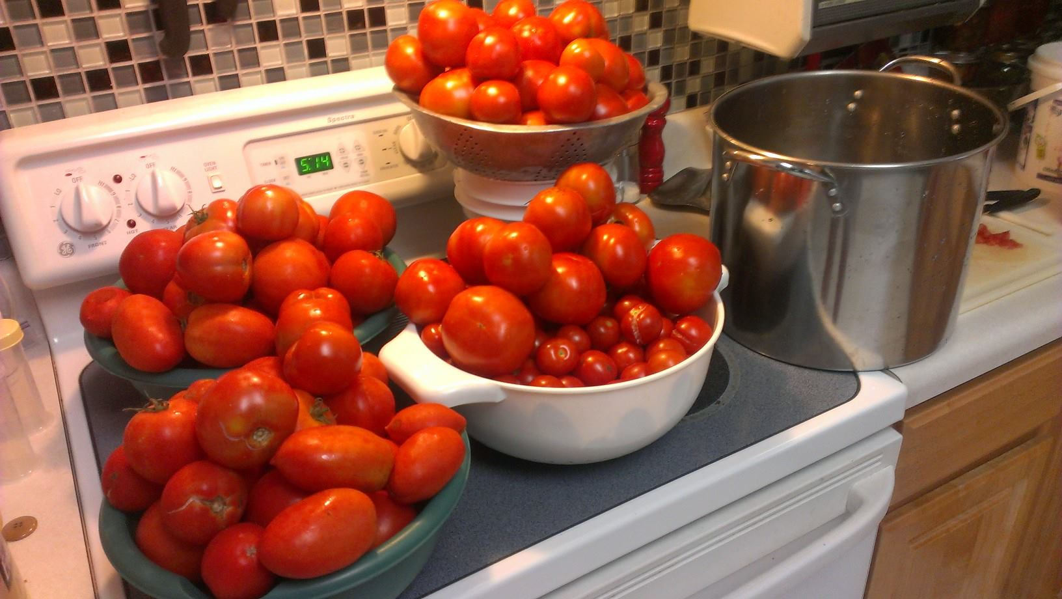
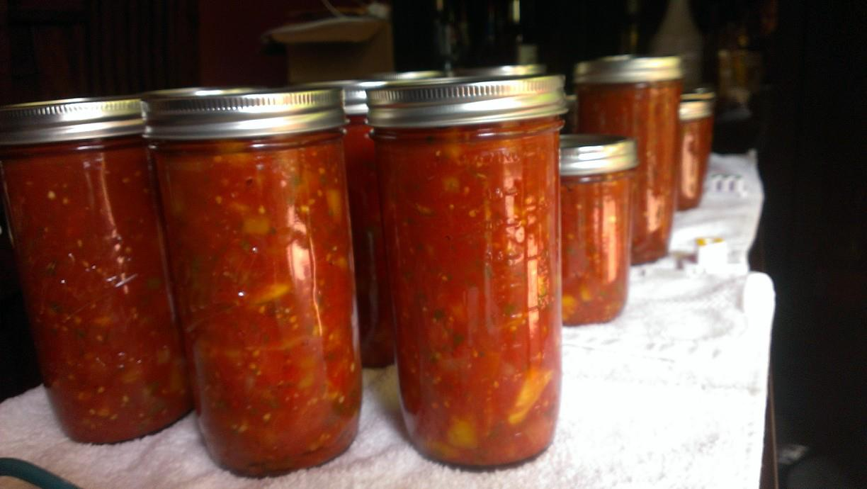
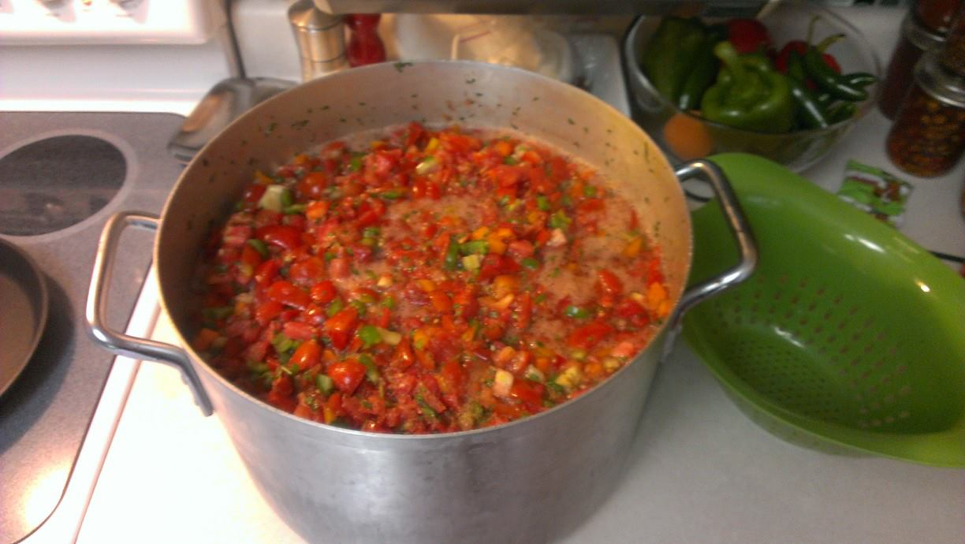
Credits: Jason Hibbets | http://hibbets.net
Notes:
Building a community is like planting a garden
What are you going to do with the fruits of your labor?

Slide 8

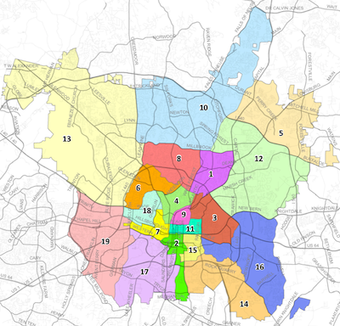
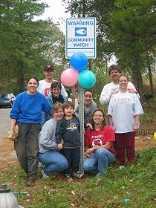
Credits: http://prr-watch.org | http://www.raleighnc.gov
Notes:
How we built a community:
Meetings
Events
Website
Mailing list
Citizen Advisory Councils
Chair for two years
Neighborhood college

Slide 9

Passion
Credit: http://www.flickr.com/photos/opensourceway/5752191750/
Notes:
Passion for
open source
civic participation
local community (Raleigh)
Community work > involved with government

Slide 10

Credit: http://opensource.com/sites/default/files/imagecache/image-full-size/images/education/gov_vending.png
Notes:
Most people view government like this
Put taxes in > services out

Slide 11

Credit: http://www.flickr.com/photos/opensourceway/4459199503/in/set-72157625738142672
Notes:
I discovered the open government / data movements

Slide 12

Beyond coding
Credit: http://www.flickr.com/photos/opensourceway/4581225603/in/set-72157623343008011/
Notes:
Apply skills as a project manager without coding
Aha moment: Organize people and events

Slide 13

WARNING: Objects in city government are more open than expected
Credit: http://hibbets.net
Notes:
Go back to early 2011. When the civic hacking movement in Raleigh / Triangle got its spark.

Slide 14

Sharing a story
Credit: http://opensource.com
Notes:
Describe the interview with Mayor Charles Meeker

Slide 15

Creating a brand
Credit: http://www.flickr.com/photos/opensourceway/5496629913/in/set-72157628737085119
Notes:
Idea/ vision to create a brand around “open source city”

Slide 16

Creating a community
Credit: http://www.flickr.com/photos/opensourceway/8516817076/in/photostream

Slide 17

The catalyst
Credit: http://citycampral.org
Notes:
Describe CityCamp

Slide 18

https://twitter.com/BonnerGaylord/status/43714934470746115
https://twitter.com/jhibbets/status/43715324276776960
Notes:
March 4, 2011.

Slide 19

Community of passion
Credit: http://citycampral.org
Notes:
A group of citizens, including one of our city councilors came together plan the first CityCamp Raleigh.

Slide 20

An open government unconference
Credit: https://www.facebook.com/CityCampRal/photos_stream
Notes:
Explain the format

Slide 21


Evolving CityCamp
Credits: http://citycampnc.org | http://codeforamerica.org
Notes:
Explain how we are evolving the brand

Slide 22


Soooo 2014:
Credit: Carsi Tong
Notes:
Explain the new logo

Slide 23

RGreenway
Credit: RGreenway – http://RGreenway.com

Slide 24

A Peace Corp for geeks
Credit: http://codeforamerica.org/
Notes:
Explain Code for America

Slide 25

Boston: Adopt-a -Hydrant
Credit: http://www.adoptahydrant.org/

Slide 26

Seattle: Adopt-a-storm drain
Credit: http://www.seattle.gov/util/EnvironmentConservation/GetInvolved/AdoptaDrain/Adopt-a-DrainSignup

Slide 27

Honolulu: Adopt-a-siren
Credit: http://sirens.honolulu.gov/

Slide 28
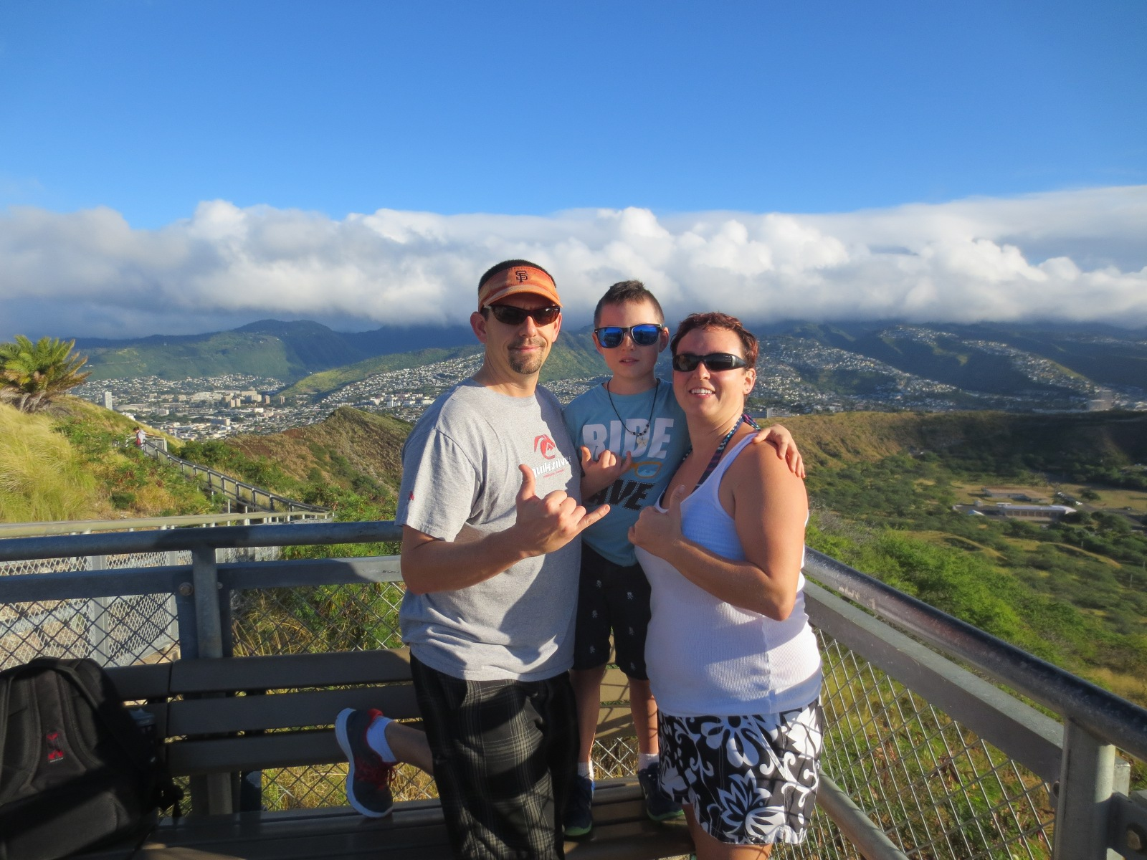
Since we’re talking about Hawaii...
Credit: http://hibbets.net

Slide 29
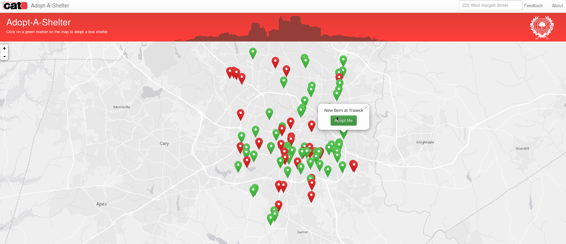
Raleigh: Adopt-a-shelter
Credit: http://openmaps.raleighnc.gov/adoptashelter/

Slide 30

Beyond voting
Credit: http://www.flickr.com/photos/opensourceway/5537457791/in/set-72157628737085119
Notes:
Improving the citizen experience!
“Never doubt that a small group of thoughtful, committed people could change the world. Indeed, it's the only thing that ever has.” Margaret Mead - cultural anthropologist

Slide 31

Code for Raleigh
Credit: http://brigade.codeforamerica.org/
Notes:
The program that Code for Raleigh is part of is the Code for America brigade.
It allows volunteers like myself and my fellow captains to help our local city through civic hacking in partnership with our city officials.
Explain how CityCamp Raleigh group became Code for Raleigh

Slide 32

Triangle Code for America Division
Join in: http://www.meetup.com/Triangle-Code-for-America/
Credit: http://brigade.codeforamerica.org/
Notes:
Code for Durham, Code for Cary
Captains meet on a regular basis to keep in sync
Meet-ups for projects
Events for code sprints and hackathons

Slide 33
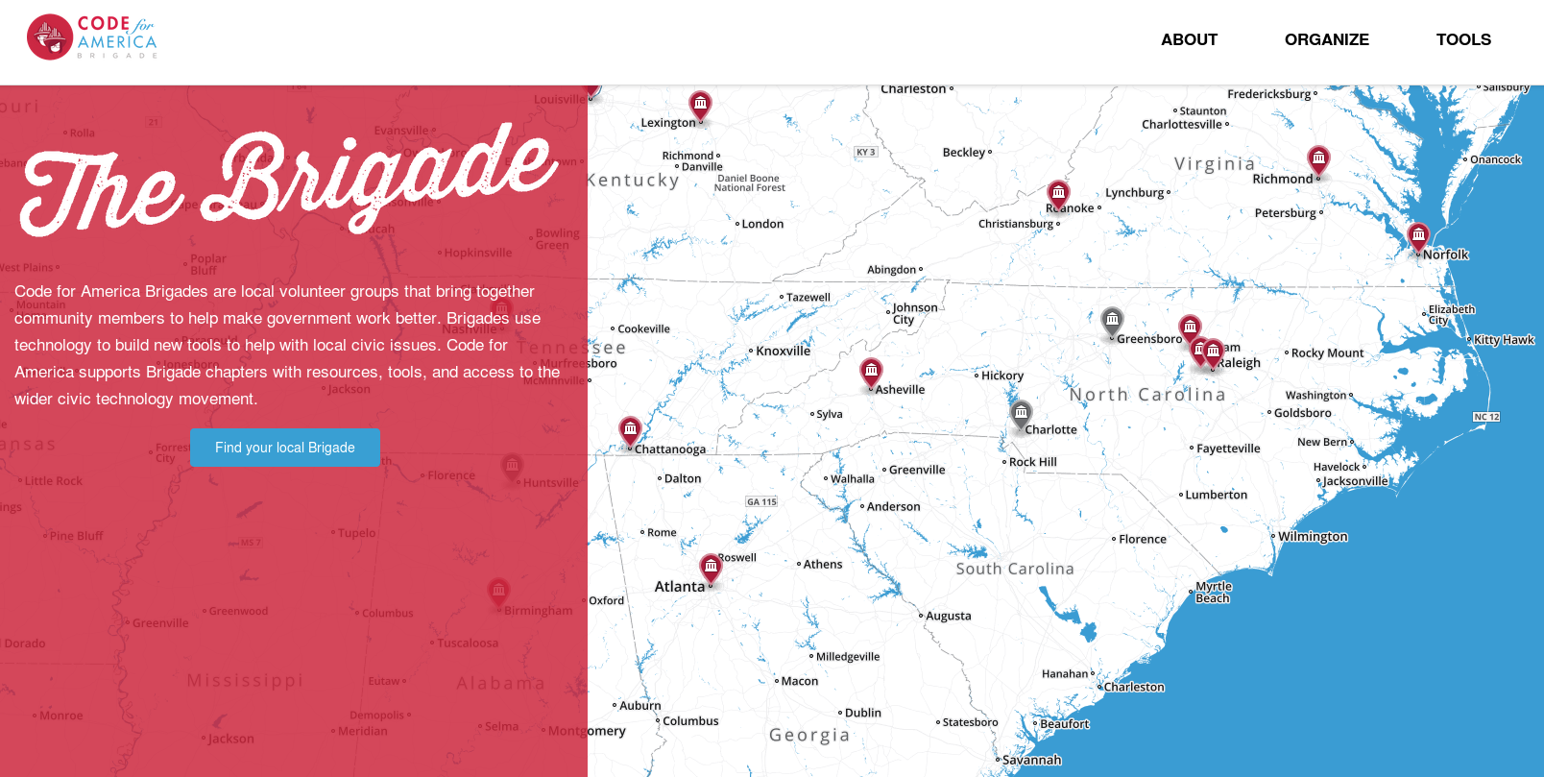
Code for North Carolina
Credit: http://brigade.codeforamerica.org/
Notes:
Explain the expanding ecosystem in NC
Snapshot of the southeast, brigades all over the US and the world
Get involved!

Slide 34
Code for NC Summit
NC Datapalooza
Code for Raleigh
Code for Greensboro
Code for Charlotte
Code for Durham
Code for Cary
Code for Asheville
Open data day
Notes:
Vision for CityCamp NC
2011 - present

Slide 35




NC Open Pass
Your pass to four open government, open data, and other innovative events around the Triangle.
Triangle Open Data Day
Two exciting days of talks and workshops at NC State's Centennial Campus on March 5-6, 2016.
National Day of Civic Hacking
Get ready to "hack for change" with Code for America on June 6, 2016.
CityCamp NC
Annual event bringing citizens, government, and businesses together to openly innovate and improve our quality of life through technology.
NC Datapalooza
An open-data startup competition to catalyze positive community and economic impact with coaching and cash prizes
Credit: http://ncopenpass.com
Notes:
Launched NC Open Pass in 2016

Slide 36


theopensourcecity.com
Credit: http://theopensourcecity.com/
Notes:
My experience with open gov't inspired me to write a book
Has anyone here written a book?
Indeogogo campaign
Self-publish via Lulu.com

Slide 37
Elements of an open source city
Culture/participation
Open government policy
Open data policy
Open source conferences & user groups
Economic development
theopensourcecity.com
Notes:
The 5 elements

Slide 38
Community
Credit: http://www.flickr.com/photos/opensourceway/4371000464/
Notes:
Transition from Code for America / Code for Raleigh -> Opensource.com

Slide 39
Community + content
Notes:
OSDC is a community driven by content, powered by stories from the open source community
3 things:
Mission
Programs
Tools

Slide 40

Discover an open world
Credit: Red Hat & Opensource.com
Notes:
thought-leadership in open source
building a community since January 2010

Slide 41
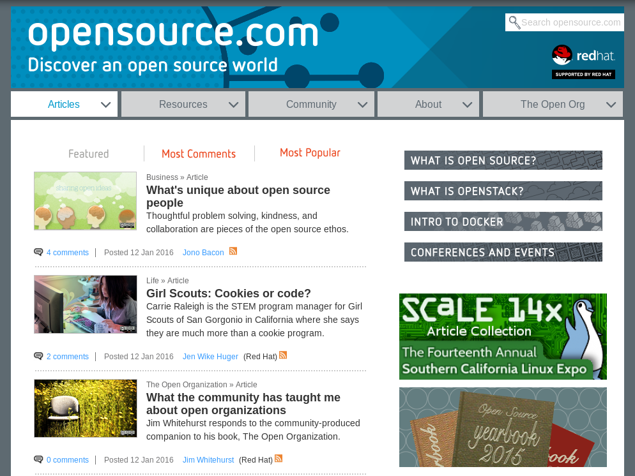

Slide 42

Build the world’s premier storytelling platform
Credits: http://www.flickr.com/photos/opensourceway/7496801912/
Notes:
catalyst for the open source community
collects stories
editorial services
platform to share stories
news: daily stories
Resources: discover open source

Slide 43
Open source is a better way
Transparency → accountability
Collaboration → innovative ideas
Participation → more eyes, ideas
Rapid prototyping → failing faster
Meritocracy → best ideas, buy-in
Passion → commitment

Slide 44

Credit: Red Hat
Notes:
Describe the Open Source Way philosophy

Slide 45



The team
Jen Alex Rikki Jason
Bryan
Notes:
Well-oiled machine that operates like a start-up

Slide 46

Programs
Notes:
Programs ... how we are building community

Slide 47
Programs: Our audience
High touch, high impact
Moderators
Writers-list =
opportunities
Curate based
on results
Repeat
guest writers
One-time guest writers
Readers, comments, & sharers
Notes:
This is an example of how we view our audience and our community of writers.
webform
one-time post
Writers-list (250) > discussion list

Slide 48



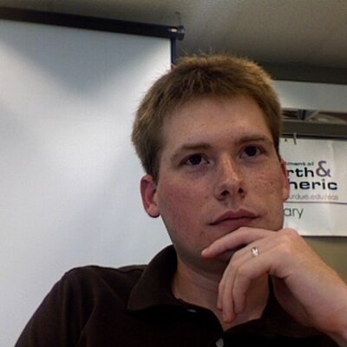


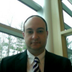







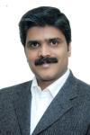

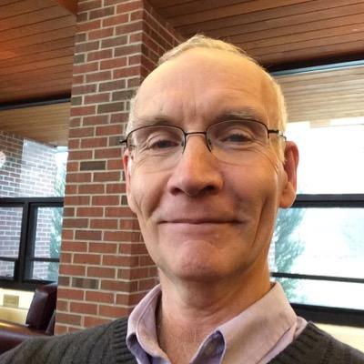
Programs: Meet the moderators
More details at: http://opensource.com/community-moderator-program
Notes:
This is the foundation of our community.
gifts to moderators
trip to All Things Open

Slide 49

Programs: Create a win-win
Notes:
Match needs of community with programs

Slide 50

Programs: Awards and badges
Newbie / 0-9 points
Community Member / 10-29
Open Enthusiast / 30-99
Open Minded / 100-499
Open Source Evangelist / 500-999
Open Source Champion / 1,000-2,499
Open Source Sensei / 2,500-4,999
Open Sourcerer / 5,000-9,999
Star / 10,000-24,999
Notes:
awards
points and badge system

Slide 51

Tools
Notes:
What does our quiver of tools look like to get the job done for Opensource.com?

Slide 52
Tools: The quiver
Drupal
Etherpad
Google Docs
Mojo (Internal documentation)
Omniture/Adobe
Trello
Moz
Eloqua
Sprout Social
Hootsuite
Email, lots of email
Mailing lists
IRC (Internal relay chat)
Social media: Twitter, Facebook, Google+, LinkedIn

Slide 53

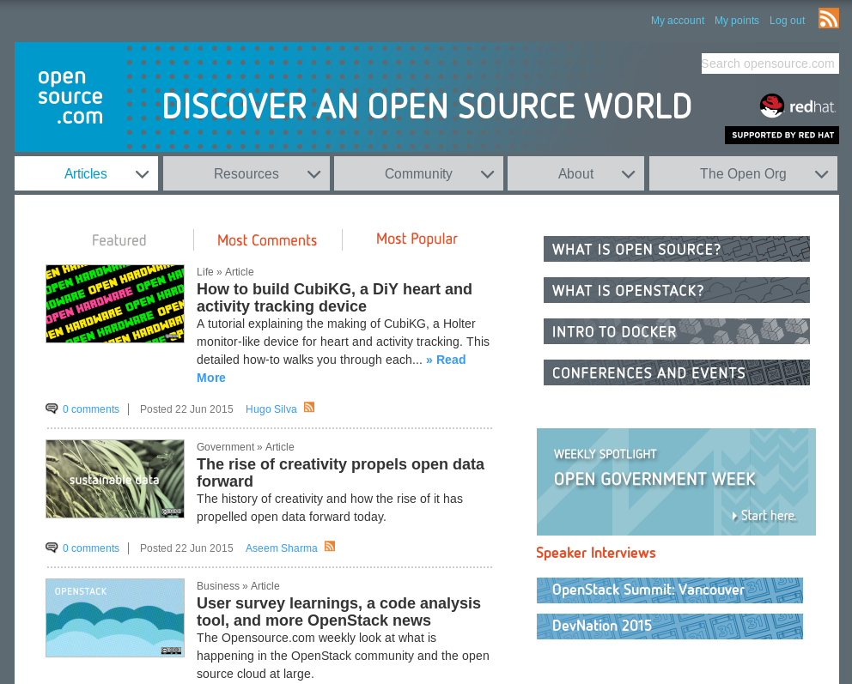
Tools: Drupal -Content Management
Notes:
Drupal
Vs Wordpress, Plone, Joomla

Slide 54

Tools: Omniture - Tracking
Notes:
Omniture (Google Analytics)

Slide 55

Tools: Etherpad - collaborative pads
Notes:
Etherpad is a light-weight Google Doc

Slide 56
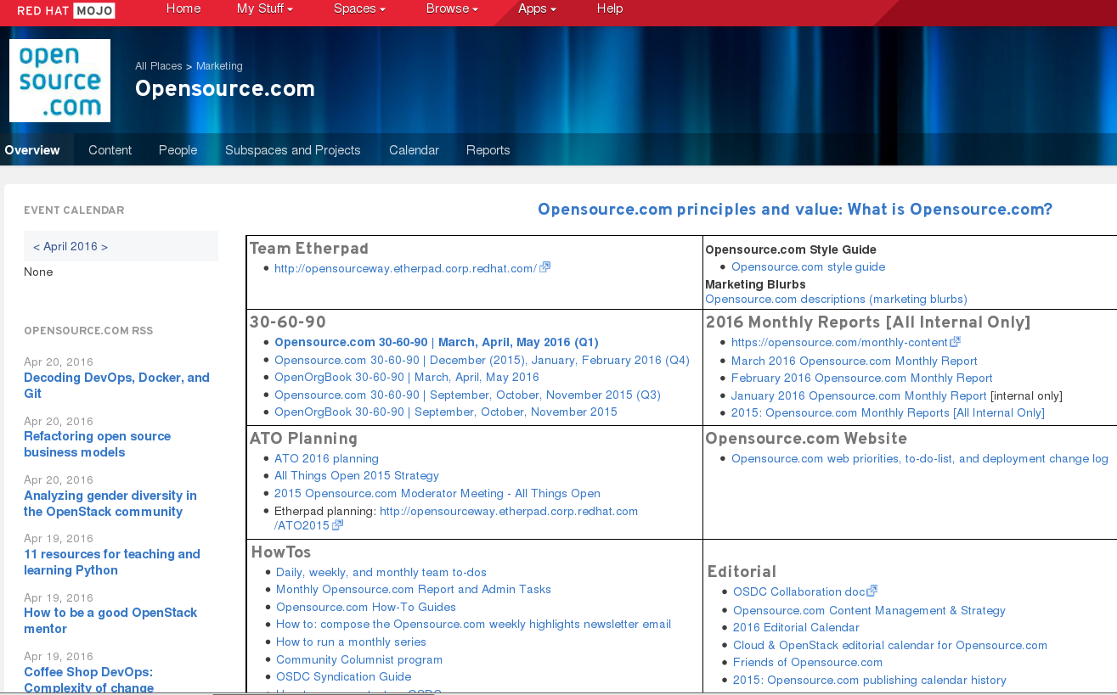
Tools: Internal documentation
Notes:
Mojo (from Jive)
Document, document, document

Slide 57

Tools: Moz
Notes:
Moz, formerly SEO moz
keyword rankings
site errors

Slide 58
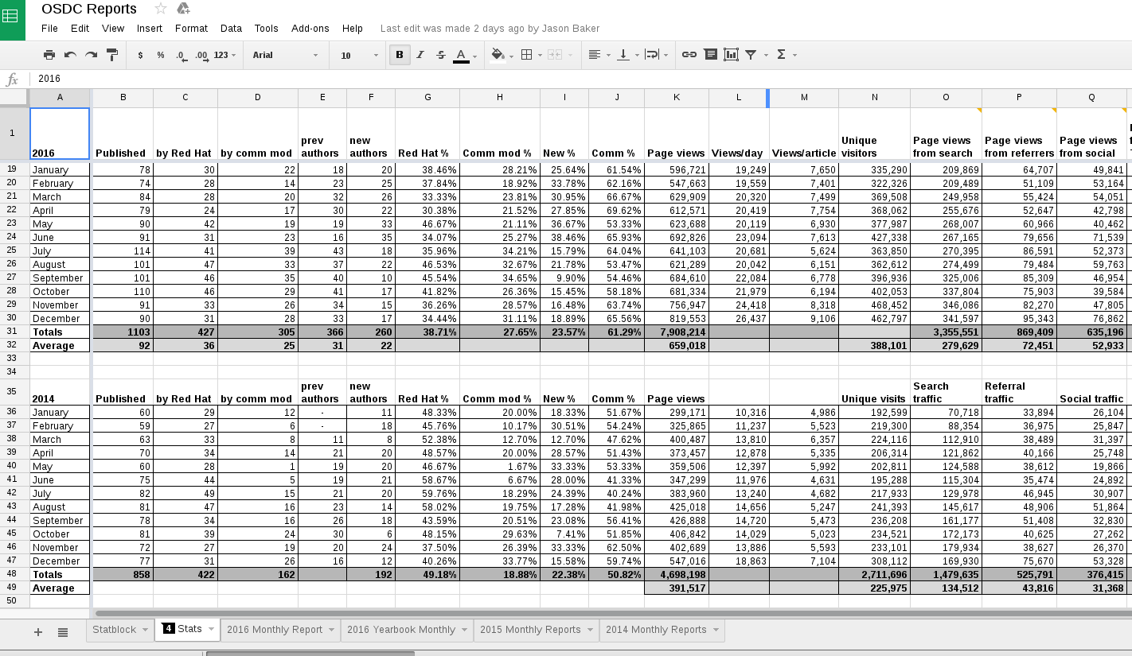
Tools: Google Docs: Tasks, stats
Notes:
Google Docs

Slide 59
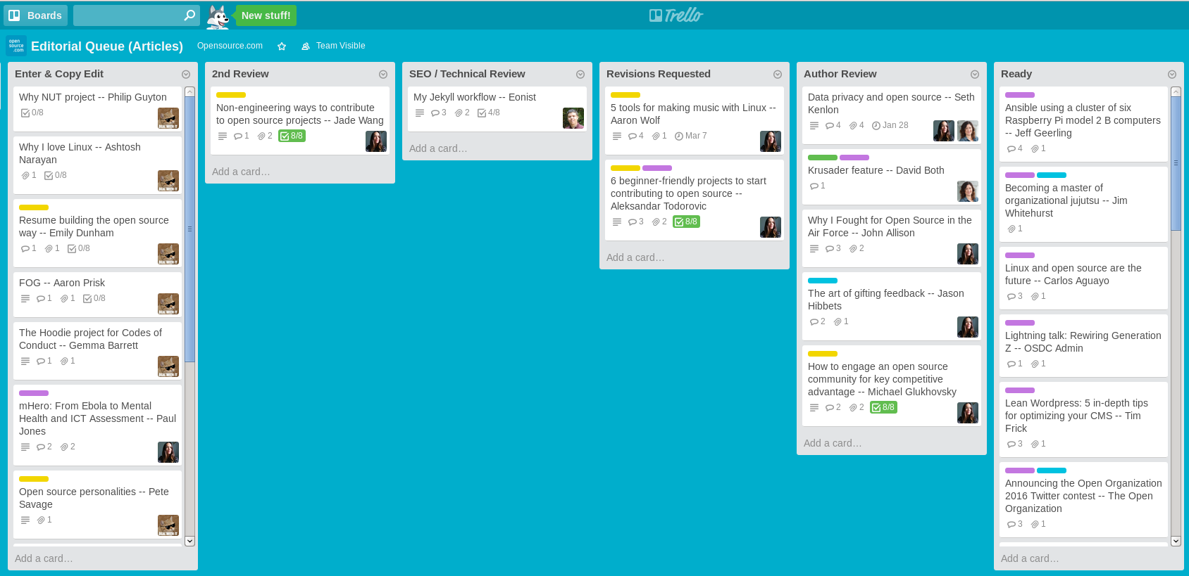
Tools: Trello
Notes:
Etherpad is a light-weight Google Doc

Slide 60

Results
Notes:
This was just a brief deep-dive into some of the tools that makes my team successful. Now let’s take a look at some of the results we track.

Slide 61
Results: Content
65%
Notes:
65% of our content comes from the open source community
25% of our content comes from our moderators

Slide 62

Results: Referral traffic
Notes:
Over 50% is from search
10-15% from social media

Slide 63

Results: Search keywords
Notes:
Topped ranked keywords for content

Slide 64
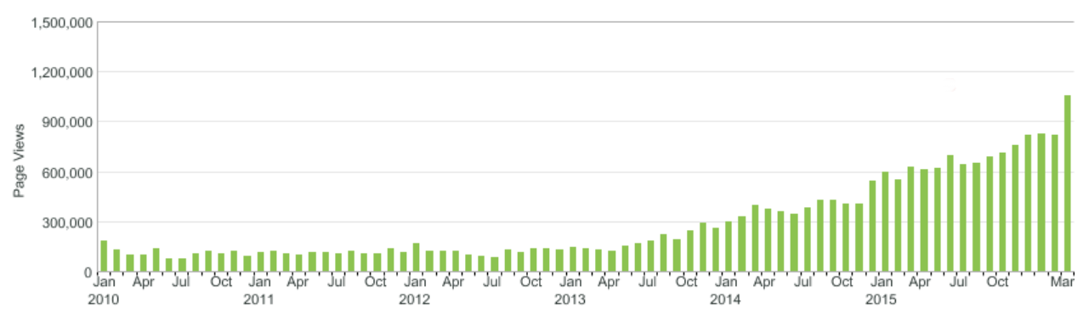
Results: Page views
Notes:
1M page views in March

Slide 65
The magic is in the community
Credit: http://opensource.com/business/13/12/five-community-management-tips
Notes:
community is everything
next contributor / community moderator
Finding these advocates is not easy
Limitations...
invest in your community advocates and the programs that invest in them.

Slide 66
Successful communities
Common purpose
Shared vision
Easy to get started
Commitment (leaders and followers)
Meritocracy
Passion
Ability to self-organize
Minimize surprises
Notes:
Surprise is the opposite of engagement
Mozilla CEO John Lilly

Slide 67
Successful community managers
Patience, lots of patience
Empower your top contributors
Understand the talents and motivations of participants
Avoid burnout
Provide value to your employer and your community
Meeting in person creates more than community
Every interaction is a gift
Notes:
“Community building is a genuine art form”
Jono bacon—The Art of Community

Slide 68
Community
Credit: http://www.flickr.com/photos/opensourceway/4371000464/
Notes:
Embrace the power of community
Define your community, build your community and nuture it
Thanks for having me here today
Have an amazing conference
Thank you very much

Slide 69

Q&A :: Contact
Questions
Contact
Email: jhibbets@redhat.com
Twitter: @jhibbets
IRC: shibby
Slides: https://github.com/jhibbets/presentations
Book: http://theopensourcecity.com
Credits: http://www.flickr.com/search/?w=47691521@N07&q=lolcat

