Slide 1
Open source all the cities
Jason Hibbets
Opensource.com editor, Red Hat
Code for Raleigh brigade captain
CityCamp NC co-chair
April 9, 2014 | ApacheCon

Slide 2

Improve the citizen experience
Credit: http://opensource.com/government/13/8/citizen-cio

Slide 3

WARNING: Objects in government are transparent, collaborative, and participatory
Credit: http://hibbets.net

Slide 4

Credits: http://www.flickr.com/photos/opensourceway/7496801912/

Slide 5
Open is better.

Slide 6

Open source model of participation
Credit: Red Hat

Slide 7

Transparency
Credit: http://www.flickr.com/photos/opensourceway/7496800772/

Slide 8

Collaboration
Credit: http://www.flickr.com/photos/opensourceway/4404008626/

Slide 9

Credit: https://wiki.gnome.org/OutreachProgramForWomen#Cartoon

Slide 10

Rapid prototyping
Credit: http://www.flickr.com/photos/opensourceway/5041738335/

Slide 11

Meritocracy
Credit: http://www.flickr.com/photos/opensourceway/4426824995/

Slide 12

Credit: http://www.flickr.com/photos/opensourceway/5752191750/

Slide 13
Open source is a better way
Transparency → accountability
Collaboration → innovative ideas
Participation → more eyes, ideas
Rapid prototyping → failing faster
Meritocracy → best ideas, buy-in
Passion → commitment

Slide 14

Credit: Red Hat

Slide 15

Discover an open world
Credit: Red Hat & Opensource.com

Slide 16

Credit: http://www.flickr.com/photos/opensourceway/4459199503/in/set-72157625738142672

Slide 17

Beyond coding
Credit: http://www.flickr.com/photos/opensourceway/4581225603/in/set-72157623343008011/

Slide 18

Credit: http://opensource.com/sites/default/files/imagecache/image-full-size/images/education/gov_vending.png

Slide 19

Credit: http://www.flickr.com/photos/opensourceway/5537457791/in/set-72157628737085119

Slide 20

Open government initiative
Credit: http://whitehouse.gov

Slide 21
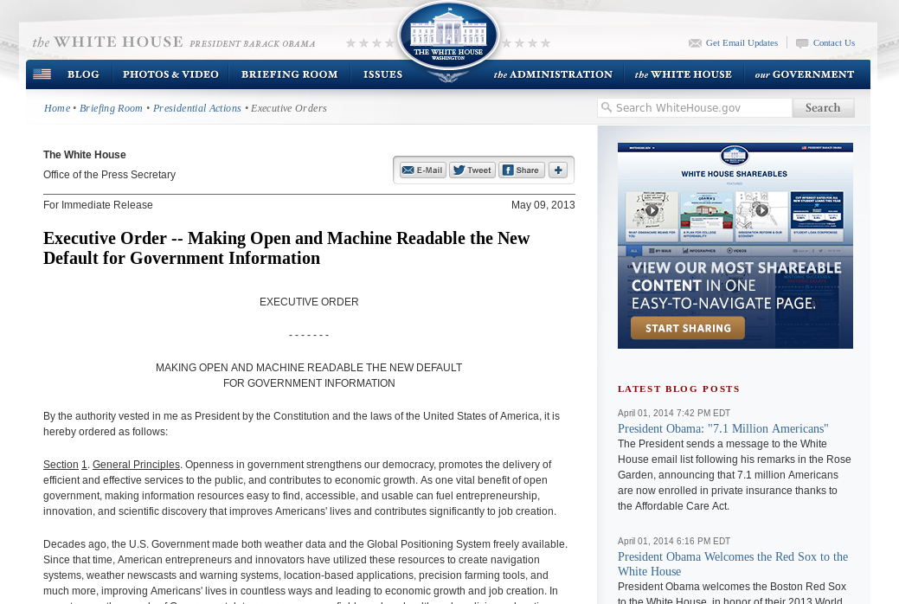
Default to open
Credit: http://whitehouse.gov

Slide 22
WARNING:
Objects in city government are more open than expected
Credit: http://hibbets.net

Slide 23

Sharing a story
Credit: http://opensource.com

Slide 24

Creating a community
Credit: http://www.flickr.com/photos/opensourceway/8516817076/in/photostream

Slide 25

Creating a brand
Credit: http://www.flickr.com/photos/opensourceway/5496629913/in/set-72157628737085119

Slide 26

The catalyst
Credit: http://citycampral.org

Slide 27

Community of passion
Credit: http://citycampral.org

Slide 28

An open government unconference
Credit: https://www.facebook.com/CityCampRal/photos_stream

Slide 29

TriangleWiki
Credit: http://trianglewiki.org

Slide 30

TriangleWiki Day
Credit: http://citycampral.org

Slide 31

The impact
633 page edits
100 maps
138 new photos added
Credit: http://citycampral.org

Slide 32

Credit: RGreenway – http://RGreenway.com

Slide 33


Evolving our CityCamp
Credits: http://citycampnc.org | http://codeforamerica.org

Slide 34

A Peace Corp for geeks
Credit: http://codeforamerica.org/

Slide 35

Code for Raleigh
Credit: http://brigade.codeforamerica.org/

Slide 36

Recycling code/projects
Credit: http://brigade.codeforamerica.org/

Slide 37

Adopt-a-bus shelter
Credit: http://adoptashelter.raleighnc.gov/

Slide 38

Triangle Code for America Division
Join in: http://www.meetup.com/Triangle-Code-for-America/
Credit: http://brigade.codeforamerica.org/

Slide 39
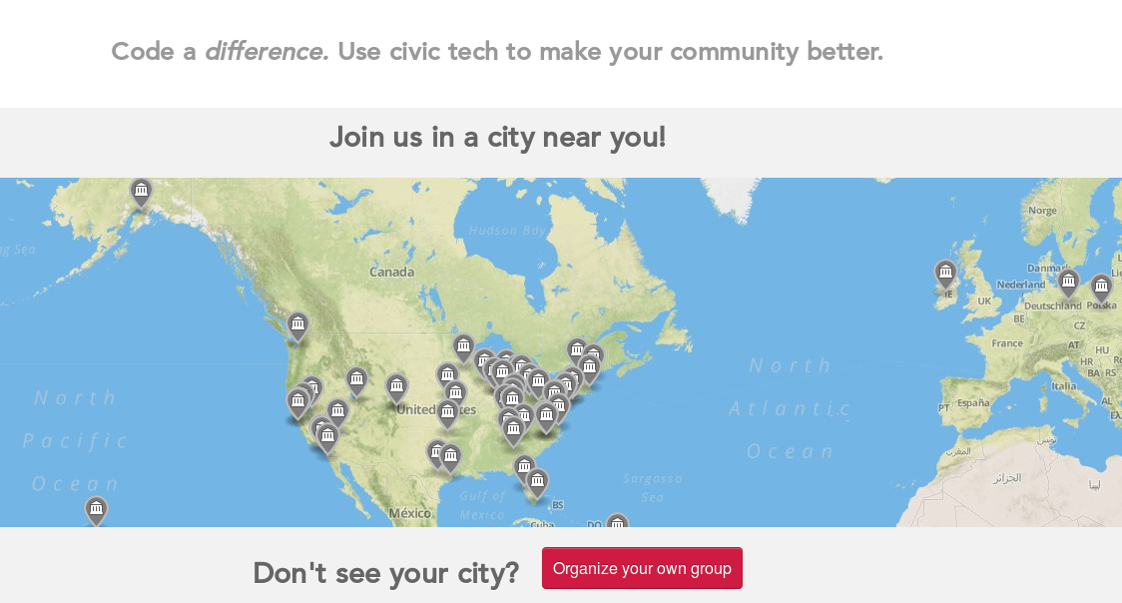
Join or form a brigade
Credit: http://brigade.codeforamerica.org/

Slide 40
Raleigh: A case study
Credit: http://www.flickr.com/photos/opensourceway/5496629913/in/set-72157628737085119

Slide 41

SeeClickFix
Credit: http://seeclickfix.com/raleigh

Slide 42

Open government resolution
Credit: http://opensource.com/government/12/2/how-get-your-city-pass-open-government-policy

Slide 43

Open Raleigh
Credit: City of Raleigh – http://raleighnc.gov

Slide 44

Credit: City of Raleigh – http://myraleighideas.com

Slide 45

data.raleighnc.gov
Credit: https://data.raleighnc.gov/

Slide 46

Credit: https://data.raleighnc.gov/

Slide 47


We built this city on open source
Open Raleigh
Code for Raleigh
Open government
resolution
My Raleigh Ideas!
My Raleigh
Subscriptions
RGreenway
NC Datapalooza

Slide 48

theopensourcecity.com
Credit: http://theopensourcecity.com/

Slide 49

Elements of an open source city
Culture/participation
Open government policy
Open data policy
Open source conferences & user groups
Economic development
Credit: http://theopensourcecity.com/

Slide 50

The game is changing
Credit: http://opensource.com/government/13/8/citizen-cio

Slide 51
Change the world.

Slide 52

Contact
  Twitter: @jhibbets
  Email: jhibbets@redhat.com
  or: jhibbets@gmail.com
  IRC: shibby
  Slides: https://github.com/jhibbets/presentations
  Book: http://theopensourcecity.com
Credits: http://www.flickr.com/search/?w=47691521@N07&q=lolcat

