Slide 1


Slide 2
Drupal-Powered
Community Building
Jason Hibbets

Slide 3
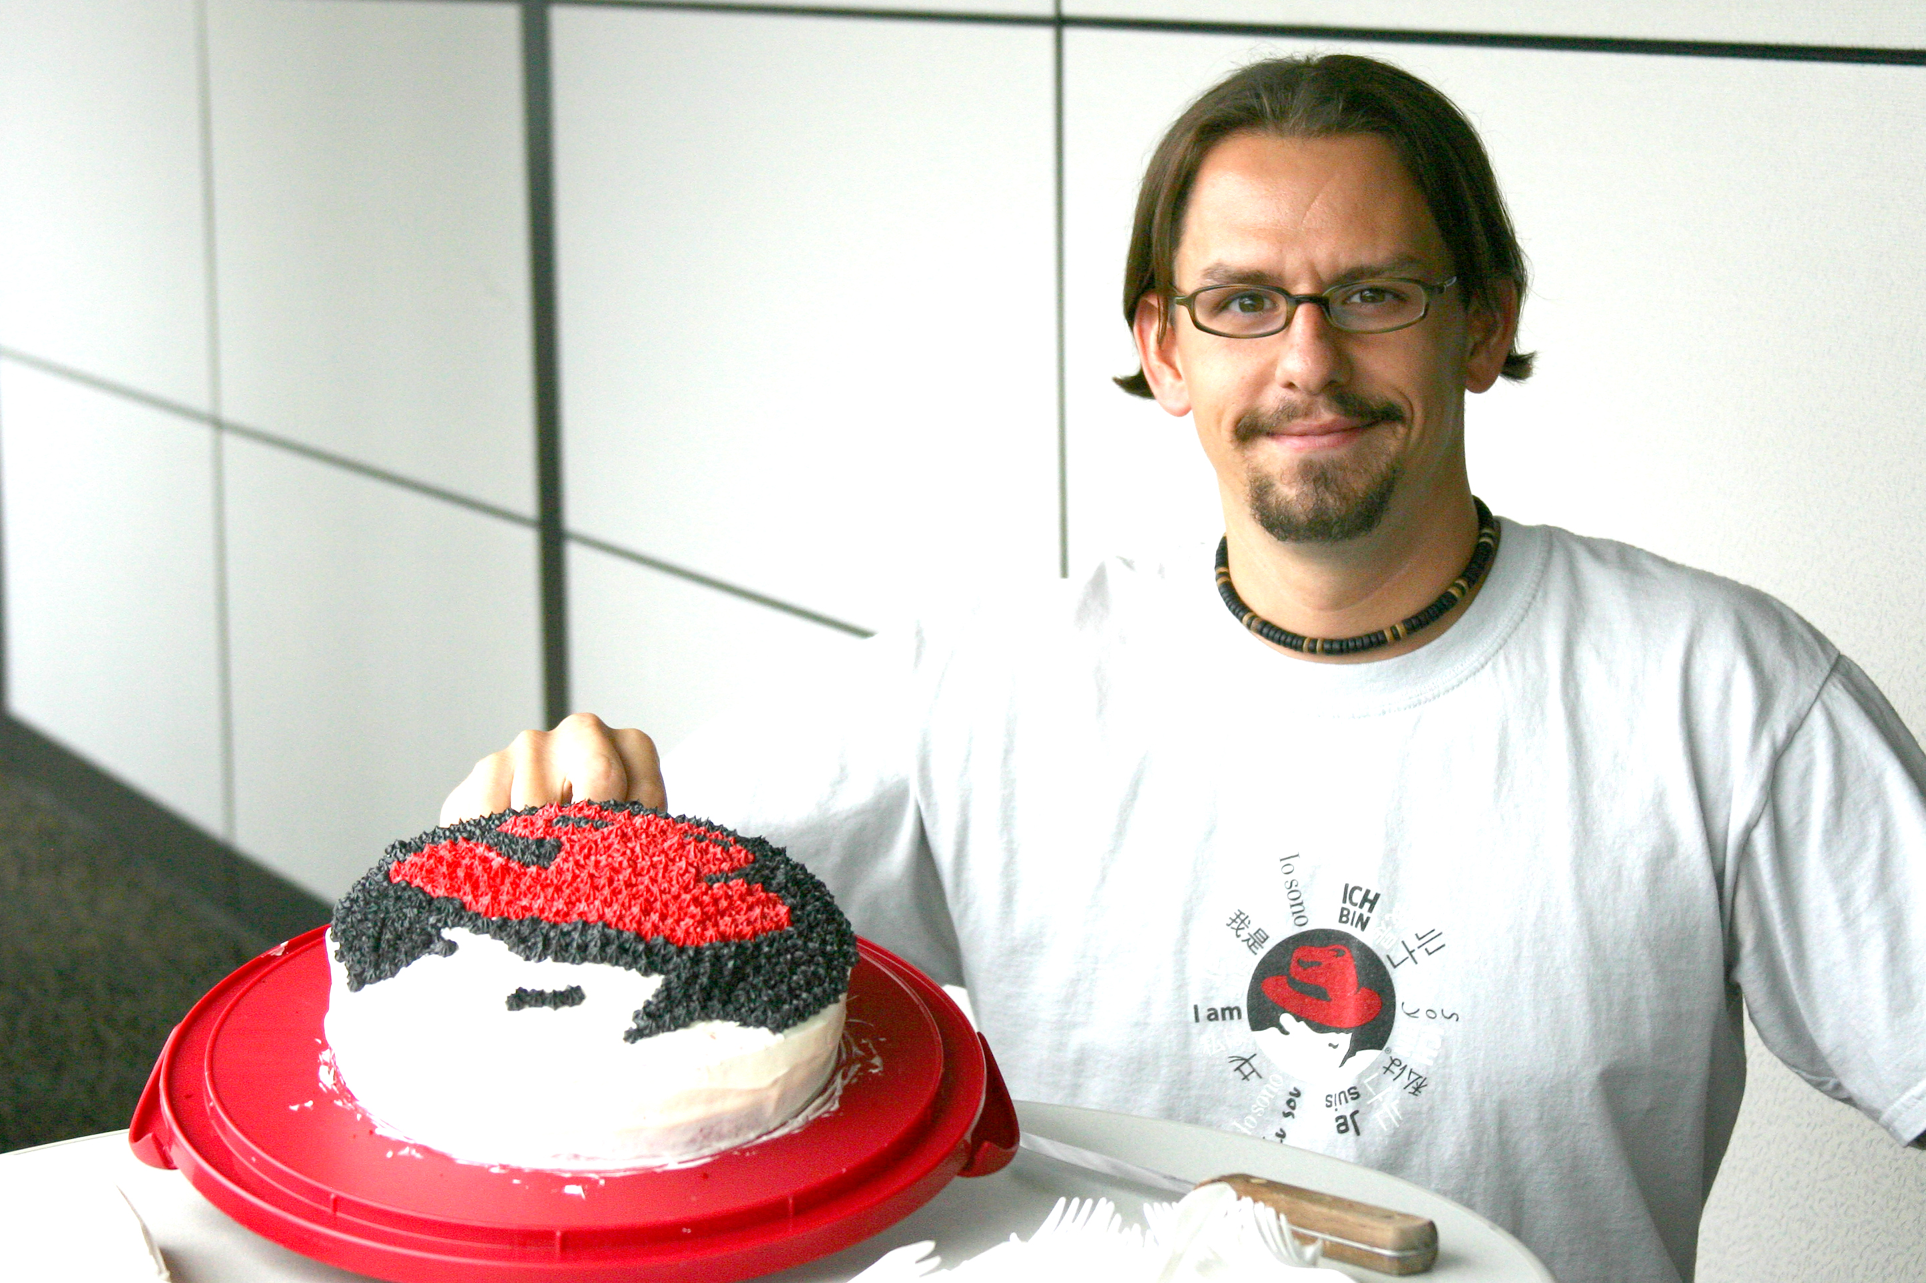
Drupal-Powered Community Building
Jason Hibbets
Senior community evangelist
Opensource.com, Red Hat
DrupalCon NOLA
May 12, 2016
Credit: Jonathon Opp, circa 2003
Notes:
Brief intro – Describe your role
follow @opensourceway
Tweet questions
Stop a few places for questions
Save most for the end

Slide 4
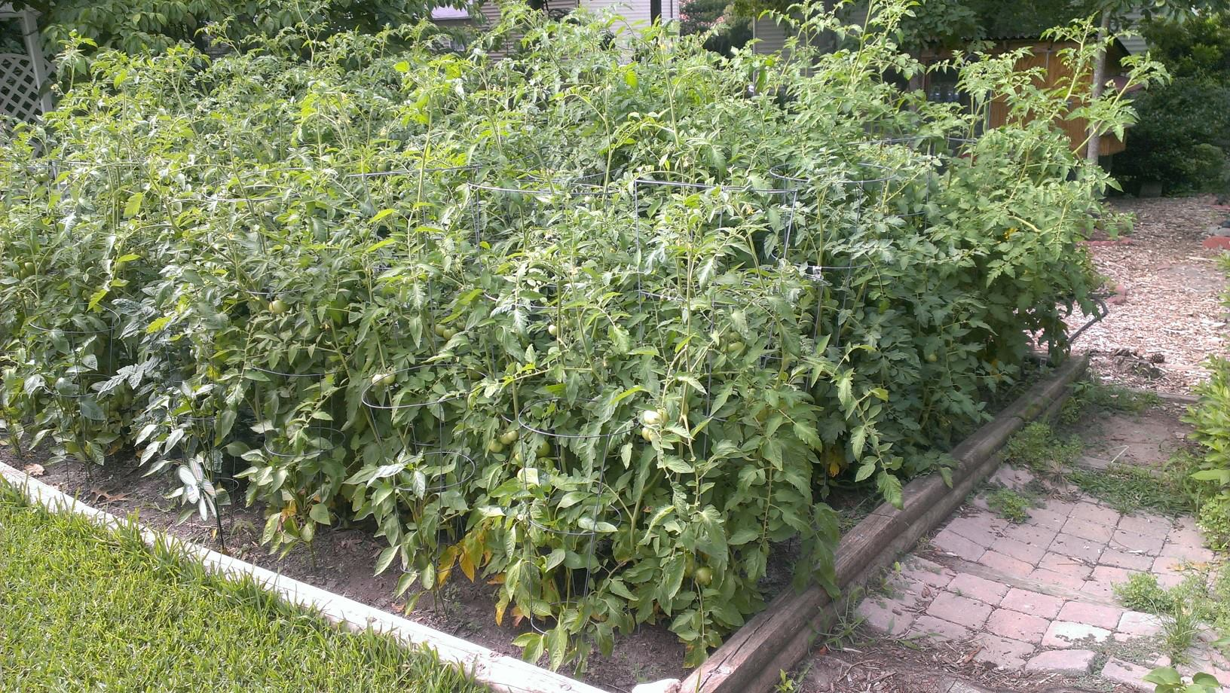
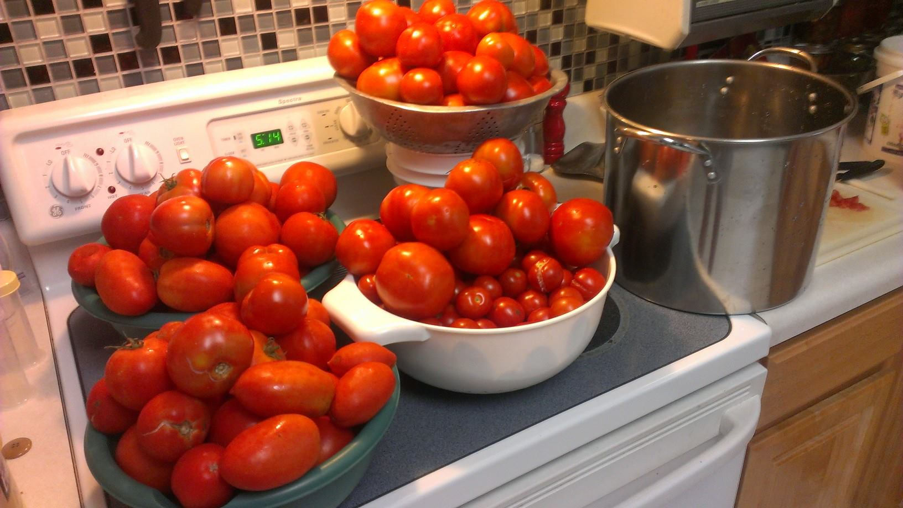
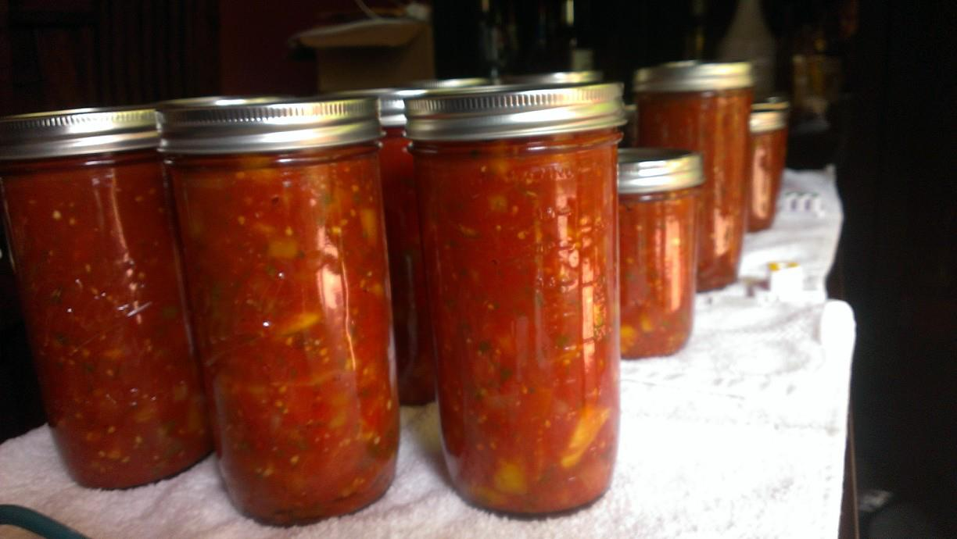
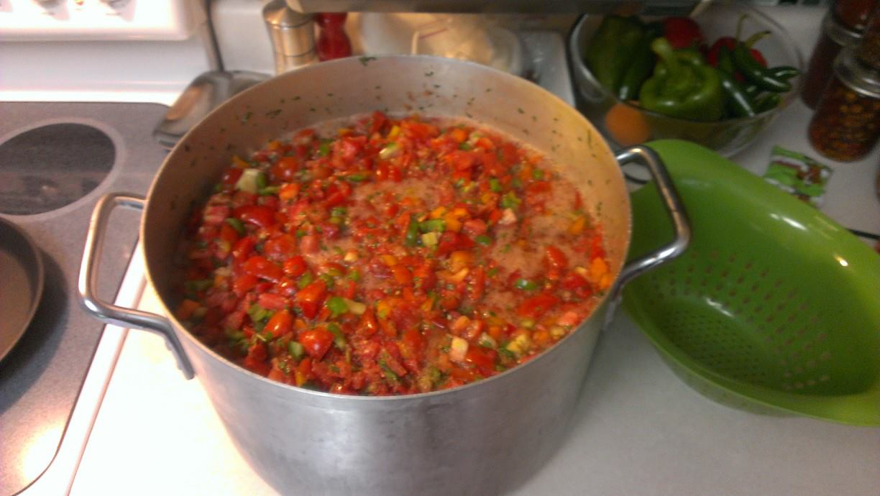
Credits: Jason Hibbets | http://hibbets.net
Notes:
Building a community is like planting a garden
What are you going to do with the fruits of your labor?

Slide 5

Why do communities form?
Credit: https://opensource.com/open-organization/16/2/how-hire-people-who-just-get-it
Notes:
Why do communities form?
Common purpose, mission
Fueled by passion

Slide 6


Community + content
Credit: http://opensource.com/business/13/12/five-community-management-tips
Notes:
Hook
building community with great content
share community building techniques
Outline – topics:
Roles
Points and badges
User profiles
Workflow
SEO
Programs, tools, results

Slide 7
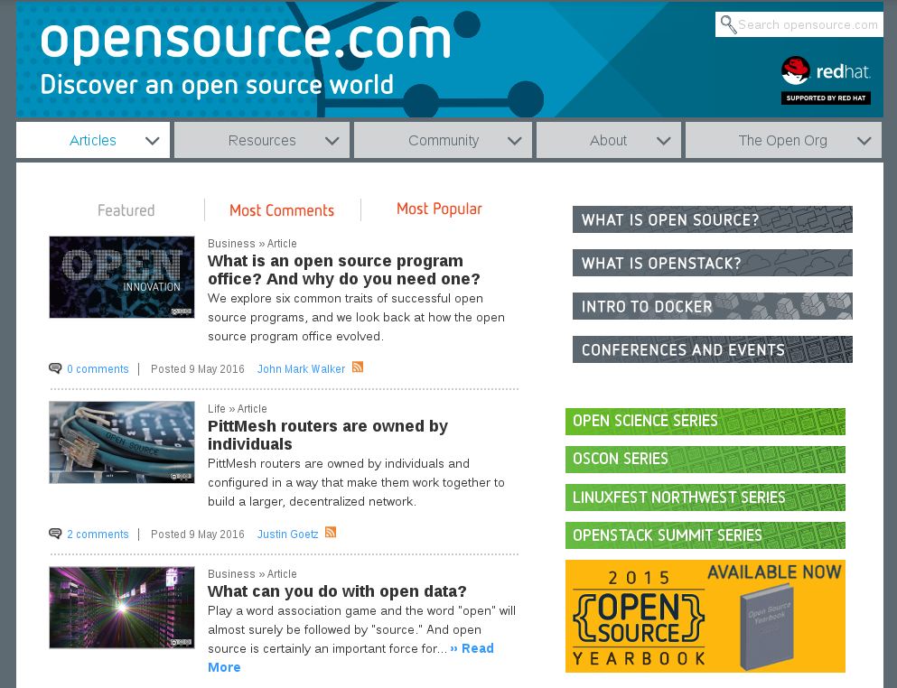
Notes:
describe Opensource.com
20 articles a week
1,000,000+ page views / month
platform to share stories
news: daily stories
Resources: discover open source

Slide 8

Discover an open world
Credit: Red Hat & Opensource.com
Notes:
thought-leadership in open source
building a community since January 2010
share community building techniques

Slide 9

Build the world’s premier storytelling platform
Credits: http://www.flickr.com/photos/opensourceway/7496801912/
Notes:
Mission / Methodology
catalyst for the open source community
collects stories from OS comm
editorial services

Slide 10

Methodology
Notes:
Drive for efficiency
Automate all the things
Challenge for the best way to do things
Practice lean

Slide 11

Methodology: Lean
Decision-making
Feedback loops
Measure everything
Data-driven decisions
MVP – minimum viable product
Credit: Eric Ries, http://theleanstartup.com/
Notes:
Examples:
Community calendar

Slide 12
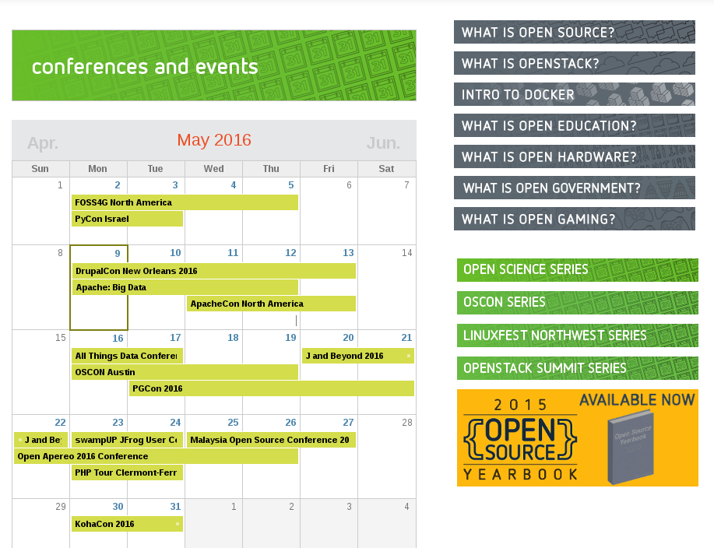
Notes:
Example: Community calendar

Slide 13

Using Drupal to build community
Notes:
Dive in to how we are using Drupal to build community and foster engagement
Then talk about programs

Slide 14

Roles
Notes:
Anonymous / Authenticated user
Non-confirmed
Editor
Community moderators
Admin

Slide 15
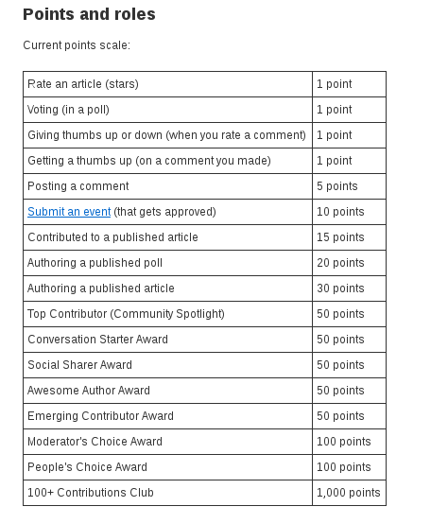
Points
Notes:
Make is easier for community to earn points
Admins can award points

Slide 16
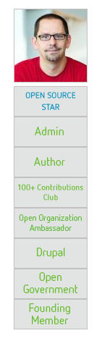
Role-based badges
Newbie / 0-9 points
Community Member / 10-29
Open Enthusiast / 30-99
Open Minded / 100-499
Open Source Evangelist / 500-999
Open Source Champion / 1,000-2,499
Open Source Sensei / 2,500-4,999
Open Sourcerer / 5,000-9,999
Star / 10,000-24,999
Notes:
points and badge system
gamification

Slide 17
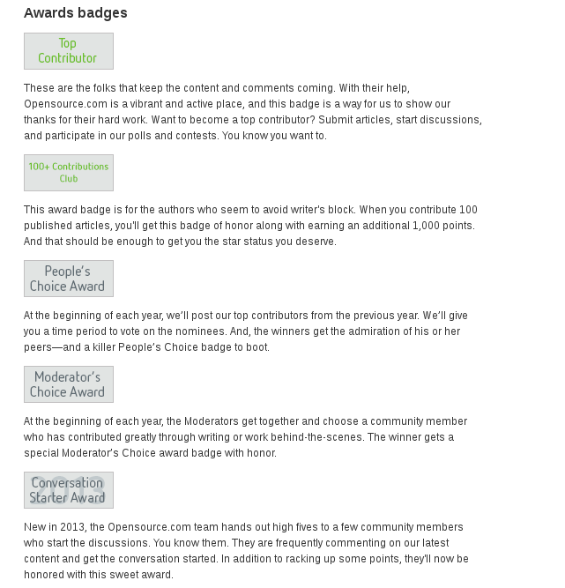

Award-based badges
Notes:
Examples of award badges
Talk about annual awards

Slide 18
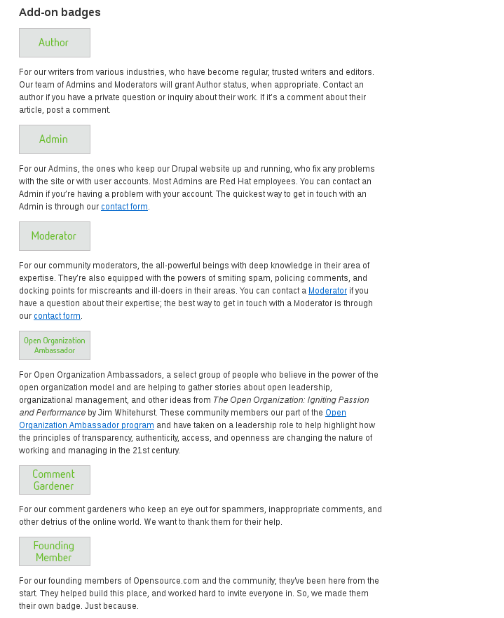
Add-on badges
Notes:
Examples of add-on badges (fun)

Slide 19
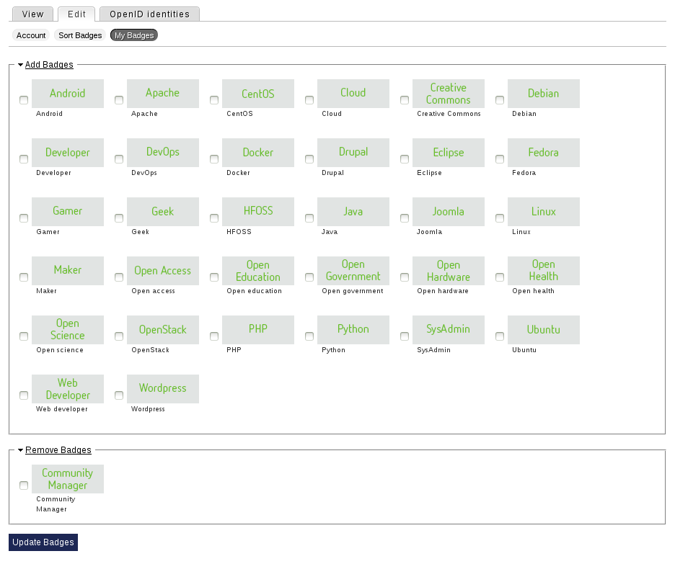
Notes:
User optional badges

Slide 20
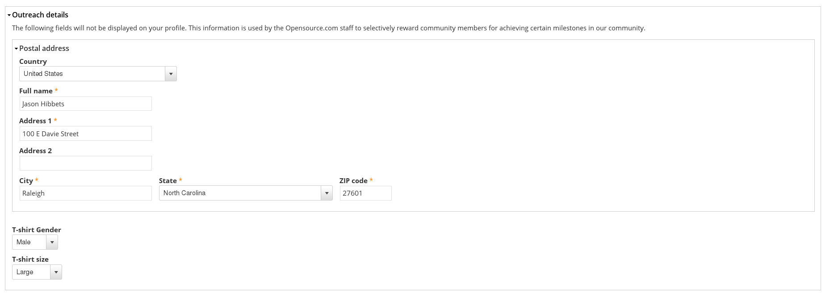
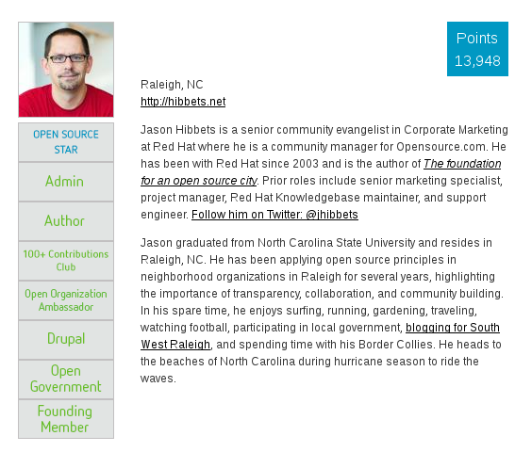
Profile data
Notes:
Collect profile data
Ideas for: welcome kit, community member kit

Slide 21
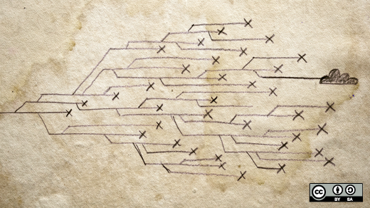
Workflow
Notes:
Authors can submit in any format
My team manages the content workflow
In Drupal we use:
Embargoed
Draft
Author review
Published
Scheduler module

Slide 22
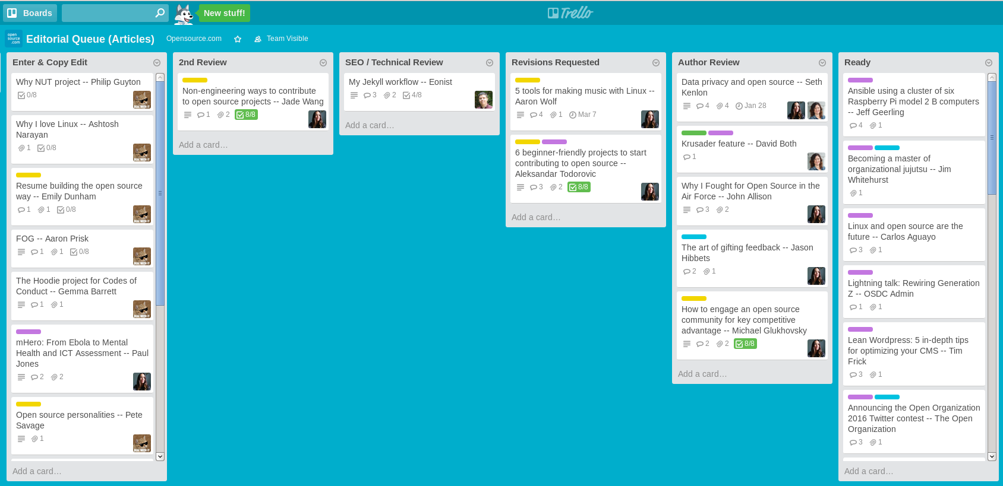
Worfklow: Trello
Notes:
We use Trello to manage our publishing calendar and workflow

Slide 23

SEO
Notes:
Content creation
SEO strategy: write naturally, topics we have expertise in
Example: What is open source page
Moz, formerly SEO moz
keyword rankings
site errors

Slide 24

Syndication
Notes:
Drupal: RSS + Share button widget
Beyond: Manual syndication:
Hackernews
Slashdot
Reddit
Others
Social media
Weekly newsletter + Friday top 5

Slide 25
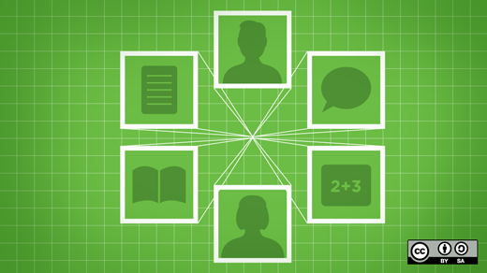
Programs & tools
Notes:
Pause for questions
Programs ... catalyst in the open source community

Slide 26
Programs: Our audience
High touch, high impact
Moderators
Writers-list =
opportunities
Curate based
on results
Repeat
guest writers
+ columnists
One-time guest writers
Readers, commenters, & sharers
Notes:
This is an example of how we segment our audience and our community of writers.
webform
one-time post
Writers-list
Describe Writer list transition

Slide 27






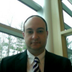







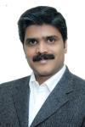

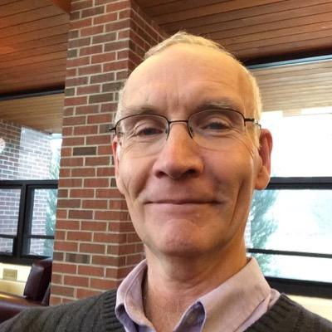
Programs: Meet the moderators
More details at: http://opensource.com/community-moderator-program
Notes:
This is the foundation of our community
Explain the community moderators program
25% of content
Spend the most time
trip to All Things Open

Slide 28

Tools
Notes:
What does our quiver of tools look like to get the job done for Opensource.com?
Hoping you can use what we do to improve your daily work flows.

Slide 29
Tools: The quiver
Drupal
Trello
Moz
Adobe analytics
Etherpad
Google Docs
Mojo (Internal documentation)
Sprout Social
Hootsuite
Email, lots of email
Mailing lists
IRC (Internal relay chat)
Social media

Slide 30

Tools: Adobe Analytics
Notes:
Omniture (Google Analytics)

Slide 31

Tools: Etherpad - collaborative pads
Notes:
Etherpad is a light-weight Google Doc

Slide 32
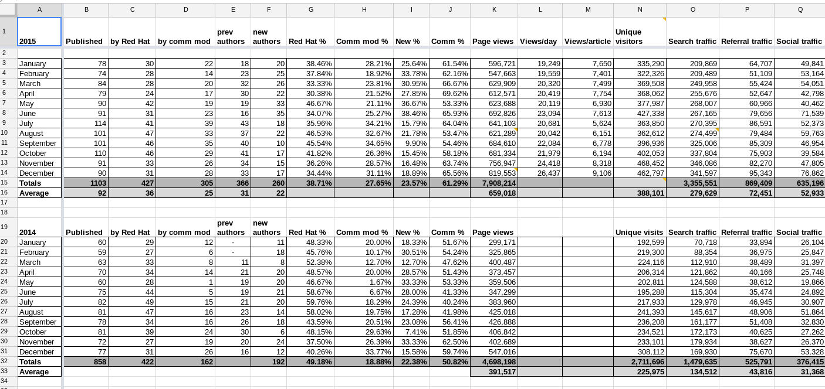
Tools: Google Docs: Tasks, stats
Notes:
Google Docs

Slide 33
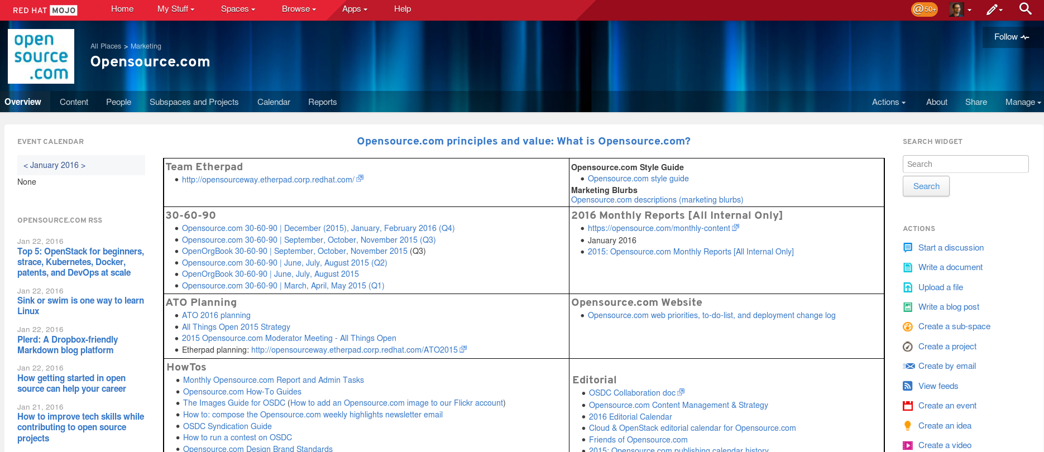
Tools: Internal documentation
Notes:
Mojo (from Jive)
Document, document, document

Slide 34

Results
Notes:
This was just a brief deep-dive into some of the tools that makes my team successful. Now let’s take a look at some of the results we track.

Slide 35
Results: Content
65%
Notes:
65% of our content comes from the open source community
25% of our content comes from our moderators

Slide 36

Results: Referral traffic
Notes:
Over 50% is from search
10-15% from social media

Slide 37
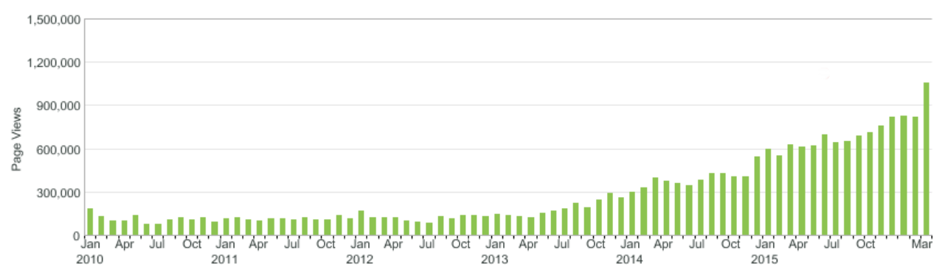
Results: Page views
Notes:
1M page views in March

Slide 38
The magic is in the community
Credit: http://opensource.com/business/13/12/five-community-management-tips
Notes:
community is everything
next contributor / community moderator
Finding these advocates is not easy
Limitations...
invest in your community advocates and the programs that invest in them.

Slide 39
Build the world’s premier storytelling platform
Credits: http://www.flickr.com/photos/opensourceway/7496801912/
Notes:
We are fulfilling our mission
Executive support
Calendare
Roles
Points and badges
User profiles
few lessons learned / future

Slide 40
Lessons learned
Content is king
Know your SEO (Search Engine Optimization)
Find your stars and let them shine
Keep your platform/website simple
Practice Lean methodology

Slide 41

Change the world
Credit: http://www.flickr.com/photos/opensourceway/4371000464/
Notes:
Drupal is changing the world
Open source is changing the world
“Never doubt that a small group of thoughtful, committed people could change the world. Indeed, it's the only thing that ever has.” Margaret Mead
Take what you’ve learned today (and at #DrupalCon) and change the world with open source
Thank you

Slide 42

Q&A :: Contact
Questions
Contact
Email: jhibbets@redhat.com
Twitter: @jhibbets
d.o: jhibbets
IRC: shibby
Slides: https://github.com/jhibbets/presentations
Book: http://theopensourcecity.com
Credits: http://www.flickr.com/search/?w=47691521@N07&q=lolcat

Slide 43
So How Was It? - Tell Us What You Think
Evaluate this session: http://red.ht/1WmClZj
Thanks!

