Slide 1
Open source all the cities
Jason Hibbets
Opensource.com editor, Red Hat
Code for Raleigh brigade captain
CityCamp NC co-chair
April 2, 2014 | Great Wide Open

Slide 2

Improve the citizen experience
Credit: http://opensource.com/government/13/8/citizen-cio

Slide 3

WARNING: Objects in government are transparent, collaborative, and participatory
Credit: http://hibbets.net

Slide 4

Credits: http://www.flickr.com/photos/opensourceway/7496801912/

Slide 5

Open source is like a recipe
Credit: http://www.flickr.com/photos/47691521@N07/5497223072/

Slide 6
Open is better.

Slide 7

Open source model of participation
Credit: Red Hat

Slide 8

Transparency
Credit: http://www.flickr.com/photos/opensourceway/7496800772/

Slide 9

Collaboration
Credit: http://www.flickr.com/photos/opensourceway/4404008626/

Slide 10

Participation
Credit: https://wiki.gnome.org/OutreachProgramForWomen#Cartoon

Slide 11

Rapid prototyping
Credit: http://www.flickr.com/photos/opensourceway/5041738335/

Slide 12

Meritocracy
Credit: http://www.flickr.com/photos/opensourceway/4426824995/

Slide 13

Passion
Credit: http://www.flickr.com/photos/opensourceway/5752191750/

Slide 14

Credit: Red Hat

Slide 15


Discover an open world
Credit: Red Hat & Opensource.com

Slide 16
Open source is a better way
Transparency → accountability
Collaboration → innovative ideas
Participation → more eyes, ideas
Rapid prototyping → failing faster
Meritocracy → best ideas, buy-in
Passion → commitment

Slide 17

Beyond coding
Credit: http://www.flickr.com/photos/opensourceway/4581225603/in/set-72157623343008011/

Slide 18

Credit: http://www.flickr.com/photos/opensourceway/4459199503/in/set-72157625738142672

Slide 19

Credit: http://opensource.com/sites/default/files/imagecache/image-full-size/images/education/gov_vending.png

Slide 20

Credit: http://www.flickr.com/photos/opensourceway/5537457791/in/set-72157628737085119

Slide 21
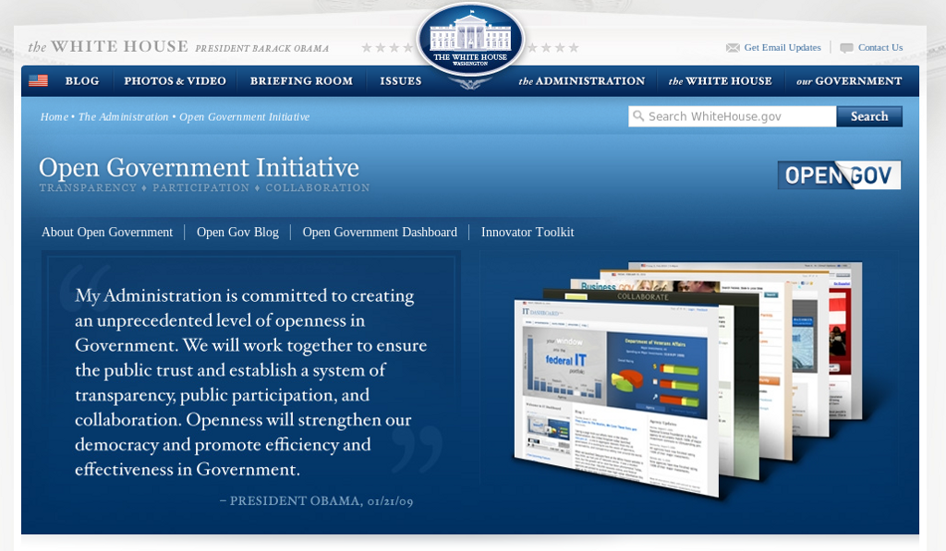
Open government initiative
Credit: http://whitehouse.gov

Slide 22
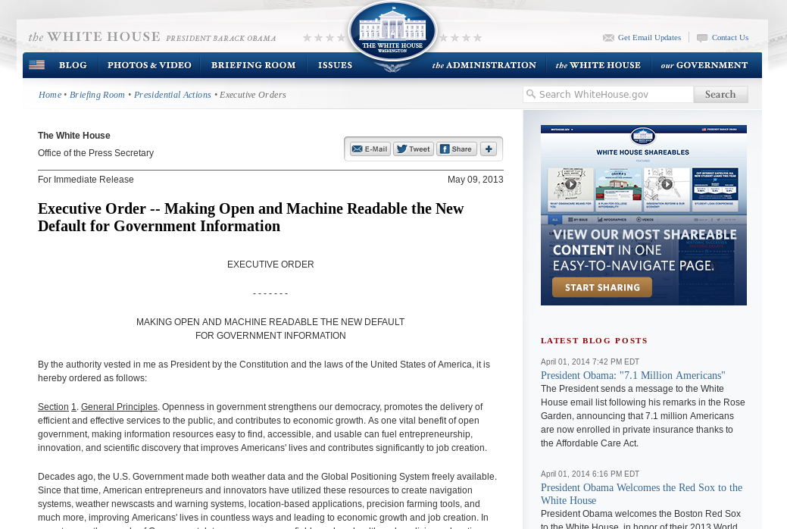
Default to open
Credit: http://whitehouse.gov

Slide 23
WARNING: Objects in city government are more open than expected
Credit: http://hibbets.net

Slide 24

Sharing a story
Credit: http://opensource.com

Slide 25

Creating a brand
Credit: http://www.flickr.com/photos/opensourceway/5496629913/in/set-72157628737085119

Slide 26

Creating a community
Credit: http://www.flickr.com/photos/opensourceway/8516817076/in/photostream

Slide 27

The catalyst
Credit: http://citycampral.org

Slide 28

Community of passion
Credit: http://citycampral.org

Slide 29

An open government unconference
Credit: https://www.facebook.com/CityCampRal/photos_stream

Slide 30

TriangleWiki
Credit: http://trianglewiki.org

Slide 31

TriangleWiki Day
Credit: http://citycampral.org

Slide 32

The impact
633 page edits
100 maps
138 new photos added
Credit: http://citycampral.org

Slide 33

RGreenway
Credit: RGreenway – http://RGreenway.com

Slide 34


Evolving CityCamp
Credits: http://citycampnc.org | http://codeforamerica.org

Slide 35

A Peace Corp for geeks
Credit: http://codeforamerica.org/

Slide 36

Code for Raleigh
Credit: http://brigade.codeforamerica.org/

Slide 37

Recycling code/projects
Credit: http://brigade.codeforamerica.org/

Slide 38
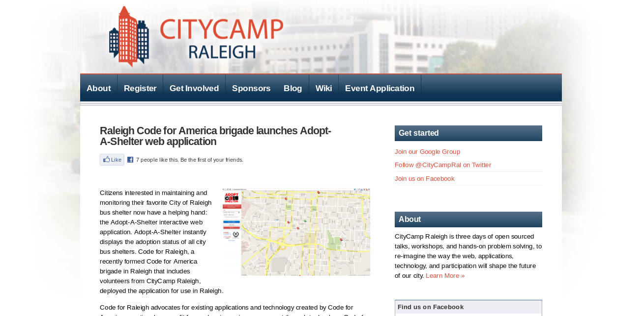
Credit: http://citycampral.org/2012/11/raleigh-code-for-america-brigade-launches-adopt-a-shelter-web-application/

Slide 39

Adopt-a-bus shelter
Credit: http://adoptashelter.raleighnc.gov/

Slide 40

Triangle Code for America Division
Join in: http://www.meetup.com/Triangle-Code-for-America/
Credit: http://brigade.codeforamerica.org/

Slide 41
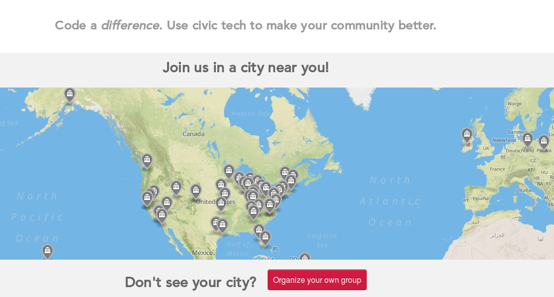
Join or form a brigade
Credit: http://brigade.codeforamerica.org/

Slide 42
Raleigh: A case study
Credit: http://www.flickr.com/photos/opensourceway/5496629913/in/set-72157628737085119

Slide 43

SeeClickFix
Credit: http://seeclickfix.com/raleigh

Slide 44

Open government resolution

Slide 45

Open Raleigh
Credit: City of Raleigh – http://raleighnc.gov

Slide 46
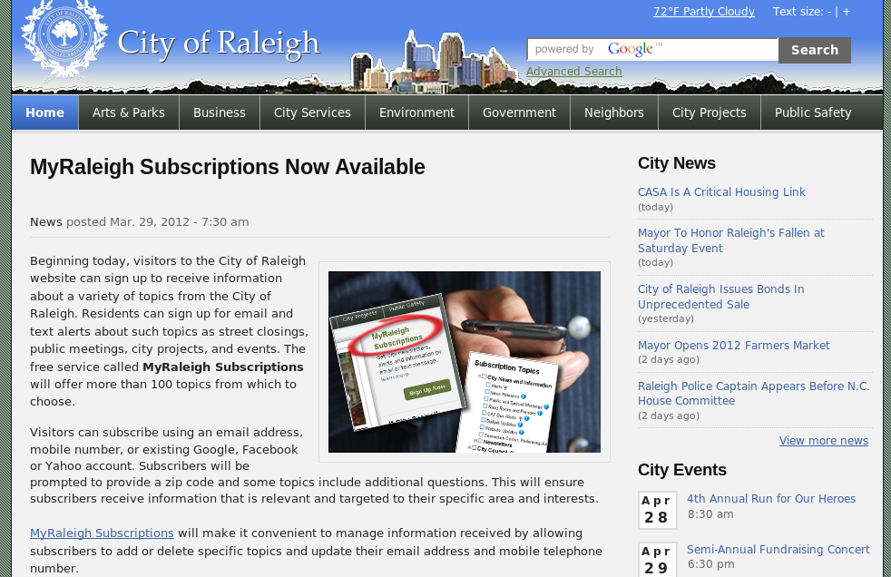
My Raleigh Subscriptions
Credit: City of Raleigh – http://raleighnc.gov

Slide 47
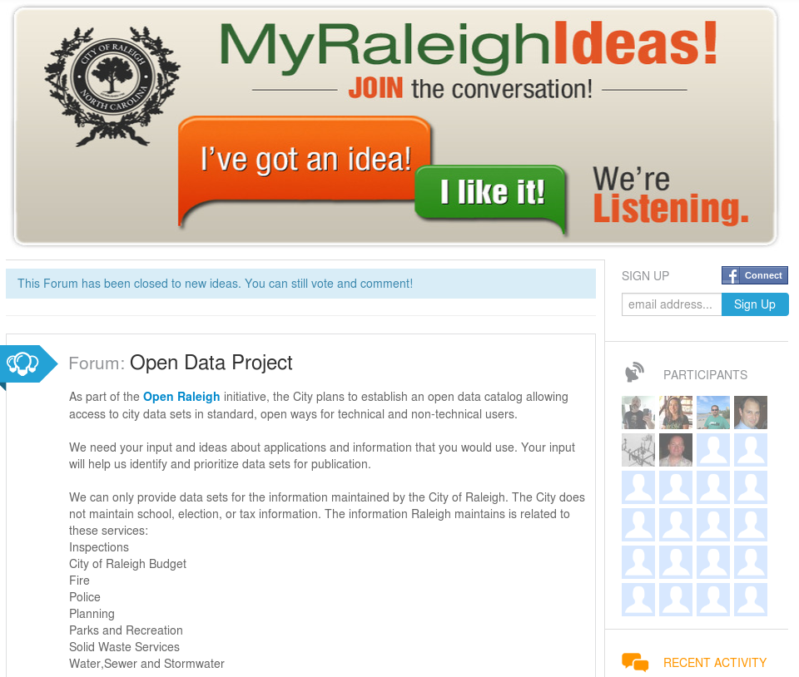
Credit: City of Raleigh – http://myraleighideas.com

Slide 48

data.raleighnc.gov
Credit: https://data.raleighnc.gov/

Slide 49

Credit: https://data.raleighnc.gov/

Slide 50

Open source all the data!
Credits: http://www.flickr.com/photos/opensourceway/5538036200/

Slide 51
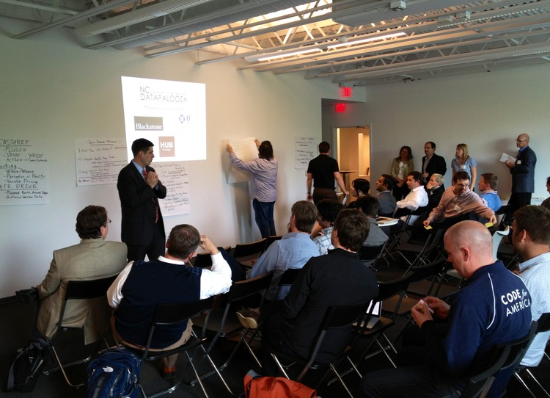

DataJam & Datapalooza
Credits: http://ncdatapalooza.com/ | #NCDataPalooza

Slide 52


We built this city on open source
Open Raleigh
Code for Raleigh
Open government
resolution
My Raleigh Ideas!
My Raleigh
Subscriptions
RGreenway
NC Datapalooza

Slide 53

theopensourcecity.com
Credit: http://theopensourcecity.com/

Slide 54

Credit: http://theopensourcecity.com/

Slide 55
Elements of an open source city
Culture/participation
Open government policy
Open data policy
Open source conferences & user groups
Economic development

Slide 56

The game is changing
Credit: http://opensource.com/government/13/8/citizen-cio

Slide 57

Change the world
Credit: http://www.flickr.com/photos/opensourceway/4371000464/

Slide 58

Q&A :: Contact
Questions
Contact
  Email: jhibbets@redhat.com
  Twitter: @jhibbets
  IRC: shibby
  Slides: https://github.com/jhibbets/presentations
  Book: http://theopensourcecity.com
Credits: http://www.flickr.com/search/?w=47691521@N07&q=lolcat

