Slide 1
Community building:
The open source way
Jason Hibbets
Senior community evangelist
Opensource.com editor, Red Hat
DevNation 2015
June 24, 2015
Notes:
Brief intro – Describe your role
follow @opensourceway
Tweet questions
Stop a few places for questions
Save most for the end

Slide 2


Community + content
Notes:
Hook
building community with great content
Outline:
Team
Methodology
Strategy
Programs
Tools

Slide 3

Discover an open world
Credit: Red Hat & Opensource.com
Notes:
thought-leadership in open source
building a community since January 2010
redirect to redhat.com
share tools and techniques

Slide 4
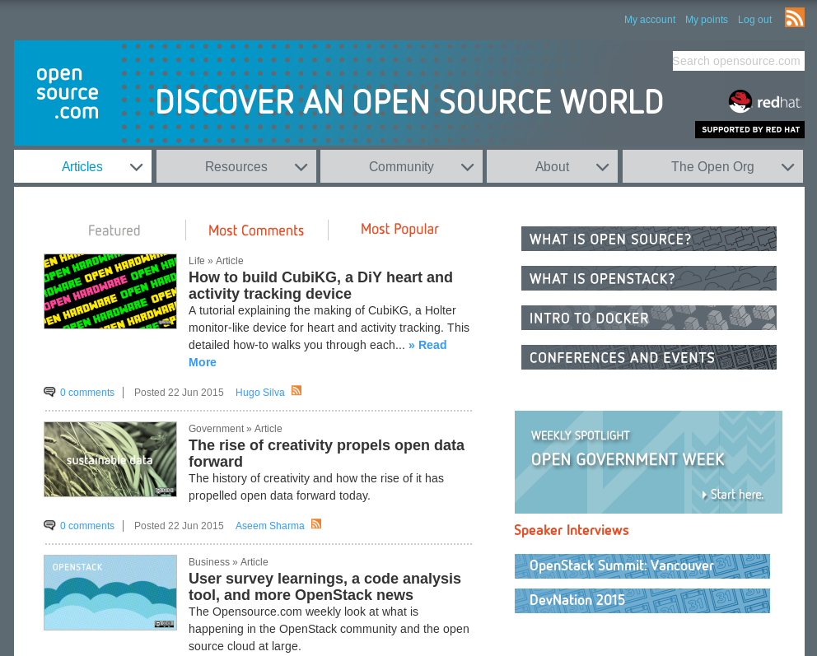
Notes:
describe Opensource.com
20 articles a week
600,000+ page views / month

Slide 5

Build the world’s premier storytelling platform
Credits: http://www.flickr.com/photos/opensourceway/7496801912/
Notes:
catalyst for the open source community
collects stories
editorial services
platform to share stories
news: daily stories
Resources: discover open source
Bii-code – dependency management project

Slide 6
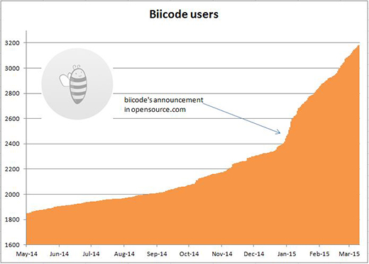
Credits: http://opensource.com/business/15/5/biicode-goes-open-source-early
Notes:
results

Slide 7
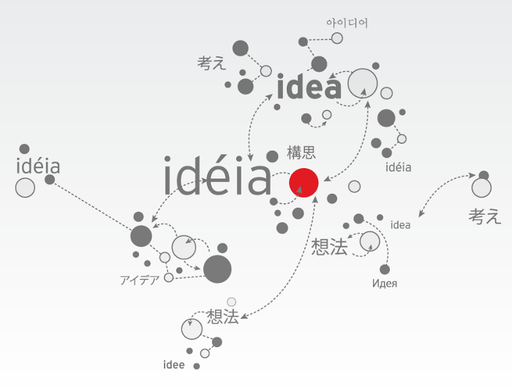
Open source model of participation
Credit: Red Hat
Notes:
open source creates better software

Slide 8






Credit: http://www.flickr.com/photos/opensourceway/7496800772/
Credit: http://www.flickr.com/photos/opensourceway/4404008626/
Credit: https://wiki.gnome.org/OutreachProgramForWomen#Cartoon
Credit: http://www.flickr.com/photos/opensourceway/5041738335/
Credit: http://www.flickr.com/photos/opensourceway/4426824995/
Credit: http://www.flickr.com/photos/opensourceway/5752191750/

Slide 9
Open source is a better way
Transparency → accountability
Collaboration → innovative ideas
Participation → more eyes, ideas
Rapid prototyping → failing faster
Meritocracy → best ideas, buy-in
Passion → commitment

Slide 10

Credit: Red Hat
Notes:
Describe the Open Source Way.
How Opensource.com shares stories

Slide 11



The team
Notes:
Well-oiled machine that operates like a start-up

Slide 12

Methodology
Notes:
Team operations
Hire people
Skillset
entrepreneurial-spirit

Slide 13

Methodology: Lean
Decision-making
Feedback loops
Measure everything
MVP – minimum viable product
Credit: Eric Ries, http://theleanstartup.com/
Notes:
Examples:
Community calendar
Top 5 YouTube post

Slide 14
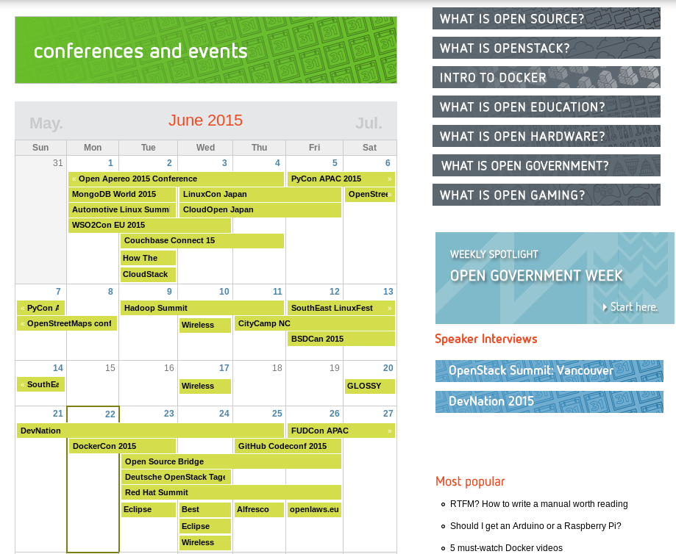
Notes:
Example: Community calendar

Slide 15
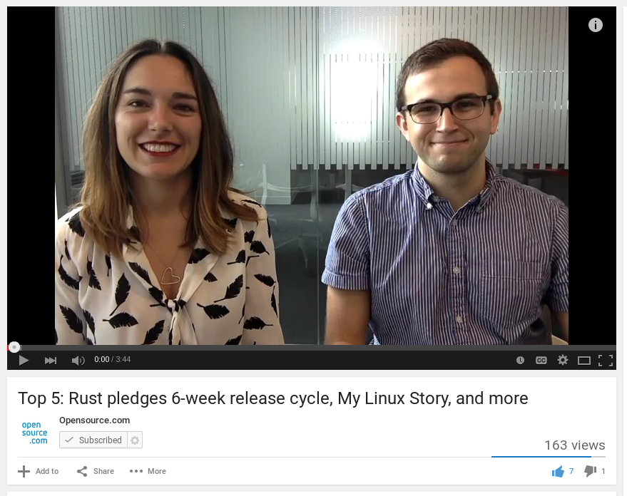
Notes:
Example: Weekly top 5

Slide 16

Methodology: ROWE
Modified results only work environment
30-60-90 monthly goals
Notes:
ROWE
flexible schedule
30-60-90 goal setting
Example, upgrade our Drupal platform
Example: WFH Wednesday

Slide 17

Strategy
Notes:
Let’s get down to the nuts and bolts of how we GSD. Part of this is the daily grind, but you’ll also see how we use our strategy to feed into our everyday work as a publication.

Slide 18

Strategy: Daily heartbeat
Strategy
Notes:
This is an example of our daily heartbeat.

Slide 19

Strategy: Content is king
Notes:
Weekly topics: Linux, Docker, etc.
Weekly columns: OpenStack news, weekly news, open gaming, HFOSS, DevOps, Apache, Open Hardware, Open CMS
Themed content weeks: Women in OSS, back to school, partnering with events
Resources – evergreen content
What is open source, what open is education

Slide 20

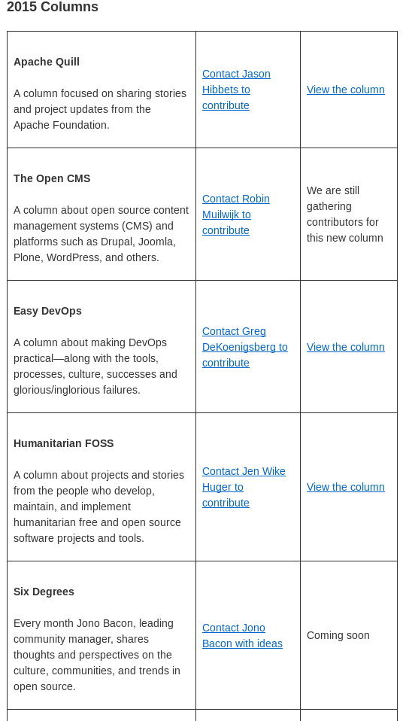
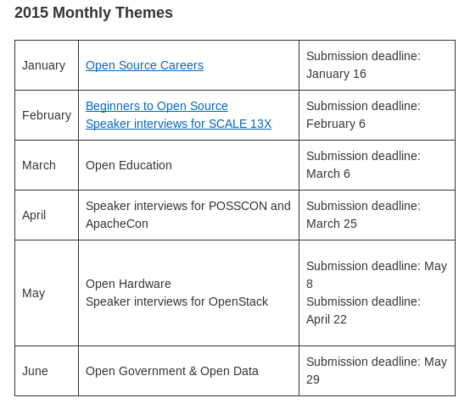
Strategy: Planning ahead
opensource.com/resources/editorial-calendar
Notes:
Themed content
Editorial calendar

Slide 21
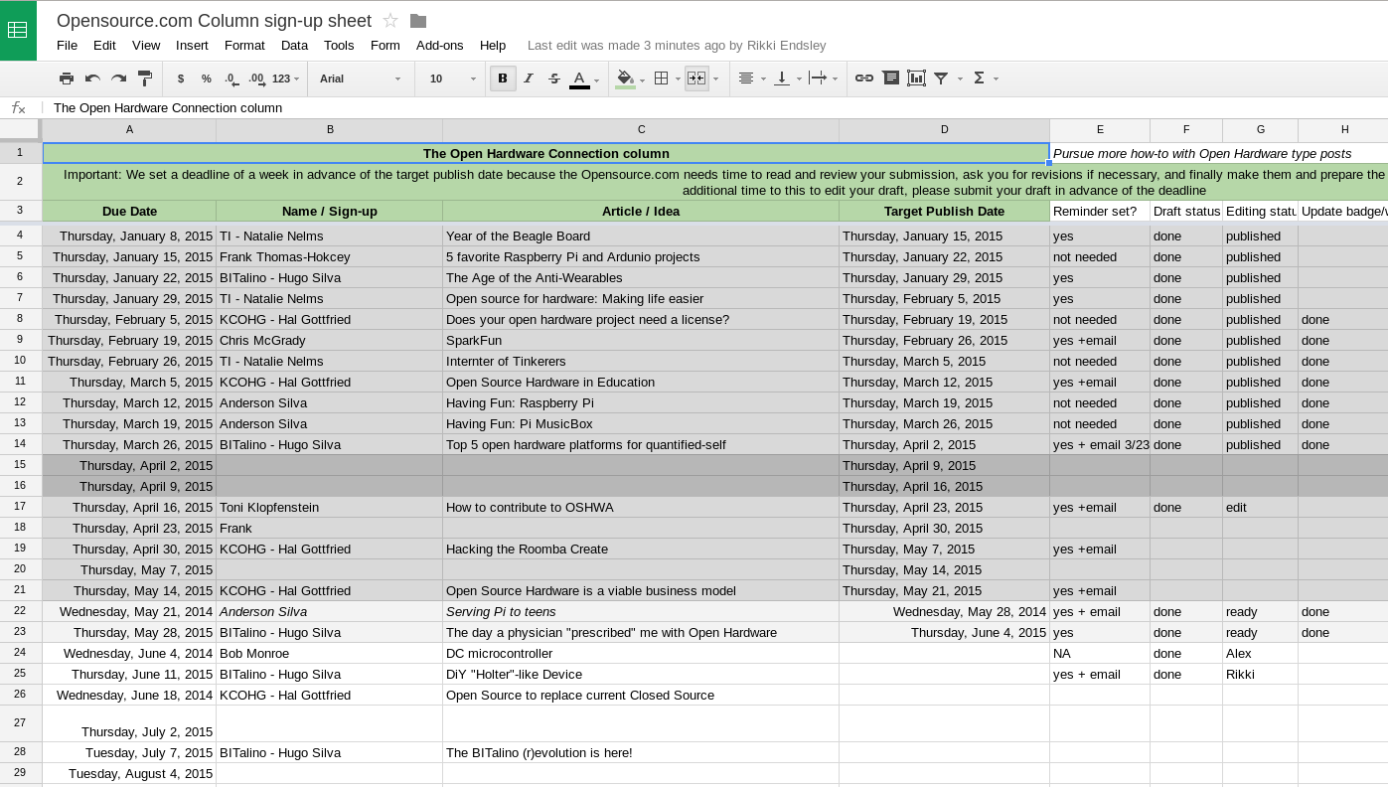
Strategy: Columns
Notes:
Example: recurring columns
Collaborative columnist instead of one author
Transparency created accountability

Slide 22
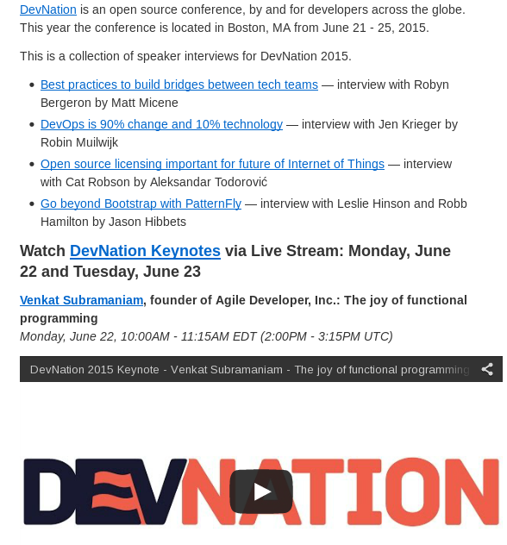
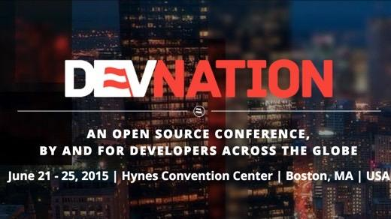
Strategy: Speaker interviews
opensource.com/devnation2015
Notes:
Example: speaker interview series

Slide 23

Strategy: SEO
Notes:
Constantly changing.
Example: Google Panda update (May 2012). SEO audit and Google News.
Write naturally and avoid keyword stuffing.
Generate content -- domain expertise in.

Slide 24

Strategy: Content distribution
Notes:
50% distribution.
Email: 220K subscribers
documented social media strategy for Twitter, Facebook, and Google+
YouTube, Reddit, etc.

Slide 25

Strategy: Social media
Notes:
Schedule social media
Don’t just tweet an article once.
Success for us on Twitter
Describe our Facebook and Google+ strategy.

Slide 26

Programs
Notes:
Programs ... catalyst in the open source community
curate content
community moderators

Slide 27
Programs: Our audience
High touch, high impact
Moderators
Writers-list =
opportunities
Curate based
on results
Once/month
guest writers
One-time guest writers
Readers, comments, & sharers
Notes:
This is an example of how we segment our audience and our community of writers.
webform
one-time post
writers-list

Slide 28



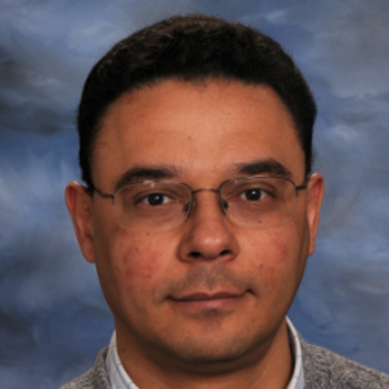
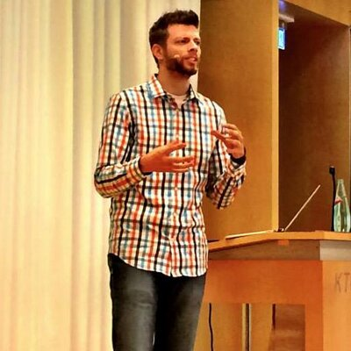








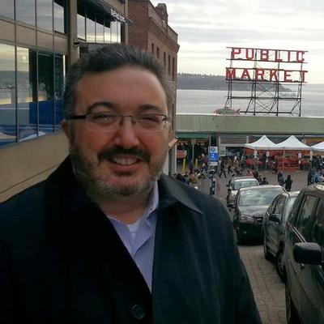
Programs: Meet the moderators
More details at: http://opensource.com/community-moderator-program
Notes:
This is the foundation of our community.
This is the future of marketing.
celebrated community
points and badge system
community awards
community moderator v1 and v2
One thing we need: More diversity, more women, more international.

Slide 29

Programs: Create a win-win
Notes:
Win-win
Trip to All Things Open

Slide 30

Programs: Awards and badges
Newbie / 0-9 points
Community Member / 10-29
Open Enthusiast / 30-99
Open Minded / 100-499
Open Source Evangelist / 500-999
Open Source Champion / 1,000-2,499
Open Source Sensei / 2,500-4,999
Open Sourcerer / 5,000+
Notes:
awards
community spotlight
points and badge system
Blackhat SEO

Slide 31

Tools
Notes:
What does our quiver of tools look like to get the job done for Opensource.com?

Slide 32
Tools: The quiver
Drupal
Etherpad
Google Docs
Mojo (Internal documentation)
Omniture
Moz (formerly SEOmoz)
Eloqua
Sprout Social
Hootsuite
Email, lots of email
Mailing lists
IRC (Internal relay chat)
Social media: Twitter, Facebook, Google+, LinkedIn

Slide 33

Tools: Drupal -Content Management
Notes:
Drupal
Vs Wordpress, Plone, Joomla

Slide 34

Tools: Omniture - Tracking
Notes:
Omniture (Google Analytics)

Slide 35
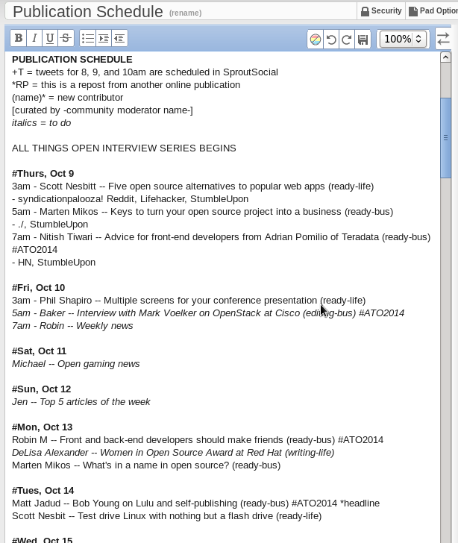
Tools: Etherpad - collaborative pads
Notes:
Etherpad is a light-weight Google Doc

Slide 36
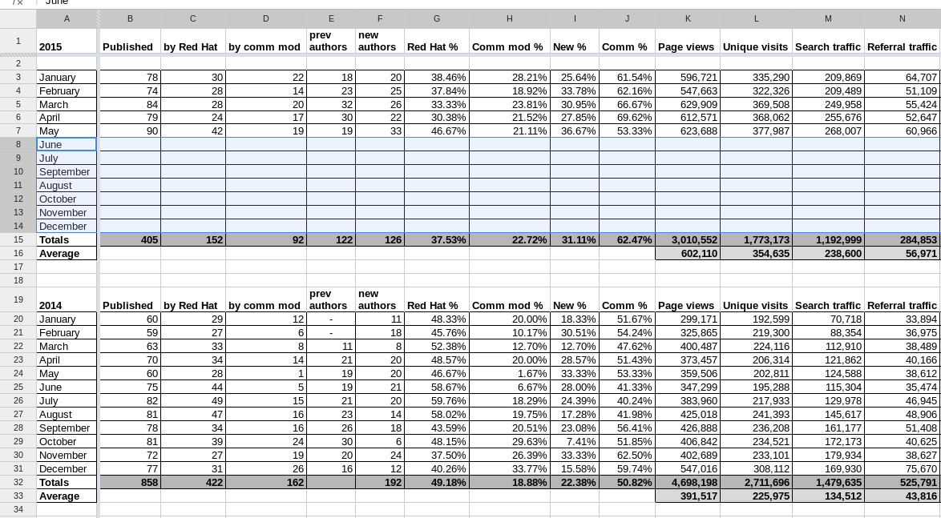
Tools: Google Docs: Tasks, stats
Notes:
Google Docs

Slide 37

Tools: Internal documentation
Notes:
Mojo (from Jive)
Document, document, document

Slide 38

Tools: Moz
Notes:
Moz, formerly SEO moz
keyword rankings
site errors

Slide 39

Results
Notes:
This was just a brief deep-dive into some of the tools that makes my team successful. Now let’s take a look at some of the results we track.

Slide 40
Results: Content
60%
Notes:
60% of our content comes from the open source community

Slide 41

Results: Referral traffic
Notes:
Over 50% is from search
10-15% from social media

Slide 42

Results: Search keywords
Notes:
Our SEO audit has paid off. We corrected some unintentional bad SEO practices and started paying attention to on-page SEO, page titles, and tagging. Again, we write naturally, but on strategic topics.
For example, we noticed that people were getting to our site by searching for the term “open source” but bouncing. So we created a What is open source page that now generates 20k page views a month and is #1 is search results.
We are now proactive in creating evergreen resource content such as What is OpenStack, What is open gaming, and what is open education—and this is a main driver for our content strategy.

Slide 43
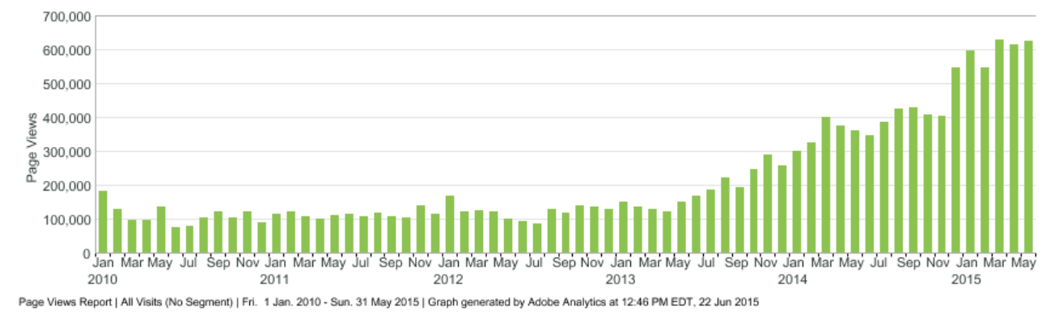
Results: Page views
Notes:
600,000 + page views
May 2013

Slide 44
The magic is in the community
Credit: http://opensource.com/business/13/12/five-community-management-tips
Notes:
community is everything
next contributor / community moderator
Finding these advocates is not easy
Limitations...
invest in your community advocates and the programs that invest in them.

Slide 45
Build the world’s premier storytelling platform
Credits: http://www.flickr.com/photos/opensourceway/7496801912/
Notes:
We are fulfilling our mission
Executive support
few lessons learned / future

Slide 46
Lessons learned
Content is king
Know your SEO (Search Engine Optimization)
Find your stars and let them shine
Keep your platform/website simple
Practice Lean methodology

Slide 47
The future for Opensource.com
Increase number of community moderators
Continue to expand on strategic content
Optimize for mobile and responsive design

Slide 48

Change the world
Credit: http://www.flickr.com/photos/opensourceway/4371000464/
Notes:
Helps you improve your day-to-day work.
Define your community, build your community and nuture it
Community building is the future of content marketing
Invest in programs and find your advocates
take what you’ve learned today about open source and change the world
Thank you

Slide 49

Q&A :: Contact
Questions
Contact
Email: jhibbets@redhat.com
Twitter: @jhibbets
IRC: shibby
Slides: https://github.com/jhibbets/presentations
Book: http://theopensourcecity.com
Credits: http://www.flickr.com/search/?w=47691521@N07&q=lolcat

Slide 50
Jim Whitehurst, Red Hat CEO
“This site is one of the ways in which Red Hat gives something back to the open source community. Our desire is to create a connection point for conversations about the broader impact that open source can have--and is having--even beyond the software world.”
“This will not be a site for Red Hat, about Red Hat. Instead this will be a site for open source, about the future.”
Notes:
about the broader impact that open source can have
even beyond the software world
“This will not be a site for Red Hat, about Red Hat. Instead this will be a site for open source, about the future.”

