Slide 1

Open culture:
A driving force for IT transformation
Panel discussion: Patricia Bogoevici,
David Egts, E.G. Nadhan
Moderators: Thomas Cameron, Jason Hibbets
May 4, 2017

Slide 2

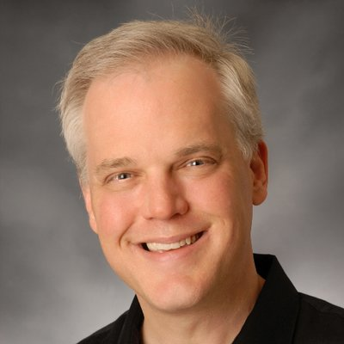
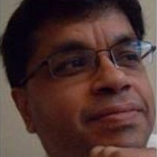
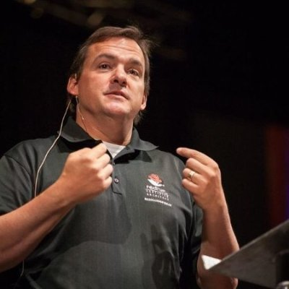
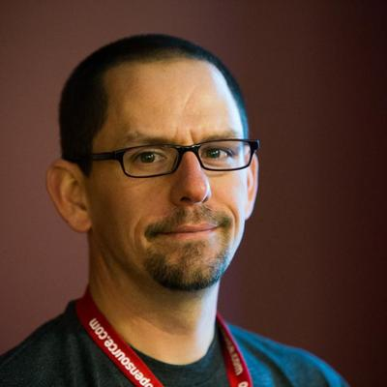
Sr. IT Manager for DevOps & Agile
@patriciabogoevi
Chief Technologist, North America Public Sector
@davidegts
Chief Technology Strategist (Central)
@NadhanEG
Senior Principal Cloud Evangelist @thomasdcameron
Opensource.com Community Manager
@jhibbets
Open culture:
A driving force for
IT transformation

Slide 3

THANK YOU
plus.google.com/+RedHat
facebook.com/redhatinc
linkedin.com/company/red-hat
twitter.com/RedHatNews
youtube.com/user/RedHatVideos

Slide 4


Slide 5

Sr. IT Manager for DevOps & Agile
@patriciabogoevi
Senior Principal Cloud Evangelist @thomasdcameron
Opensource.com Community Manager
@jhibbets
Chief Technologist, North America Public Sector
@davidegts
Chief Technology Strategist (Central)
@NadhanEG

Slide 6

Sr. IT Manager for DevOps & Agile
@patriciabogoevi
Chief Technologist, North America Public Sector
@davidegts
Chief Technology Strategist (Central)
@NadhanEG
Senior Principal Cloud Evangelist @thomasdcameron
Opensource.com Community Manager
@jhibbets

