Slide 1
Open source
beyond technology
Jason Hibbets
Opensource.com editor, Red Hat
Code for Raleigh brigade captain
CityCamp NC co-chair
Atlanta Drupal Business Summit
May 15, 2014

Slide 2

Improve the citizen experience
Credit: http://opensource.com/government/13/8/citizen-cio

Slide 3

WARNING: Objects in government are transparent, collaborative, and participatory
Credit: http://hibbets.net

Slide 4

Credits: http://www.flickr.com/photos/opensourceway/7496801912/

Slide 5

Open source is like a recipe
Credit: http://www.flickr.com/photos/47691521@N07/5497223072/

Slide 6
Open is better.

Slide 7

Open source model of participation
Credit: Red Hat

Slide 8

Transparency
Credit: http://www.flickr.com/photos/opensourceway/7496800772/

Slide 9

Collaboration
Credit: http://www.flickr.com/photos/opensourceway/4404008626/

Slide 10

Participation
Credit: https://wiki.gnome.org/OutreachProgramForWomen#Cartoon

Slide 11

Rapid prototyping
Credit: http://www.flickr.com/photos/opensourceway/5041738335/

Slide 12

Meritocracy
Credit: http://www.flickr.com/photos/opensourceway/4426824995/

Slide 13

Passion
Credit: http://www.flickr.com/photos/opensourceway/5752191750/

Slide 14

Credit: Red Hat

Slide 15


Discover an open world
Credit: Red Hat & Opensource.com

Slide 16
Open source is a better way
Transparency → accountability
Collaboration → innovative ideas
Participation → more eyes, ideas
Rapid prototyping → failing faster
Meritocracy → best ideas, buy-in
Passion → commitment

Slide 17

Beyond coding
Credit: http://www.flickr.com/photos/opensourceway/4581225603/in/set-72157623343008011/

Slide 18

Credit: http://www.flickr.com/photos/opensourceway/4459199503/in/set-72157625738142672

Slide 19

Credit: http://opensource.com/sites/default/files/imagecache/image-full-size/images/education/gov_vending.png

Slide 20

Credit: http://www.flickr.com/photos/opensourceway/5537457791/in/set-72157628737085119

Slide 21

Open government initiative
Credit: http://whitehouse.gov

Slide 22
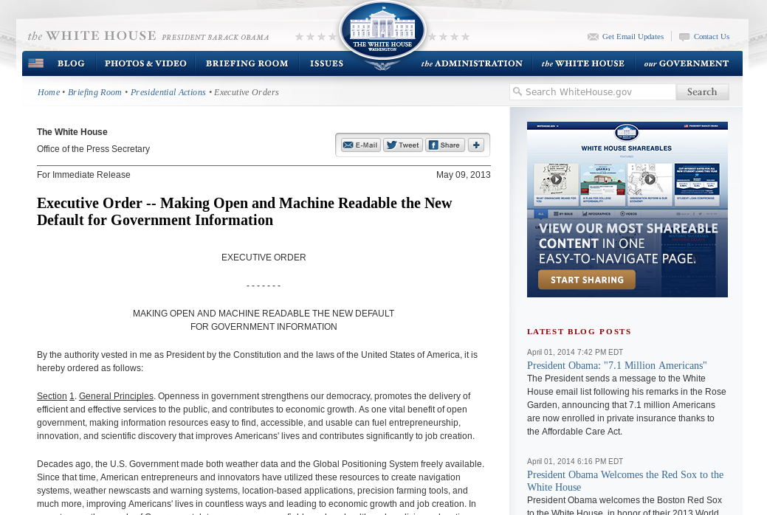
Default to open
Credit: http://whitehouse.gov

Slide 23
WARNING: Objects in city government are more open than expected
Credit: http://hibbets.net

Slide 24

Sharing a story
Credit: http://opensource.com

Slide 25

Creating a brand
Credit: http://www.flickr.com/photos/opensourceway/5496629913/in/set-72157628737085119

Slide 26

Creating a community
Credit: http://www.flickr.com/photos/opensourceway/8516817076/in/photostream

Slide 27

The catalyst
Credit: http://citycampral.org

Slide 28

Community of passion
Credit: http://citycampral.org

Slide 29

An open government unconference
Credit: https://www.facebook.com/CityCampRal/photos_stream

Slide 30

TriangleWiki
Credit: http://trianglewiki.org

Slide 31

TriangleWiki Day
Credit: http://citycampral.org

Slide 32

The impact
633 page edits
100 maps
138 new photos added
Credit: http://citycampral.org

Slide 33

RGreenway
Credit: RGreenway – http://RGreenway.com

Slide 34


Evolving CityCamp
Credits: http://citycampnc.org | http://codeforamerica.org

Slide 35

A Peace Corp for geeks
Credit: http://codeforamerica.org/

Slide 36

Code for Raleigh
Credit: http://brigade.codeforamerica.org/

Slide 37

Adopt-a-bus shelter
Credit: http://adoptashelter.raleighnc.gov/

Slide 38

Triangle Code for America Division
Join in: http://www.meetup.com/Triangle-Code-for-America/
Credit: http://brigade.codeforamerica.org/

Slide 39
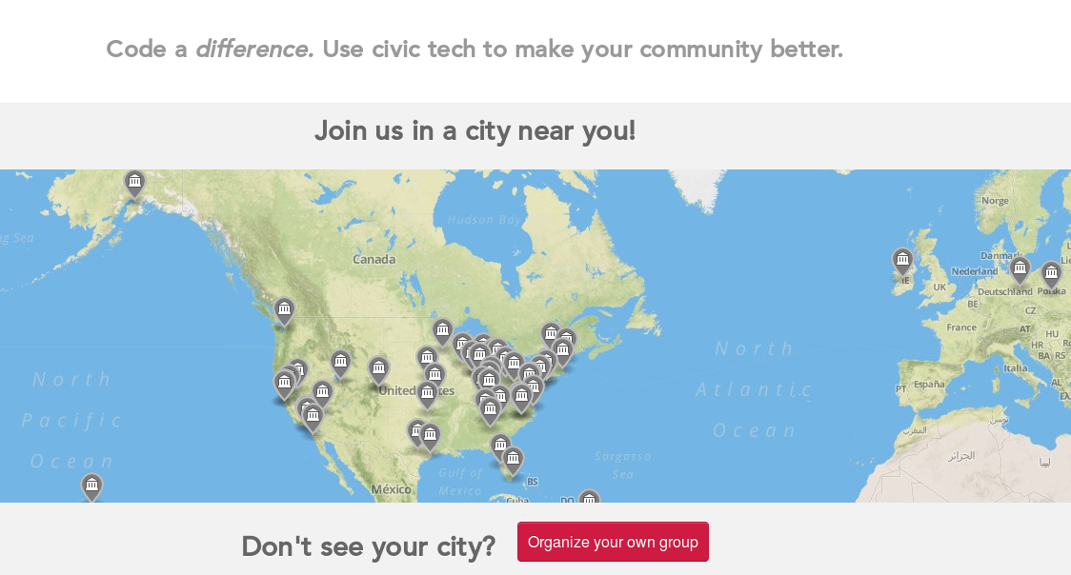
Join or form a brigade
Credit: http://brigade.codeforamerica.org/

Slide 40
Raleigh: A case study
Credit: http://www.flickr.com/photos/opensourceway/5496629913/in/set-72157628737085119

Slide 41

SeeClickFix
Credit: http://seeclickfix.com/raleigh

Slide 42

Open government resolution

Slide 43

Open Raleigh
Credit: City of Raleigh – http://raleighnc.gov

Slide 44
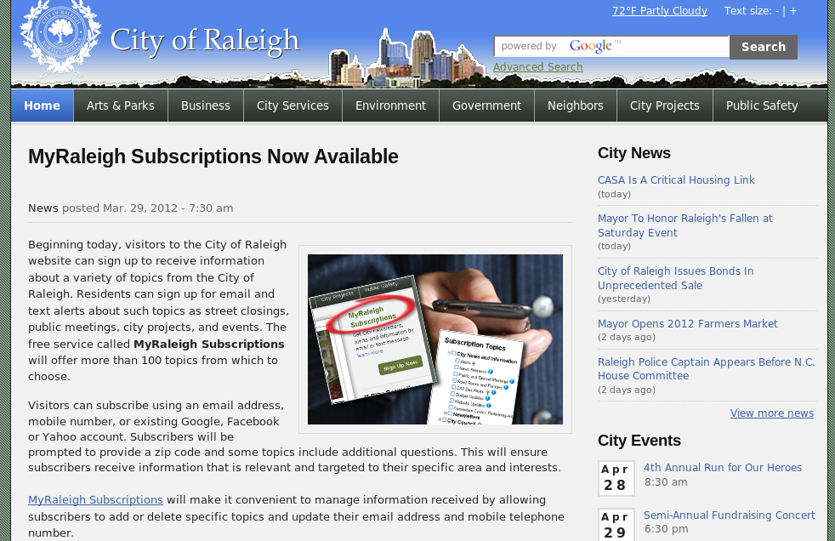
My Raleigh Subscriptions
Credit: City of Raleigh – http://raleighnc.gov

Slide 45
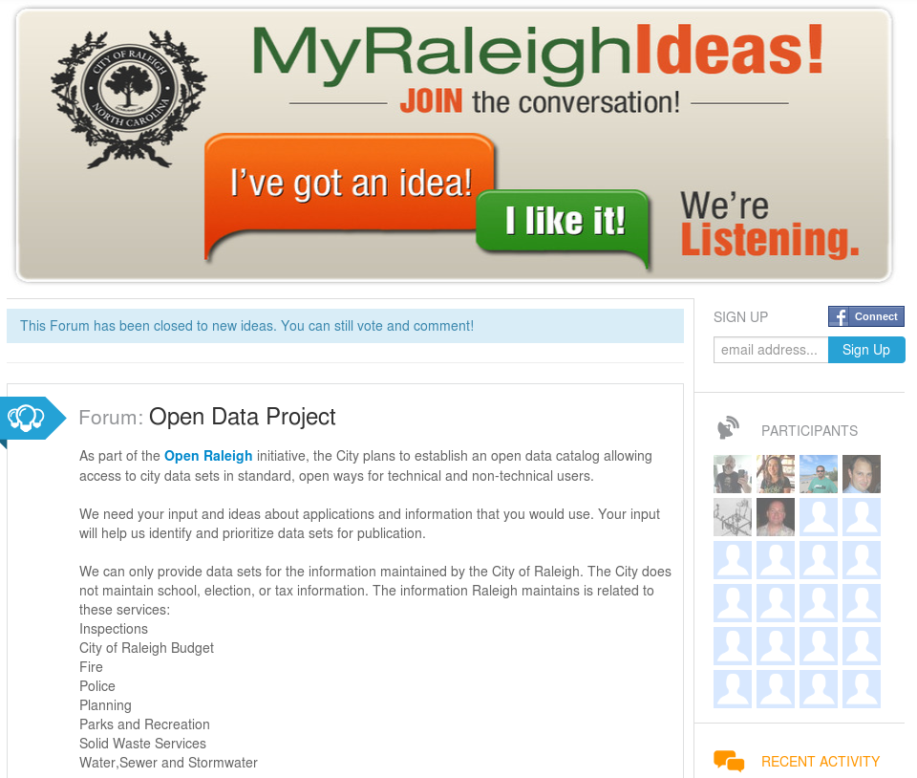
Credit: City of Raleigh – http://myraleighideas.com

Slide 46

data.raleighnc.gov
Credit: https://data.raleighnc.gov/

Slide 47

Credit: https://data.raleighnc.gov/

Slide 48


We built this city on open source
Open Raleigh
Code for Raleigh
Open government
resolution
My Raleigh Ideas!
My Raleigh
Subscriptions
RGreenway
NC Datapalooza

Slide 49
Elements of an open source city
Culture/participation
Open government policy
Open data policy
Open source conferences & user groups
Economic development

Slide 50

theopensourcecity.com
Credit: http://theopensourcecity.com/

Slide 51

Credit: http://theopensourcecity.com/

Slide 52

The game is changing
Credit: http://opensource.com/government/13/8/citizen-cio

Slide 53

The magic is in the community
Credit: http://opensource.com/business/13/12/five-community-management-tips

Slide 54

The Enterprisers Project
Credit: https://enterprisersproject.com/

Slide 55

Change the world
Credit: http://www.flickr.com/photos/opensourceway/4371000464/

Slide 56

Q&A :: Contact
Questions
Contact
  Email: jhibbets@redhat.com
  Twitter: @jhibbets
  IRC: shibby
  Slides: https://github.com/jhibbets/presentations
  Book: http://theopensourcecity.com
Credits: http://www.flickr.com/search/?w=47691521@N07&q=lolcat

