Slide 1
Open Source All The Cities
Jason Hibbets
opensource.com project manager, Red Hat
October 24, 2013
All Things Open

Slide 2

Explaining open source
Credit: http://www.flickr.com/photos/opensourceway/4371000818/in/set-72157623343017387

Slide 3

Open source is like a recipe
Credit: http://opensource.com/life/12/12/open-source-pumpkin-spice-latte

Slide 4

Open source model of participation
Transparency
Collaboration
Rapid prototyping
Meritocracy
Passion
Credit: Red Hat

Slide 5

Transparency
Credit: http://www.flickr.com/photos/opensourceway/7496800772/

Slide 6

Collaboration
Credit: http://www.flickr.com/photos/opensourceway/4404008626/

Slide 7

Rapid prototyping
Credit: http://www.flickr.com/photos/opensourceway/5041738335/

Slide 8

Meritocracy
Credit: http://www.flickr.com/photos/opensourceway/4426824995/

Slide 9

Passion
Credit: http://www.flickr.com/photos/opensourceway/5752191750/

Slide 10
Open source is a better way
Transparency → accountability
Collaboration → innovative ideas
Rapid prototyping → failing faster
Meritocracy → best ideas, buy-in
Passion → commitment

Slide 11

Credit: Red Hat

Slide 12


Beyond software
Credit: Red Hat & opensource.com

Slide 13

Open source applied to government
Credit: http://www.flickr.com/photos/opensourceway/4459199503/in/set-72157625738142672

Slide 14

Beyond coding
Credit: http://www.flickr.com/photos/opensourceway/4581225603/in/set-72157623343008011/

Slide 15

Beyond voting
Credit: http://www.flickr.com/photos/opensourceway/5537457791/in/set-72157628737085119

Slide 16

Sharing a story
Credit: http://opensource.com

Slide 17

Creating a community
Credit: http://www.flickr.com/photos/opensourceway/8516817076/in/photostream

Slide 18

Creating a brand
Credit: http://www.flickr.com/photos/opensourceway/5496629913/in/set-72157628737085119

Slide 19

The catalyst
Credit: http://citycampral.org

Slide 20

Community of passion
Credit: http://citycampral.org

Slide 21

An open government unconference
Credit: https://www.facebook.com/CityCampRal/photos_stream

Slide 22

TriangleWiki
Credit: http://trianglewiki.org

Slide 23

TriangleWiki Day
Credit: http://citycampral.org

Slide 24

The impact
633 page edits
100 maps
138 new photos added
Credit: http://citycampral.org

Slide 25

RGreenway
Credit: RGreenway – http://RGreenway.com

Slide 26


Evolution
Credits: http://citycampnc.org | http://codeforamerica.org

Slide 27

A Peace Corp for geeks
Credit: http://codeforamerica.org/

Slide 28

Code for Raleigh
Credit: http://brigade.codeforamerica.org/

Slide 29

Recycling code/projects
Credit: http://brigade.codeforamerica.org/

Slide 30
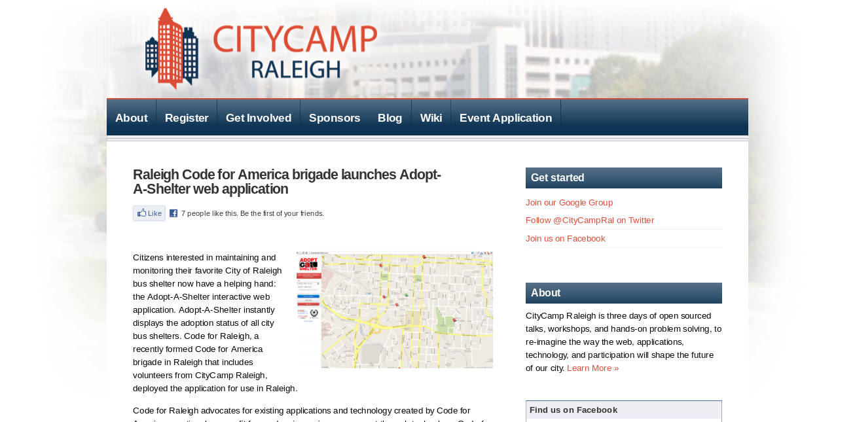
Credit: http://citycampral.org/2012/11/raleigh-code-for-america-brigade-launches-adopt-a-shelter-web-application/

Slide 31

Adopta
Credit: http://adoptashelter.raleighnc.gov/

Slide 32
Triangle Code for America Division
Join in: http://www.meetup.com/Triangle-Code-for-America/
Credit: http://brigade.codeforamerica.org/

Slide 33
Raleigh: A case study
Credit: http://www.flickr.com/photos/opensourceway/5496629913/in/set-72157628737085119

Slide 34

SeeClickFix
Credit: http://seeclickfix.com/raleigh

Slide 35

Open government resolution

Slide 36
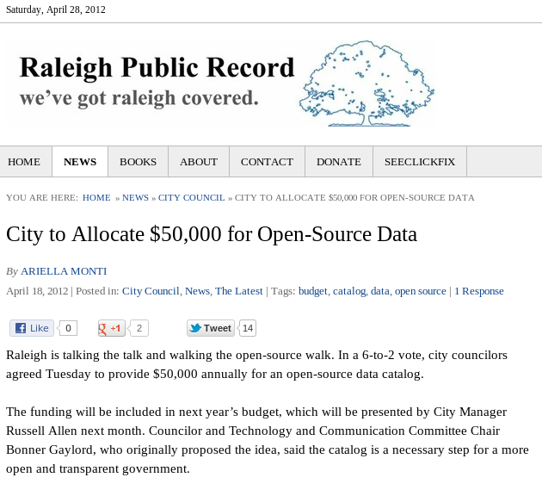
$50k for open data portal
Credit: http://raleighpublicrecord.org

Slide 37

Open Raleigh
Credit: City of Raleigh – http://raleighnc.gov

Slide 38
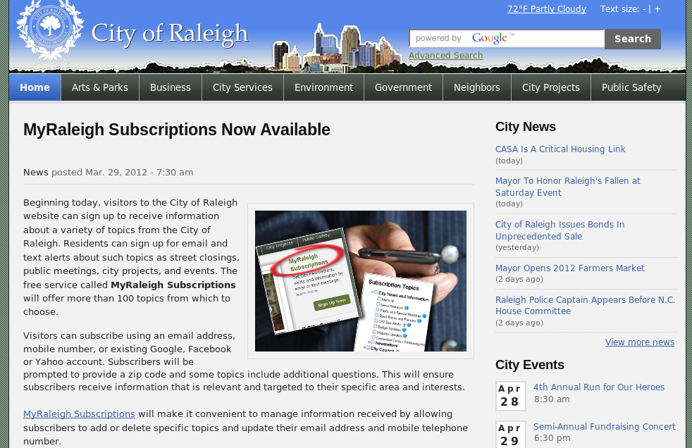
My Raleigh Subscriptions
Credit: City of Raleigh – http://raleighnc.gov

Slide 39

My Raleigh Ideas!
Credit: City of Raleigh – http://myraleighideas.com

Slide 40
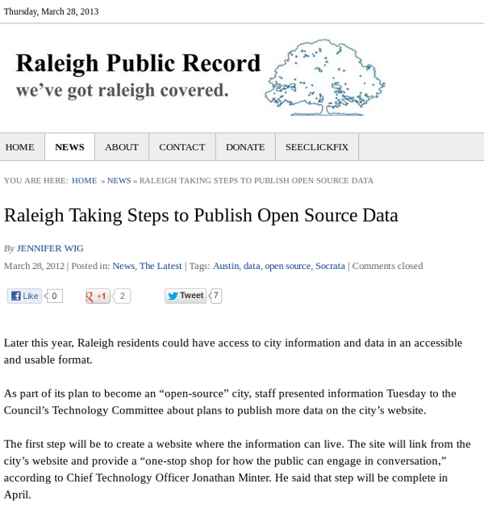
Open data sets
Credit: http://www.raleighpublicrecord.org/news/2012/03/28/raleigh-taking-steps-to-publish-open-source-data/

Slide 41

data.raleighnc.gov
Credit: https://data.raleighnc.gov/

Slide 42
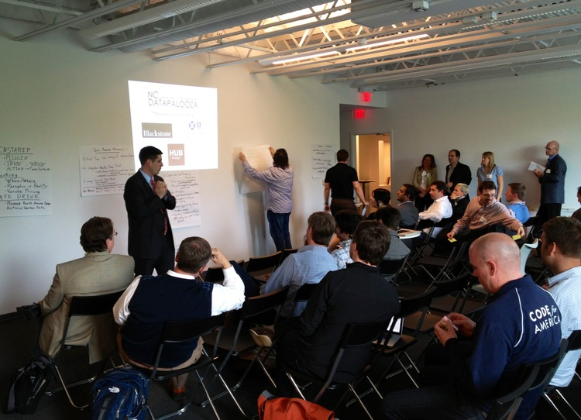

DataJam & Datapalooza
Credits: http://ncdatapalooza.com/ | #NCDataPalooza

Slide 43


We built this city on open source
Open Raleigh
Code for Raleigh
Open government
resolution
My Raleigh Ideas!
MyRaleigh
Subscriptions
RGreenway
NC Datapalooza

Slide 44

Credit: http://theopensourcecity.com/

Slide 45
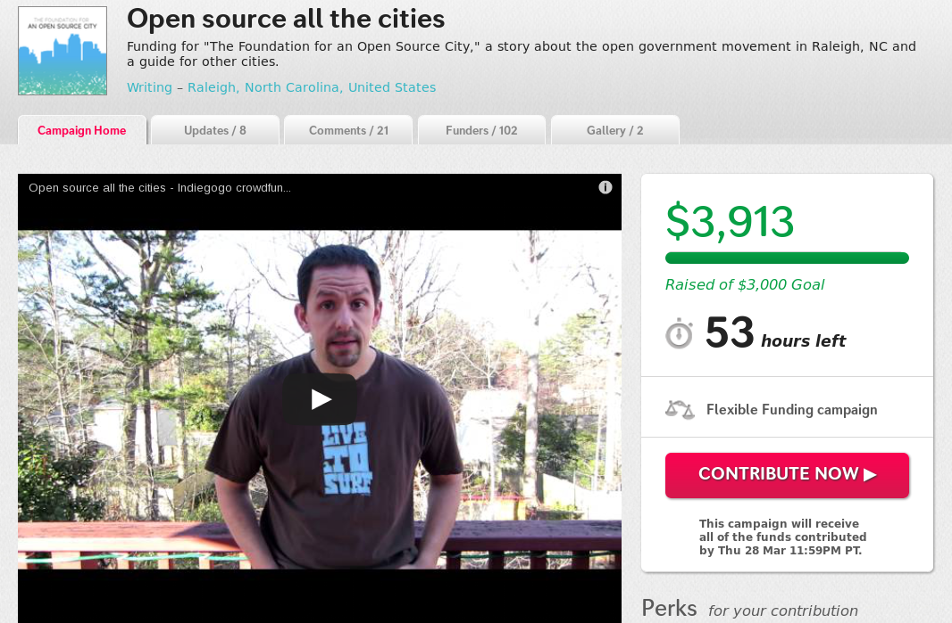
Credit: http://www.indiegogo.com/projects/open-source-all-the-cities/x/2452834

Slide 46

Credit: http://theopensourcecity.com/

Slide 47
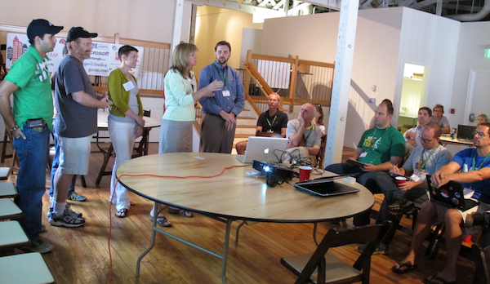
Elements of an open source city
Culture/participation
Open government and data policies
Open source conferences & user groups
Economic development
Credit: http://www.facebook.com/CityCampRal

Slide 48

Credit: http://opensource.com/government/13/8/citizen-cio

Slide 49

Change the world
Credit: http://www.flickr.com/photos/opensourceway/4371000464/

Slide 50
Q&A
Questions
Contact
  Email: jhibbets@redhat.com
  Twitter: @jhibbets
  IRC: shibby

