Slide 2
Thursday

Slide 3
CityCamp NC 2017

Slide 4
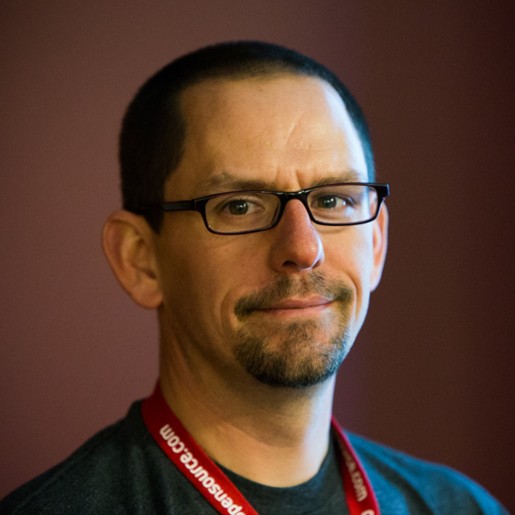
Welcome, Jason Hibbets
CityCamp NC co-chair

Slide 5
CityCamp NC
Overview

Slide 6
Code of conduct
http://citycampnc.org/about/code-of-conduct/

Slide 7
Environmental friendly
event

Slide 8
Let’s talk lightning talks

Slide 9
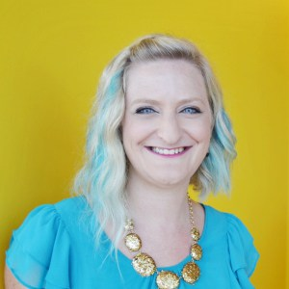
Lightning talks
Emcee, Erin Terry

Slide 10
The world’s first ever
Mega-lightning talk.
(We think.)

Slide 11
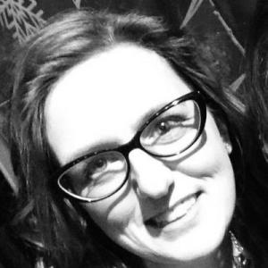
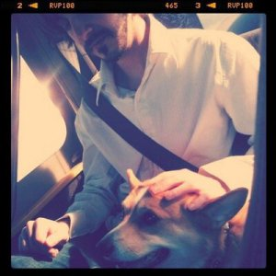
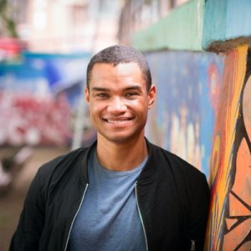
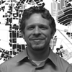
The State of Open Data
Bonnie Brown, City of Raleigh
Daniel Dunn,
Town of Chapel Hill
Ben Strauss, Wake County
Sam McClenney, City and County of Durham

Slide 12
Intermission
(restock pizza & beverages
and use the restroom)
Return at 7:05 pm

Slide 13
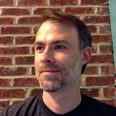
Lightning Talk:
NC Reentry Resources Hub and Brigade Collaboration – Jason Marshall

Slide 14
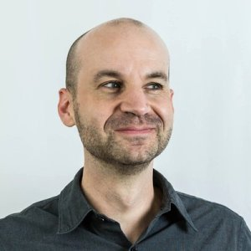
Lightning Talk:
Creative communities and the power of storytelling – Jonathan Opp

Slide 15
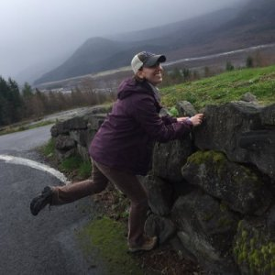
Lightning Talk:
STEM Engagement:
Hey you!! – Dr. Sarah Windsor

Slide 16
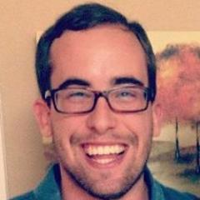
Lightning Talk:
There's a Fee For That?
A Case Study in Building a Public-Facing Application – Peter Elbaum

Slide 17
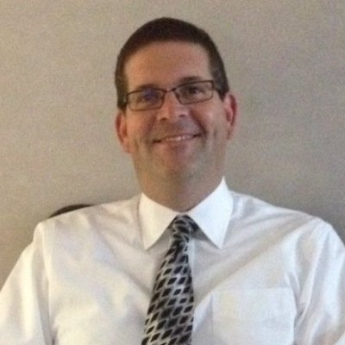
Lightning Talk:
Environmental Health and Safety Director / Innovation Partner – Andre Pierce &
Bill Scanlon

Slide 18
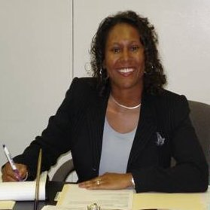
Lightning Talk:
Improving Digital Inclusion through Design Thinking in the City of Raleigh – Linda Graham Jones

Slide 19
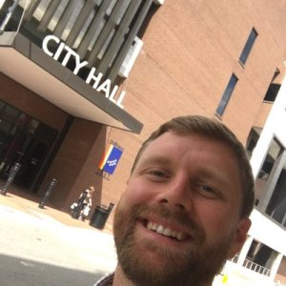
Lightning Talk:
Innovate Durham, A Public-Private Innovation Partnership – Ben Kittelson

Slide 20
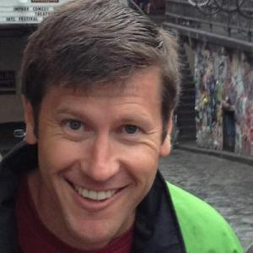
Lightning Talk:
Using Open Data to Build News Tools & Products – Ryan Thornburg

Slide 21
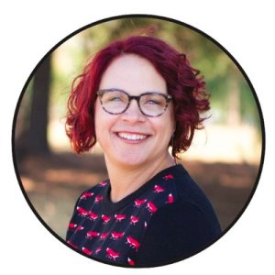
Lightning Talk:
Hacking Government Innovation – K. Melissa Kennedy

Slide 22
Thank you!
Networking time. Get to know your fellow CityCampers.

Slide 23
Friday

Slide 24
Welcome to
CityCamp NC

Slide 25
Welcome, Jason Hibbets
CityCamp NC co-chair

Slide 26
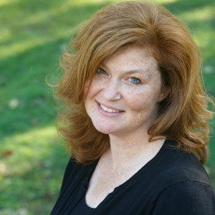
Emcee
Ginny Ghezzo

Slide 27
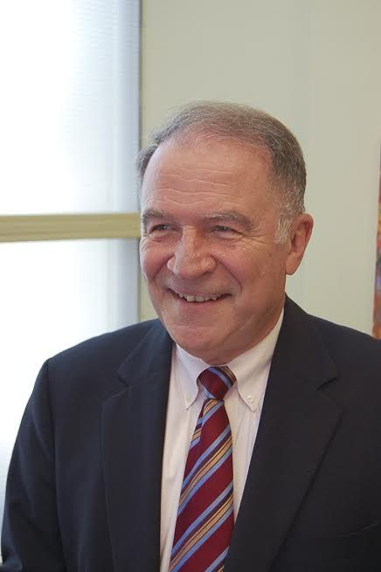
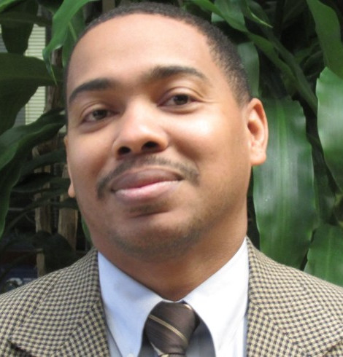
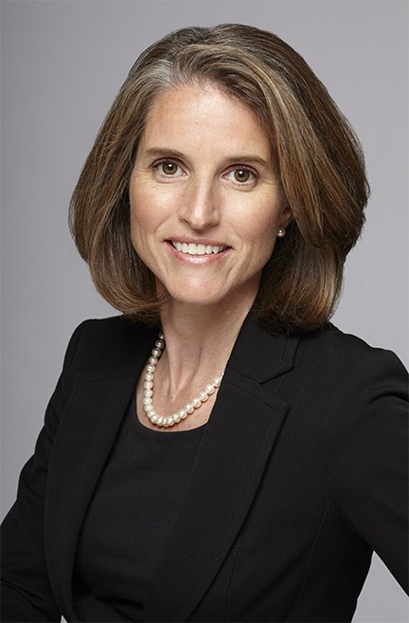
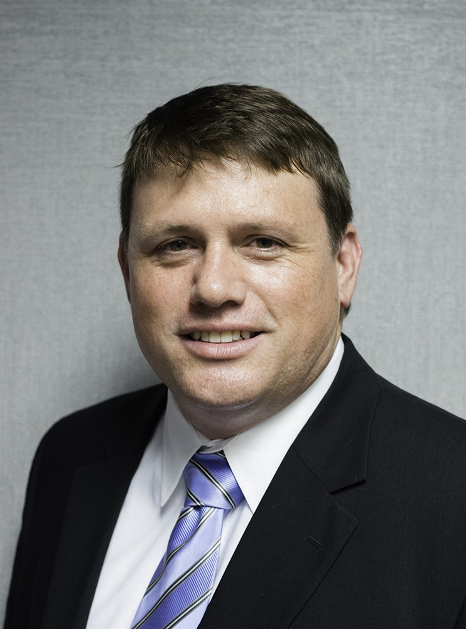
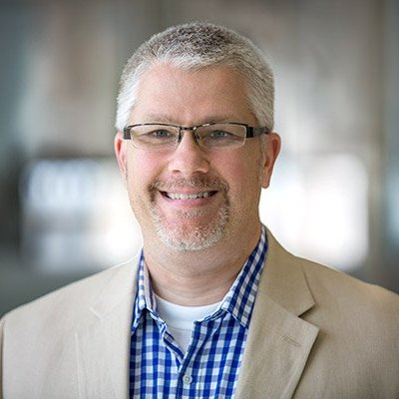
Smart Cities Panel
Dennis Kekas,
NC State
Rodney Roberts,
City of Greensboro
Jennifer Robinson,
SAS
Terry Yates,
Town of Cary
Moderator, Bill Greeves,
CIIO, Wake County

Slide 28
Keynotes
&
Inspiration

Slide 29
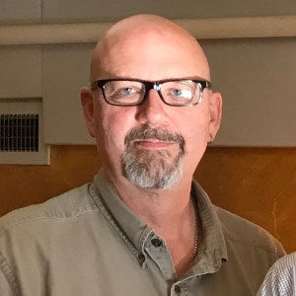
Featured Code for NC project:
NC Reentry Resources Hub:
A Journey From 1 to 100 Counties
Eric Jackson, Code for Asheville
Jason Marshall,
Code for Greensboro

Slide 30
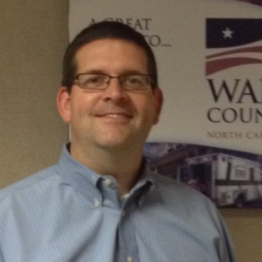
Introduction to open data, challenges, and data.world
Bill Scanlon,
Wake County

Slide 31
Break until 10:45

Slide 32
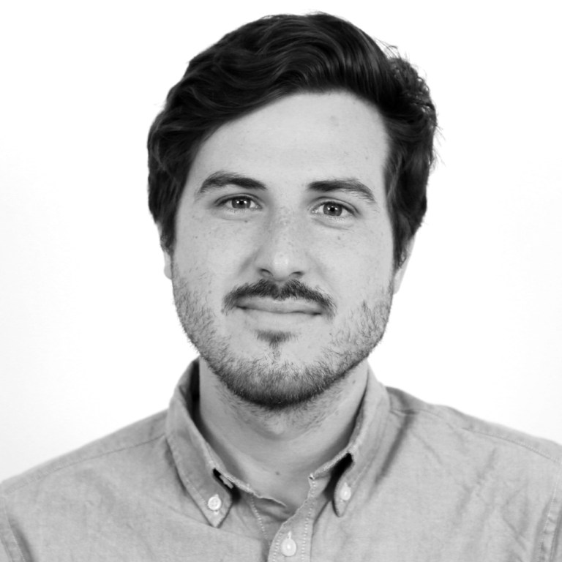
Keynote
Stephen Larrick
Open Cities Director,
Sunlight Foundation

Slide 33
Let’s start the (un)Conference.

Slide 34
What's a good pitch?

Slide 35
Your turn.
Let’s create the (un)conference agenda.

Slide 36
Time to vote.
Lunch.

Slide 37
Unconference
sessions.

Slide 38
Thank you!
Networking social happy hour hosted by Google Fiber,
518 W Jones Street

