Slide 1
How Raleigh became
an open source city
Jason Hibbets
Opensource.com editor, Red Hat
Code for Raleigh brigade captain
CityCamp NC co-chair
October 22, 2014 | All Things Open
Notes:
By day, I’m the project manager and team lead for Opensource.com. An online publication and community highlights how the principles of open source can be applied to other disciplines business, education, and government.
By night, I’m a self proclaimed civic geek. I’m a captain for the Code for Raleigh brigade and co-chair for CityCamp NC.

Slide 2

Credit: http://www.flickr.com/photos/opensourceway/4459199503/in/set-72157625738142672
Notes:
Through my work at Opensource.com, I discovered the open government and open data movement.
I found a way to blend my passions. My passion for open source, my passion for civic participation, and my passion for my local community...Raleigh NC.

Slide 3

Improve the citizen experience
Credit: http://opensource.com/government/13/8/citizen-cio
Notes:
My mission has been to improve the citizen experience. Today, I’d like to share a few things that are making the vision become realty.

Slide 4
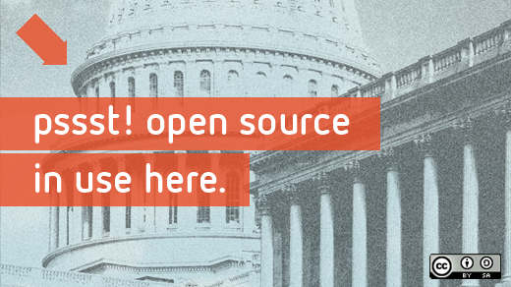
Beyond coding
Credit: http://www.flickr.com/photos/opensourceway/4581225603/in/set-72157623343008011/
Notes:
I’m not a coder I’m a community organizer.
And like any open source project that needs contributors, I found a way to bring my skillset to the table.

Slide 5

Credit: http://opensource.com/sites/default/files/imagecache/image-full-size/images/education/gov_vending.png
Notes:
Most people view government like this, you put taxes in and get services like police, fire, and trash collection out.

Slide 6

Credit: http://www.flickr.com/photos/opensourceway/5537457791/in/set-72157628737085119
Notes:
I view government like this. Us. Citizens actively engaged in their city.

Slide 7

WARNING:
Objects in city government are more open than expected
Credit: http://hibbets.net
Notes:
My story begins here in Raleigh. I got a chance to interview Mayor Charles Meeker a few years ago.
We sat down and talked about how we could apply the principles of open source to a living and breathing city.

Slide 8

Sharing a story
Credit: http://opensource.com
Notes:
After publishing the interview, something happened that I didn’t expect.
People started to contact me to say they wanted to help explore the idea of an open source city.

Slide 9

Creating a community
Credit: http://www.flickr.com/photos/opensourceway/8516817076/in/photostream
Notes:
A community started to form in Raleigh around the ideas of open source and open government. That eventually included open data.

Slide 10

Creating a brand
Credit: http://www.flickr.com/photos/opensourceway/5496629913/in/set-72157628737085119
Notes:
We started talking about how we could brand Raleigh as an open source city and what that would mean.

Slide 11

The catalyst
Credit: http://citycampral.org
Notes:
I discovered a movement called CityCamp—which is an international unconference series designed to bring open source thinking to local governments through technology and citizen ideation.
There have been CityCamp events all over the world. I’ve had the privilege to attend CityCamps in Denver, Kansas City, and Honolulu.

Slide 12

Community of passion
Credit: http://citycampral.org
Notes:
A group of citizens, including one of our city councilors came together plan the first CityCamp Raleigh. Gail and her team was very supportive of our citizen-led efforts.

Slide 13

An open government unconference
Credit: https://www.facebook.com/CityCampRal/photos_stream
Notes:
We’ve run four successful CityCamps in the Triangle, two as CityCamp Raleigh and two as a CityCamp NC.
These events have drawn interest from over 150 attendees at each event to help improve our government and explore ways that citizens could contribute.

Slide 14


Citizen-led projects
Notes:
We’ve had great success with our CityCamps and some really cool projects have come out of our events and competitions.
We have TriangleWIki, a hyperlocal version of Wikipedia that allows citizens to “edit” their city.
Our most successful app to date has been Rgreenway, a mobile app that uses open data from the city that allows people to explore our extension trail and park system.

Slide 15


Evolving our CityCamp
Credits: http://citycampnc.org | http://codeforamerica.org
Notes:
We needed to evolve CityCamp. We rebranded as CityCamp NC to extend our reach beyond the Triangle.
Along the way, CityCamp organizers eventually become Code for Raleigh and we partnered with a great organization called Code for America

Slide 16

A Peace Corp for geeks
Credit: http://codeforamerica.org/
Notes:
CfA is a non-profit in San Francisco who’s missions it to bring open source technologies to government. They have several programs to accomplish this, the most popular being their fellowship program that assigns a team of problem solvers to applicant cities each year.
The solutions the fellows design are all open source, and that means other municipalities around the world can implement and deploy these solutions.

Slide 17

Code for Raleigh
Credit: http://brigade.codeforamerica.org/
Notes:
The program that Code for Raleigh is part of is the brigade. It allows volunteers like myself and my fellow captains to help our local city through civic hacking in partnership with our city officials.

Slide 18
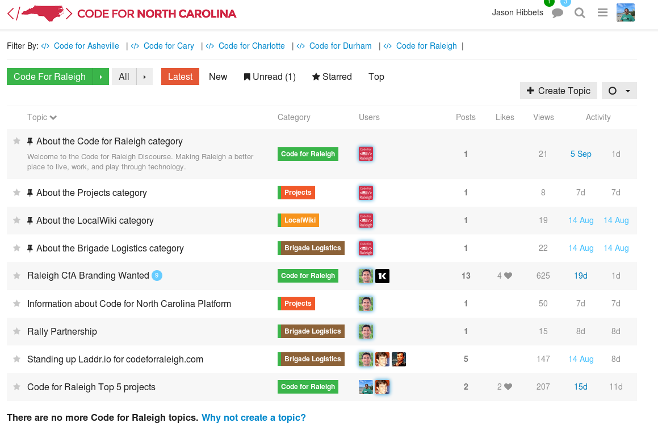
A safe place to code
Credit: http://forum.codeforraleigh.com/category/code-for-raleigh
Notes:
I like to think that our brigade is a safe place to learn how to code.
Our brigade is working on building out the infrastructure we need to be successful. We’re using Laddr for a web presence.
We’ve deployed a discussion forum using Discourse to host conversations and reduce our email.
We’re working on projects at our monthly meet-up such as NC Free Wheeling—an app that uses open data from the state of NC to promote safe bike routes.

Slide 19

Triangle Code for America Division
Join in: http://www.meetup.com/Triangle-Code-for-America/
Credit: http://brigade.codeforamerica.org/
Notes:
Locally, we have other brigades in Cary and in Durham. If you are interested in participating, I encourage you to visit our meet-up page.

Slide 20
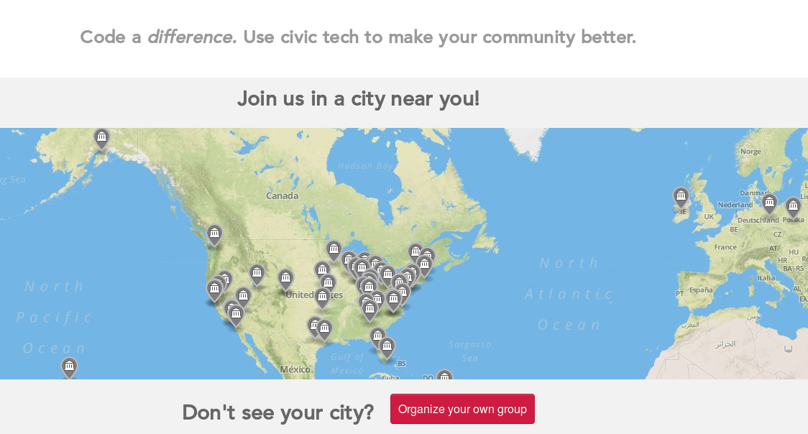
Join or form a brigade
Credit: http://brigade.codeforamerica.org/
Notes:
There are brigade all over the US, in fact, all over the world.
The opportunity that each of you have is to join an existing brigade or if you’re bold enough, start one in your city if there isn’t a civic hacking presence yet.

Slide 21

Partner with your city
Digital Connector Program
Code for Raleigh
CityCamp NC
Innovate Raleigh
American Underground & HQ Raleigh
Credit: http://opensource.com/government/13/8/citizen-cio
Notes:
Part of the reason we’ve been so successful is because of our municipal partners. Our brigade works closely with Gail’s team.

Slide 22


We built this city on open source
Open Raleigh
Code for Raleigh
Open government
resolution
My Raleigh Ideas!
My Raleigh
Subscriptions
RGreenway
NC Datapalooza
Notes:
Raleigh is helping to lead parts the open government and open data movements. We are helping to blaze a trail for others to become open source cities and we’re sharing our story along the way.

Slide 23

theopensourcecity.com
Credit: http://theopensourcecity.com/
Notes:
While I’m on stage here today sharing our story, all the details are in a book I wrote last year called The Foundation for an Open Source City.

Slide 24

Elements of an open source city
Culture/participation
Open government policy
Open data policy
Open source conferences & user groups
Economic development
Credit: http://theopensourcecity.com/
Notes:
The book outlines the elements of an open source city highlighting the culture of participation we have here in Raleigh.
It includes details on our open government and open data policies.
I also talk about why it’s important to support user groups and host conference such at All Things Open.
Lastly, I touch on how open source and open data can impact economic development and provide a ripe business environment for open source-minded companies and start-ups to thrive in.

Slide 25

Discover an open world
Credit: Red Hat & Opensource.com
Notes:
And of course, I’ll continue my story-telling on Opensource.com

Slide 26
Change the world
the open source way
Notes:
At Red Hat, our mission is to be a catalyst in communities. I’m fortunate to be able to work with such passionate open source communities.
I have a great team at Opensource.com, including our amazing community moderators.
Working with CityCamp, Code for Raleigh, and the City of Raleigh has been a great experience. Together we are changing the citizen experience.
Your mission. Find your community and go change the world the open source way.

Slide 27

Contact
  Twitter: @jhibbets
  Email: jhibbets@redhat.com
  or: jhibbets@gmail.com
  IRC: shibby
  Slides: https://github.com/jhibbets/presentations
  Book: http://theopensourcecity.com
Credits: http://www.flickr.com/search/?w=47691521@N07&q=lolcat

