Slide 1


2:00pm // HANNOVER II
A COMMUNITY-GENERATED CONTENT STRATEGY THAT WORKS
Jason Hibbets
Twitter: @ jhibbets

Slide 2
A community-generated content strategy that works
Jason Hibbets
Senior Community Architect, Red Hat
high^5five - March 4, 2019
Notes:
Smile
Introduce yourself
Quiz audience
Who is running or involved in a blog or publication?
Who is involved somehow with UGC?
Would anyone like to briefly share why they came to this session?
I might not have all the answers, but I will talk about our
content strategy
community moderator program
techniques were using to get community-generated content

Slide 3

What is open source
Image source: https://opensource.com/article/19/3/news-march-2
Notes:
The term "open source" refers to something people can modify and share because its design is publicly accessible
Read Hat does this with software and technology
You could open source a book or a project plan--architectural plans or artwork
Examples of open source that you might be familiar with include Android, Wikipedia, Linux, and WordPress
It’s really about sharing knowledge and giving people the ability to participate

Slide 4

What is Opensource.com?
Notes:
Publication platform and community of writers sharing open source stories
Sponsored by Red Hat with a team of 5 people supporting the project
A way to give something back to the open source community

Slide 5

What purpose does Opensource.com serve?
Image source: https://opensource.com/open-organization/16/2/how-hire-people-who-just-get-it
Notes:
Started as “open source beyond technology”
Launched with a philosophy called The Open Source Way
Goal was to influence the conversation about open source
Build a platform for the open source community to share their stories
Evolved to provide great content about open source, Linux, and associated technologies

Slide 6

Connection to the business is a natural next step
Image source: https://opensource.com/article/18/11/3-new-tipping-points-open-source
Notes:
Some of you may be wondering, why is this important to the business?
Top of the marketing funnel: AWARENESS
WHEN APPROPRIATE: We provide a natural next step to another Red Hat property or piece of content
IMPORTANT -- do not force this
How: Primarily from email newsletter, social media, and links in content (mostly resource menus)

Slide 7
“We're a new kind of publication: newsroom-less with hundreds of writers from various backgrounds, expertise, and skill levels. Our focus on writing articles that address readers’ needs is what drives us every day. And having many voices chiming in to help with those problems is what makes Opensource.com a go-to resource for beginners as well as veterans.”
Jen Wike Huger, Editorial manager
Source: https://opensource.com/article/19/1/happy-birthday
@jhibbets | #high5conf
Notes:
Focus: Readers needs and interest; providing a platform for the open source community
These are the most words you’ll see on a slide from me today :)

Slide 8
How we performed in 2018
Notes:
Who likes metrics and KPIs?
I thought it would be fun to start by taking a look back at 2018
I geek out with these stats all the time, so please pause me if you need clarification for anything

Slide 9
1,000+ articles
Averaging 90 articles/month

Slide 10
1.5M page views
Grew from 1.2M to 1.5M page views in 2018
Notes:
New record in January: 1.8M page views

Slide 11
1M unique visitors
Grew from 700k to 1M unique monthly visitors
Notes:
New record in January: 1.2M unique visitors

Slide 12
1.1M views from search
Grew from 750k to 1.1M page views from search (organic)
[Yearly]
Notes:
Although we’ve experimented in paid search in the past, we pivoted and spend our time creating awesome content
All search traffic is organic

Slide 13
>60% community
Staff curates and solicits content from the open source community
[2018 average]
Notes:
61% content from community / 39% from Red Hat authors (includes Opensource.com team)

Slide 14
>20% community moderators
[Yearly]
Notes:
23% from community moderators

Slide 15
33% new authors
[2018 average]
Notes:
33% from new authors
Average 21 new authors/month
A new author is someone how hasn’t published with us before

Slide 16
44 authors
[2018 average]
Notes:
44 returning authors/month
A returning author is someone who has an article published with us before

Slide 17

20k views/month
From Twitter

Slide 18

15k views/month
From Facebook
And continuing to trend downward
Notes:
Facebook is tanking sending 15k page views per month (was 50k at the beginning of the year)

Slide 19
85,000 subscribers
Email newsletter subscribers

Slide 20
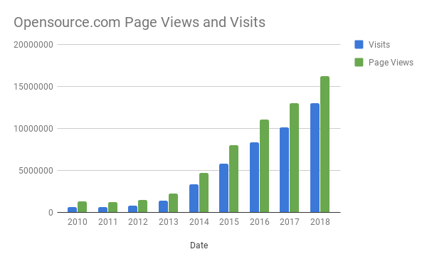
Page view traffic from 2010 - 2018
Notes:
Launched community moderator program in 2013
The growth we’ve experienced is correlated with having community input and involvement

Slide 21
Content creation
Notes:
Any questions so far?

Slide 22

Different models to support content generation
Image source: https://opensource.com/article/18/11/how-non-engineer-got-devops
Notes:
Must have: Editorial manager (common in all)
In-house writers
Contractor model
Paid writers
Community model
Did I miss any that you’re using?

Slide 23

Let’s look at our community model
Image source: https://opensource.com/open-organization/17/2/tracking-issues-publicly
Notes:
Goal: Give writers a great editorial experience so they write again
Staff working directly with authors to curate and solicit articles
We’ll get more specific on tactics and content strategy shortly
Here’s how we view our community...

Slide 24
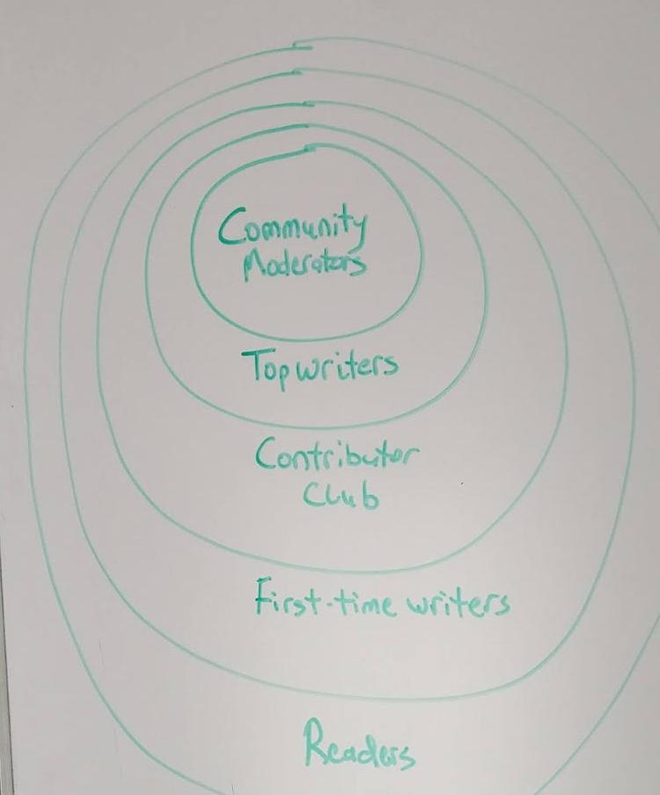
Community mapping
“Marketing funnel” for authors and contributors
Notes:
“Marketing funnel” for authors and contributors
Describe different ways to contribute
Searchers / casual readers / everyday readers & sharers
With luck and strategy, we can convert a reader to an author and recruit some to write an article → first time writer
Create a great first experience
Returning authors / contributor club - 3 articles in a 12 month period
Top writers - continue to write high performing content
Community moderators (>20%)

Slide 25

Some of our challenges
Image source: https://opensource.com/article/18/5/agile-devops-cycling
Notes:
Challenges
Letting people know they can write for us
Getting someone’s first articles

Slide 26

Our community model
Image source: https://opensource.com/article/19/2/resiliency-maps
Notes:
Explain our community moderator program
Red Hat moderators then we pivoted
Started in 2013 with 4 moderators
15-20 people
1 year commitment for 12 pieces of content
What they do: Write, curate, promote, comment gardening, help with strategy
More access; more insights; more interactions
Explain the value of the community moderator program (what do they get out of it?)
Explain the investment we make in the moderator program (ATO, in-person meeting, strategy)

Slide 27
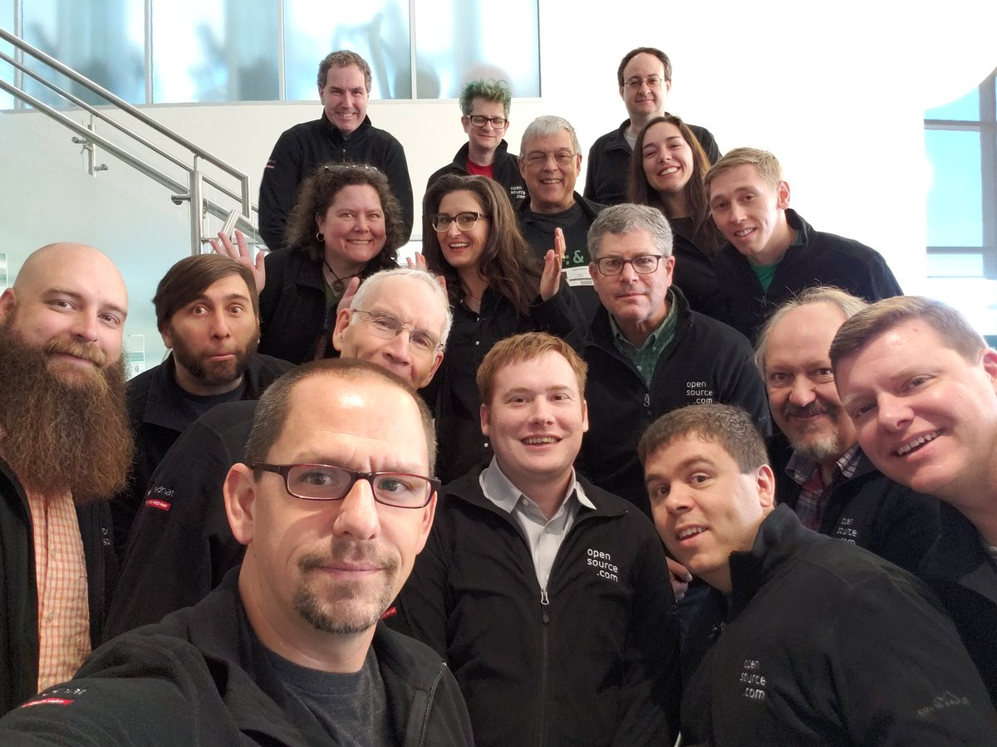
Notes:
In-person time is AMAZING; make the most of it
Community moderators and team at All Things Open 2018
Creating a group of people with a shared passion
Think about what shared passions you could focus on to create community

Slide 28
Content strategy

Slide 29

Rapid content generation
Image source: https://opensource.com/article/18/8/what-cicd
Notes:
Publishing 3-5 articles per day, +20 per week = Rapid content generation
How many of you are publishing at this rate or higher?
Community content vs in-house
How long does it take for an in-house writer to create content?
How much does it cost for an in-house writer to create content?
Community content costs less
Why: You only focused on content fit, copy editing, and publishing preparation

Slide 30

Editorial services & storytelling
Image source: https://opensource.com/article/19/2/getting-started-vim-visual-mode
Notes:
Editorial services we provide:
Reviewing abstracts for UGC
Copy editing and prep
Writing headlines
Other considerations:
Sometime dealing with highly technical content beyond our domain expertise
Non-native English authors
If we didn’t provide these services: These stories may not get told!
If they did: personal blogs without as much exposure

Slide 31

Content strategy details
Image source: https://opensource.com/article/19/2/getting-started-vim-visual-mode
Notes:
Strategy:
Publish everyday M → F and sometimes Saturday and Sunday
Distribute content via social media, syndication (Linux Today), send the top content out in a weekly newsletter, weekly top 10 post, monthly top 10 post
Core: Publish on topics we know will be popular with our readers
Publish on niche topics community members are passionate about (surprise results)
We can cover a larger breadth of content then with a small team
SEO - organic, write strategic content for long-term traffic
What in Linux? What is Kubernetes?
X tools to replace proprietary technology
Top X open source CMS/ERP/etc projects
Not breaking news or flipping press releases

Slide 32
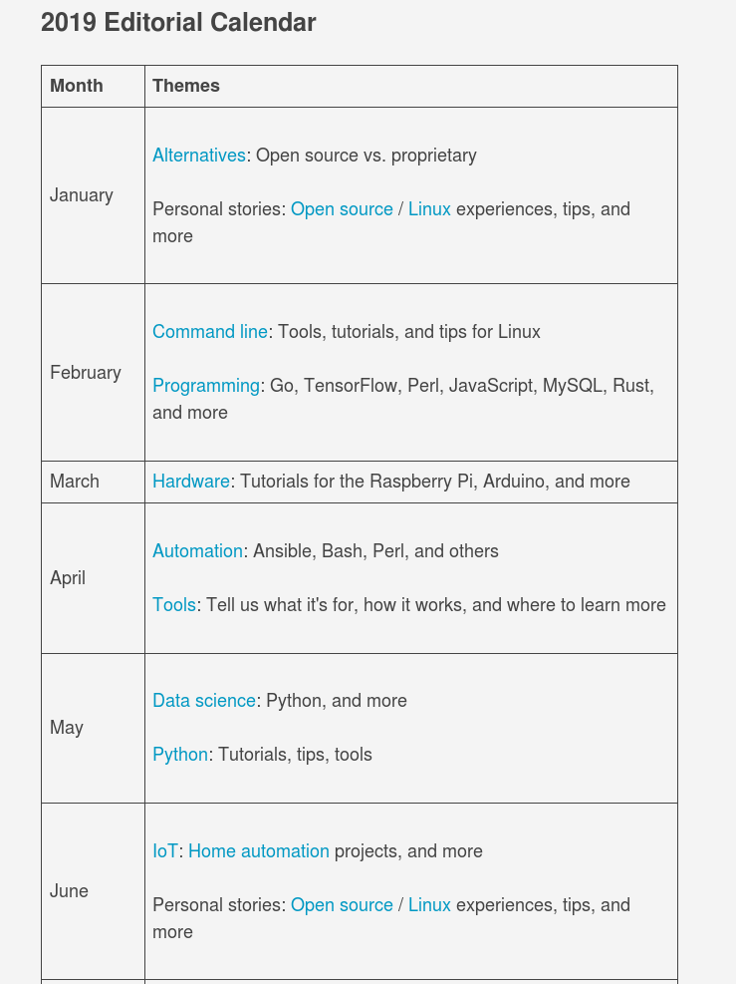
Editorial calendar
https://opensource.com/resources/editorial-calendar
Notes:
We have a public facing publishing calendar that we point authors to all the time
Helps attract new authors
Helps give existing authors writing ideas

Slide 33

How we get community generated content
Image source: https://opensource.com/article/19/1/what-does-devops-mean-you
Notes:
Here are the different ways we get community generated content
Community moderators
Writing or curating 10-12 articles / year (minimum)
Some are writing 30+ articles
Columnists
Writing once per month without community moderator commitment
Event partnerships and outreach
Get new authors, new topics
Writer’s list with weekly suggestions
450 subscribers, invite-only (after first article is published)
Send weekly suggestions of articles we are looking for with sample headlines
Shared interest groups: DevOps, programming
Similar to writers list with a smaller group of people for a specialized topic

Slide 34
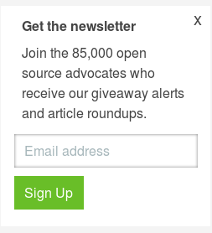
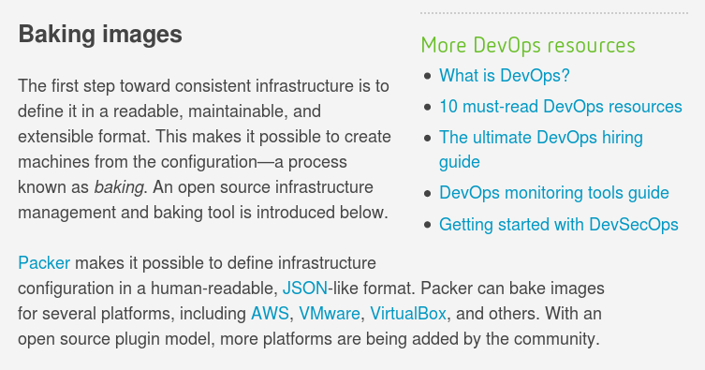
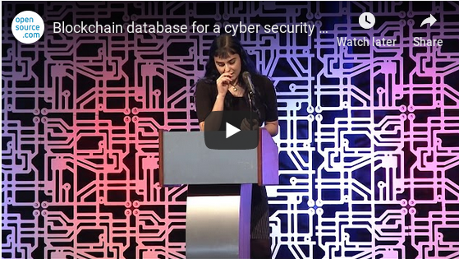
Tactics we use
Editorial calendar
Social media
Email newsletter
Resource links
Lightning talks: record and publish
Cheat sheets & downloads
Notes:
Editorial calendar
Social media
Email newsletter
Resource links
Lightning talks: record and publish
Cheat sheets & downloads

Slide 35
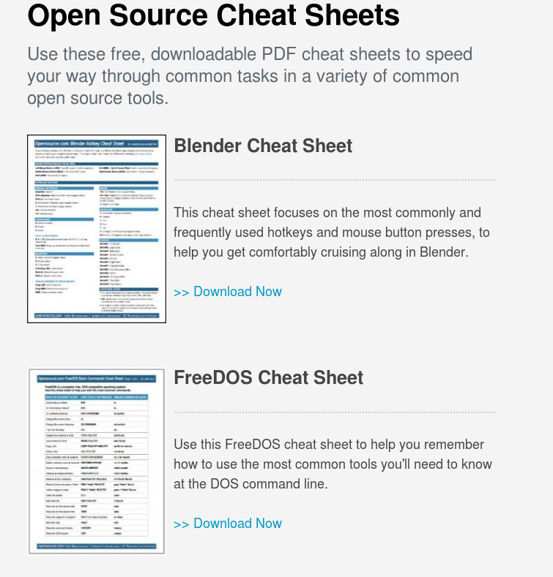
Notes:
An example of gated content
We created an entire downloads section for cheat sheets and bundled content

Slide 36
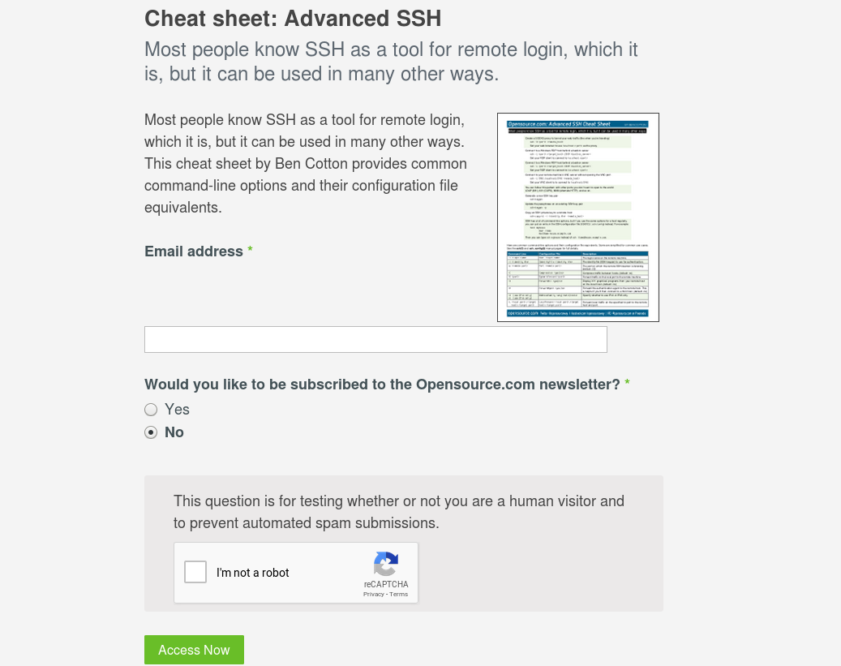
Notes:
And we’re using this content to collect email addresses
Nothing new, but this is effective for us;
Bundles allows us to re-purpose UGC

Slide 37

Who wants to talk about tools?
Image source: https://opensource.com/article/18/10/nice-things
Notes:
Whenever I attend conferences, I always want to know what tools people are using on their teams

Slide 38
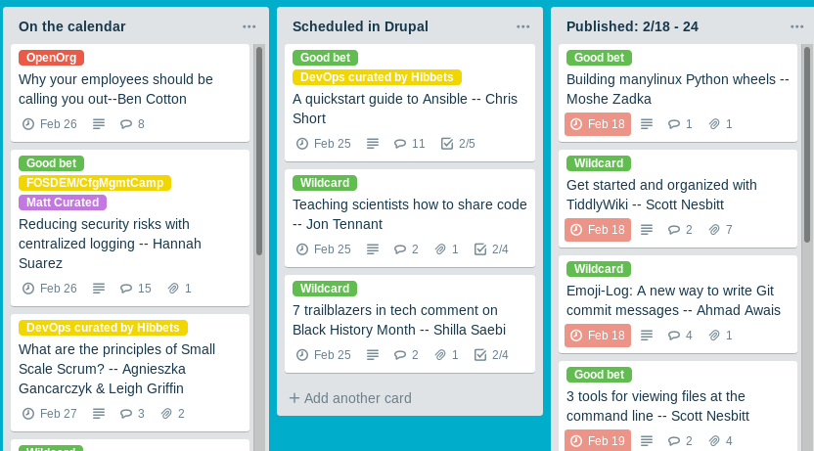
Tools we use
Trello
Drupal
Editorial calendar
Adobe analytics
Eloqua
Writing: Google docs, office docs, md files
Notes:
Trello:
Editorial workflow
Copy editing
Longer-term projects
Drupal
Partner for hosting and development (we do not use internal IT)
In house tools from IT
Adobe
Eloqua
Writing: However the author wants to wirte!

Slide 39
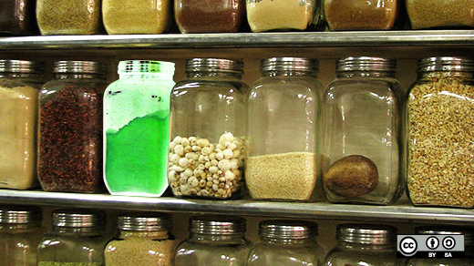
Always experimenting
Image source: https://opensource.com/business/12/12/secret-ingredient-open-source
Notes:
Always questions the way we do things
Agile: Constant feedback loops
Example: Weekly meeting for metrics and health check
New experiments:
Publishing on the weekends
Publishing a series (advent calendar, productivity hacks)
Productivity: 19 posts in a row: 75k page views
What can you try? What can you A/B test? If it fails, learn from it an move on.

Slide 40

Image source: http://opensource.com/life/13/11/open-source-thank-you
Notes:
That’s what we’re doing on Opensource.com:
Learn from our 9 years of experience
Apply it to what you’re doing
Borrow and idea and make it your own!
Think about what shared passions you could focus on to create community
Thanks for your time and attention today.

Slide 41


Contact
Email: jhibbets@redhat.com
Twitter: @jhibbets
IRC: shibby | Slack: jhibbets
Book: http://theopensourcecity.com
Slides: https://github.com/jhibbets/presentations
Notes:
We have time for questions.
If you have a blank piece of paper, I have failed you and I apologize. If you have a full page of notes, I appreciate it.
What did I miss? What did I cover too fast? What else would you like to know?

