Slide 1
Building sustainable civic tech with open data
Jason Hibbets, Senior Community Architect Opensource.com, Red Hat
Notes:
By day, I’m a community architect at Red Hat.
I work on Opensource.com, an online publication and community highlighting how the principles of open source can change the world
By night, I’m a self proclaimed civic geek
Open Raleigh Brigade
Co-chair for NC Open Pass
Code for America Brigade National Advisory Council
CfA: network of people making government work for the people, by the people, in the 21st century

Slide 2

The evolution of civic tech
Image credits: http://opensource.com/government/13/8/citizen-cio (Opensource.com)
Notes:
Mission for the last 7 years has been to improve the citizen experience with civic tech
Superpower: community organizing
Create an environment for people to do amazing things, to re-engage with local government
Goal: Find ways to foster participation and increase engagement
The only ones who can change government are us
Civic tech is evolving, we’ve learned from the early experiments
Today I want to talk about how the civic tech movement is evolving
But first, a brief quiz

Slide 3
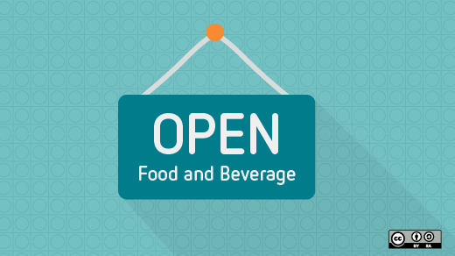
Quiz: Who likes to eat out at restaurants?
Image credits: https://opensource.com/life/15/11/tasty-translations-the-open-source-way (Opensource.com)
Notes:
By a show of hands
Quiz 1: How many of you have been out to eat in a restaurant?
Quiz 2: How many of you have noticed a health inspection score/grade?
Quiz 3: How many of you know how those scores calculated?

Slide 4

Image credits: https://www.rivcoeh.org/Programs/food
Notes:
Quiz 4: How many of you would eat in a restaurant who scored a C or worse?

Slide 5

Exploring sustainable civic tech
Image credits: https://opensource.com/article/18/1/foss-tools-agile-teams (Opensource.com)
Notes:
Story: In 2016, a group lead by the IT staff in my local county government, Wake County, started a project related to health inspection score risk factors
Goal: Allow people to drill down into the Health inspection scores on Yelp (and Wake County open data portal) to learn more about the violations
Examples: raw meat left out vs a sealed box stored improperly
Didn’t have to start from scratch: NC Food Inspector
Partnership with Code for Durham volunteers
The NC Food Inspector project had new life with a government partner
Top three in the open data competition

Slide 6

Forming an innovative partnership
Image credits: https://opensource.com/article/17/12/who-drives-culture-devops (Opensource.com)
Notes:
Story: Bill Greeves, Wake County CIO, approached me about an innovative way to partner with his team
2016 was an MVP to answer the question
Could government successfully partner with civic tech volunteers?
We expanded on this prototype in 2017

Slide 7

The future of civic tech
Image credits: https://opensource.com/open-organization/16/9/culture-trumps-tools-every-time (Opensource.com)
Notes:
Involved in civic tech for 7 years
The game is changing and evolving
Not: another app for government
Not: 24-48 hour hackathon; where teams/projects disappear after the event
Is: Smart cities/communities initiatives
Is: volunteer civic technologists working in partnership government

Slide 8

Civic tech challenges
Image credits: http://opensource.com/government/14/5/national-day-civic-hacking (Opensource.com)
Notes:
Don’t want our work to look like a hack job
Project management
People

Slide 9

Civic tech challenges: Project management
Image credits:: http://opensource.com/government/15/10/ato-interview-kaitlin-devine-18f (Opensource.com)
Notes:
3 models of civic tech
Green field / new projects
Open source / re-used / cloned projects
Augmentation model
Today, we’re going to focus on the idea of an augmentation model and how partnership play a valuable role in the future of civic tech

Slide 10

Civic tech challenges: People/consumers
Image credits: https://opensource.com/article/18/2/essential-roles-devops-culture-success (Opensource.com)
Notes:
People who need help in our community aren’t attending civic tech meet-ups or coming to tech conferences
They can ill-afford to attend town council meetings
Probably not engaging in the latest rezoning case in their neighborhood

Slide 11

Work on stuff that matters
Image credits: https://opensource.com/article/18/2/essential-roles-devops-culture-success (Opensource.com)
Notes:
10 years ago, Tim O’Reilly told us to work on stuff that matters
What resonated to me was to create more value than you capture
You could probably go a few blocks from here and find
A person who was formerly incarcerated who is having trouble getting work
Someone who applied for food stamps but was rejected because of a clerical error or gave up because the system is too complicated
A person working 2-3 jobs just to survive in our current economy
We have the tech skills, the connections, the ideas
This is why we should work on stuff that matters

Slide 12

A valuable partnership
Image credits: https://opensource.com/open-organization/17/2/tracking-issues-publicly (Opensource.com)
Notes:
Instead of focusing on the next cool app the Open Raleigh Brigade wanted to tie our efforts to actual government objectives
Up to this point, we relied on participant input and their passions
Why didn’t we think of this before?
Connecting our volunteer efforts to government objectives
It sounds boring doesn’t it?
We were focused on building a movement, now that we’ve got momentum, it was time for us to be more strategic
How did we does this?

Slide 13

Effective collaboration with government
Image credits: https://opensource.com/open-organization/17/4/how-branding-decisions-open (Opensource.com)
Notes:
Started with key leaders meeting and collaborating
We agreed to narrow down the list of 75 goals
We got the list down to 12 ideas that we could map to civic tech
Sent out a survey to our brigade
We hosted a meet-up to get feedback
We made a decision for the top 3
Key difference was to connect volunteers with county staff responsible for the objective

Slide 14

2017 civic tech focus
Image credits: https://opensource.com/article/18/2/devops-delivers-cool-apps-users (Opensource.com)
Notes:
Parks and Rec park finder – an app to find all the parks and greenways across our region, including programs and amenities in all municipalities
Not just a flu-shot finder – an app to where you can search for where to get flu shots and expanding the capabilities to include other health-related needs such as finding narcan and prescription drop-off locations
Business development diversity accelerator – looking at ways to help minority and underrepresented people turn their business ideas into actual businesses by providing resources to streamline the business-creation process

Slide 15
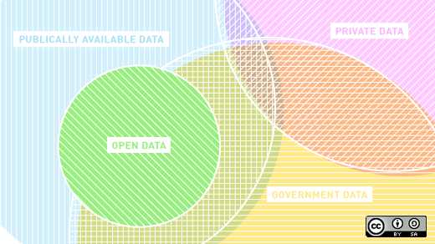
Open data, open data, and more open data
Image credits: https://opensource.com/article/17/5/open-data-trends (Opensource.com)
Notes:
Where do you start with open data?
There are so many open data sets available from local to state to federal
Data.gov has almost 235,000 data sets
Our team curated local, state, and federal data sets for our 3 initiatives
County IT team pitched to stakeholders

Slide 16
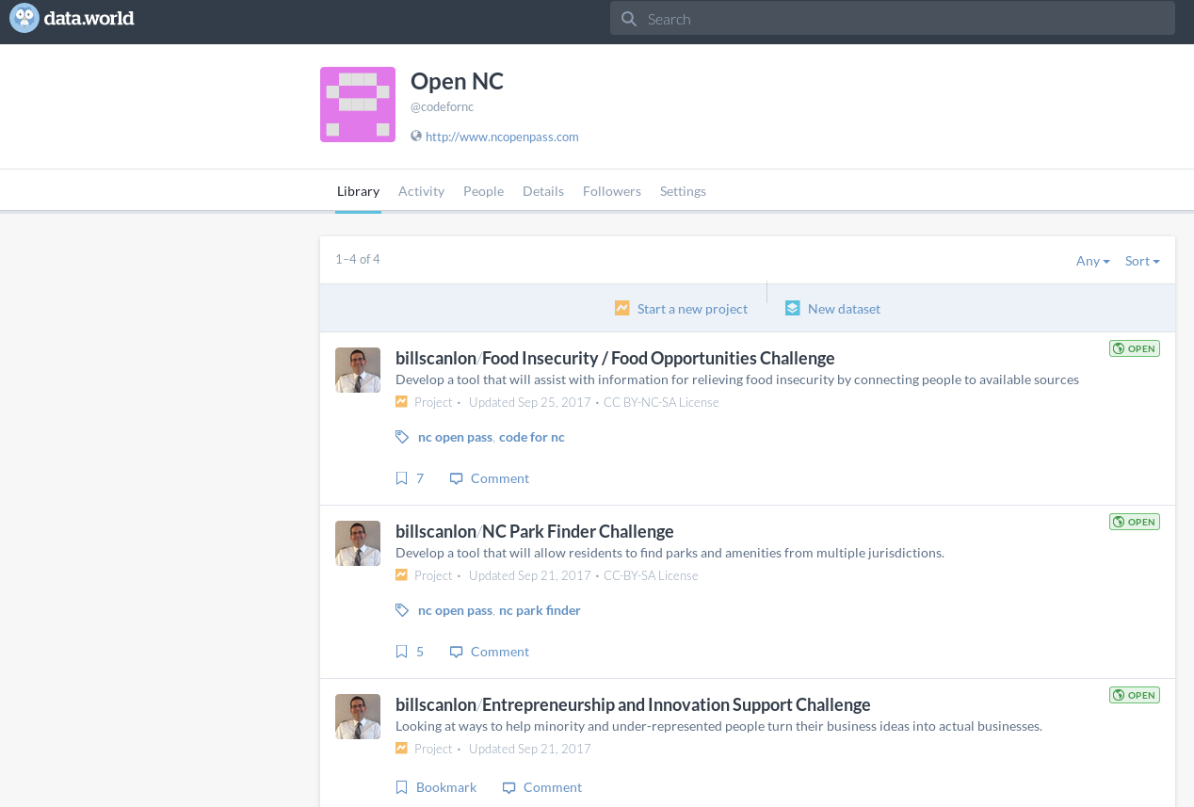
data.world
Image credits: data.world
Notes:
Created project for the 3 challenges
Each project had a description, MVP, and curated data sets
You can add all types of datasets, for example GeoJSON or html
d.w helps you connect as much data as you want
You can then query across the datasets in a project and save the query in d.w as SQL or SPARQL (maybe other formats too)

Slide 17
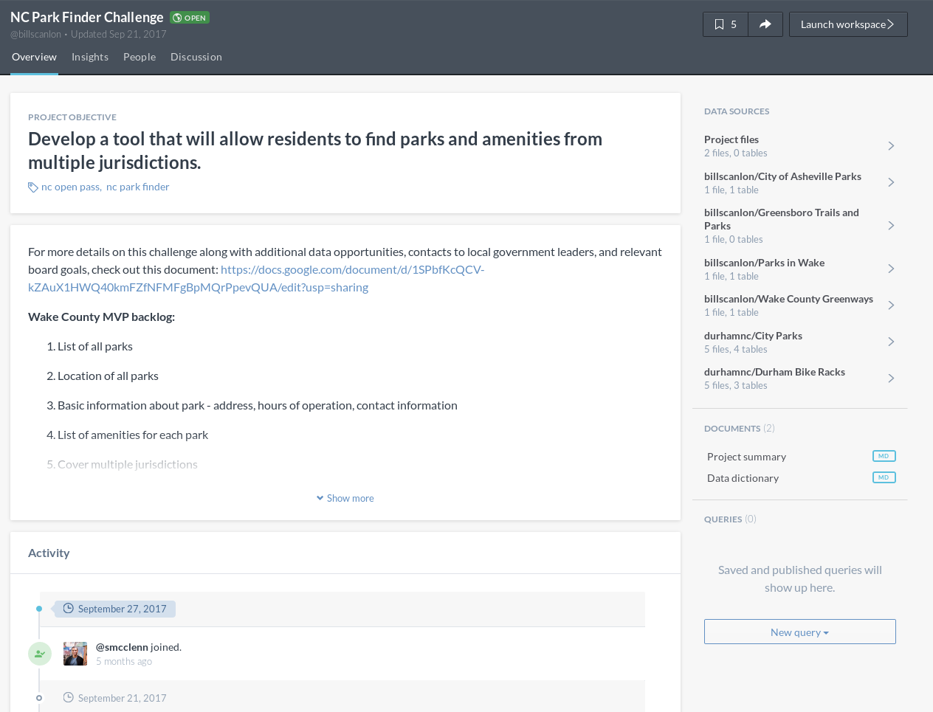
Image credits: data.world
Notes:
Takeaways:
Easy to add datasets
Ability to add other files
Allows project discussion
Ability to query within projects

Slide 18
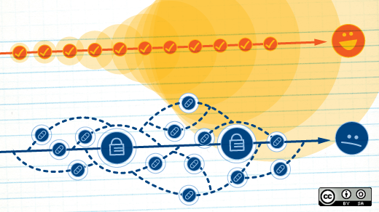
NC Open Pass event series
Image credits: https://opensource.com/business/15/6/interview-jen-krieger-redhat (Opensource.com)
Notes:
Open Data Day - intro to open data
National Day of Civic Hacking - start to build teams
Civic Camp (formerly CityCamp NC) - gathering of the civic tech tribes and open data competition kickoff
DataPalooza (formerly NC DataPalooza) - open data competition
6-7 week period between Civic Camp and open data finale

Slide 19

Discovering our community issues
Image credits: https://opensource.com/life/16/3/creating-welcoming-and-inclusive-open-source-space (Opensource.com)
Notes:
Story: Meeting with the Mayor and city councilors
Gained an understanding of community issues
Learned that affordable housing was a major issue
Our leadership team decided that should be our focus for 2018
This is the work that matters

Slide 20

2018: A focus on affordable housing
Image credits: https://opensource.com/government/11/4/blockboard-puts-whole-neighborhood-your-hands (Opensource.com)
Notes:
More than 400 Open Data Day events
Focus on affordable housing—the holistic view (housing costs, location, transit options, food)
We used our datajam to bring together community partners
During the hackathon we did data analytics and policy analytics
Workshop Data journalism: How reporters use data to find and tell stories

Slide 21
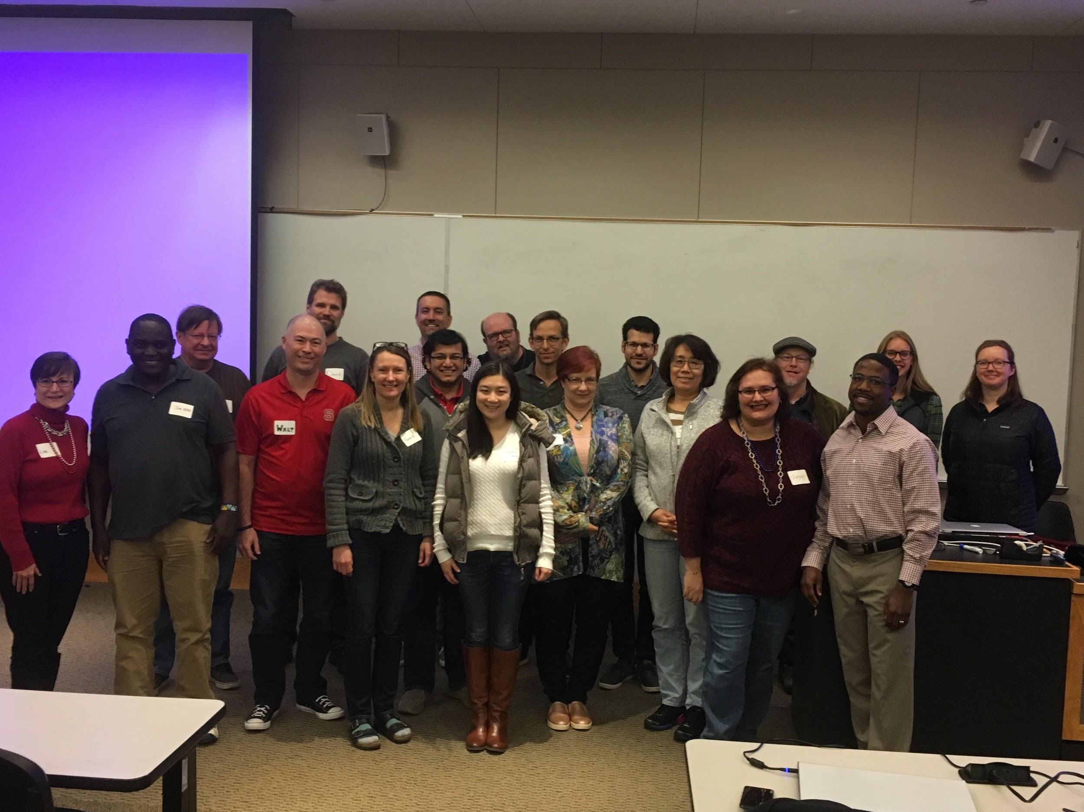
Image credits: NC Open Pass
Notes:
Used a weekend to unite our community, start the conversation
Goal: Use open data and our new knowledge to make progress
Seed ideas for Civic Camp and DataPalooza

Slide 22

5 ways to create sustainable civic tech
Image credits: https://opensource.com/article/17/4/top-5-april-21 (Opensource.com)
Notes:
5 ways to create sustainable civic tech
Form strategic partnerships
Engage with civic tech volunteers, focus passion with strategy
Use an augmentation model where government partners own the projects
Curate open data sets for success
Update your community on progress

Slide 23

Image credits: http://opensource.com/life/13/11/open-source-thank-you (Opensource.com)
Notes:
Your mission:
Discover your passion, make great partnerships, and let's continue to evolve civic tech to work not only in our communities, but for our communities
Thank you for attending today

Slide 24
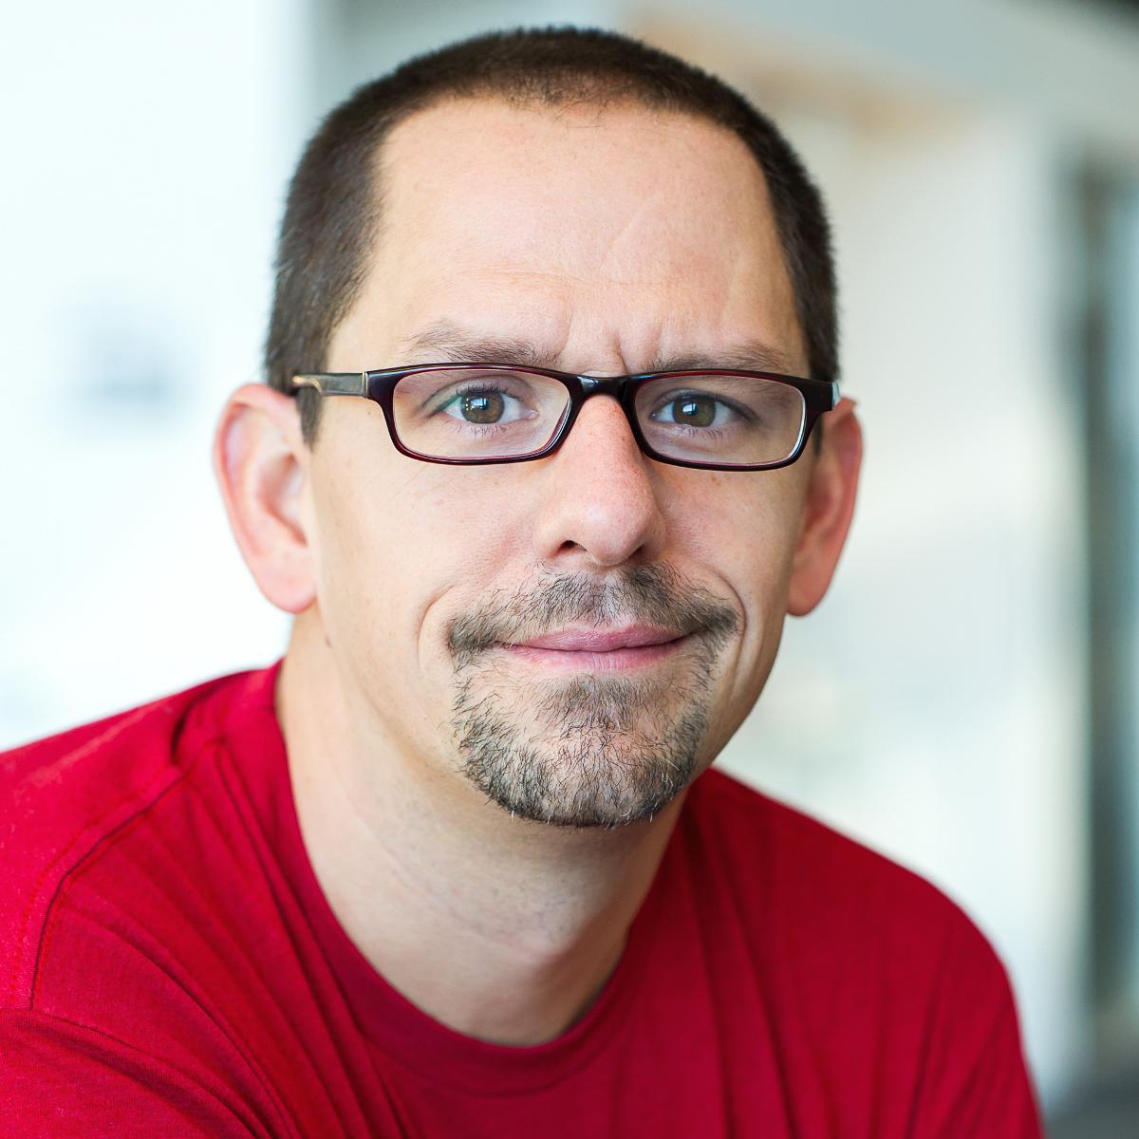

Contact
Email: jhibbets@redhat.com
Twitter: @jhibbets
IRC: shibby | Slack: jhibbets
Book: http://theopensourcecity.com
Slides: https://github.com/jhibbets/presentations
Notes:
Hope you learned something today about sustainable civic tech and open data, I’m happy to take any questions

