Slide 1
10 ways to get started with open source
[with<0ut> #writing $any c0d3]
RTP 180
Jason Hibbets
September 17, 2013

Slide 2

Open source is like a recipe
Image credits: http://opensource.com/life/12/12/open-source-pumpkin-spice-latte

Slide 3

No code? No problem!
Based on “10 ways to get started with open source,” (c) opensource.com, published under a Creative Commons Attribution-ShareAlike 3.0 Unported license, available at
http://opensource.com/life/13/1/10-ways-get-started-open-source

Slide 4

1) Everyday productivity
Image credits: http://www.flickr.com/photos/opensourceway/8296581995/in/photostream

Slide 5
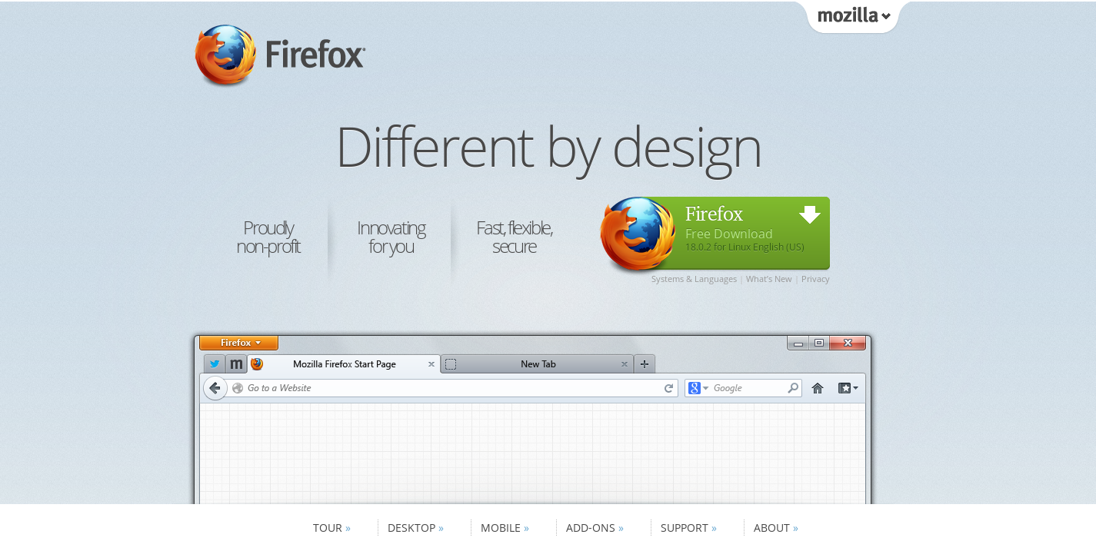
Web browsing – Firefox
Image credits: http://www.mozilla.org/en-US/firefox/

Slide 6
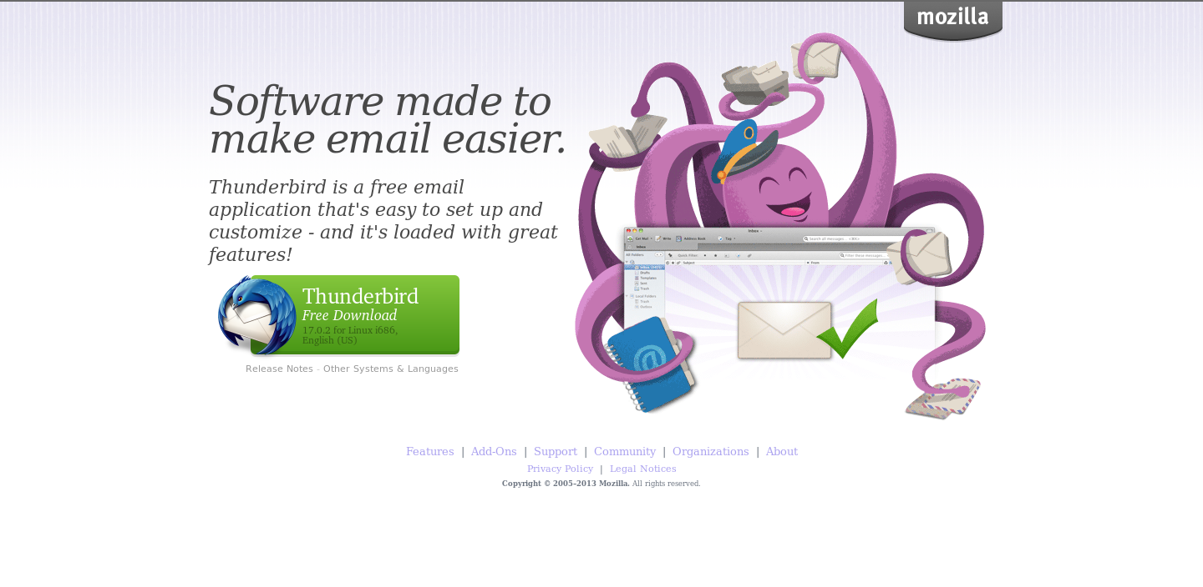
Email – Thunderbird
Image credits: http://www.mozilla.org/en-US/thunderbird/

Slide 7
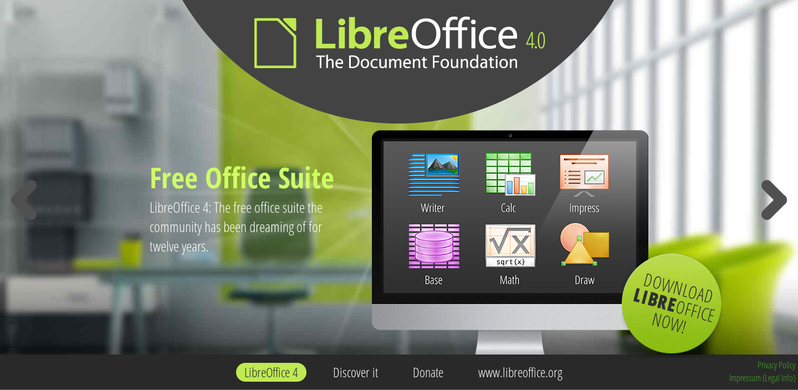
Office suite – Libre Office
Image credits: http://www.libreoffice.org/

Slide 8

2) Join an open source project
Repositories: Github, SourceForge
Wanted:
project managers
designers
writers
marketers
other skills
and yes...coders
Image credits: opensource.com, http://opensource.com/life/12/3/its-scary-join-open-source-project

Slide 9

3) Read a book about open source
Open Advice, edited by Lydia Pintscher
  for new open source contributors and the more experienced
Coding Freedom, by Gabriella Coleman
  how FOSS is lived
The Power of Open, by Creative Commons
  highlight the benefits of sharing
Opensource.com eBooks
  Open minded CEOs
  Applying open source principles
to government
  An open world:
Stories from the open source community
Image credits: http://opensource.com/

Slide 10
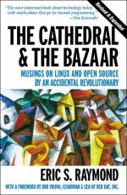
3) Open source classics
The Cathedral and the Bazaar, by Eric S. Raymond
Free Software, Free Society, by Richard M. Stallman
Rebel Code, by Glyn Moody
Producing Open Source Software, by Karl Fogel
Image credits: http://www.1000manifestos.com/eric-raymond-the-cathedral-and-the-bazaar/

Slide 11

Image credits: http://theopensourcecity.com

Slide 12
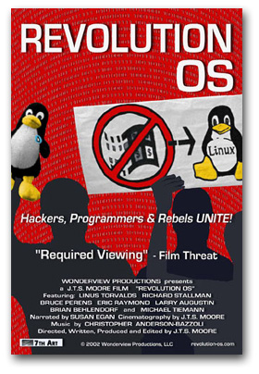
4) Watch a movie
www.revolution-os.com

Slide 13
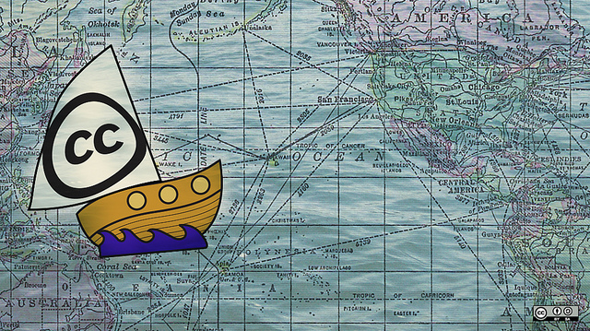
5) Start using Creative Commons
CreativeCommons.org
Image credits: http://www.flickr.com/photos/opensourceway/8249753855/in/photostream

Slide 14
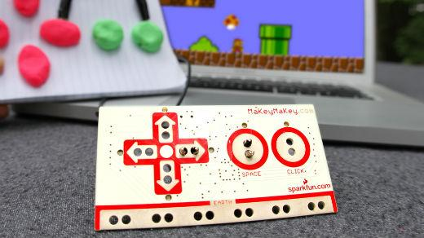
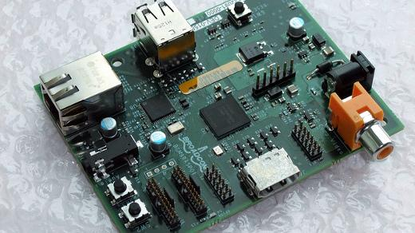
6) DIY & create something
Make anything into a key with Makey Makey invention kit
opensource.com/life/12/8/make-anything-key-makey-makey-invention-kit
Raspberry Pi, Allwinner, and CuBox in the Linux hardware race to tiniest and cheapest
opensource.com/life/12/1/linux-hardware-race-tiniest-and-cheapest-15-cheap
Image credits: MaKey MaKey
Image credits: Raspberry Pi by blogeee.net
http://www.flickr.com/photos/13815526@N02/6055754448/

Slide 15
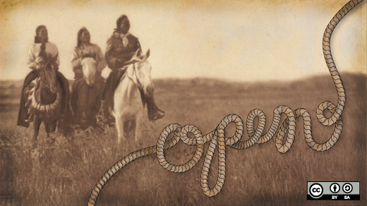
7) Get creative
GNU Image Manipulation Program (GIMP)
Scribus
MyPaint
Inskape
Audacity
Blender
Dream Studio
TuxPaint
KDEnlive
A look back at open source creative tools in 2012
http://opensource.com/life/13/1/open-source-design-tools-review-2012

Slide 16
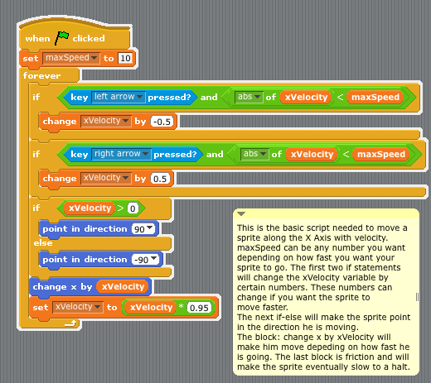
8) Learn to program
Scratch, a programming language for kids
http://opensource.com/education/12/10/scratch-programming-language-kids
Image credits: http://en.wikibooks.org/wiki/Scratch/Lessons/Movement

Slide 17
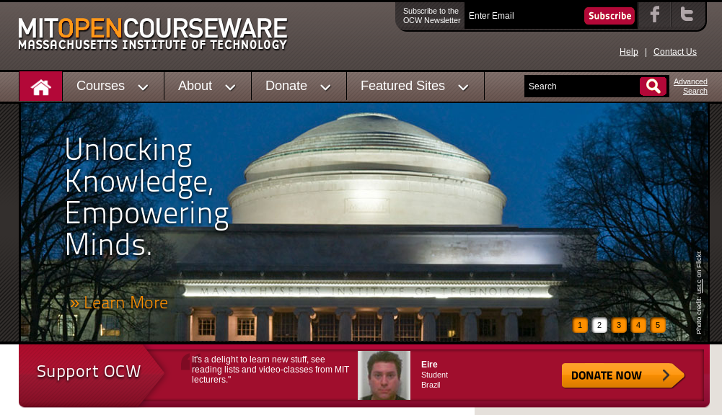
9) Learn something
OCW.MIT.EDU

Slide 18


10) Hack on government
Join in: http://www.meetup.com/Triangle-Code-for-America/
Image credits: http://codeforamerica.org

Slide 19
11) Attend a conference
All things open – Raleigh, NC (October 23-24)
NC FOSS Fair – Raleigh, NC (February)
POSSCON – Columbia, SC (March)
CityCamp NC – Raleigh, NC (June)
OSCON – Portland, OR (July)

Slide 20

Open source is a better way
Image credits: http://www.flickr.com/photos/opensourceway/5751540267/

Slide 21

Image credits: http://www.flickr.com/photos/opensourceway/5752191750/

Slide 22

Email: jhibbets@redhat.com
Twitter: @jhibbets
IRC: shibby
Image credits: http://www.flickr.com/search/?w=47691521@N07&q=lolcat

