Slide 1
The balance of creativity:
Left brain vs. right brain
PKN Raleigh
Jason Hibbets
September 12, 2013

Slide 2
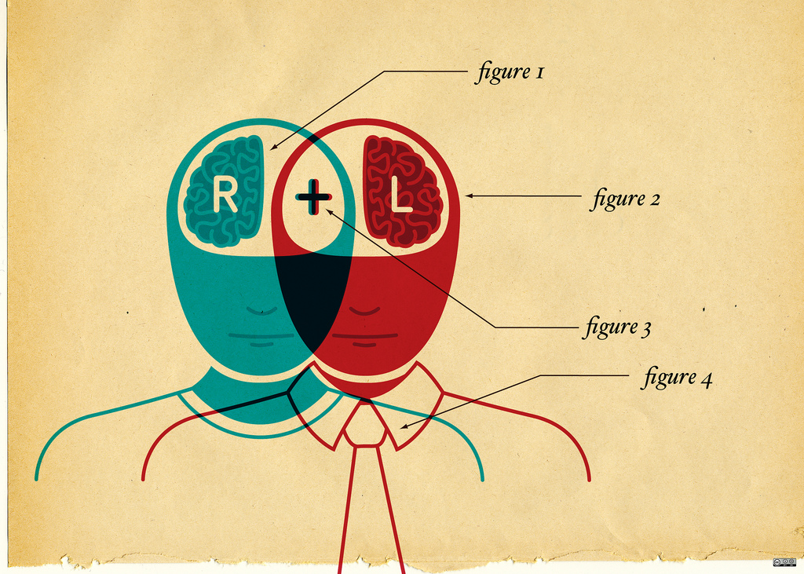
Credits: http://www.flickr.com/photos/opensourceway/4639590640/

Slide 3
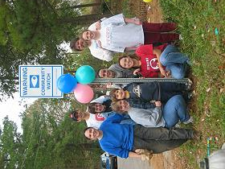
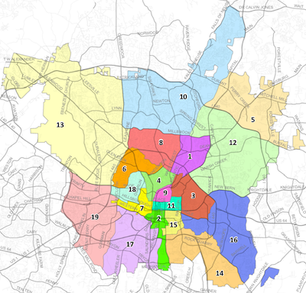

Credits: http://prr-watch.org | http://www.raleighnc.gov

Slide 4


Credits: http://citycampnc.org

Slide 5


Join in: http://www.meetup.com/Triangle-Code-for-America/
Credits: http://codeforamerica.org

Slide 6

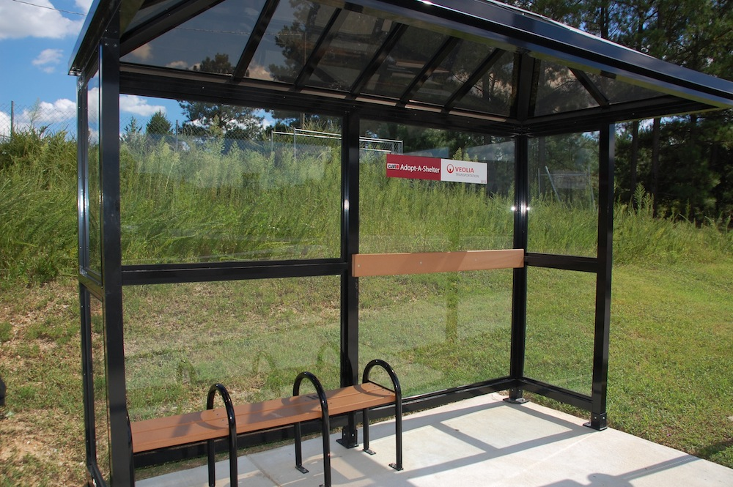

Credits: http://trianglewiki.org | http://adoptashelter.raleighnc.gov/
http://www.raleighnc.gov/services/content/PWksTransit/Articles/AdoptAShelter.html

Slide 7
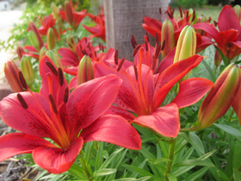
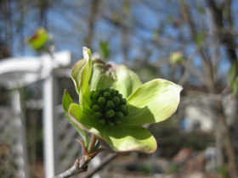
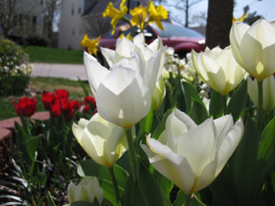
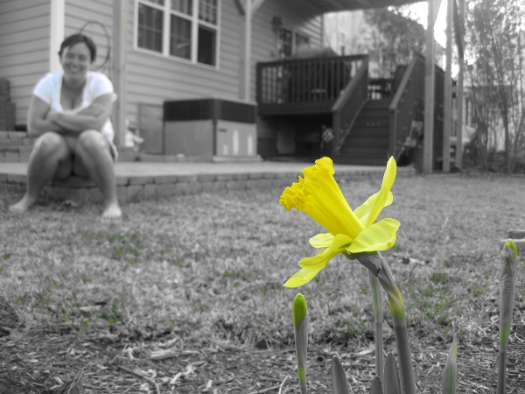

Credits: http://hibbets.net

Slide 8
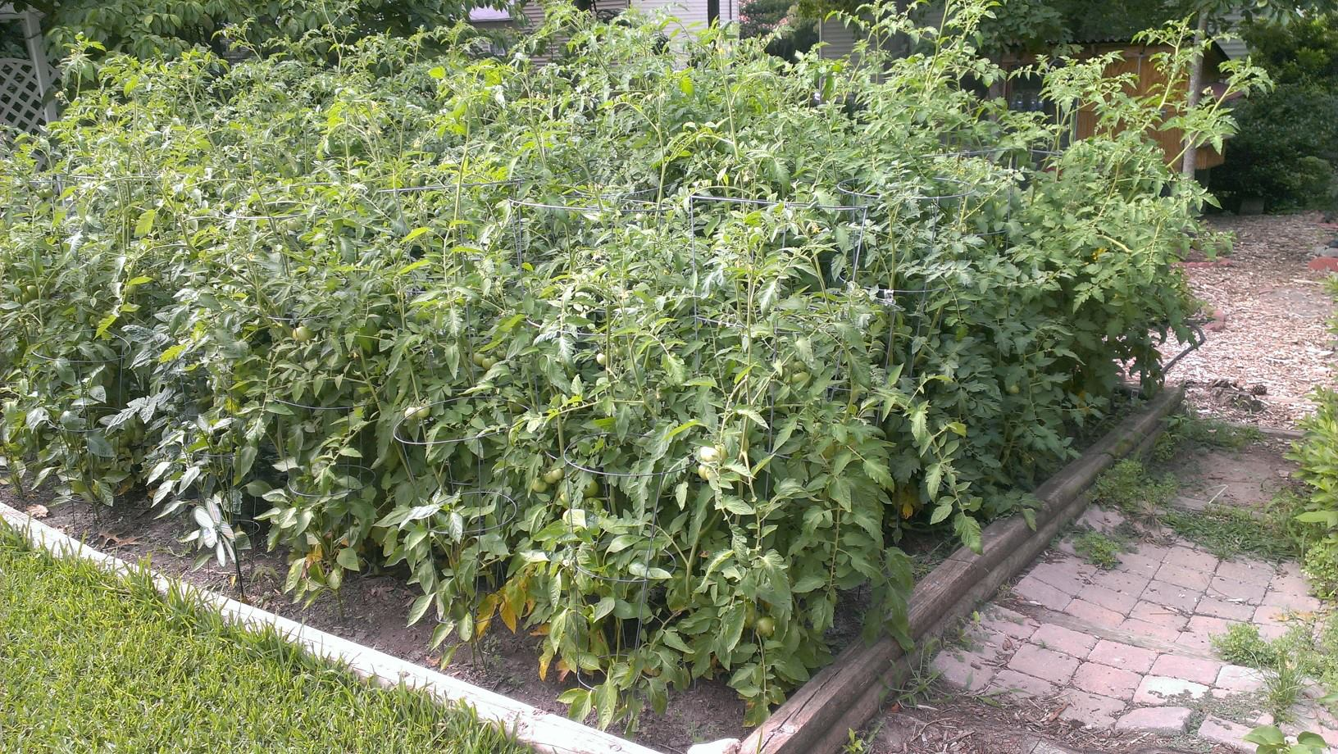
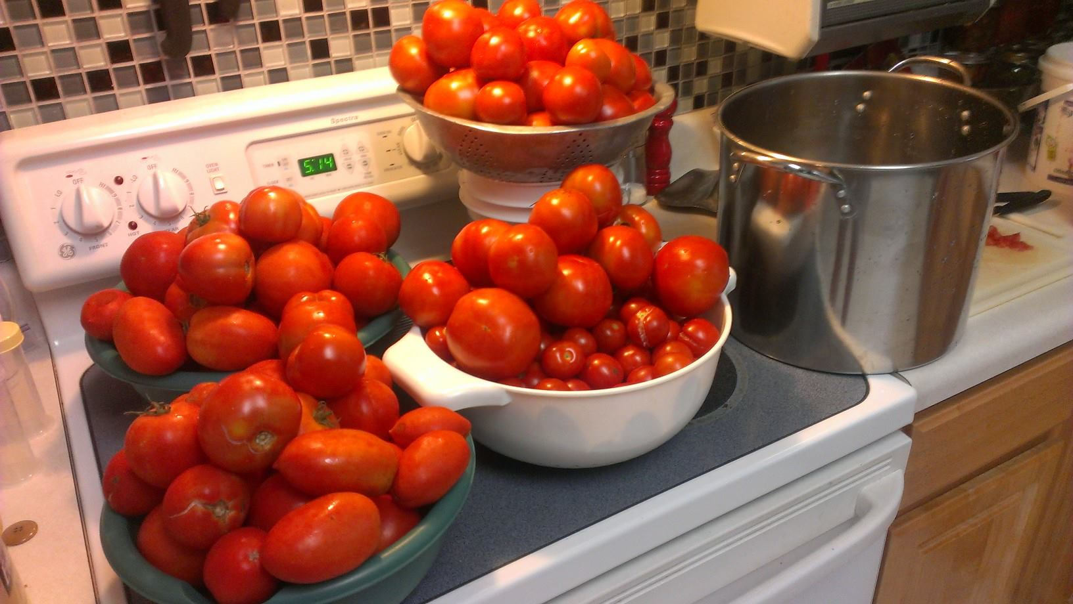
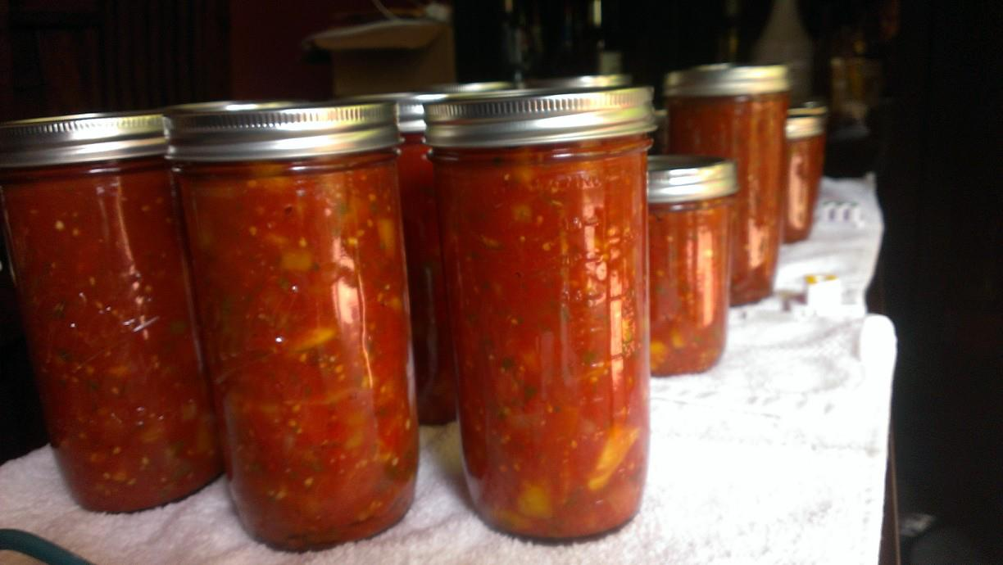
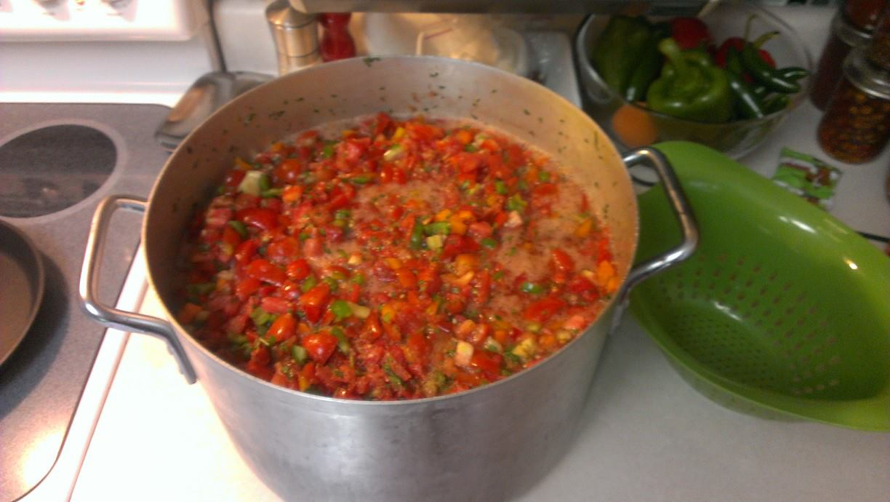
Credits: http://hibbets.net

Slide 9
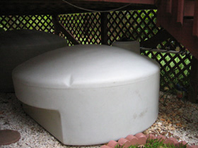
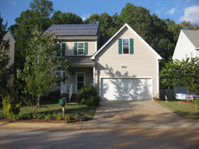
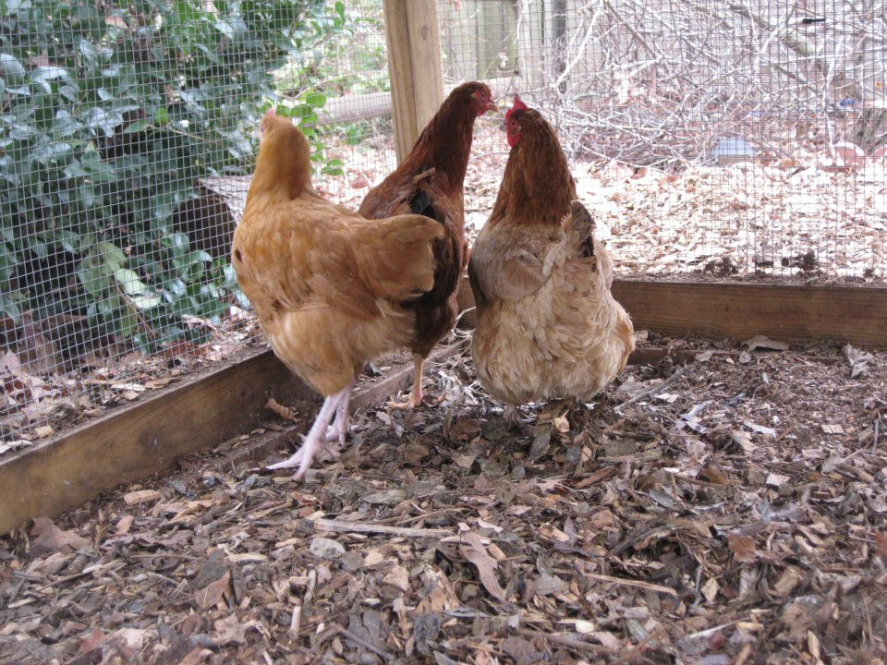
Credits: http://hibbets.net

Slide 10
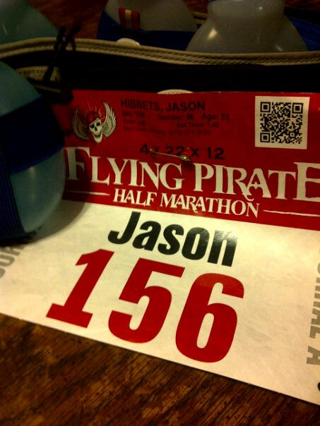
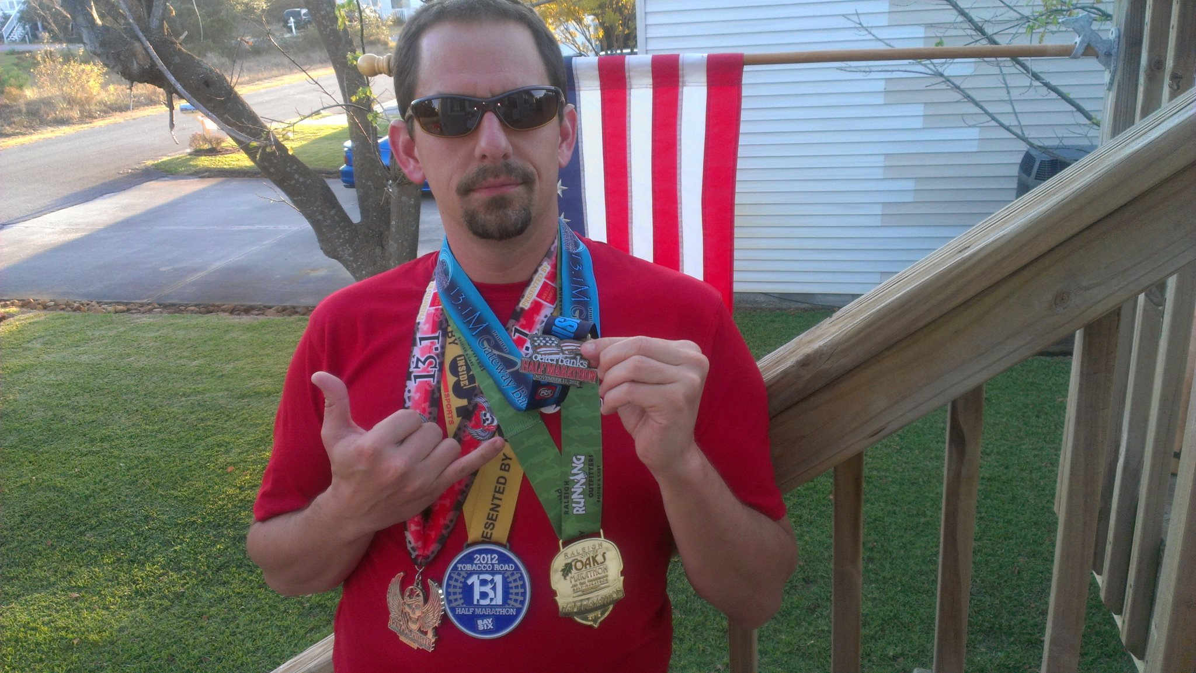
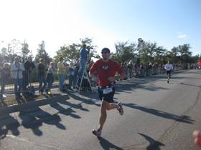
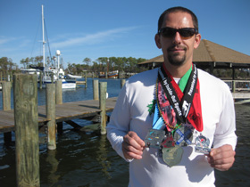
Credits: http://hibbets.net

Slide 11
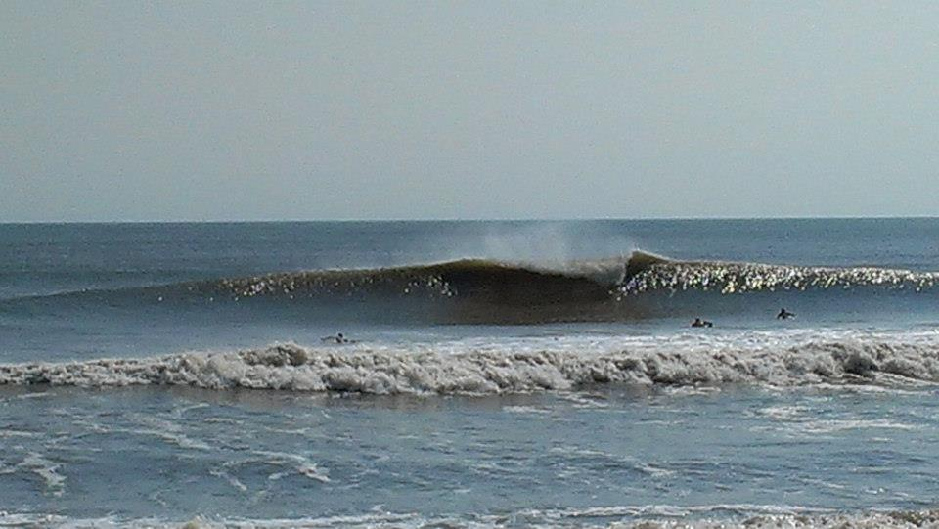
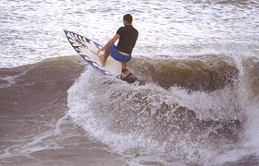
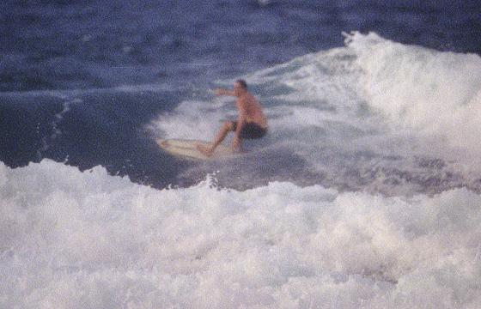
Credits: http://hibbets.net

Slide 12
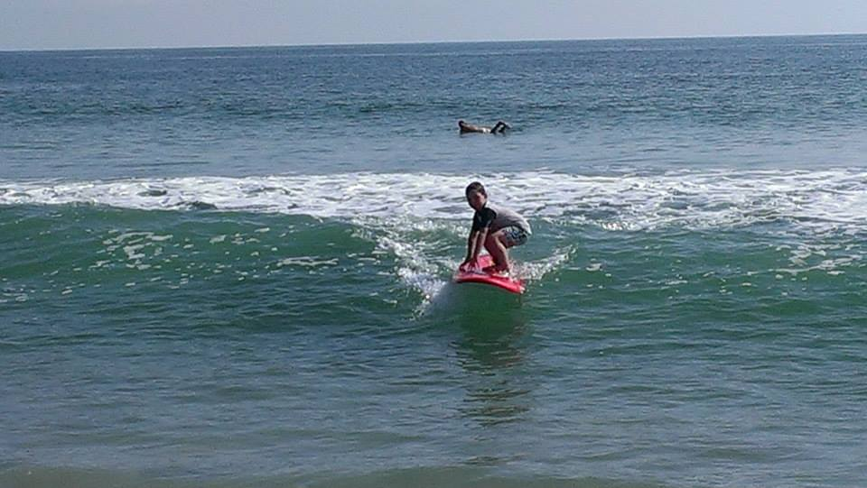
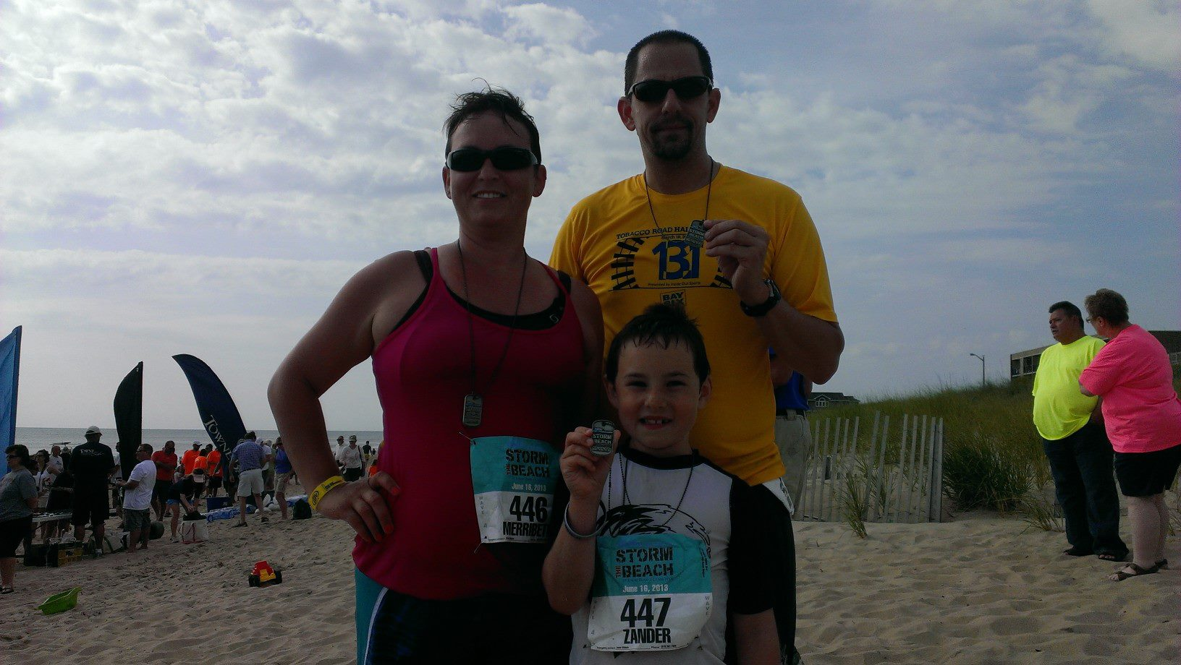
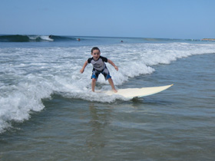
Credits: http://hibbets.net

Slide 13


http://innovateraleigh.com/ | #innovateRal

Slide 14
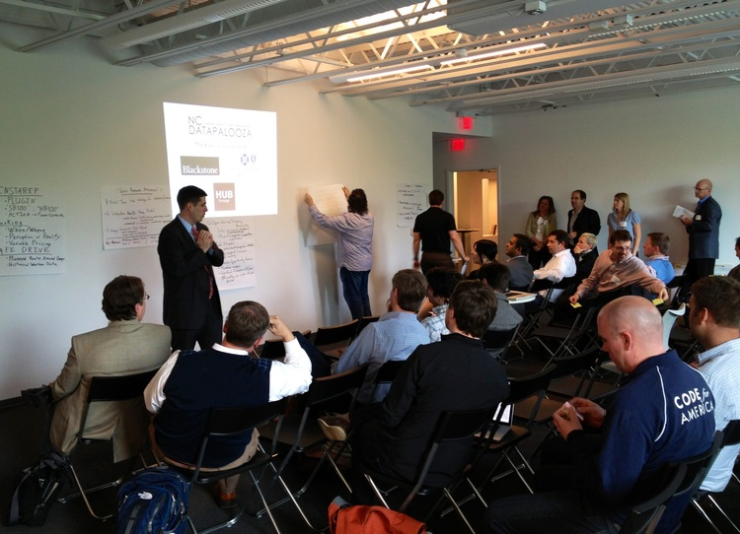

http://ncdatapalooza.com/ | #NCDataPalooza

Slide 15
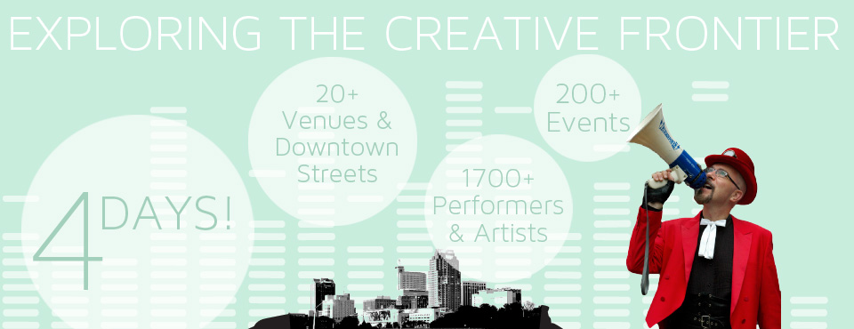
http://www.sparkcon.com/ | @sparkconner

Slide 16
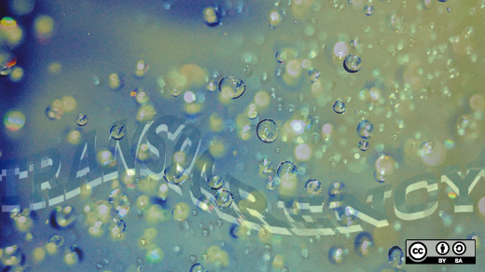
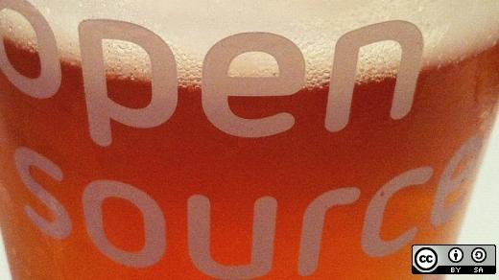


http://www.flickr.com/photos/opensourceway/7496800772/
http://opensource.com/life/12/11/beer-open-source-beverage-choice
http://www.flickr.com/photos/opensourceway/4404008626/
http://www.flickr.com/photos/opensourceway/4426824995/

Slide 17


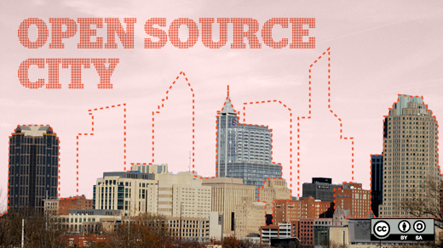
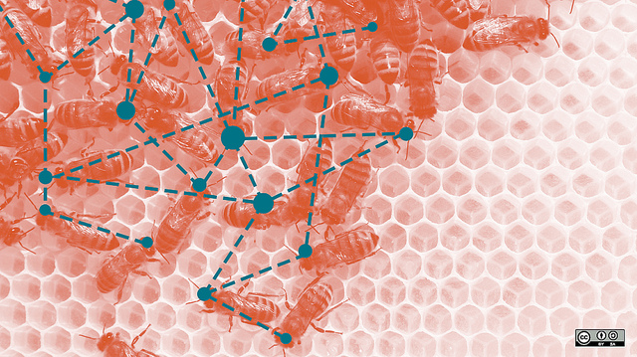
http://www.flickr.com/photos/opensourceway/5496629913/
http://www.flickr.com/photos/opensourceway/5537457791/
http://www.flickr.com/photos/opensourceway/5752191750/
http://www.flickr.com/photos/opensourceway/8516817076/

Slide 18

Credits: http://theopensourcecity.com/

Slide 19
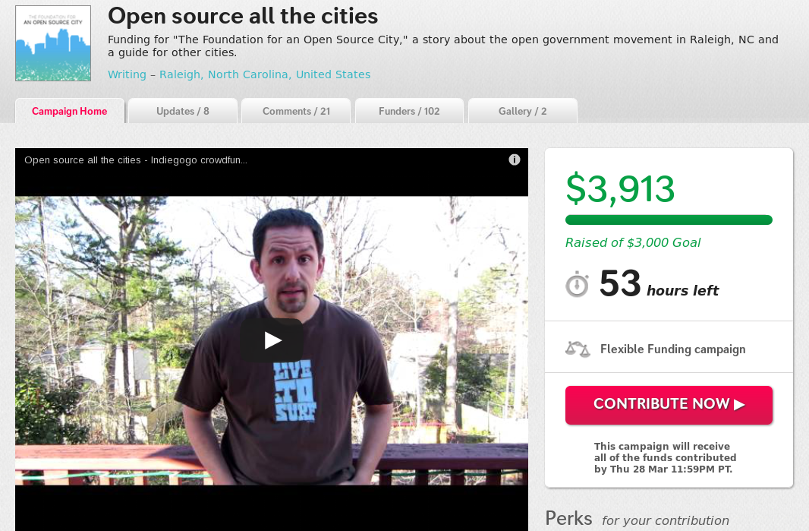
Credits: http://www.indiegogo.com/projects/open-source-all-the-cities/x/2452834

Slide 20

Credits: http://theopensourcecity.com/

Slide 21
Credits: http://www.flickr.com/photos/opensourceway/4639590640/

