Slide 1
Patient Portal – HCR View
MVP Phase 1 Release Readout
Status as of: Feb 19, 2026
Weighted Dev Complete
Weighted QA Complete
Work Queue
90%
30%
100%
Across tracked workstreams
QA in progress
Dev + QA
Screenshots: preserved in landscape appendix slides

Slide 2
Readout overview
Agenda
Progress dashboard (Dev & QA)
Phase 1 feature / functionality status (from estimate sheet)
Workstream readiness and gaps
Risks / dependencies
Appendix: UI evidence (landscape screenshots)
Patient Portal • HCR View (MVP Phase 1)
2

Slide 3
Progress dashboard
Dev vs QA completion by workstream
Weighted Dev Complete
Weighted QA Complete
Sentinel Auth
90%
30%
100%
Across tracked workstreams
QA in progress
Dev + QA
Key notes
Work Queue items are complete in Dev and QA.
Intake Verification is complete in Dev; QA in progress (~20%).
Eligibility Screening is in development (~80% Dev); QA not started.
PACE Integration (POE API) is early (low completion in sheet).
Patient Portal • HCR View (MVP Phase 1)
3

Slide 4
Phase 1 Features – HCR Workqueue
Features/functionality from Patient Portal High Estimate (Phase 1)
FEATURE / FUNCTIONALITY
EST
DEV
QA
NOT STARTED
IN PROGRESS
DONE
NOT STARTED
IN PROGRESS
DONE
In House
5
✔
✔
Discharge
5
✔
✔
Completed
5
✔
✔
Page level filtering
✔
✔
• Hospital group
5
✔
✔
hospital facility
✔
✔
Hospital
✔
✔
Visit status detail
✔
✔
Column level filtering
8
✔
✔
Column level sorting
3
✔
✔
Default filtering to assigned user
8
✔
✔
(Prioritization)
5
✔
✔
Grid Configuration based on user
1
✔
✔
Self-Assignment
5
✔
✔
Manager Assignment
8
✔
✔
New Referral Indicator (Visit)
3
✔
✔
Patient Portal • HCR View (MVP Phase 1)
4

Slide 5
Phase 1 Features – Intake Verification (Registration)
Features/functionality from Patient Portal High Estimate (Phase 1)
FEATURE / FUNCTIONALITY
EST
DEV
QA
NOT STARTED
IN PROGRESS
DONE
NOT STARTED
IN PROGRESS
DONE
Patient Demographics
8
✔
✔
Visit Info
8
✔
✔
Ins info
8
✔
✔
Data Pre-Population
5
✔
✔
Data Verification
8
✔
✔
Prompting/Scripting
8
✔
✔
Recommended Input Fields
5
✔
✔
Read Only Person ID
1
✔
✔
Data formatting
5
✔
✔
Patient Portal • HCR View (MVP Phase 1)
5

Slide 6
Phase 1 Features – Screening / Eligibility & PACE Integration
Features/functionality from Patient Portal High Estimate (Phase 1)
FEATURE / FUNCTIONALITY
EST
DEV
QA
NOT STARTED
IN PROGRESS
DONE
NOT STARTED
IN PROGRESS
DONE
Screening Portion - Eligibility
✔
✔
• Dynamic Screening questions
20
✔
✔
• eligibility Determination
20
✔
✔
• Screening/Eligibility Summary Report
20
✔
✔
• Recommended Programs
60
✔
✔
HCR Available Override Programs
✔
✔
Form Relationship Linkage(SC)
✔
✔
PACE Integration (POE API)
✔
✔
Patient Portal • HCR View (MVP Phase 1)
6

Slide 7
Workstream readiness
Where we are vs what remains to ship
Workstream
Dev
QA
Status
HCR Work Queue
100%
100%
ON TRACK
Intake Verification
100%
20%
QA IN PROGRESS
Screening / Eligibility
80%
0%
AT RISK
PACE Integration (POE API)
10%
0%
AT RISK
Next: prioritize Eligibility QA + POE API validation; run end-to-end regression across Work Queue → Intake → Eligibility.
Patient Portal • HCR View (MVP Phase 1)
7

Slide 8
Risks, dependencies, and mitigations
Top risks
Mitigation (near-term)
Eligibility QA has not started; could compress the overall timeline.
PACE Integration (POE API) shows low completion; may gate release readiness.
End-to-end regression bandwidth across modules and edge cases.
Start QA as soon as Eligibility build is stable; daily defect triage.
Validate POE API requirements + test data early; escalate blockers fast.
Schedule an end-to-end rehearsal including auth and reporting.
Patient Portal • HCR View (MVP Phase 1)
8

Slide 9


HCR View – UI Screenshot
LANDSCAPE
Patient Portal • HCR View (MVP Phase 1)
9

Slide 10
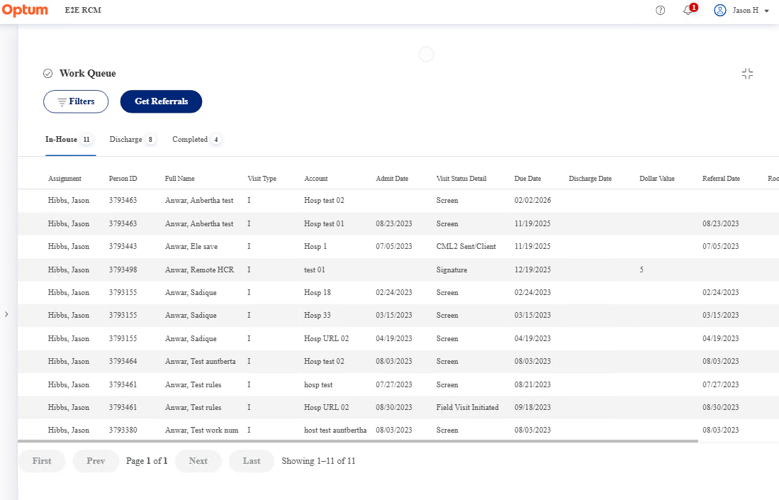
HCR View – UI Screenshot
LANDSCAPE
Patient Portal • HCR View (MVP Phase 1)
10

Slide 11
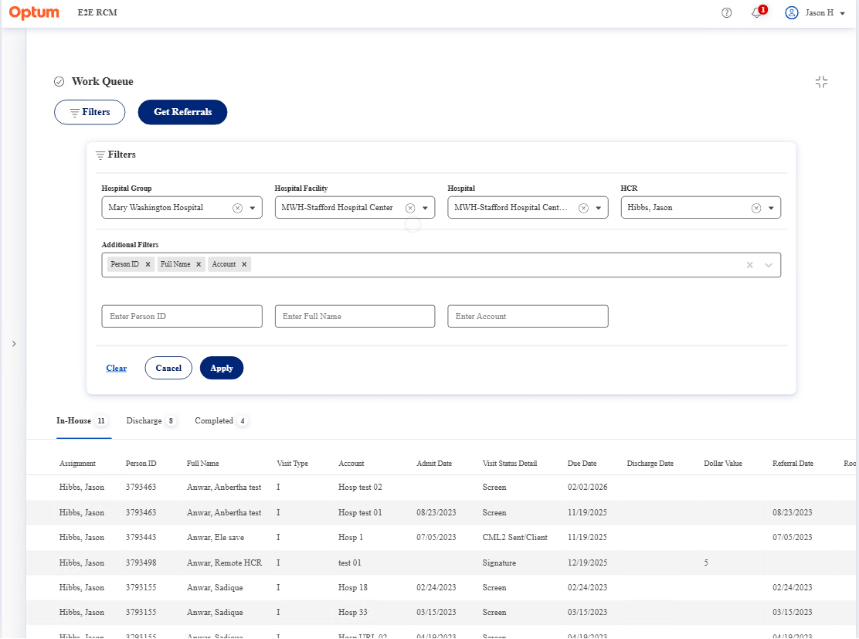
HCR View – UI Screenshot
LANDSCAPE
Patient Portal • HCR View (MVP Phase 1)
11

Slide 12
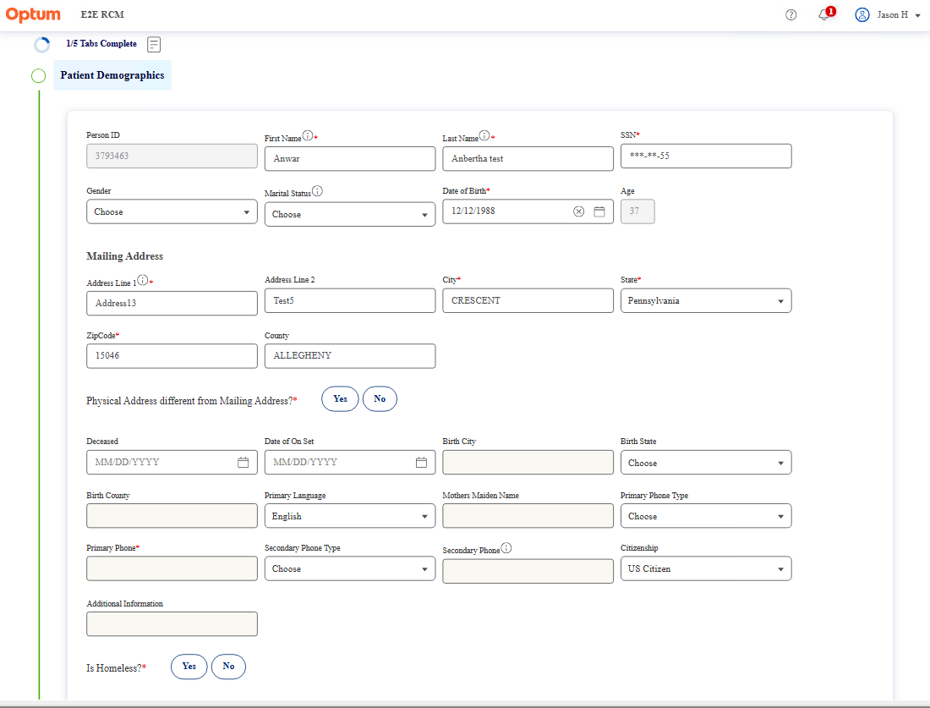
HCR View – UI Screenshot
LANDSCAPE
Patient Portal • HCR View (MVP Phase 1)
12

Slide 13
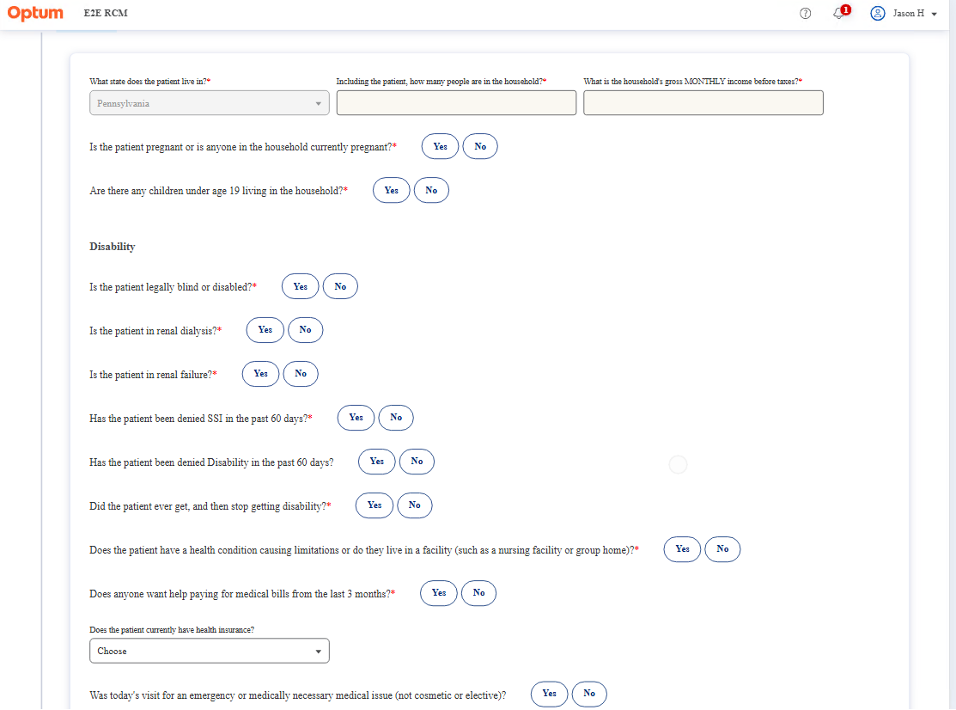
HCR View – UI Screenshot
LANDSCAPE
Patient Portal • HCR View (MVP Phase 1)
13

Slide 14
Feature completion (Dev / QA)
Summary view
Feature area
Dev
QA
Work Queue
100%
100%
Intake Verification (Registration)
100%
20%
Eligibility Screening (dynamic + determination)
80%
0%
PACE Integration (POE API)
10%
0%
Note: Eligibility screenshots are included in the landscape appendix as provided.
Patient Portal • HCR View (MVP Phase 1)
14

Slide 15
MVP Phase 1 timeline (draft)
Milestones (placeholders)
Dev wrap-up: finalize Screening/Eligibility + POE API integration work
QA execution: Intake + Eligibility (start ASAP once build is stable)
End-to-end regression and UAT sign-off
Release readiness checks + deployment plan
Update the dates once sprint planning is finalized.
Patient Portal • HCR View (MVP Phase 1)
15

