Slide 1

Patient Portal – HCR View
MVP Phase 1 Release Readout
Status as of: Feb 19, 2026
At-a-glance
Overall Dev Complete
Overall QA Complete
Sentinel Auth
90%
30%
100%
Weighted by est. effort (237)
Eligibility QA not started
Dev + QA complete
Highlights & watch-outs
Work Queue items in estimate tracker are complete in Dev and QA (100% / 100%).
Intake Verification (Registration) is complete in Dev; QA in progress (~20%).
Eligibility Screening is in development (~80% Dev); QA not started (screenshots not yet available).
Sentinel integration for authentication is 100% complete in Dev and QA (team update).
Notes:
[Sources]
- Internal: Patient Portal High Estimate.xlsx (Phase 1 tab) – completion and estimates
- Internal: Team update – Sentinel Integration authentication 100% Dev and QA
[/Sources]

Slide 2
Readout overview
Agenda
1. MVP Phase 1 scope
2. Progress dashboard (Dev & QA)
3. Workstream readiness and gaps
4. Risks / dependencies
5. Next milestones to release
6. Appendix: UI screenshots (non-Eligibility)
MVP Phase 1 scope (high-level)
Work Queue: filtering, sorting, assignment, indicators
Intake Verification (Registration): demographics, visit, insurance, verification
Eligibility Screening: dynamic questions, determination, summary report, recommended programs
Authentication: Sentinel integration
Note: detailed requirement specs exist for Patient Account, Insurance Screening, Intake, Work Queue, and Eligibility; this readout focuses on release readiness from the estimate tracker plus UI evidence.
Patient Portal • HCR View (MVP Phase 1)
2
Notes:
[Sources]
- Internal: Requirement documents (Work Queue, Intake Form, Insurance Screening, Patient Account, Eligibility Summary)
- Internal: Patient Portal High Estimate.xlsx (Phase 1 tab)
[/Sources]

Slide 3
Progress dashboard
Weighted Dev Complete
Weighted QA Complete
Work Queue
Eligibility
90%
30%
100%
80%
Across tracked workstreams
QA in progress
Dev + QA
Dev (QA pending)
Dev vs QA completion by workstream
Key callout: Eligibility QA not started (screens still in development).
Patient Portal • HCR View (MVP Phase 1)
3
Notes:
[Sources]
- Internal: Patient Portal High Estimate.xlsx (Phase 1 tab)
- Internal: Team update – Sentinel Integration authentication 100% Dev and QA
[/Sources]

Slide 4
Workstream readiness
Workstream
Dev
QA
Status
Notes / next steps
HCR Work Queue
100%
100%
On track
Items in estimate tracker complete; validate in integrated flow & regression
Green
Intake Verification (Registration)
100%
20%
QA in progress
Finish QA, defect triage, and confirm data pre-population behaviors
Amber
Screening / Eligibility
80%
0%
At risk
Complete remaining dev, start QA, and finalize summary + recommended programs
Red
Sentinel Authentication
100%
100%
Complete
Confirm environments and SSO edge cases during UAT
Green
Status legend: Green = ready / minor items • Amber = QA in progress • Red = gating work
What we need to ship
Complete Eligibility remaining dev + PACE integration validation (POE API).
Start and complete Eligibility QA; run end-to-end regression across Work Queue → Intake → Eligibility flows.
Confirm accessibility (unique titles, alt text, reading order) and security checks are satisfied.
Patient Portal • HCR View (MVP Phase 1)
4
Notes:
[Sources]
- Internal: Patient Portal High Estimate.xlsx (Phase 1 tab)
- Internal: Team update – Sentinel Integration authentication 100% Dev and QA
[/Sources]

Slide 5
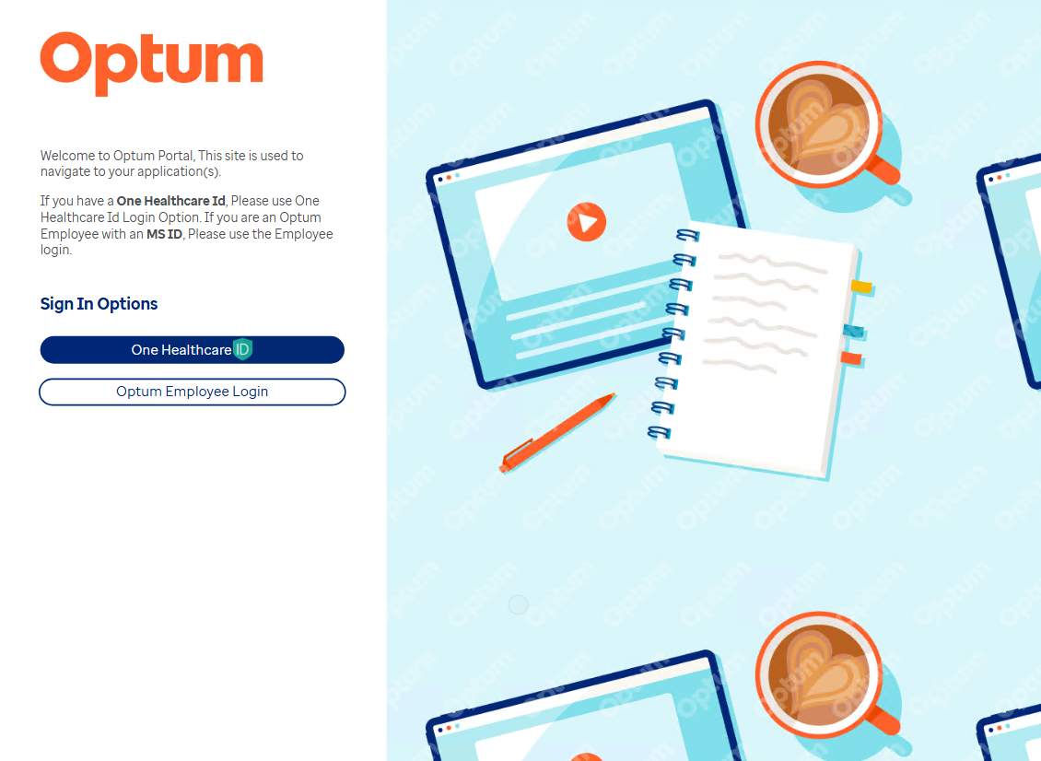
HCR View – UI Screenshot
LANDSCAPE
LANDSCAPE

Slide 6
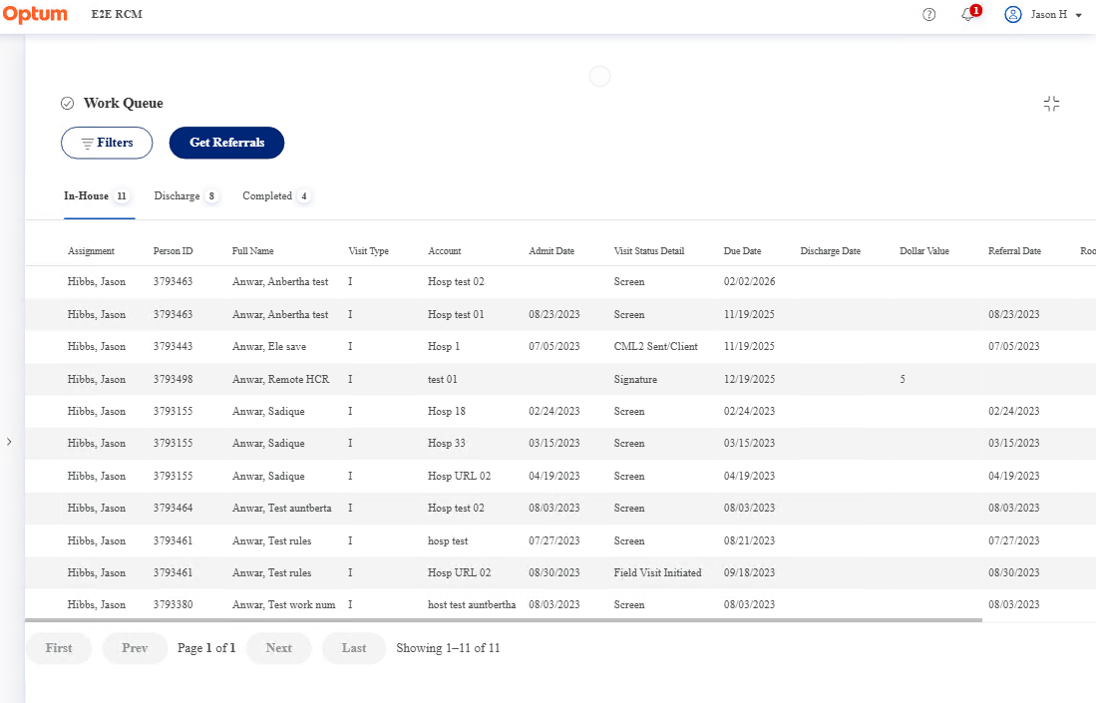
HCR View – UI Screenshot
LANDSCAPE
LANDSCAPE

Slide 7
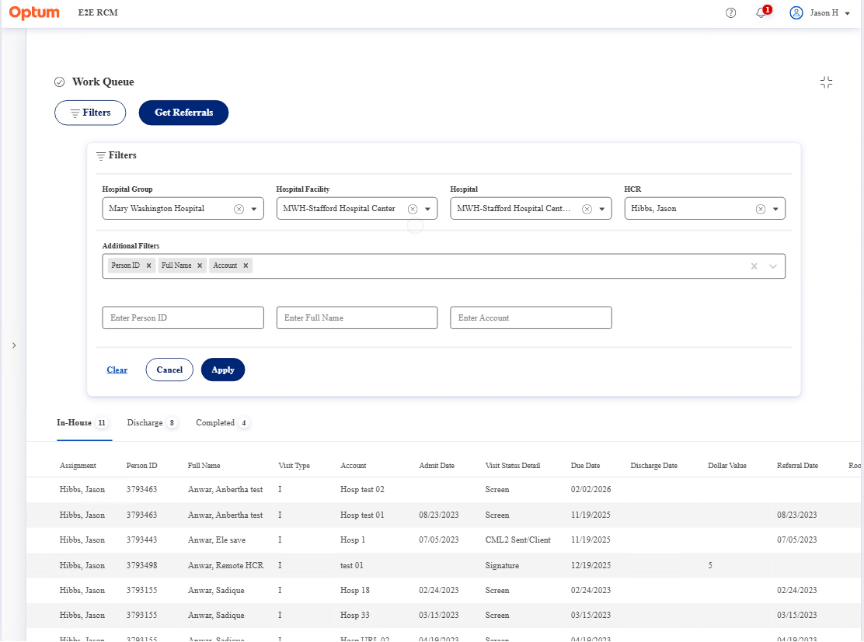
HCR View – UI Screenshot
LANDSCAPE
LANDSCAPE

Slide 8
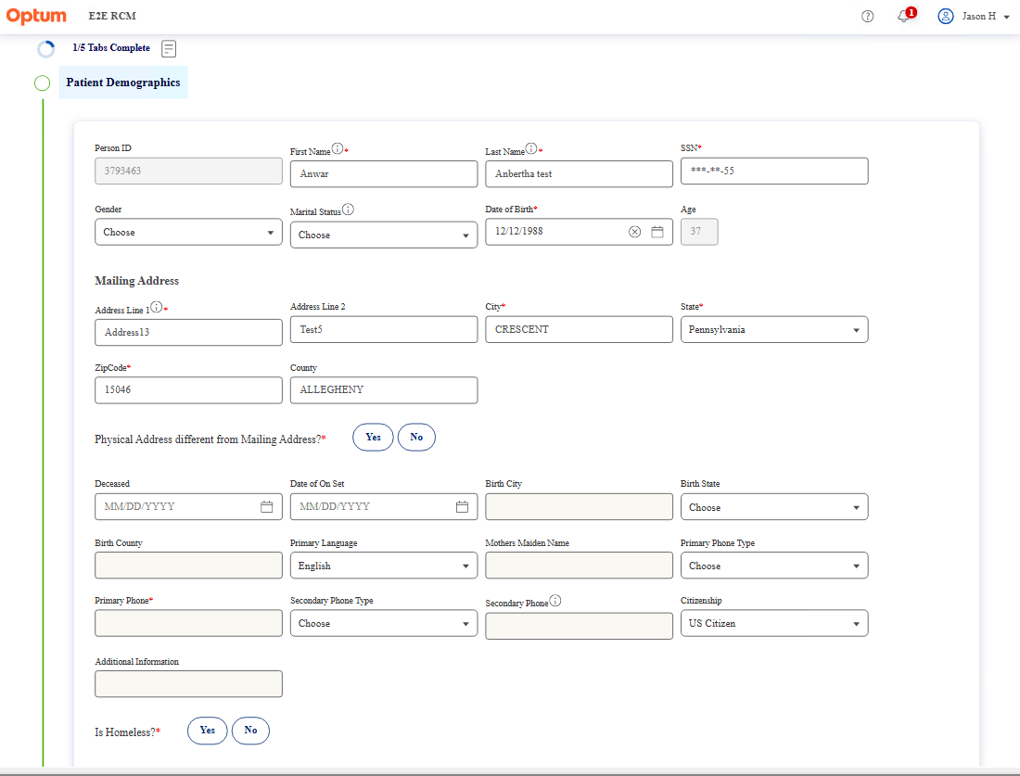
HCR View – UI Screenshot
LANDSCAPE
LANDSCAPE

Slide 9
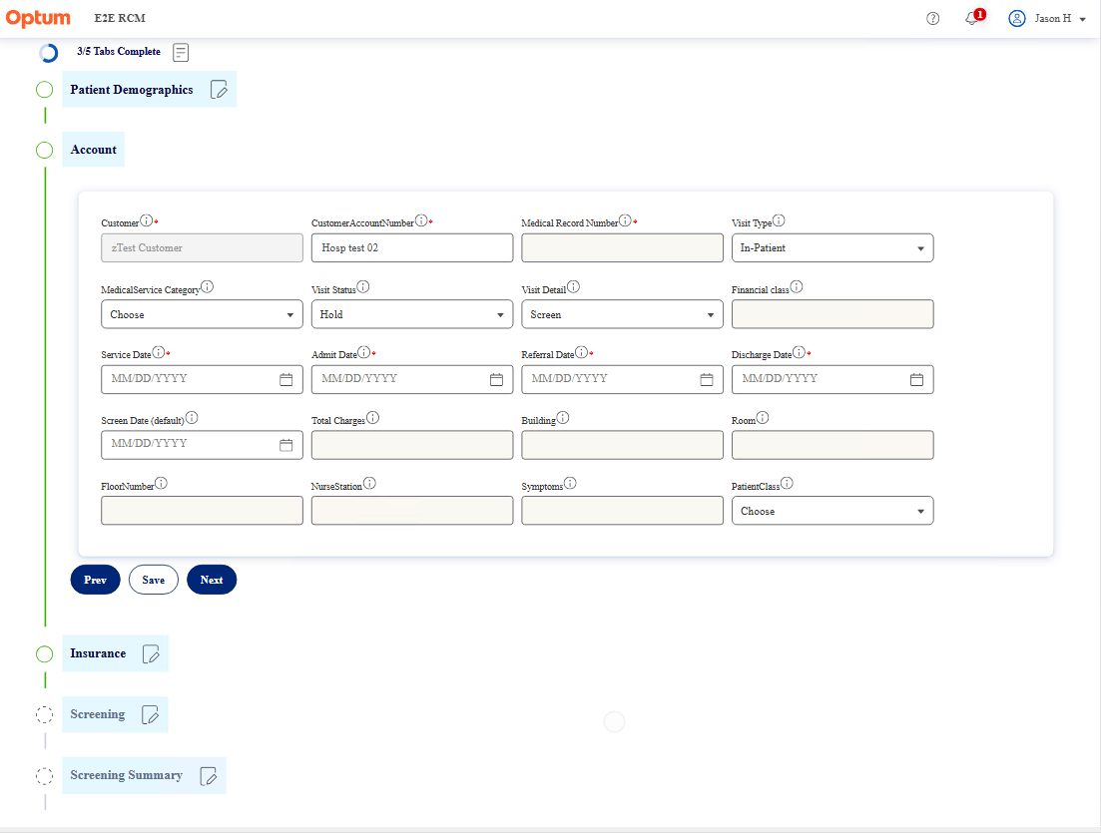
HCR View – UI Screenshot
LANDSCAPE
LANDSCAPE

Slide 10
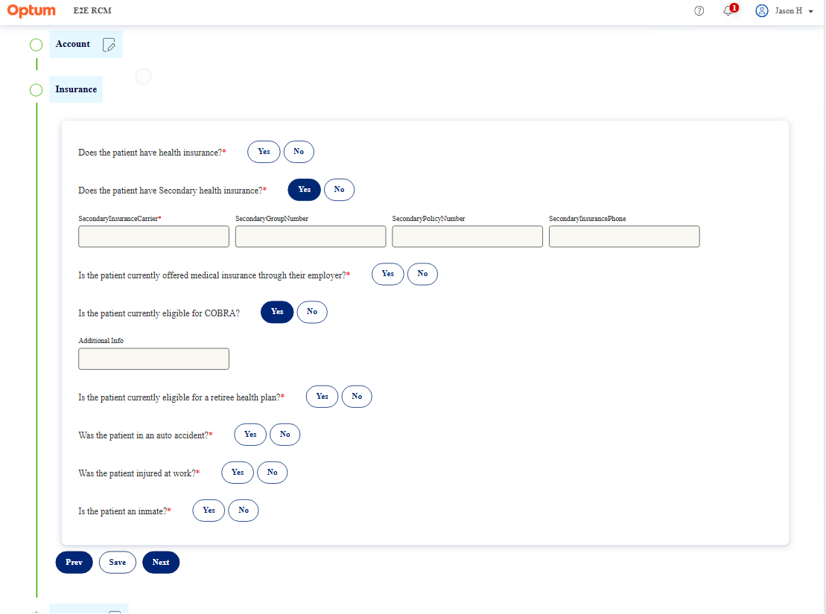
HCR View – UI Screenshot
LANDSCAPE
LANDSCAPE

Slide 11
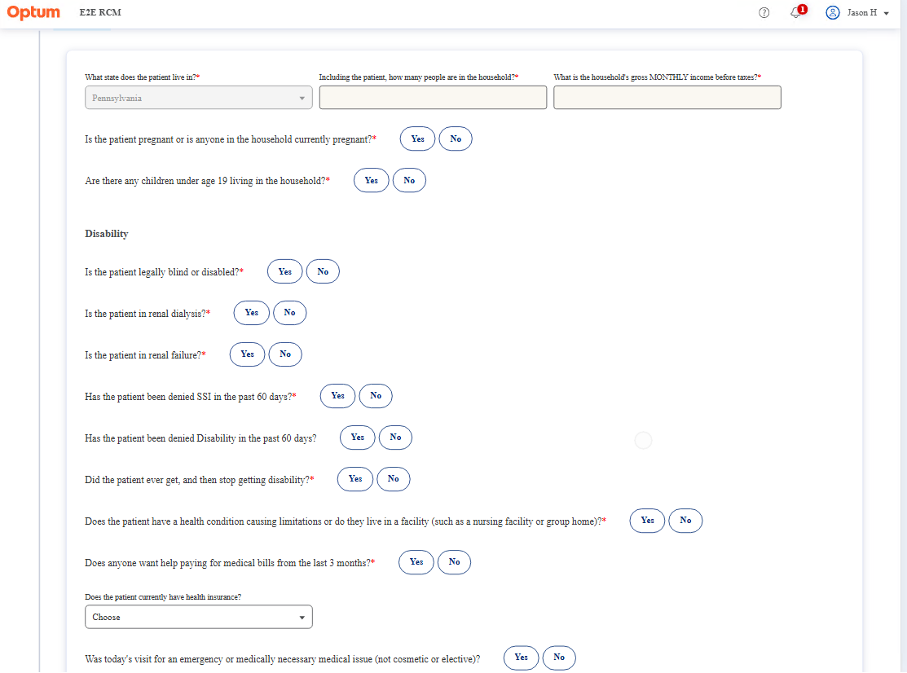
HCR View – UI Screenshot
LANDSCAPE
LANDSCAPE

