Slide 1

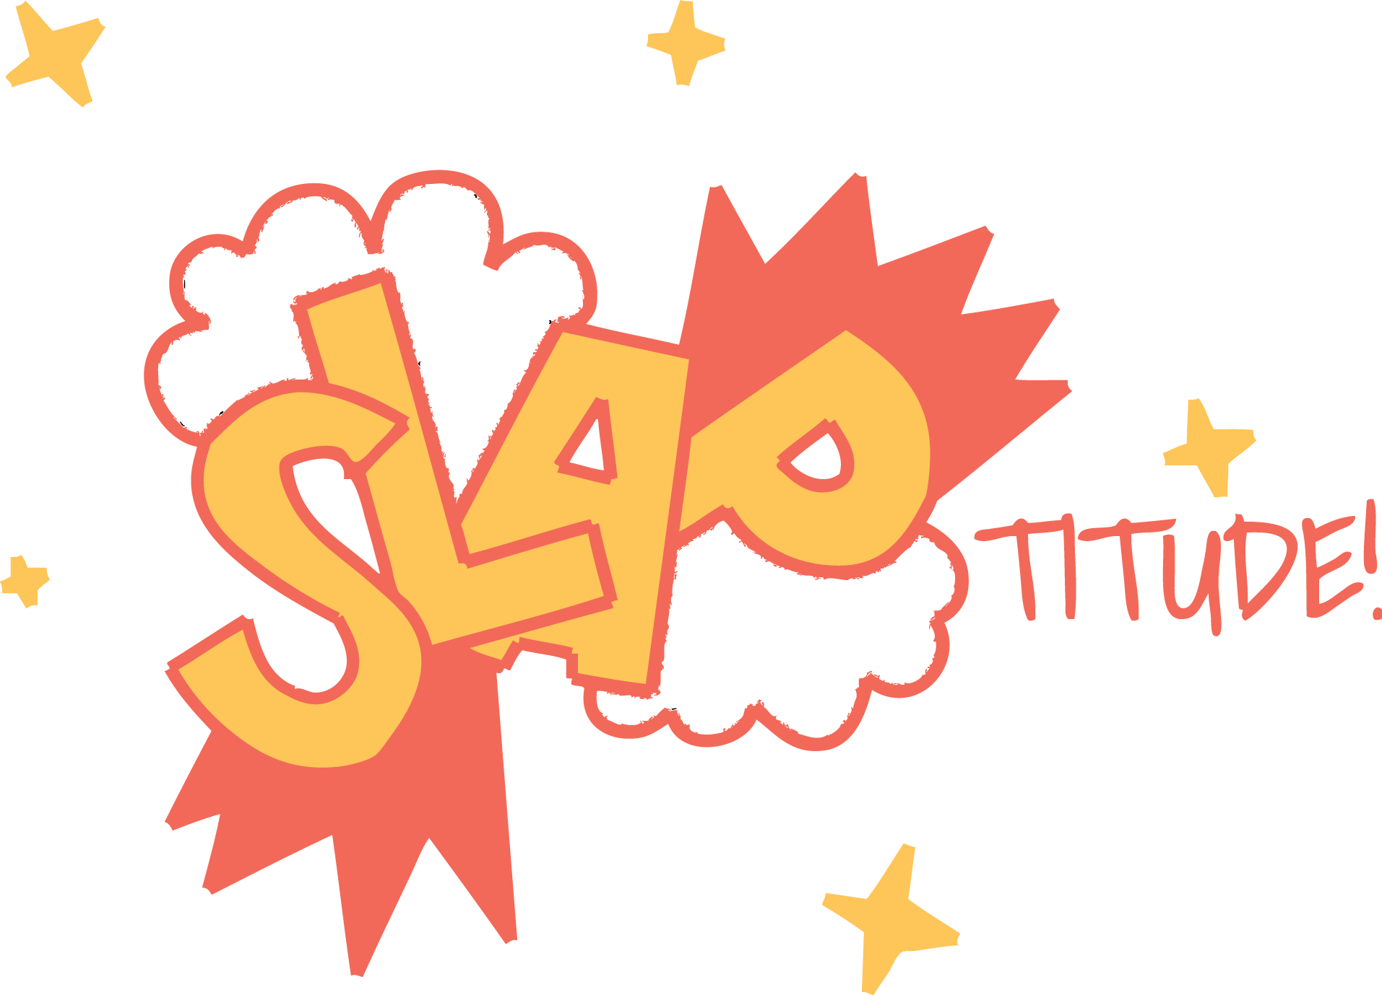
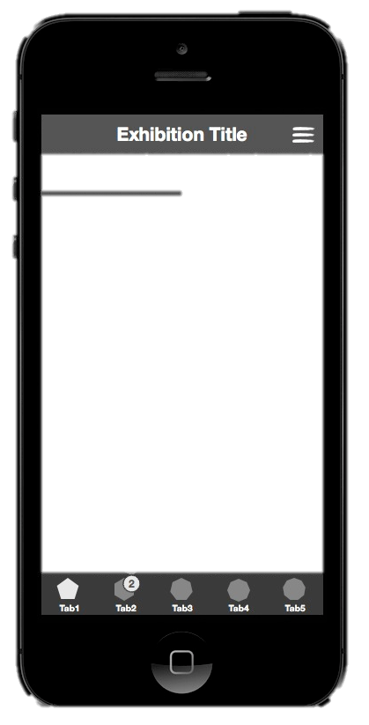
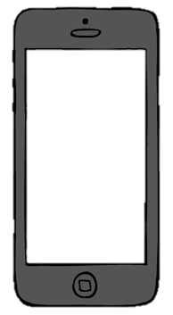
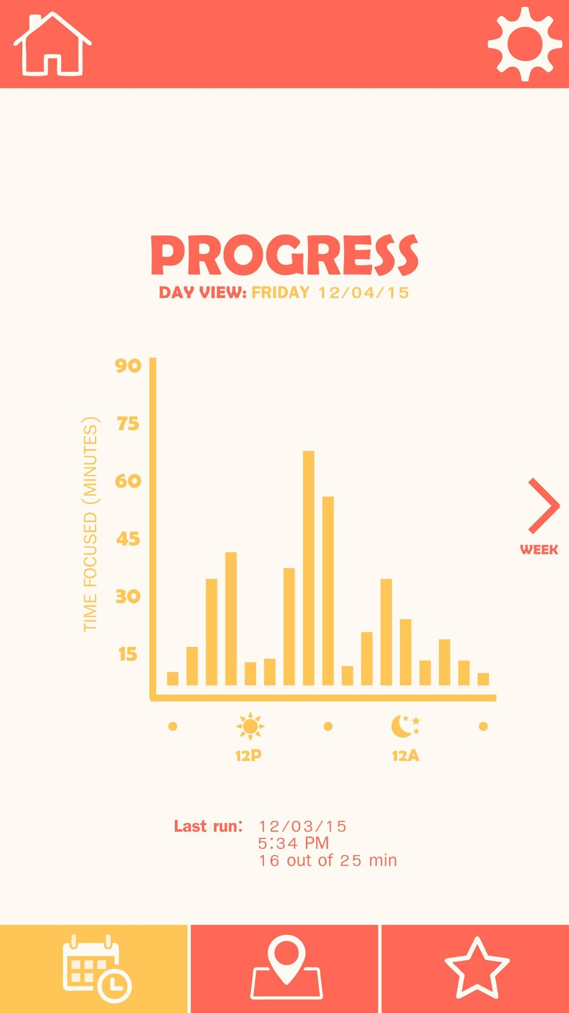
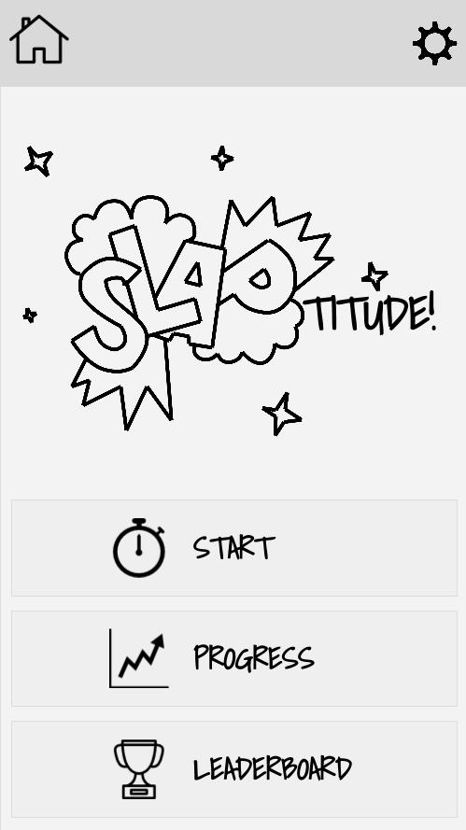
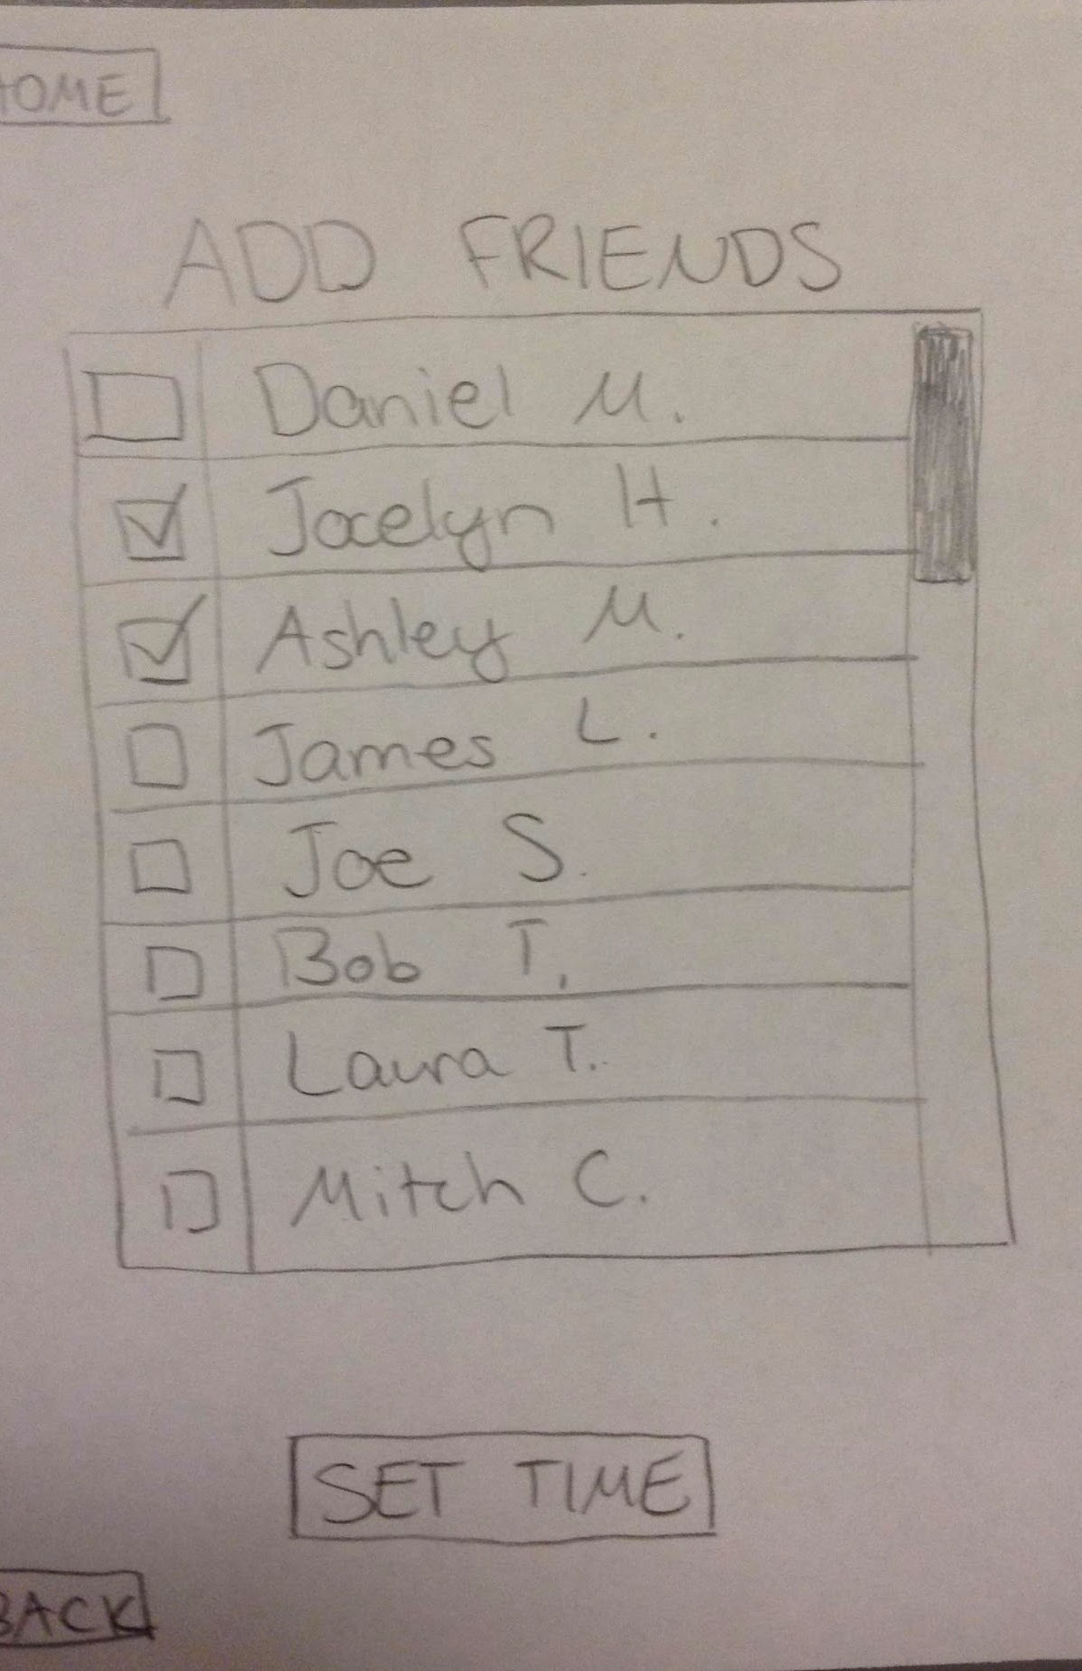
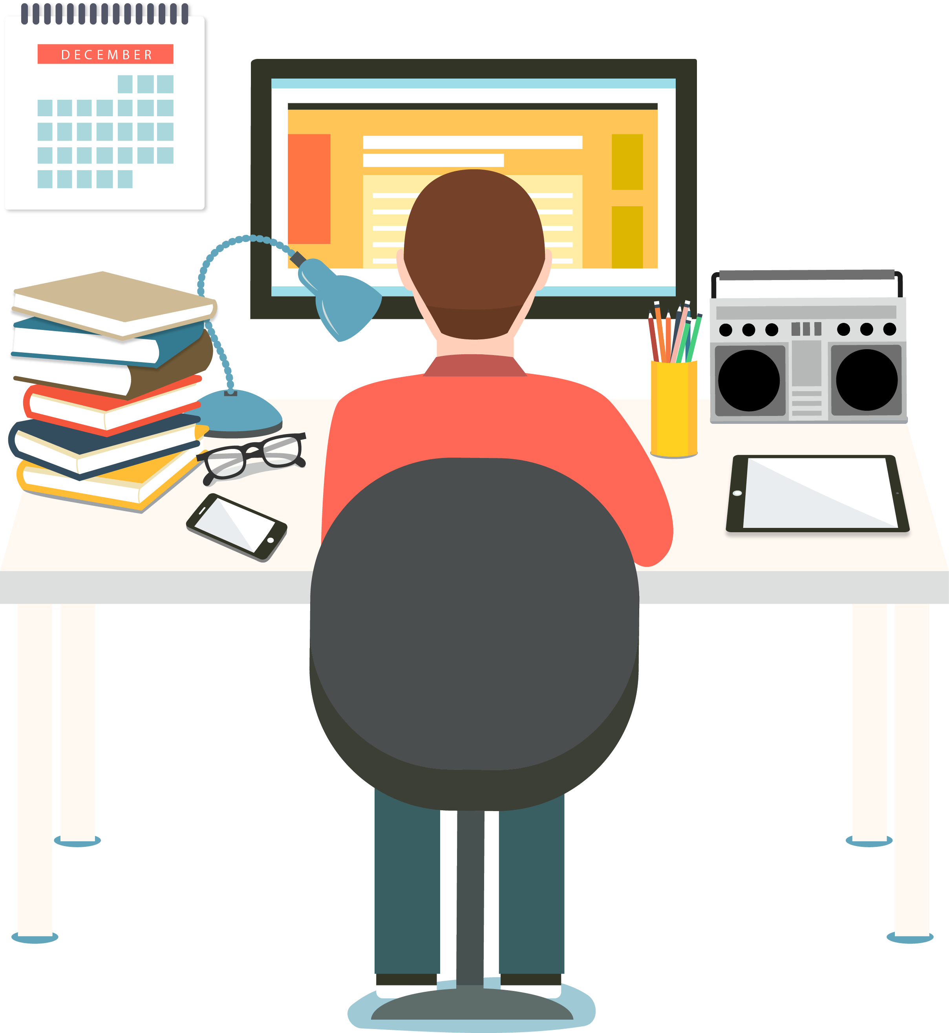
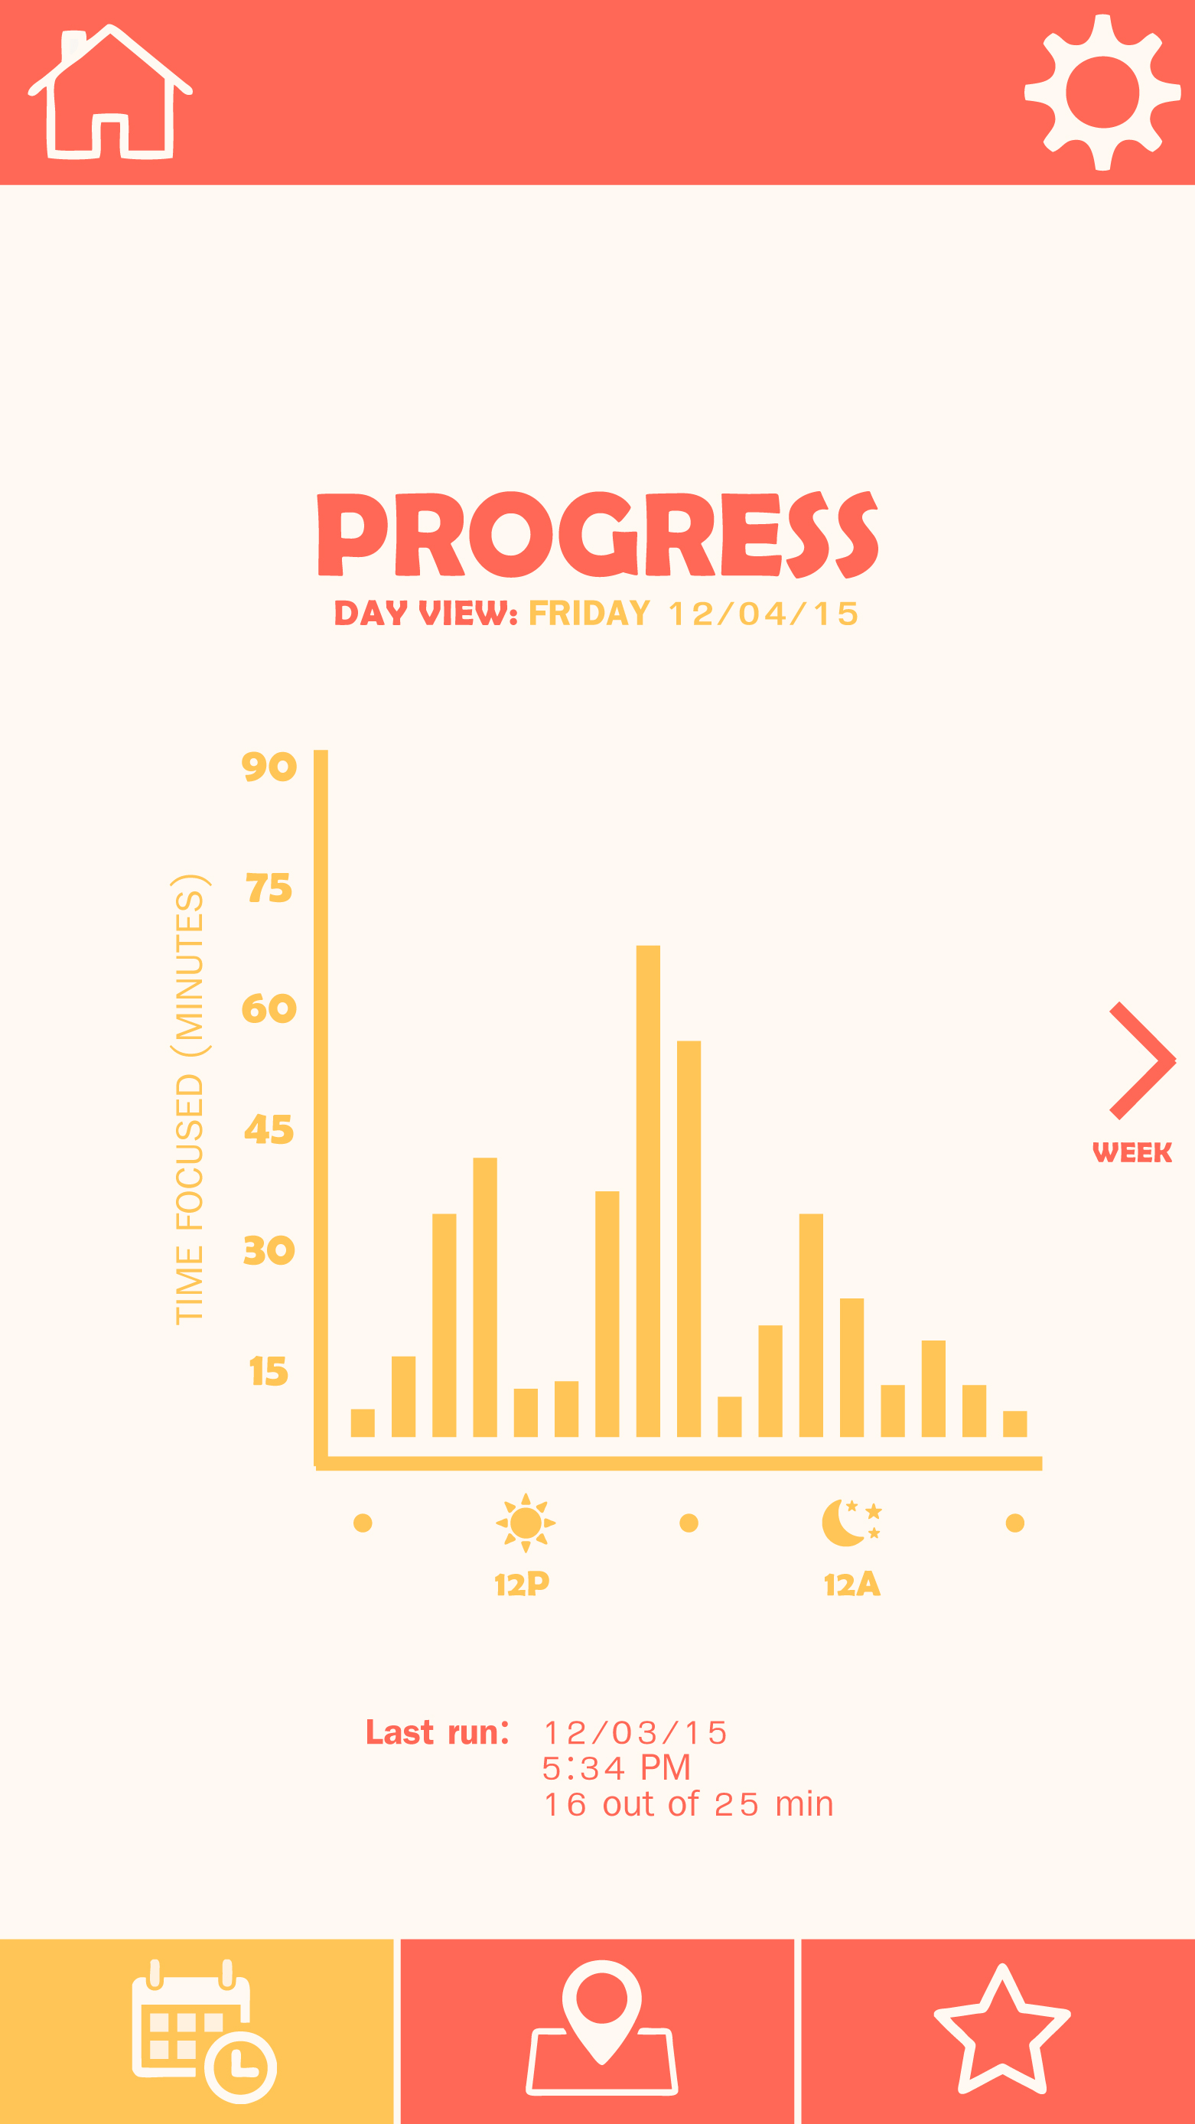
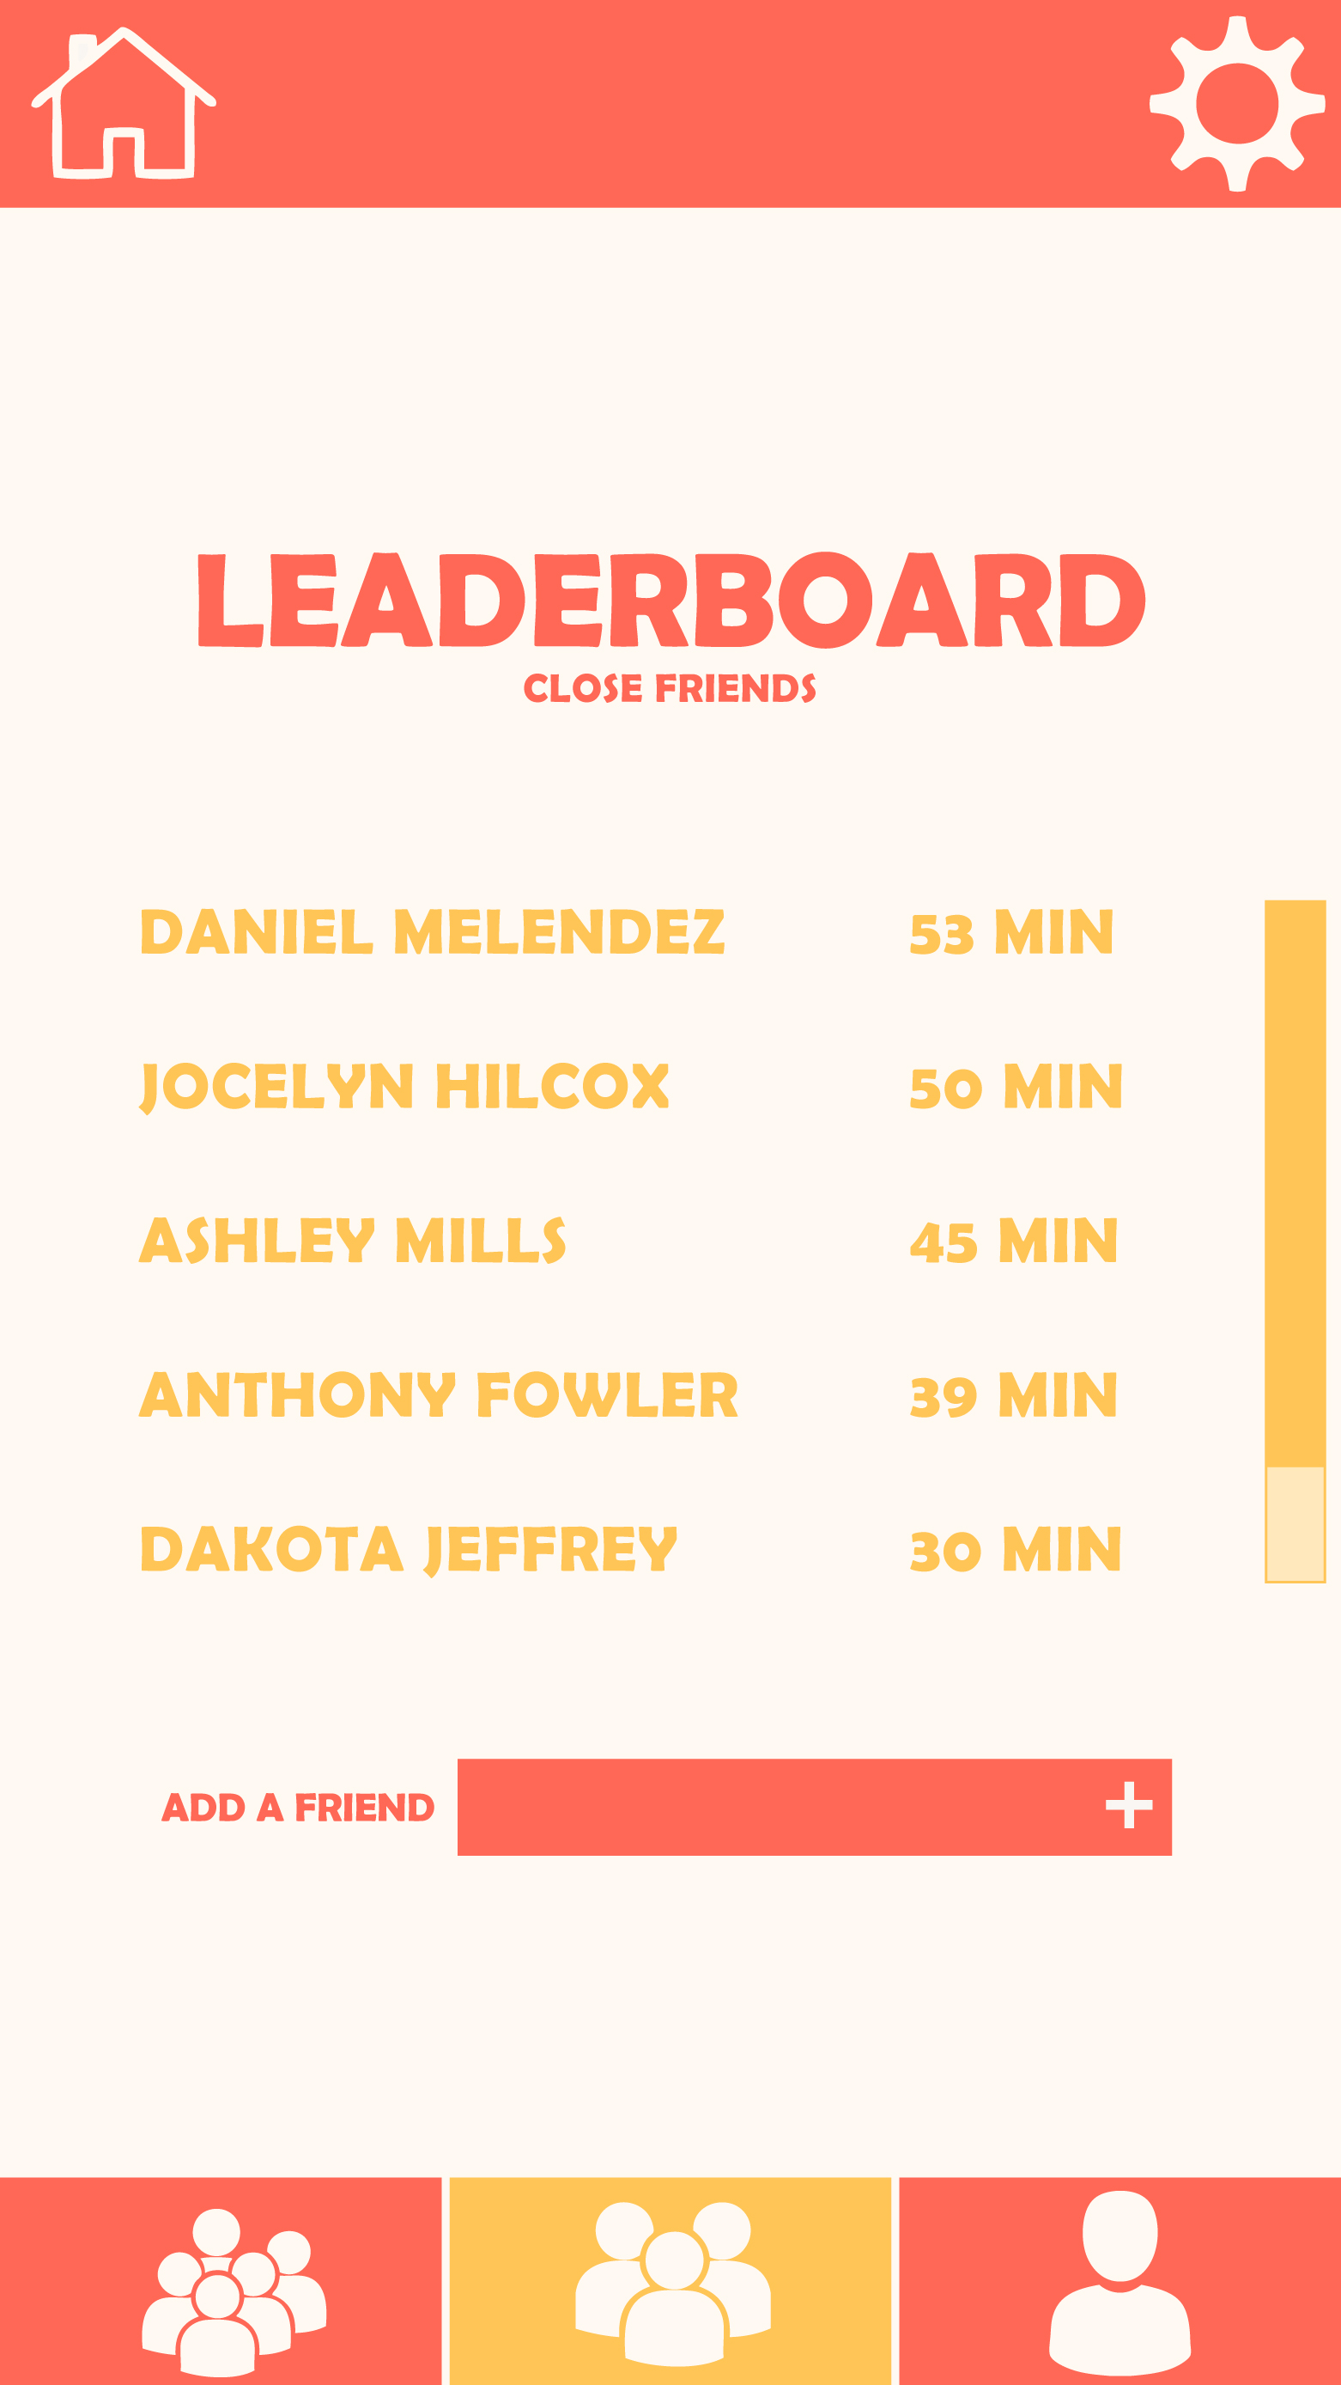
CONCEPT SKETCH
MED-FI CONCEPT
HI-FI PROTOTYPE
Empowering users to train their focus
Set a focus timer to resist distraction and measure attention span
Track your progress over time, SEE where and when you focus best
See where you rank against friends on leaderboard
NOWADAYS, OUR lives are full of distractions.
Slaptitude helps users focus on the task at hand, with Personalized feedback that takes the guesswork out of productivity.
Challenge yourself to stay focused with slaptitude!
JOCELYN HICKCOX | DANIEL MELENDEZ | ASHLEY MILLS | www.stanford.io/1RlhOR

