Slide 1
Para Performance Funnels
USA athletes vs the medalist standard — Elo rating by years of experience
Benchmark = Paralympic (Tokyo 2020 + Paris 2024) + World Championship medalists. PTVI · PTWC · PTS3.

Slide 2
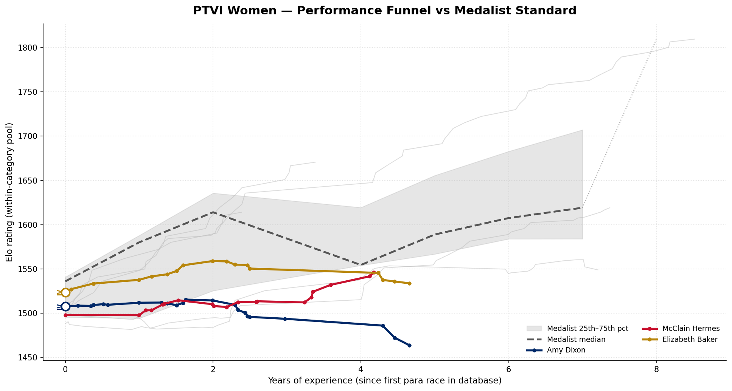
Women's PTVI — Performance Funnel
Gray = 5 benchmark athletes (Tokyo 2020 + Paris 2024 + Wollongong 2025 medalists). Blue = top USA by event count: Amy Dixon, McClain Hermes, Elizabeth Baker. Open marker (≥) = athlete's career predates our 2017 data floor.

Slide 3
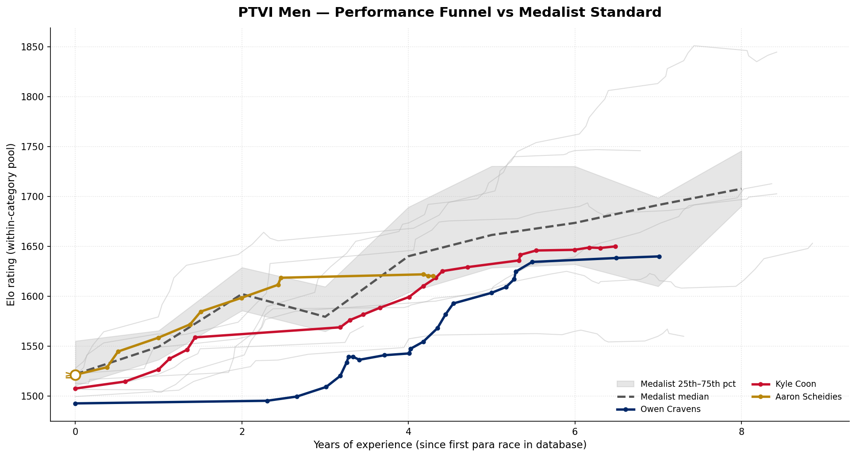
Men's PTVI — Performance Funnel
Gray = 7 benchmark athletes (Tokyo 2020 + Paris 2024 + Wollongong 2025 medalists). Blue = top USA by event count: Owen Cravens, Kyle Coon, Aaron Scheidies. Open marker (≥) = athlete's career predates our 2017 data floor.

Slide 4
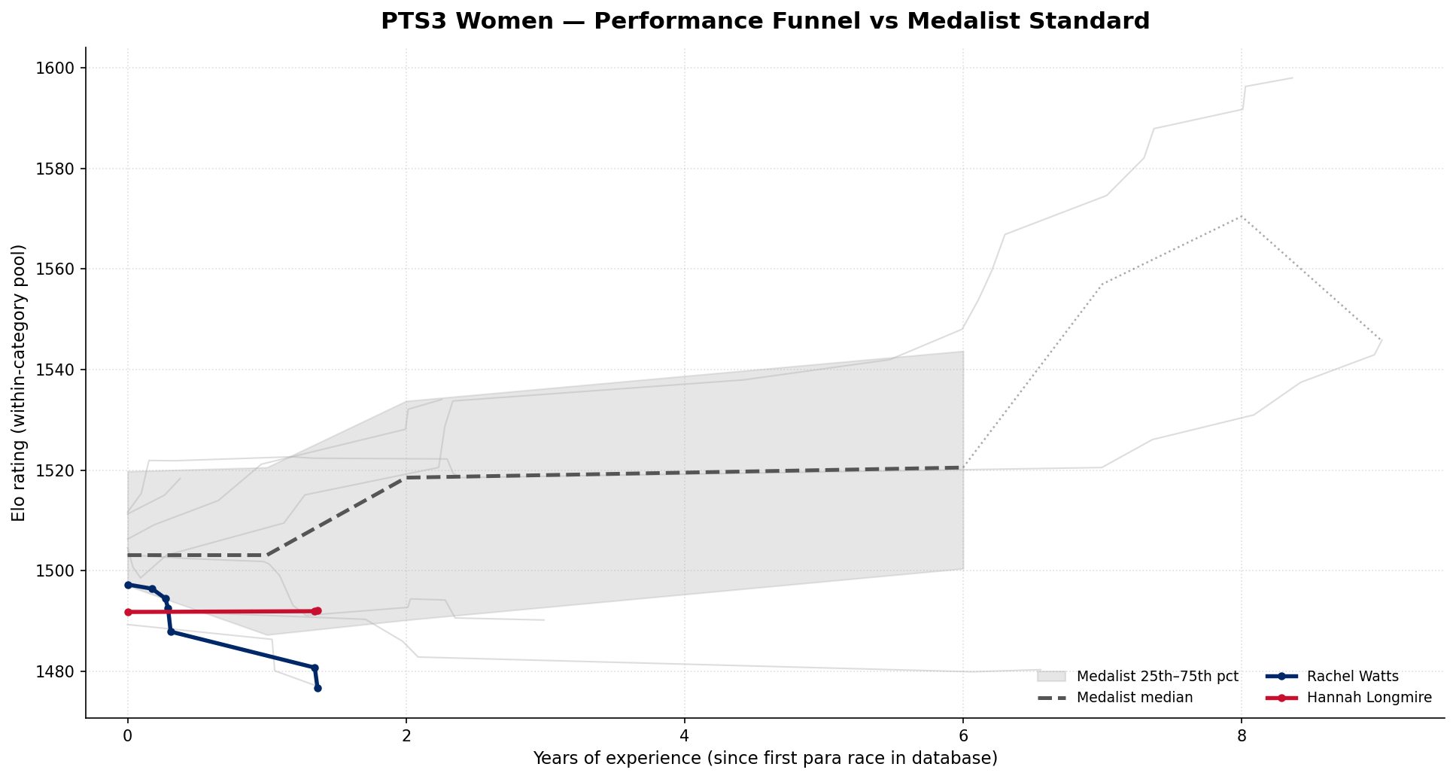
Women's PTS3 — Performance Funnel
Gray = 7 benchmark athletes (World Championship medalists since 2021). Blue = top USA by event count: Rachel Watts, Hannah Longmire. Open marker (≥) = athlete's career predates our 2017 data floor.

Slide 5
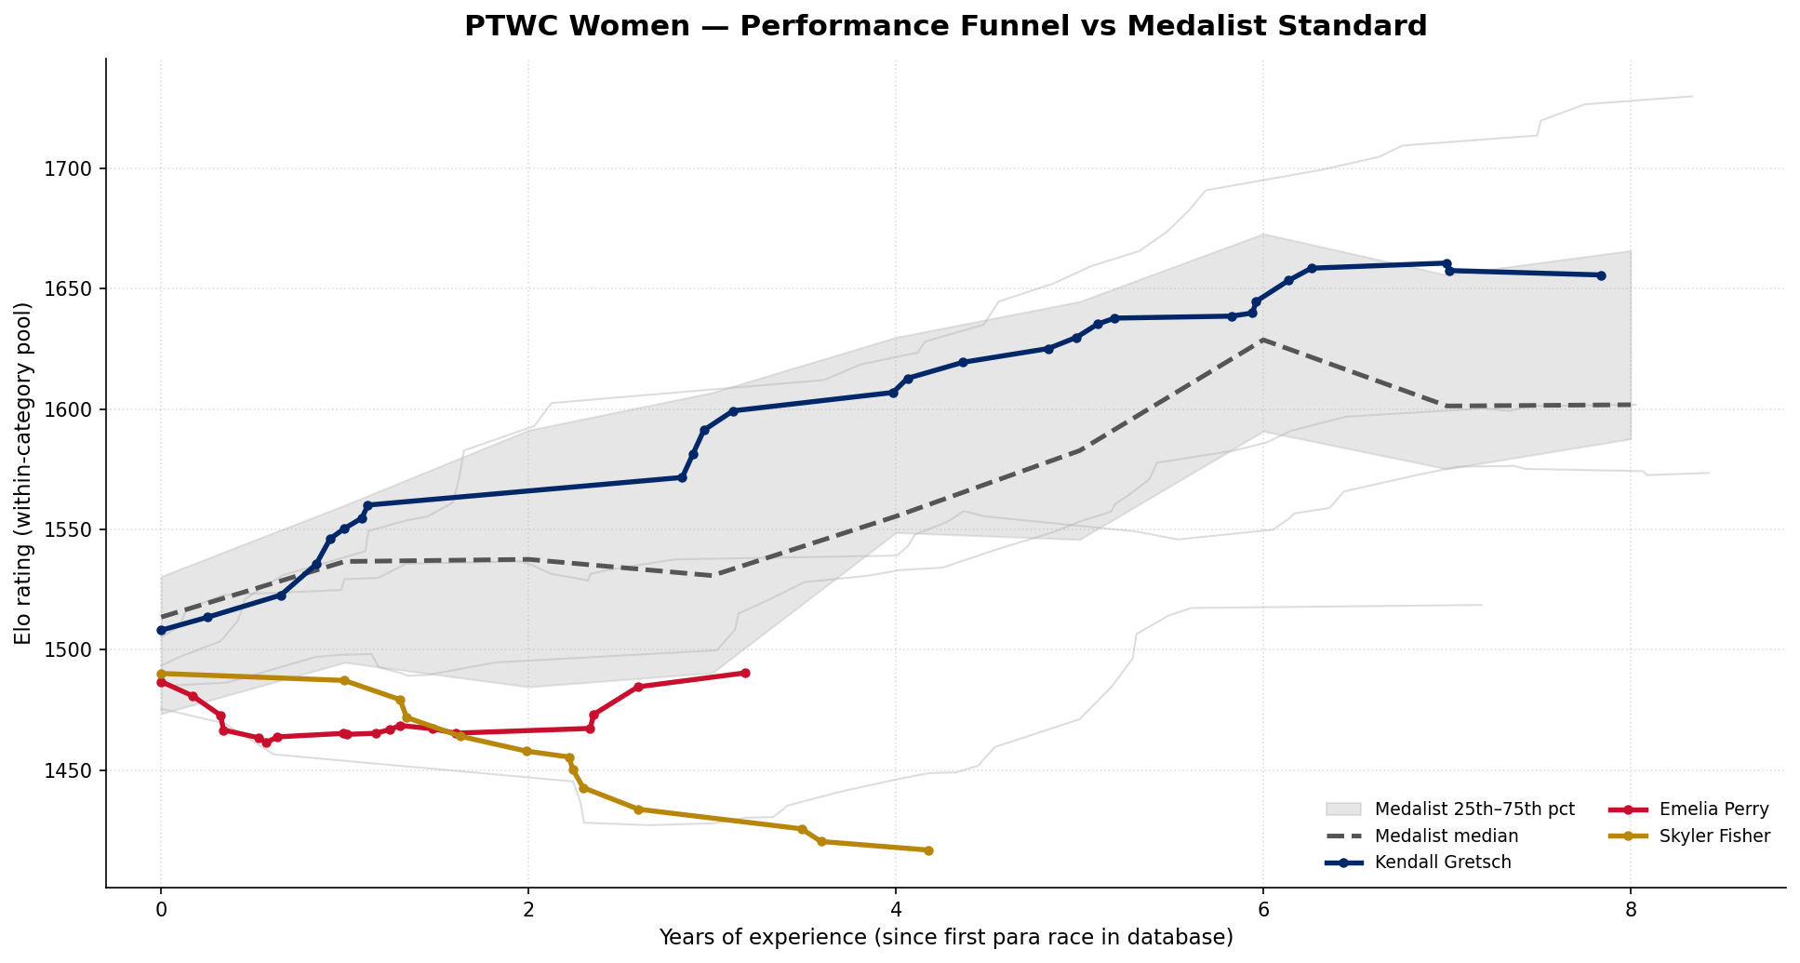
Women's PTWC — Performance Funnel
Gray = 6 benchmark athletes (Tokyo 2020 + Paris 2024 + Wollongong 2025 medalists). Blue = top USA by event count: Kendall Gretsch, Emelia Perry, Skyler Fisher. Open marker (≥) = athlete's career predates our 2017 data floor.

Slide 6
How to Read These Funnels — Notes & Caveats
• X-axis is YEARS OF EXPERIENCE, not age — para athletes enter the sport at very different ages, so experience (time since first para race) is the fairer development clock.
• Y-axis is Elo rating computed WITHIN each category pool (PTVI, PTWC, PTS3 are separate competition pools). Ratings are not comparable across categories. All athletes start at 1500.
• The gray band is the 25th–75th percentile of medalist trajectories; the dashed line is the median — this is the 'medal-capable' development corridor. Blue USA lines below the band are developing toward it.
• DATA FLOOR: our para history begins 2017-03-11. Athletes who competed before then are left-censored (open '≥' marker) — their true experience is higher than plotted, so their curve should be read as shifted right.
• AGE: a true age overlay was not feasible — only ~19% of benchmark medalists have a birth year on file. Qualitatively, PTVI/PTWC medalists tend to peak (highest Elo) around 6–10 years of experience, with several still climbing past year 10; the band's downturn at the far right reflects late-career medalists rather than a hard experience ceiling.
• A USA athlete who is also a medalist (e.g. Kendall Gretsch) appears BOTH as a blue line and inside the gray band — they are part of the standard they are measured against.
• Source: World Triathlon official results (race_results, events). Elo: pairwise, field-size-scaled K, tier-weighted (Worlds/Paralympics weighted highest).

