Slide 1
McClain Hermes
PTVI Progression vs Rodriguez (B1) & Tarantello (B3)
19 career races · 5 vs Rodriguez · 3 vs Tarantello

Slide 2
Story
Fast swimmer, narrowing the bike gap, and a step-change in run pace in 2025.
-14.8
2025 swim vs podium (sec / 100m)
+3.1
2025 bike vs podium (sec / km)
-5.8
2025 run vs podium (sec / km)
3.5→2.2
Avg finish position 2023 → 2025

Slide 3
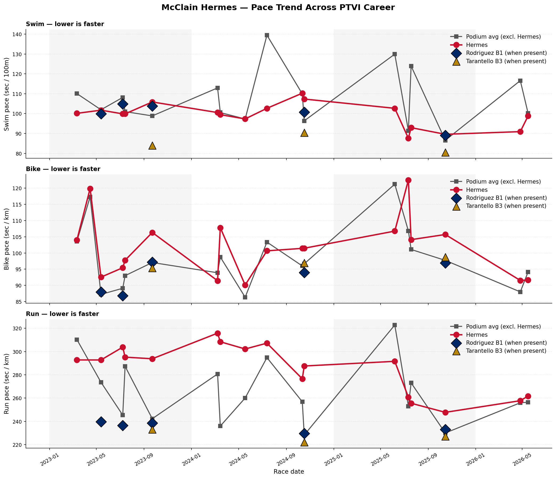
Pace Trend — All PTVI Races
Red = Hermes. Grey = podium avg excl. Hermes. Navy diamonds = Rodriguez B1. Gold triangles = Tarantello B3.

Slide 4
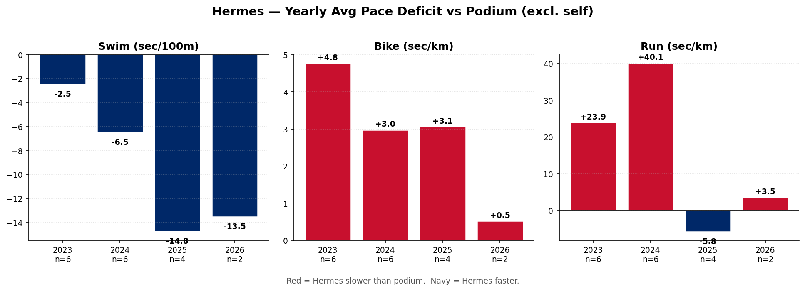
Yearly Avg Pace Deficit vs Podium — All Races
Red = Hermes slower than podium. Navy = Hermes faster. Yearly avg is field-depth sensitive — see Worlds-only view next.

Slide 5
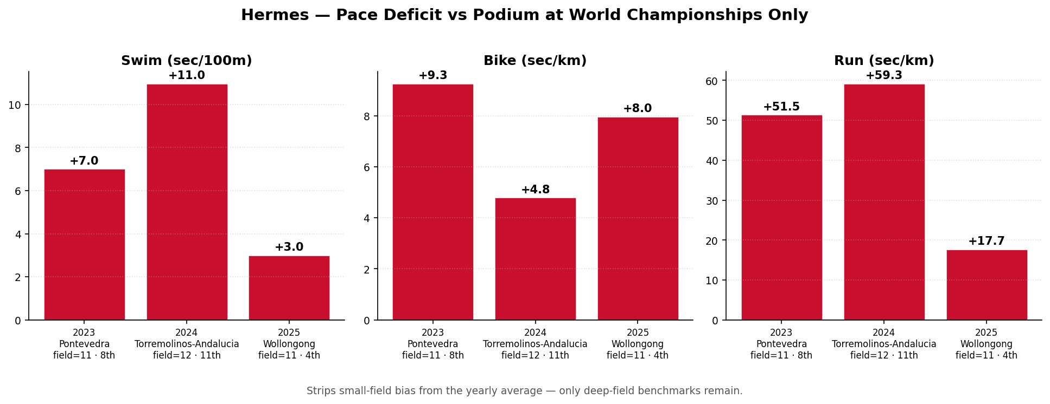
Worlds Only — Apples-to-Apples Trajectory
One race per year (Pontevedra '23, Torremolinos '24, Wollongong '25). Removes small-field bias.

Slide 6
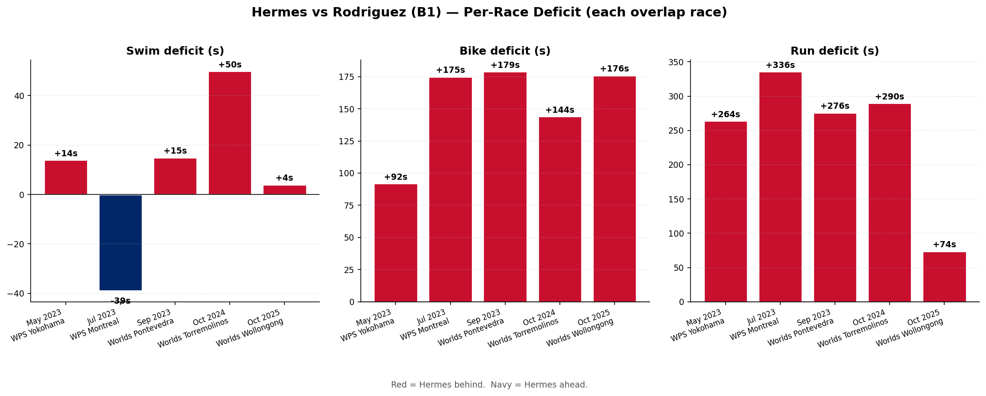
Head-to-Head vs Susana Rodriguez (B1) — 5 overlap races
Red = Hermes behind. Navy = Hermes ahead.

Slide 7
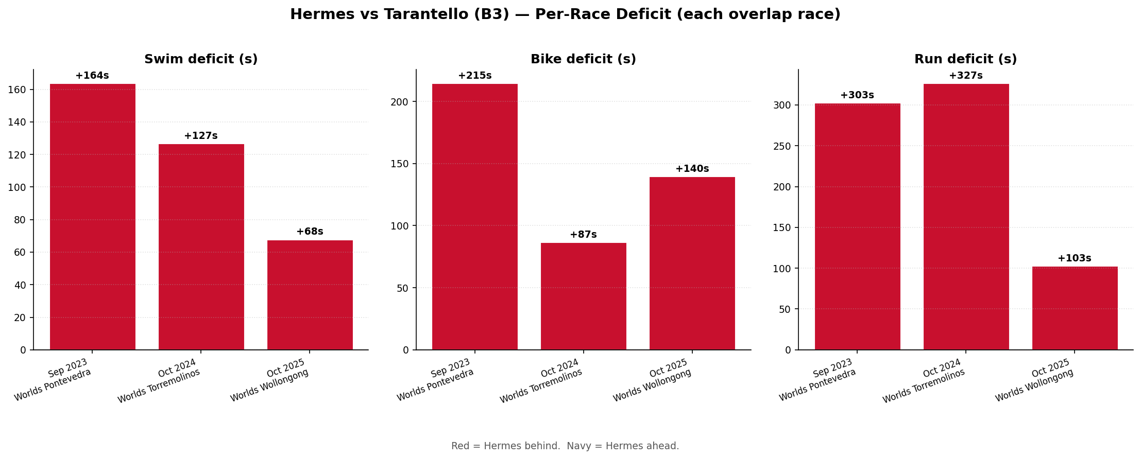
Head-to-Head vs Francesca Tarantello (B3) — 3 overlap races
Tarantello is in the B3 sub-class — comparison uses official factor-adjusted times.

Slide 8
Notes
• Direct overlap data is thin: 5 races vs Rodriguez, 3 vs Tarantello. Per-race charts are more honest than year-over-year averaging.
• Two 2025 races (Calima Cont. Champs, Tata WC) had only 3 finishers; Hermes was on the podium in both. The 2025 'vs podium avg' yearly number is favorably skewed by those tiny fields.
• Hermes and Rodriguez are both B1; Tarantello is B3. PTVI results are factor-adjusted to equalize across sub-classes — the deficits shown are the gap on official classification.
• Source: World Triathlon official results — race_results and events tables.

