Slide 1

USAT Project Podium Sullivan Middaugh Update

Slide 2
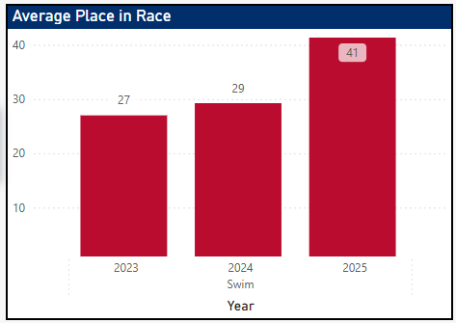
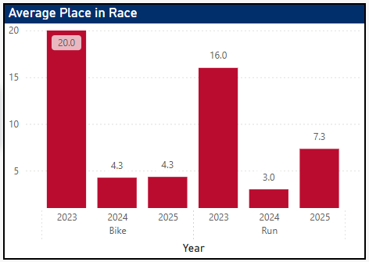
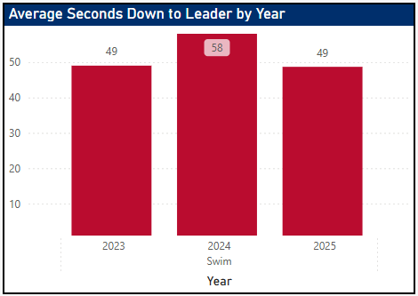
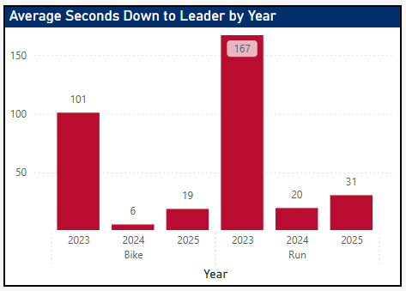
Individual Focus
Continental Cup Sprint Distance Trends
Sullivan has demonstrated improved swim fitness through his ability to better utilize his run and swim fitness.
While maintaining similar swim deficit and positioning he has become a better overall triathlete and can utilize his world class bike and run fitness to move into the top 10
Maintain Swim Deficit with Less Energy
Move Up on the Bike and Run
Improve From Top 20 to Top 10
In 7/8 Races Sullivan had a Top 3 Bike Split
In 5/8 races, Sullivan had the 1st fastest bike split
In 5/8 races, Sullivan had a Top 10 Run Split
Note: 2023-2025 Elite Men’s Continental Cup Racing Series (Excludes Edmonton 2024)
Notes:
shape
No alt text provided
pageNavigator
No alt text provided
Gap to Lead by Stage
No alt text provided
Name
No alt text provided
Place Change by Stage
No alt text provided
Place at Stage
No alt text provided
pivotTable
No alt text provided
slicer
No alt text provided
slicer
No alt text provided
shape
No alt text provided
Key Point
No alt text provided
Recent Performance
No alt text provided
image
No alt text provided

Slide 3
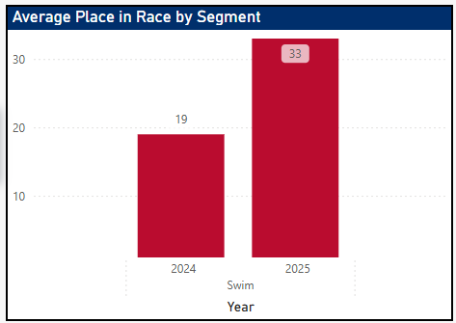
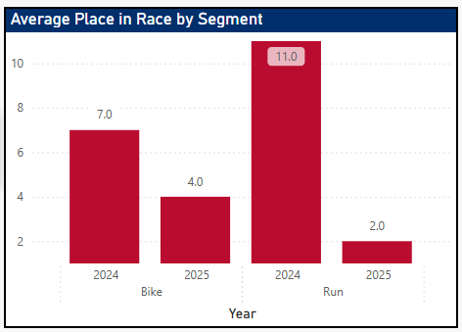
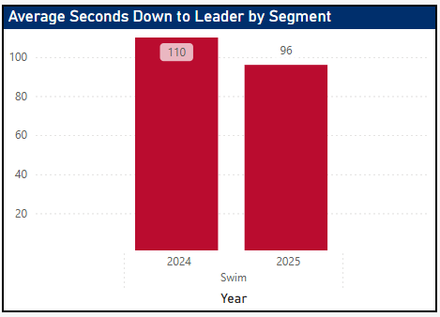
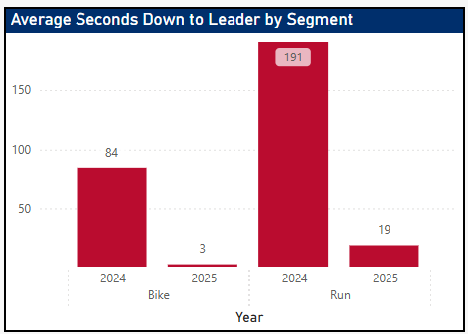
Individual Focus
Continental Cup Championships Trends
From 2024 to 2025 Sullivan improved from 11th to 2nd at the Continental Championships thanks to an improved swim deficit that enabled him catch the breakaway and start the run at the front
Maintain Swim Deficit with Less Energy
Move Up on the Bike and Run
Move Up From Top 20 to Top 10
Sullivan had the 1st bike in both races, but the extra energy allowed him to have the 2nd fastest run split in 2025 vs. 15th in 2024
Note: 2023-2025 Elite Men’s Continental Cup Racing Series (Excludes Edmonton 2024)
Notes:
shape
No alt text provided
pageNavigator
No alt text provided
Gap to Lead by Stage
No alt text provided
Name
No alt text provided
Place Change by Stage
No alt text provided
Place at Stage
No alt text provided
pivotTable
No alt text provided
slicer
No alt text provided
slicer
No alt text provided
shape
No alt text provided
Key Point
No alt text provided
Recent Performance
No alt text provided
image
No alt text provided

Slide 4
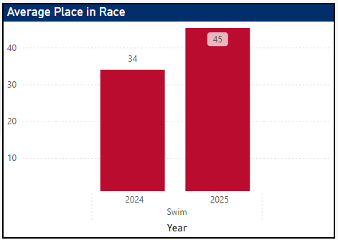
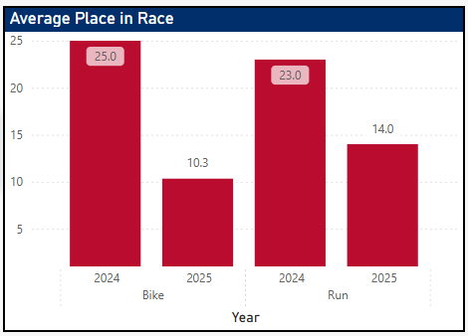
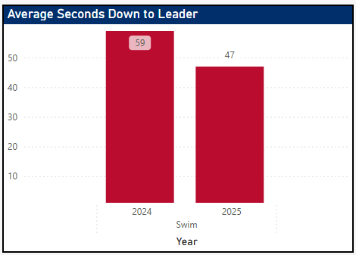
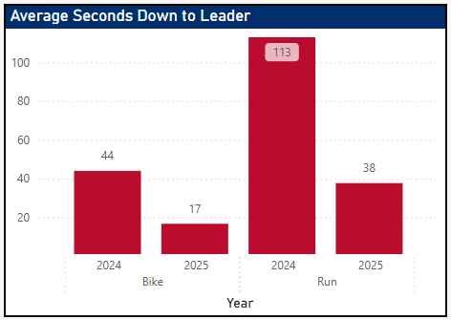
Individual Focus
World Cup Sprint Distance Trends
At the World Cup Level Sullivan has always been a top biker but by improving his swim fitness he now has more energy throughout the race and been able to achieve two Top 10’s in 2025 at Napier and San Pedro de la Paz.
By coming out of the water closer to front, Sullivan remains a key athlete to watch for in races that can quickly eliminate breakaways.
Maintain Swim Deficit with Less Energy
Move Up on the Bike and Run
Move Up From Top 20 to Top 10
In all four World Cup Races Sullivan has achieved the fastest bike split.
In Napier and San Pedro de la Paz, Sullivan had the 11th fastest runs en route to Top 10 finishes
Note: 2023-2025 Elite Men’s World Cup Racing Series
Notes:
shape
No alt text provided
pageNavigator
No alt text provided
Gap to Lead by Stage
No alt text provided
Name
No alt text provided
Place Change by Stage
No alt text provided
Place at Stage
No alt text provided
pivotTable
No alt text provided
slicer
No alt text provided
slicer
No alt text provided
shape
No alt text provided
Key Point
No alt text provided
Recent Performance
No alt text provided
image
No alt text provided

