Slide 1
Skyler Fisher
PTWC Progression vs Parker (H1, reigning Paralympic gold) & Perry (H1, USA teammate)
14 career races · 3 vs Parker · 9 vs Perry

Slide 2
Story
Cup-podium regular with a 2026 Yokohama breakthrough at depth.
14
PTWC career race finishes
5
Para Cup podium results
384s
Closest gap to Parker (May 2026)
45s
Closest 2026 gap to Perry (Mar 2023)

Slide 3
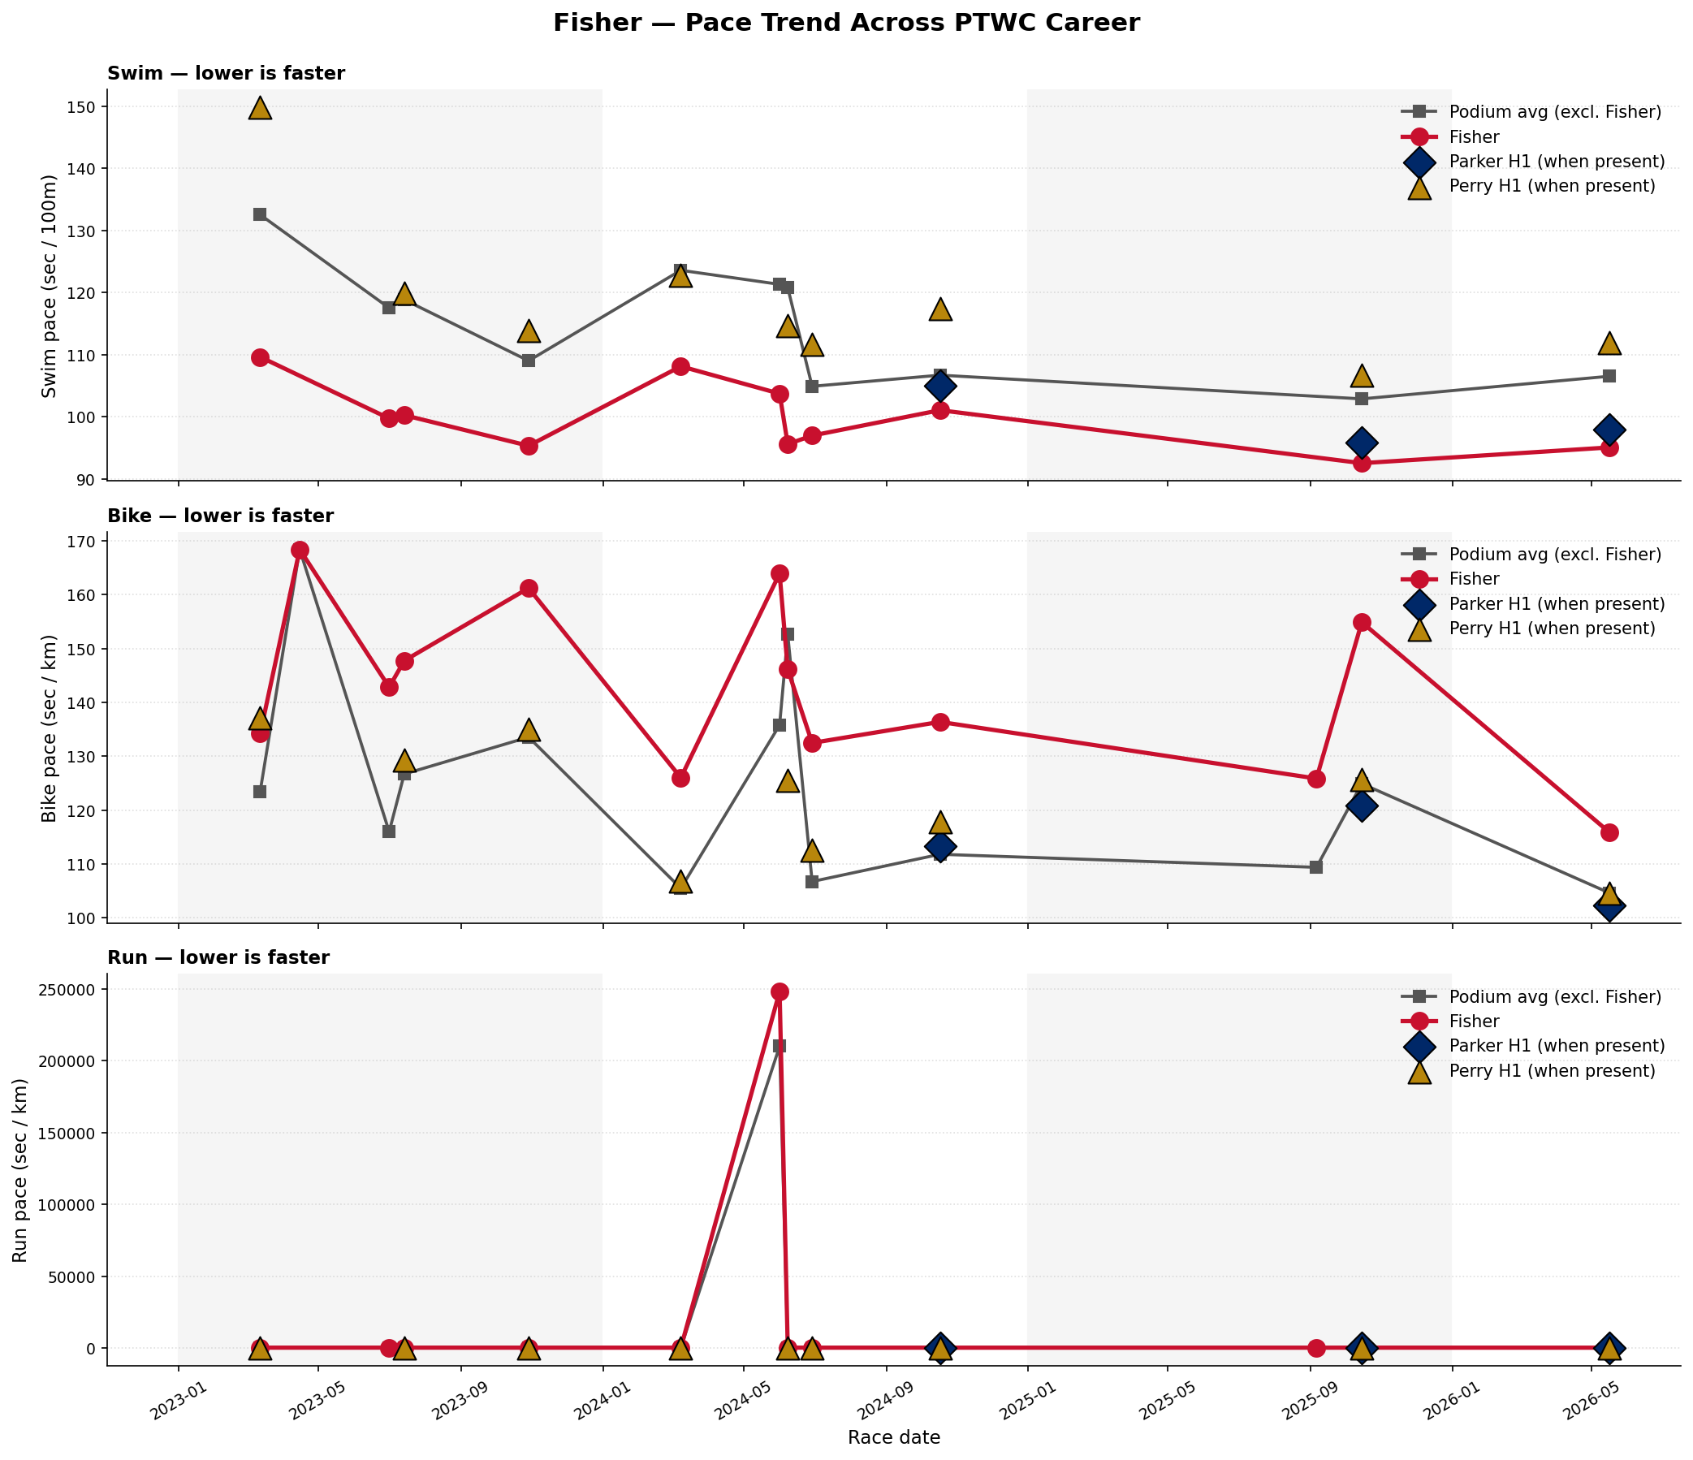
Pace Trend — All PTWC Races
Red = Fisher. Grey = podium avg excl. Fisher. Navy diamonds = Parker H1. Gold triangles = Perry H1.

Slide 4
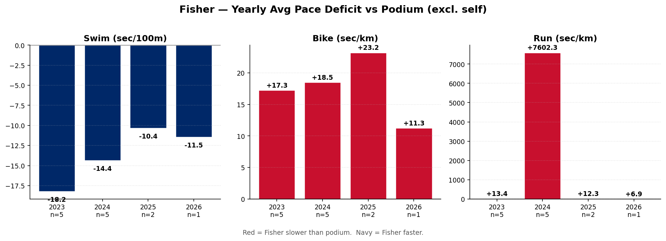
Yearly Avg Pace Deficit vs Podium — All Races
Red = Fisher slower than podium. Navy = Fisher faster. Yearly avg is field-depth sensitive — see Worlds-only view next.

Slide 5
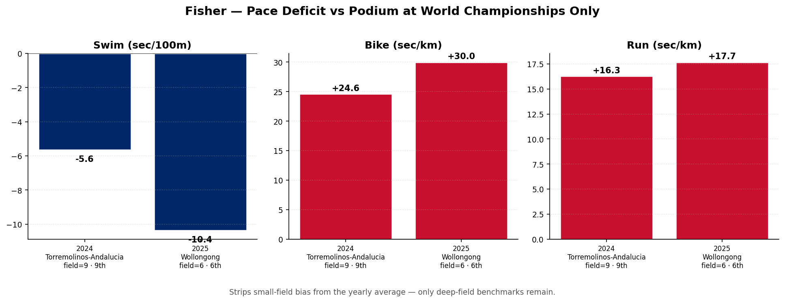
Worlds Only — Apples-to-Apples Trajectory
One race per year at the World Championships level. Removes small-field bias.

Slide 6
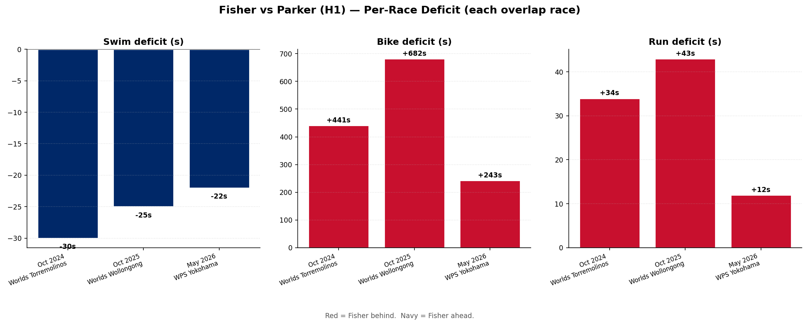
Head-to-Head vs Lauren Parker (H1) — 3 overlap races
Red = Fisher behind. Navy = Fisher ahead. Parker is in the H1 sub-class.

Slide 7
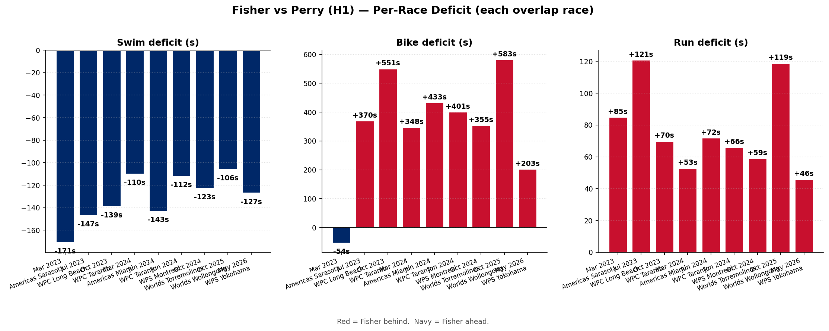
Head-to-Head vs Emelia Perry (H1) — 9 overlap races
Red = Fisher behind. Navy = Fisher ahead. Both USA, but Perry is H1, Fisher is H2.

Slide 8
Notes
• Direct overlap data: 3 races vs Parker, 9 vs Perry. Parker overlap is concentrated at Worlds + WPS Series; the per-race chart is the honest view.
• Fisher is H2; Parker and Perry are H1. PTWC results are factor-adjusted to equalize across sub-classes — deficits shown are the gap on the official classification (the gap that actually determined finishing order).
• Some Para Cup races had very small fields (2–4 finishers). When Fisher was on the podium in those, the 'podium avg excl. self' reduces to just 1–2 other athletes — interpret 2025 yearly numbers with this in mind.
• Source: World Triathlon official results — race_results and events tables.

