Slide 1
Emelia Perry
PTWC Progression vs Lauren Parker, 2023–2025
10 head-to-head races · World Triathlon results

Slide 2
Story
Closing the gap on the Paralympic gold medalist — every segment, every year.
76%
Total deficit reduction (2023 → 2025)
74%
Bike deficit reduction
-47s
2025 run advantage (Perry ahead)
7th → 2.3
Avg finish position

Slide 3
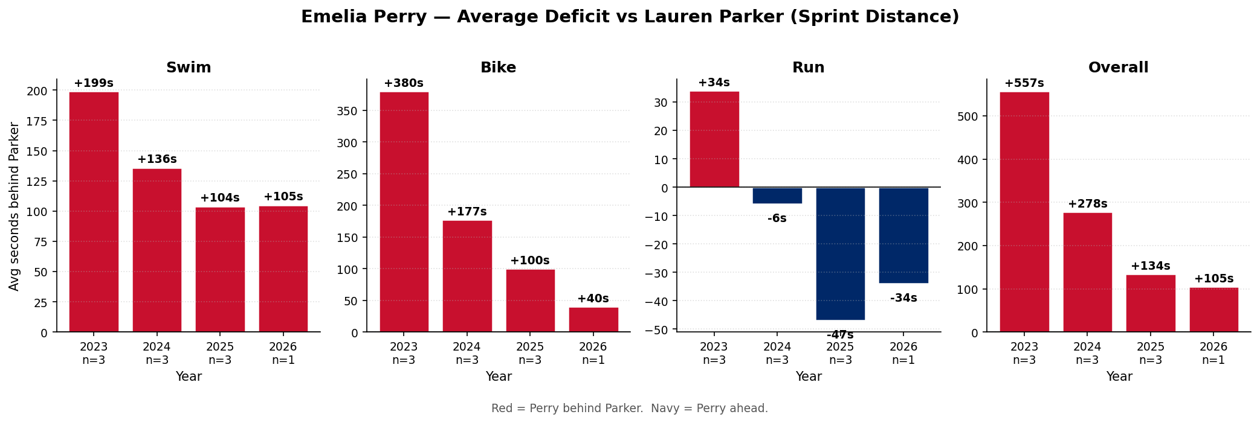
Sprint Yearly Deficit vs Lauren Parker
Red = Perry behind. Navy = Perry ahead. n = sprint races per year.

Slide 4
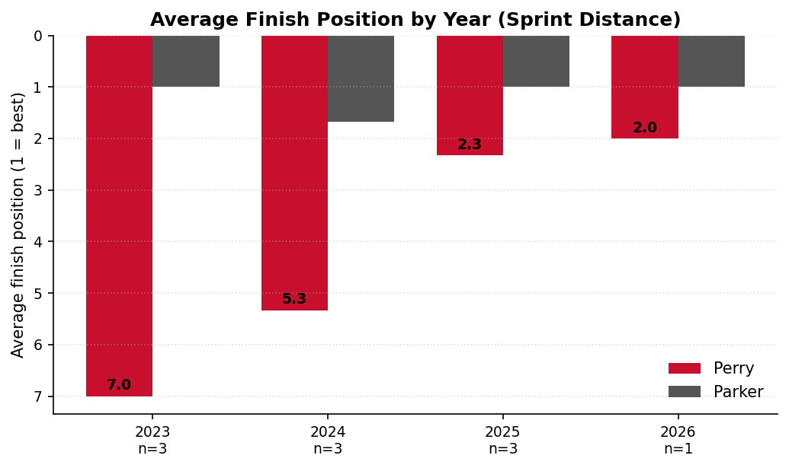
Average Finish Position by Year
Lower bar = better finish. Perry has gone from avg 7th to avg 2.5 in PTWC sprint racing.

Slide 5
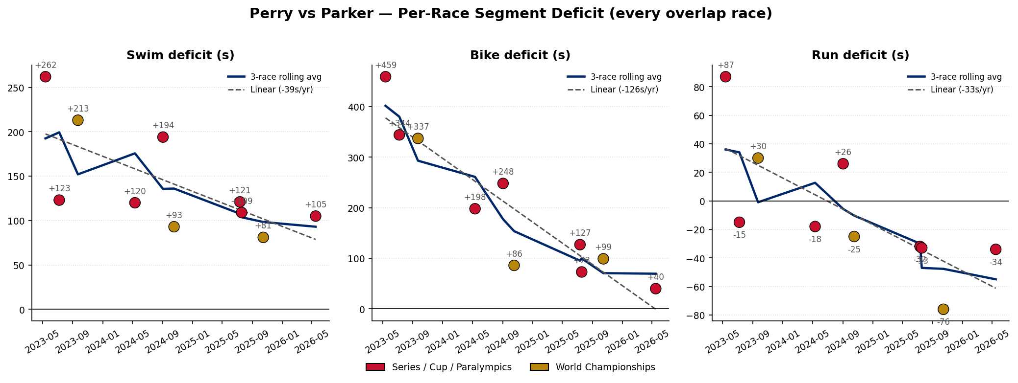
Every Overlap Race — Per-Segment Deficit
Gold marker = standard-distance race (2025 Worlds, Wollongong).

Slide 6
2025 World Championships, Wollongong — Worlds Silver
Silver — +70s on total time
Perry beat Parker on the run by 76s at PTWC Worlds.
Best individual head-to-head result of Perry's career — confirms the 2025 fitness step.

Slide 7
Notes
• Both athletes race in the H1 wheelchair sub-class — within-class comparison is exact (no time-factor effects).
• 2025 sprint sample is 2 races (Magog, Montreal); 2025 standard sample is 1 race (Wollongong). Further 2026 races will tighten the yearly averages.
• Source: World Triathlon official results — race_results and events tables.

