Slide 1
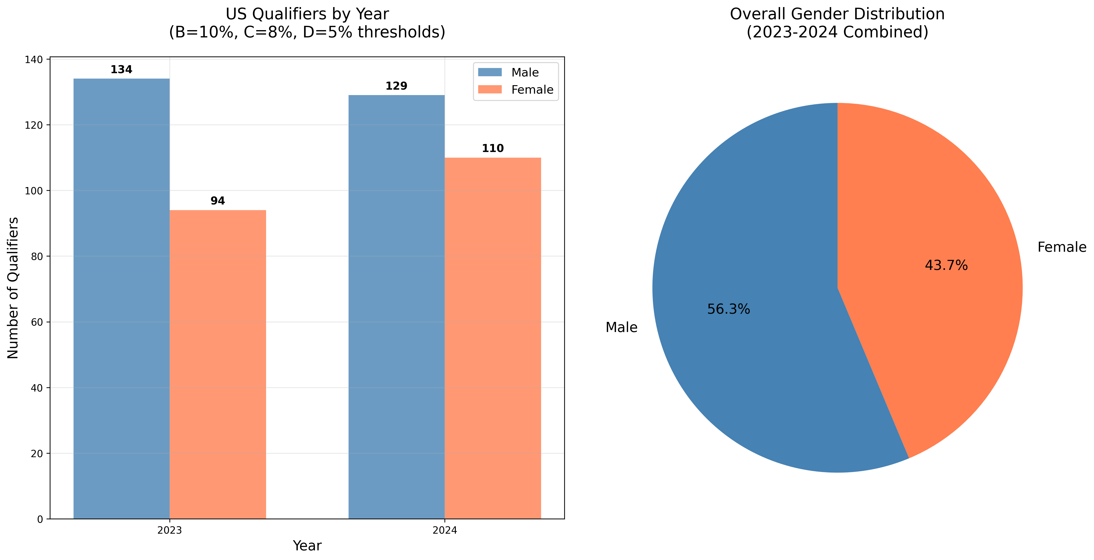
US Qualifier Summary: Default Threshold Analysis
2023: 228 Total Qualifiers | 2024: 239 Total Qualifiers | Threshold Settings: B-Events 10%, C-Events 8%, D-Events 5%

