Slide 1
Triathlon Event Performance Analysis
Qualifier Analysis & Threshold Sensitivity Study
Prepared for USA Triathlon & IRONMAN Leadership | July 2025

Slide 2
Executive Summary
Key Findings from Triathlon Performance Analysis
Analysis covers B-Events (T100, World Championships), C-Events (Major IRONMAN), and D-Events (Regional IRONMAN 70.3)
Qualifier sensitivity varies significantly based on event category and threshold percentages
B-Events show highest sensitivity to threshold changes, affecting qualification numbers substantially
Gender parity maintained across most threshold scenarios
Threshold optimization can balance qualifier pool size with performance standards

Slide 3
Event Categories & Analysis Scope
Event Classification System
B-Events (Premier): T100 World Tour, World Championships, Major IRONMAN (Texas, St George)
C-Events (Regional Major): IRONMAN Arizona/Lake Placid/Chattanooga, IRONMAN 70.3 Eagleman/Oceanside/Boulder
D-Events (Local/Regional): IRONMAN 70.3 Indian Wells, Oregon, Santa Cruz, Texas, Maine, Wisconsin
Analysis covers 2023-2024 seasons with threshold sensitivity from 4% to 10% above winner times
Focus on US athletes and qualification patterns for strategic planning

Slide 4
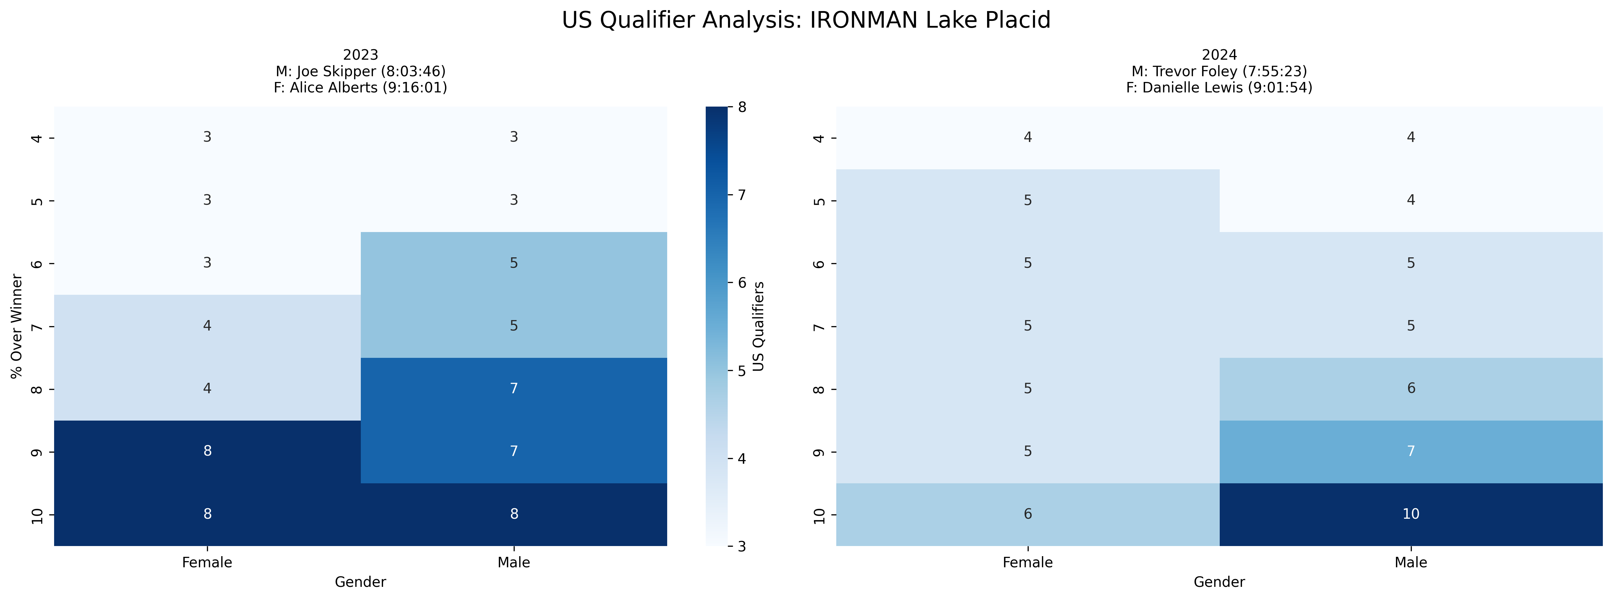
Event Analysis: IRONMAN Lake Placid
Multi-year comparison showing US qualification patterns across different threshold percentages

Slide 5
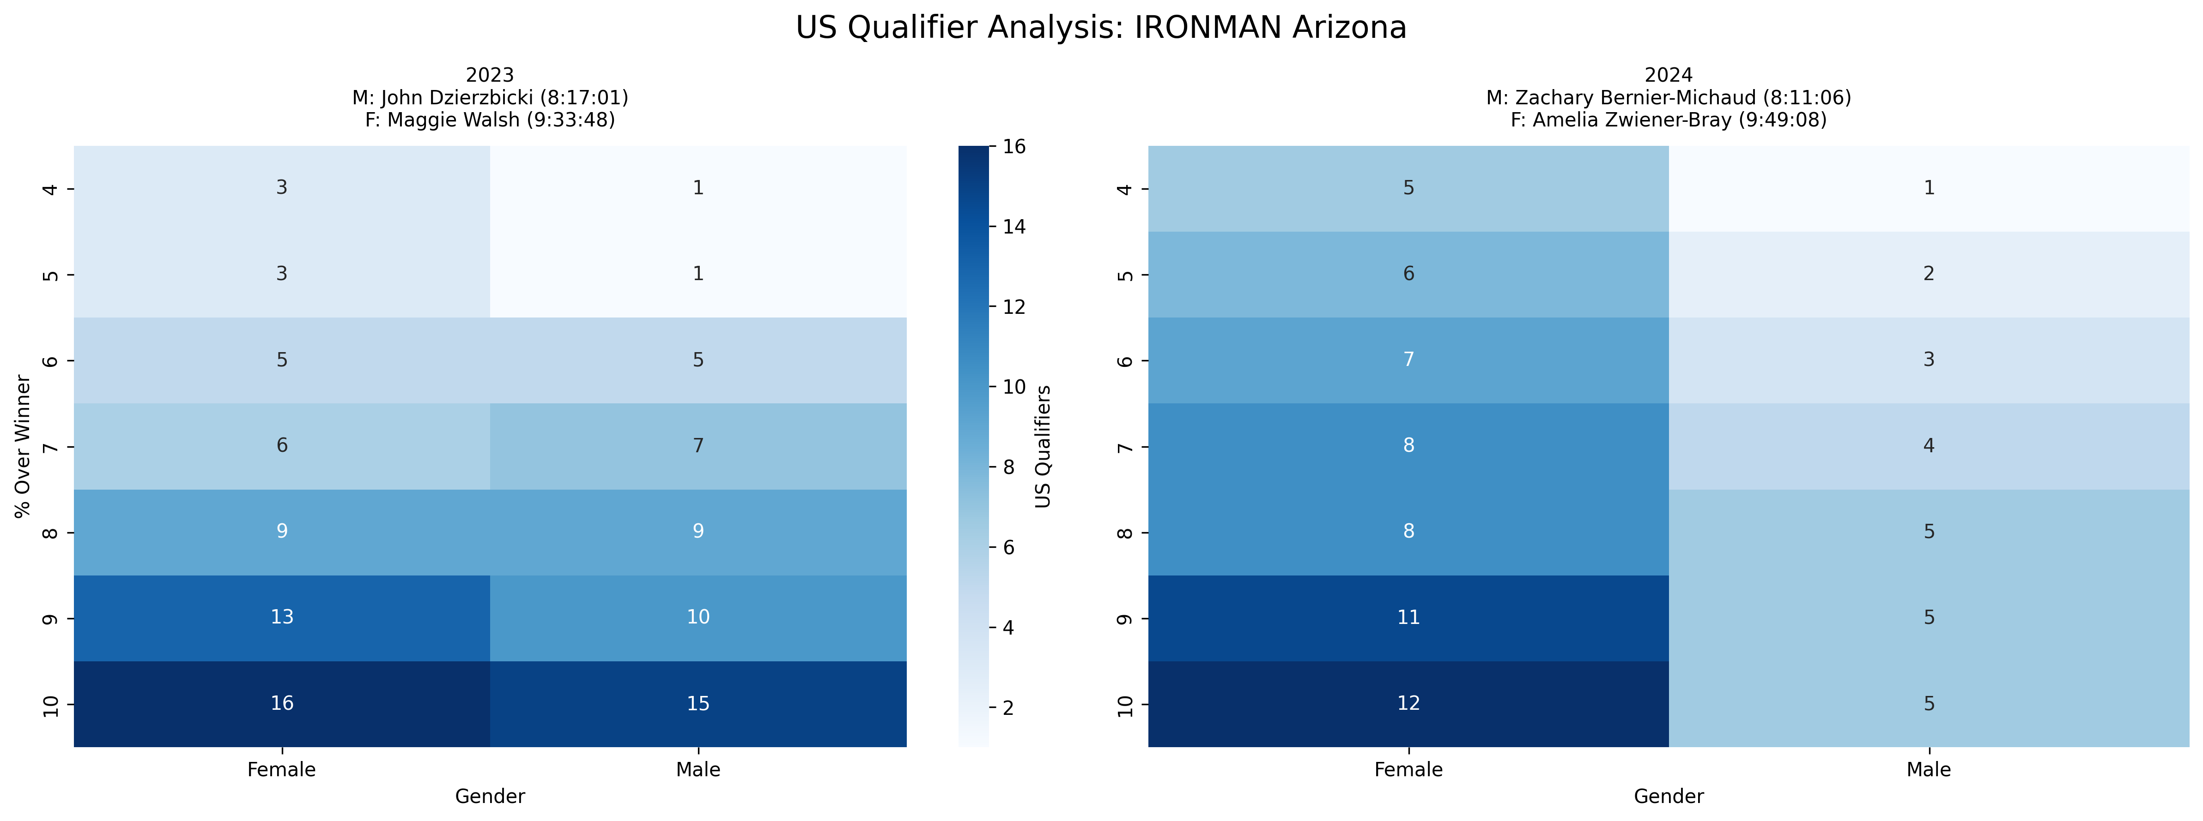
Event Analysis: IRONMAN Arizona
Multi-year comparison showing US qualification patterns across different threshold percentages

Slide 6
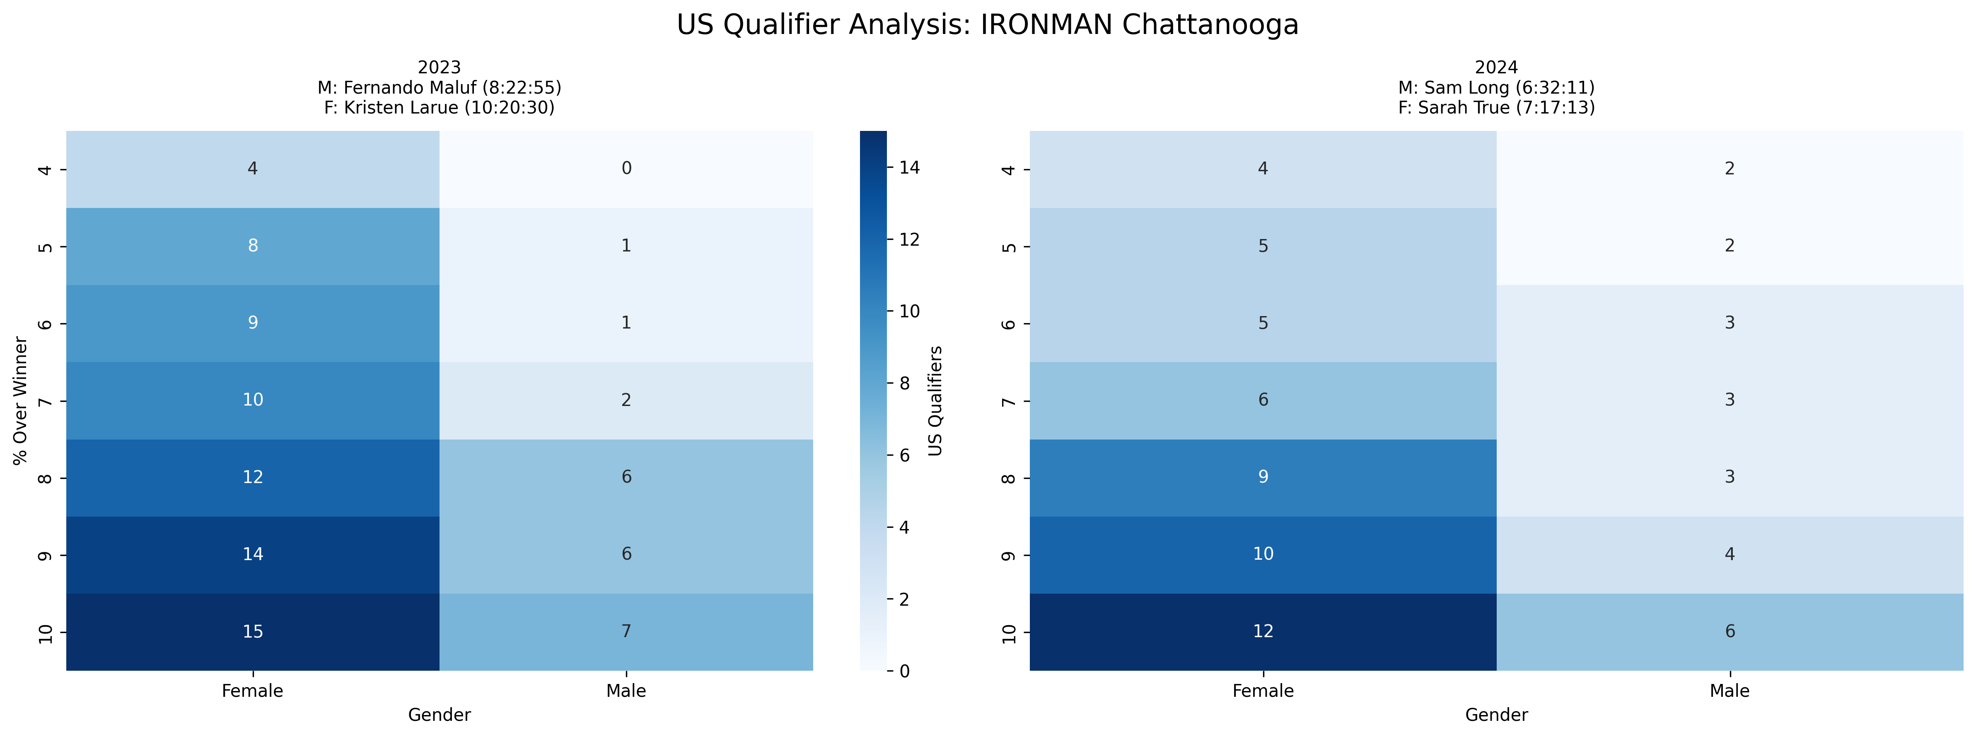
Event Analysis: IRONMAN Chattanooga
Multi-year comparison showing US qualification patterns across different threshold percentages

Slide 7
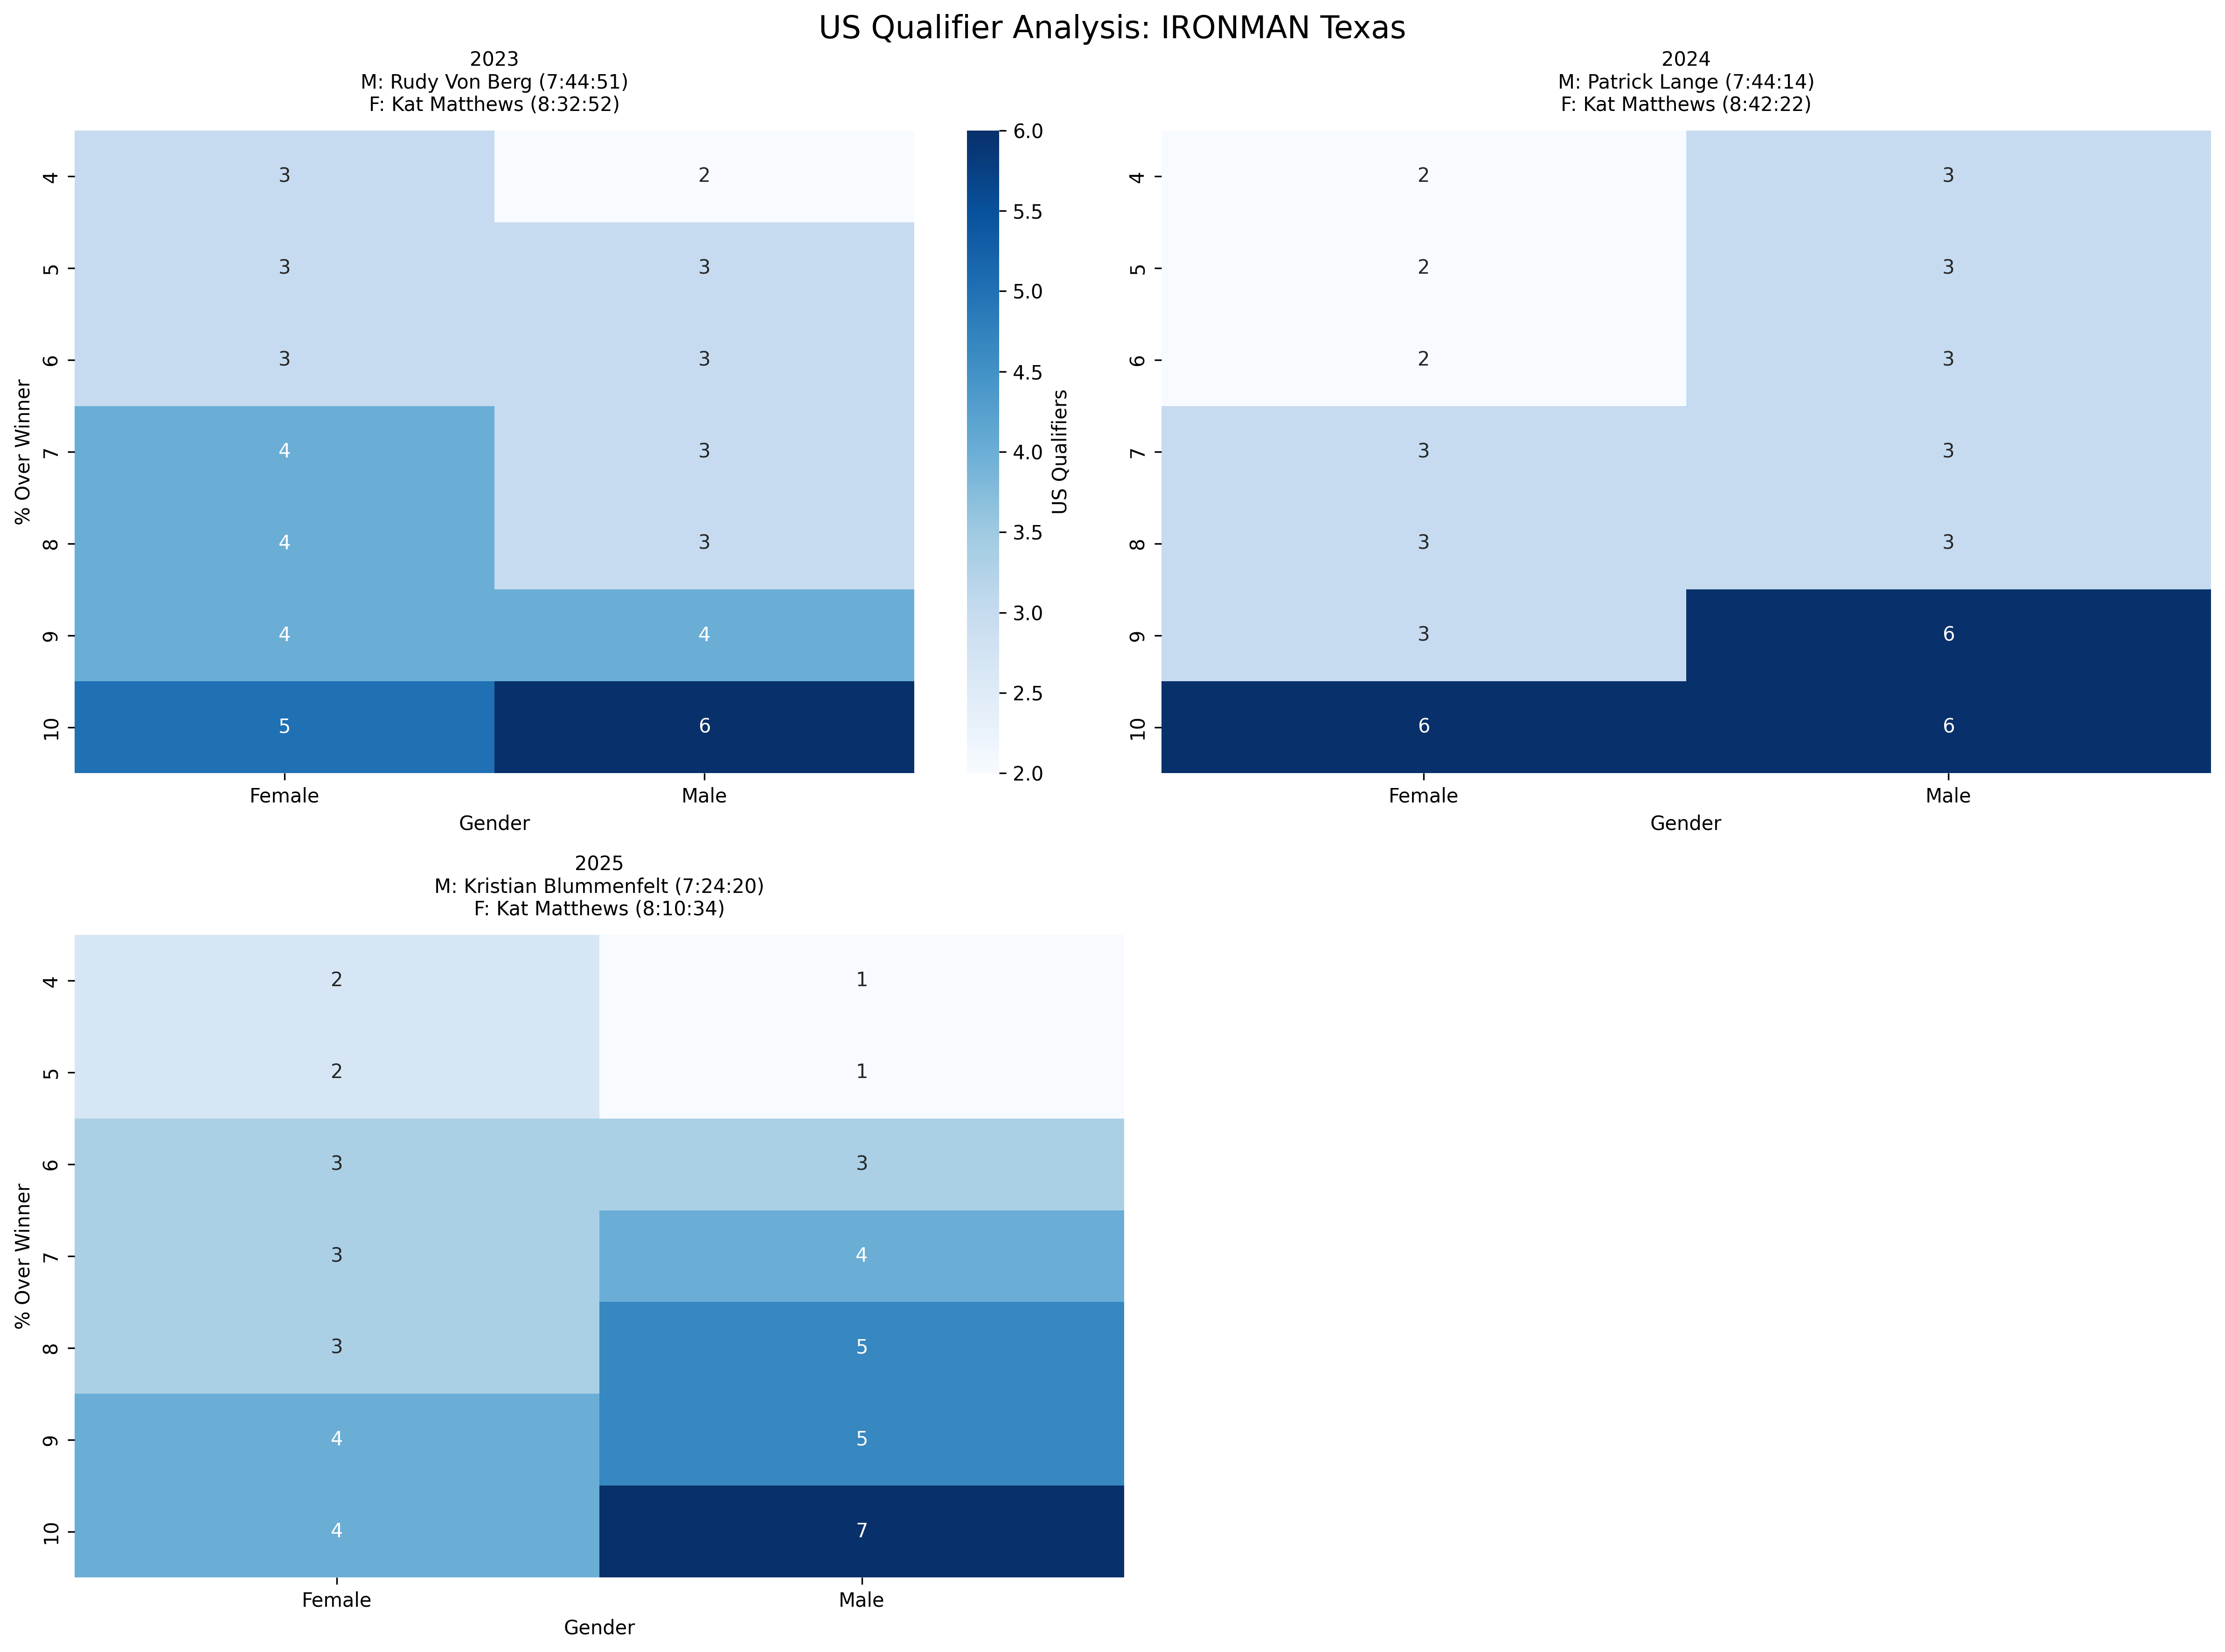
Event Analysis: IRONMAN Texas
Multi-year comparison showing US qualification patterns across different threshold percentages

Slide 8
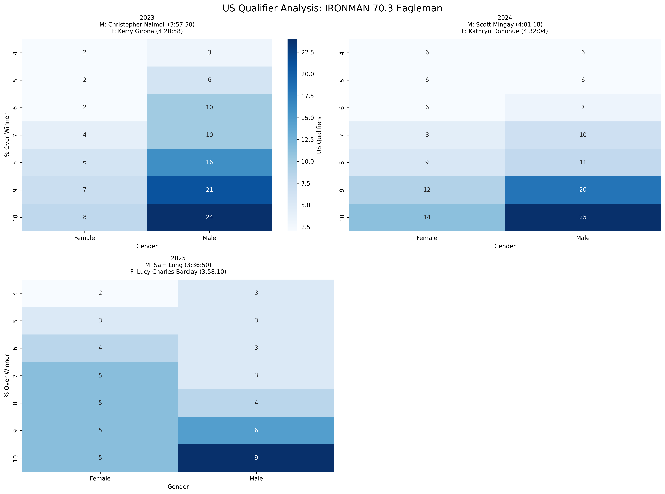
Event Analysis: IRONMAN 70.3 Eagleman
Multi-year comparison showing US qualification patterns across different threshold percentages

Slide 9
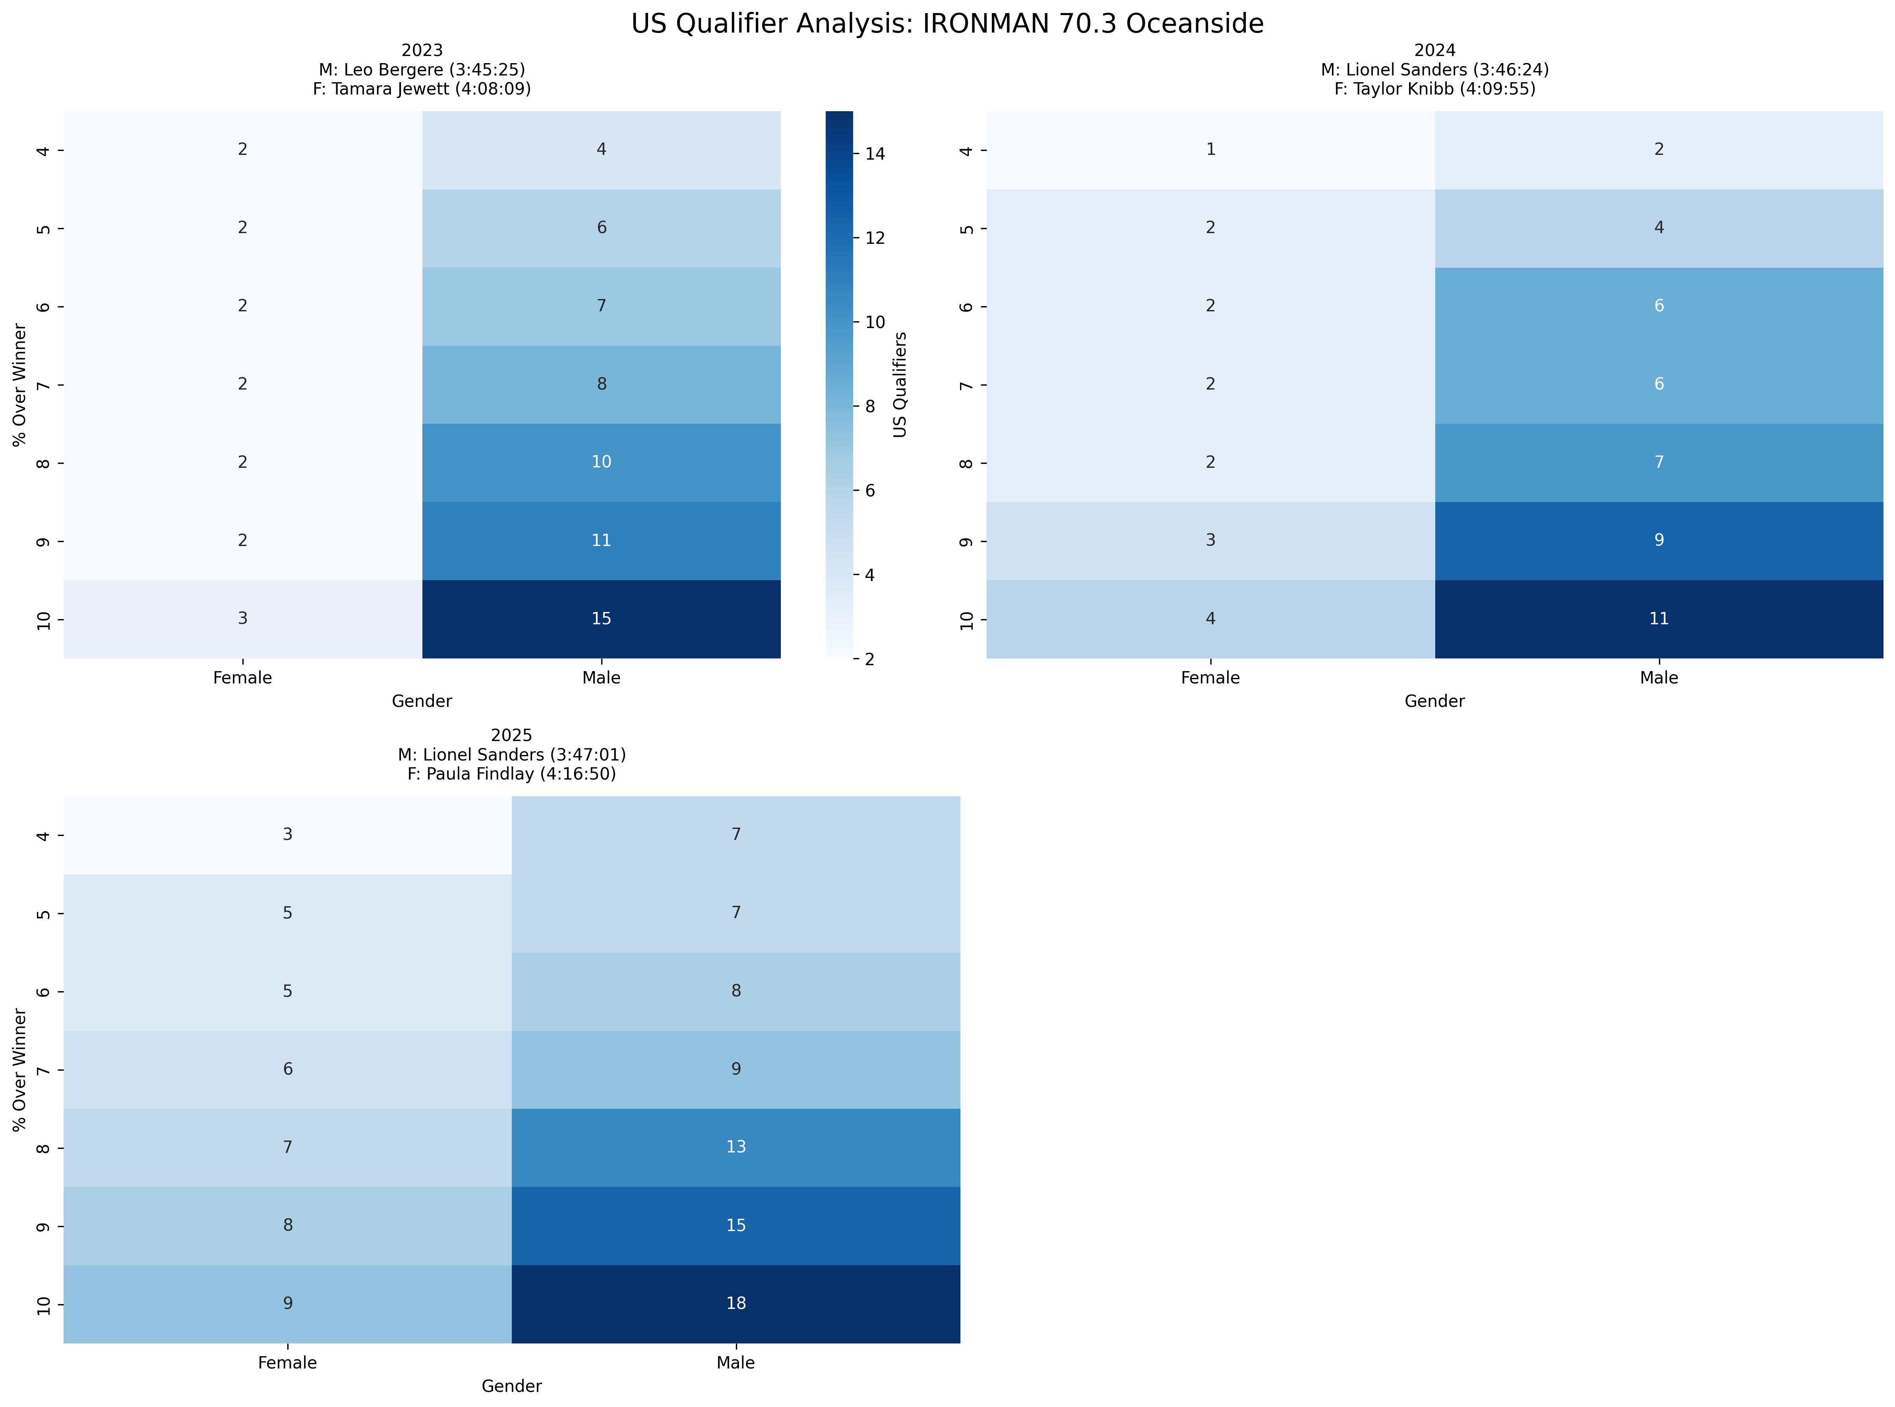
Event Analysis: IRONMAN 70.3 Oceanside
Multi-year comparison showing US qualification patterns across different threshold percentages

Slide 10
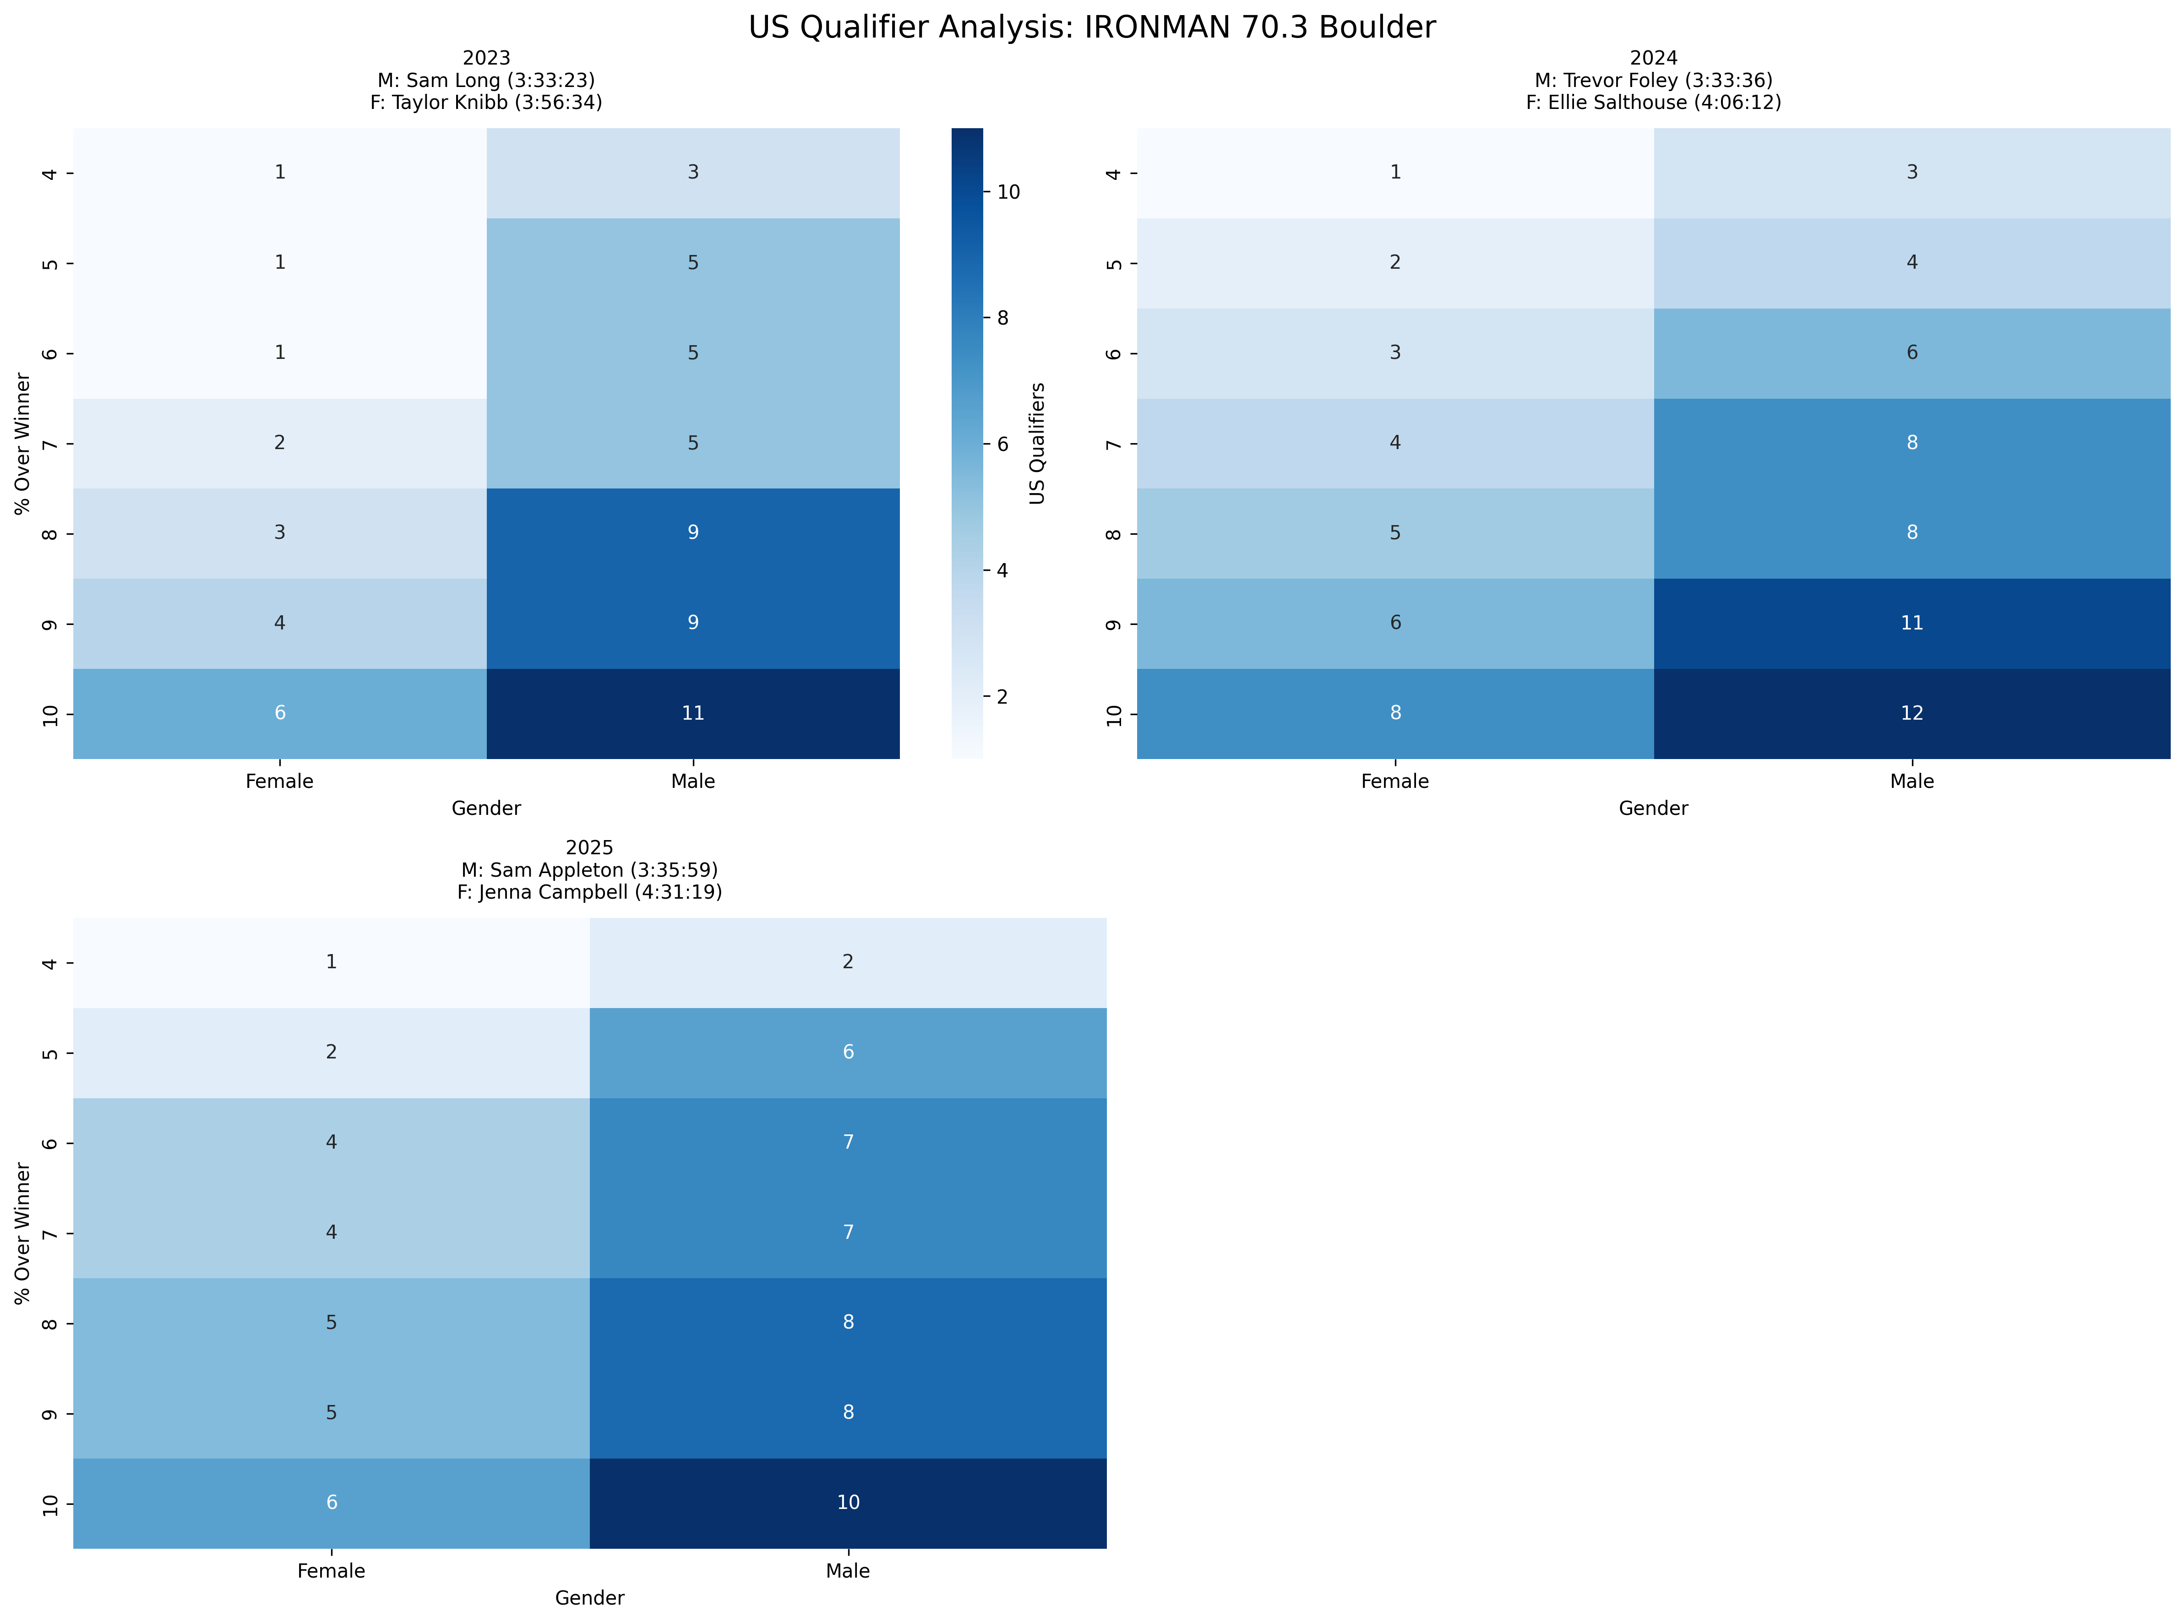
Event Analysis: IRONMAN 70.3 Boulder
Multi-year comparison showing US qualification patterns across different threshold percentages

Slide 11
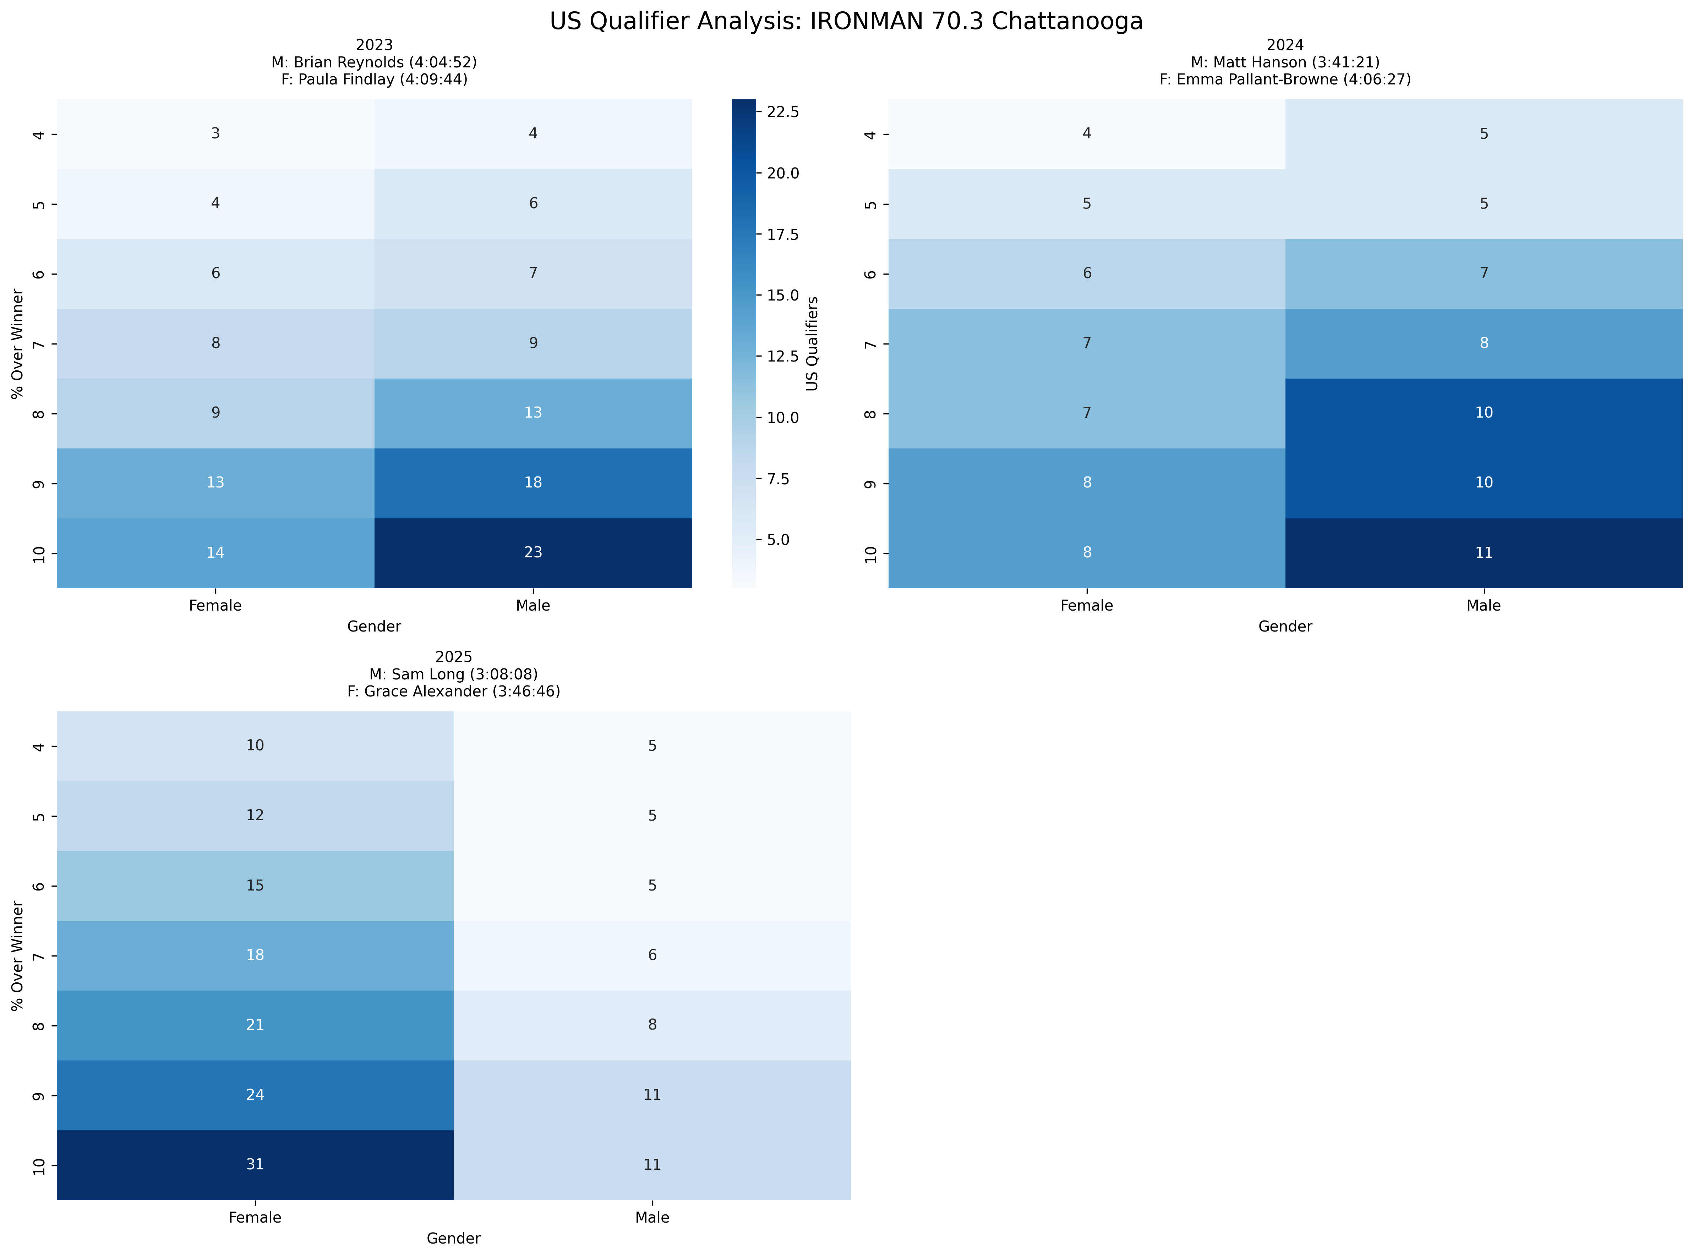
Event Analysis: IRONMAN 70.3 Chattanooga
Multi-year comparison showing US qualification patterns across different threshold percentages

Slide 12
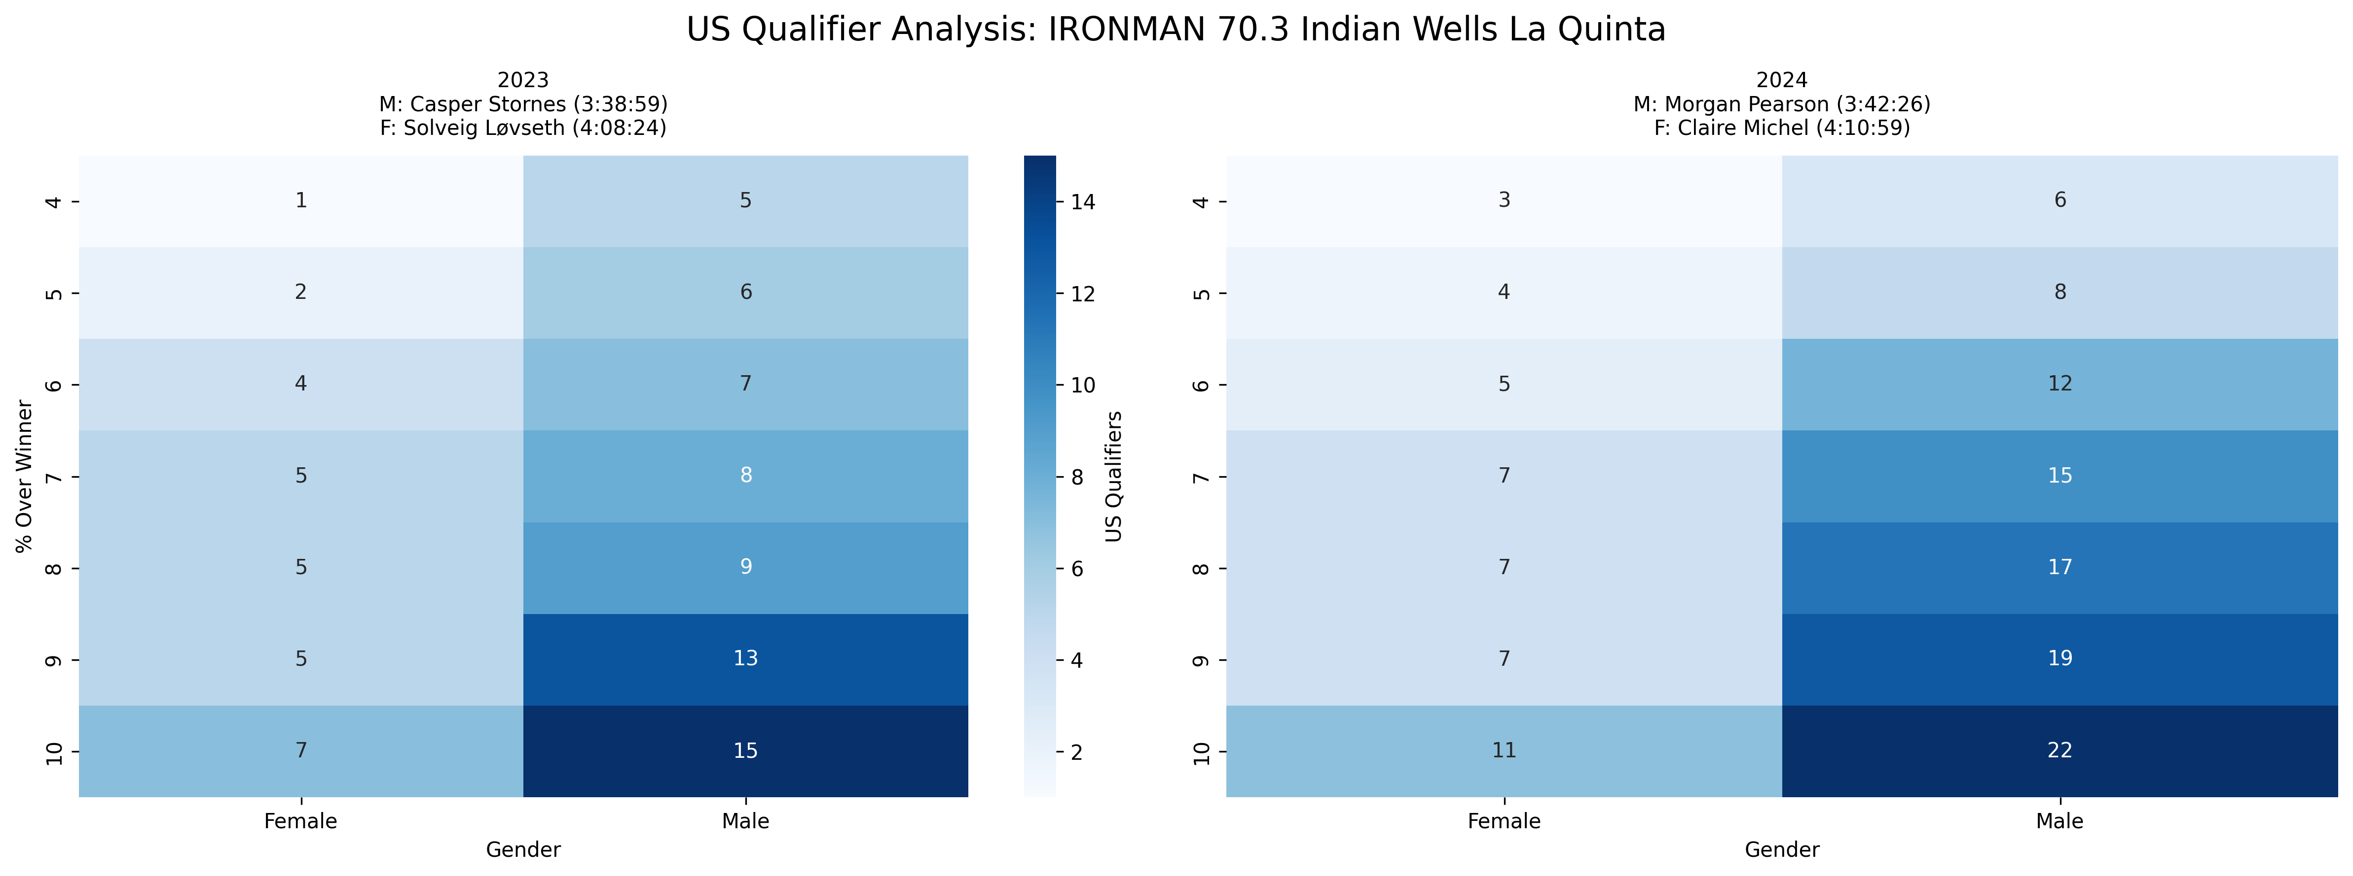
Event Analysis: IRONMAN 70.3 Indian Wells La Quinta
Multi-year comparison showing US qualification patterns across different threshold percentages

Slide 13
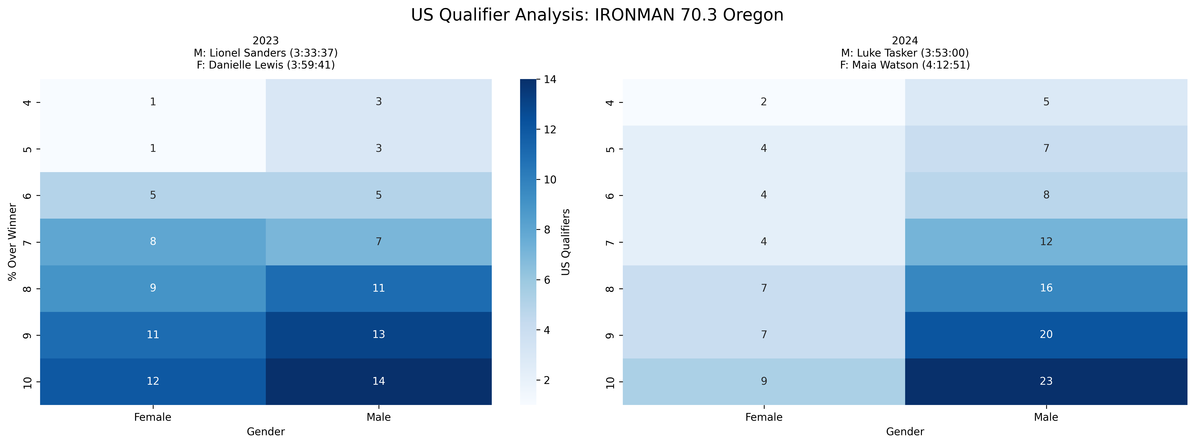
Event Analysis: IRONMAN 70.3 Oregon
Multi-year comparison showing US qualification patterns across different threshold percentages

Slide 14
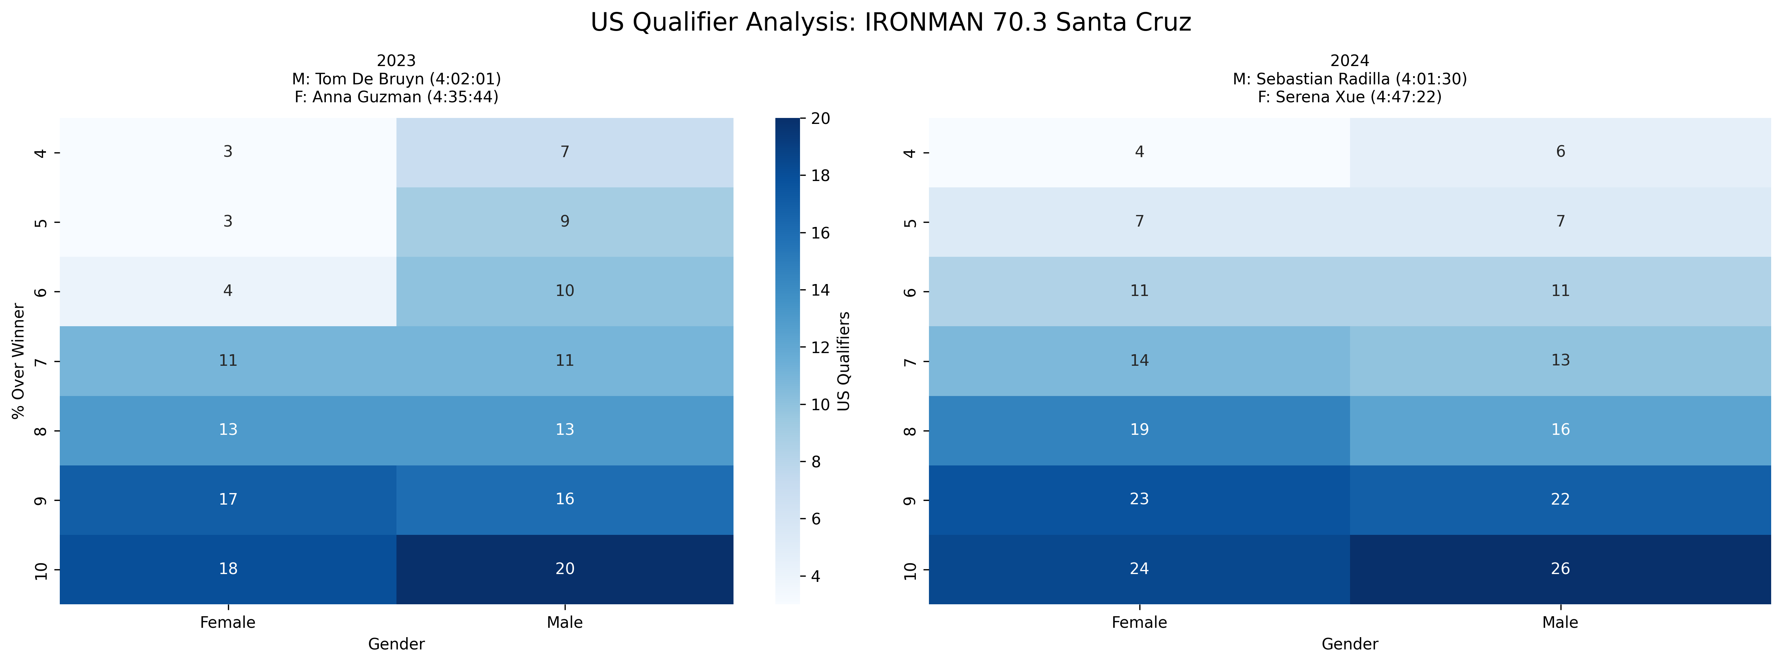
Event Analysis: IRONMAN 70.3 Santa Cruz
Multi-year comparison showing US qualification patterns across different threshold percentages

Slide 15
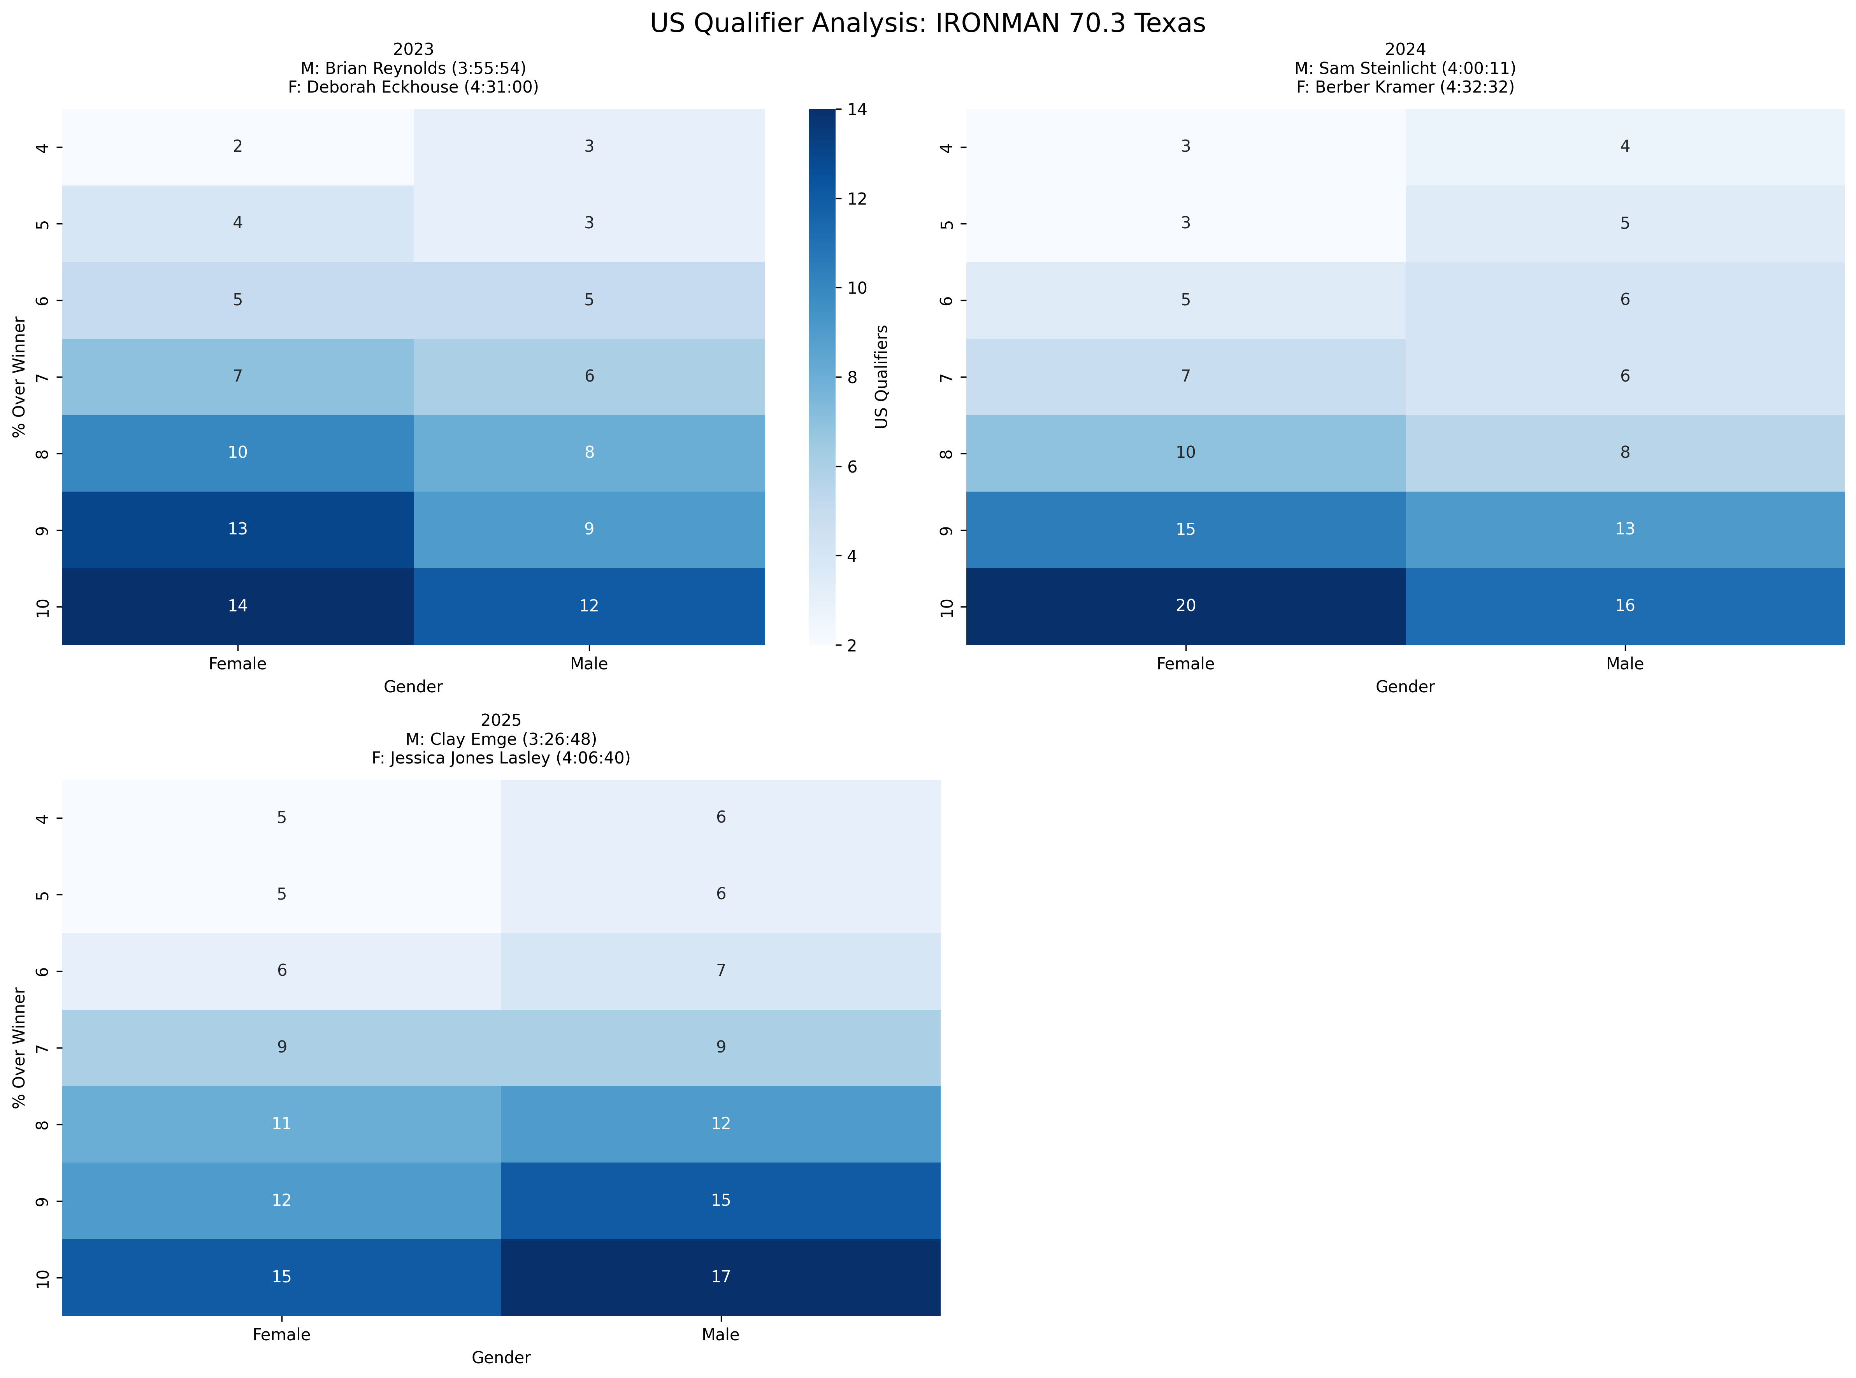
Event Analysis: IRONMAN 70.3 Texas
Multi-year comparison showing US qualification patterns across different threshold percentages

Slide 16
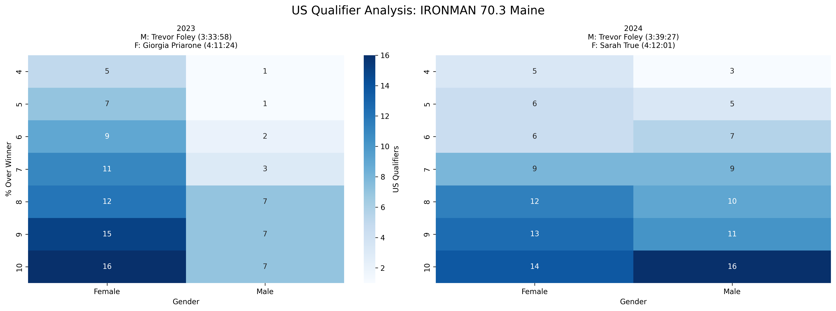
Event Analysis: IRONMAN 70.3 Maine
Multi-year comparison showing US qualification patterns across different threshold percentages

Slide 17
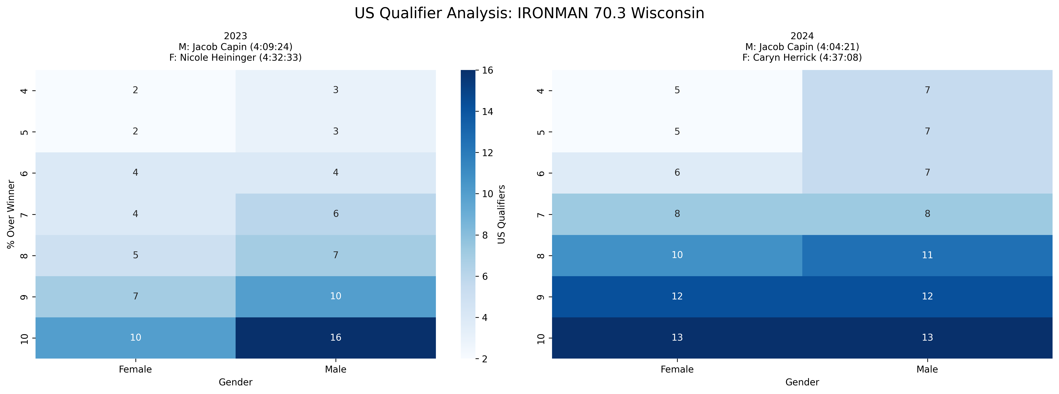
Event Analysis: IRONMAN 70.3 Wisconsin
Multi-year comparison showing US qualification patterns across different threshold percentages

Slide 18
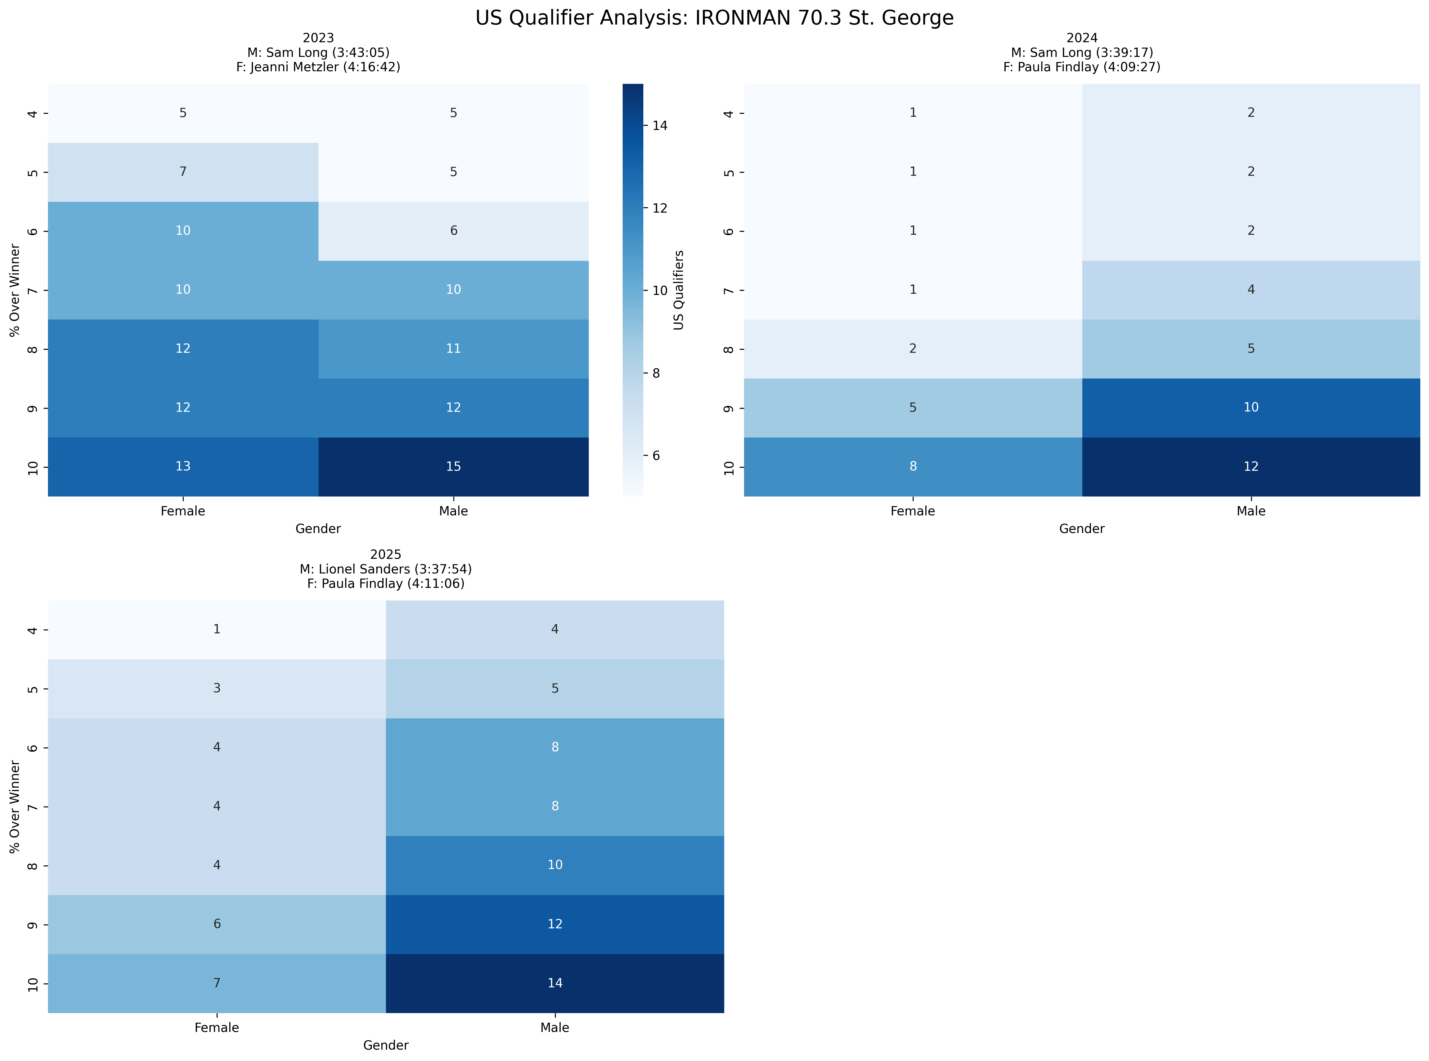
Event Analysis: IRONMAN 70.3 St. George
Multi-year comparison showing US qualification patterns across different threshold percentages

Slide 19
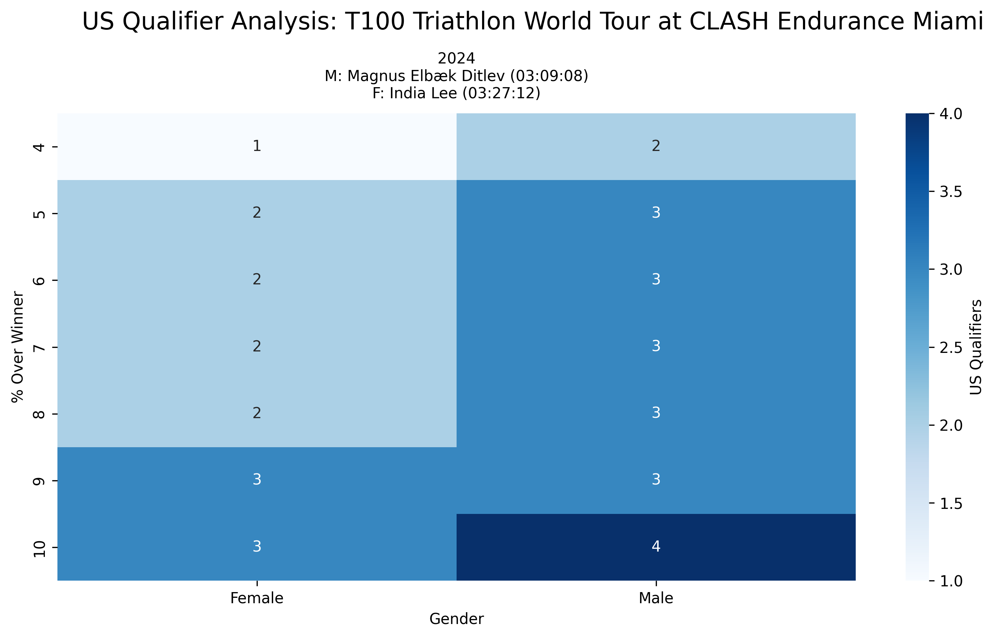
Event Analysis: T100 Triathlon World Tour at CLASH Endurance Miami
Multi-year comparison showing US qualification patterns across different threshold percentages

Slide 20
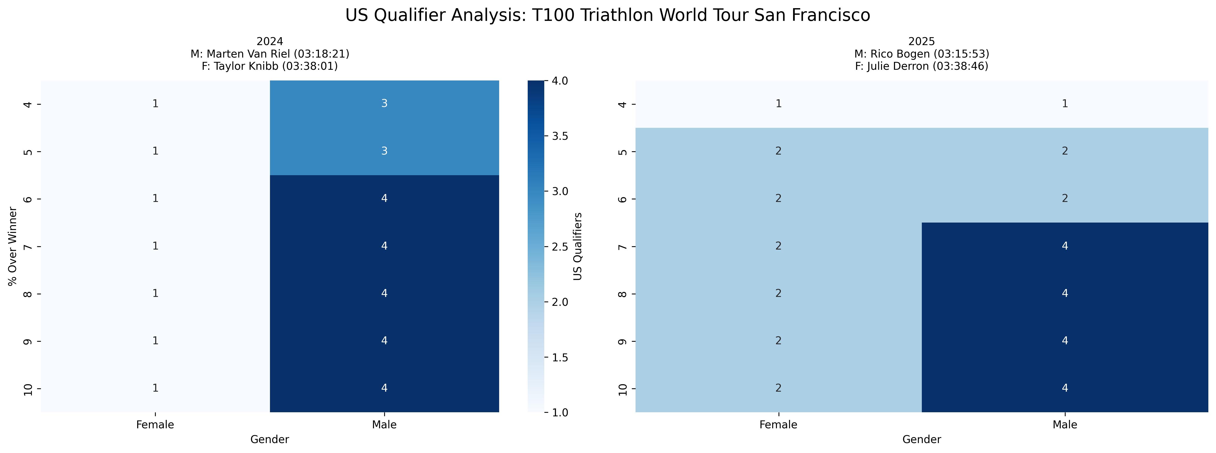
Event Analysis: T100 Triathlon World Tour San Francisco
Multi-year comparison showing US qualification patterns across different threshold percentages

Slide 21
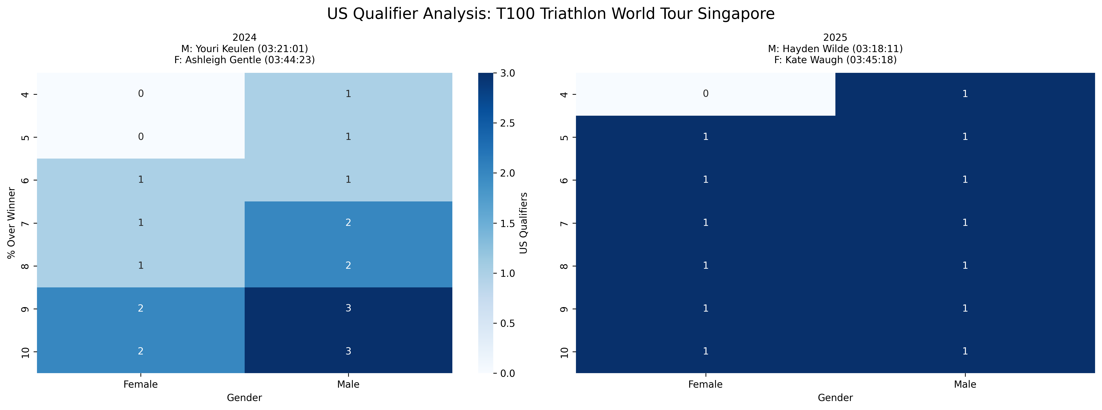
Event Analysis: T100 Triathlon World Tour Singapore
Multi-year comparison showing US qualification patterns across different threshold percentages

Slide 22
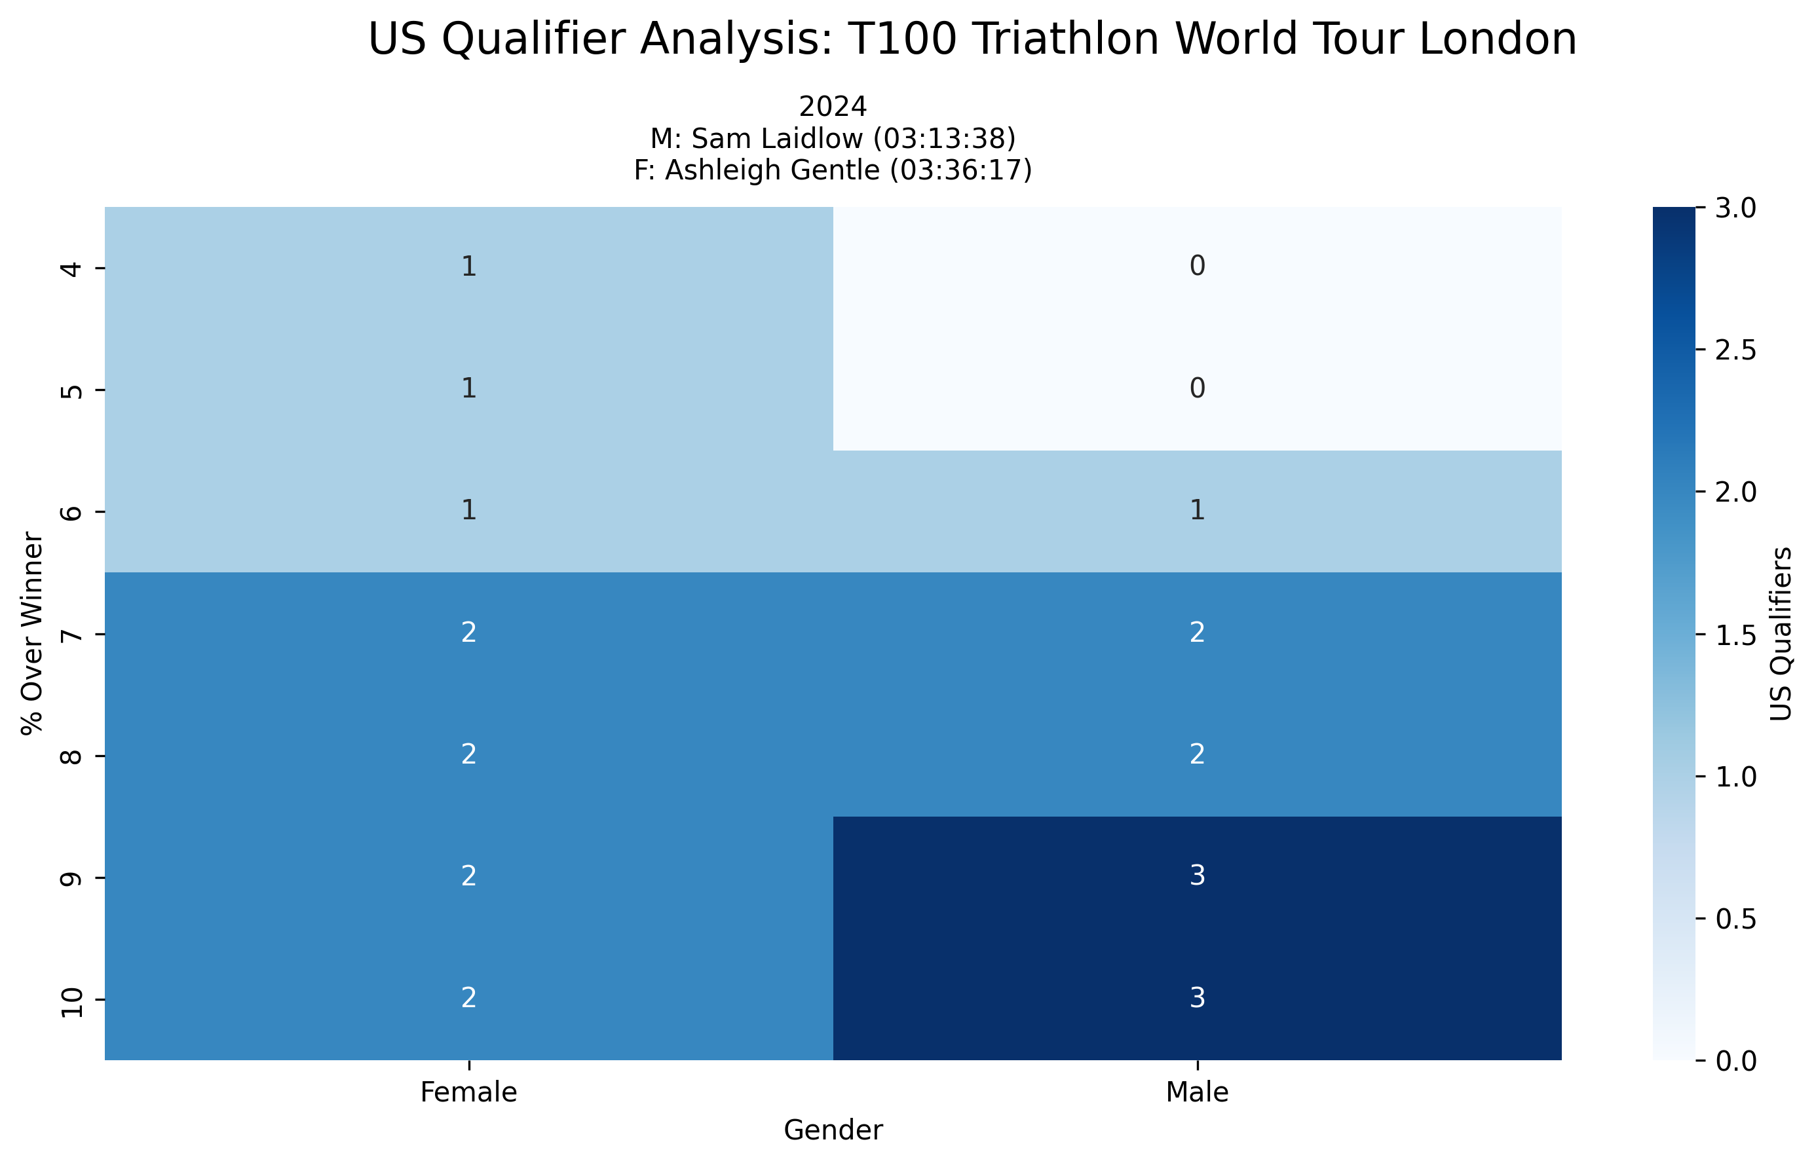
Event Analysis: T100 Triathlon World Tour London
Multi-year comparison showing US qualification patterns across different threshold percentages

Slide 23
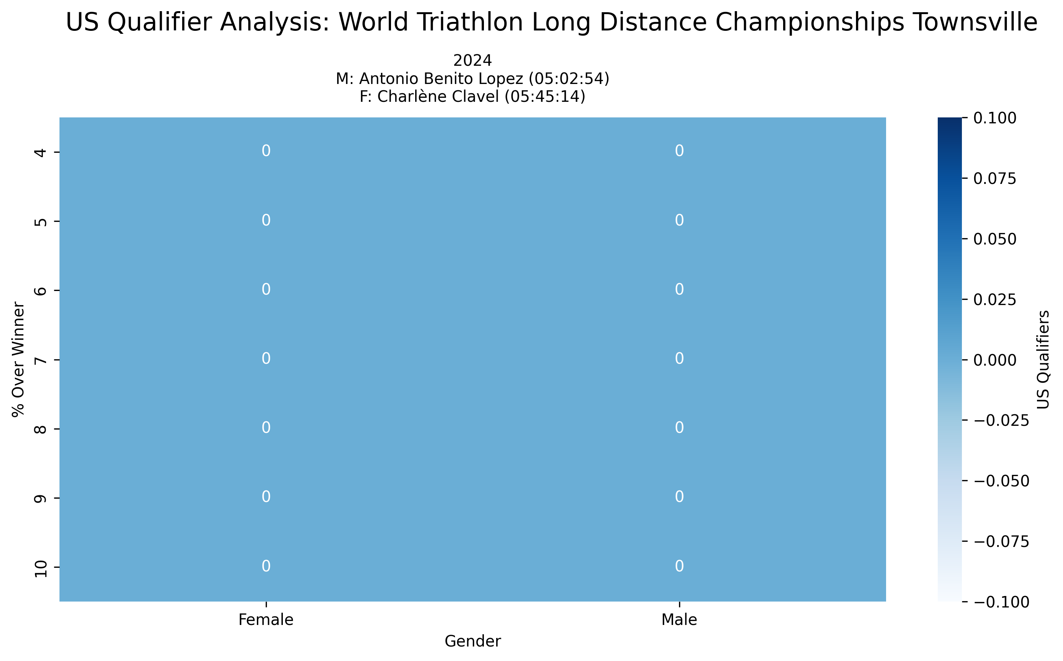
Event Analysis: World Triathlon Long Distance Championships Townsville
Multi-year comparison showing US qualification patterns across different threshold percentages

Slide 24
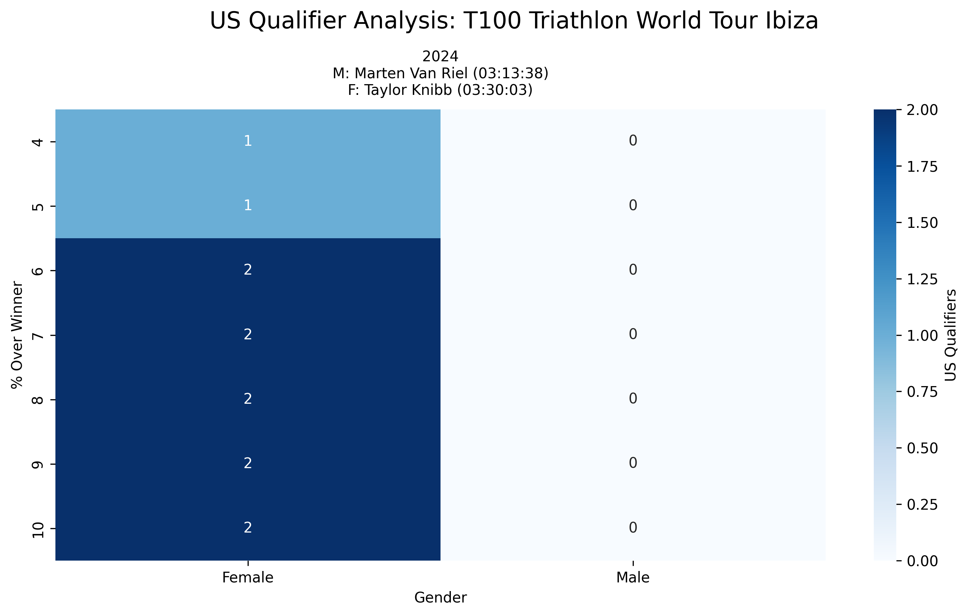
Event Analysis: T100 Triathlon World Tour Ibiza
Multi-year comparison showing US qualification patterns across different threshold percentages

Slide 25
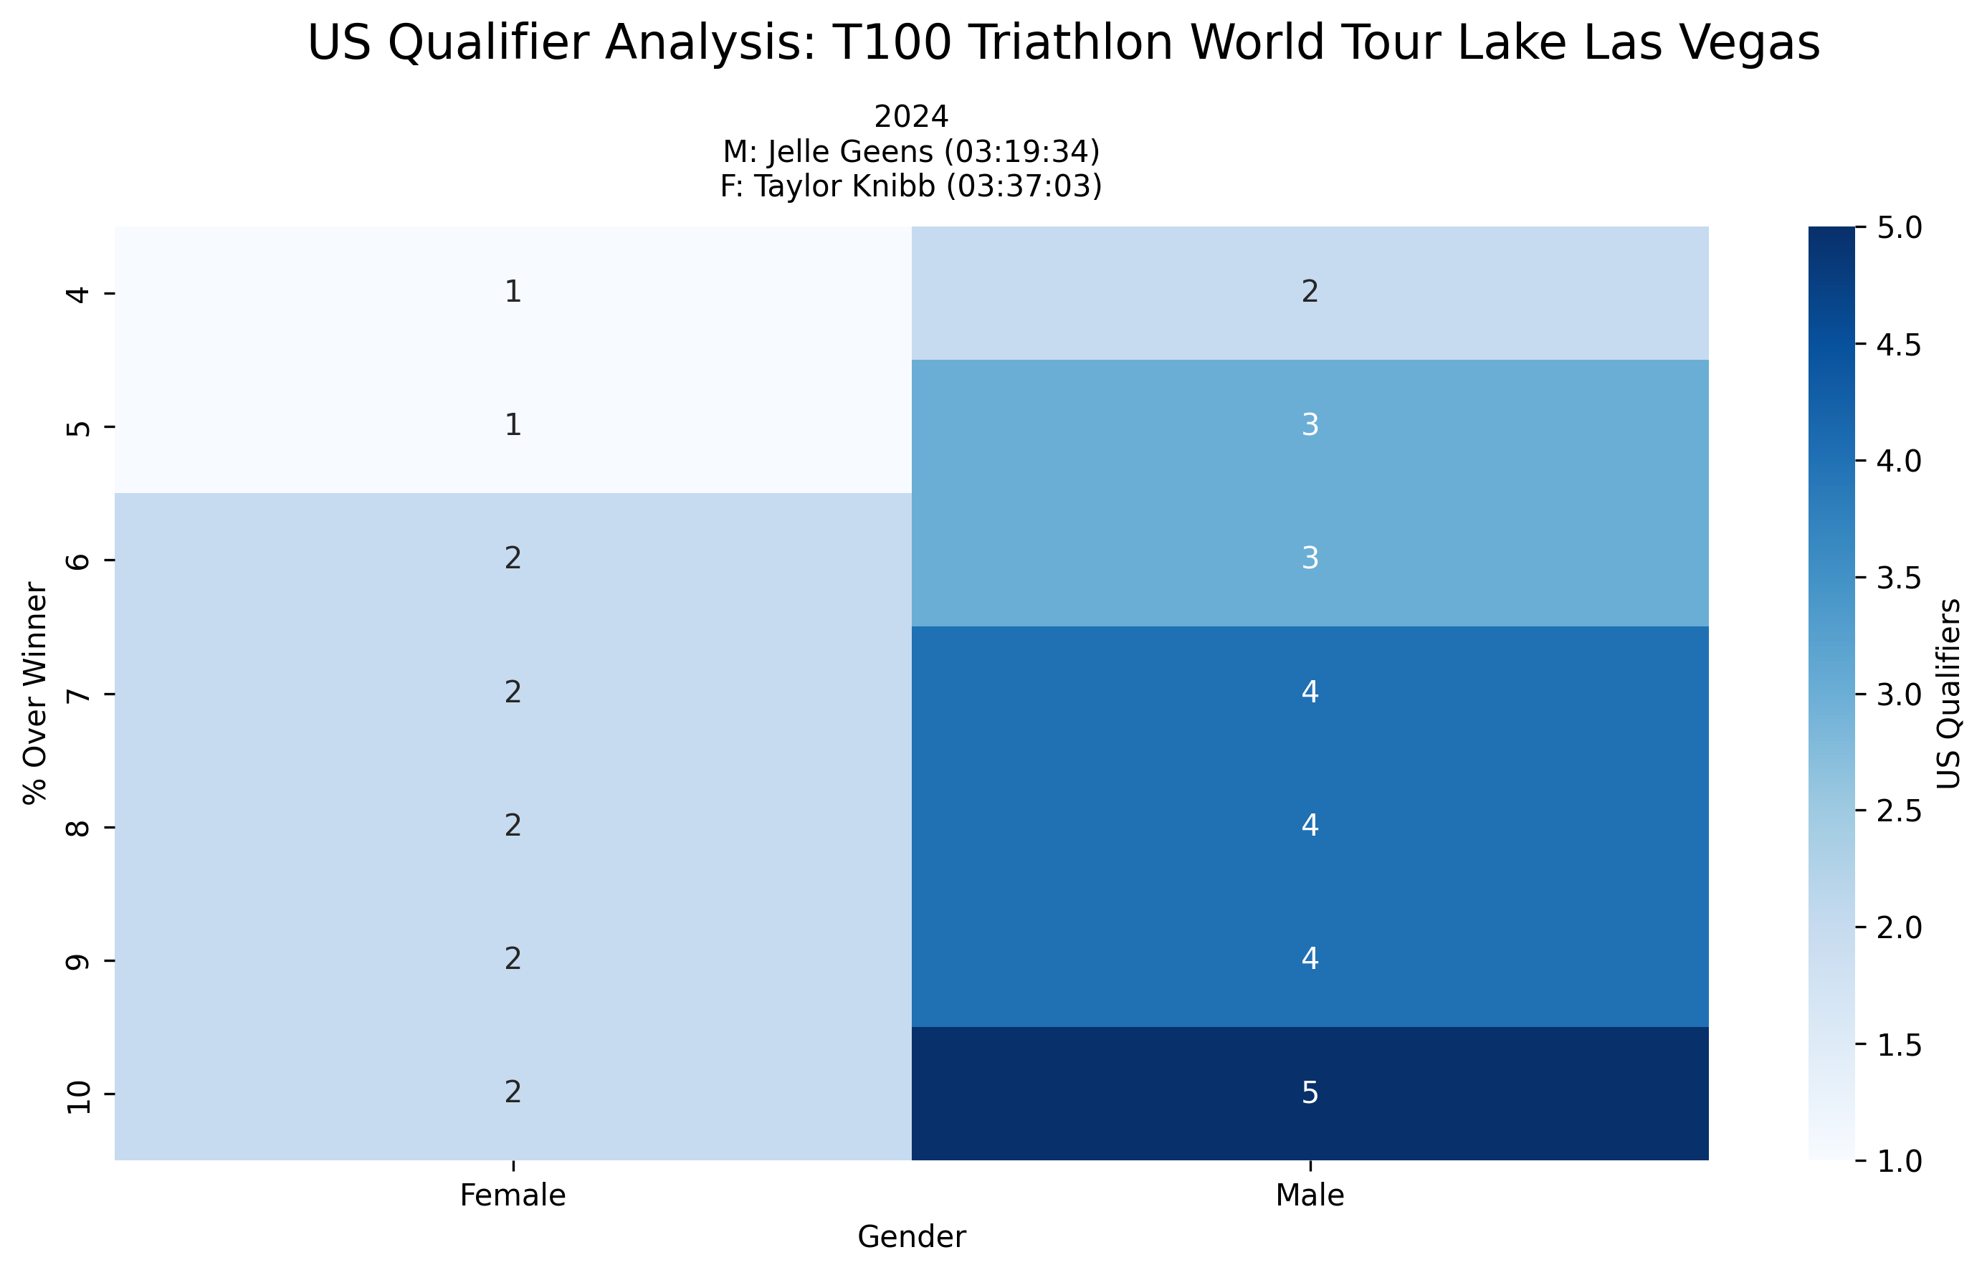
Event Analysis: T100 Triathlon World Tour Lake Las Vegas
Multi-year comparison showing US qualification patterns across different threshold percentages

Slide 26
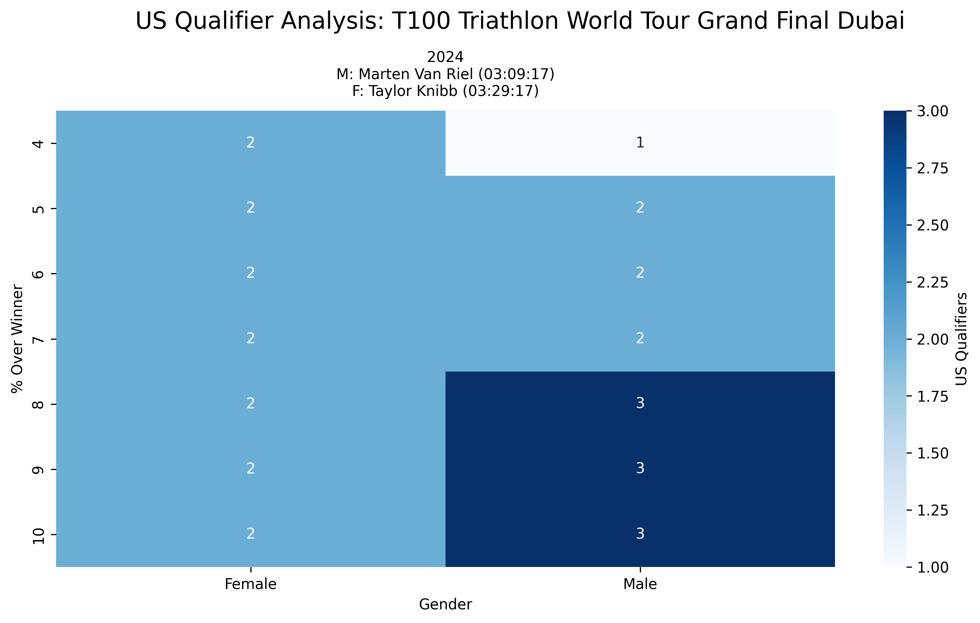
Event Analysis: T100 Triathlon World Tour Grand Final Dubai
Multi-year comparison showing US qualification patterns across different threshold percentages

Slide 27

Event Analysis: World Triathlon Long Distance Championships Ibiza
Multi-year comparison showing US qualification patterns across different threshold percentages

Slide 28
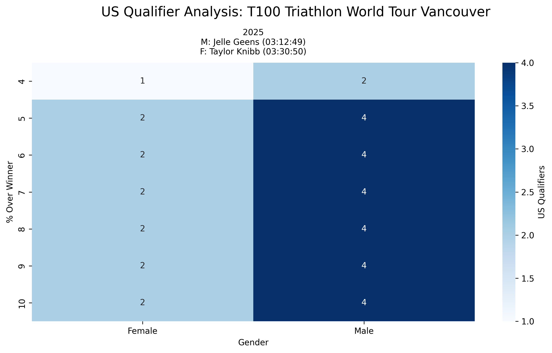
Event Analysis: T100 Triathlon World Tour Vancouver
Multi-year comparison showing US qualification patterns across different threshold percentages

Slide 29
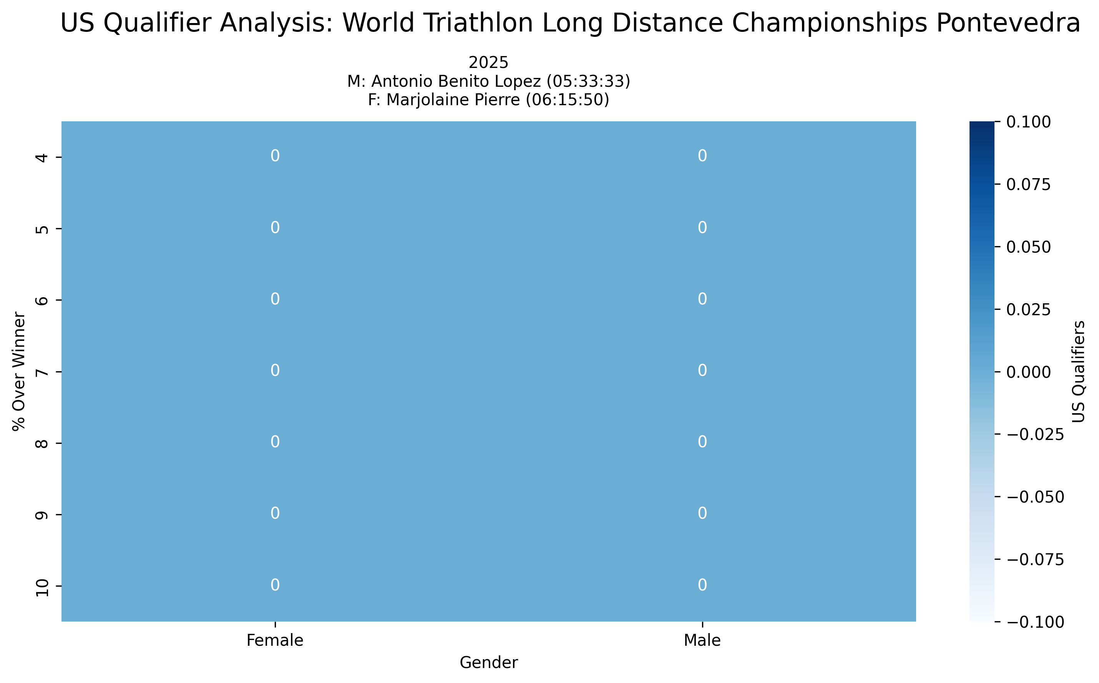
Event Analysis: World Triathlon Long Distance Championships Pontevedra
Multi-year comparison showing US qualification patterns across different threshold percentages

Slide 30
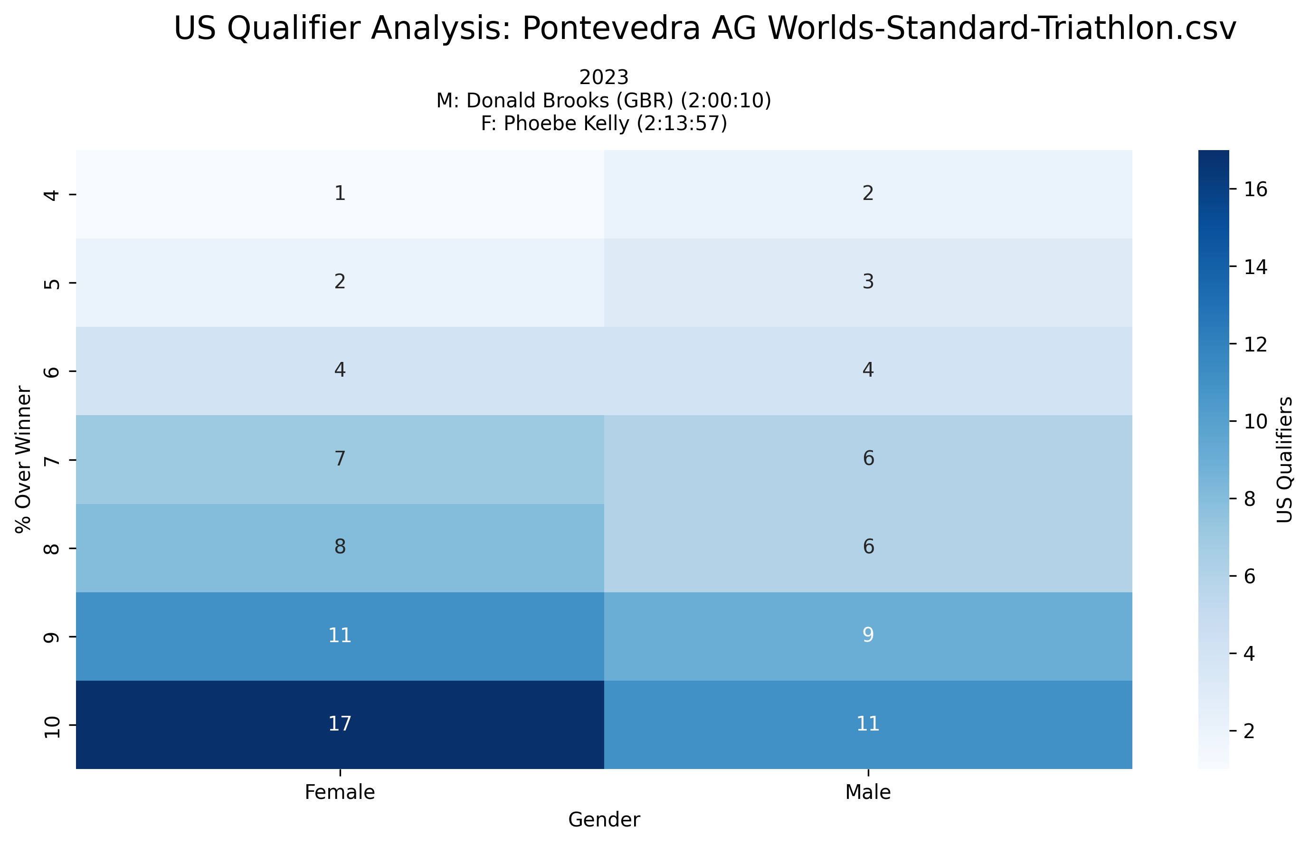
Event Analysis: Pontevedra AG Worlds-Standard-Triathlon.csv
Multi-year comparison showing US qualification patterns across different threshold percentages

Slide 31
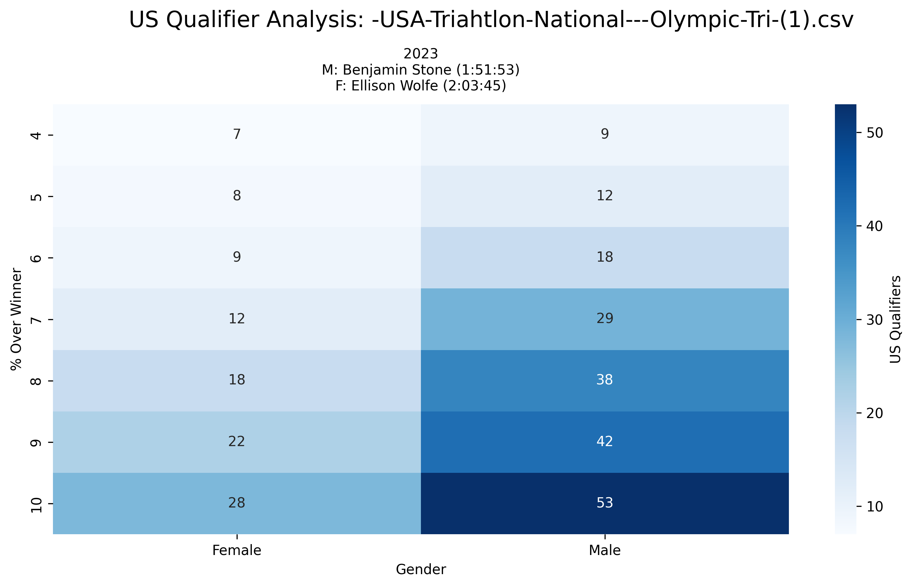
Event Analysis: -USA-Triahtlon-National---Olympic-Tri-(1).csv
Multi-year comparison showing US qualification patterns across different threshold percentages

Slide 32
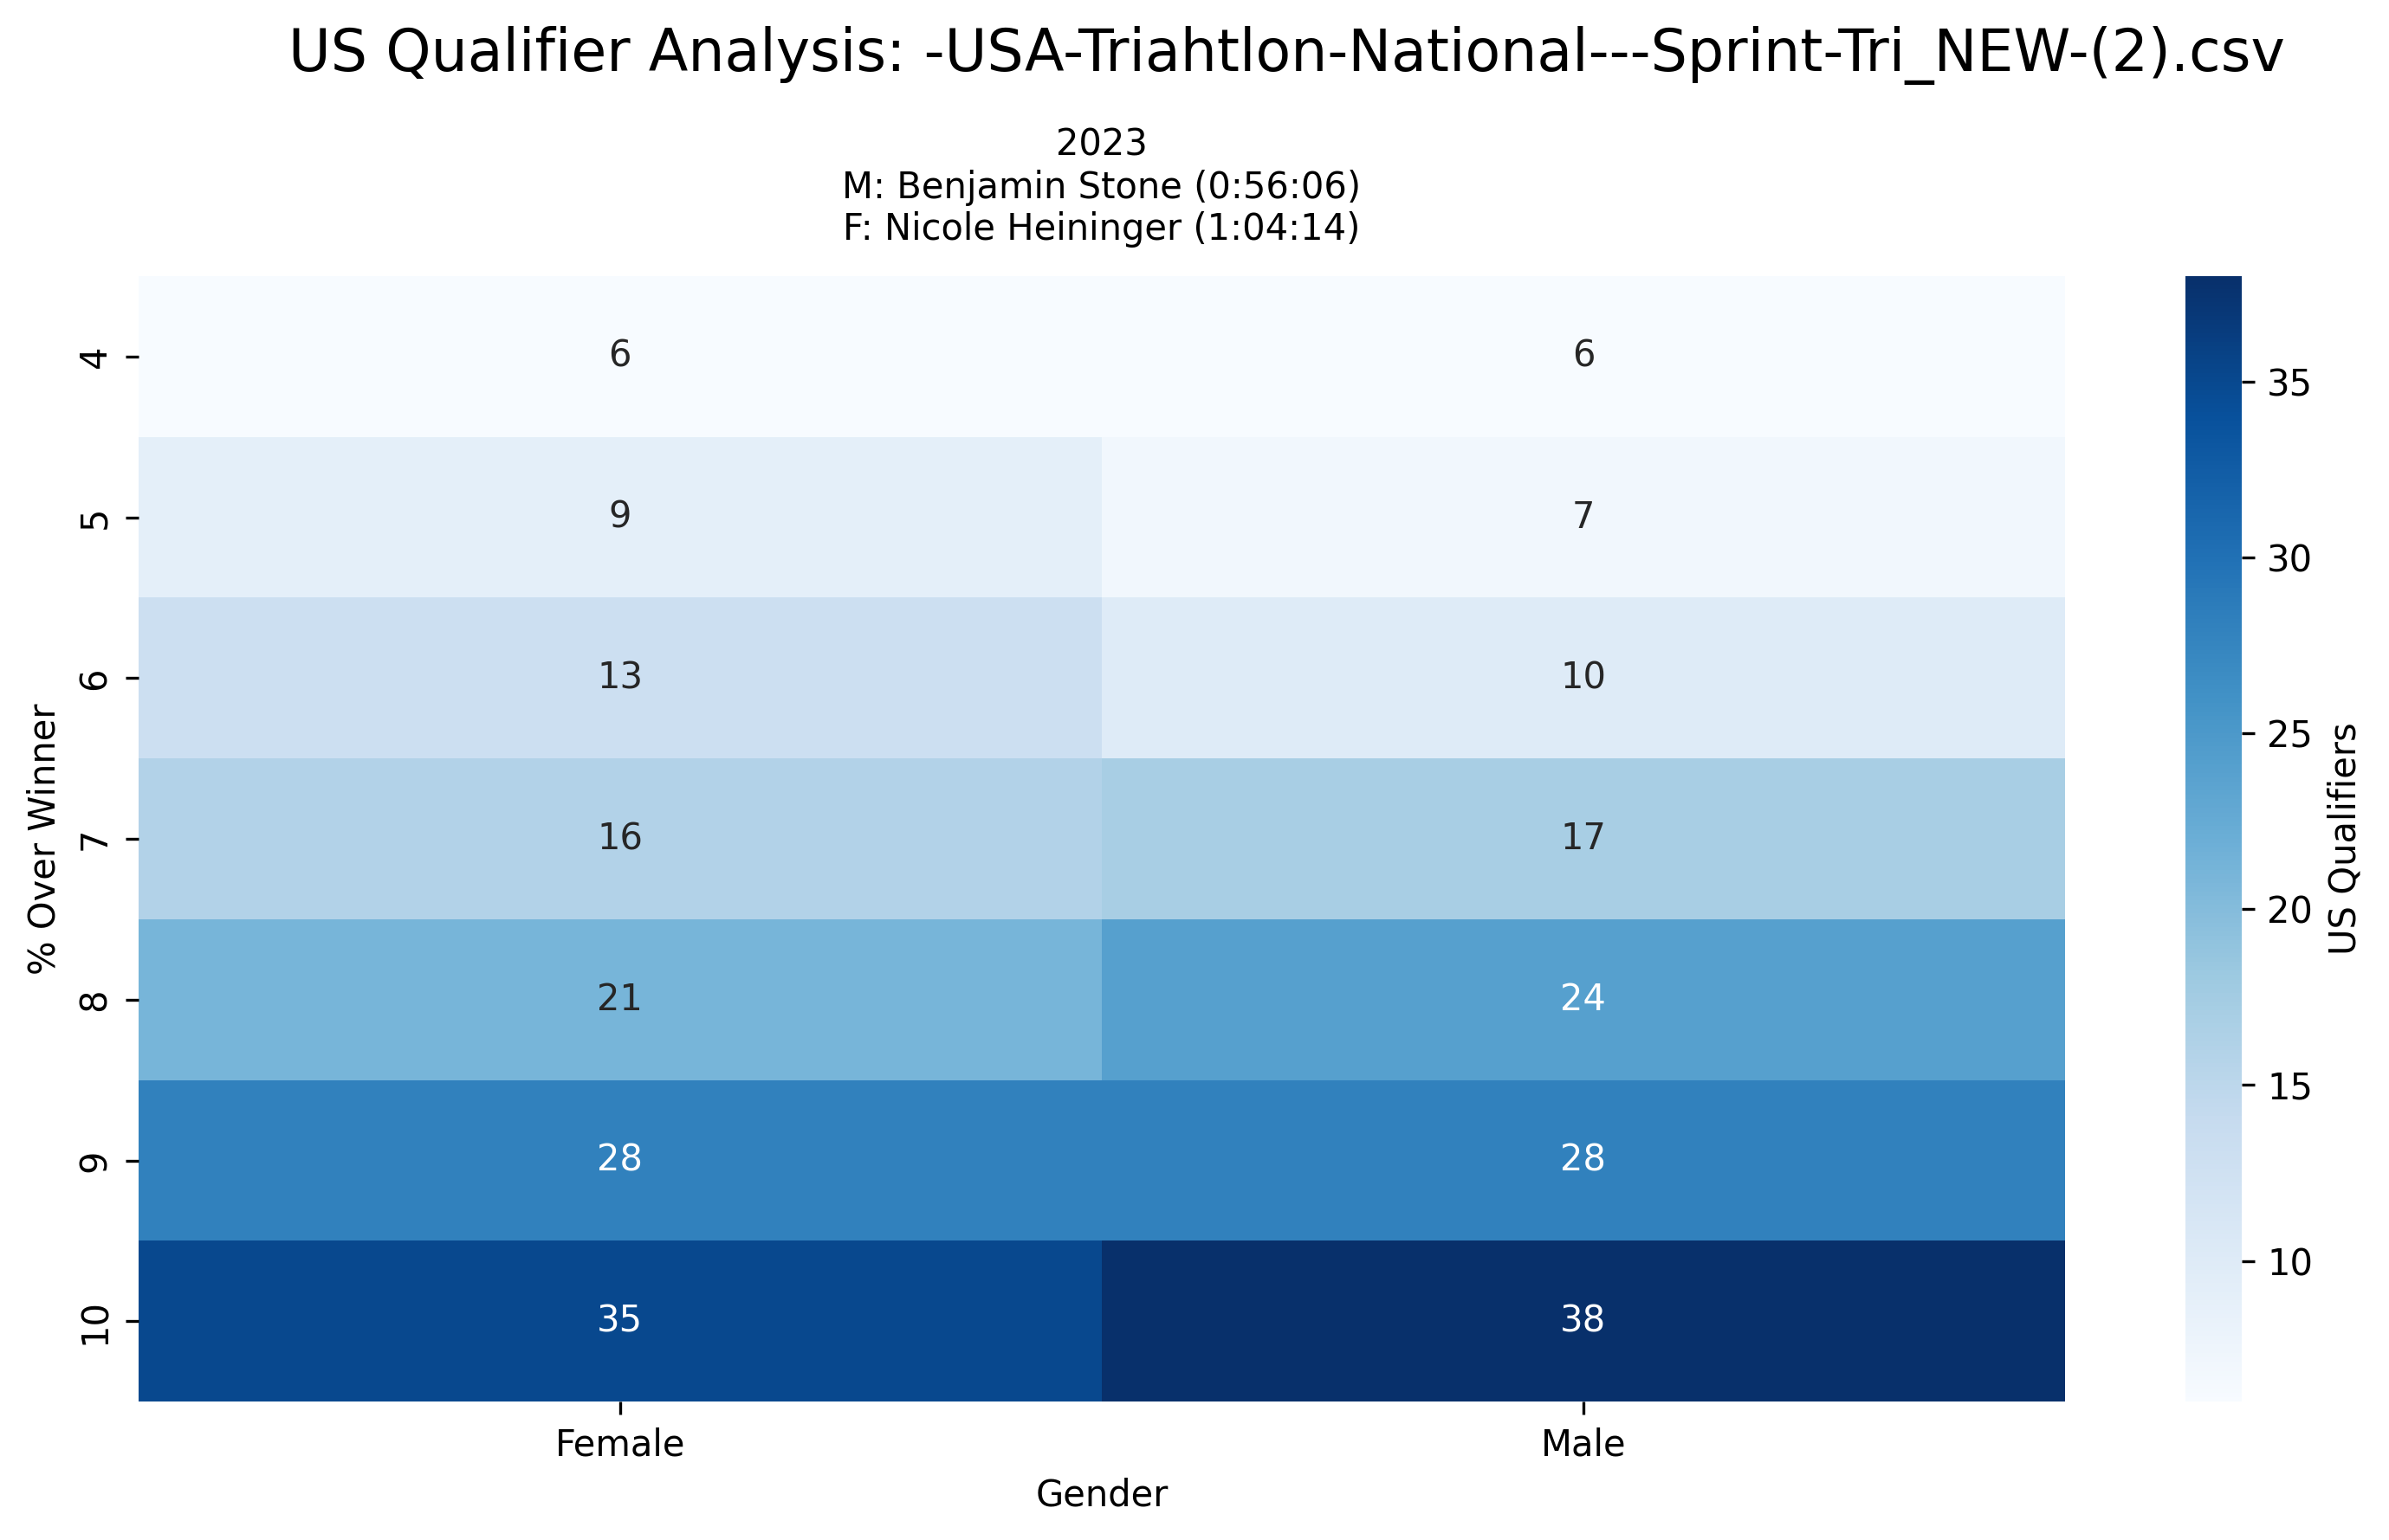
Event Analysis: -USA-Triahtlon-National---Sprint-Tri_NEW-(2).csv
Multi-year comparison showing US qualification patterns across different threshold percentages

Slide 33
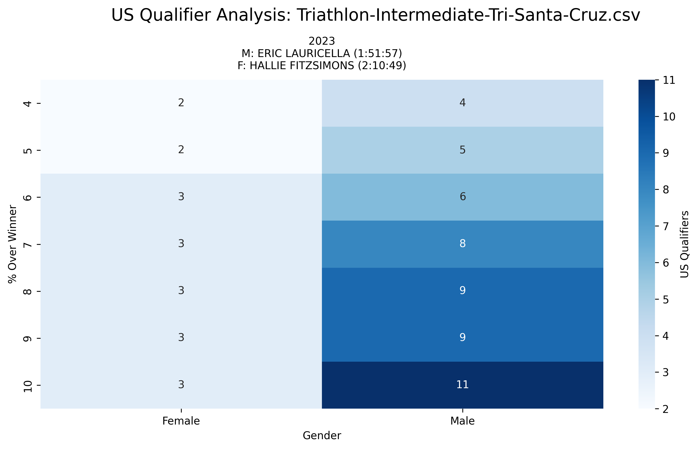
Event Analysis: Triathlon-Intermediate-Tri-Santa-Cruz.csv
Multi-year comparison showing US qualification patterns across different threshold percentages

Slide 34
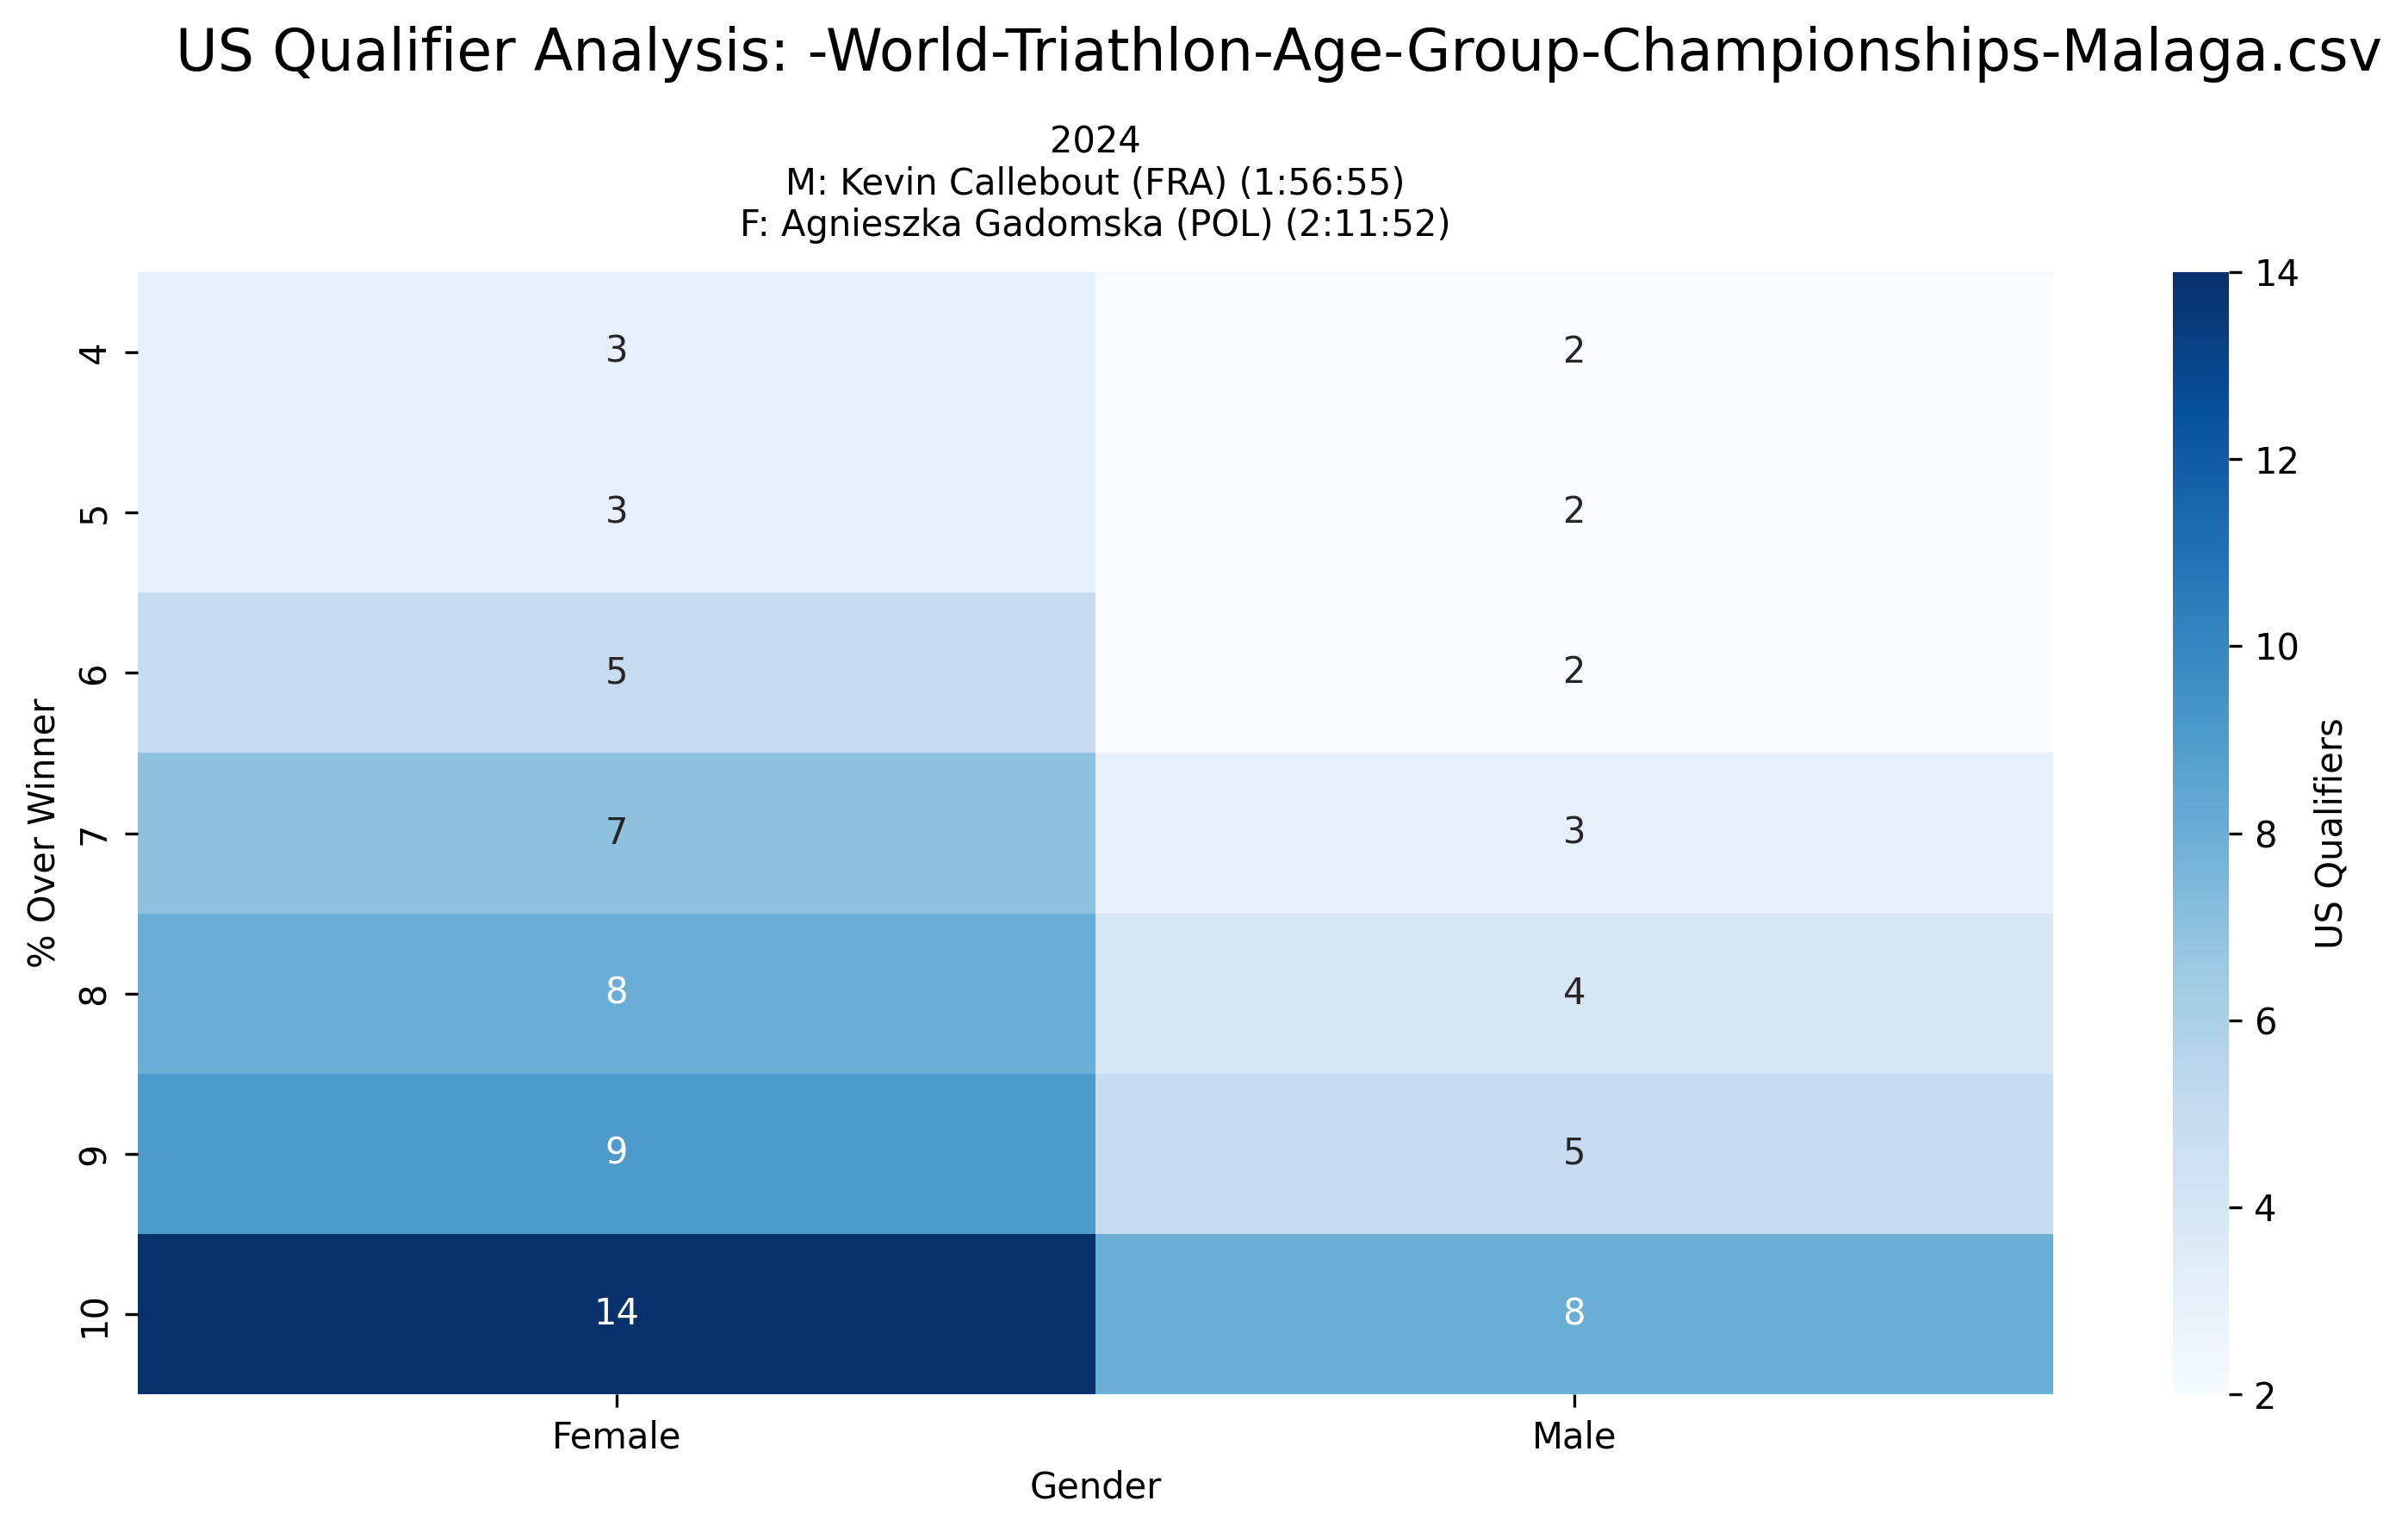
Event Analysis: -World-Triathlon-Age-Group-Championships-Malaga.csv
Multi-year comparison showing US qualification patterns across different threshold percentages

Slide 35
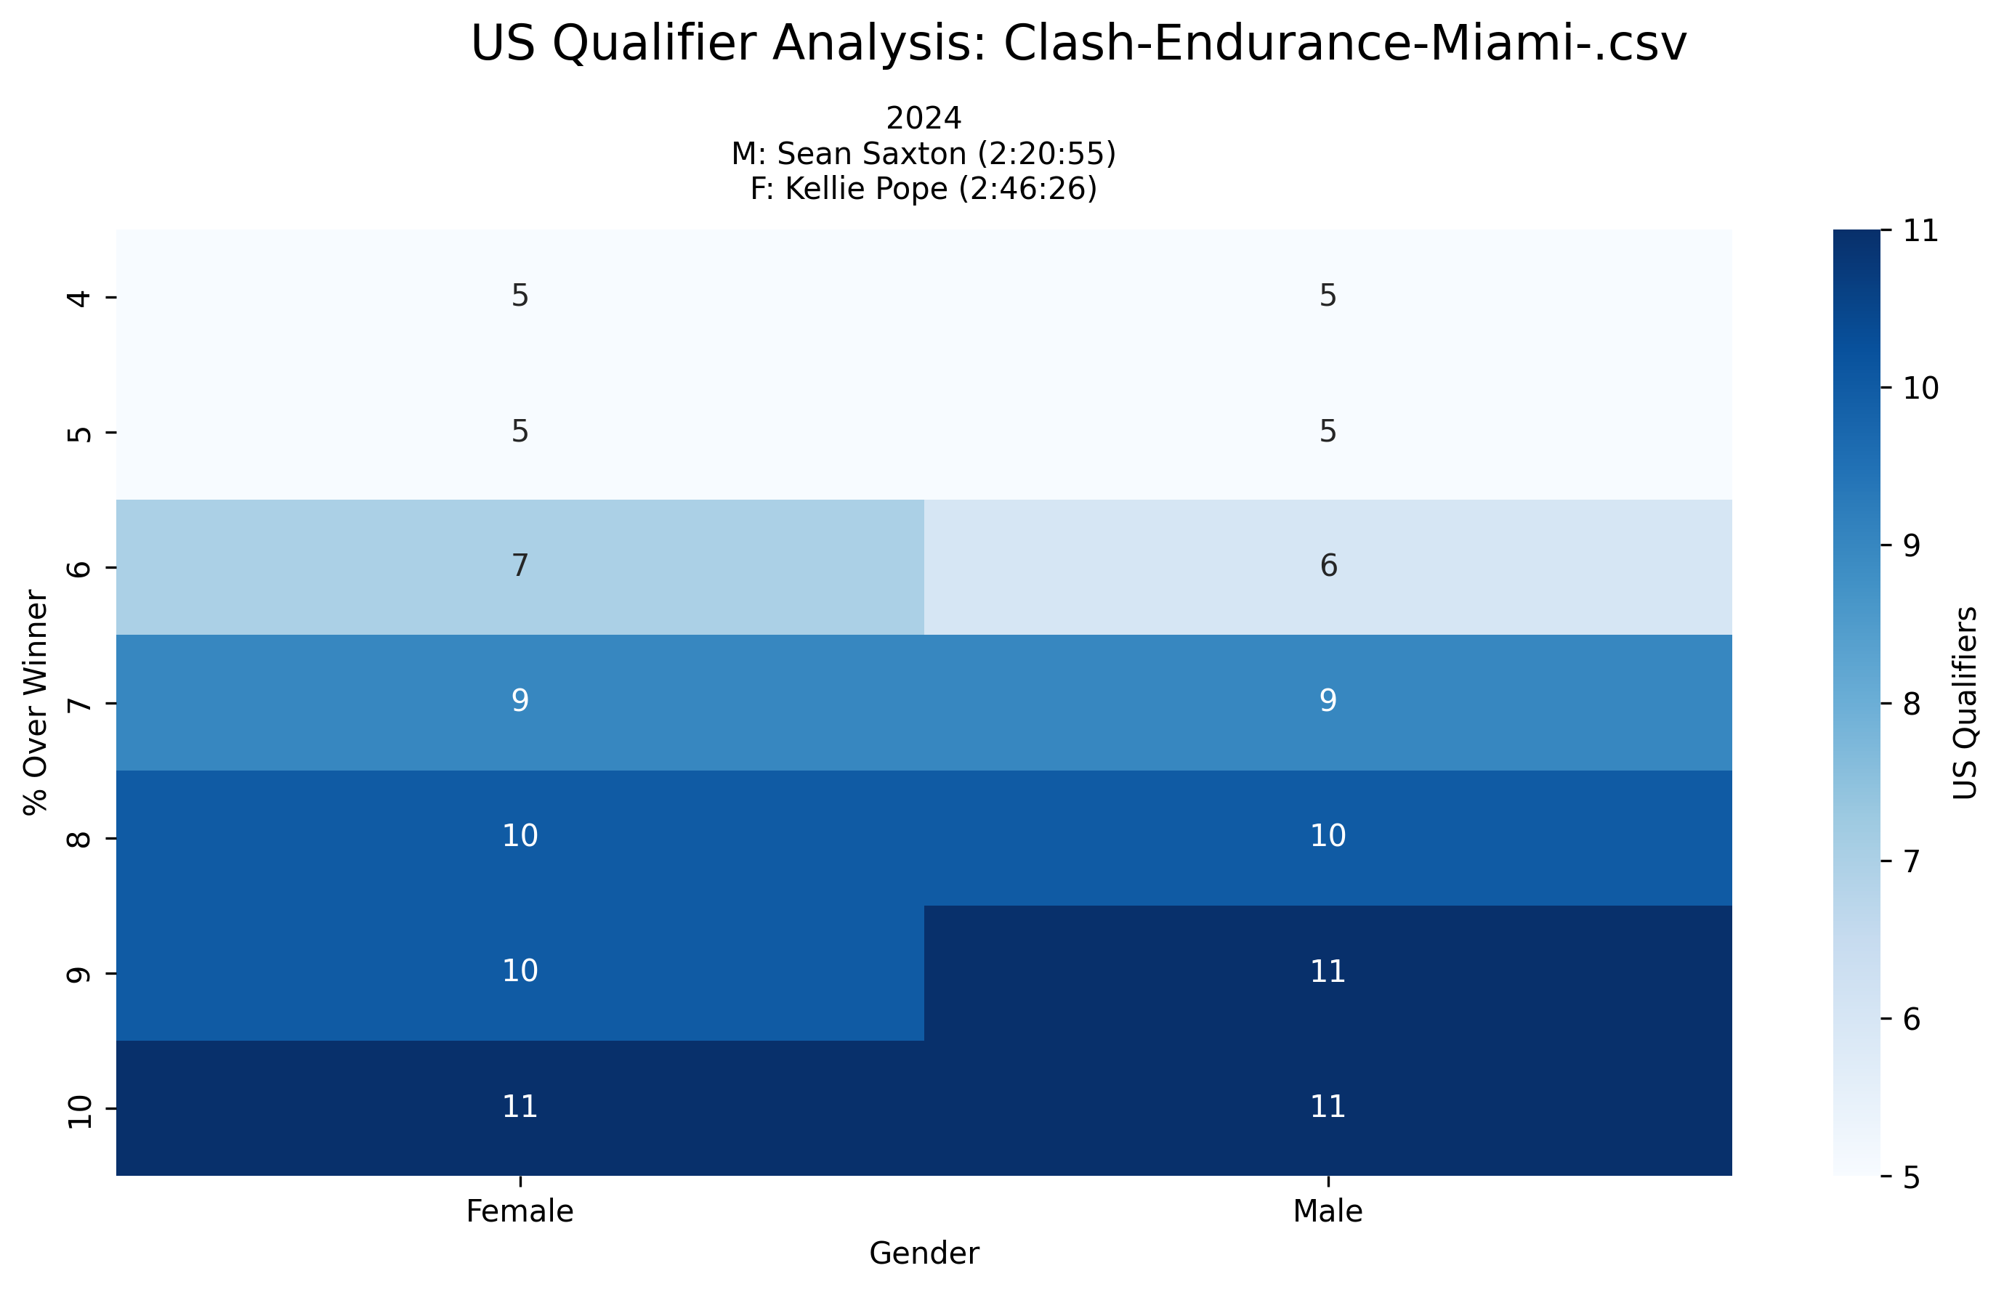
Event Analysis: Clash-Endurance-Miami-.csv
Multi-year comparison showing US qualification patterns across different threshold percentages

Slide 36
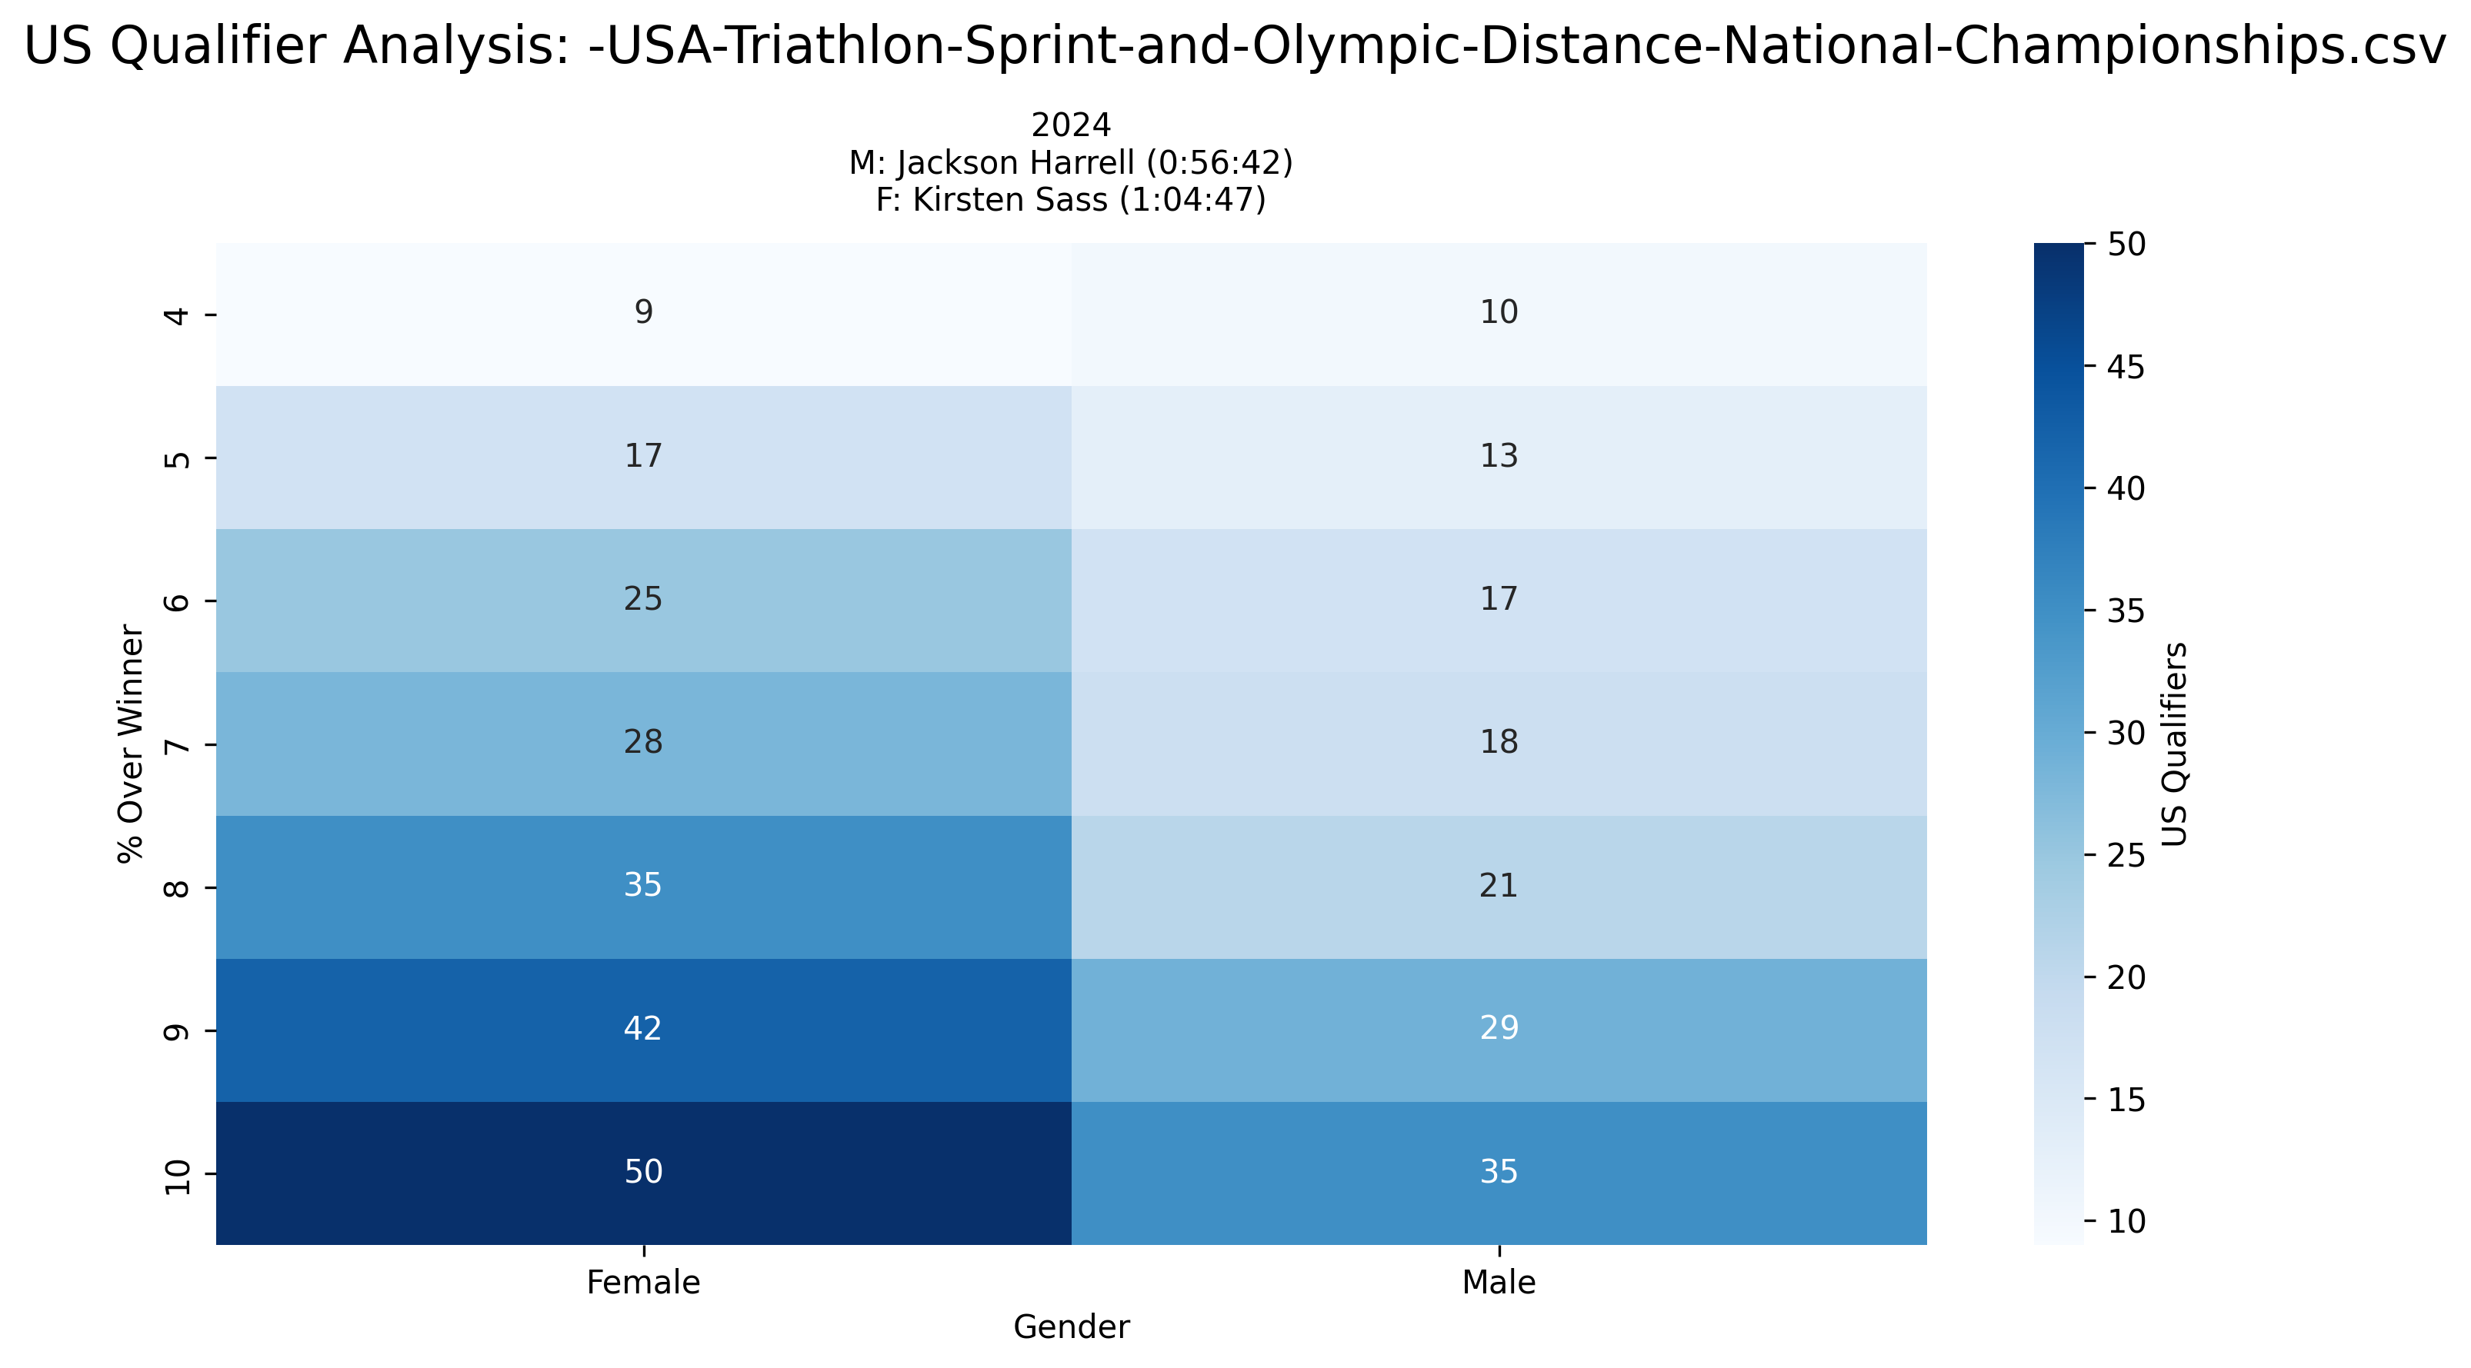
Event Analysis: -USA-Triathlon-Sprint-and-Olympic-Distance-National-Championships.csv
Multi-year comparison showing US qualification patterns across different threshold percentages

Slide 37
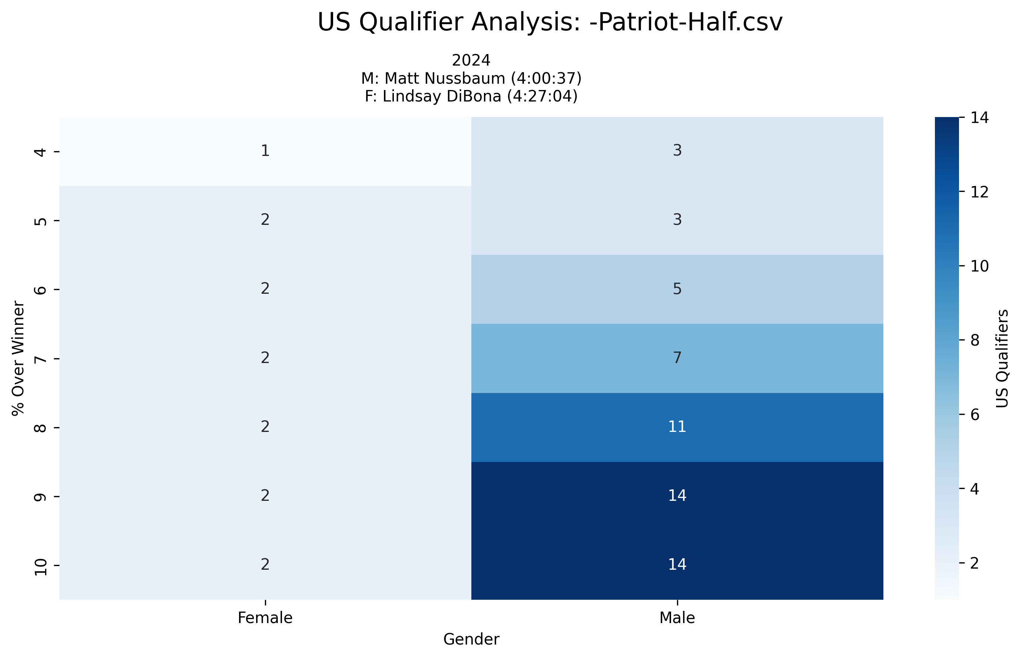
Event Analysis: -Patriot-Half.csv
Multi-year comparison showing US qualification patterns across different threshold percentages

Slide 38
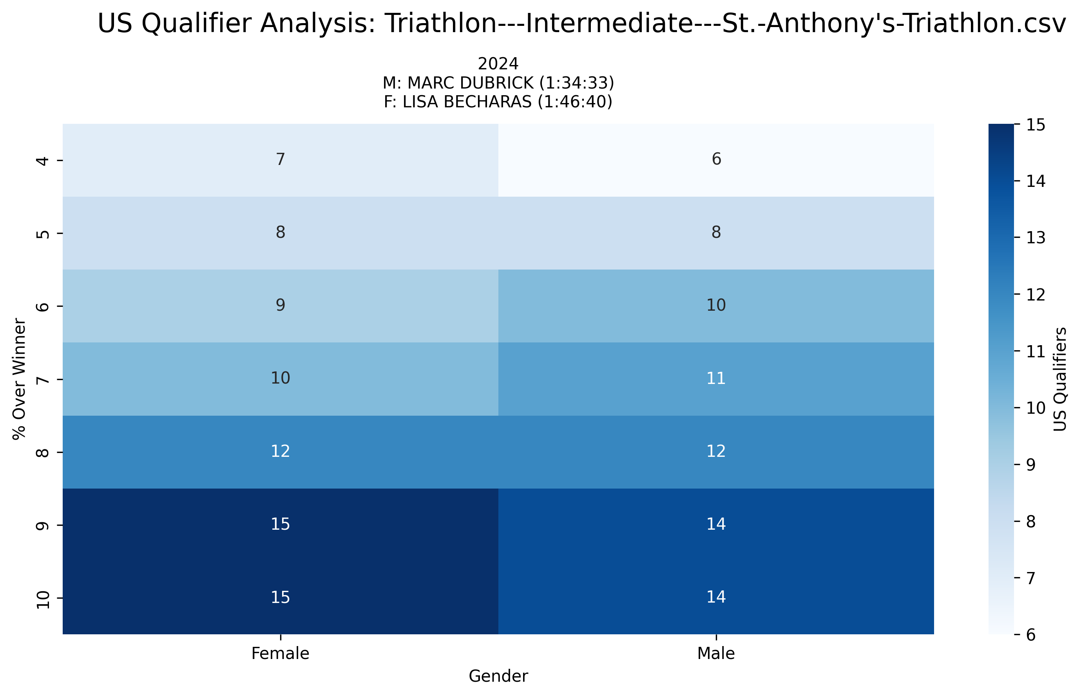
Event Analysis: Triathlon---Intermediate---St.-Anthony's-Triathlon.csv
Multi-year comparison showing US qualification patterns across different threshold percentages

Slide 39
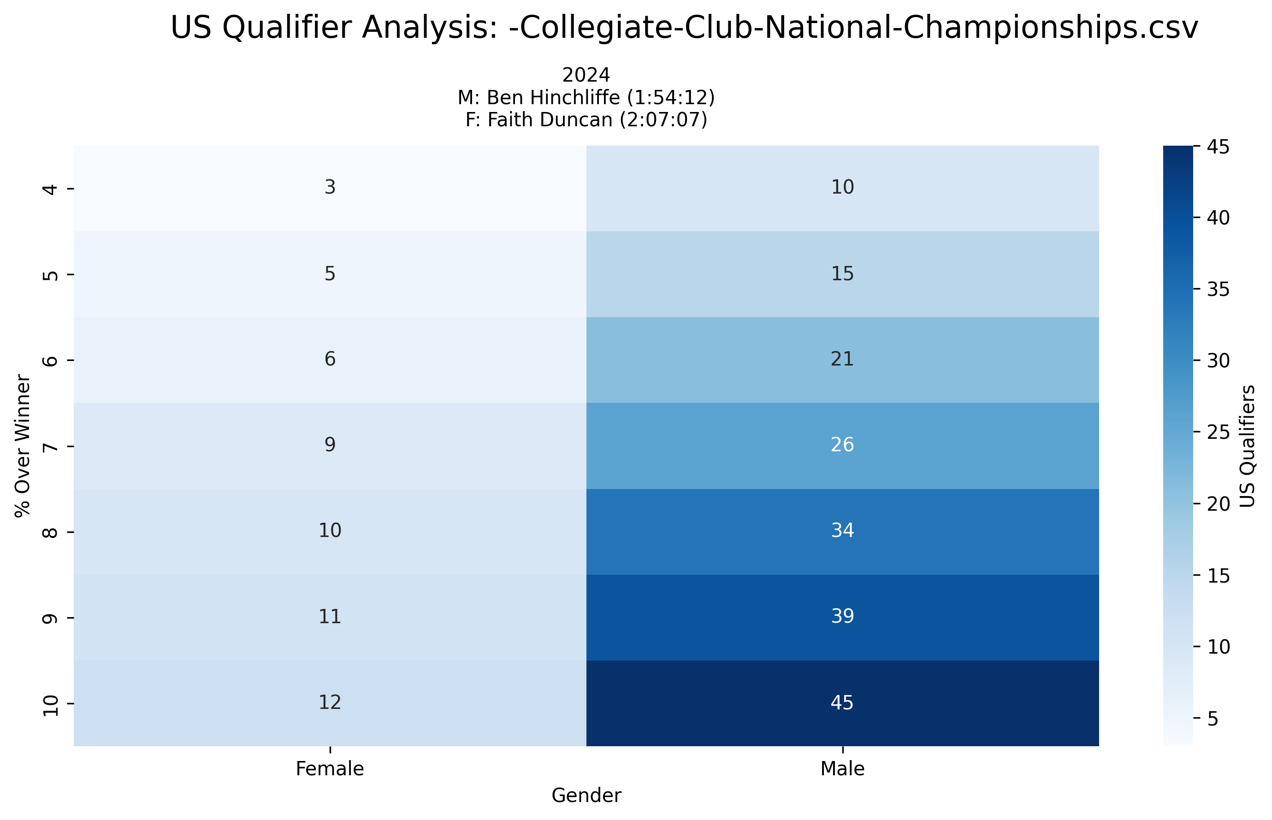
Event Analysis: -Collegiate-Club-National-Championships.csv
Multi-year comparison showing US qualification patterns across different threshold percentages

Slide 40
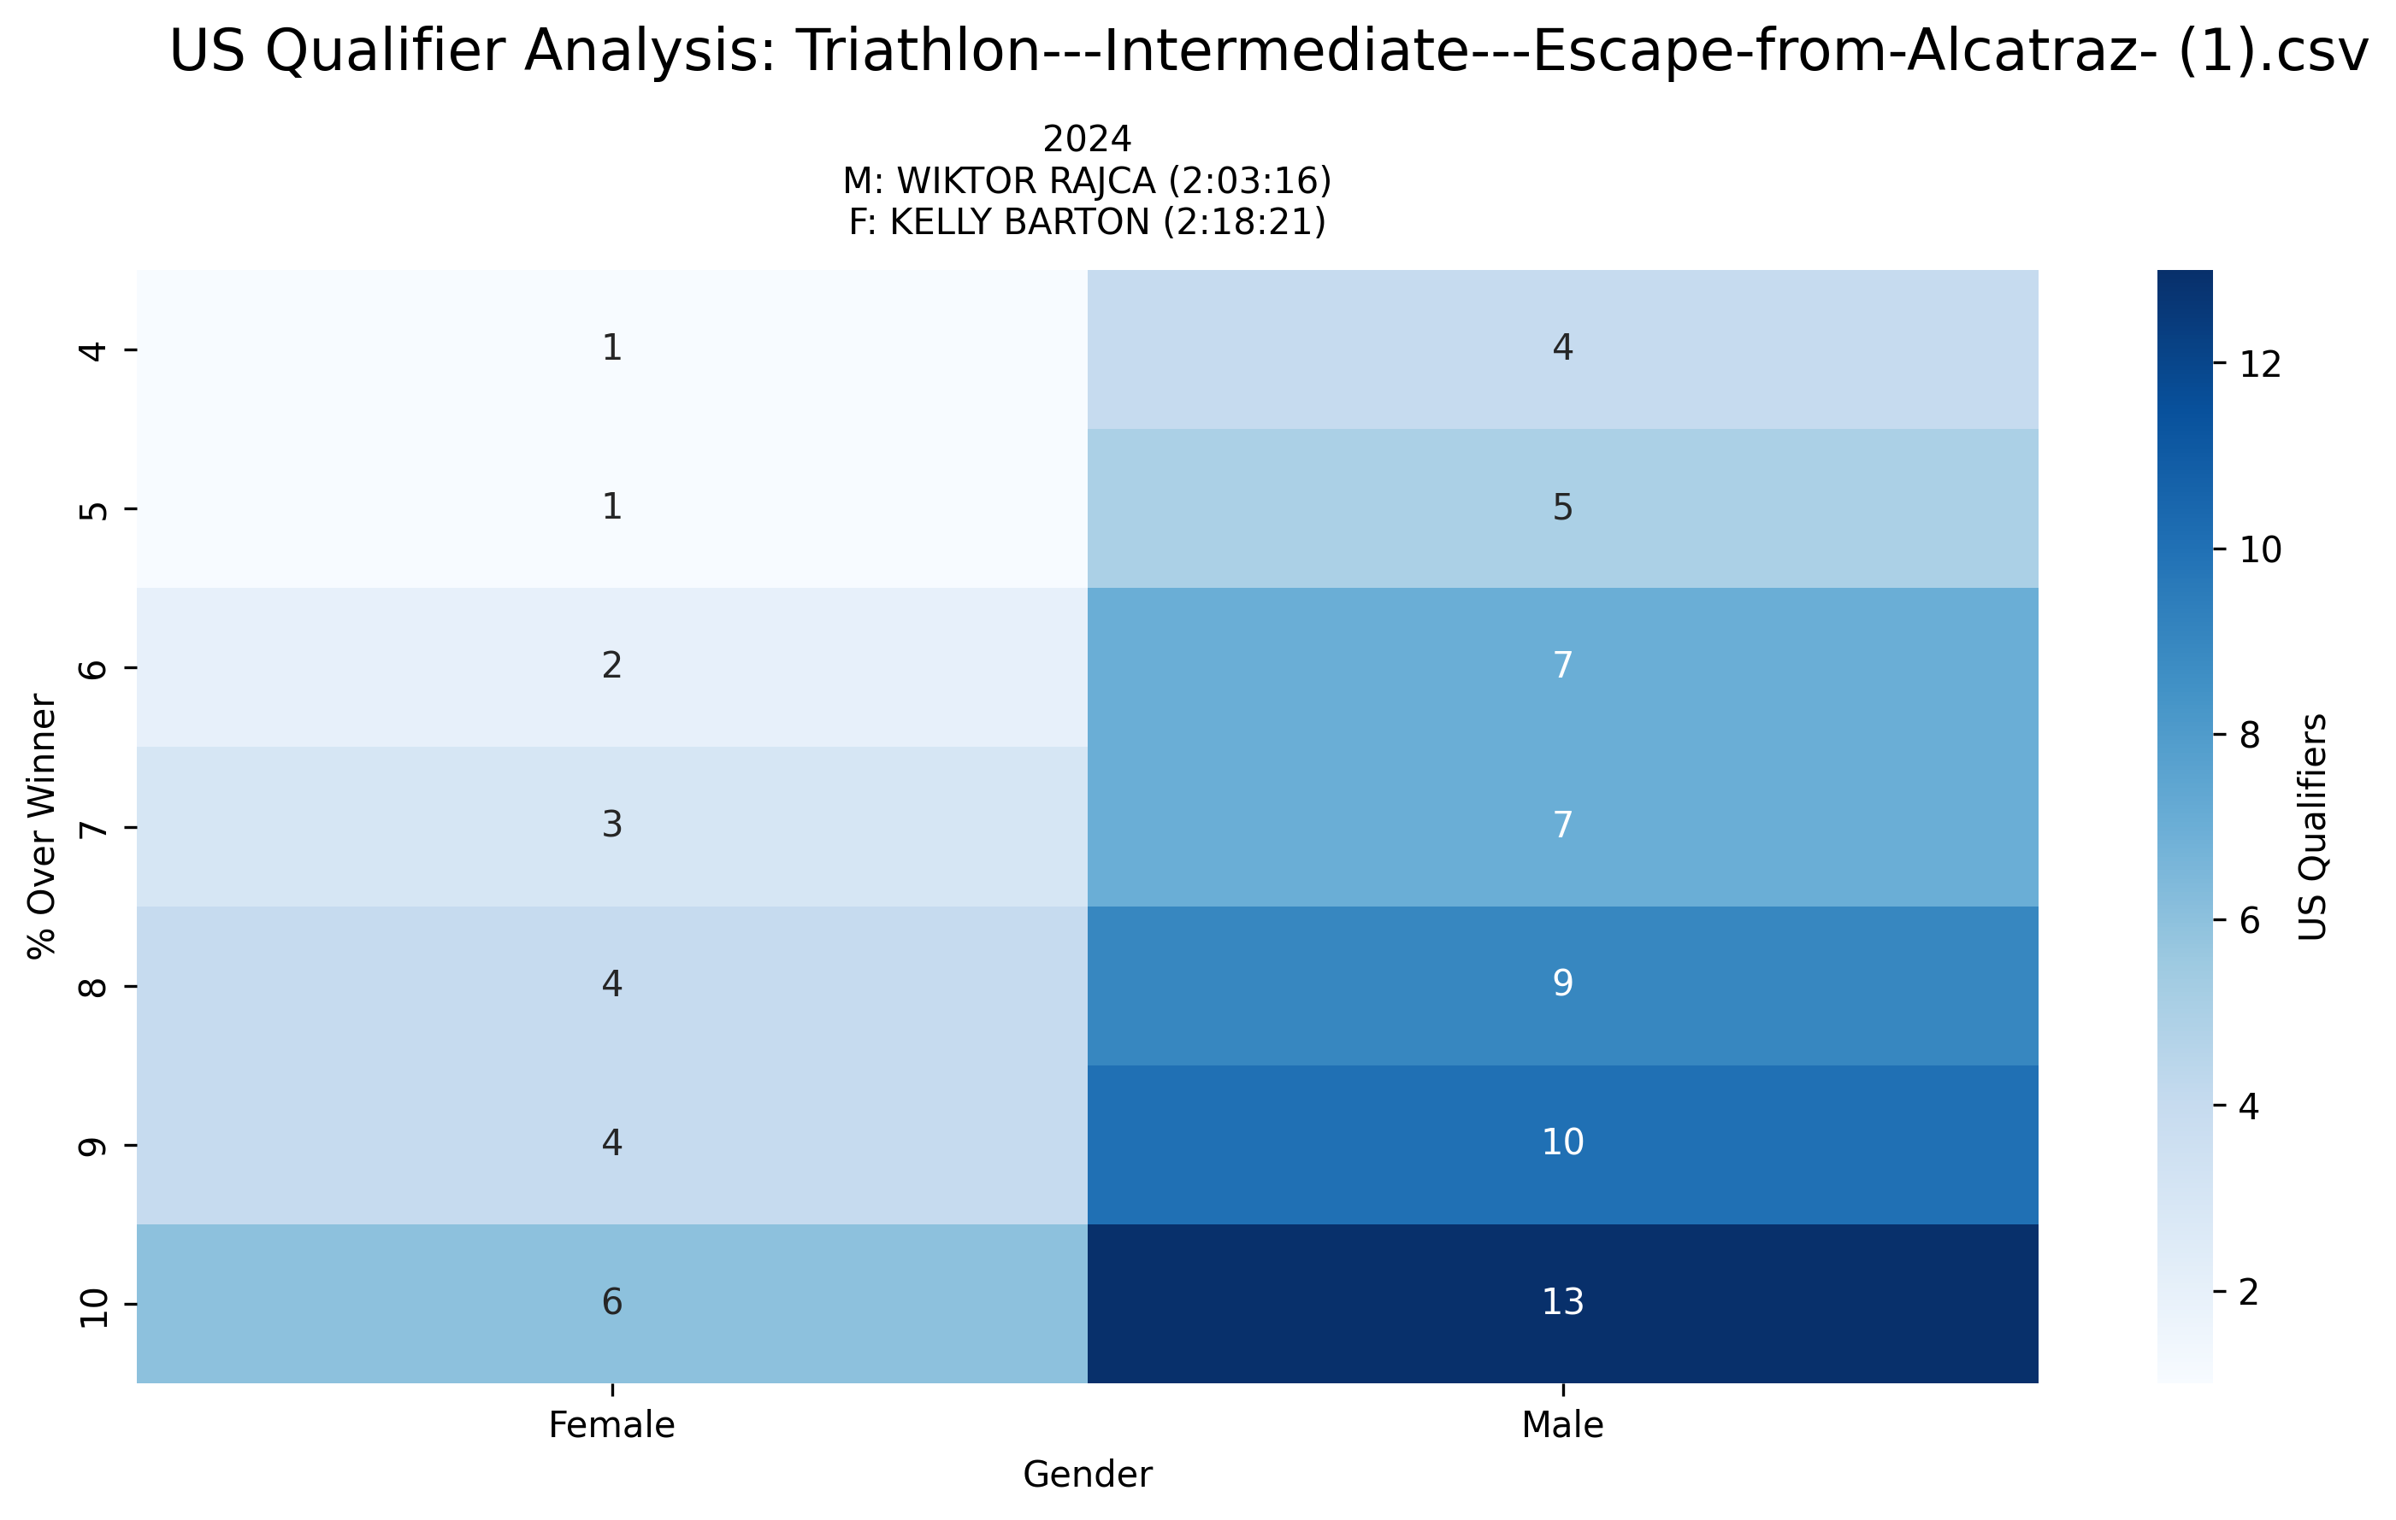
Event Analysis: Triathlon---Intermediate---Escape-from-Alcatraz- (1).csv
Multi-year comparison showing US qualification patterns across different threshold percentages

Slide 41
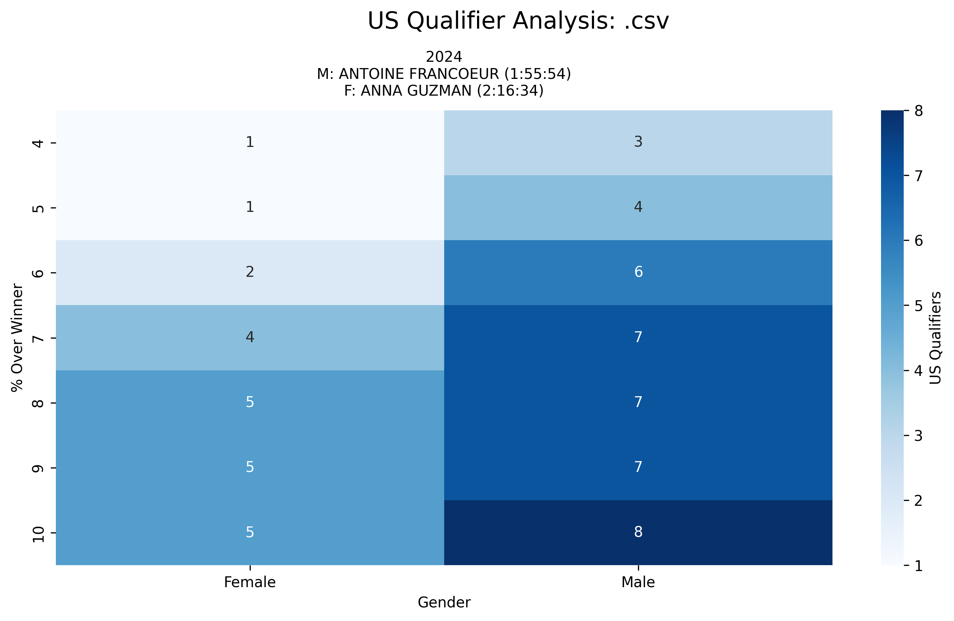
Event Analysis: .csv
Multi-year comparison showing US qualification patterns across different threshold percentages

Slide 42
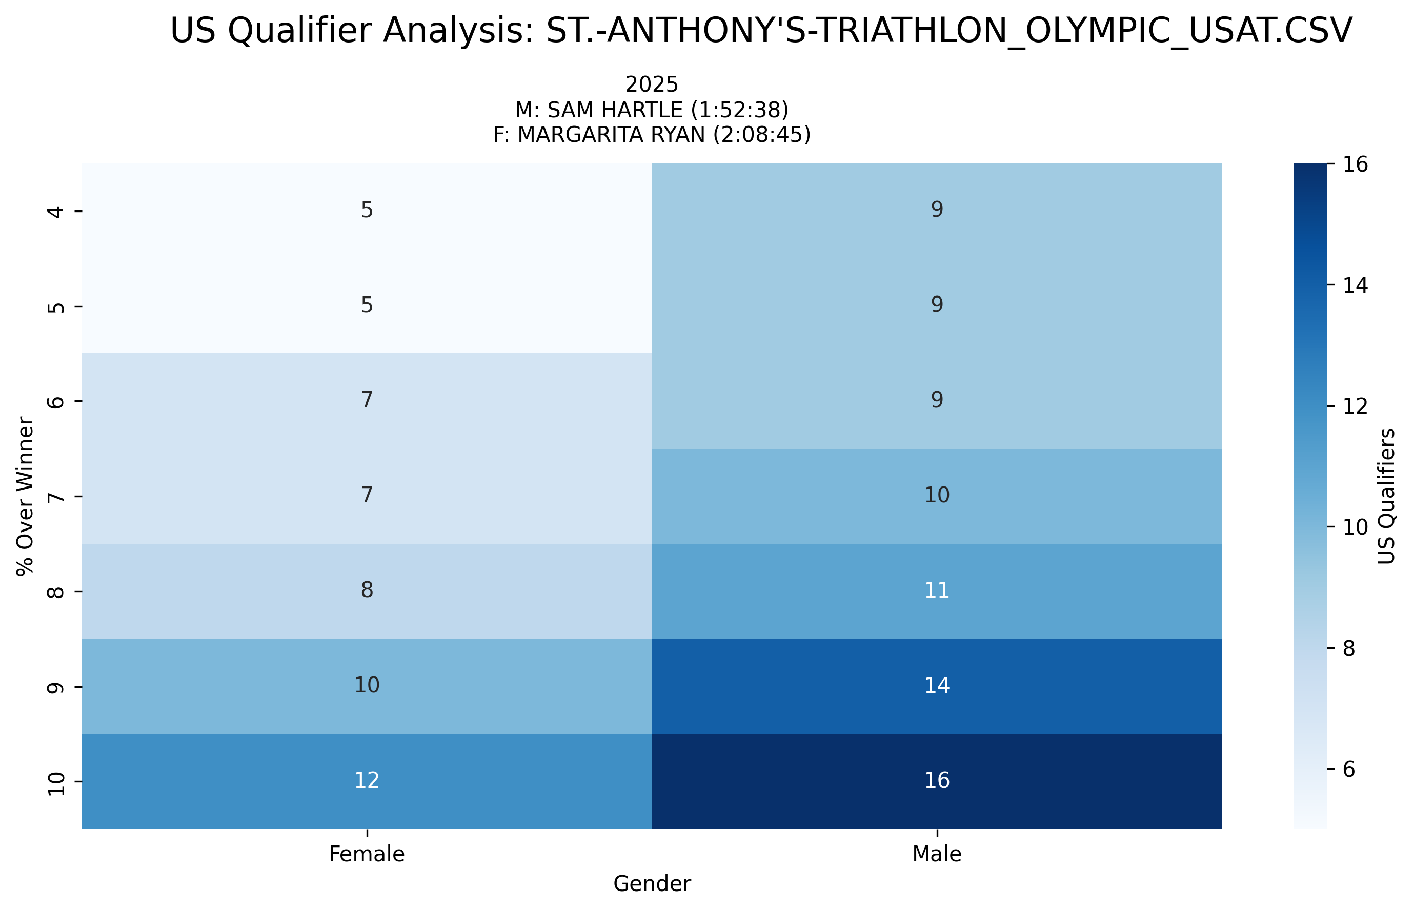
Event Analysis: ST.-ANTHONY'S-TRIATHLON_OLYMPIC_USAT.CSV
Multi-year comparison showing US qualification patterns across different threshold percentages

Slide 43
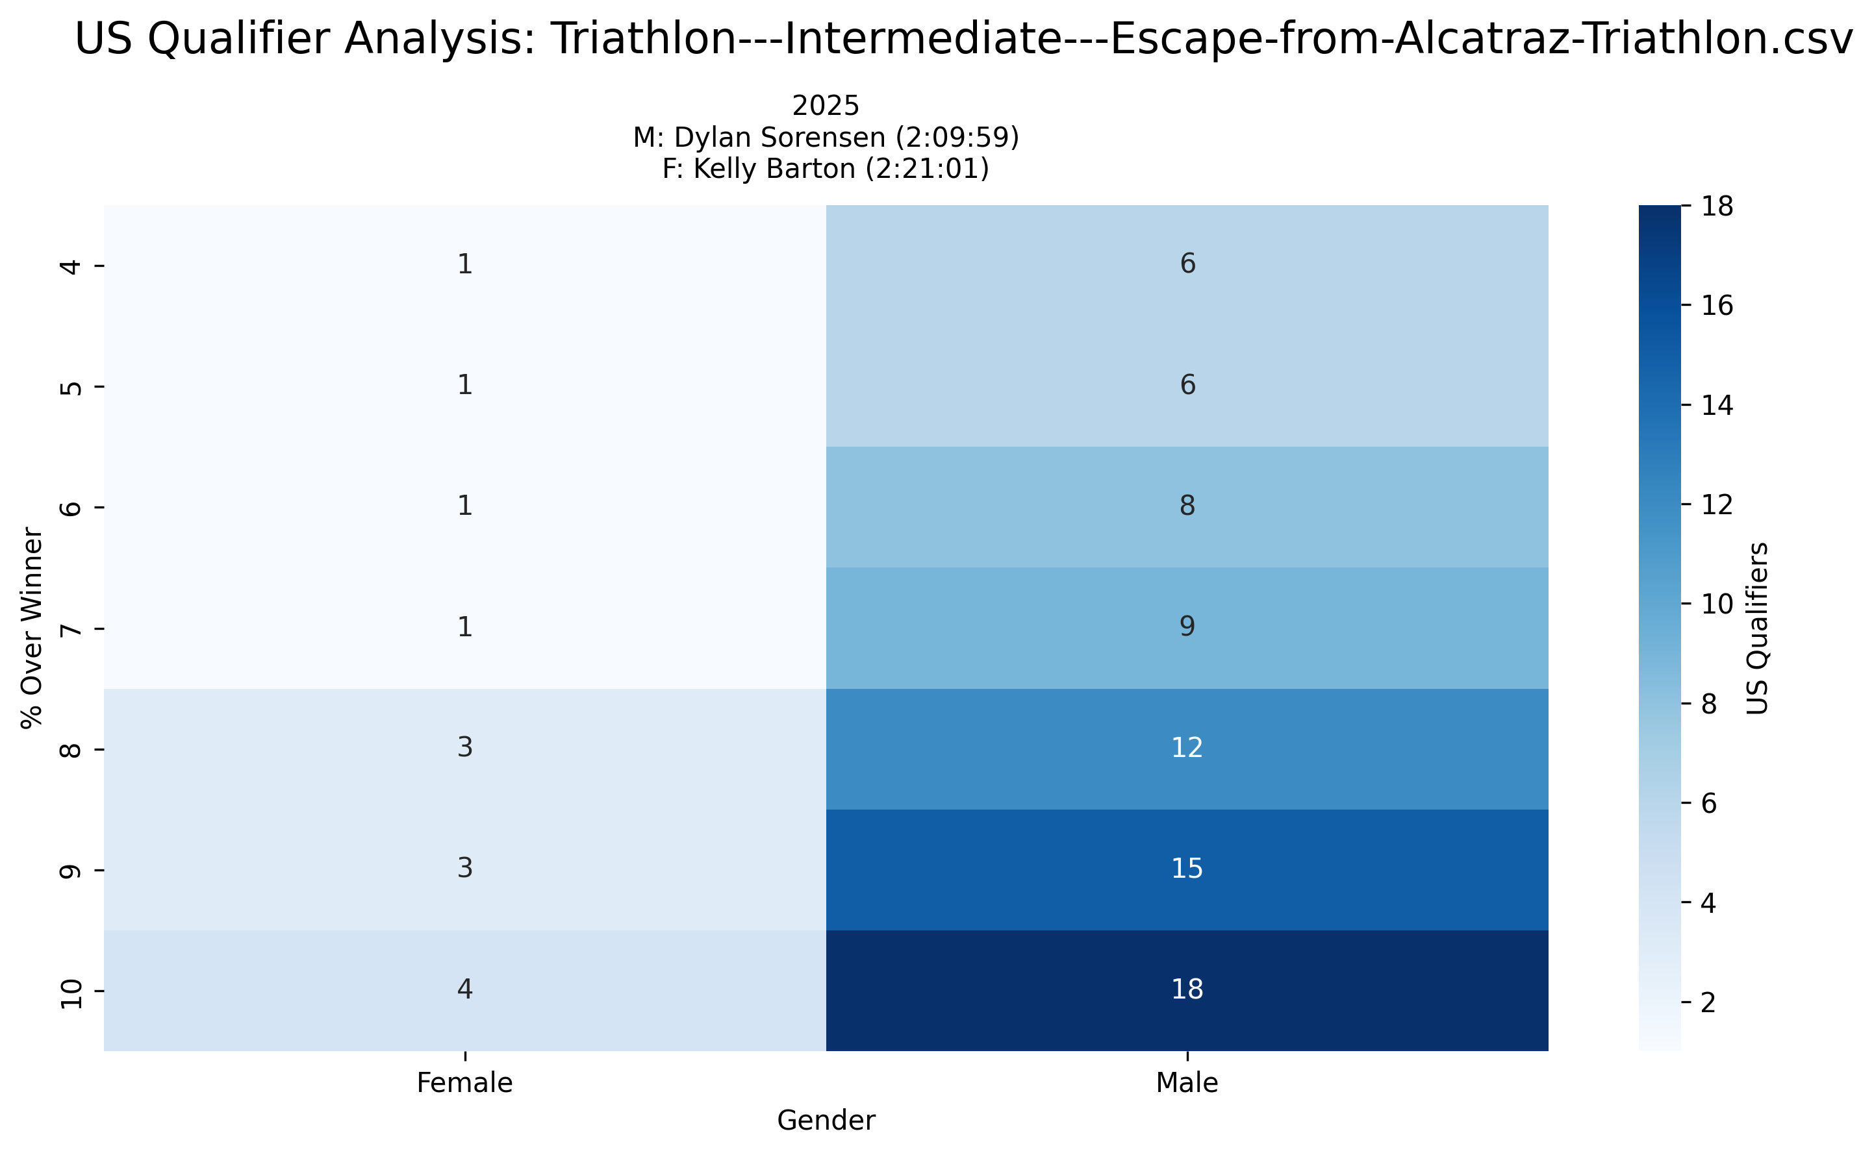
Event Analysis: Triathlon---Intermediate---Escape-from-Alcatraz-Triathlon.csv
Multi-year comparison showing US qualification patterns across different threshold percentages

Slide 44
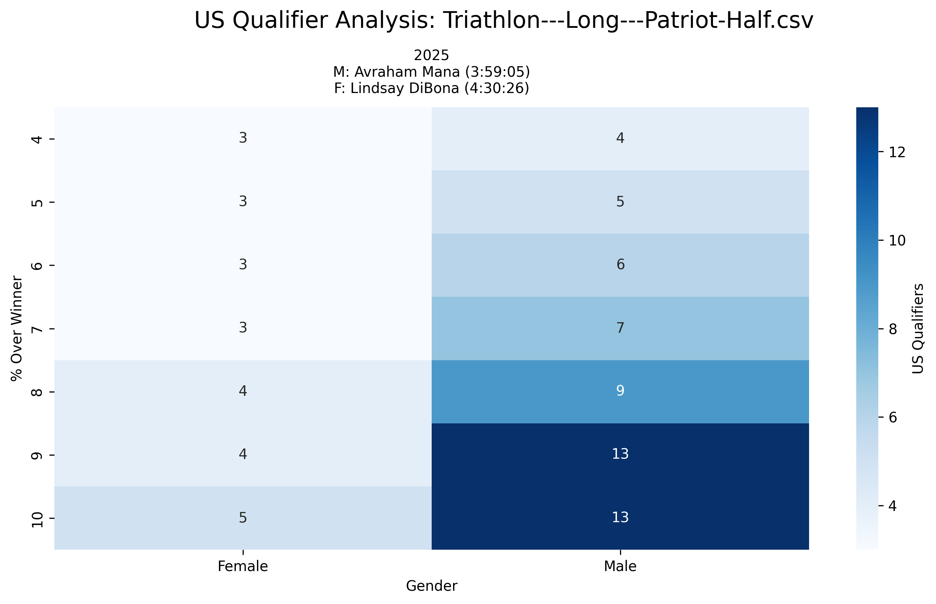
Event Analysis: Triathlon---Long---Patriot-Half.csv
Multi-year comparison showing US qualification patterns across different threshold percentages

Slide 45
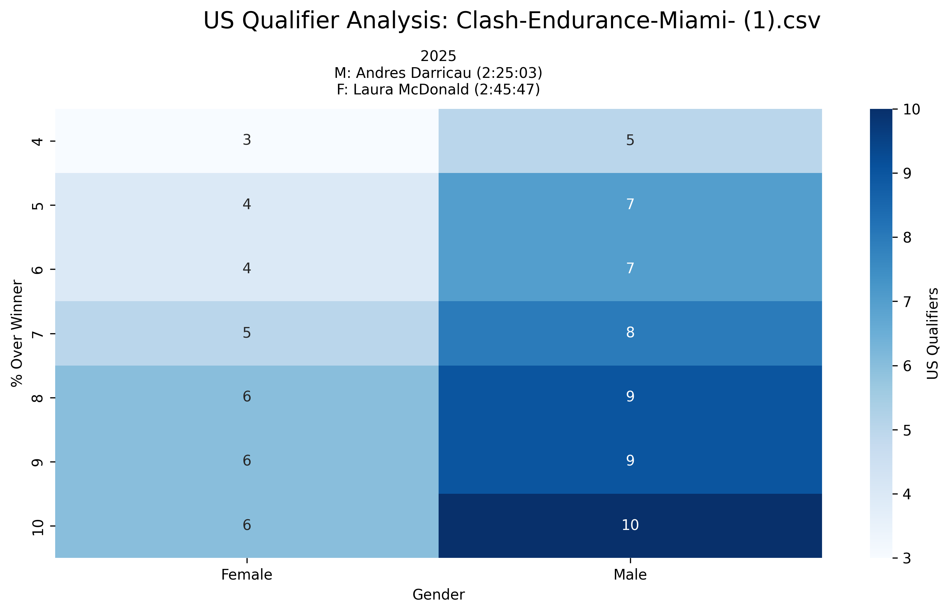
Event Analysis: Clash-Endurance-Miami- (1).csv
Multi-year comparison showing US qualification patterns across different threshold percentages

Slide 46
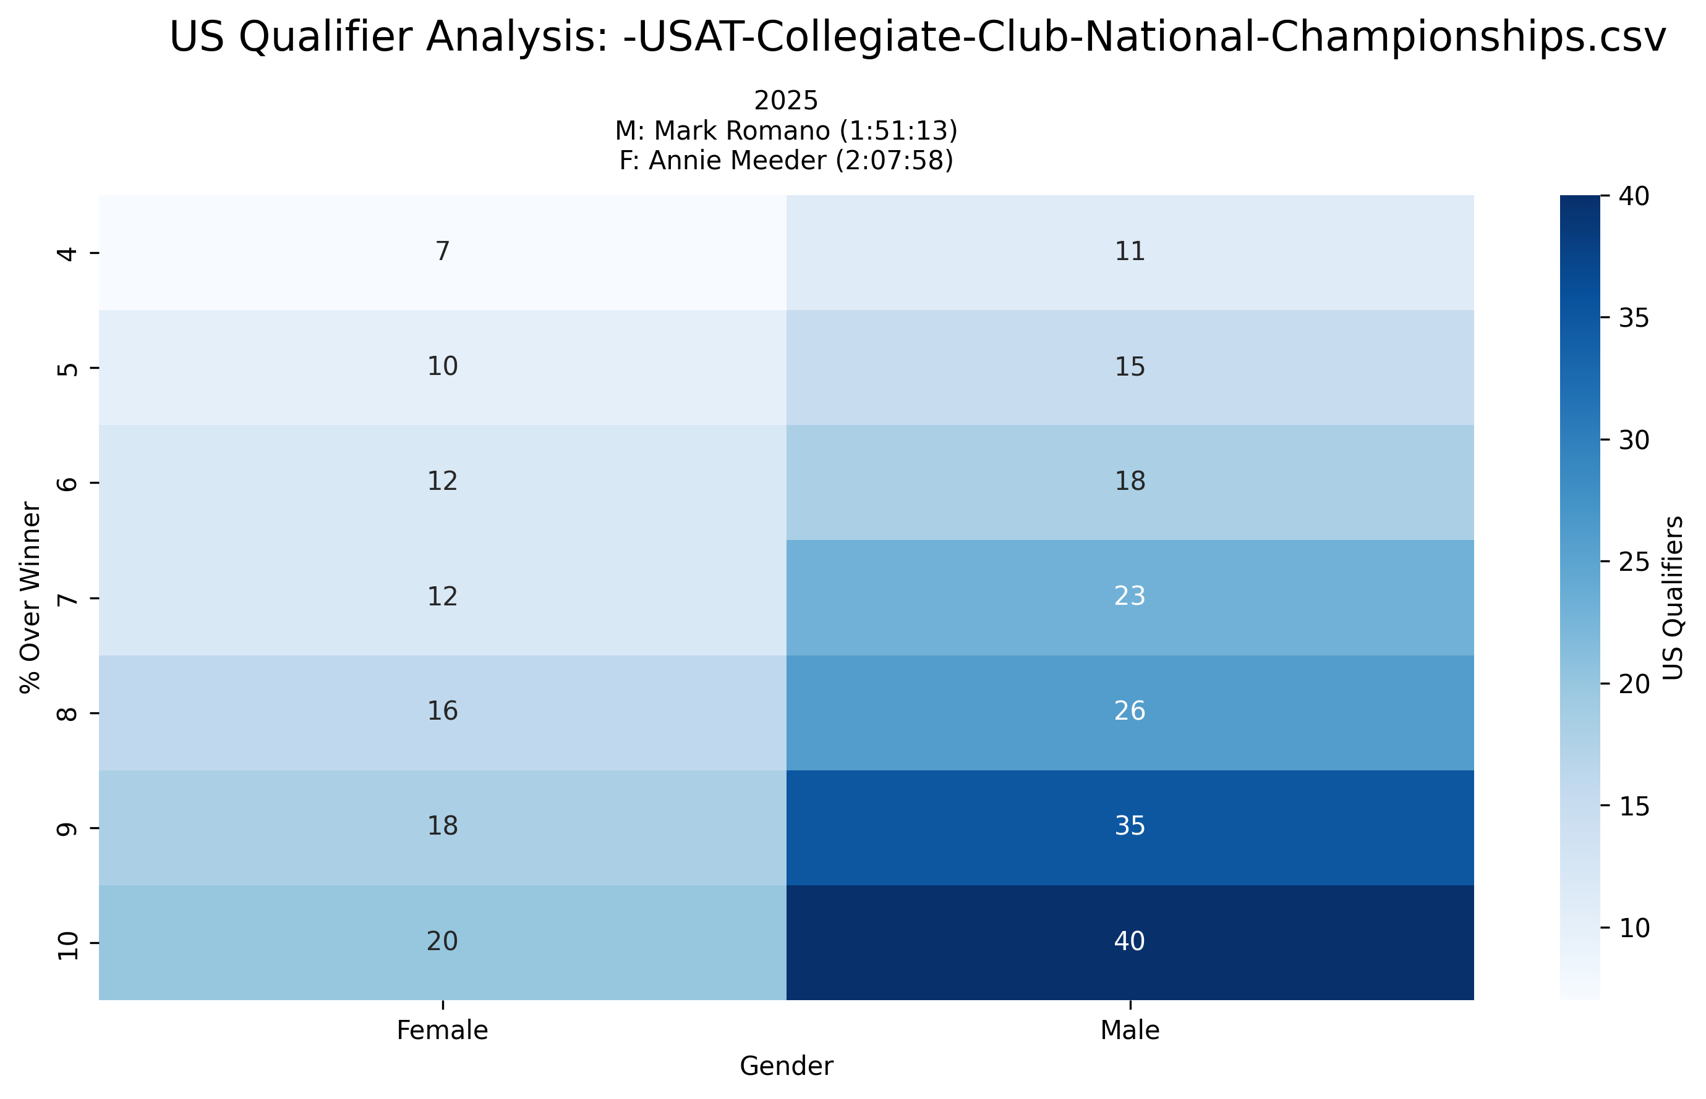
Event Analysis: -USAT-Collegiate-Club-National-Championships.csv
Multi-year comparison showing US qualification patterns across different threshold percentages

Slide 47
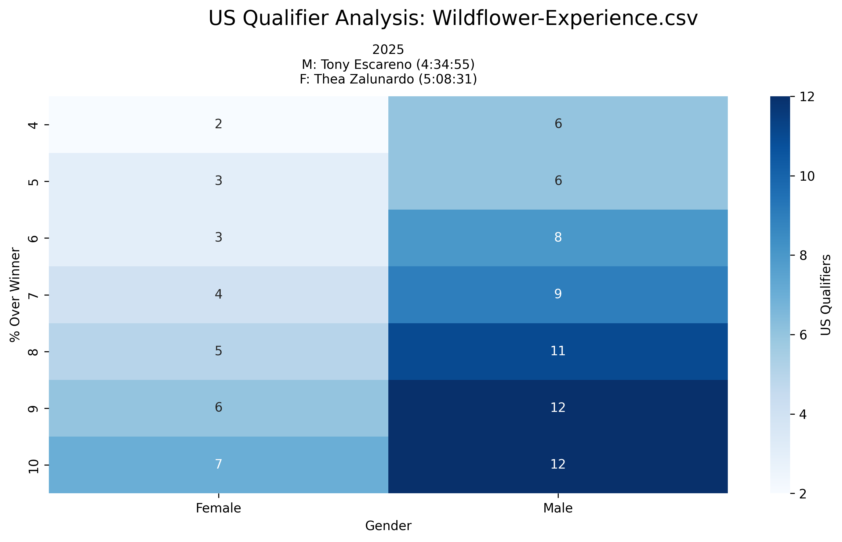
Event Analysis: Wildflower-Experience.csv
Multi-year comparison showing US qualification patterns across different threshold percentages

Slide 48
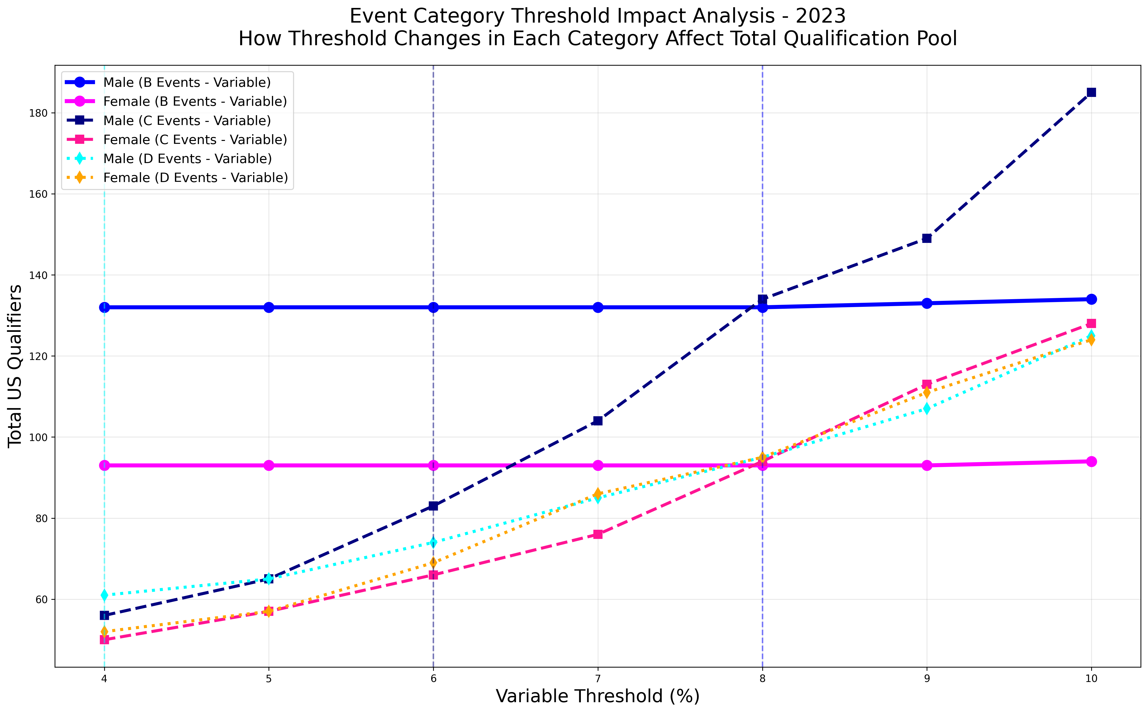
Event Category Threshold Impact Analysis (2023)
Comprehensive view showing how threshold changes in each event category affect total US qualification numbers for 2023

Slide 49
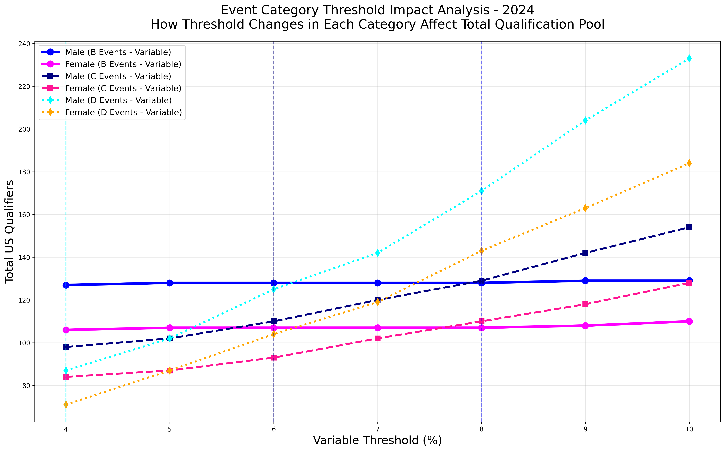
Event Category Threshold Impact Analysis (2024)
Comprehensive view showing how threshold changes in each event category affect total US qualification numbers for 2024

Slide 50
Strategic Recommendations
Data-Driven Insights for Qualification Strategy
B-Events (T100/Championships): 8% threshold provides balanced qualifier pool (~40-60 athletes per gender)
C-Events (Major IRONMAN): 6% threshold maintains selectivity while ensuring adequate representation
D-Events (Regional): 4% threshold preserves competitive standards for local/regional qualifiers
Implementation Benefits:
• Predictable qualification numbers for event planning
• Maintains competitive integrity across event tiers
• Ensures gender parity in qualification opportunities
• Provides clear athlete performance targets

