Slide 1
Java Continued

Slide 2

Example
Let’s say we were creating a program for an animal shelter – in this shelter we have a number of dogs. We want a program to model these dogs.
Each dog in our shelter has certain characteristics
Woof!
As well as certain behaviors like barking
name
weight
breed
age

Slide 3
Dog Class
Then we want to create a Dog class to model these characteristics and behaviors.
Our state or characteristics, name, weight, breed, and age, will be saved in variables and our behavior, barking, will be defined in a method.

Slide 4
Dog
NOTE: This class doesn’t actually run or do anything at all on its own.
It provides the code that would need to be used somewhere else in the program.
public class Dog {
String name;
double weight;
String breed;
int age;
public void bark(){
System.out.println(“Woof!!”);
}
}

Slide 5
Using the Dog class…
public class Dog {
String name;
double weight;
String breed;
int age;
public void bark(){
System.out.println(“Woof!!”);
}
}
Scruffy
Woof!
Daisy
public class TestDog {
public static void main(String[] args){
Dog daisy = new Dog();
daisy.name = “Daisy”;
daisy.bark();
Dog scruffy = new Dog();
scruffy.name = “Scruffy”;
}
}

Slide 6
Objects as Representations
A class is a blueprint for objects
Outline shared states and behaviors for instances
Values of those states may change
An object methods may change the object’s state
Dog class has a variable “isFed”, an eat() method may change that variable’s value to “true”
An object’s state is unique to itself. Each object operates its own behavior independently.
With exceptions.

Slide 7
Constructors
Constructors are used to create objects.
Instantiating the class
When a new object is created from a class, the class’ constructor is run.
Example myExample = new Example();
They have no return type and always are named with the same name as the class in which they are defined.
Every class must have at least one constructor.
If you don’t provide one, a default no-argument constructor is implicitly provided.
public MyClass() {} // it looks like this
If you do provide a constructor, you lose the default one!

Slide 8
Default Constructor
package one;
public class Dog {
private double size = 6.5;
public Dog(){}
public double getSize(){
return this.size;
}
public void setSize(double size){
this.size = size;
}
}
Here implicitly.
package two;
import one.Dog;
public class TestDog{
public static void main(String[] args){
Dog dog = new Dog();
dog.setSize(9.0);
System.out.println(dog.getSize());
}
}
This is how we would invoke that constructor (regardless of whether it was explicitly or implicitly defined). It reserves the memory needed to store all of the variables associated with our Dog object.

Slide 9
Constructor Overloading
A class can have multiple constructors, differentiated by their parameters
public Example() { }
public Example(int num) { }
public Example(int num, String name) { }
Calling a specific constructor is a matter of passing in the right types/numbers of parameters.
Example myEx = new Example(3);

Slide 10


this()…
When you call a constructor only one of the constructors in each class runs unless one of the constructors calls this(…)
this is a reference to the current class, so this() is an invocation of one of the current class’ constructors.
this() can be used in place of - it must be the first instruction of the constructor.
package one;
public class Dog {
private double size = 6.5;
public Dog(){this(12);}
public Dog(int size){
this.size = size;
}
}

Slide 11

Background…
Recall how we typically call/invoke an instance method
First we declare/define it.
public class Dog{
public void bark(){
System.out.println(“woof!”);
}
}
public class TestDog{
public static void main(String[] args){
Dog daisy = new Dog();
daisy.bark();
}
}
Running these instructions
Then we call the instance method on our object.

Slide 12
Now this…
So what if we want the instructions in our method to affect the state of the object that the method is called on…
That’s why we have the this keyword- a reference to the current object.
So let’s see this in action.

Slide 13
This in action
Let’s create a Dog class with an instance variable size. Let’s also create a grow method…
public class Dog{
public double size = 5.5;
public void grow(){
this.size += 1;
}
}
public class TestDog{
public static void main(String[] args){
Dog daisy = new Dog();
daisy.grow();
}
}
Here we use the this keyword to indicate that we want to modify the size of the Dog object grow() is called on.
Running these instructions
Then we call the instance method on our object.

Slide 14
Clarifications
If you are sitting there going- but couldn’t we have just said:
You are correct.
So then why?
Using this makes it even more clear that you are referring to an instance variable.
Also, we could have created a local size variable- having two variables of the same name we need a way to differentiate between them.
public class Dog{
public double size = 5.5;
public void grow(){
size += 1;
}
}

Slide 15
This in action
Now the word size refers to the parameter, size.
public class Dog{
public double size = 5.5;
public void growToSize(double size){
this.size = size;
}
}
public class TestDog{
public static void main(String[] args){
Dog daisy = new Dog();
daisy.growToSize(7.7);
}
}
So, we use the this keyword to refer to the actual size instance variable.

Slide 16
Modules
Java Platform Module System (JPMS)
Introduced with Java 9
Collection of associated packages, resources, and a module descriptor
Module descriptor specifies
Name of module
Dependencies
i.e. other modules that your module relies on
The packages available to other modules
And more…

Slide 17
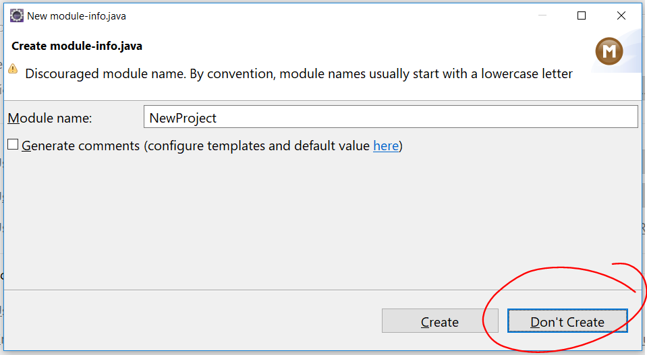
Module Descriptor
Created from module-info.java
module moduleName{
//module directives go in here
//technically all of these are optional
//you would specify things like
exports mypackage;
requires modulesNeededInModuleName;
}
For our purposes though you can simply select Don’t Create

Slide 18
Package Structure
Java classes are stored in packages
Packages become nested folders
com.revature.example → /com/revature/example
How do we specify what package we want our file to be in?
Add a line at the top of your java file
What if we don’t specify?
The class ends up in the default package
package com.revature.example;
public class MyClass{
// …
}

Slide 19
Packages Continued…
What about String? Or System.out.println()?
They come from java.lang
We have access to java.lang and our current package by default
Java libraries and frameworks from other packages are “imported” by package or by class.
import java.util.*;
import java.util.ArrayList;
This prevents name confusion (java.util.Date vs java.sql.Date)
Package + Class name = “fully qualified class name”
com.revature.example.MyClass
When we use the fully qualified class name we don’t have to import our class

Slide 20
Strings
Most commonly used class
Immutable
Can be created through two notations, both behave differently:
String str1 = “hello world”; // string literals String str2 = new String(“hello world”); // object
String literals are “pooled”, no two String literals have the same value. References to duplicate literals are shared. Object-notation Strings are not pooled.

Slide 21

Let’s take the following program
public class TestString{
public static void main(String[] args){
int number = 9;
String s1 = new String(“Hello”);
String s2 = “Hello”;
String s3 = “Hello”;
}
}
Stack
s3
s2
s1
number = 9
main
Hello
Hello
String Pool
Heap

Slide 22
Common String Methods
char charAt(int index)
Returns the character at the specified position in the String.
int indexOf(String str)
Returns the position of the first occurrence of the specified substring
int length()
Returns the number of characters in the string
String substring(int beginIndex)
Returns a substring starting from the given index of the parent String.
boolean equals(String str)
Returns whether the two strings have the same sequence of characters.

Slide 23
equals() vs ==
.equals() determines equivalency – whether two objects share the same state.
== determines equality, whether two variables have the same value (do reference variables point to the same object in memory?)
In other words, == isn’t comparing the objects themselves, it’s comparing the reference variables used in the statement.
Using == on Strings can be confusing. When used to compare String literals, it can return true when comparing two different String reference variables if the values are the same, because the JVM minimizes String object creation.

Slide 24
The Javadoc
The Javadoc is the documentation for the Java language.
https://docs.oracle.com/javase/9/docs/api/overview-summary.html
The Javadoc describes every class and method in the Java API.

Slide 25
Math
Class containing useful static methods for common mathematical operations.
abs()
floor()
max()
min()
sqrt()
random()

Slide 26
StringBuilder
Essentially a mutable String
append()
replace()
charAt(index)
delete(start, end)
insert(index, value)

Slide 27
StringBuffer
Essentially thread safe StringBuilder
append()
replace()
charAt(index)
delete(start, end)
insert(index, value)

Slide 28
Input/Output Streams
https://docs.oracle.com/javase/tutorial/essential/io/streams.html
InputStream, OutputStream
FileInputStream, FileOutputStream
FileReader, FileWriter
System.in, System.out, System.err

Slide 29
Scanner Class
The are many ways to collect user input in Java, we will focus on one method that is straightforward, the Scanner class.
The Scanner class causes program execution to pause while the user provides input into the console. When the user presses Enter/Return, the input is read and stored in a variable.
Syntax:
Scanner myScanner = new Scanner(System.in);
String str = myScanner.nextLine(); // String input
int num = myScanner.nextInt(); // Integer input

Slide 30
Scanner
Reads from an input stream
Import from java.util
hasNext()
next();
nextLine();
nextInt();
nextDouble();
close();

