Slide 1
Servlets Continued

Slide 2
Servlet Container
A servlet container manages the life cycle of a servlet.
Servlet is an interface defined in javax.servlet package.
A servlet container uses the Servlet interface to understand a specific Servlet object and manage it.

Slide 3
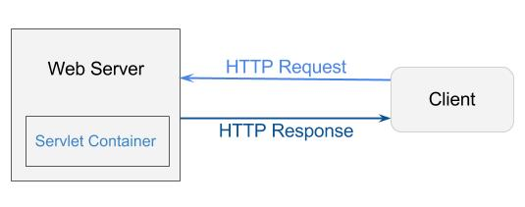
Servlet Container
The Servlet Container is a component of applications (which use servlets) that interacts with Java servlets. It is responsible for:
managing the life-cycle of servlets
mapping a URL to a particular servlet
ensuring that the URL requester has the correct access rights
and some other services

Slide 4
Servlet Life Cycle
Servlet is Loaded
When the application server (such as Tomcat) starts up, the servlet contain deploys and loads all servlet classes.
Servlet instance Created
Once all servlet classes are loaded, the servlet contain creates only one instance of each servlet class.
All requests to the servlet are executed on that same servlet instance.
Some applications can create multiple instances of a servlet to handle high-volumes of incoming requests, but this is not the default behavior.
init() method invoked once
Once all servlet classes are instantiated, the init() method is invoked once, and only once for each instantiated servlet, which initialized the servlet.
service() method invoked repeatedly for each client request
The servlet contain calls the service method each time a request for the servlet is received. The service method determines the type of request (GET, POST, PUT, DELETE, etc…) and also performs the respective doGet(), doPost(), doPut(), doDelete() method
Invoke the destroy() method once
The servlet container will call the destroy() method prior to removing the servlet instance from the service.

Slide 5
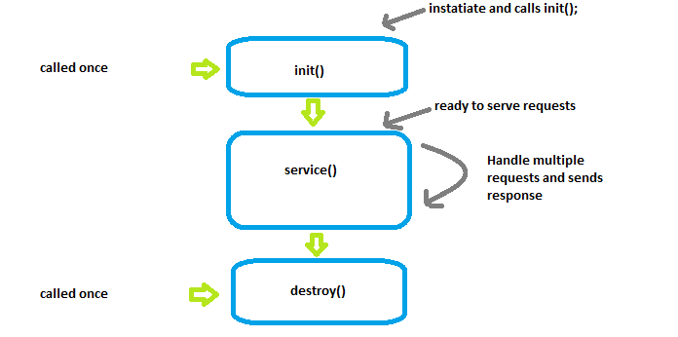
Servlet Life Cycle

Slide 6
Servlet API
The Servlet API includes the classes and interfaces required to build servlets.
These interfaces and classes are represented in two packages:
javax.servlet
javax.servlet.http
The Servlet interface is the root interface of the servlet class hierarchy.
The GenericServlet class implements the Servlet, ServletConfig, and Serializable interfaces.
The HttpServlet class extends the Generic Servlet class, and provides methods such as doGet, doPost, doDelete, etc…
User-defined servlets can be created by implementing the Servlet interface or extending the GenericServlet class; however, it is most common to extend the HttpServlet class.

Slide 7
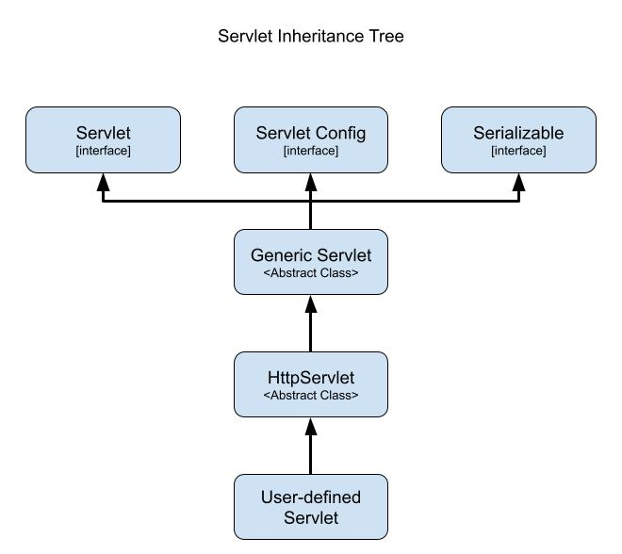
Servlet API

Slide 8
Deployment Descriptor
Java web applications use a deployment descriptor file to define the urls that map to servlets, and determine which URLs require authentication and/or additional information.
Deployment descriptor files specify the classes, resources and configurations for the application and how the web server uses them to serve HTTP requests.
For Servlets, the deployment descriptor is a file called web.xml and resides within the application’s WEB-INF directory
The web.xml defines mappings between URL paths and servlets that will handle requests.
The application server uses this configuration to find the servlet that handles a given request and calls the servlet methods that correspond to the HTTP request method used.

Slide 9
Servlet Mapping
Servlets are configured within the Web.xml using the <servlet> element.
Servlet elements should include a nested <servlet-name> and <servlet-class> elements
<servlet-name> : defines the name.
The servlet name must be unique across the deployment descriptor.
<servlet-class> : The fully-qualified name for the class of the defined servlet.
Servlets are mapped to a URL or URL pattern using the <servlet-mapping> element.
Servlet mappings should include a nested <servlet-name> and <url-pattern> elements:
<servlet-name> : details the associated servlet used to handle requests
<url-pattern> : requests sent to this specified url will be handled by the associated named servlet.

Slide 10
Servlet Mapping
<web-app xmlns="http://xmlns.jcp.org/xml/ns/javaee" xmlns:xsi="http://www.w3.org/2001/XMLSchema-instance”
xsi:schemaLocation="http://xmlns.jcp.org/xml/ns/javaee
http://xmlns.jcp.org/xml/ns/javaee/web-app_3_1.xsd"
version="3.1">
<servlet>
<servlet-name>servlet1</servlet-name>
<servlet-class>com.revature.MyFirstServlet</servlet-class>
</servlet>
<servlet-mapping>
<servlet-name>servlet1</servlet-name>
<url-pattern>/index</url-pattern>
</servlet-mapping>
</web-app>

Slide 11
Sending Users to Different Locations
SendRedirect:
Supplied by the response object
Method signature: response.sendRedirect(location [String])
This sends a response back to the client and a new request back.
The information from the previous request is lost
Forward:
Supplied by the request object
Method is declared in the request dispatcher interface
When using forward, the request never leaves the server
You cannot dispatch to another location (it must come from resources within the same project or ones that are immediately available)
This action makes a singe request rather than 2, and therefore is faster
The browser is not made aware of the move to a new location.

Slide 12
Request-Response LifeCycle
Client sends request to server
(If the server is on), it creates an empty (flat) response file and forwards both the request and response to the web container.
Web Container – does a lot of “heavy-lifting”. It references an application’s deployment descriptor (web.xml), which is a configuration file that tells the server how to deploy the content.
The web container checks the deployment descriptor for where to send the request and response.
The web container wraps the request and response as Java Objects (HttpServletRequest and HttpServletResponse) and sends them to the appropriate servlet.
Here, the Servlet life-cycle takes place, in which services are performed and the response is populated.
The servlet passes the request and newly populated response back to the web container.
The Web container unwraps the request and response and sends them to the server
The server passes the request and response back to the client.

Slide 13
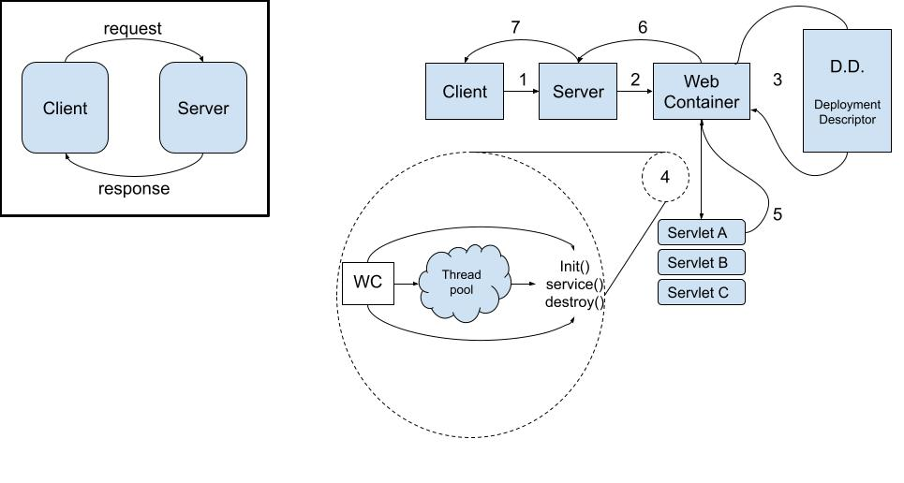
Request-Response LifeCycle

Slide 14
ServletRequest and ServletResponse
Allow us to get information contained in the request and set information to include in the response
ServletRequest:
getParameter(“name_of_parameter”)
Returns a String
getParameterNames()
Returns an Enumeration of String values- Enumeration<String>
getParameterMap()
Returns Map<String, String[]>
getHeader("NAME_OF_HEADER")
Returns the value of the specified header
ServletResponse:
setHeader("NAME_OF_HEADER", "VALUE_OF_HEADER");
get…
getWriter
getOutputStream
sendRedirect(“path”);

Slide 15
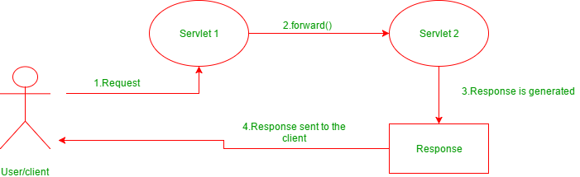
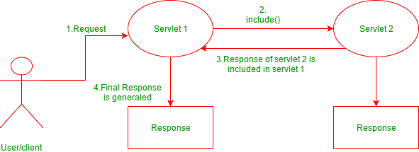
Request Dispatcher interface
forward(ServletRequest request, ServletResponse response)
passes a request from one servlet to another resource on the server
request and response are forwarded to the next resource which processes the data and returns the response to the client
include(ServletRequest request, ServletResponse response)
does not entirely transfer full control to the next resource
includes the content of the original resource in the response returned to the client

Slide 16
Examples
// "request" is a HttpServletRequest Object and "hello.html" is a resoure name
RequestDispatcher rd = request.getRequestDispatcher("hello.html");
//includes the response of "hello.html" page in current servlet response
rd.include(request,response);
Example of using includes
// "request" is a HttpServletRequest Object and "hello.html" is a resoure name
RequestDispatcher rd = request.getRequestDispatcher("hello.html");
//forward the request and response to “hello.html" page
rd.forward(request,response);
Example of using forward

