Slide 1
Web Technologies and Intro to Servlets

Slide 2
Broad Categories of Languages
Binary
“0’s and 1’s”, lowest level language, not actually written
Assembly
Language used by the processor (CPU) to generate binary.
Compiled Languages
Written in plain text, so need to be transformed into another form that can be directly used by the CPU (Assembly) or another application (interpreted language)
Interpreted / Scripting Languages
Treated as a series of instructions by other software which in turn generates Assembly from it.
Interpreted languages are generally not human-readable, scripting languages are.
Markup Languages
Used by another application to give context to or describe static content. Not “programming” languages

Slide 3
Markup Languages and Web Browsers
Web browsers render (draw) HTML documents into static content
HTML is no different than a fancy Word document.
HTML is not “streamed” from a server, the entire file is downloaded to a temp directory on your computer.
HTML is markup that gives meaning and structure to a plain text file.
CSS can be used to change how the browser displays HTML content
JavaScript can be used to cause the browser to perform additional tasks, and modify the HTML or CSS used to render a file.

Slide 4
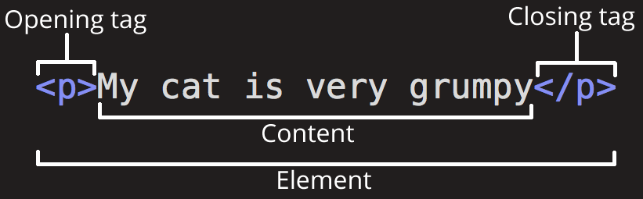
HTML Element

Slide 5
HTML Resources
HTML is one of the simplest languages to learn and test.
You can write HTML code in any text editor
You can run HTML code in any web browser
https://www.w3schools.com/html/
https://developer.mozilla.org/en-US/docs/Web/HTML

Slide 6
Common HTML Attributes
Attributes add “metadata” to an element. They describe what the element is doing.
Some attributes are usable by every HTML element
id=“value” : used to give a unique ID to a single element
class=“value” : used to group elements for styling or scripting purposes. Can have multiple values separated by spaces
style=“key:value;” : used to set styling directly on an element. Can have multiple key:value pairs, separated by semicolons (;)

Slide 7
How the Internet Works
Browsers and servers generally do not keep open connections to each other.
Browser → Request → Server
Browser ← Response ← Server
Connection is closed
HTTP is a protocol. It defines how communication happens.
Other protocols: FTP, SMTP, HTTPS, Telnet
Browser sends HTTP request to URL.
HTTP request arrives at server.
Server finds requested resource (page, file, or program). Server may forward request to program
Server returns requested resource in HTTP response
Browser renders (draws) response to screen, or downloads file

Slide 8
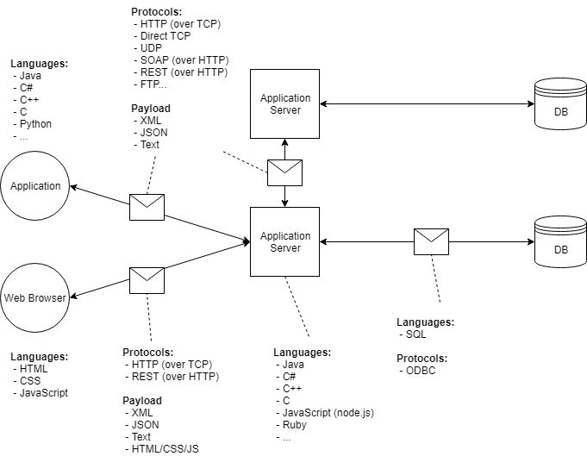
Client-Server-Database Architecture

Slide 9
Types of Client-Server Architecture
2-Tier architecture : The user interface is stored in the client’s machine and the database is stored on the server.
If Business logic and data is mostly handled on the client side, it is known as fat/thick client thin server architecture.
If Business logic & data is handled on the server, it is known as thin client fat/thick server architecture.
2-tier architecture has some limitations with performance, security and portability.
3-Tier architecture : Includes some middleware between the user interface and the database.
The 3 tiers are named the presentation tier, application tier and data tier.
The presentation tier is the front-end layer and consists of the User Interface.
The application tier contains the functional business logic, which driver the application’s core.
The data tier consists of the database system and data access layer.
N-Tier architecture : There are multiple business logic and data logic layers. This increases the flexibility and reusability of applications; however, it is more difficult to implement.

Slide 10
Types of HTTP Request
Two flavors: GET and POST
Technically also PUT, DELETE, OPTION, TRACE, and more, but these are only used by applications, not browsers.
Also called “HTTP methods”.
GET requests:
Used to “retrieve” data from the server
Parameters will be included in the URL after ‘?’
Whenever an HTTP request is generated from typing a URL into an address bar, or clicking a link, it’s a GET request.
URLs typically have a character limit depending on browser and server settings. Generally < 2000 characters is safe

Slide 11
Types of HTTP Request Cont.
POST requests:
Used to send data to a server
Parameters are only in the “body” of the request, do not appear in URL
Data is sent as key-value pairs
HTTP POST requests typically have a maximum size depending on the server configuration (~2-10 MB)
What if I need to send a bigger file?
Multipart POST requests: used to break data up across multiple requests to respect size limits.
Server must be configured to accept multipart requests.

Slide 12
HTML Forms and HTTP Methods
The method attribute of the <form> element determines the HTTP request used to send form data (GET or POST)
GET:
Form data will appear in the URL
http://website.com/destination?key1=value1;key2=...
Subject to URL length limits
DO NOT USE FOR CONFIDENTIAL INFORMATION
POST:
Form data will be in HTTP request body, and thus hidden
The name attribute of an <input> element becomes the name of the key for the value. The value is the value of the input.

Slide 13
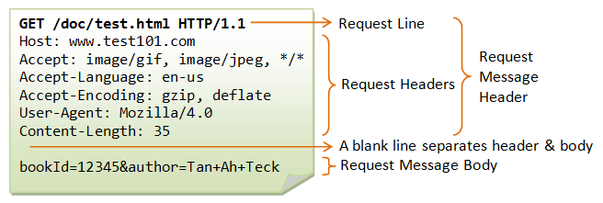
Structure of HTTP Requests
HTTP Requests have a head (filled with “headers”) and a body www.test101.com/doc/test.html?bookId=12345&author=Tan+Ah+Teck
Request Line: method, path, protocol
“Accept” headers: What types of data can be in the response. Restrictive. No match: no response/404.

Slide 14
What is CSS?
A language that utilizes “key-value-pairs” to describe how elements in a markup language should be rendered.
Key – What you are specifically altering.
Value – How you want it to be altered.
Key value pairs are denoted as follows:
Key: Value
Ex:
Background-color: blue;
Font-size: 12pt;
Font-family: 'Times New Roman', Times, serif;

Slide 15
Types of Style Sheets
Inline: Using the ‘Style’ Attribute within specific HTML elements.
Pros: The most specific and the easiest to control.
Cons: Cumbersome and hard to read.
Internal: Specifying all CSS within a ‘Style’ element in the ‘Head’ element of an HTML page
Pros: Easier to read and organize.
Cons: Hard to keep consistent among multiple webpages.
External: Specifying all CSS within a css file and referencing it in the ‘Head’ element of an HTML page
Pros: Promotes code reuse and easier management.
Cons: If resources are not available, or pathing is incorrect, all styles are lost.

Slide 16
CSS Selectors: Elements
CSS selectors “select” which elements to apply styling to
Selector | Description
* | All elements
x | All <x> elements
.x | All elements where class=“x”
#x | The element with the id=“x”
x, y | All <x> and <y> elements
x y | All <y> elements nested in an <x> element
x>y | All <y> elements where <x> is the immediate parent
x+y | All <y> elements immediately after a sibling <x> element
x~y | All <y> elements after a sibling <x> element

Slide 17
CSS Resources and Frameworks
Modern websites generally use some form of CSS Framework or leverage an external library or tool to achieve a consistent look to their websites without needing to provide their own complex CSS.
Information about some common CSS frameworks and tools can be found below:
https://getbootstrap.com/
https://bulma.io/
https://getuikit.com/

Slide 18
Java Servlets
A Servlet is a Java interface that takes incoming requests, processes them, and generated responses to send back to a user.
Implementation examples include the HttpServlet, which processes HTTP requests.
The Servlet interface is defined in the javax.servlet package.
The Servlet Container is the component of an application server that interacts with Java servlets and is responsible for managing the execution of servlets and JSPs (Java Servlet Pages) for java applications.
The servlet container uses the Servlet interface to understand a specific Servlet object and manage it.

Slide 19
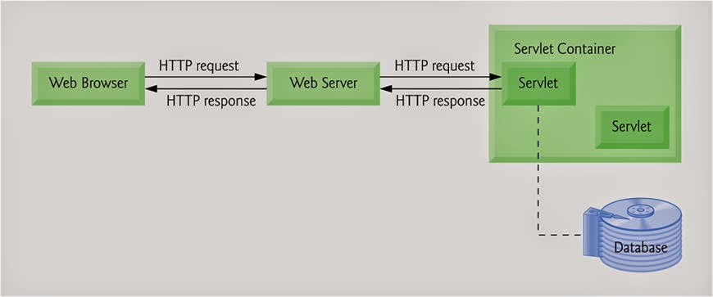
How Servlets Work
When a request is sent to the application server, the server receives and passes the request to the appropriate servlet.
The Servlet processes the request, generates the response and sends the response back to the application server. The application server sends the response back to the client.

Slide 20
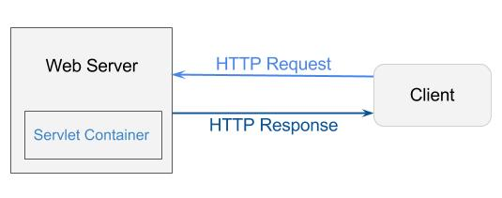
Servlet Container
The Servlet Container is a component of applications (which use servlets) that interacts with Java servlets. It is responsible for:
managing the life-cycle of servlets
mapping a URL to a particular servlet
ensuring that the URL requester has the correct access rights
and some other services

Slide 21
Request-Response LifeCycle
Client sends request to server
(If the server is on), it creates an empty (flat) response file and forwards both the request and response to the web container.
Web Container – does a lot of “heavy-lifting”. It references an application’s deployment descriptor (web.xml), which is a configuration file that tells the server how to deploy the content.
The web container checks the deployment descriptor for where to send the request and response.
The web container wraps the request and response as Java Objects (HttpServletRequest and HttpServletResponse) and sends them to the appropriate servlet.
Here, the Servlet life-cycle takes place, in which services are performed and the response is populated.
The servlet passes the request and newly populated response back to the web container.
The Web container unwraps the request and response and sends them to the server
The server passes the request and response back to the client.

Slide 22
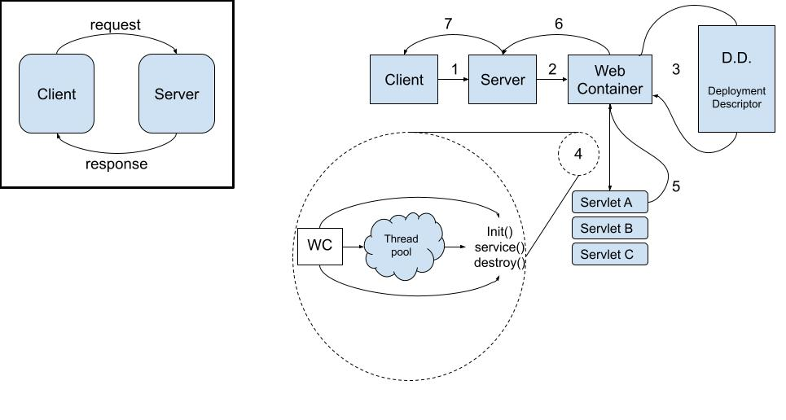
Request-Response LifeCycle

Slide 23
Servlet Life Cycle
Servlet is Loaded
When the application server (such as Tomcat) starts up, the servlet contain deploys and loads all servlet classes.
Servlet instance Created
Once all servlet classes are loaded, the servlet contain creates only one instance of each servlet class.
All requests to the servlet are executed on that same servlet instance.
Some applications can create multiple instances of a servlet to handle high-volumes of incoming requests, but this is not the default behavior.
init() method invoked once
Once all servlet classes are instantiated, the init() method is invoked once, and only once for each instantiated servlet, which initialized the servlet.
service() method invoked repeatedly for each client request
The servlet contain calls the service method each time a request for the servlet is received. The service method determines the type of request (GET, POST, PUT, DELETE, etc…) and also performs the respective doGet(), doPost(), doPut(), doDelete() method
Invoke the destroy() method once
The servlet container will call the destroy() method prior to removing the servlet instance from the service.

Slide 24
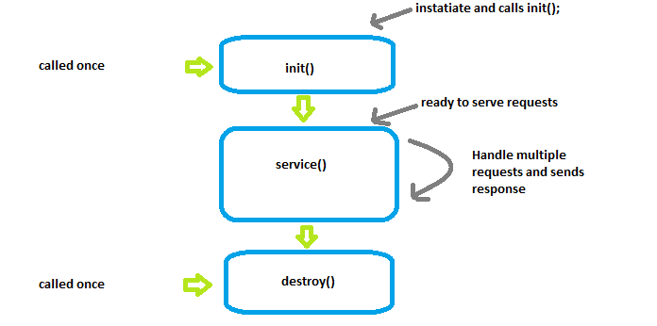
Servlet Life Cycle

Slide 25
Servlet API
The Servlet API includes the classes and interfaces required to build servlets.
These interfaces and classes are represented in two packages:
javax.servlet
javax.servlet.http
The Servlet interface is the root interface of the servlet class hierarchy.
The GenericServlet class implements the Servlet, ServletConfig, and Serializable interfaces.
The HttpServlet class extends the Generic Servlet class, and provides methods such as doGet, doPost, doDelete, etc…
User-defined servlets can be created by implementing the Servlet interface or extending the GenericServlet class; however, it is most common to extend the HttpServlet class.

Slide 26
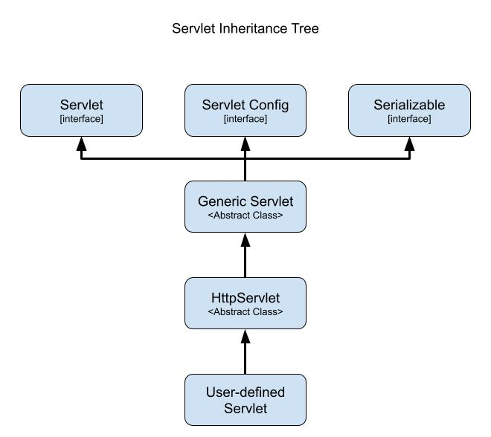
Servlet API

Slide 27
Deployment Descriptor
Java web applications use a deployment descriptor file to define the urls that map to servlets, and determine which URLs require authentication and/or additional information.
Deployment descriptor files specify the classes, resources and configurations for the application and how the web server uses them to serve HTTP requests.
For Servlets, the deployment descriptor is a file called web.xml and resides within the application’s WEB-INF directory
The web.xml defines mappings between URL paths and servlets that will handle requests.
The application server uses this configuration to find the servlet that handles a given request and calls the servlet methods that correspond to the HTTP request method used.

Slide 28
Servlet Mapping
Servlets are configured within the Web.xml using the <servlet> element.
Servlet elements should include a nested <servlet-name> and <servlet-class> elements
<servlet-name> : defines the name.
The servlet name must be unique across the deployment descriptor.
<servlet-class> : The fully-qualified name for the class of the defined servlet.
Servlets are mapped to a URL or URL pattern using the <servlet-mapping> element.
Servlet mappings should include a nested <servlet-name> and <url-pattern> elements:
<servlet-name> : details the associated servlet used to handle requests
<url-pattern> : requests sent to this specified url will be handled by the associated named servlet.

Slide 29
Servlet Mapping
<web-app xmlns="http://xmlns.jcp.org/xml/ns/javaee" xmlns:xsi="http://www.w3.org/2001/XMLSchema-instance”
xsi:schemaLocation="http://xmlns.jcp.org/xml/ns/javaee
http://xmlns.jcp.org/xml/ns/javaee/web-app_3_1.xsd"
version="3.1">
<servlet>
<servlet-name>servlet1</servlet-name>
<servlet-class>com.revature.MyFirstServlet</servlet-class>
</servlet>
<servlet-mapping>
<servlet-name>servlet1</servlet-name>
<url-pattern>/index</url-pattern>
</servlet-mapping>
</web-app>

Slide 30
Sending Users to Different Locations
SendRedirect:
Supplied by the response object
Method signature: response.sendRedirect(location [String])
This sends a response back to the client and a new request back.
The information from the previous request is lost
Forward:
Supplied by the request object
Method is declared in the request dispatcher interface
When using forward, the request never leaves the server
You cannot dispatch to another location (it must come from resources within the same project or ones that are immediately available)
This action makes a singe request rather than 2, and therefore is faster
The browser is not made aware of the move to a new location.

