Slide 1
Threads

Slide 2
Concurrency
Concurrency refers to breaking up a task or piece of computation into different parts that can be executed independently, out or order, or in partial order without affecting the final outcome.
One way (but not the only way) of achieving concurrency is by using multiple threads in the same program.
Operating systems use concurrency to manage different programs.
GUI (Graphical User Interfaces) are run simultaneously with other processes. Otherwise other processes would prevent the GUI from working and vice versa.

Slide 3
Multi-Core Processing
Most computers have multiple cores or CPUs, which means calculations can be done in parallel.
Multi-core systems can run different processes simultaneously on different CPUs entirely, which enables true parallelization.
Even without multiple cores, concurrency can be achieved with time splicing
Time splicing – performing short bursts of different processes and switching between them rapidly.

Slide 4
Threads
A thread is a subset of a process that is also an independent sequence of execution
Threads act as a line of program execution or as a “path of execution”.
Threads are managed independently by a scheduler.
All threads are given their own call stack which store local variables and references
All threads share the same heap.

Slide 5
Multithreading
Multithreading extends the multitasking of applications by subdividing operations in a single application into individual, parallel threads.
Multithreading can increase efficiency immensely
Very useful in multi-user scenarios
Multithreading can be accomplished through time slicing
Best practices:
Generally, it is best to avoid implementation of multithreading yourself if possible.
Although multithreaded applications can provide better performance due to non-blocking execution, you should always measure (or attempt to estimate) performance benefit you will get using threads versus the increased complexity and bugs that may be generated.
Multithreading can also be accomplished using frameworks, tools or libraries that have implemented the problem you are trying to solve on your own.

Slide 6
Thread Class Methods
Some important thread methods include:
getters and setters for id, name and priority
interrupt() – used to explicitly interrupt a thread’s operations
isAlive(), isInterrupted(), isDaemon() – used to test the state of a thread
join() – used to wait for the thread to finish execution
start() – used to begin thread execution after instantiation.
Additionally, some important static methods include:
Thread.currentThread() – returns the thread that is currently executing
Thread.sleep(long millis) – causes the currently executing thread to temporarily stop for a specified number of milliseconds.

Slide 7
Thread Lifecycle
At any given time a thread can be in one of the following states:
New – newly created thread that has not started executing
Runnable – either running, or ready for execution but waiting for resource allocation
Blocked – thread waiting to acquire a monitor lock to entre or re-enter a synchronized block/method
Waiting – waiting for some other thread to perform an action within any time limit
Timed_Waiting – waiting for some other thread to perform a specific action for a specified time period
Terminated – has completed execution.

Slide 8
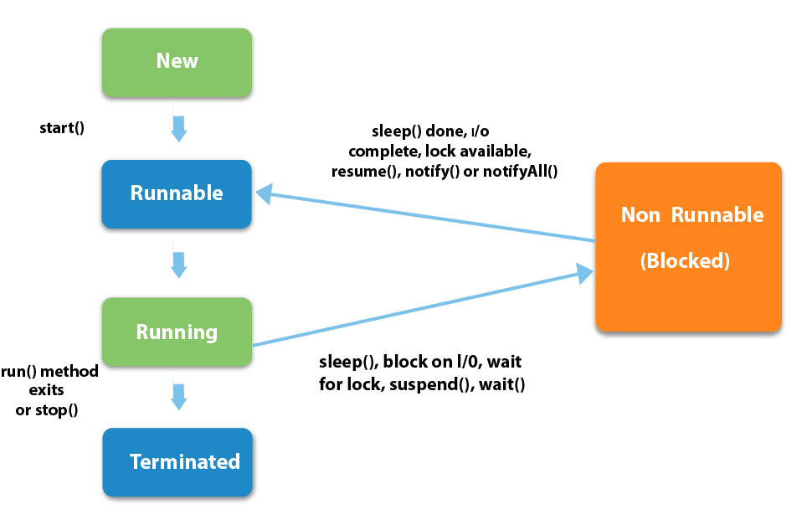
Thread Lifecycle

Slide 9
Thread Priority
Threads can be configured with a priority number, which signifies which order the threads are to run.
The Thread class contains a few static variables to determine priority (range from 1-10):
MIN_PRIORITY – (typically 1)
NORM_PRIORITY – (defaults to 5)
MAX_PRIORITY – (typically 10)

Slide 10
Creating a Thread – Three* methods
There are three options to create a thread:
Create a class the implements the runnable functional interface
Implement the run() method of this class
Pass an instance of your class to a Thread constructor
Invoke the start() method on the thread
Create a class that extends Thread
Implement the run() method
Instantiate the class
Invoke the start() method
Create a Lambda* (this is an extension of the interface method, since lambdas are used to provide an implementation of an interface)

Slide 11
Creating a Thread – Implement Runnable
Implement the run() method of this class
Pass an instance of your class to a Thread constructor
Invoke the start() method on the thread
public class RunnableExample implements Runnable {
@override
public void run() {
System.out.println(“Implemented Runnable interface”);
}
}
public class Simulator {
public static void main(String[] args) {
Thread myRunnable = new Thread(new RunnableExample());
myRunnable.start();
}
}

Slide 12
Creating a Thread – Extend Thread
Implement the run() method
Instantiate the class
Invoke the start() method
public class ExampleThread extends Thread {
@override
public void run() {
System.out.println(“Extended Thread Class”);
}
}
public class Simulator {
public static void main(String[] args) {
Thread myThread = new ExampleThread();
myThread.start();
}
}

Slide 13
Problems with Threads
Although multi-threading can offer a great deal of efficiency, there are a number of problems and considerations which must be kept in mind before the implementation of custom threads for instance:
Race Conditions
Thread Starvation
Producer-Consumer Problem

Slide 14
Race Conditions
Race Conditions: The result of a transaction is dependent on other threads access to it
i.e. if object 2 sets a value to null, then it should be completed after object 1 performs operations that requires the information.
Race conditions can be solved using synchronization, to limit access to a resource to only one thread at a time.

Slide 15
DeadLock, LiveLock and Thread Starvation
The term ‘deadlock’ describes a situation where two (2) or more threads are blocked, trying to access the same resource.
Deadlock will cause a program to stall or fail since the threads cannot progress.
The term ‘livelock’ describes a situation where two or more threads are attempting to provide information to another thread, which continues indefinitely.
Livelock causes a program to stall due to an infinite loop of code attempting to respond to eachother without a means to proceed further.
Both of these scenarios lead to ‘Thread Starvation’. Note: Neither deadlock or livelock have a strict, built-in solution. It is up to the developer to design a program in such as way as to avoid these situations.

Slide 16
Producer-Consumer Problem
The producer-consumer problem is a class example of a multi-process synchronization problem.
Producer – an entity which creates or populates an area with data, known as the queue.
Consumer – an entity which takes and removes data from an area, known as the queue.
Problem: The producer should produce data when the queue is not full. If the queue is full, then the produce should not be allowed to put any data into the queue. The consumer should consume data only when the queue is not empty. If the queue is empty, then the consumer should not be allowed to take any data from the queue.
Solution: use of the wait() and notify() methods can be used to communicate between produce and consumer threads.
The wait() method is used to pause the producer or consumer thread based on the size of the queue.
The notify() method sends a notification to the waiting thread

Slide 17
Producer-Consumer Problem
public synchronized void produce() {
while (messages.size() == MAX_SIZE) {
wait(); // when queue is full, wait...
}
/* when the queue has space, the Producer
* produces data and adds to queue
*/
messages.add(data);
notify();
...
}
public synchronized String consume() {
while (messages.isEmpty()) {
wait(); // when queue is empty, wait...
}
/* when the queue has data, the Consumer
* consumes data and removes it from the queue
*/
messages.remove(data);
notify();
...
}

