Slide 1
Algorithms

Slide 2
Key Topics
Algorithm Intro
Common Algorithms
Searching
Iterative Sorting
Recursive Sorting
Complexity

Slide 3
What is an Algorithm?

Slide 4
What are Algorithms?
A series of steps taken or a set of rules to be followed (typically by a computer) with the goal of solving a problem.
Certain problems in programming are common, for instance:
sorting sets of data
searching data for particular values
Solving these problems require balancing resources available:
Memory space
Execution time
“Algorithms” are typically generic steps independent of the data provided. Sort(x), it doesn’t matter if x is numbers or people.

Slide 5
Creating Algorithm
‘Algorithm’ is often a buzzword, but its just a step-by-step approach to solving a problem.
Following directions to bake a cake
Giving directions to get to your house
If you have an array of numbers, and you want to sort them from lowest to highest. How do you do it?
There is no programming tricks here:
Break the problem down
Talk it out, like you're explaining it to a child.
Use Psuedocode
Practice!

Slide 6
Searching

Slide 7
Common Algorithms – Linear Search
Searching algorithms are methods used to find an element within some collection or list.
Linear search is the most basic searching algorithm, which functions by checking each element of a collection in sequence until a match is found or until the whole list has been searched.

Slide 8
Linear Search
public int linearSearch(Integer target, Integer[] collection) {
int index = -1;
for (int i = 0; i < collection.length; i++) {
if (collection[i] == target) {
index = i;
}
}
return index;
}

Slide 9
Linear Search (visualization)
Target
35
10
15
19
23
28
35
41
49
62

Slide 10
Common Algorithms – Binary Search
A Binary Search (a.k.a. half-interval search) is another common algorithm used to find elements within a sorted collection.
Binary search finds the position of an element by looking at the element halfway between the recognized minimum and maximum value and eliminating half of the remaining elements if the target value is less than or greater than this halfway point.
The algorithm ends after finding the target value is found or all elements have been eliminated.

Slide 11
Binary Search
public int binarySearch(Integer target, Integer[] collection) {
int left = 0;
int right = collection.length-1;
while (left <= right) {
int mid = (right+left)/2
if (target < collection[mid]) {
right = mid - 1;
} else if (target > collection[mid]) {
left = mid + 1;
} else {
return mid;
}
}
return -1; // target number doesn’t exist
}

Slide 12
Binary Search (visualization)
Target
35
10
15
19
23
28
35
41
49
62

Slide 13
Iterative Sort

Slide 14
Common Algorithms – Swapping Elements
When sorting data in any programming language, a ‘swap’ is a typical algorithm to perform and is often performed multiple times as elements are moved into order.
/* Swap position of two indexes of an array */
void swap (Object[] arr, int l_index, int r_index) {
Object temp = arr[l_index];
arr[l_index] = arr[r_index];
arr[r_index] = temp;
}

Slide 15
Swap (visualization) - TODO
void swap (Object[] arr, int l_index, int r_index) {
Object temp = arr[l_index];
arr[l_index] = arr[r_index];
arr[r_index] = temp;
}
Temp
A
A
arr[l_index]
arr[r_index]
B
A
A
B
B
A

Slide 16
Common Algorithms – Bubble Sort
Bubble Sort is one of the simplest sorting algorithms, used to organize elements of a collection into a particular order.
Bubble Sort organizes elements by repeatedly comparing and swapping adjacent elements if they are in the wrong order.

Slide 17
Bubble Sort
public void bubbleSort(Integer[] arr) {
int n = arr.length;
for (int i = 0; i < n – 1; i++) {
for (int j = 0; j < n - 1; j++) {
if (arr[j] > arr[j+1]) {
int temp = arr[j];
arr[j] = arr[j+1];
arr[j+1] = temp;
}
}
}
}

Slide 18
Bubble Sort (visualization)
compare
compare
compare
compare
10
62
19
15
28
35
23
49
41

Slide 19
Common Algorithms – Selection Sort
Selection Sort is another common sorting algorithm that organizes elements within a collection.
The Selection Sort works by repeatedly finding the smallest element of a collection and moving the found element forward by swapping the position of the left-most element, with the smaller.

Slide 20
Selection Sort
public void selectionSort(Integer[] arr) {
int n = arr.length;
for (int i = 0; i < n – 1; i++) {
int minIndex = i;
for (int j = minIndex+1; j < arr.length - 1; j++) {
if (arr[minIndex] > arr[j]) {
minIndex = j;
}
}
int temp = arr[i];
arr[i] = arr[minIndex];
arr[minIndex] = temp;
}
}

Slide 21
Selection Sort (visualization)
Target
Current
Current
Current
Current
Current
Current
Current
Current
81
52
22
18
31
48
25
67
4
Low
Low
Low
Low
Low
Low
Low
Low

Slide 22
Recursive Sort

Slide 23
What is Recursion?
A recursive function is another method to repeat functionality by creating a function which calls itself, and returns the output
Successive executions are added to the execution stack
There must exist a base case at which the recursion stops, otherwise you will get a stack overflow
When the base case is found, values are returned down the execution stack, potentially being transformed along the way.
int recursion(int n ) {
if (n <= 0)
return 0; else
return recursion(--n);
}

Slide 24
Common Algorithms – Merge Sort
The Merge Sort is a more complex sorting algorithm that organizes elements of a collection by dividing continually dividing a collection into two halves, and then merging the split collections back together in sorted order.
The Merge sort relies on using recursion to repeatedly partition data into auxiliary collections before combining the values back together into a single collection.

Slide 25
Merge Sort
void merge(Integer arr[], int l, int m, int r) {
/* Find Sizes of two sub-arrays to be merged */
int n1 = m - l + 1;
int n2 = r - m;
/* Create temp arrays */
int[] L = new int[n1];
int[] R = new int[n2];
/* Copy data to temp arrays */
for (int i = 0; i < n1; ++i) L[i] = arr[l + i];
for (int j = 0; j < n2; ++j) R[j] = arr[m + 1 + j];
/* Merge the temp arrays */
int i = 0, j = 0; // Initial indexes of first and second subarrays
int k = l; // Initial index of merged subarry array
while (i < n1 && j < n2) {
if (L[i] <= R[j]) {
arr[k] = L[i];
i++;
} else {
arr[k] = R[j];
j++;
}
k++;
}
/* Copy remaining elements of L[] if any */
while (i < n1) {
arr[k] = L[i];
i++;
k++;
}
/* Copy remaining elements of R[] if any */
while (j < n2) {
arr[k] = R[j];
j++;
k++;
}
}
void sort(Integer arr[], int l, int r) {
if (l < r) {
// Find the middle point
int m = l + (r - l) / 2;
// Sort first and second halves
sort(arr, l, m);
sort(arr, m + 1, r);
// Merge the sorted halves
merge(arr, l, m, r);
}
}

Slide 26
Merge Sort (visualization)
51
17
22
45
37
91
5
72

Slide 27
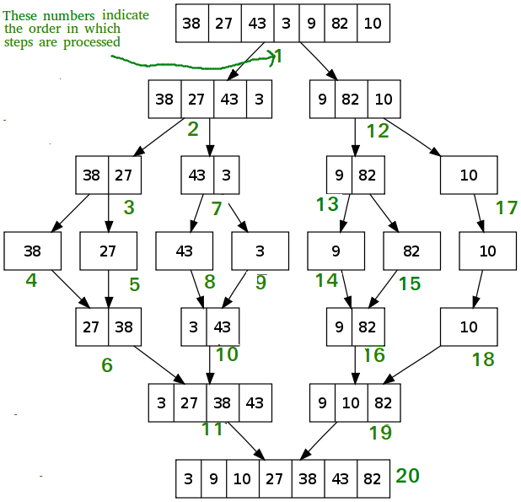
Merge Sort (visualization)

Slide 28
More Algorithms…
Quick Sort – Recursive Algorithm which swaps elements based on a ‘partition’.
Insertion Sort – Iterative Algorithm which moves lower elements toward the front by swapping their position with higher elements and continuing until the lower element is in the correct position.
Counting Sort – Iterative Algorithm that sorts elements of an array by counting the number of occurrences of each unique element and storing values an auxiliary Array. Then we use the index of the auxiliary array to map the sorted output.
Tim Sort – Recursive Algorithm which combines both Insertion sort and Merge sort to organize elements in blocks, known as ‘Runs’, and merging sorted blocks together.
And more…
Practice, Study and Experience

Slide 29
Measuring Algorithms
Algorithms are designed independent of the inputs they are given. An algorithm isn’t designed differently if it sorts 5 objects or 500.
…but we must respect resources used. The same algorithm will likely take longer to sort 500 elements than it would to sort 5.
…but how much longer? How quickly/slowly do the time requirements grow as the number of inputs grows?
Algorithms are measured by the relative rates that they consume resources as their inputs grow. We sometimes call this efficiency or complexity.

Slide 30
Big-O Notation
An algorithm does something to inputs that are provided. More inputs = more steps to complete.
Inputs are called “n”. Algorithms are expressed as a function describing how quickly they grow as ‘n’ increases.
The function O is used to express how the algorithms grow as ‘n’ approaches infinity. Sometimes called the “worst-case” growth.
For example, O(n) function grows linearly with n. As n increases, the number of steps required increases a proportionate amount.
Big-O can be used to measure:
Time Complexity : how many processes occur?
Space Complexity : how much extra memory is needed to perform the algorithm?

Slide 31
Big-O and Math
Big-O can involve a bit of limit calculus and algebra. This is the science of computer science.
In most circumstances, you can avoid the crunchy mathematical details if you understand the rules involved.
Deducing the complexity of an algorithm can often be done through pattern recognition.
We’ll try to keep it approachable, but algorithms are important.

Slide 32
Big-O
O(1) – Constant Time
Get item at index 0 in an array
Swap Elements.
There is only a single* process taking place.
*Single here doesn’t mean one, it just means that we don’t have potential repetition
O(log n) – Log N
Binary search
An algorithm eliminates many values (around half) during each step
O(n) – Linear
Linear Search
There is a single process taking place for each element of a collection.
O(n log n) – N Log N
Merge sort.
Each element is processed multiple times, but those processes work on “chunks” of data.
O(n^2) – Exponential
Bubble Sort
For each element of a collection, a process occurs for the Size of the collection. Nested loops can often lead to this complexity.
O(!n) – Factorial
Check every possible combination
Typically used in cryptography.

Slide 33
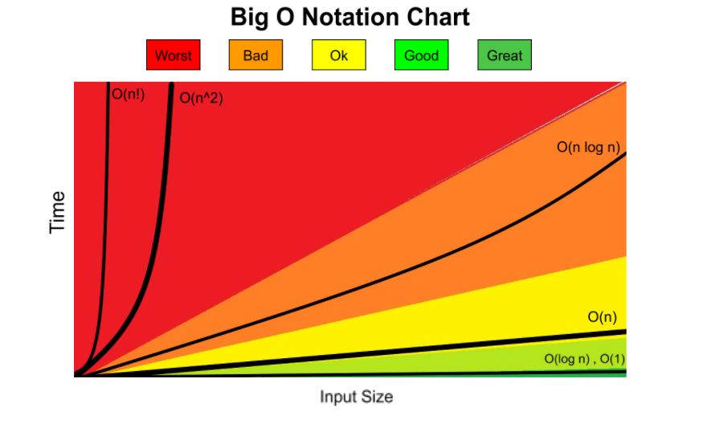

Big-O
Based on the number of inputs, how does our solution scale as they get extremely large (as the number of inputs approach infinity)?
O(1)
Constant time
Get item at index 0 in an array
O(n)
Linear time
Search through each item in an array
O(log n)
Search through a sorted array using binary search
O(n log n)
Merge sort
O$\left(n^{2}\right)$
For each item in an array multiply that item by every other item in the array
Quick sort

Slide 34
Algorithm Big-O
Linear Search
Time Complexity : O(n) – linear
Space Complexity : O(1) – Constant
Binary Search
Time Complexity : O(log n) – Logarithmic
Space Complexity : O(1) – Constant
Swap Elements
Time Complexity : O(1) – Constant
Space Complexity : O(1) – Constant
Bubble Sort
Time Complexity : O(n^2) – Exponential
Space Complexity : O(1) – Constant
Selection Sort
Time Complexity : O(n^2) – Exponential
Space Complexity : O(1) – Constant

Slide 35
Algorithm Big-O
Merge Sort
Time Complexity : O(n log(n)) – N times logarithm of N
Space Complexity : O(n) – Linear
Quick Sort
Time Complexity : O(n^2) – Exponential
Space Complexity : O(n) – Linear
Insertion Sort
Time Complexity : O(n^2) – Exponential
Space Complexity : O(1) – Constant
Counting Sort
Time Complexity : O(N+K) – Complexity is dependent on the size of the collection and the range of the values within the collection.
Space Complexity : O(k) – Complexity can vary depending on the range different of values. N = number of element. K = range for elements.
N = number of elements
K = Range of elements (largest – smallest)
Time Sort
Time Complexity : O(n log(n)) – N times logarithm of N
Space Complexity : O(1) – Constant

