Slide 1
Data Structures Introduction

Slide 2
What is a Data Structure?
A data structure is a format for storing and managing more than one piece of data
Arrays are data structures
Elements can be removed, added, searched for, etc
Each data structure has its own way of storing and working with the data it holds
There are two fundamental ways of storing information in data structures:
In arrays
With nodes

Slide 3
Array Based Structures
array-based structures simply use an array to store the data
Because arrays are used, data is saved in positions that each have corresponding indices.
Array-based structures further build on an array by modifying how the values are accessed and worked with
An arraylist is an array-based structure. It uses an array to store the data but defines a specific way of managing and accessing the data
Info
Index: 0
Info
Index: 1
Info
Index: 2
Info
Index: 3
Info
Index: 4
Info
Index: 5

Slide 4
Node Based Structures
A node-based structure stores information in node objects which may have one or more references to other node objects.
Recall that reference variables point to an object’s location in memory
Node objects usually contain data as well as reference variables that point to the previous and/or next node in the structure
data variable
ref variable
data variable
ref variable

Slide 5
Java Collection Framework

Slide 6
The Collection Interface
The Java Collection Framework provides built-in data structures for the user to work with
It contains interfaces that define what behavior the data structures should have
It also contains concrete classes that represent each data structure
The main branch of the Collection Framework is the collection hierarchy. Its root is the Collection interface and it defines a set of behaviors common to all collections in Java (except Maps, which are in another branch entirely)
https://docs.oracle.com/javase/8/docs/api/java/util/Collection.html
Collections can be broken down into three types: Lists, Sets, and Queues

Slide 7
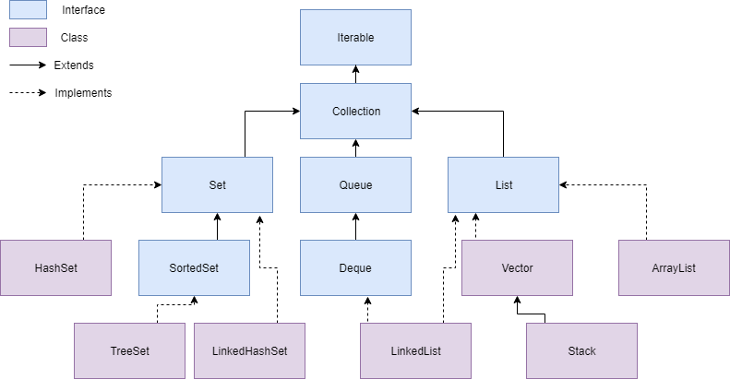
Collection Hierarchy

Slide 8
Important Interfaces in the Collection Framework
Iterable – Requires that every collection can be iterated over (each element can be accessed, one by one)
Collection – An Interface in Java that defines an architecture for storing and manipulating objects
Set – A collection which cannot contain duplicate elements
Queue – An ordered collection of objects which utilizes a first-in-first-out principle
List – An ordered collection of objects which utilizes indexes

Slide 9
Maps

Slide 10
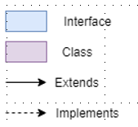
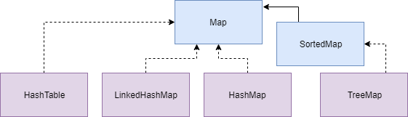
Map Hierarchy
Although maps are a branch of the Collection Framework, they are not collections
Collections are groups of objects
Maps are groups of key-value pairs

Slide 11
Creating Java Maps
When you create a collection, you specify the type of objects it will hold. This is due to the use of Generics in Collections. More on this soon!
When you create a map, you must specify the type of key and the type of value that it will hold
List<String> list = new ArrayList<> ();
Map<String, Integer> map = new HashMap<> ();

Slide 12
Map vs Collection Methods
 | Collection | Map
Add an element | add(object) | put(key, value)
Remove an element | remove(object) | remove(key)
Iterate over data structure | For-each loop | get something iterable using either keySet(), values(), or entrySet() then use for-each loop

Slide 13
Recall
What is a data structure?
What is the Java Collection Framework?
What is a Set, Queue, List, and Map?
What are some methods I can use with collections? With Maps?

