Slide 1
Maven servlet project guide

Slide 2
Setting up Apache Tomcat or Oracle Weblogic server
To Set Up Apache Tomcat Server: click the link
https://drive.google.com/a/revature.com/file/d/0B9n46l8nCFw2em5sR2pJOFl6cE0/view?usp=sharing
To Set Up Oracle Weblogic Server: click the link
https://docs.google.com/document/d/1x3zCdxN1i2WtM13akgZDUEYDVFthfl64GzyUL2K9H3M/edit

Slide 3
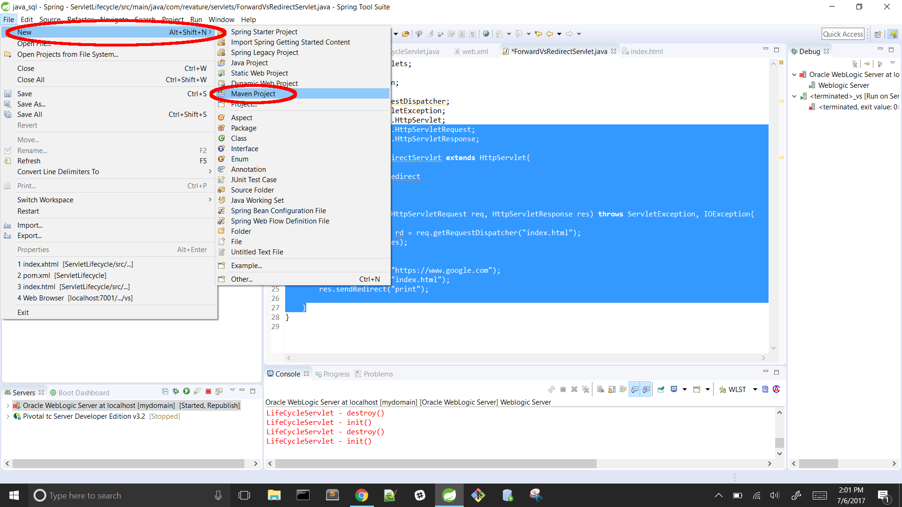
Establish The Maven Project Setup:
Open Spring Tools Suite
Designate a workspace to a certain directory on your C:/
File -> new -> Maven Project

Slide 4
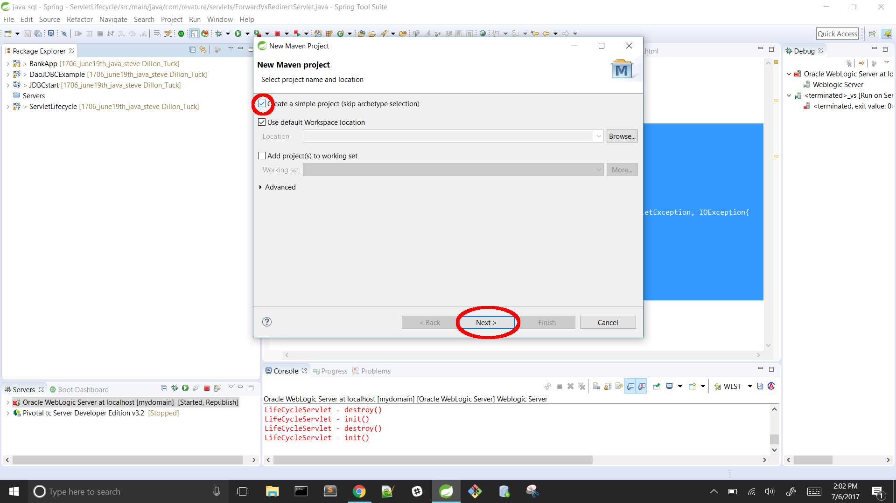
Establish The Maven Project Setup:
Click on the “create simple project” icon located at the top of the window
Click next

Slide 5
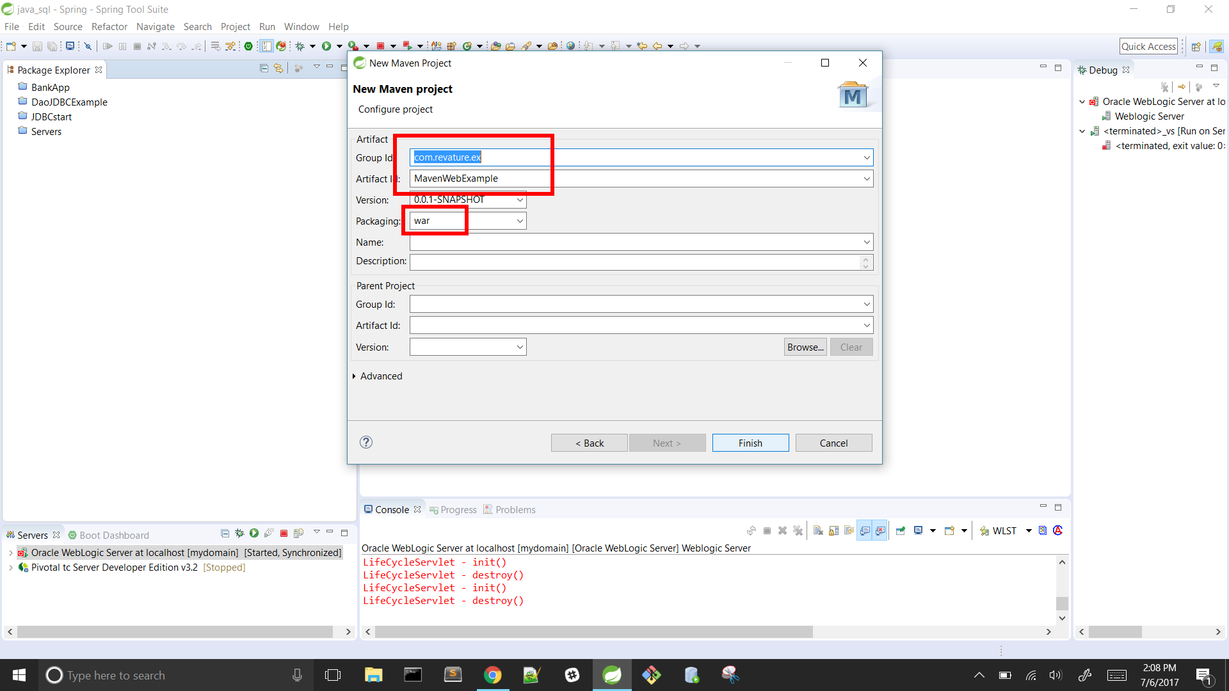
Establish The Maven Project Setup:
Enter a group ID: place file path e.g(com.revature.project name)
Enter an artifact ID: project name
Listed below, change packaging to “.war”
Click finish

Slide 6
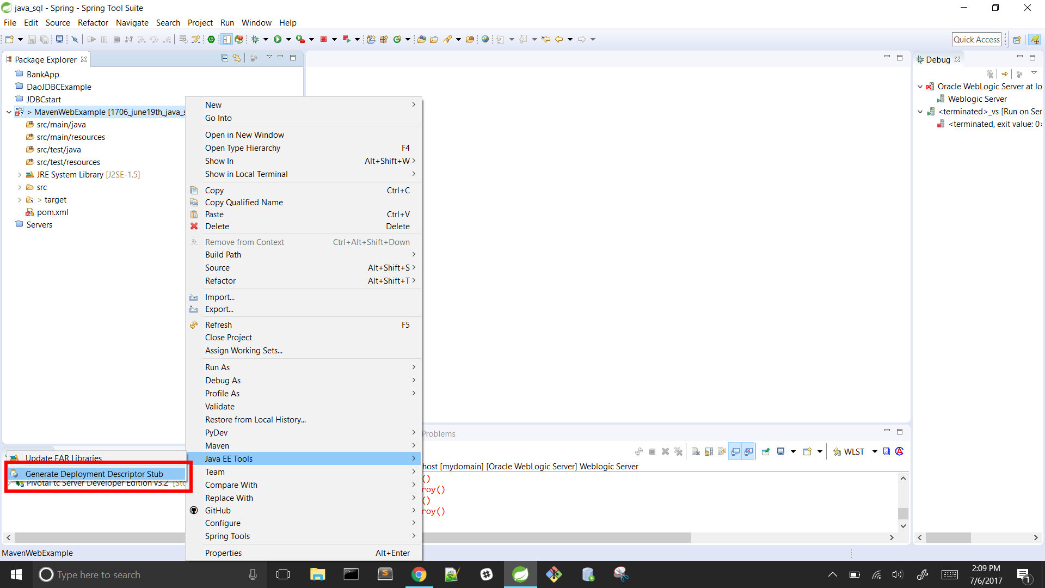
Establish The Maven Project Setup:
Right click your project → go to Java EE tools → Click generate deployment descriptor stub

Slide 7
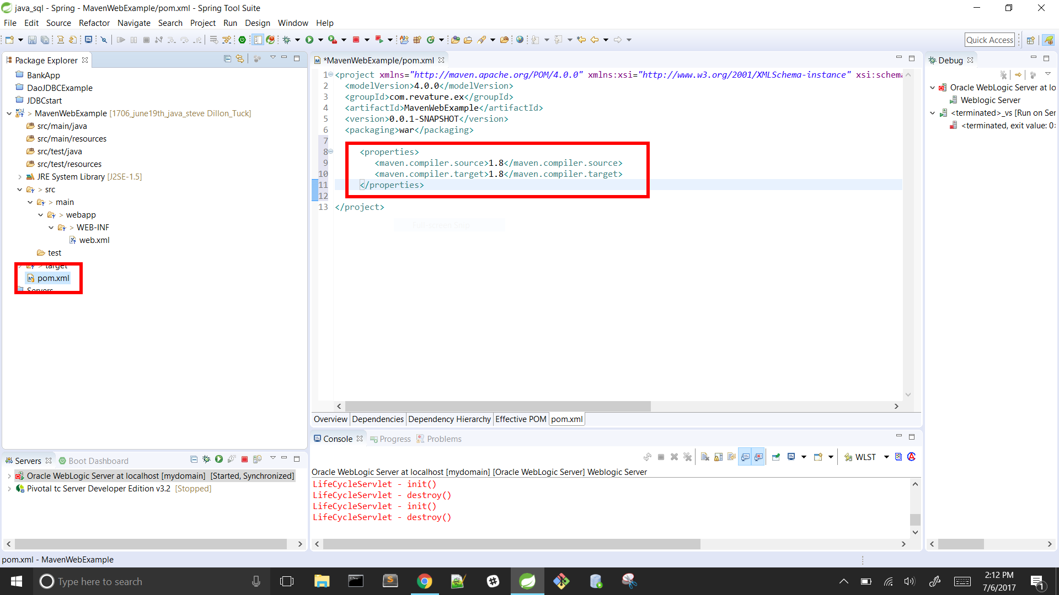
Setting up the Java Version For Pom.xml:
Update the Java version of the Maven project in the pom.xml
Under project, select your target folder → select pom.xml
Click on pom.xml tag located at the bottom of the window
Create <properties> tag inside the project body listed below the <packaging> tag
Inside the <properties> tag specify, Java version we want to use (in this case java 1.8)
Type: <maven.compiler.source> 1.8 </maven.compiler.source>
Type:<maven.compiler.target> 1.8 </maven.compiler.target>
Close the </properties> tag

Slide 8
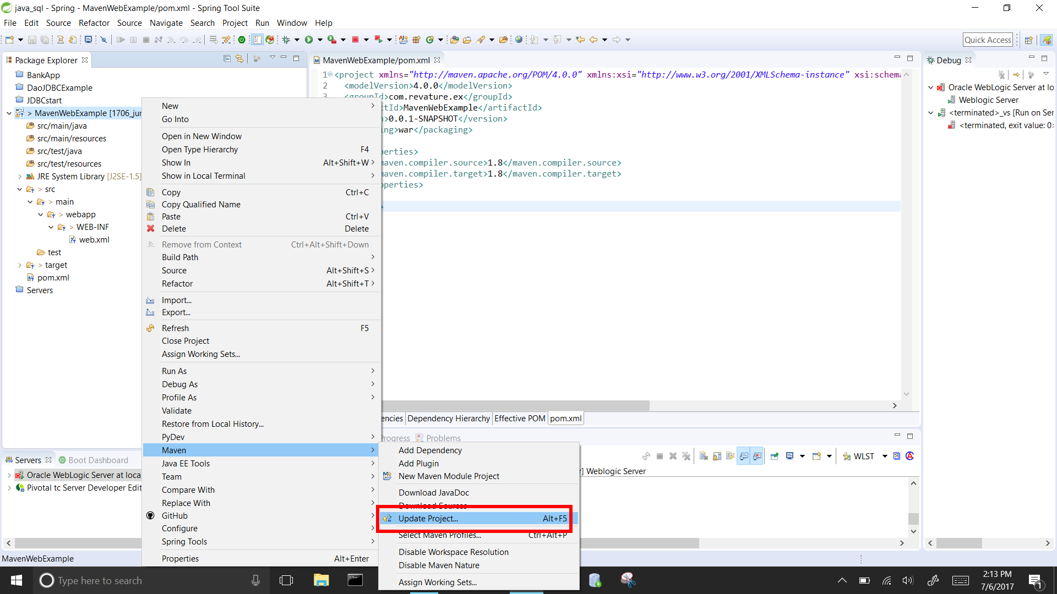
Setting up the Java Version For Pom.xml:
Right click your project folder
Select Maven → select “update project”(Alt+F5)
Select the project name → select Ok

Slide 9
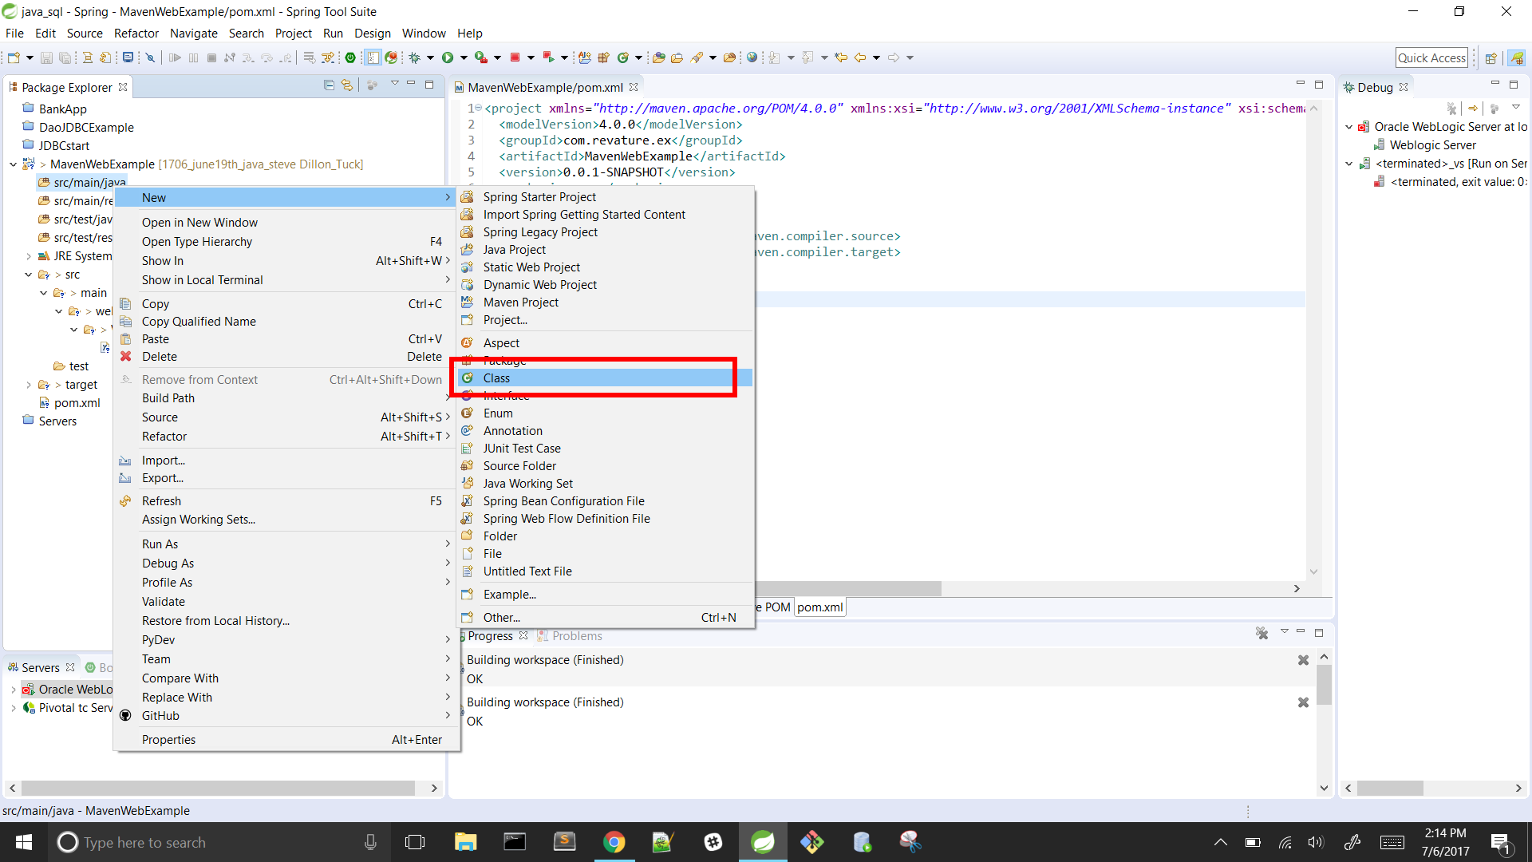
Setting up the Servlet:
Right-click your project folder → select new → select class

Slide 10
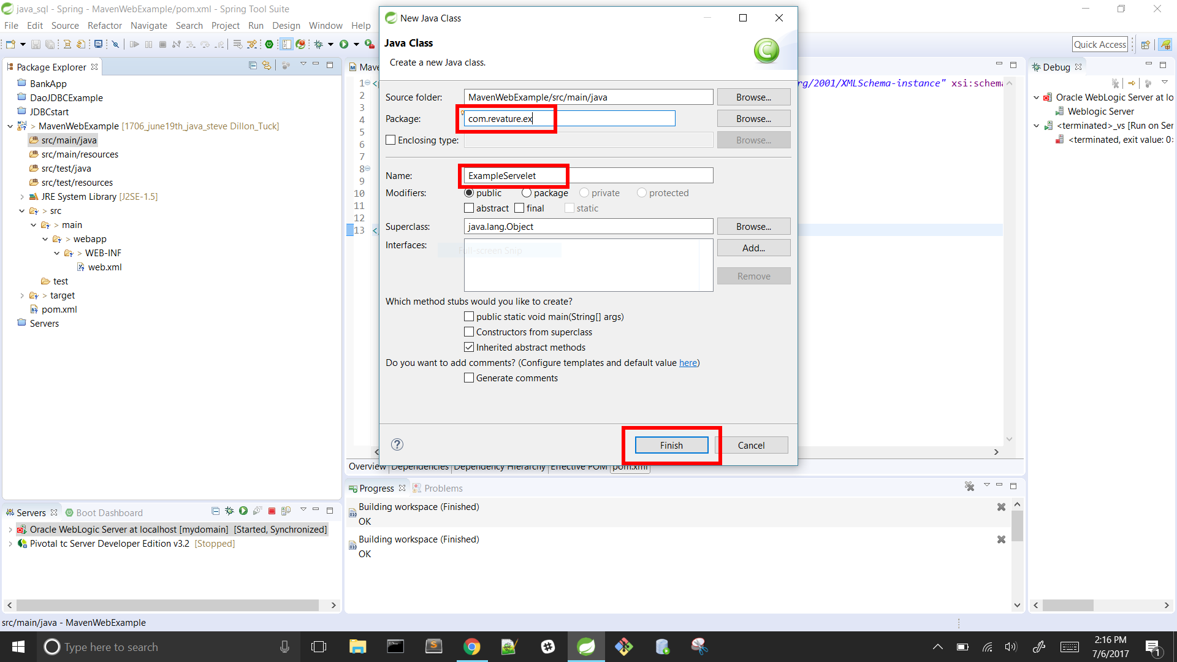
Setting up the Servlet:
Name package for project e.g com.example.servlets package name
Name the class for the servlet → select finish

Slide 11
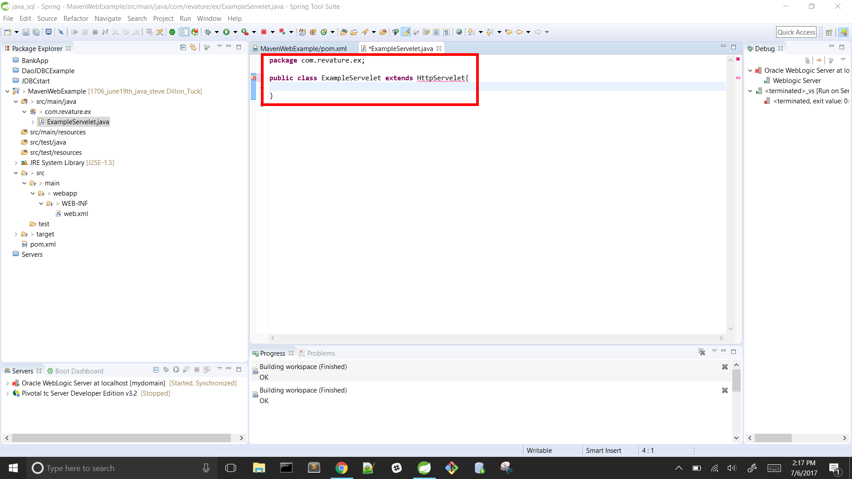
Setting up the Servlet:
Add “extends HttpServlet” to the class signature
e.g. public class ServletExample extends HttpServlet

Slide 12
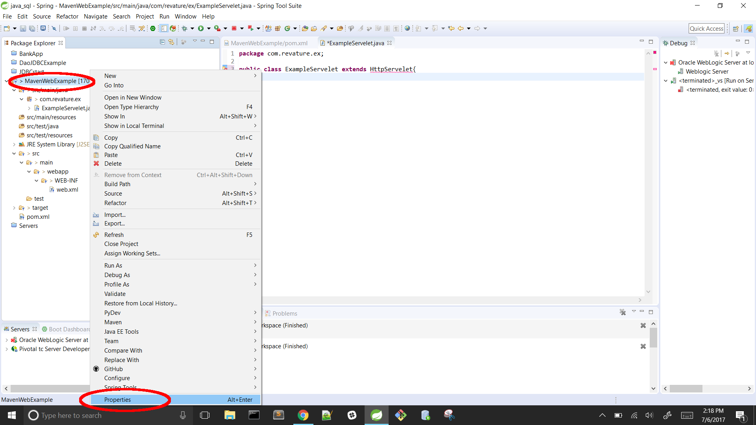
Setting up the Servlet:
In the package explorer view, right click on project folder → select properties

Slide 13
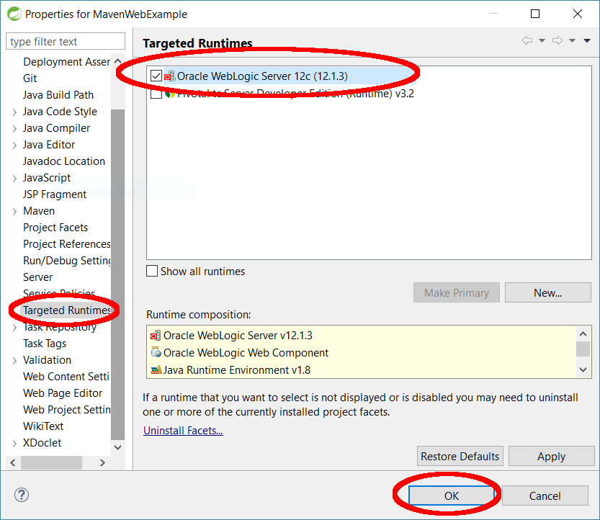
Setting up the Servlet:
Scroll down to target runtimes(listed in the left column) → select server
E.g TomCat or Oracle Weblogic
Select Apply

Slide 14
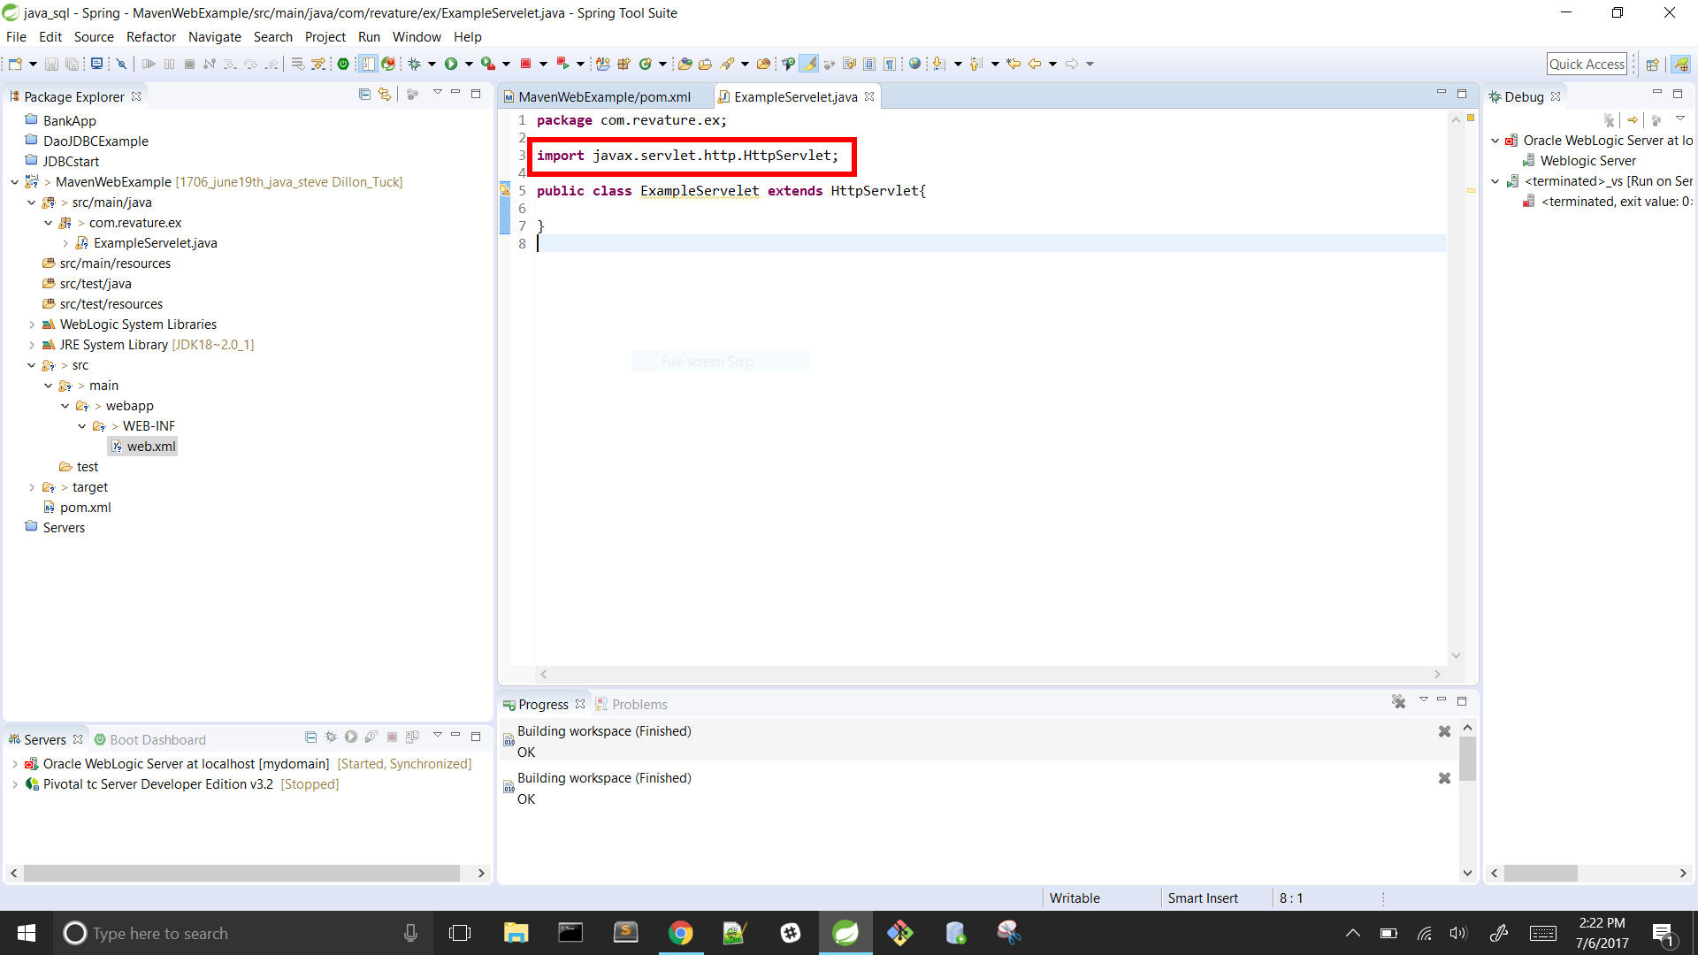
Setting up the Servlet:
Redirect back to you servlet class
Hover over “HttpServlet” and listed in the ToolTipBox Select “Import HttpServlet”
Ex: shortcut keys ctrl+shift+o

Slide 15
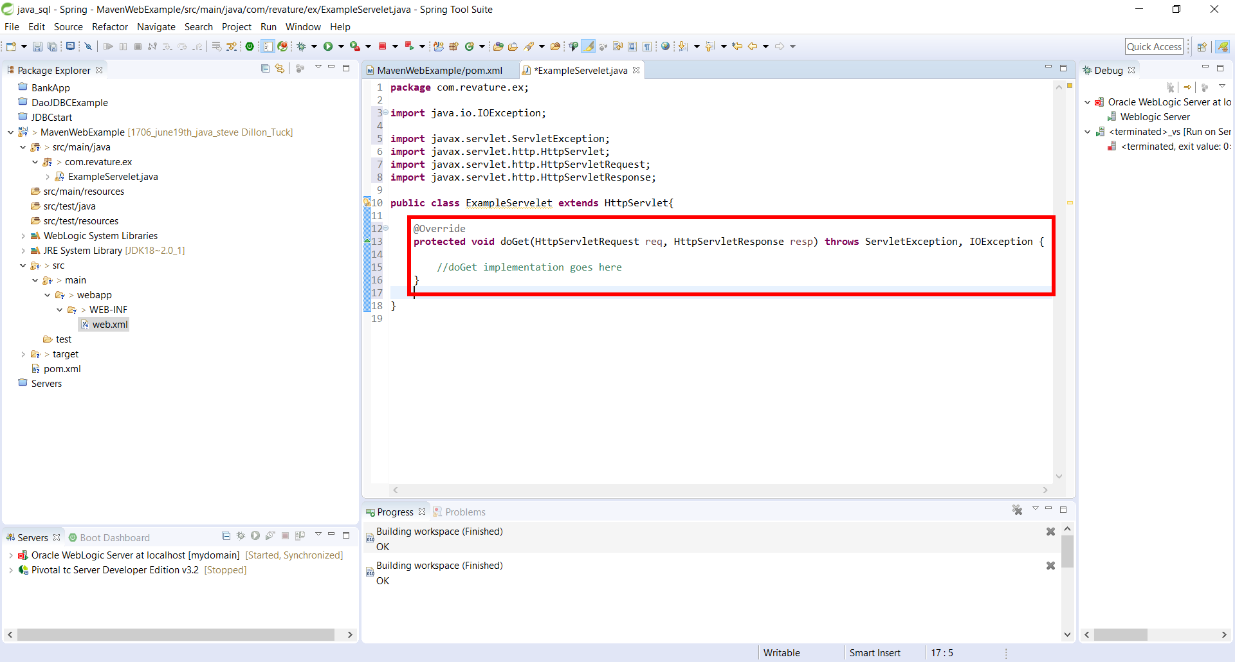
Setting up the Servlet:
Optional: add a comment to help you remember the intended endpoint url
Eg. /* URL for ExampleServlet: /example */
Override the doGet/doPost method as needed, each method has the same signature format:
Protected void doGet(HttpServletRequest req, HttpServletResponse rep) throws IOException, ServletException

Slide 16
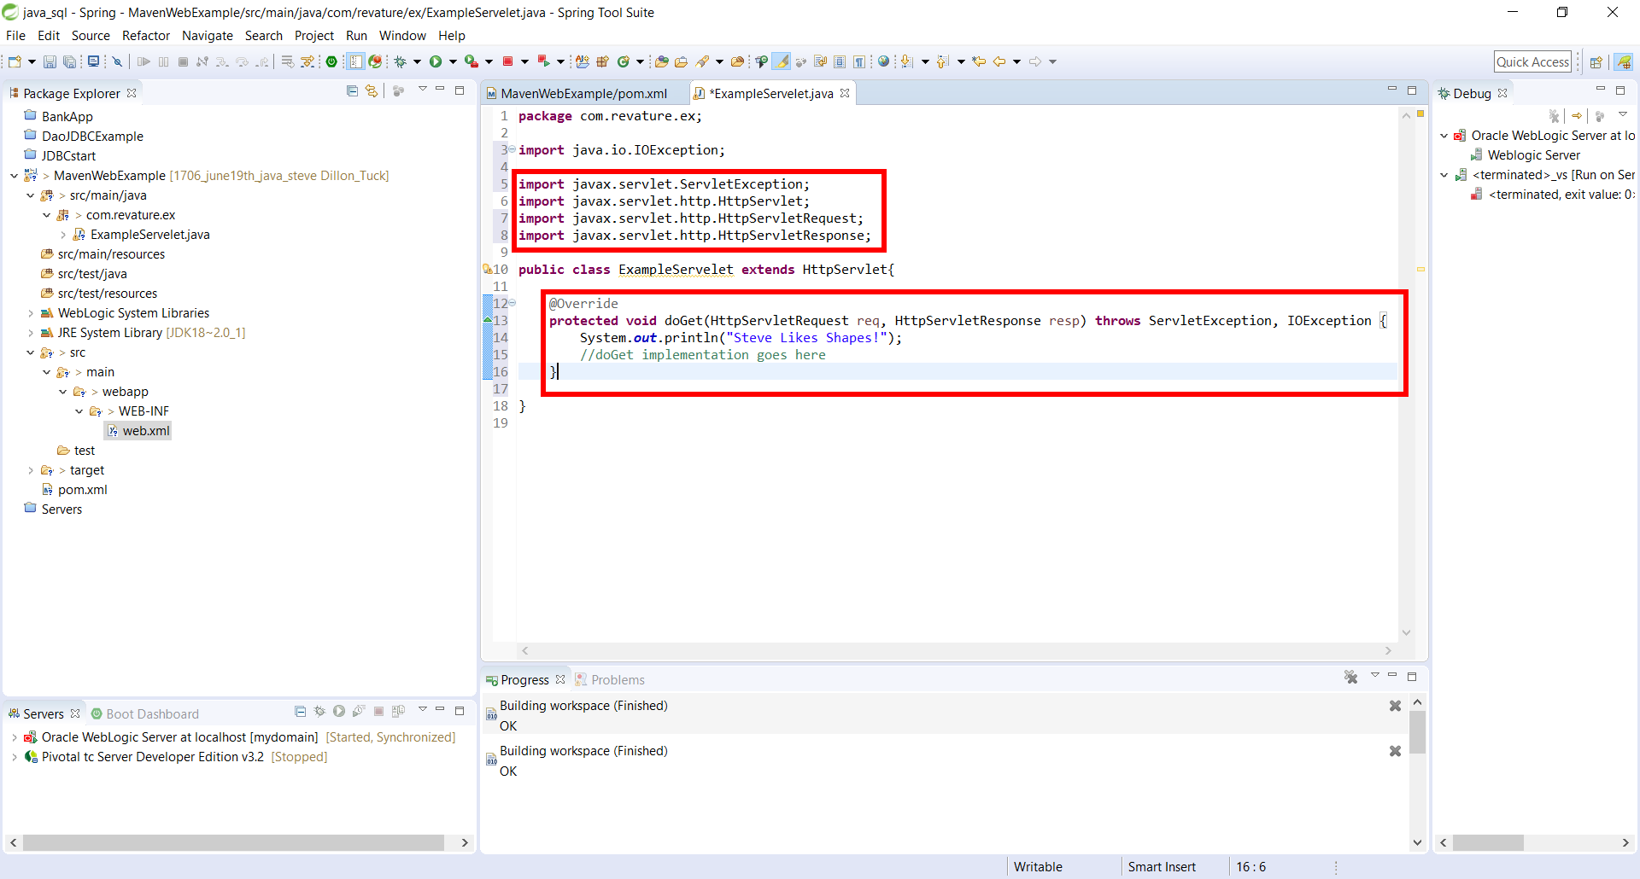
Setting up the Servlet:
Under text underline in red, import the following HttpServletResponse, HttpServletRequest, ServletException, IOException(java.io)
Shortcut key: ctrl + shift + o , to import all at once
Test case: System.out.println, (“Test SLS, Steve’s favorite shape is a triangle”);

Slide 17
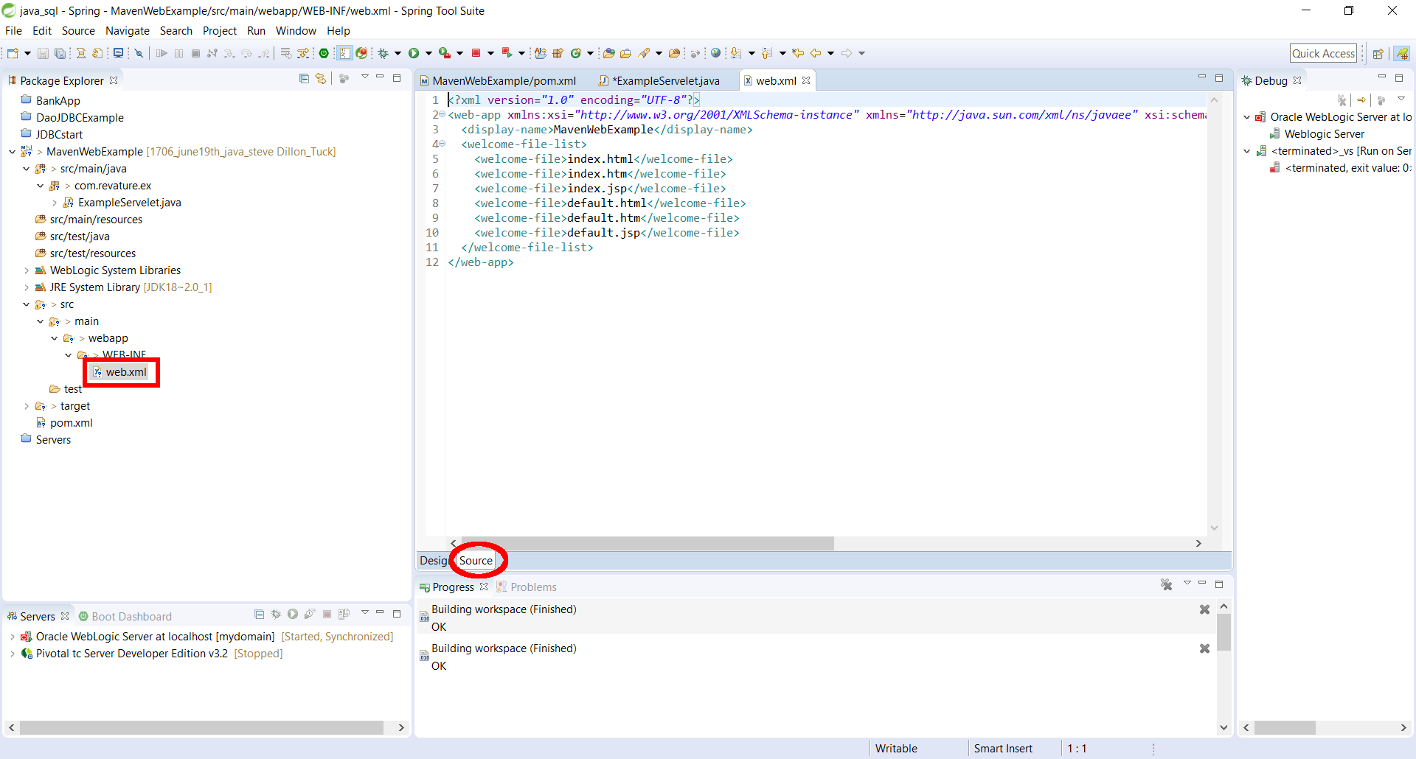
Setting Up the Web.xml:
Select project folder → select src → select main → select webapp → WEB-INF → open web.xml

Slide 18
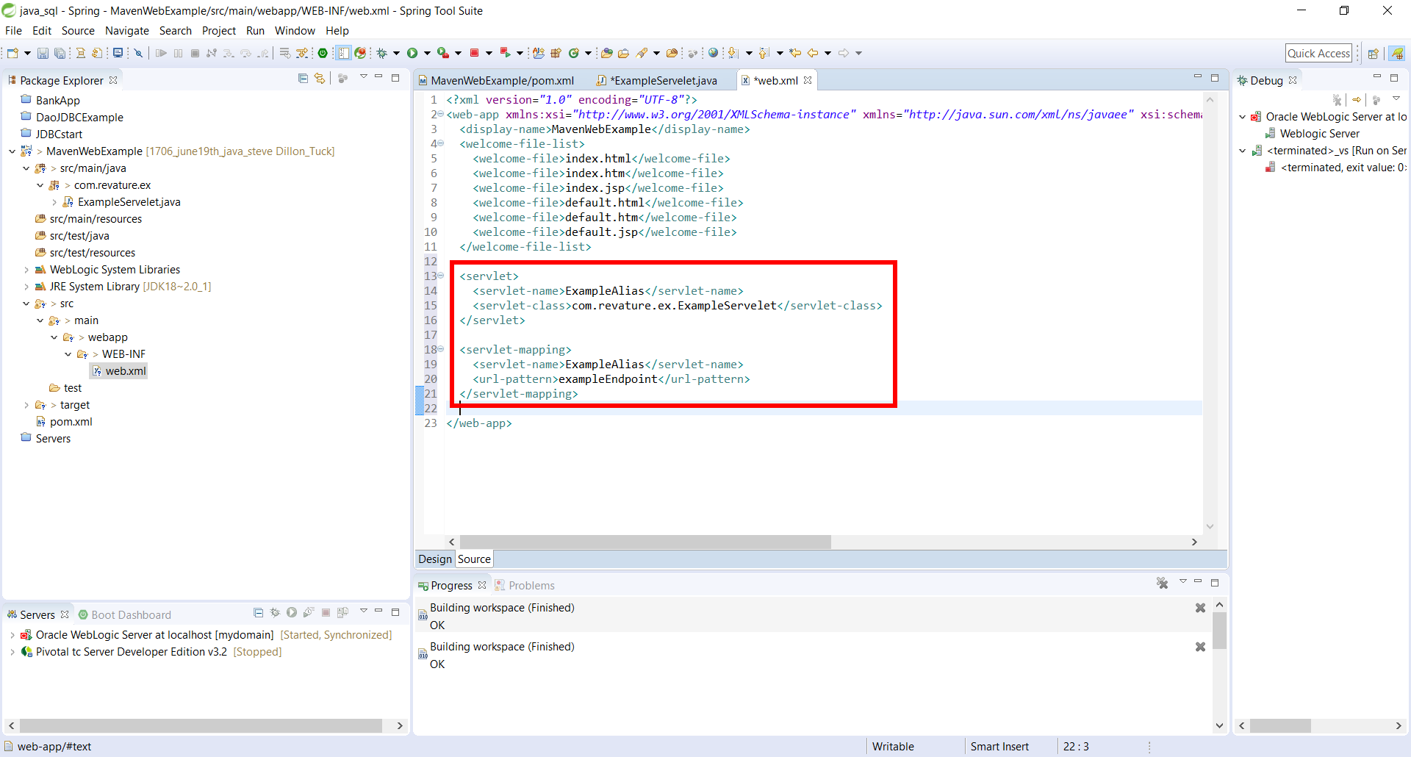
Setting Up the Web.xml:
Under the </welcome-file-list> type the <servlet> tag
Inside the servlet tag type:
<servlet-name>AliasName</servlet-name>
<servlet-class>com.ex.servlets.classname</servlet-class>
Close the </servlet> tag
Under the <servlet> closing tag type <servlet-mapping> tag
<servlet-name>AliasName</servlet-name>
<url-pattern>/endpoint</url-pattern>
Close the </servlet-mapping> tag

Slide 19
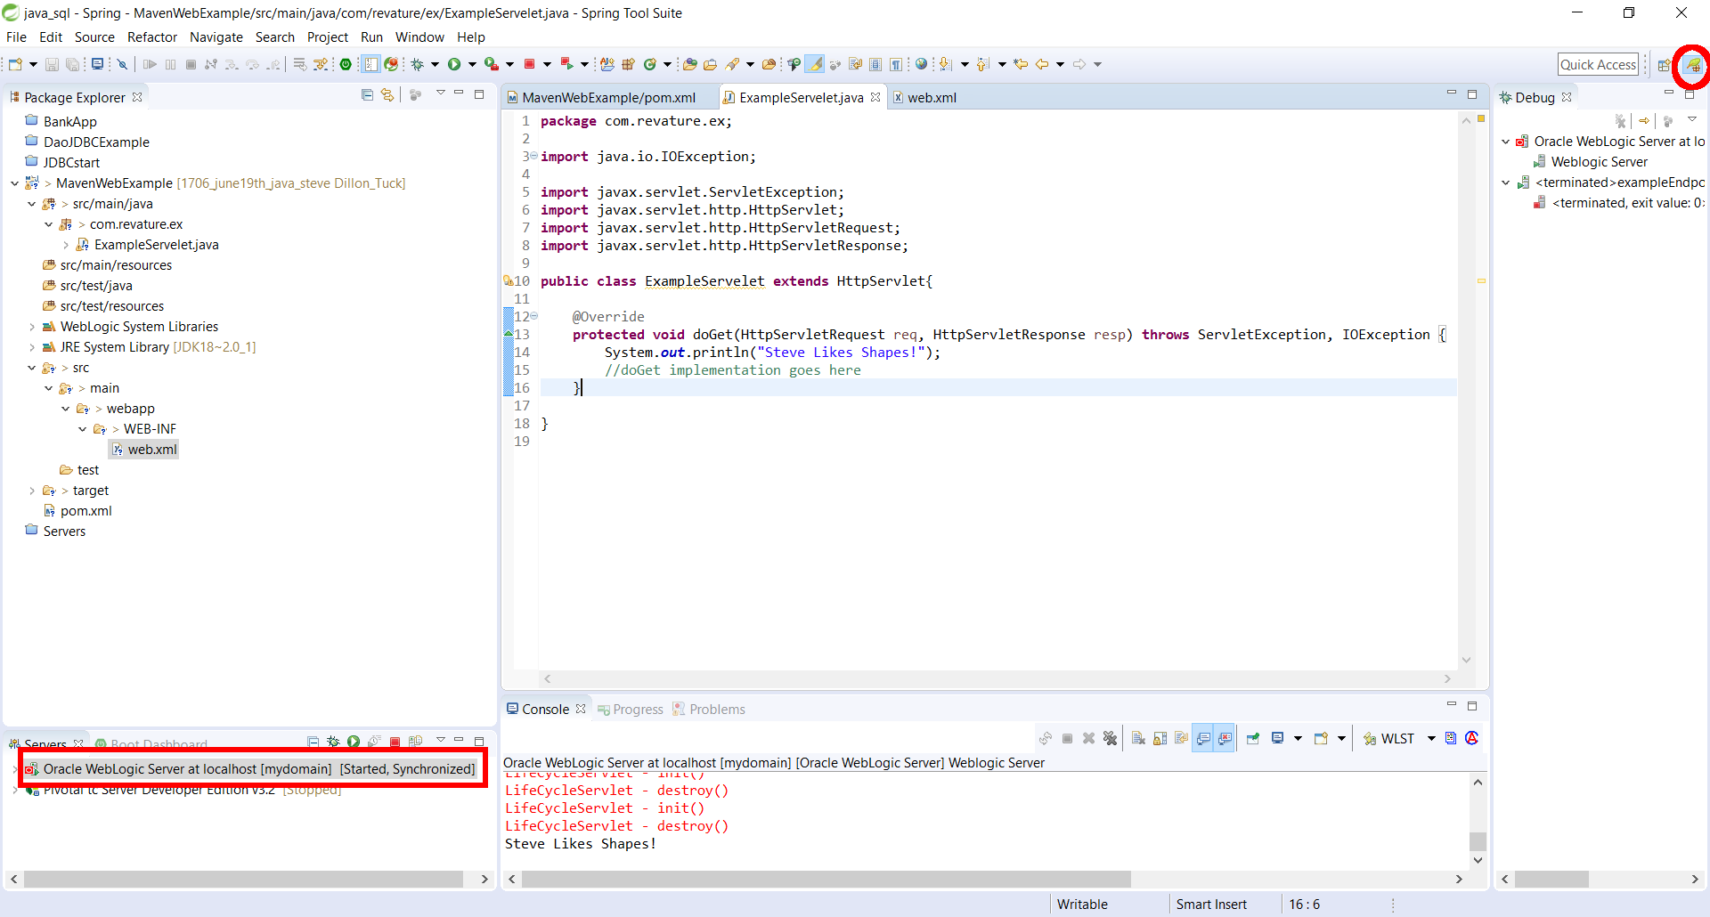
Testing the Servlet on Server:
On the top right hand corner of Spring Tools Suite,select Spring perspective Icon
At the bottom-left hand corner , click on the server (Tomcat or Weblogic)
On the tooltip bar listed slightly above, select the green start icon, to start server.

Slide 20
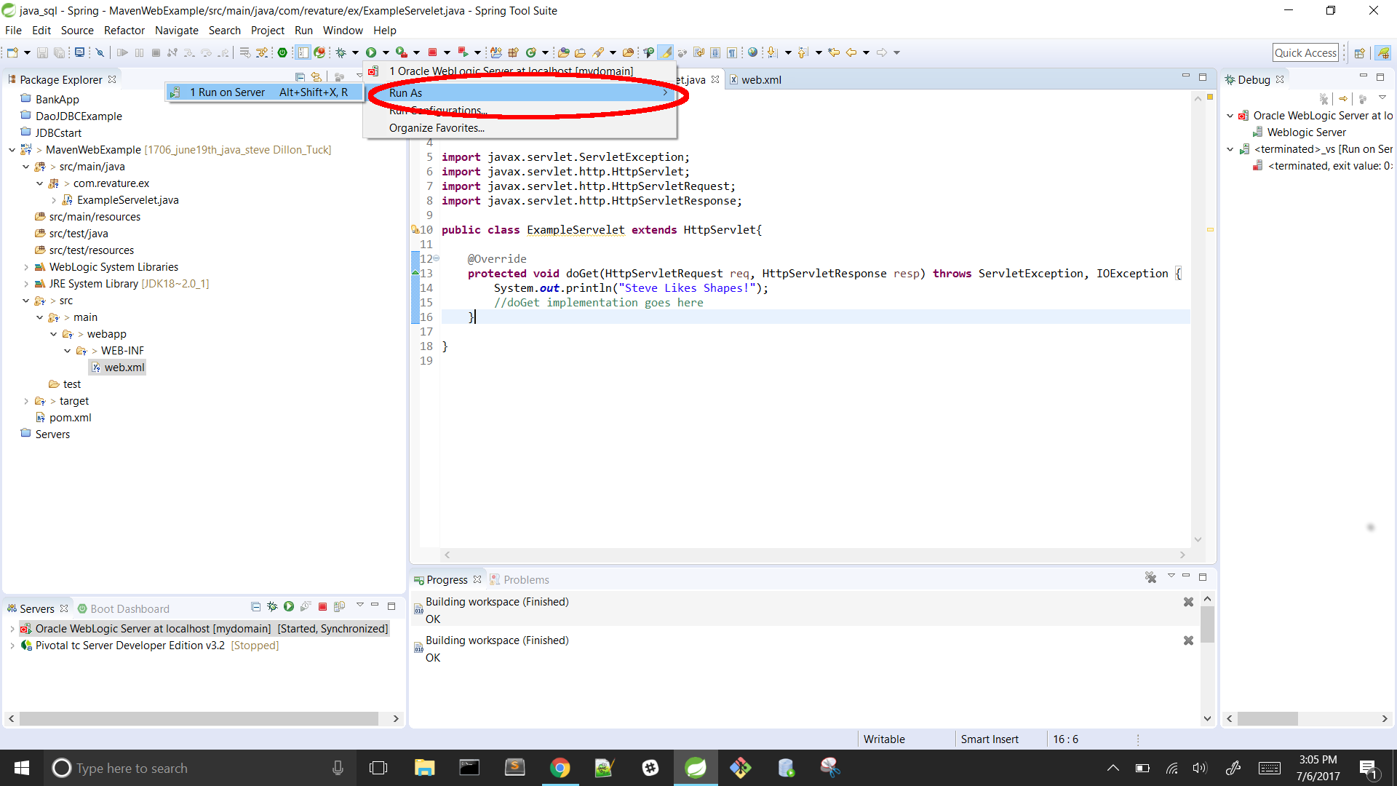
Testing the Servlet on Server:
Located on the tooltip above , click the green run button, select → run as → run on server

Slide 21
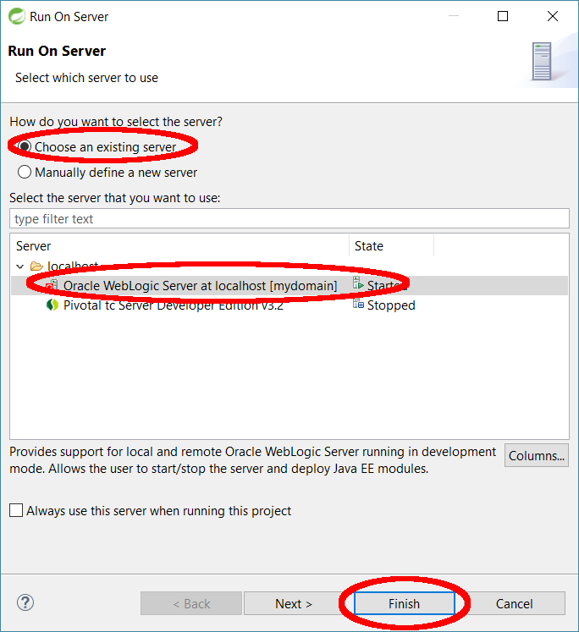
Testing the Servlet on Server:
Select “Choose existing server” , make sure correct server and select finish

Slide 22
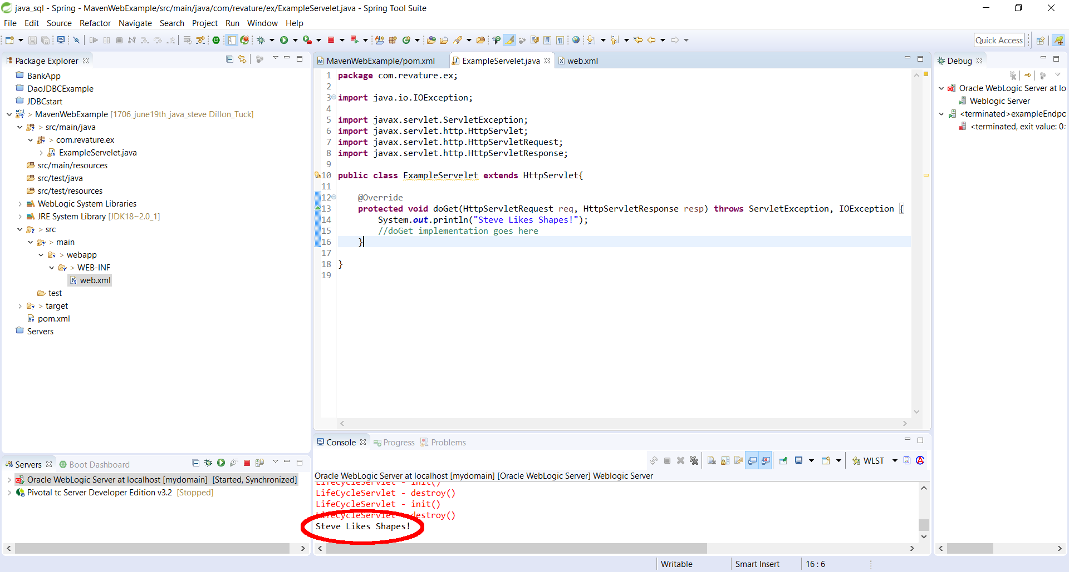
Testing the Servlet on Server:
Done.

